Slide 1
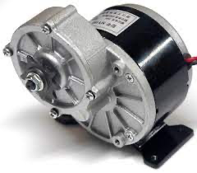
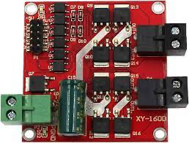
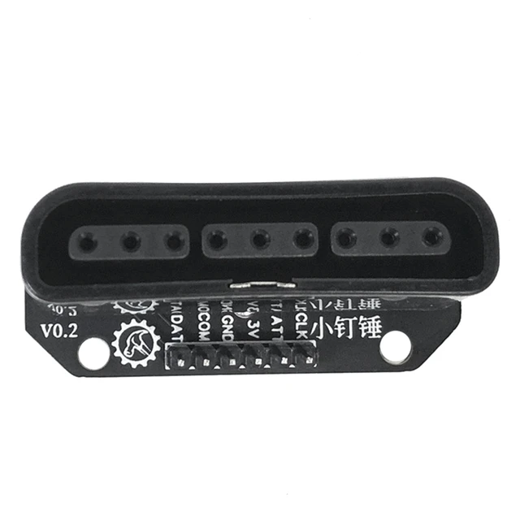
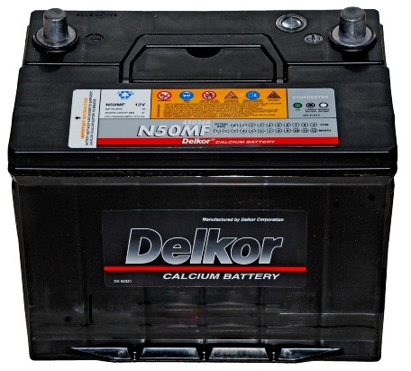

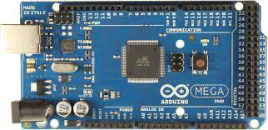
24V-DC-250W
24V-DC-250W
+5V
GND
24V-DC
Power Supply
enaA – A2 enaB – A3
out1 – 12 out3 – 10 out2 – 11 out4 – 9
Note
 | Wireless connection
 | Arduino control DC Motor
 | Arduino – PS2 Interface

Slide 2
Điều khiển bánh xe bên trái
Điều khiển bánh xe bên phải

Slide 3
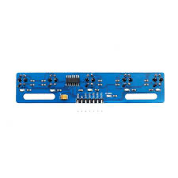
24V-DC-250W
24V-DC-250W
+5V
GND
24V-DC
Power Supply
5 Channel Infrared Reflective Sensor TCRT5000
enaA – A2 enaB – A3
out1 – 12 out3 – 10 out2 – 11 out4 – 9
8 - lineSensor1
7 - lineSensor2
6 - lineSensor3
5 – lineSensor4
4 – lineSensor5

Slide 4
s1
s2
s3
s4
s5
Wheelchair

Slide 5
s1
s2
s3
s4
s5
Wheelchair

Slide 6
s1
s2
s3
s4
s5
Wheelchair

Slide 7
s1
s2
s3
s4
s5
Wheelchair

Slide 8
s1
s2
s3
s4
s5
Wheelchair

Slide 9



Slide 10
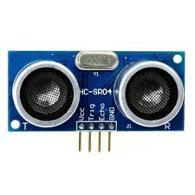
Detects objects on the left
Detects holes
Detects objects in the front
Detects holes
Explanation
Detects objects on the left
Object detect sensor HC-SR04
Hole detect sensor HC-SR04
Ultrasonic sensor ( HC – SR04 )

Slide 11
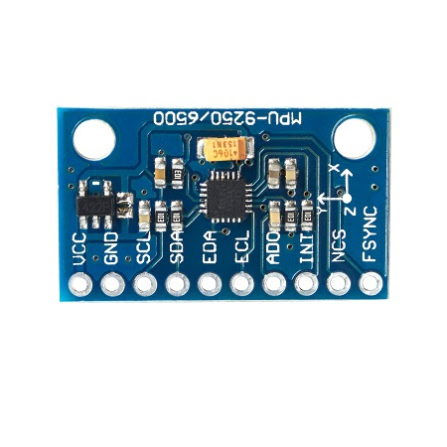
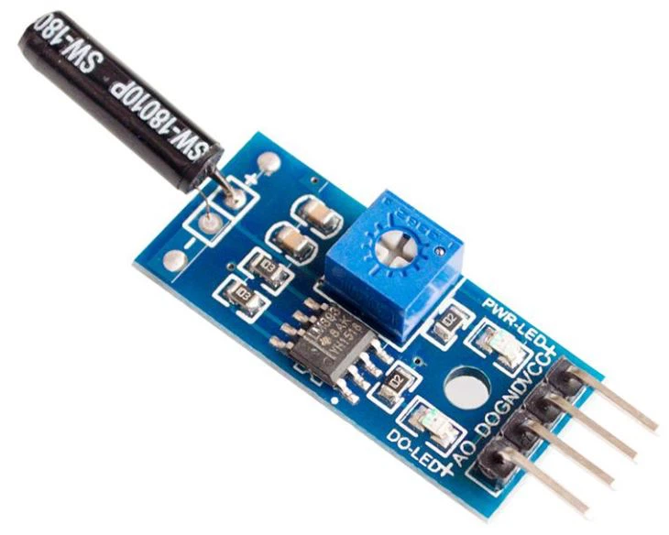


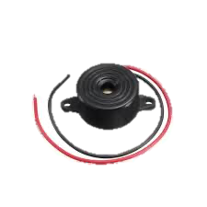
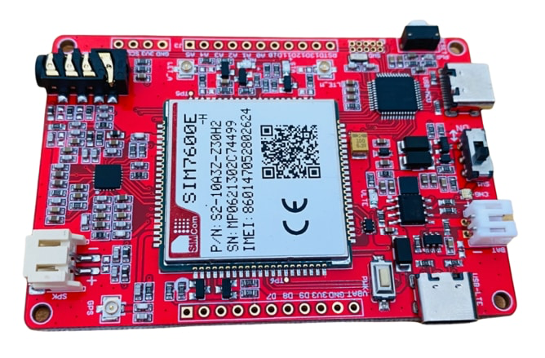
SW1801P
MPU9250
BUZZER
SMARTPHONE
SIM 4G

