Slide 1
MEMBERS & ASSIGNMENT
Nguyen Van Nham-20215105 : UI , general class diagram
Ngo Doan Ngoc-20215103 : UI, use case diagram
Duong Van Nhat-20215106 : Algorithm, class diagram
Le Cao Phong-20215113 : Algorithm, use case diagram

Slide 2
PROBLEM STATEMENT
PROBLEM: Explain 3 sorting algorithms Merge, Counting and Radix sort
REQUEST:Represent the sort algorithm on an array, making it easier to understand

Slide 3
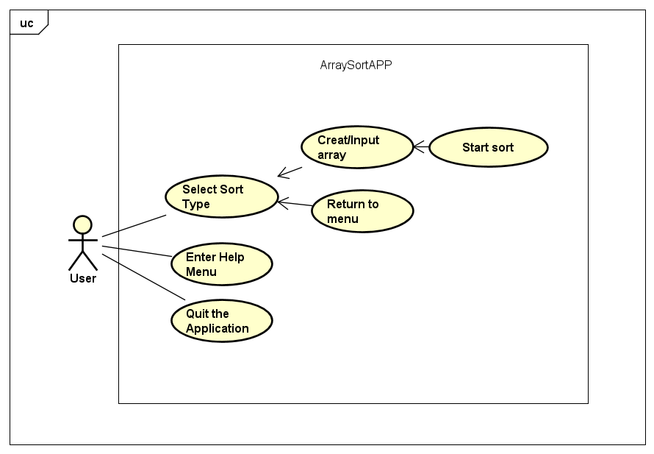
USECASE DIAGRAM

Slide 4
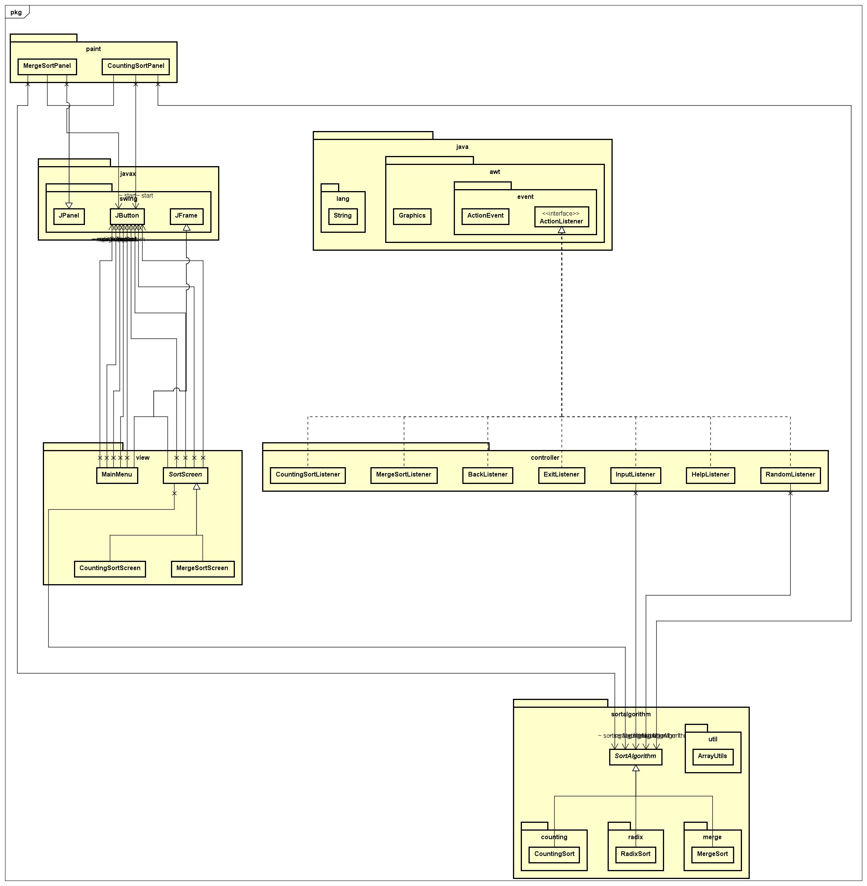
GENERAL CLASS DIAGRAM

Slide 5
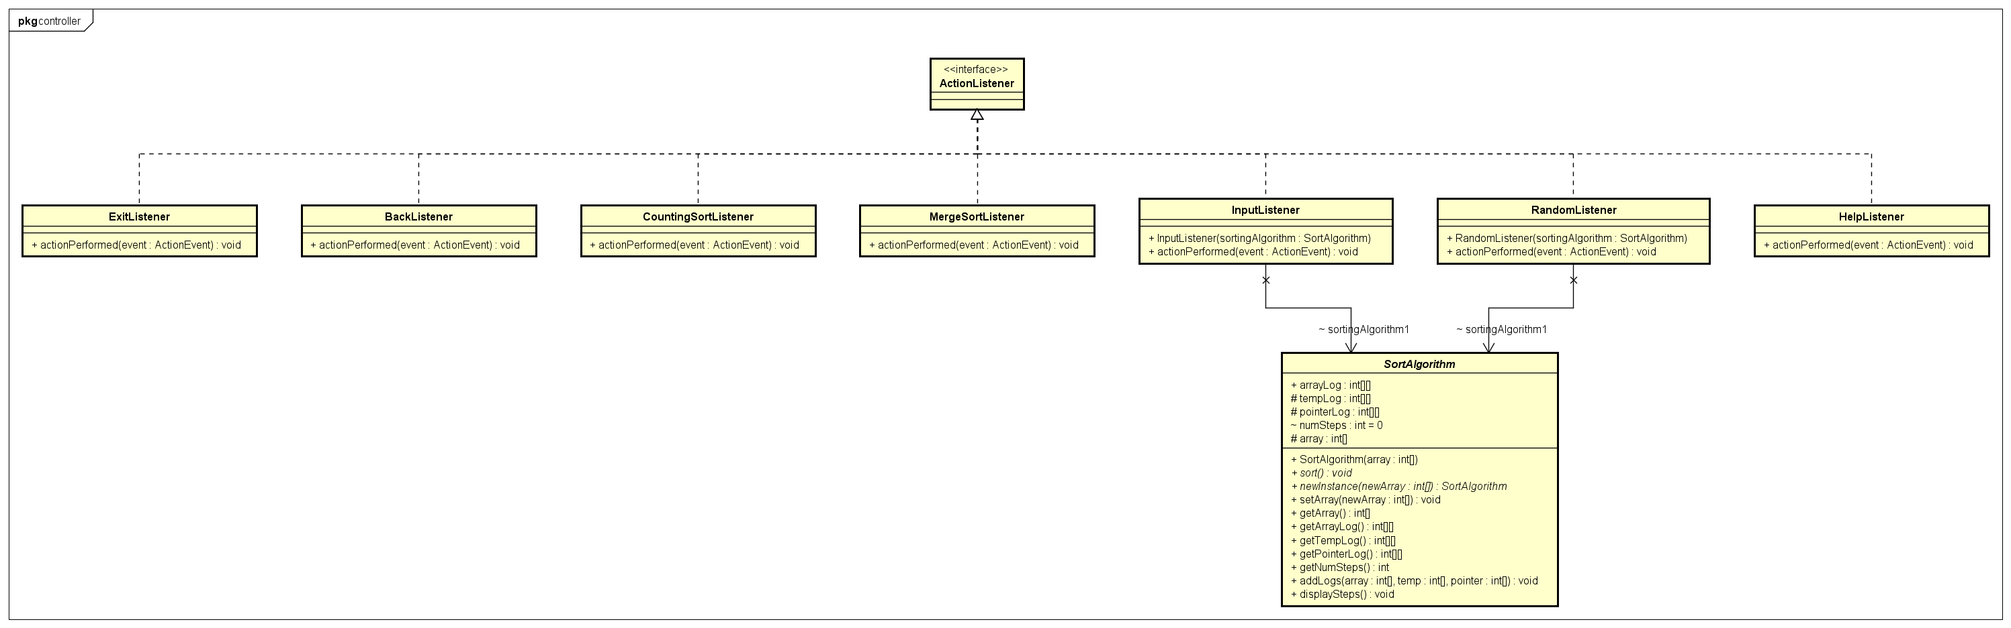
CLASS DIAGRAMS FOR PACKAGES/MODULES
CONTROLLER

Slide 6
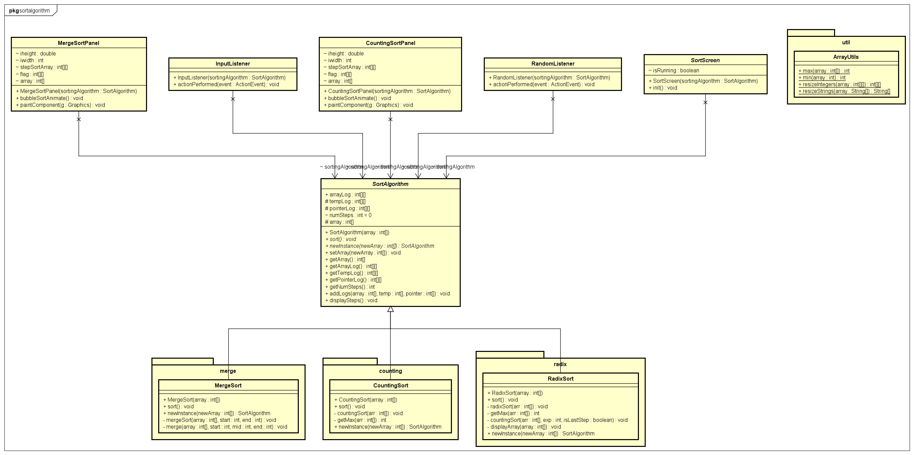
CLASS DIAGRAMS FOR PACKAGES/MODULES
SORTALGORITHM

Slide 7
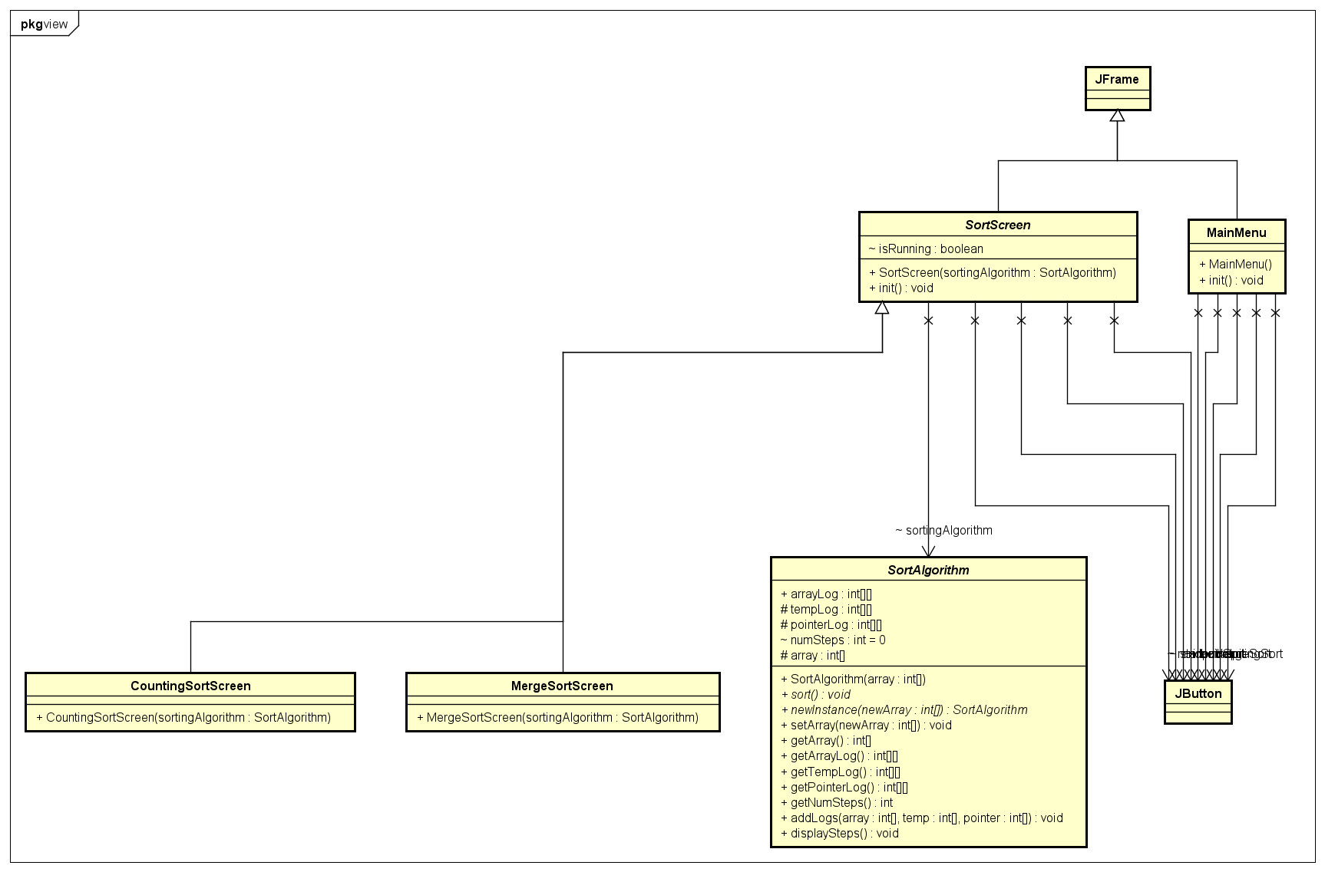
CLASS DIAGRAMS FOR PACKAGES/MODULES
VIEW

Slide 8
EXPLANATION OF OOP TECHNIQUES
INHERITANCE: MergeSort, CountingSort, RadixSort inherit from SortAlgorithm
POLYMORPHISM: MergeSort, CountingSort, RadixSort override sort
MergeSort, Counting Sort, RadixSort override newInstance

Slide 9
DEMO SCENARIO
DEMO VIDEO

