Slide 1
Occupation Segmentation Insights: Customer Value, Membership Maturity, and Regional Opportunity

Slide 2
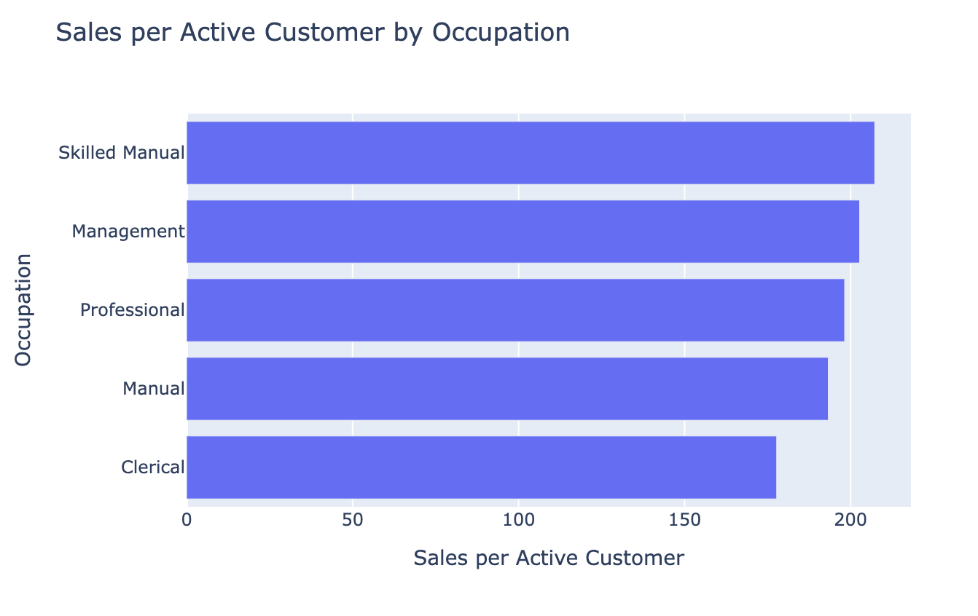
Chart 1: Sales per Active Customer by Occupation
Skilled Manual has the highest sales per active customer, indicating the strongest per-customer spending value among all occupation groups.
Clerical ranks lowest on sales per active customer and has a relatively small customer base, making it a lower-priority segment.

Slide 3
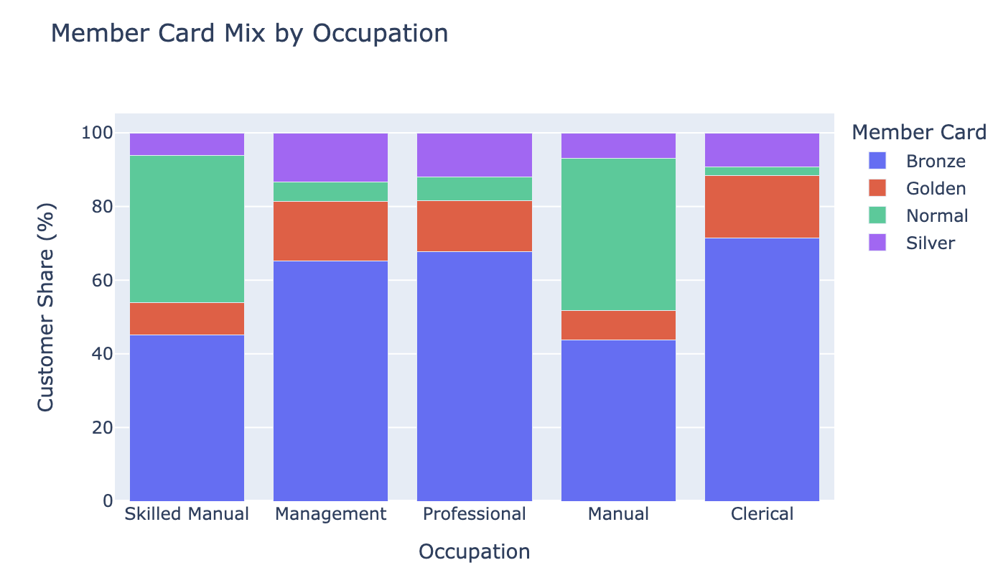
Chart 2: Member Card Mix by Occupation
Clerical and Management have a higher share of Golden and Silver members, suggesting a more mature and established high-value customer base.
Skilled Manual and Manual show a much larger share of Normal members, which suggests stronger upside for membership upgrade and conversion.
Across most occupation groups, Bronze still dominates, indicating that the overall membership base still has room to move upward.

Slide 4
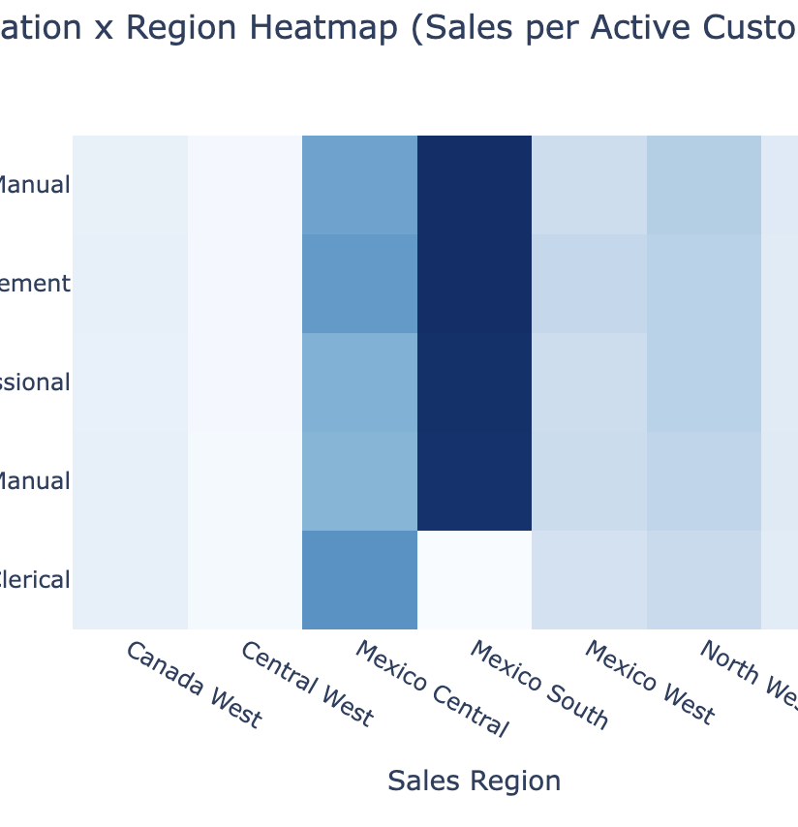
Chart 3: Occupation x Region Heatmap (Sales per Active Customer)
Mexico Central and Mexico South show the highest sales per active customer across occupations, indicating stronger customer value density in those regions.
Central West is consistently weaker across occupations, suggesting lower near-term commercial priority.

Slide 5
Business Insight Takeaway
Professional is the core scale segment, Skilled Manual is the highest-potential growth segment, Management is a mature high-quality segment, and Mexico South and Central is the most actionable high-value region.

