Slide 1
FAIR-based Refugee Protection Data Systems
FieldLab1
Group Members:
Muez Haftu Kassa
Ataklti Kidanemariam,
Huishi Wang
11 December 2025

Slide 2
Project Overview
Objective:
Develop a secure, FAIR-oriented data pipeline to report refugee protection information.
Developed a multilingual UI, ontology-driven data model, and secure ETL pipeline.
• FAIR data architecture integration

Slide 3
Problem Statement
Refugee protection data is often fragmented, inconsistent, or insecure
Field workers need a simple and trusted tool to report sensitive incidents.
Existing systems rarely meet FAIR, security, and accountability standards.
Our project addresses these challenges with a FAIR-compliant, ontology-based reporting workflow

Slide 4
Project Objectives
Develop a secure, multilingual, user-friendly interface for field workers• Personal identifiers
• Implement a FAIR-based Common Data Model (CDM) for structured refugee protection data.
Build an ETL pipeline to transform form inputs into RDF triples
Store and query data using AllegroGraph with SPARQL endpoints
Enable role-based viewing of cases to respect data sensitivity & access rules.

Slide 5
System Architecture Overview
Frontend: Streamlit-based multilingual UI (English, Amharic)
Backend Logic: Python scripts handle validation, transformation, and secure form submission
ETL Layer:
Converts user form inputs → CDM-compliant RDF triples. And uses Python + rdflib to generate valid Turtle files
Triple Store>> Allegograph cloud repository
SPARQL engine>>live queries integrated to the UI

Slide 6
User Interface Features(Streamlit App)
Structured, Easy-to-Use Reporting Form
Multilingual Support(English and amharic)
Role-Based Access (Admin, Field worker, sector officer)
• Case Viewer & Filters
- search by coutry, event type and sensitivity

Slide 7
Local Data Storage & Management (SQLite)
Secure Local Database (SQLite offline)
Structured Case Table(with different attributes)
Auto-Generated IDs
Safe Access Rules (sensitive cases hidden from non authorized roles)

Slide 8
RDF Conversion & FAIR ETL Pipeline
Automatic RDF Generation (Turtle Format
- Every case (or filtered dataset) can be exported as RDF/Turtle
Ontology-Driven Mapping
- supports fair principles( interoperable, reusable and finable)
ETL Flow – extract from SQLite
- convert it into RDF triples
- load it into Allegograph

Slide 9
Integration With AllegroGraph Triple Store (Cloud)
Cloud Repository Setup
- Repository created on AllegroGraph Cloud
- Supports HTTP SPARQL endpoint + WebView UI
Secure Upload From the Application
- Admin users can press “Upload RDF to AllegroGraph” in the UI
SPARQL Endpoint Exposure
- Automatically provides an FDP-ready SPARQL URL

Slide 10
What We Achieved
fully working reporting application for refugee protection data
bilingual user interface (English + Amharic)
Implemented secure local storage (SQLite)
Produced RDF knowledge graph output using FieldLab CDM
Integrated with AllegroGraph Cloud triple store
FAIR-by-Design Accomplishment

Slide 11
Future Work
Improve Amharic translation across all UI labels
Add mobile-friendly interface for field workers.
Add more analytics dashboards (maps, timelines, risk indicators).
Strengthen authentication & encrypted report transmission

Slide 12
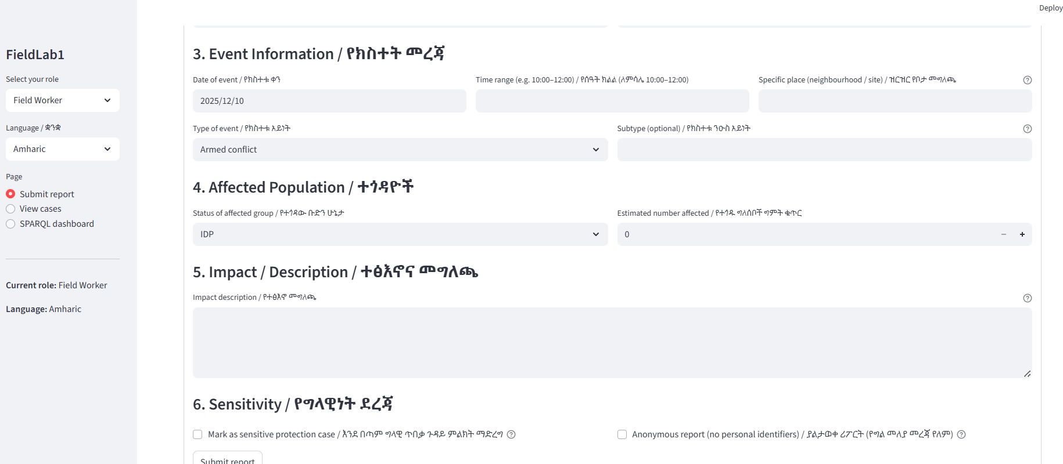
Output screenshots

Slide 13
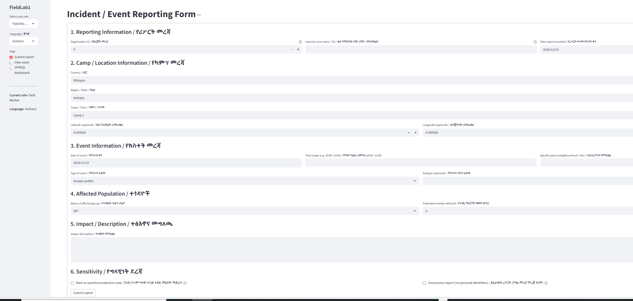

Slide 14
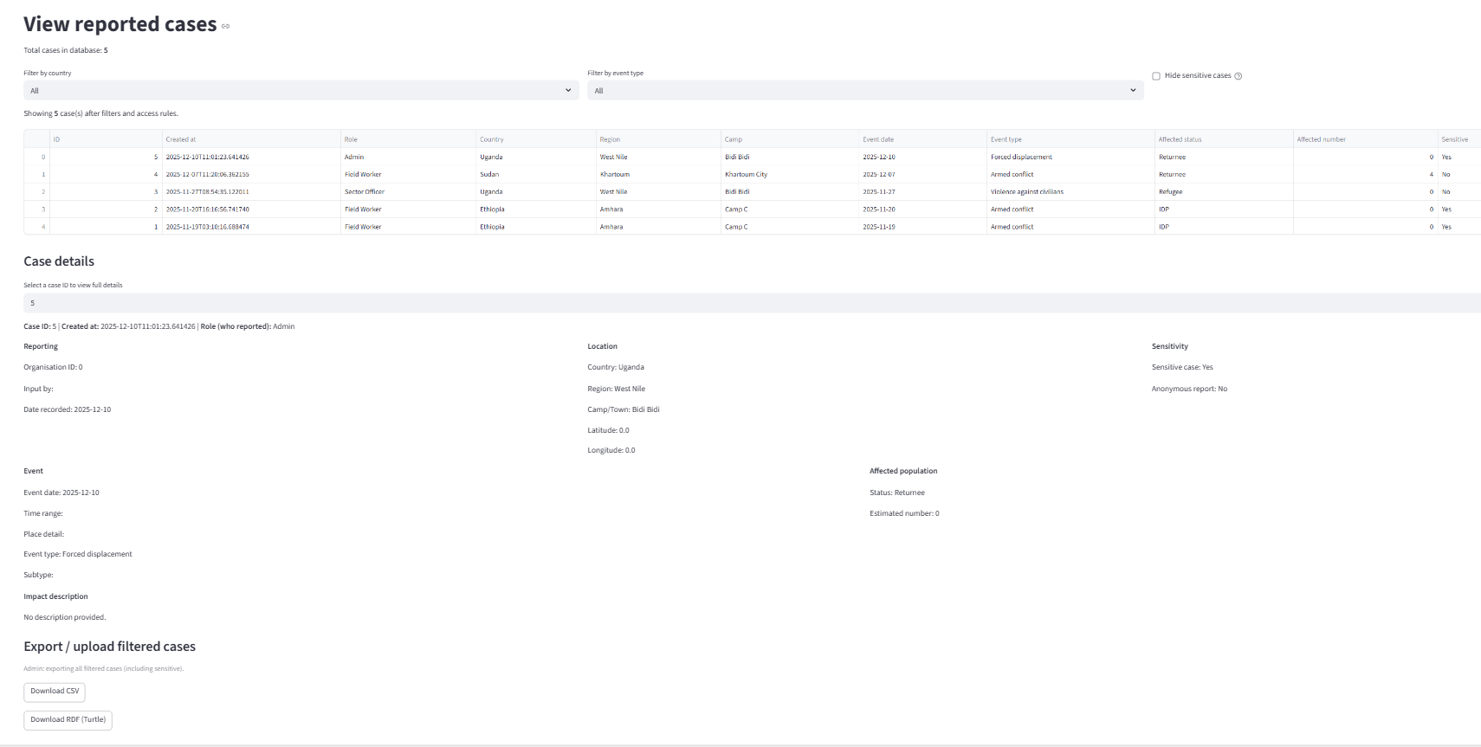

Slide 15
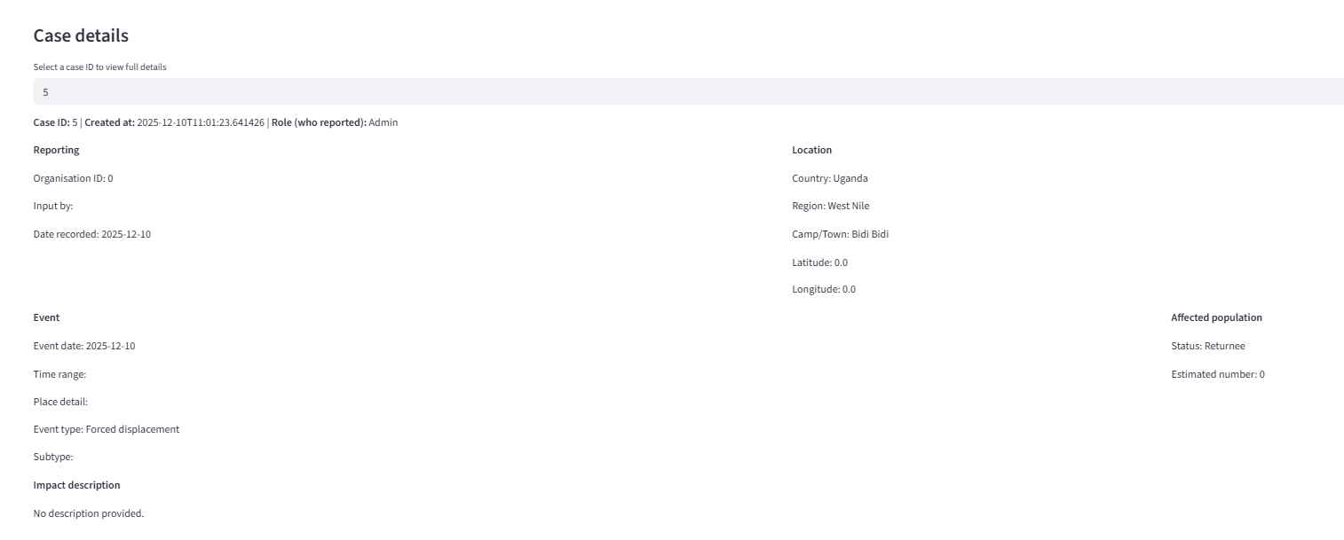

Slide 16
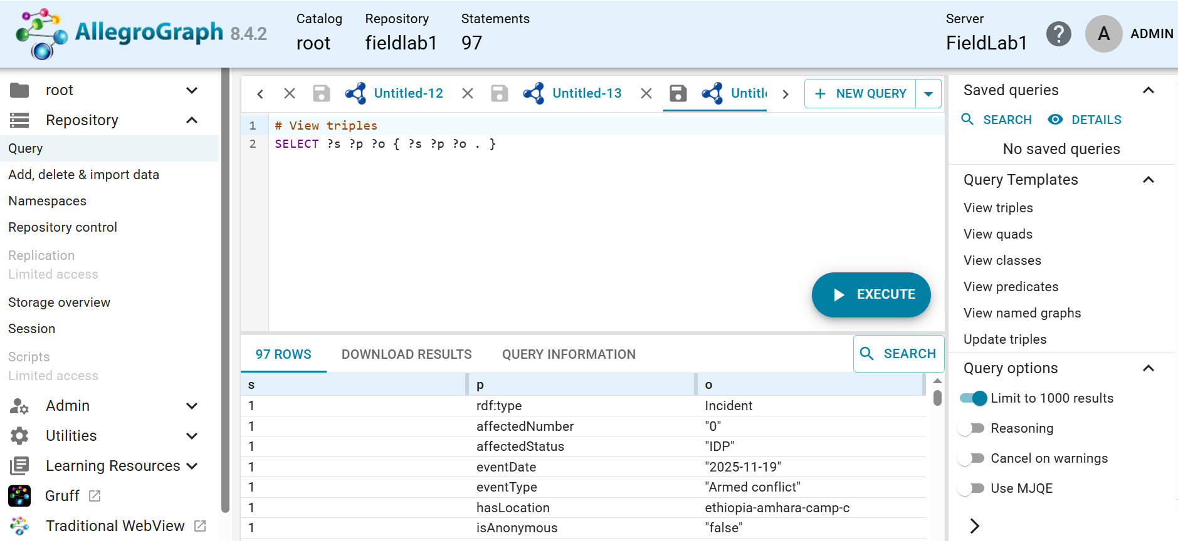

Slide 17
Thank you!!

