Slide 1
CFF_TRAVEL
Developed by CFF team

Slide 2
LAYOUT
Introduction
Data processing
01
04
Business model
Team work
02
05
Technologies
Future plan
03
06

Slide 3
01
Introduce

Slide 4
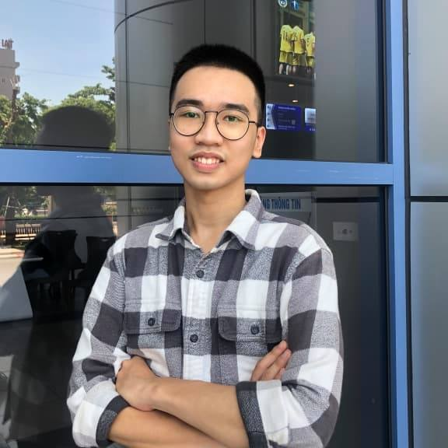





Slide 5
02
Business model

Slide 6



ISSUES
The choice of hotel is very important.
So many prices and review make user confuse.

Slide 7


POTENTIAL USERS
Young people .
Under 35 years old who is a finanially independent.
Love to explore and enjoy new experiences.

Slide 8

USERS PAIN POINT
Extremely hard to choose a hotel in vacation due to a lot of choices
Many booking website with unstable and different prices

Slide 9
IDEA
Searching and comparison between hotels in tourist destinations.
Based on the accompanying services, the quality of the amenities in the hotel, especially price.
Recommended available hotels.

Slide 10
03
Technologies

Slide 11
MISSION STATEMENT
Technologies
Back-end
Front-end

Slide 12



Technologies
Front-end
React Native
Google Services
Base on Expo
Facebook
Log-in, Maps
Facebook Log-in

Slide 13
Programming
Database
Back-end
Python
Django framework
Machine learning
PostgreSql

Slide 14
04
DATA PROCESSING

Slide 15
Mapping problem
Using data from clickhouse. After cleaning and processing the data, convert the data into file csv file for import into Postgresql
Using the features (cosine name, cosine address, distance, similar point, ...) in the cosine hotel table in the data provided to maping the hotel data of Tripi , group hotels by province to get more accurate data
Data collected: data on more than 16,000 hotels in Vietnam

Slide 16
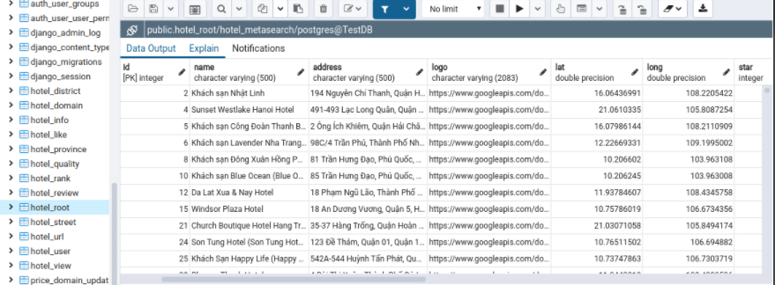
Mapping problem
Hotel data

Slide 17
Ranking problem
Ranking is based on 18 attributes data about hotel facilities and services, especially the attributes of price, number of reviews, review score
Handle missing value:
+ for data about facility hotel (score: overall_score, review score, …), use mean function
+ for data about hotel service (is_wifi free, … : [-1,0,1]), use mode function
+ remove attributes that lose too much data from the ranking function (loss > 40%)

Slide 18
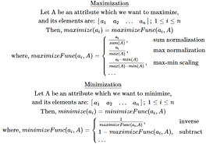
Ranking problem
Using algorithms to scale data (minimization function for the price and maximization function for the remaining attribute

Slide 19
Ranking problem
Apply a weight to each attribute to form a rating function for each hotel
Divides the hotel data into different type for the ranking: hotel, homestay, hostel
Apply an algorithm and adjust the weights of a few important attributes(price, review score, star) to optimize ranking result

Slide 20
Nature language processing
Using machine learning to analyze user review data about hotels (positive and negative)
+ Data collected: more than 130000 reviews for hotels (from early 2020)
+ Labeling 10,000 data to train, include both English and Vietnamese review data

Slide 21
Nature language processing
Using module sklearn SVM (model SVC) to training input data
For Vietnamese data:
+ Using Vietnam_stopwords to remove stopwords
+ Using module VnTokenizer (module pyvi) to preprocess data
Accurency: Vietnamese model – 88,56 %
English model – 87.3 %

Slide 22
05
UI/UX

Slide 23
05
TEAMWORK

Slide 24
Communication tools
Team work management : Slack
Keep track of people’s work: Trello
General contact: Messenger
Document storage: Google Drive
Source code: Github
SDLC: Waterfall Model

Slide 25
Project Organization
Assign specific tasks to each member in each week.
Weekend review meeting:
- Summarize the results achieved during this week.
- Make plan and tasks for the new week.
Group communication is always given the highest priority.

Slide 26
Lessons learned
Need agreement on communication and working style at the first stage.
Reasonable deadlines.

Slide 27
06
Future Plan

Slide 28
Improvement
Make UI/UX more friendly with user.
Long-term plan:
- Develop more algorithms to improve experience of user and market.
- Advertising for hotels to get initial revenue.

Slide 29

Thank you for listening

