Slide 1
BWT
One block at a time
(install vscode+estension Remote - SSH)

Slide 2
Small steps
BWT of a string
Last to first
Inverse BWT
BWMatching (the vanilla version - without counts, partial suffix array and mismatches)

Slide 3
BWT of a string
We can follow the definition and implement it directly.
We add the end symbol '$' to our string, then we obtain all its possible cyclic rotations as a list and sort the resulting list, then concatenate their last characters.
To get the i^{th} rotation of a string we append its i^{th} character to the rest of them:
i=1
0 1 2 3 4 5 6
P A N A M A $
------------------------> A N A M A $ P
Python string slices makes this simple to code.

Slide 4
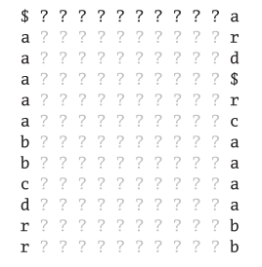
Reasoning on the InverseBWT
We have the BWT of a string, i.e. the last column of the matrix.
Determining the first it's easy, it's simply the characters of the last column lexicographicaly ordered:
Having the end of string marker and we know that the first letter of our string will be a.
Then we can continue going backwards, but we have 5 positions with a in the last column

Slide 5

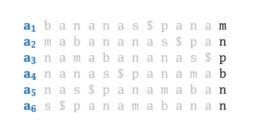
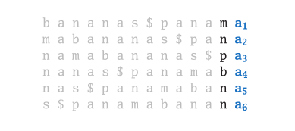
First-last Property
These are other entries of the BWT matrix and appear in the same order
If we chop off these a_{s} and add them as last column we get other rotations and they are still ordered
The k^{th} occurrence of a character in the first column corresponds to its k^{th} occurrence in the last column.

Slide 6
Going back to abracadabra…
Having the end of string marker and we know that the first letter of our string will be a.
Then we can continue going backwards, but we have 5 positions with a in the last column
We know that the want the 3rd in the last column… so the second letter is a b.

Slide 7
We could number our characters to implement the inverseBWT, but…
Can be just build two "maps", first to last and last to first (this will be needed for BWMatching in reality) that will bring us from one position of a column to the corresponding of the other one?
We know that if we get the characters of the last column and order them we get the first column
BWT('PANAMA$')= 'AMNPAA$'
0 1 2 3 4 5 6
A M N P A A $
6 0 4 5 1 2 3 —> The first column is '$ A A A M N P'

Slide 8
Maps
BWT('PANAMA$')= 'AMNPAA$'
1 2 3 4 5 6 7
A M N P A A $
6 0 4 5 1 2 3 —> The first column is '$ A A A M N P'
In the vector = [6 0 4 5 1 2 3] indexes are positions in the first column and values are positions of the corresponding characters in the last column.
So:
FC='$ A A A M N P'
LC='A M N P A A $'
We search for $ in LC, its index is 6 -> Our first letter is P.

Slide 9
Maps - II
ftol = [6 0 4 5 1 2 3] - indexes are positions in the first column and values are indices
of the corresponding characters in the last column.
FC='$ A A A M N P'
LC='A M N P A A $'
We search for $ in LC, its index is 6 -> Our first letter is P
But $ is the only character that we can search directly, then we must use only our map to move between the two columns…we know that we are at position 3 of FC.

Slide 10
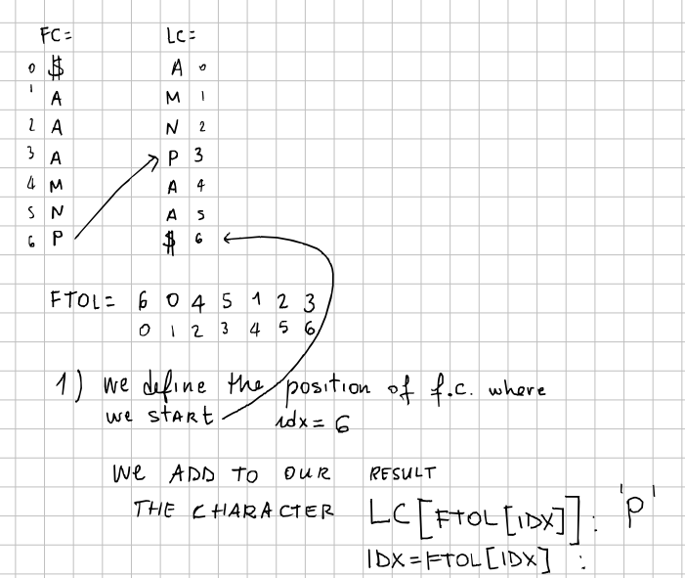
3

Slide 11
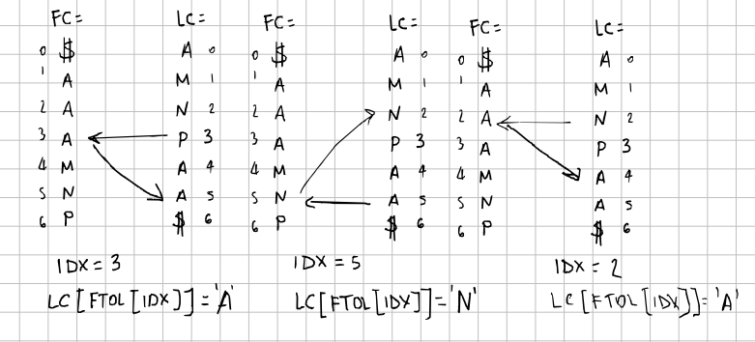
ftol = [6 0 4 5 1 2 3]

Slide 12
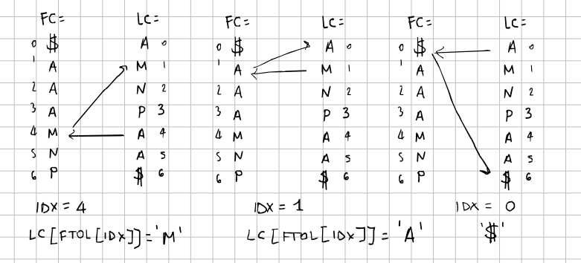
ftol = [6 0 4 5 1 2 3]

Slide 13
Suggestions for FTOL in Python/R
sorted(iterable, /, *, key=None, reverse=False)
Return a new list containing all items from the iterable in ascending order.
A custom key function can be supplied to customize the sort order, and the
reverse flag can be set to request the result in descending order.
>>> sorted(range(0,10))
[0, 1, 2, 3, 4, 5, 6, 7, 8, 9]
>>> sorted(range(0,10), key=lambda x: -x)
[9, 8, 7, 6, 5, 4, 3, 2, 1, 0]
order returns a permutation which rearranges its first argument into ascending or descending order, breaking ties by further arguments.
> order(c(3,1,2))
[1] 2 3 1

Slide 14
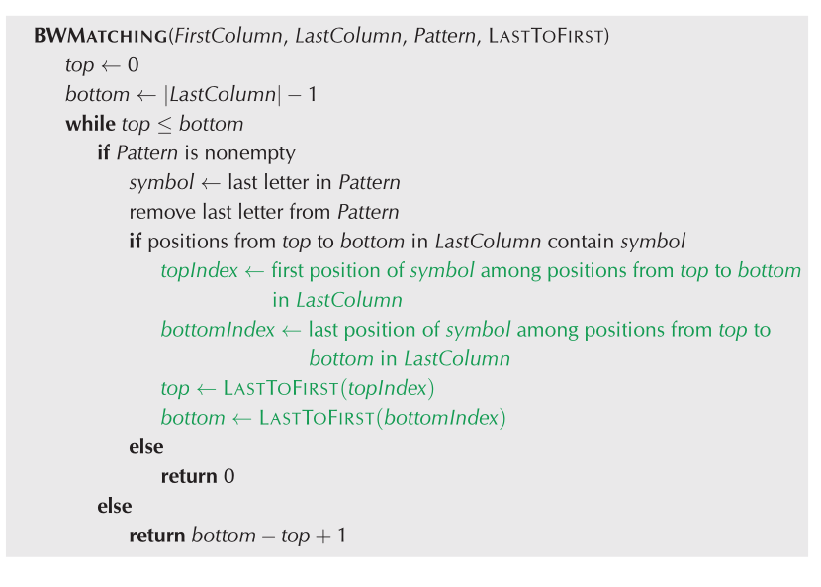
BWMatching

