Slide 1
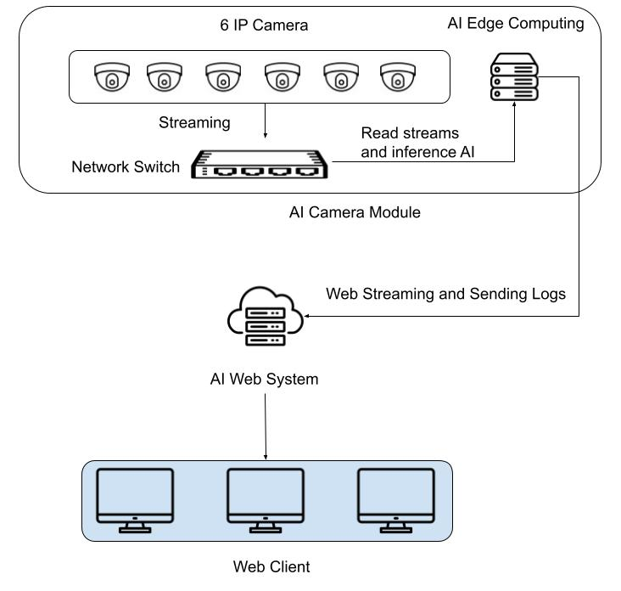
2. Smart Inspection IPCAM
AI-Driven Edge Vision Architecture
Infrastructure: 6 High-Definition IP Cameras connected via a high-speed Network Switch.
AI Edge Computing: Performs On-device Inference (Object detection, facial recognition, or behavior analysis) directly at the source.
Key Benefit: Reduces latency and saves bandwidth by processing heavy video data locally.
1
2. Cloud/Server Management (Centralized Logic)
AI Web System: Acts as the central hub for the entire ecosystem.
Data Flow: Receives Real-time Web Streams and Event Logs (metadata) from the Edge module.
Functions: Handles data storage, user authentication, and system-wide configurations.
2
3. AI-Driven Edge Vision Architecture
Web Client: A cross-platform dashboard accessible via any modern browser.
User Experience: Provides live monitoring, instant AI alerts, and historical log retrieval for end-users on multiple monitors.
3
AI-Driven Edge Vision Architecture

Slide 2
2. Smart Inspection IPCAM
Hardware requirments
# | Spec | Number of cameras per edge computer | Qty of edge computer | Note | Price per unit (est.) | Total
1 | Intel Core i7-14700F 20C/28T (2.1GHz Base / 5.4GHz Boost) or better 128GB DDR5 (2×64GB) 5600–6000MT/s Non-ECC 1TB M.2 NVMe Gen4 SSD 4TB HDD 7200rpm SATA3 1Gbps Ethernet interface (Onboard LAN) NVIDIA GeForce RTX 5060 TI (16GB GDDR7) or equivalent | 6 ~ 8 (Depend on number of features enabled) | Total 21 IP CAM 6 Camera/Computer Number of camera = 21/6 = 4 | For IP CAMERA | 45,000,000 VND | 180,000,000 VNĐ
2 | AMD Ryzen 9 9900X3D 12C/24T (5.5GHz Boost) or better 128GB DDR5 (2×64GB) 5200–6000MT/s Non-ECC 1TB M.2 NVMe Gen4 SSD 4TB HDD 7200rpm SATA3 1Gbps Ethernet interface (Onboard LAN) NVIDIA GeForce RTX 5090/4090 (32GB GDDR7) or equivalent | 6 ~ 8 (Depend on number of features enabled) | Total 10 360 deg CAM 6 Camera/Computer Number of camera = 10/6 = 2 | For 360 deg CAMERA, (360 CAMERA need higher quality AI model so it needs better GPU | 150,000,000 VNĐ | 300,000,000 VNĐ
 |  |  |  |  |  | 480,000,000 VNĐ

