Slide 1
Comparative Area Analysis in New York and London
By Elena Tuchina
November 2018

Slide 2
Business Problem
The relocation company that specializes in relocating finance professionals between New York and London needs a tool to help their customers find suitable neighborhoods/districts of the city they are moving to by narrowing down a list of potential areas based on their location preferences in their home city.
This process can be greatly facilitated by customer’s knowledge of their home city and its areas. By identifying what area(s) in their home city the new location should resemble, the cluster analysis can narrows down the list of the areas to consider to a few that the customer should further research/visit before making final decision.

Slide 3
Area Data
New York City neighborhood dataset is taken from New York University Spatial Data Repository (https://geo.nyu.edu/catalog/nyu_2451_34572) and contains the boroughs and the neighborhoods that exist in each borough as well as the the latitude and longitude coordinates of each neighborhood.
The London district dataset is created by using information from Wikipedia page (https://en.wikipedia.org/wiki/List_of_areas_of_London) and contains the boroughs and the districts that exist in each borough. Only Inner London boroughs (as per London Government Act 1963) are used in this analysis. The latitude/longitude coordinates were determined using Nominatum geolocator from Geopy library.

Slide 4
Venue Data
Foursquare location data is used for information on existing venues in each area of the city. The venues are aggregated by category for further frequency analysis that is served as basis for area comparison and clustering.
The following venue information was used for analysis:
Venue name
Venue category
Venue latitude
Venue longitude

Slide 5
Methodology – Stage 1 “Area Profile”
Venue location data provided by Foursquare is obtained for each area from both New York and London datasets, and then aggregated by venue categories (Only areas with at least 100 venues reported are retained for further analysis)
Aggregated venue data for the chosen New York neighborhood is added to the the aggregated venue dataset for London. This combined dataset is then converted into each area profile by calculating the frequency with which various venue categories appear

Slide 6
Methodology – Stage 2 “Segmentation”
Areas are segmented by applying k-means clustering method to area profiles
This relatively simple model is fast and sufficient for the complexity of the task at hand, and will allow for adding further dimensions to area profiles in the future
The chosen number of clusters is 10 (based on the optimal performance of the model)

Slide 7
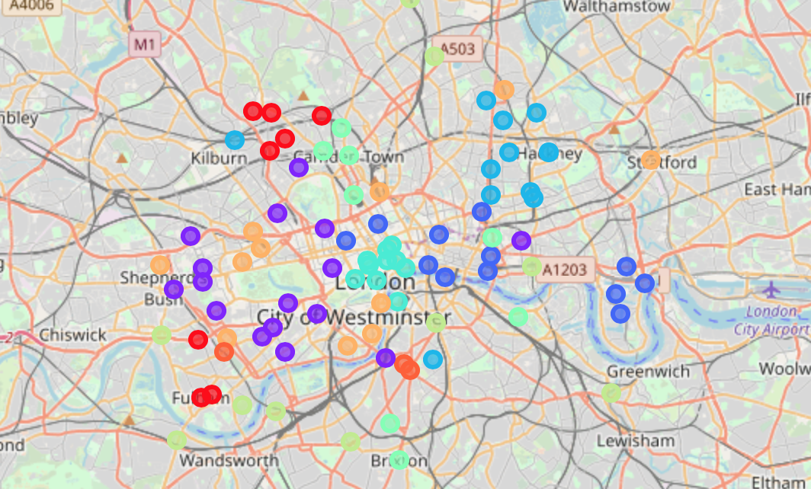
Results – Area Clusters
The analysis shows clusters of London districts on the map, with each cluster drawn in a different color:

Slide 8
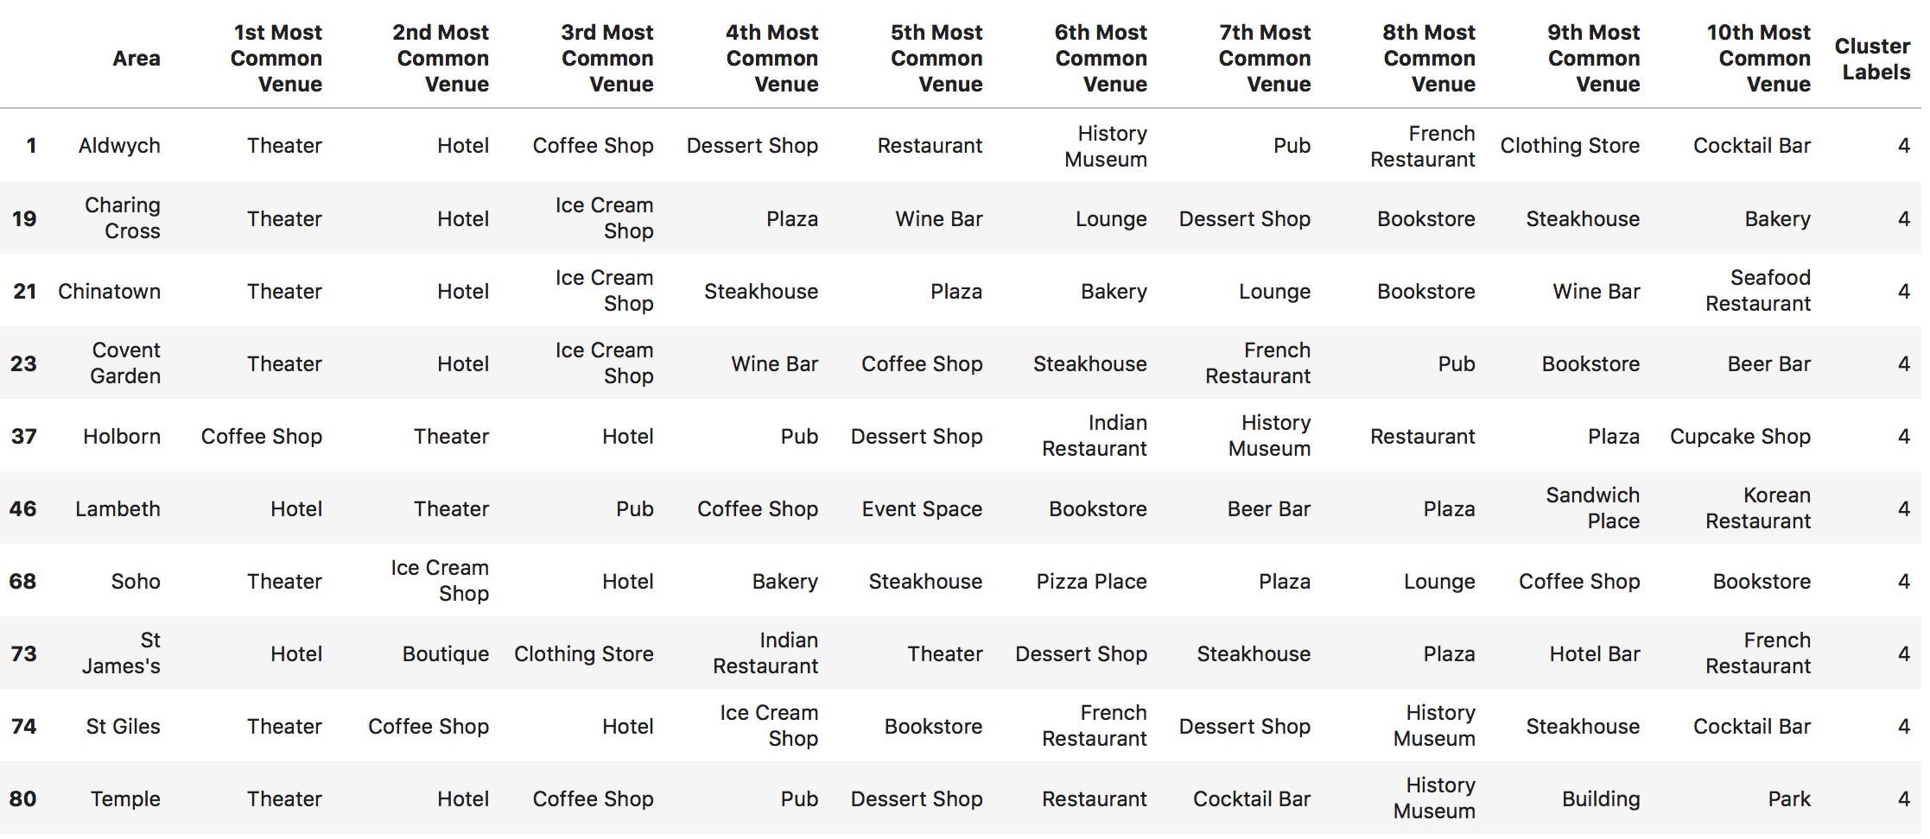
Results – List of Areas
The result is a list of London districts, most similar to the chosen neighborhood in New York:

Slide 9
Results – Discussion
The city areas returned by the model represents a narrowed down list that most closely match customer's preferences.
This list can now be used to perform in-depth research by the customer and relocation agency to take into account additional criteria and housing availability, followed by customer visit to the area before making final decision.

Slide 10
Conclusion
The application of the analysis by the relocation company would result in allowing finance professionals to relocate quickly and successfully while staying focused on their professional transition, and with reduced cost for business.
Further steps to improve the model could include incorporation of additional information that enhance the description of areas such as property data, educational (schools, universities, etc) and medical facilities, parks and other recreational centers, crime and safety records, ethnic composition etc.

