Slide 1


$$t$$
$$S$$

Slide 2


$$t$$
$$x$$

Slide 3




$$t$$
$$∆t$$
$$x$$
$$∆x$$

Slide 4

$$t$$
$$x$$

Slide 5
$$t$$
$$x$$

Slide 6
$$t$$
$$x$$

Slide 7
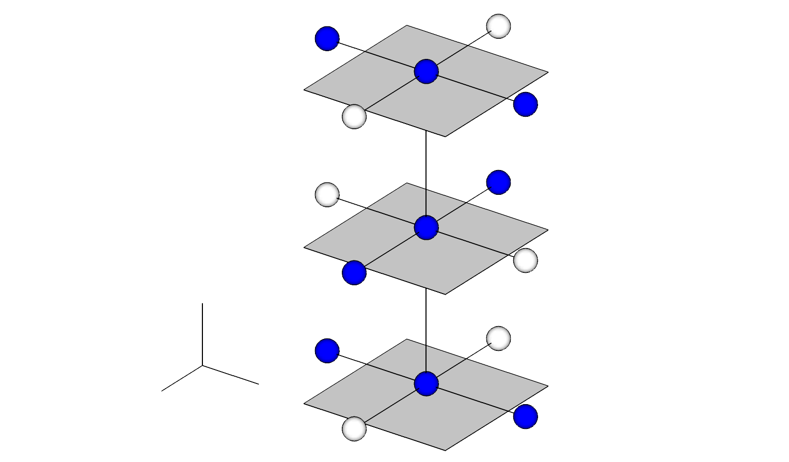













$$i, j −1$$
$$n+1$$
$$i, j$$
$$i, j+1$$
İ - $1, j$
$$n+1/2$$
$$i, j$$
$$z$$
$$i+1, j$$
$$i, j −1$$
$$n$$
$$x$$
$$y$$
$$i, j$$
$$i, j+1$$

Slide 8
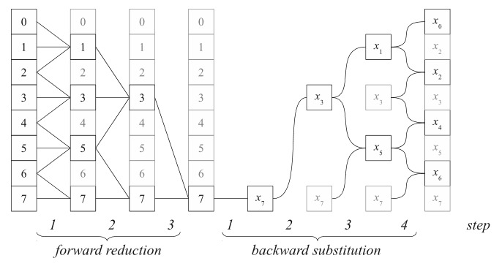











0
0
0
0
$$x_{0}$$
1
1
1
1
$$x_{1}$$
$$x_{1}$$
2
2
2
2
$$x_{2}$$
3
3
3
3
$$x_{3}$$
$$x_{3}$$
$$x_{3}$$
4
4
4
4
$$x_{4}$$
5
5
5
5
$$x_{5}$$
$$x_{5}$$
6
6
6
6
$$x_{6}$$
7
7
7
7
$$x_{7}$$
$$x_{7}$$
$$x_{7}$$
$$x_{7}$$
Steps
1
2
3
1
2
3
4
Forward Reduction
Backward Substitution

Slide 9
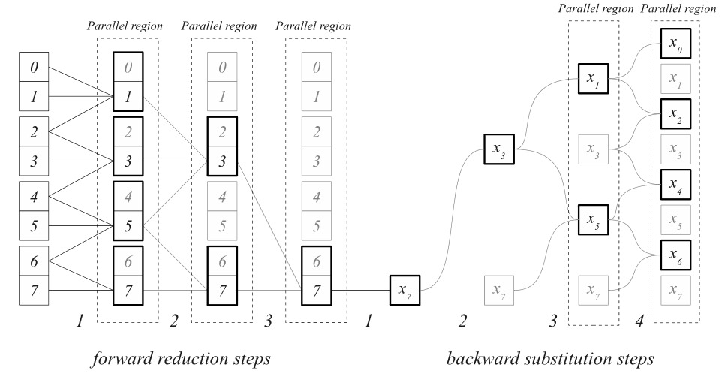
Parallel Region
Parallel Region
Parallel Region
Parallel Region
Parallel Region
0
0
0
0
$$x_{0}$$
1
1
1
1
$$x_{1}$$
$$x_{1}$$
2
2
2
2
$$x_{2}$$
3
3
3
3
$$x_{3}$$
$$x_{3}$$
$$x_{3}$$
4
4
4
4
$$x_{4}$$
5
5
5
5
$$x_{5}$$
$$x_{5}$$
6
6
6
6
$$x_{6}$$
7
7
7
7
$$x_{7}$$
$$x_{7}$$
$$x_{7}$$
$$x_{7}$$
Steps
1
2
3
1
2
3
4
Forward Reduction
Backward Substitution

Slide 10
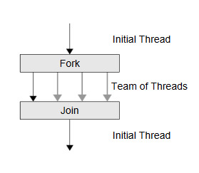
Initial Thread
Fork
Team of Threads
Join
Initial Thread

Slide 11
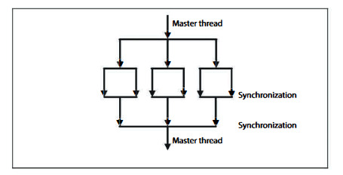
Initial Thread
Team of Threads
Team of Threads
Synchronization
Synchronization
Initial Thread

Slide 12
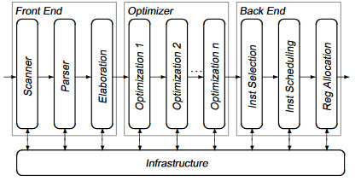
Front End
Optimizer
Back End
Parser
Selection
Scanner
Elaboration
Optimization 2
Scheduling
Optimization 1
Optimization k
Registry Allocation
...
Infrastructure

