Slide 1
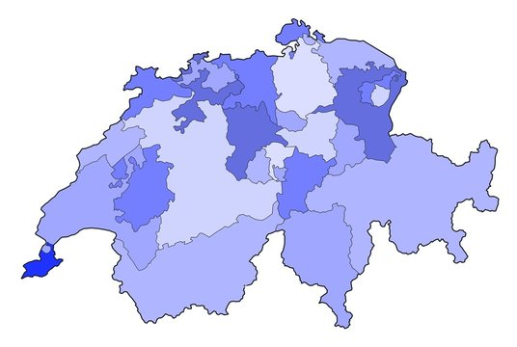
Zürich
Bern
Chur
Genf
Waadt
RESET
UNDO
SCORE: 155km

Slide 2


1
The totally accurate SBB Simulator
START

Slide 3

2
Zürich
Bern
Chur
Genf
Waadt
RESET
UNDO
SCORE: 0km

Slide 4
3
Zürich
Bern
Chur
Genf
Waadt
RESET
UNDO
SCORE: 155km

Slide 5
4
Zürich
Bern
Chur
Genf
Waadt
RESET
UNDO
SCORE: 540km

Slide 6
5
Zürich
Bern
Chur
Genf
Waadt
RESET
UNDO
SCORE: 540km

Slide 7
6
Zürich
Bern
Final Score 540km
Chur
Genf
Waadt
RESET
UNDO
SCORE: 540km

