Slide 1
Systemdesign
Lektion 1

Slide 2
Agenda
Introduktion til Systemdesign kurset
Recap af agil tilgang
Systemudviklingsmodeller
Opstart af eXtreme programming
Til næste gang…

Slide 3
Kursets struktur og emner
Systemudviklingsmetoder​
Design og arkitektur​
Case med IT og økonomi
Projekt
Eksamen

Slide 4
Studieordning - læringsmål
Viden​ - den studerende har:​
• viden om kravindsamling og kravbeskrivelse.​
• viden om modeller til omformning af krav til løsningsarkitektur.​
• viden om modelbaseret softwaredesign.​
Færdigheder​ - den studerende kan:​
• anvende metoder og modeller til udarbejdelse af en løsningsarkitektur.​
• anvende standarder som en integreret del af en løsningsarkitektur.​
• anvende arkitektur patterns som grundlag for en løsningsarkitektur.​
• vurdere praksisnære og teoretiske problemstillinger inden for modelbaseret softwaredesign samt begrunde og vælge relevante løsningsmodeller.​
• formidle en løsningsarkitektur til relevante interessenter.​
Kompetencer​ - en studerende kan:​
• håndtere komplekse og udviklingssituationer med at analysere krav og metodisk og struktureret udarbejde en løsningsarkitektur baseret på standarder og arkitektur patterns.​
• identificere egne læringsbehov og udvikle egen viden, færdigheder og kompetencer i relation til udarbejdelse af løsningsarkitekturer.​
https://katalog.kea.dk/course/4111406/2023-2024

Slide 5
Undervisningsform
”Undervisning vil være en vekselvirkning mellem præsentation, øvelser og projektarbejde.” (https://katalog.kea.dk/course/4111406/2023-2024)
I skal øve jer I selv at opsøge information, så I kommer i højere grad til at være opsøgende omkring nye emner.

Slide 6
Eksamensform
Fælles prøve med Projektstyring og Projektledelse
30 min. ink. votering med kendte spørgsmål

Slide 7
Projekter
Fælles projekt med projektledelse og projektstyring
Afsluttende projekt
  Det er IKKE et eksamensprojekt
Review og feedback til IT og økonomistuderende

Slide 8
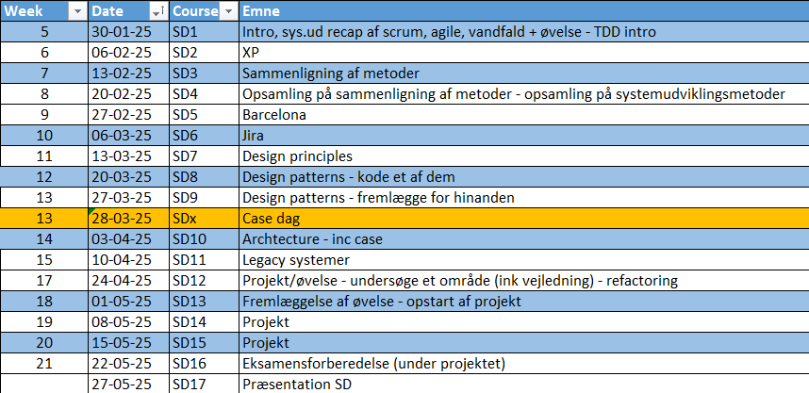

Slide 9
Recap af systemudviklingsmetoder

Slide 10
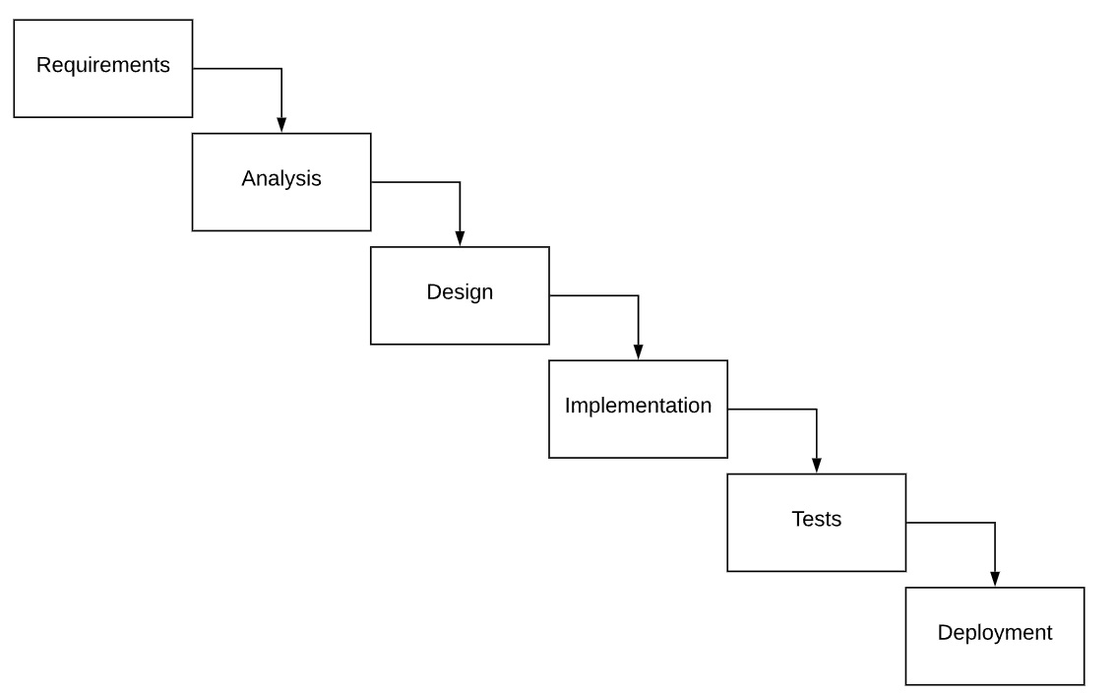
Metoder – vandfald – ”plan driven”

Slide 11
Agile
”Opfundet” pga. ”overrun” i projekter
XP, Scrum, Kanban (SAFe)
Målet/salgstalen er – hele tiden at give kunden/brugeren den størst mulige værdi
Notes:
Iterative and incremental development with frequent small releases
Adaptability to changing requirements
Continuous collaboration between development teams and stakeholders
Customer-centric approach with rapid feedback loops
Emphasis on working software over comprehensive documentation
Self-organizing, cross-functional teams
Regular reflection and process improvement

Slide 12
Agile
Iterative development: The process is broken down into short cycles called sprints or iterations, typically lasting 2-4 weeks.
Continuous delivery: Working software is produced and delivered at the end of each iteration3.
Customer collaboration: There is frequent interaction with customers or stakeholders to gather feedback and adjust requirements.
Adaptability: The process embraces change and allows for quick pivots based on new information or evolving needs.
Cross-functional teams: Development teams are self-organizing and include members with various skills needed to complete the project.
Prioritization of features: The team focuses on delivering the most valuable features first, based on customer needs.
Continuous improvement: The team regularly reflects on their process and makes adjustments to improve efficiency.
Emphasis on working software: The primary measure of progress is functional software rather than comprehensive documentation.
Notes:
Iterative development: The process is broken down into short cycles called sprints or iterations, typically lasting 2-4 weeks36.
Continuous delivery: Working software is produced and delivered at the end of each iteration3.
Customer collaboration: There is frequent interaction with customers or stakeholders to gather feedback and adjust requirements15.
Adaptability: The process embraces change and allows for quick pivots based on new information or evolving needs2.
Cross-functional teams: Development teams are self-organizing and include members with various skills needed to complete the project1.
Prioritization of features: The team focuses on delivering the most valuable features first, based on customer needs26.
Continuous improvement: The team regularly reflects on their process and makes adjustments to improve efficiency1.
Emphasis on working software: The primary measure of progress is functional software rather than comprehensive documentation5.
https://www.techtarget.com/searchsoftwarequality/definition/agile-software-development
https://www.brightwork.com/blog/5-stages-of-the-agile-system-development-life-cycle
https://www.smartsheet.com/understanding-agile-software-development-lifecycle-and-process-workflow
https://selleo.com/blog/agile-software-development-process-everything-you-need-to-know
https://www.opentext.com/what-is/agile-development
https://www.wrike.com/agile-guide/agile-development-life-cycle/
https://asana.com/resources/agile-methodology
https://www.cio.com/article/237027/agile-project-management-a-beginners-guide.html

Slide 13
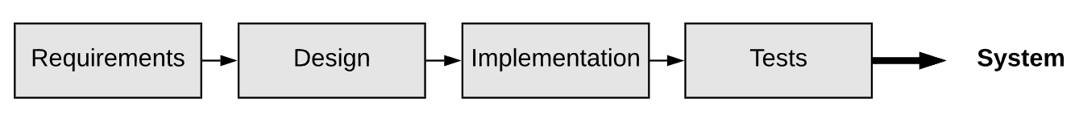
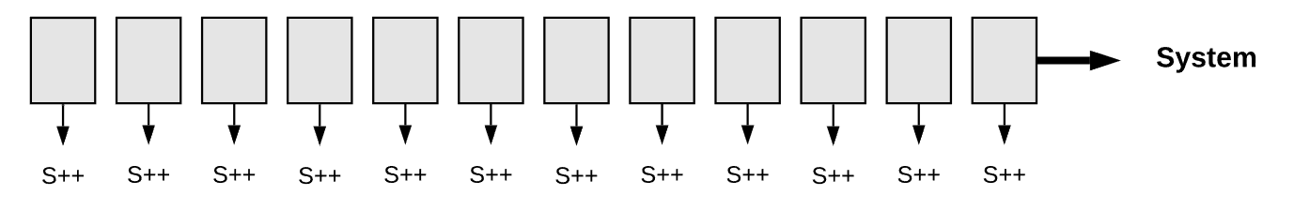
Søger at løse...
Hurtige ændringer i krav
  Teknologi bliver forældet før det er klart
  Minimal valuable product-tankegang
  Løbende validering af kunder
Dokumentation bliver ikke opdateret

Slide 14
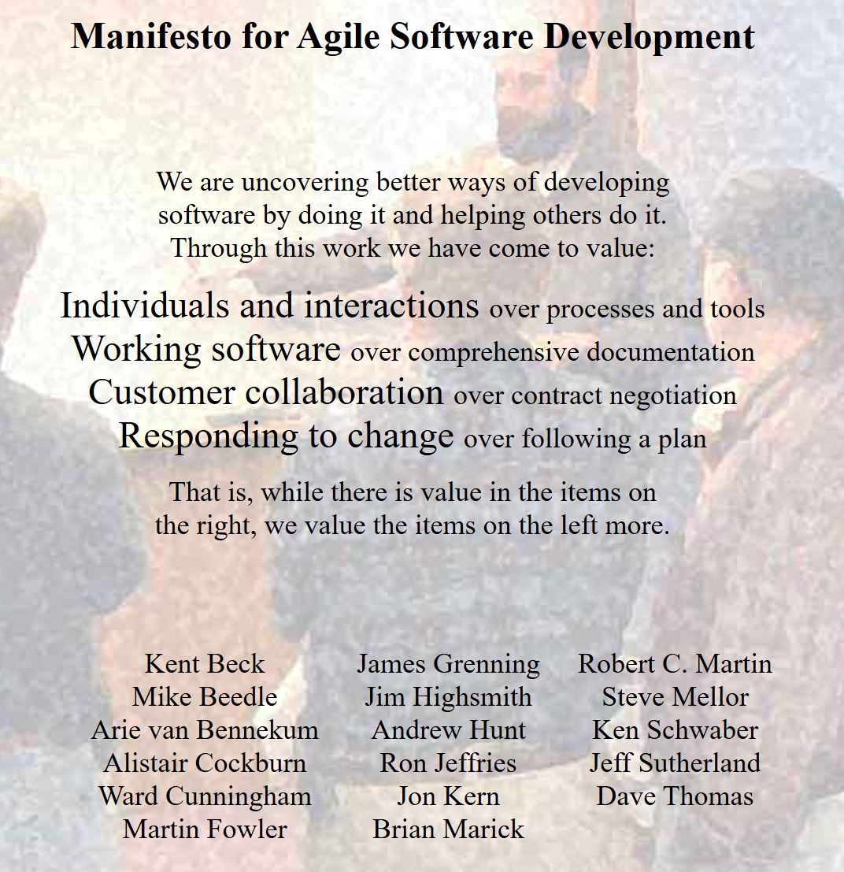
Agile Manifesto
https://agilemanifesto.org/

Slide 15
Øvelse
Overvej forskellen på den venstre og højre side i ”The agile manifesto”. Hvad betyder det for udvikling af software?
Individuals and interactions over processes and tools
Working software over comprehensive documentation
Customer collaboration over contract negotiation
Responding to change over following a plan

Slide 16
Agilt fokus I
Less emphasis on documentation: Only essential information should be documented, focusing on what is necessary for understanding and maintaining the system.
Less emphasis on detailed plans: At the start of a project, often neither the customer nor the developers have a clear understanding of all requirements that should be implemented. This understanding gradually unfolds as sprints are completed and their outcomes validated. In essence, the core principle of agile is to progress even when we have incomplete, partial, and changing requirements.
Notes:
https://softengbook.org/chapter2

Slide 17
Agilt fokus II
No dedicated design phase, i.e., no Big Design Up Front (BDUF): The design of the software is also incremental, evolving with each iteration.
Small teams: Teams typically consist of around 10-12 developers or, as Amazon CEO Jeff Bezos phrased it, teams that can be fed with two pizzas. This concept can also be compared to the size of sports teams, ranging from a basketball team (5 members) to a soccer team (11 members).
Emphasis on innovative programming practices (as of the early 2000s), such as automated testing, refactoring, and continuous integration.
Notes:
https://softengbook.org/chapter2

Slide 18
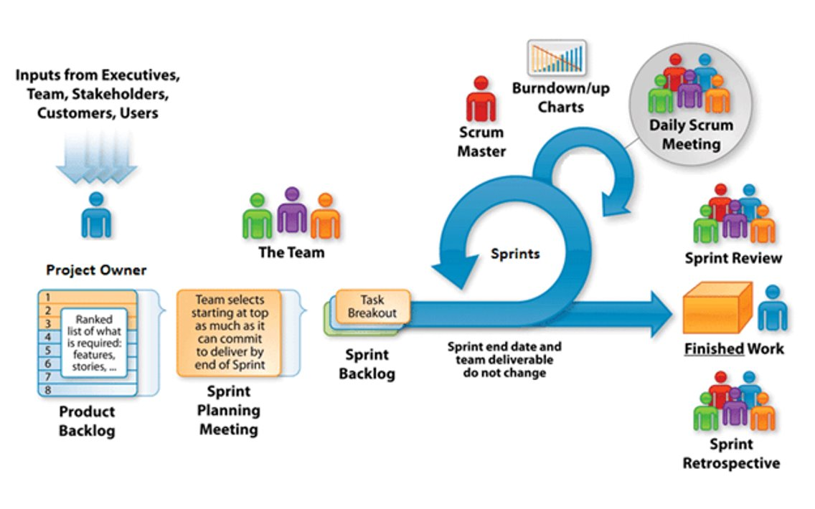
SCRUM
Notes:
Kan I huske det?

Slide 19
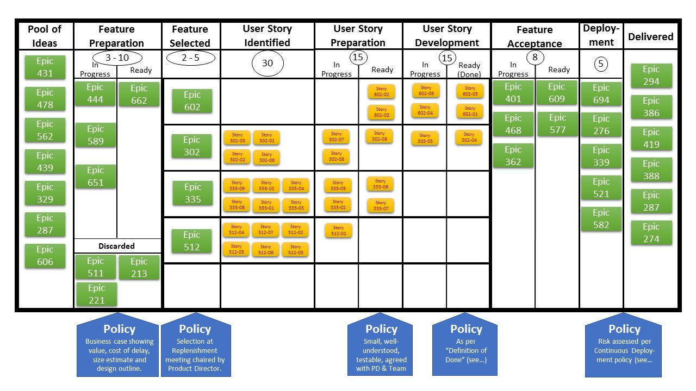
Kanban

Slide 20
Øvelse
Beskriv den grundlæggende forskel på Scrum og Kanban

Slide 21
Systemudviklingsmodeller
Metoder er anbefalinger
Organisationer er nødt til at tilpasse og reflektere over brugen af metoderne
XP, Scrum, and Kanban are examples of agile methods or, in other words, they define practices, activities, events, and techniques that align with agile principles.
Notes:
Scrum (63% of responses), Kanban (36%), and Extreme Programming (16%)

Slide 22
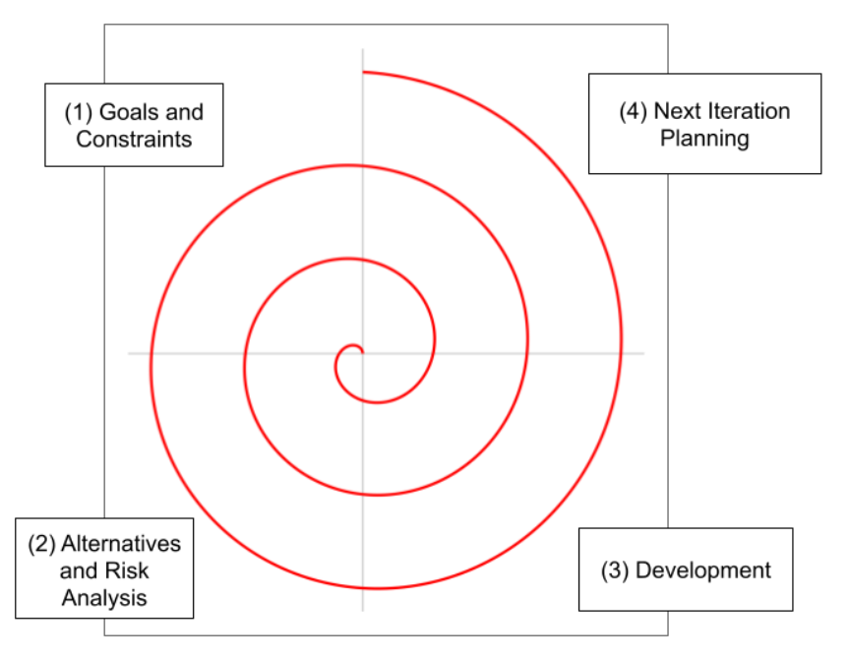
Spiral model (fra 1986)
Defining objectives and constraints, including costs, schedules, etc.
Evaluating alternatives and conducting risk analysis. For instance, considering whether it is more cost-effective to purchase a system instead of developing it in-house.
Development and testing, potentially using the Waterfall model. By the end of this stage, a prototype should be produced for demonstration to users.
Planning for the next iteration or deciding to conclude the project if the current implementation already meets the organization’s needs.
Notes:
Defining objectives and constraints, including costs, schedules, etc.
Evaluating alternatives and conducting risk analysis. For instance, considering whether it is more cost-effective to purchase a system instead of developing it in-house.
Development and testing, potentially using the Waterfall model. By the end of this stage, a prototype should be produced for demonstration to users.
Planning for the next iteration or deciding to conclude the project if the current implementation already meets the organization’s needs.

Slide 23
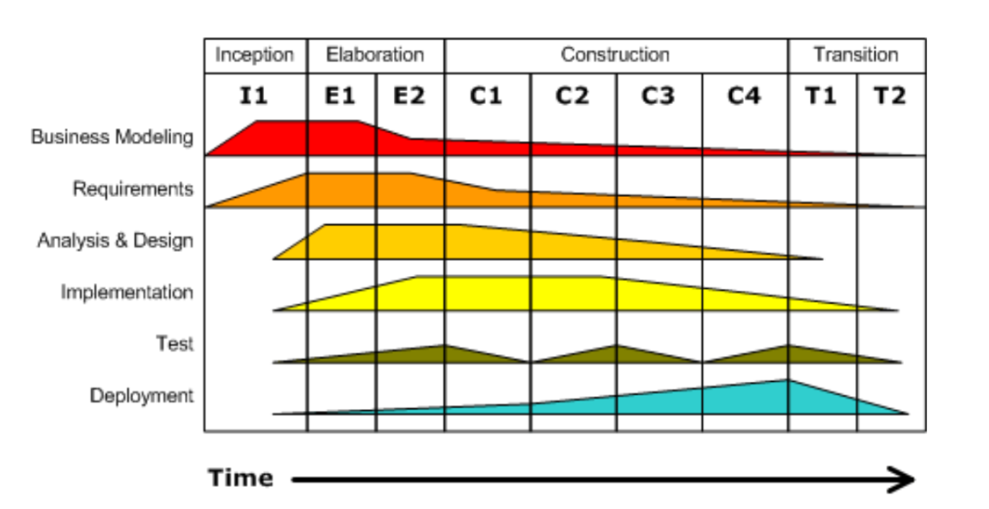
Rational Unified Process
Notes:
UML, overgang fra vandfald til scrum
Stort rammeværk
Firmaet rational – overtages af IBM i 2003
Startet i 1990

Slide 24
eXtreme Programming
Agil tilgang på linje med Scrum og Kanban
Består af
  Values (værdisæt/normer)
  Principper
  Praksis
Vi kigger på en specifik praksis i dag, test driven development

Slide 25
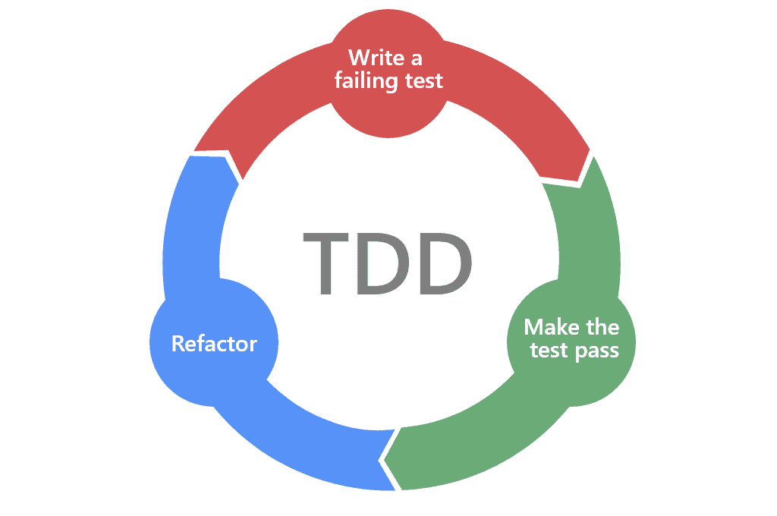
Test Driven Development
”Test First Development” - Skriv testen før koden
We start with a failing test.
We create the production code on the fly, while building our test.
We’re done when the test(s) pass.
Now we refactor, to optimize the test structure and data.

Slide 26
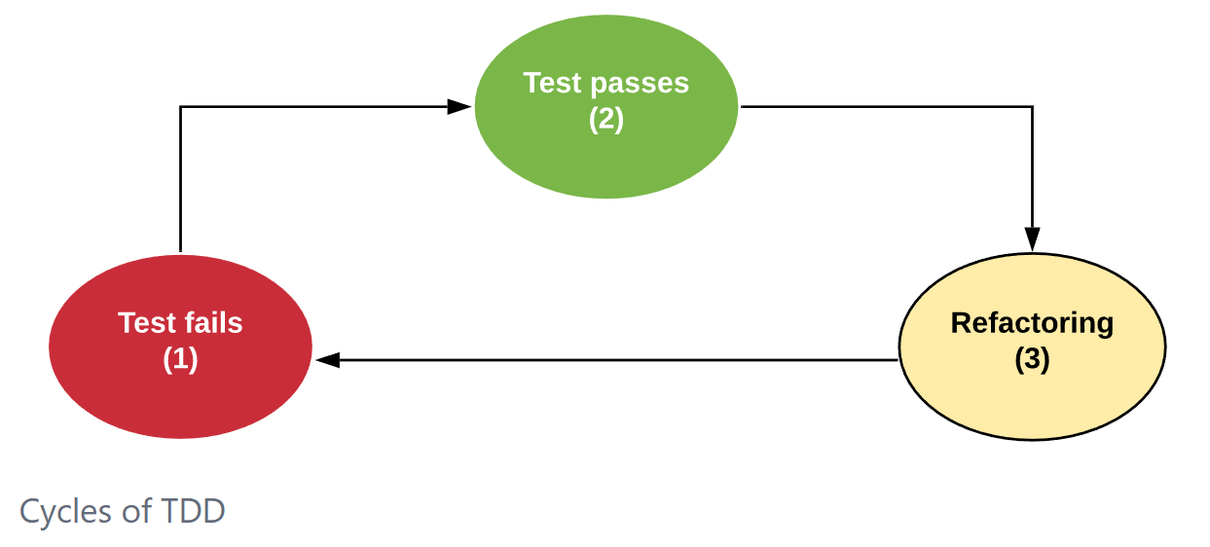

Slide 27
Hvorfor TDD?
TDD prevents developers from forgetting to write tests.
  Prevent developers to forget tests
  Gives higher test coverage
TDD encourages writing code with high testability.
  Since developers first write the test T and then the class C, they are naturally inclined to design C to facilitate testing.
TDD is not only a testing practice but also a design practice.
  This occurs because developers, by starting with the tests T, put themselves in the position of a user of the class C.
  In other words, with TDD, the first user of the class is its own developer—recall that T is a client of C, as it calls methods from C.
  Therefore, it is expected that developers will define a simple interface for the class, using readable method names and minimizing the number of parameters, among other best practices.
Notes:
TDD prevents developers from forgetting to write tests. This is because TDD promotes testing as the first activity of any programming task, whether fixing a bug or implementing a new feature. Thus, it becomes more difficult to postpone the writing of tests to a later stage. As we mentioned in Section 8.4, when using TDD, test coverage is usually greater than 90%.
TDD encourages writing code with high testability. This benefit is a natural consequence of the inverted workflow proposed by TDD: since developers first write the test T and then the class C, they are naturally inclined to design C to facilitate testing.
TDD is not only a testing practice but also a design practice. This occurs because developers, by starting with the tests T, put themselves in the position of a user of the class C. In other words, with TDD, the first user of the class is its own developer—recall that T is a client of C, as it calls methods from C. Therefore, it is expected that developers will define a simple interface for the class, using readable method names and minimizing the number of parameters, among other best practices.

Slide 28
Example of TDD: Shopping Cart

Slide 29
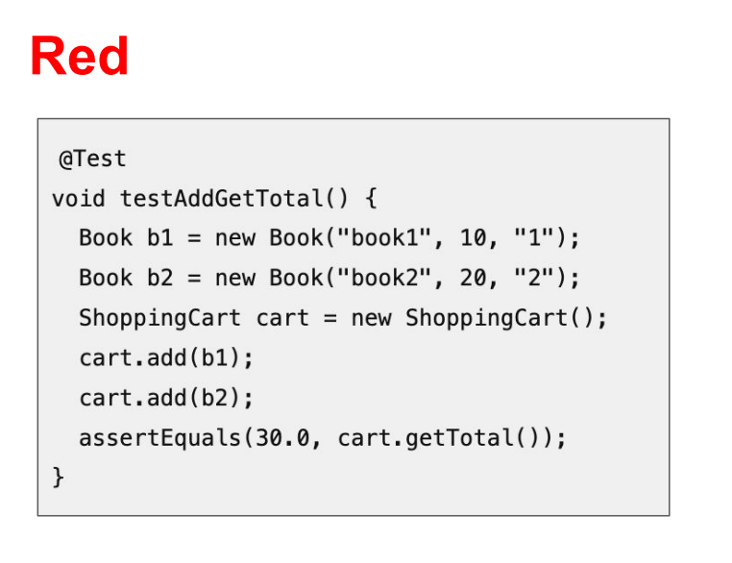
Notes:
Shopping card example
A??, Act, Asser

Slide 30
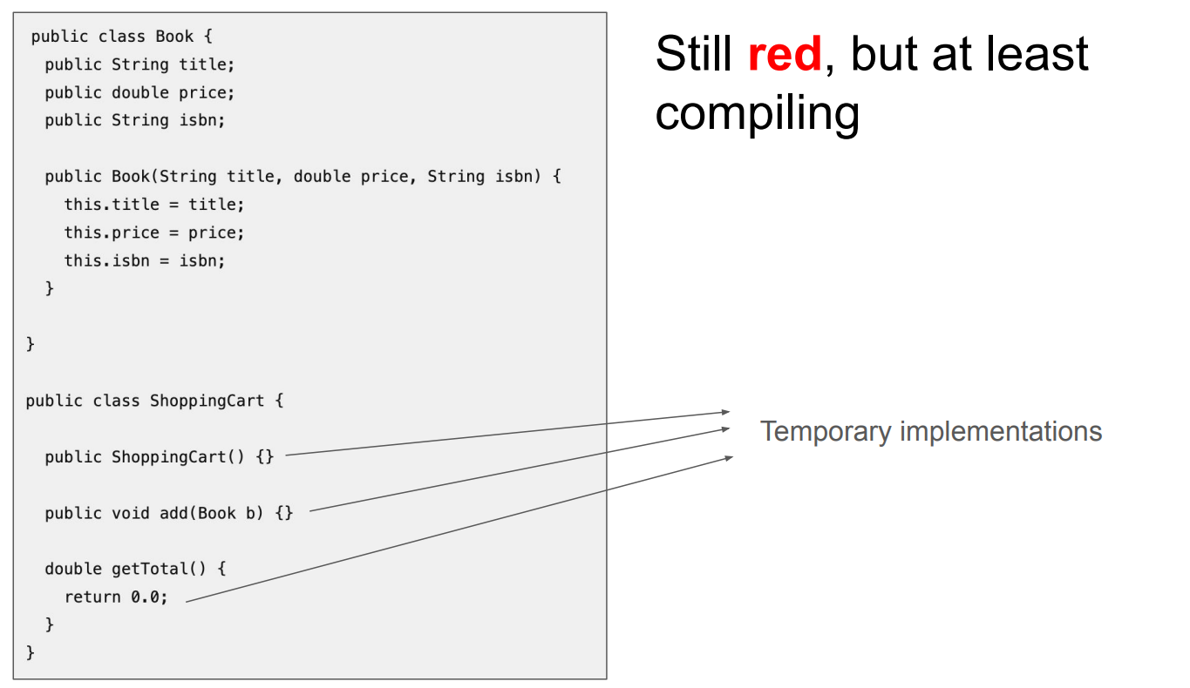

Slide 31
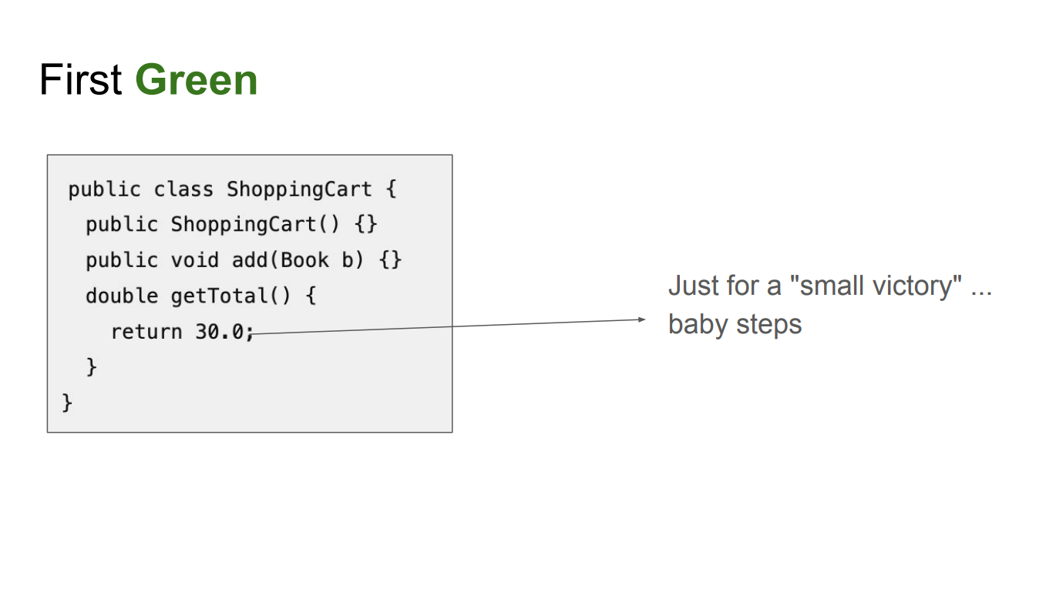

Slide 32
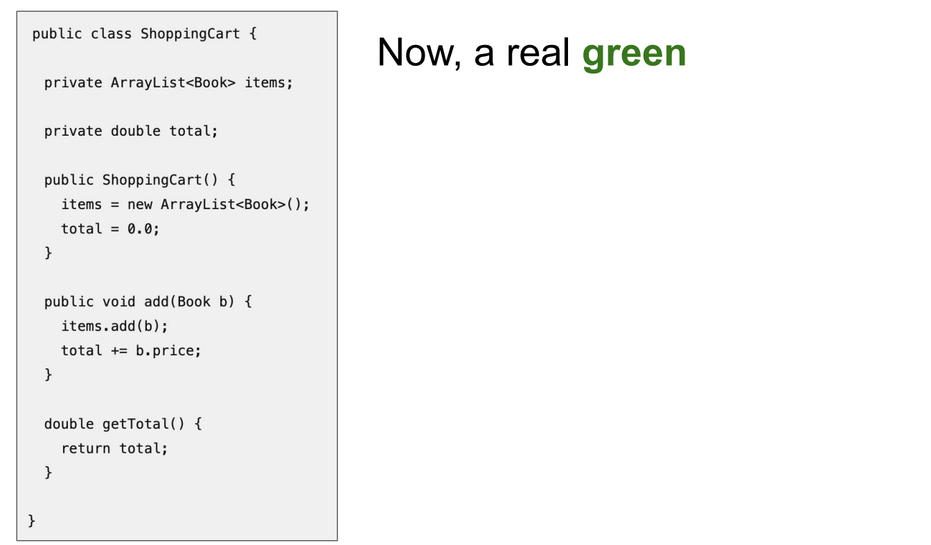

Slide 33
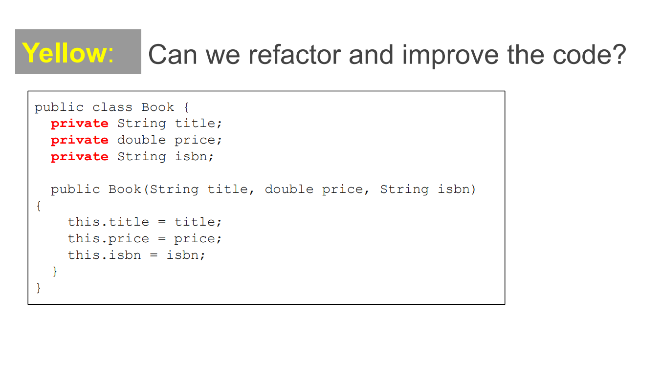

Slide 34
Opgave
I arbejder som IT-arkitekter.
I arbejder et sted, hvor der udvikles i Python.
I skal komme med et forslag til værktøjer, som kan understøtte udviklernes brug af Test Driven Development
  Fokus skal være på programmeringsdelen
  Forestil jer at den nuværende tilgang ikke er TDD
  Lad jer inspirere af andre – læs, søg, spørg (AI)
Afprøv et enkelt værktøj
Præsentation
  Fremlægges i næste uge for klassen
  1 slide
  Anbefalet værktøj
  Fordele og ulemper (evt. erfaringer)
  Evt. en slide med alternativer (bilag)
Lav evt. En simpel case f.eks. Med en funktion til at tage en kvadratrod. Start med test og fyld så på med de andre ting.

Slide 35
Unittest
Pytest
Nose2
Intet framework...

Slide 36
Pytest
pytest-html
  Generates HTML test reports
  Easy to install: pip install pytest-html
  Run with: pytest --html=report.html
pytest-sugar
  Improves terminal test output
  Colorful, more readable results
  Install: pip install pytest-sugar
Coverage.py
  Code coverage visualization
  Shows which code parts are tested
  Install: pip install coverage
  Run with: coverage run -m pytest

Slide 37
Prototyping
Bruger protyper efter hver iteration til at forbedre systemet

