Slide 1
OD: Project Presentation
github.com/vogelgesang/upc-od/
Franz Bermeo
Maryam Pashmi
Adrian Vogelsgesang

Slide 2
Contents
Goal
Data Sources
System Architecture
Mediator algorithm
Meta Data
Live Demo
Conclusion

Slide 3
Our goals
Book recommendations
Flexibitlity
Realism (→ no invented/synthetic data)
Speed! (real time)

Slide 4
Data Sources
Cern Bibliography (CC0; XML/Marc21)
→ eXistDb, Xquery
Harvard Library Cloud (CC0; JSON Api)
→ no database, access in real time
British National Library (CC0; RDF)
→ no database; access using SparQL

Slide 5
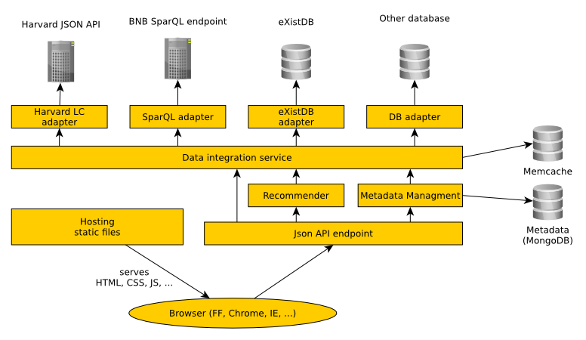
System architecture
System architecture
System architecture

Slide 6
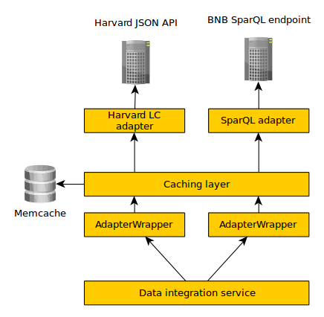
Data Integration
Wrapper
Mediator

Slide 7
The mediator algorithm
Initialize information base = empty
Broadcast initial query to all sources
Until convergence:
  Merge incoming data with our information base
  Create new queries from the information base
  Broadcast these queries to all sources
And all of this: asynchronous :)

Slide 8
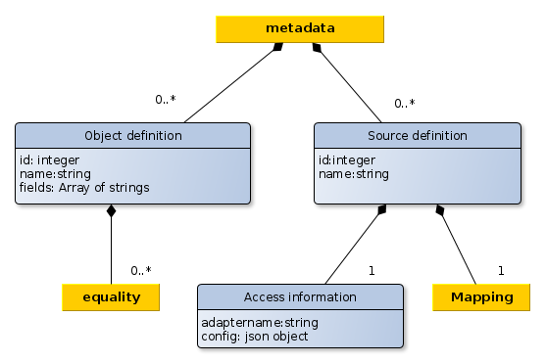
Meta data repository
{
"_id": "538359929c2946772d6b27c2",
"name": "Sparql BNB British Library",
"adapter": {
"name": "sparql",
"config": {
"limit": 20,
"sparqlEndpoint": "http://bnb.data.bl.uk/sparql"
}
},
"mapping": [
{
"sourceType": “http://purl.org/ontology/bibo/Book",
"mappedType": "book",
"fieldMapping": {
"title": [ "http://purl.org/dc/terms/title" ],
"isbn": [ "http://purl.org/ontology/bibo/isbn13" ]
}
}
],
}

Slide 9
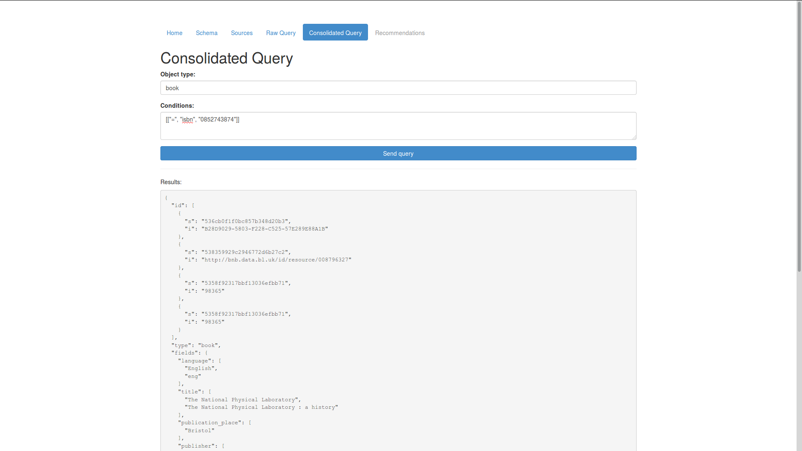
Live Demo

Slide 10
Conclusion: the dark side
Recommendations missing
Only basic remapping
Different backgrounds of team members
eXistDb: index configuration :'(
Escaping of special characters in SparQL

Slide 11
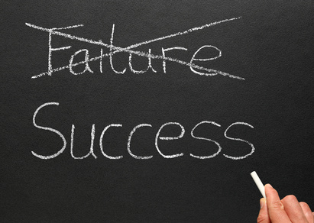

Slide 12
Conclusion: the bright side
Asynchronous querying
Provision of partial results
Splitting the Wrapper into AdapterWrapper and Adapter
Metadata: LiveEdit
Secure architecture
Very flexible SparQL adapter

Slide 13


