Slide 1
Activity Recognition System Using Mobile Phone
Neda Abolhassani Sahar Voghoei

Slide 2

Objectives …
Which activity of a specific person?
Who did this activity?
Which activity and to whom the given data belong to?
Is there any correlation between the demographic data and activities?
Which mobile position gives us better data?

Slide 3
Motivation
Track your daily life
Fitness Tracking
Health Monitoring
Fall Detection
Elder Safety
We carry our mobile phones every where with us , why not take advantage of data it senses !

Slide 4

Experimental Setup

Slide 5
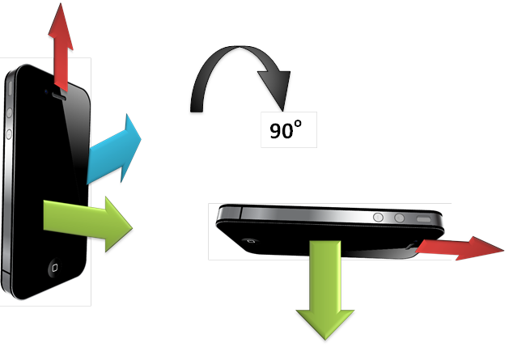
Data Collector
iPhone 4S, 5, 6
Motion Logger App (20 Hz)
Accelerometer sensor data

Slide 6
Demographics

Slide 7
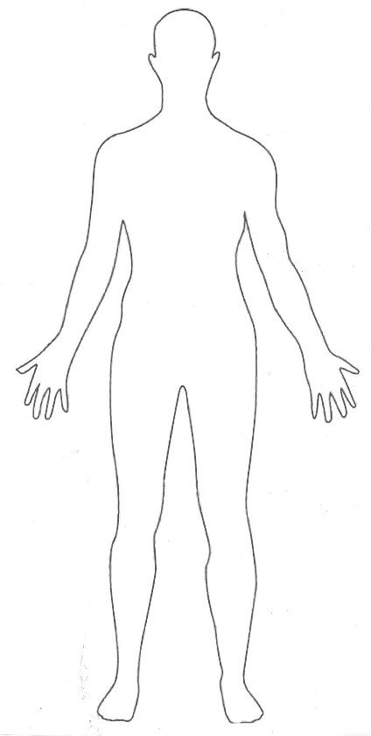


Activities
Daily Routine Activities :
Walking
Jogging
Biking
Sitting
Standing

Slide 8
Data Preprocessing Using MATLAB
Data Labeling
Noise Cancelation
Feature Selection
Aggregation
ARFF Files

Slide 9
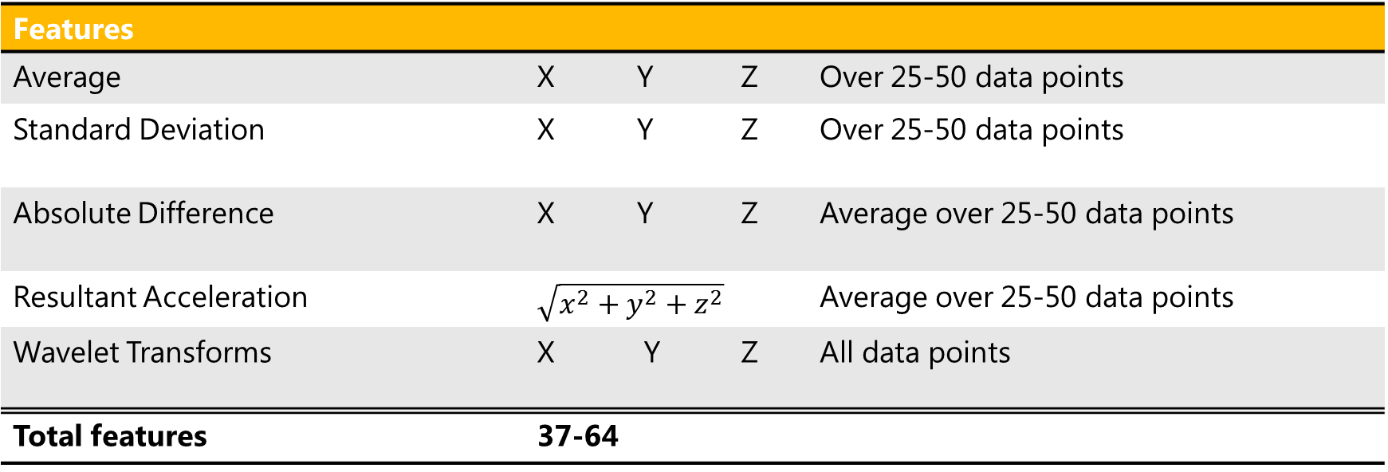
Feature Selection
Data Labeling
Feature Selection
Aggregation
ARFF Files
Noise Cancellation
Features
Average | X | Y | Z | Over 25-50 data points
Standard Deviation | X | Y | Z | Over 25-50 data points
Absolute Difference | X | Y | Z | Average over 25-50 data points
Resultant Acceleration | $$\sqrt{x^{2}+y^{2}+z^{2}}$$ |  |  | Average over 25-50 data points
Wavelet Transforms | X Y Z |  |  | All data points
Total features | 37-64

Slide 10
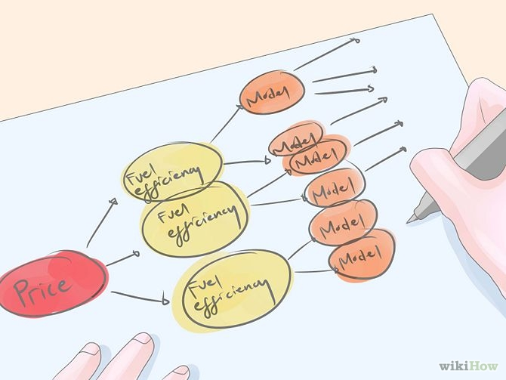
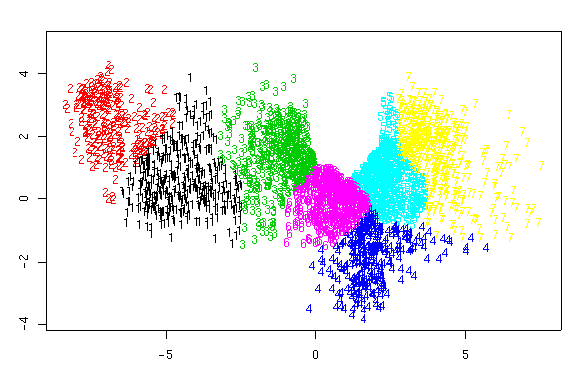
Approach
Classification :
Find the best classifier
Find the best feature parameters
Person-Activity analysis
Clustering:
Cluster individuals based on activity data
Find correlations among the clusters

Slide 11
Results

Slide 12
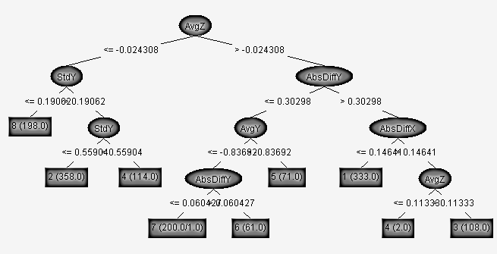
Feature Selection
Evaluator: CfsSubsetEval
Search: BestFirst
AvgX
AvgY
AvgZ
AvgTX1
AvgTY1
StdZ
AbsDiffX
AbsDiffY
AvgResultantTXYZ

Slide 13
Parameter Combinations
Level | Bin | Scaling Factor | Classifier | Correctly Classified Classes
2 | 25 | 16
 |  |  | trees.REPTree | 78.48%
 |  |  | trees.J48 -C 0.25 -M 2 | 82.73%
 |  |  | trees.RandomForest | 90.99%
2 | 50 | 16
 |  |  | functions.MultilayerPerceptron | 94.02%
 |  |  | trees.RandomForest -I 10 -K 0 -S 1 | 96.86%
 |  |  | meta.Bagging -RandomForest | 96.60%
5 | 25 | 32
 |  |  | functions.MultilayerPerceptron | 92.52%
 |  |  | trees.RandomForest -I 10 -K 0 -S 1 | 94.81%
 |  |  | meta.Bagging -RandomForest | 94.91%
2 | 50 | 32
 |  |  | trees.RandomForest -I 10 -K 0 -S 1 | 96.96%
 |  |  | functions.MultilayerPerceptron | 94.50%
 |  |  | meta.Bagging -RandomForest | 96.65%

Slide 14
Classifiers for Jogging
Classifier | TP Rate FP Rate Precision Recall F-Measure | Correctly Classified Classes
trees.REPTree | 0.785 0.017 0.785 0.785 0.784 | 78.48%
trees.J48 -C 0.25 -M 2 | 0.827 0.014 0.828 0.827 0.827 | 82.73%
trees.RandomForest | 0.91 0.008 0.912 0.91 0.91 | 90.99%
rules.OneR -B 6 | 0.288 0.063 0.267 0.288 0.262 | 28.77%
rules.DecisionTable | 0.522 0.041 0.528 0.522 0.512 | 52.20%
misc.HyperPipes | 0.423 0.045 0.642 0.423 0.413 | 42.25%
bayes.BayesNet | 0.731 0.022 0.756 0.731 0.734 | 73.09%
bayes.NaiveBayes | 0.651 0.029 0.669 0.651 0.645 | 65.07%
lazy.KStar -B 20 -M a | 0.763 0.019 0.778 0.763 0.765 | 76.32%
functions.SimpleLogistic | 0.882 0.009 0.882 0.882 0.882 | 88.22%
functions.MultilayerPerceptron | 0.926 0.005 0.93 0.926 0.924 | 92.60%
meta.Bagging -MultilayerPerceptron | 0.957 0.003 0.958 0.957 0.956 | 95.73%
Stacking.meta.Vote ZeroRBayesNet RandomForest | 0.121 0.121 0.015 0.121 0.026 | 12.11%

Slide 15
Classifiers for Person B
Classifier | TP Rate FP Rate Precision Recall F-Measure | Correctly Classified Classes
trees.J48 | 0.992 0.001 0.992 0.992 0.992 | 99.1696%
trees.RandomForest | 0.994 0.001 0.994 0.994 0.994 | 99.6400%
rules.OneR -B 6 | 0.831 0.029 0.824 0.831 0.824 | 83.1142%
rules.DecisionTable | 0.981 0.006 0.982 0.981 0.981 | 98.1315%
misc.InputMappedClassifier | 0.248 0.248 0.061 0.248 0.098 | 24.7751%
lazy.IBk | 0.669 0.072 0.712 0.669 0.658 | 98.4083%
functions.Logistic | 0.994 0.001 0.994 0.994 0.994 | 99.4464%
functions.SimpleLogistic | 0.998 0.001 0.998 0.998 0.998 | 99.7924%
bayes.NaiveBayes | 0.988 0.001 0.988 0.988 0.988 | 98.7543%
meta.Bagging - trees.RandomForest | 0.998 0.001 0.998 0.998 0.998 | 99.7924%
meta.LogitBoost - functions.LinearRegression | 0.997 0.001 0.997 0.997 0.997 | 99.7232%
meta.LogitBoost - trees.RandomForest | 0.999 0.000 0.999 0.999 0.999 | 99.9308%
meta.Bagging -MultilayerPerceptron | 0.996 0.001 0.996 0.996 0.996 | 99.5848 %
meta.Stacking -Vote\ trees.J48 - bayes.NaiveBayes - lazy.IBk | 0.248 0.248 0.061 0.248 0.098 | 24.7751%

Slide 16
Activity Analysis
Activity | Classifier | Correctly Classified Classes
Jog | trees.RandomForest | 96.96%
Bike | meta.Bagging -RandomForest | 94.34%
Bike Up | functions.MultilayerPerceptron | 99.59%
Bike Down | functions.MultilayerPerceptron | 98.34%
Jog Up | functions.MultilayerPerceptron | 98.36%
Jog Down | functions.MultilayerPerceptron | 98.96%
Walk | functions.MultilayerPerceptron | 94.12%
Walk Up | functions.MultilayerPerceptron | 99.14%
Walk Down | meta.Bagging -RandomForest | 98.79%
Sit | trees.RandomForest | 91.64%
Stand | trees.RandomForest | 92.14%

Slide 17
Activity Analysis
Person | Classifier | Correctly Classified Classes
A | meta.Bagging - trees.RandomForest | 99.84%
B | meta.Bagging - trees.RandomForest | 99.86%
C | functions.SimpleLogistic | 99.41%
D | meta.Bagging - trees.RandomForest | 99.26%
E | meta.Bagging - trees.RandomForest | 100%
F | meta.Bagging - trees.RandomForest | 98.66%
G | functions.SimpleLogistic | 99.57%
H | meta.LogitBoost - trees.RandomForest | 100%
I | meta.Bagging - trees.RandomForest | 97.84%
J | functions.SimpleLogistic | 99.66%
K | meta.Bagging - trees.RandomForest | 98.85%
L | functions.SimpleLogistic | 99.70%
M | meta.Bagging - trees.RandomForest | 99.64%
N | meta.LogitBoost - trees.RandomForest | 98.80%
O | meta.Bagging - trees.RandomForest | 99.39%
P | meta.LogitBoost - trees.RandomForest | 98.96%
Q | meta.Bagging - trees.RandomForest | 98.86%
R | meta.LogitBoost - trees.RandomForest | 99.86%

Slide 18
Person-Activity Analysis
Classifier | Correctly Classified Classes
trees.RandomForest | 89.8151%
functions.SimpleLogistic | 96.2747%
meta.Bagging -trees.RandomForest | 93.9917%
functions.MultilayerPerceptron | 92.4962%
trees.RandomForest | 89.8151%

Slide 19
Clustering
Jogging – LegLen correlations

Slide 20
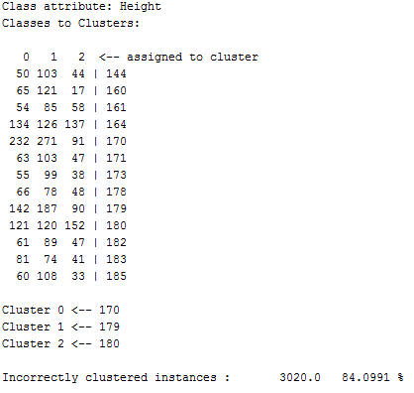
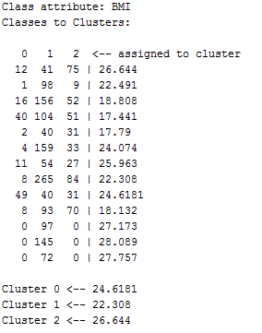
Clustering
Sit
Bike

Slide 21
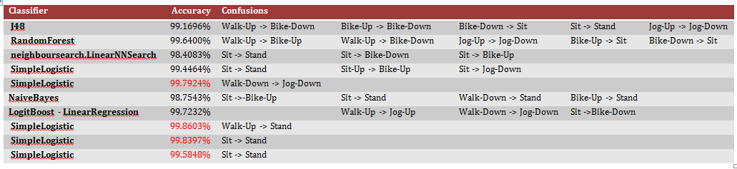
Confusions

Slide 22
Conclusions

Slide 23
Can we find …
Which activity of a specific person?
Yes with the accuracy of 98.66%-100%
Who did this activity?
Yes with the accuracy of 91.64%-99.5%
Which activity and to whom the given data belong to?
Yes with the accuracy of 96.27%
Is there any correlation between the demographic data and activities?
No
Which mobile position gives us better data?
Down (Jog/Walk) – Up (Bike)

Slide 24
Thank you …
… and we are open to your questions

