Slide 1
Treatment Plan Flowchart
HomaCare

Slide 2
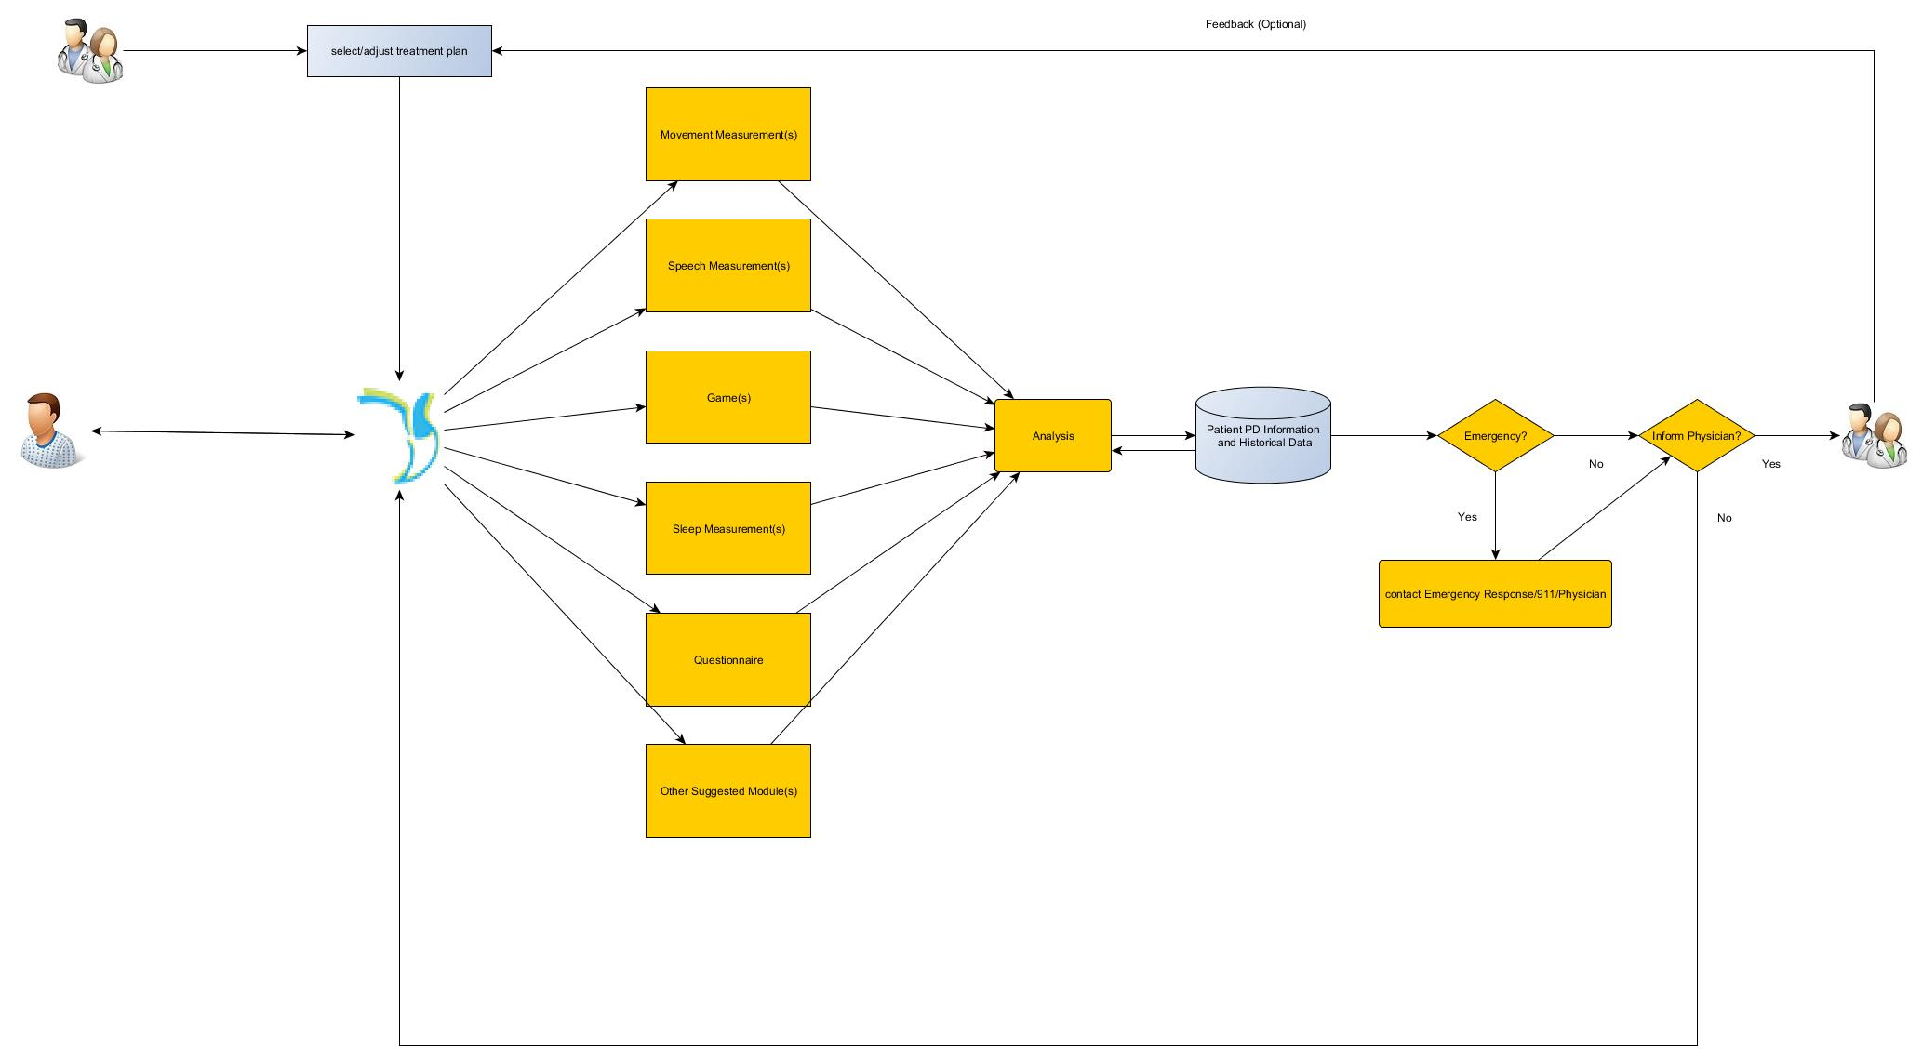

Slide 3
Thank You

Slide 4
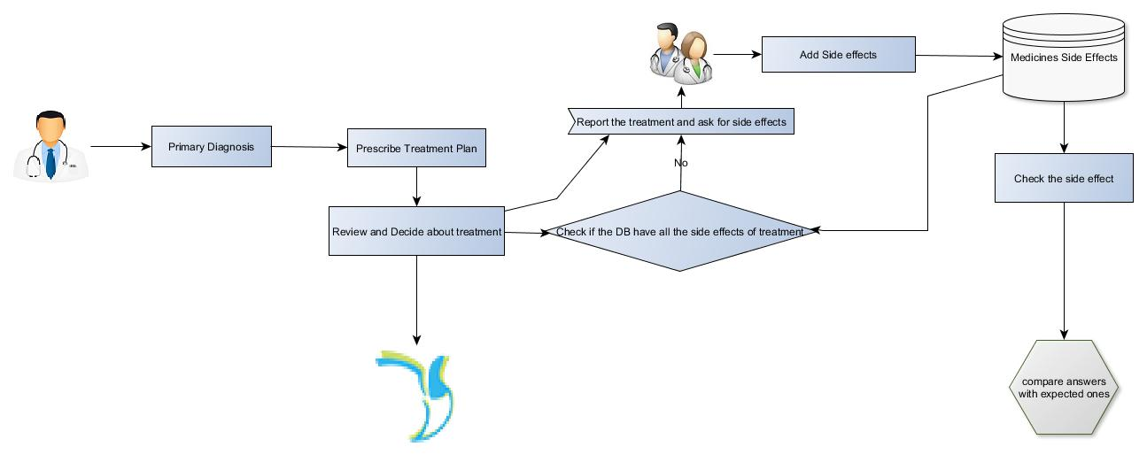
<< Back

Slide 5
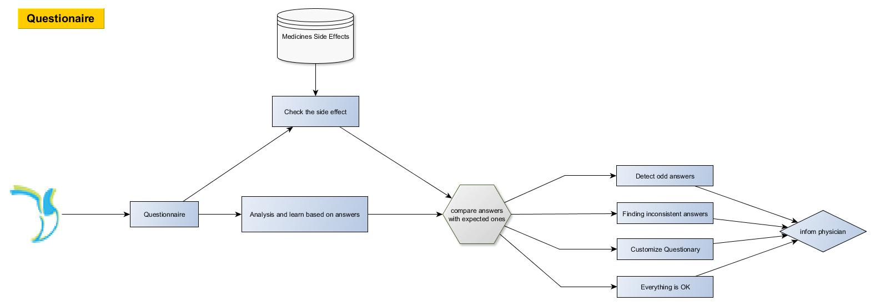
<< Back

Slide 6
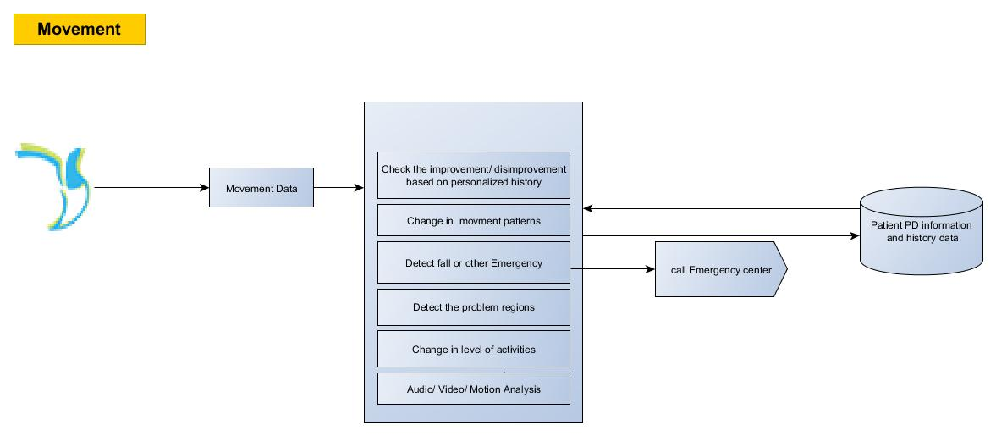
<< Back

Slide 7
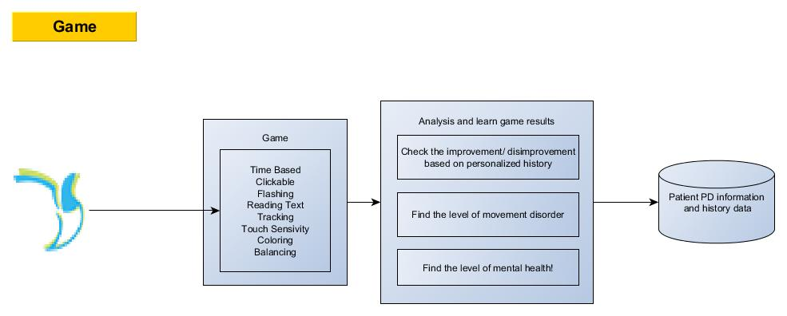
<< Back

Slide 8
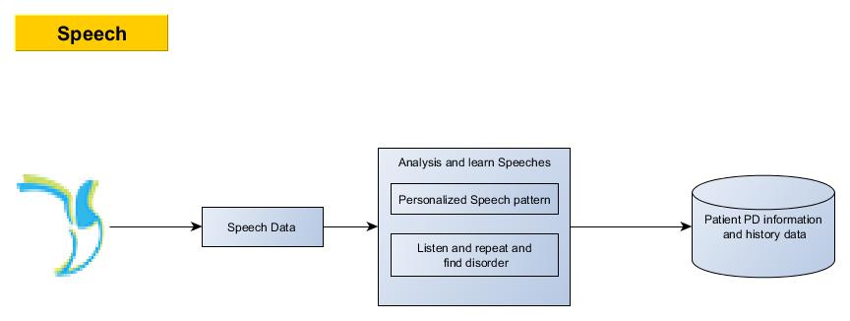
<< Back

Slide 9
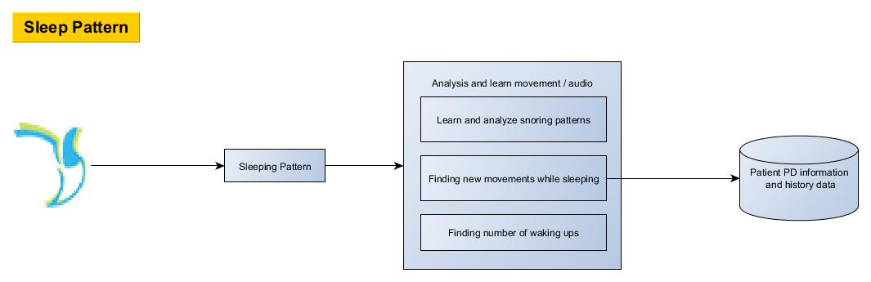
<< Back

