Slide 1
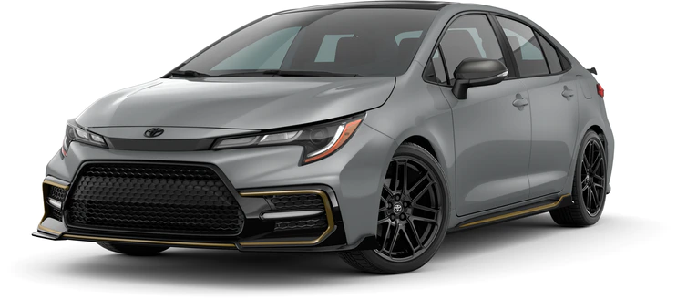
Toyota car price prediction

Slide 2

Instructors: Ths.Quach Dinh Hoang
Group 09
Member:
Vo Ha Nhat Tan 18133047
Nguyen Thanh Cong 18133004
Pham Dinh Nhien 18133038
Trinh Cong Vien 18133061

Slide 3
1.
Introduction
Let's find out about the project

Slide 4
The project uses machine learning models to solve the problem of predicting the price of old Toyota cars based on some information about the vehicle such as cylinder volume, distance traveled, horsepower, age of the vehicle, ...

Slide 5
Data
The dataset consists of 10 attributes. Including 7 value variables and 3 categorical variables. Consists of 1437 lines. - Obtained from Kaggle, the data is collected by a Japanese used car distributor. - The Dataset includes the following attributes: + Price: Toyota car price (in Euro) + Age: age of the vehicle (in years). + KM: the distance traveled by the vehicle (in KM) + HP: Horsepower (in HP, 1HP=0.746 kW) + MetColor: metallic color (0: no, 1: yes) + Automatic: Automatic number (0: no, 1: yes) + CC: Cylinder volume (in cubic centimeters) + Door: Number of doors + Weight: Weight of the vehicle (in Kg).
+ FuelType: Fuel type (Diesel, Petrol, CNG)

Slide 6
Data
Input: Age, KM, HP, Metcolor, Automatic, CC, Door, Weight, FuelType
Output: Price

Slide 7
Data Preprocessing
Check for null values
Use the one hot encoding (dummy coding) method for the FuelType variable
Data visualization

Slide 8
2.
Method
Let’s see methods used

Slide 9
Measure
RMSE
R square (R^2)

Slide 10
Model
Linear Regression
Decision Tree
Random Forest
Gradient Boosting Tree

Slide 11
Hyperparameter tuning
Using cross-validation to hyperparameter tuning, with k=3
For the random forest, the gradient boosting tree tuning maxdepth and numtrees
For the Decision tree tuning maxdepth
And Linear Regression tuning regParam, elasticNetParam.

Slide 12
3.
Implement
start with project implementation

Slide 13
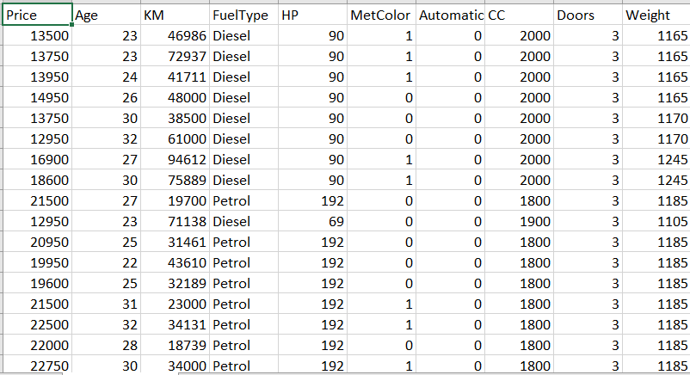
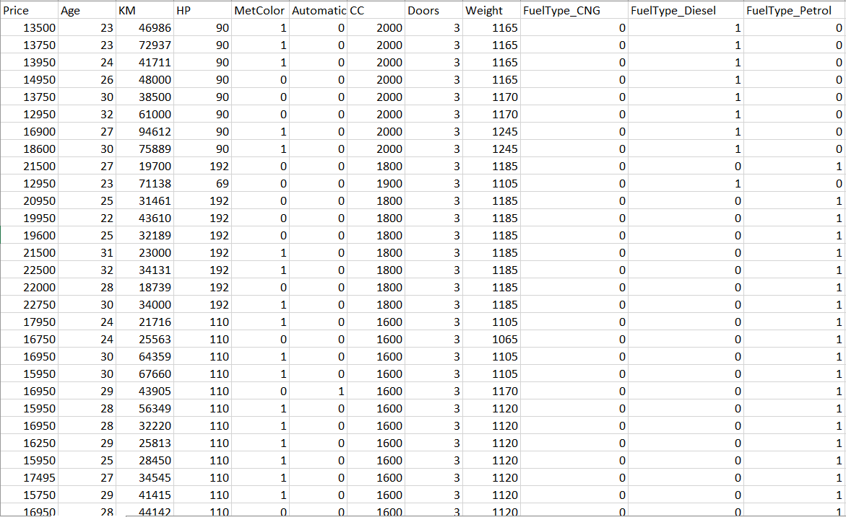
Data Preprocessing

Slide 14
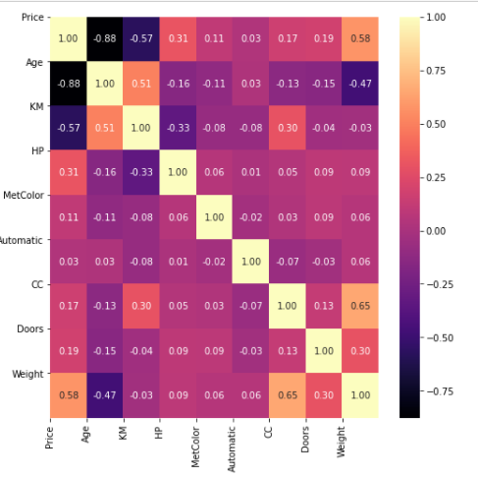
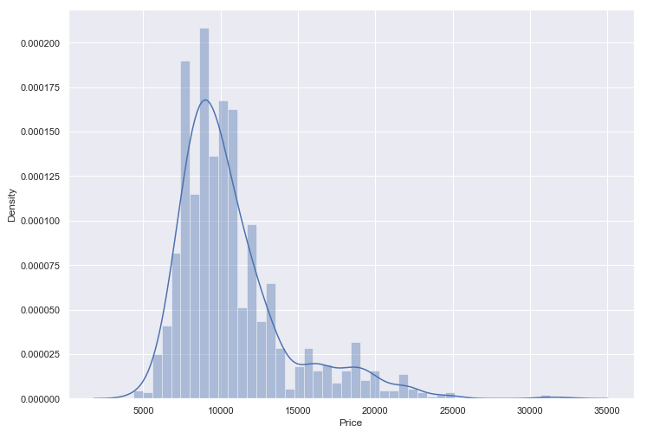
Data Visualization

Slide 15
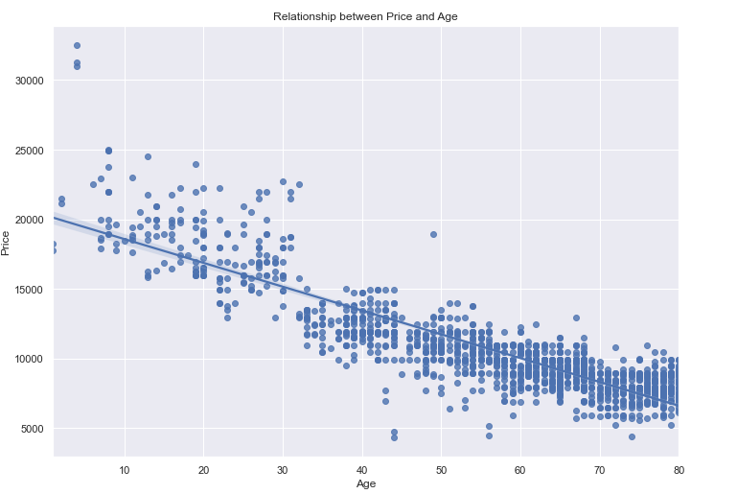
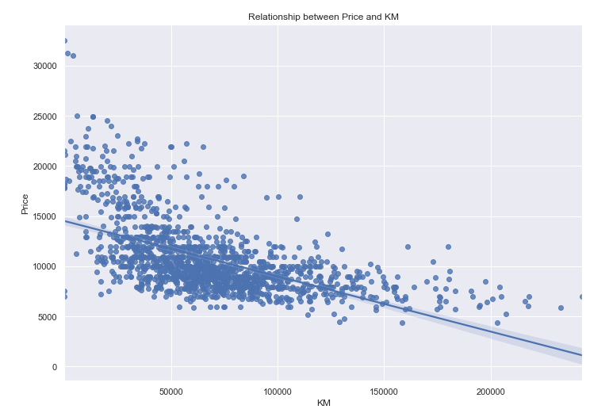
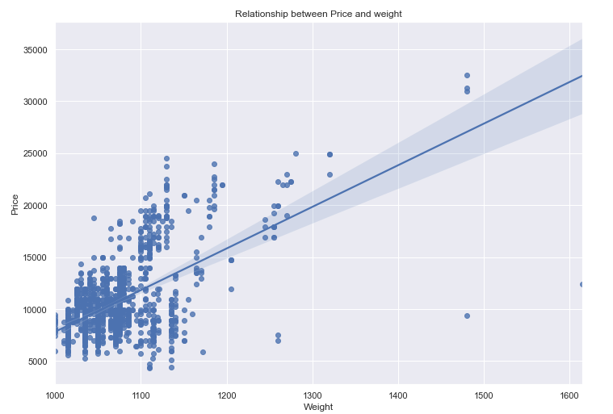
Data Visualization

Slide 16
Overview of the steps
Divide the training set 80% and the test set 20%
Train the model on the training set
Evaluate the model on test set
Hyperparameter tuning
Determine the importance of the variable based on the best model
Choose the best model

Slide 17
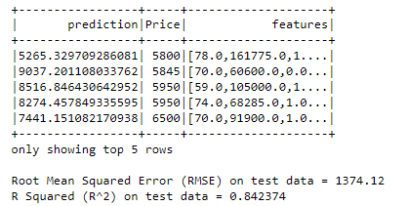
Linear Regression

Slide 18
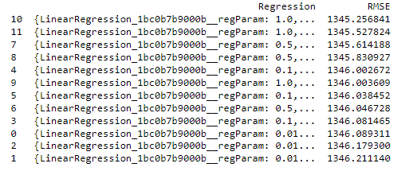
Linear Regression
regParam λ (0.01-1)
elasticNetParam α (0-1)
regParam = 1
elasticNetParam= 1

Slide 19
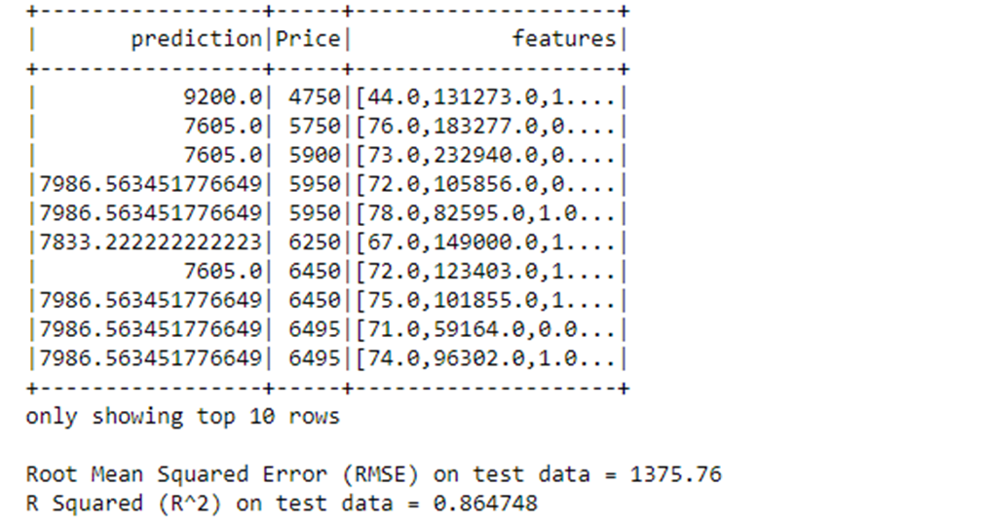
Decision Tree

Slide 20
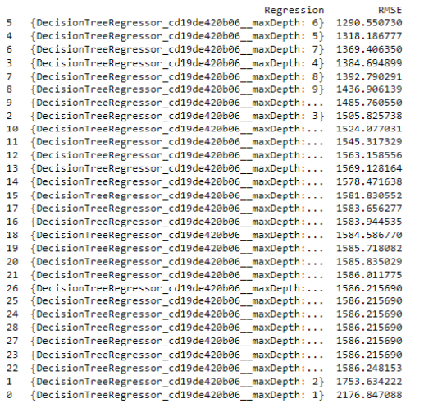
Decision Tree
maxDepth (1-20)
maxDepth = 6

Slide 21
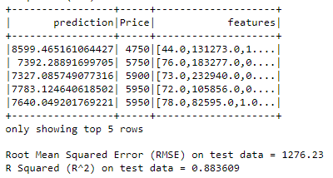
Random Forest

Slide 22
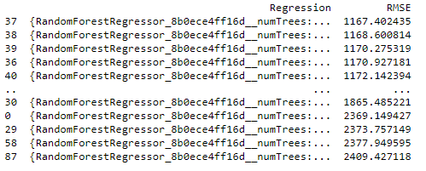
Random Forest
maxDepth (1-20)
numTrees (10-160)
numTrees = 150
maxDepth = 6

Slide 23
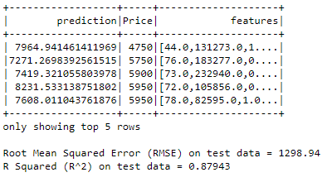
Gradient Boosting Tree

Slide 24
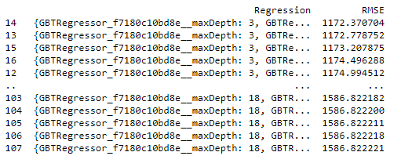
Gradient Boosting Tree
maxDepth (1-20)
numTrees (10-100)
numTrees = 50
maxDepth = 3

Slide 25
RMSE on Test set
1400
1300
1200
1000
0
Linear Regression Decision Tree Random Forest Gradient Boosting tree

Slide 26
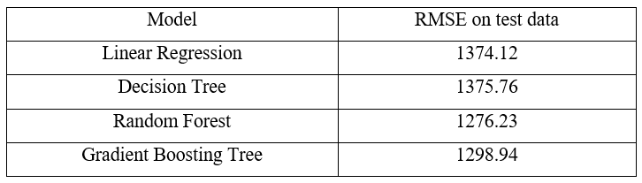
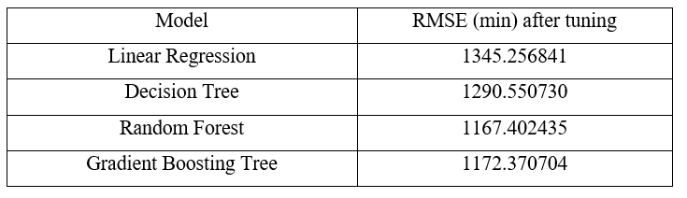
RMSE

Slide 27
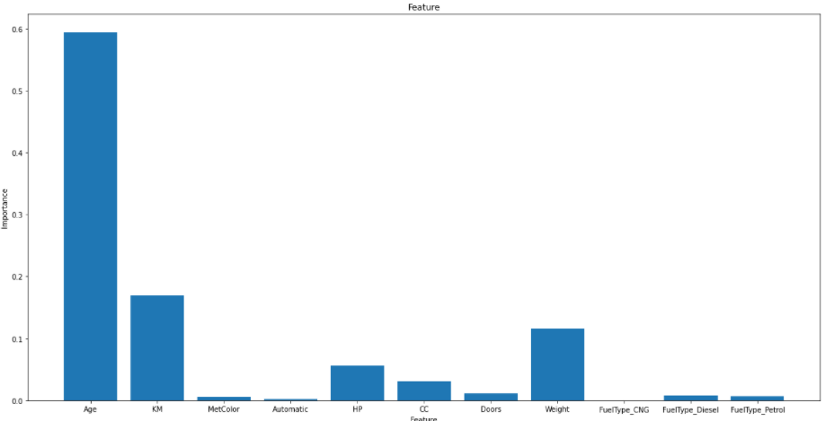
Determine the importance of variables in the Random forest Algorithm

Slide 28
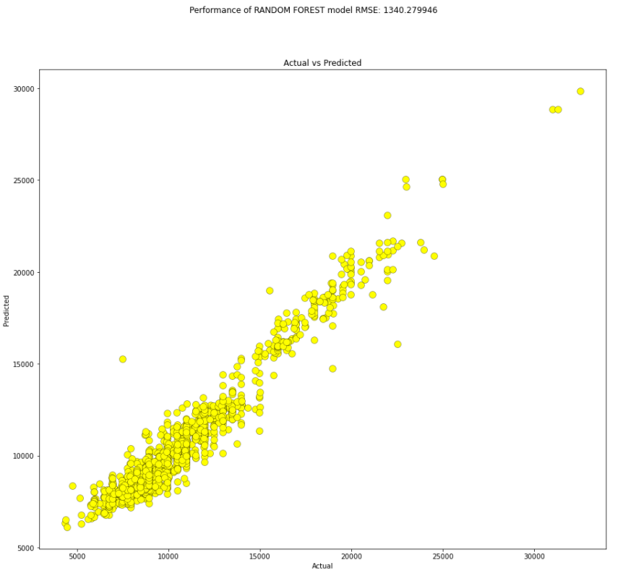
Model's predicted value vs actual value

Slide 29
Conclision
Choose the best model is Random Forest
If I have time, We will implement Support Vector Regression model
Tuning with more hyperparameters

Slide 30
Thanks for listening 😉

