Slide 1

ACHIEVEMENT REPORT · FEB 2023 – NOV 2026
Three years at Bosch
From saving
hours to owning
outcomes
2026
Leader-CIP, 7 more tools
SEP 24
Technical owner, 3 JOEM customers
2024
TEF drawing check
Võ Hoài Linh
2023
EET1 · Report for my manager · November 2026
NIKK translation tool

Slide 2
AT A GLANCE
Four proof points from three years
1,000+
€25,000+
hours saved on EN–JA translation
of labor hours won for EET1
Author’s estimate. 76% effort cut measured on a 108-word sample (NIKK tool).
Negotiated with the Platform team, who released the hours to EET1.
3
9
JOEM customers owned technically
automation projects delivered
Technical owner for three customers since September 2024.
2 Excel/VBA macros and 7 Python or web tools, 2023 to 2026.
Also: Leader-CIP commendation · Procodex compliance session for RBJP · Hino field-claim task force
Author’s own account, not provable from files: €25,000+, JOEM ownership, Procodex, commendation
Võ Hoài Linh · Achievement report 2023–2026 · 02 / 29

Slide 3
THE STORY
From tool builder to technical owner
FEB 2023
SEP 2024
NOV 2026
Chapter 1 · Feb 2023 – Aug 2024
Chapter 2 · Sep 2024 – Nov 2026
Tool builder in translation projects
Technical owner and improvement leader
NIKK EN–JA translation tool: 1,000+ hours saved (estimate)
TEF drawing check: catches paper-size, orientation and page-count errors between Japanese input and English output PDFs
Technical owner for 3 JOEM customers
€25,000+ of labor hours won for EET1 from the Platform team
Procodex compliance session for the RBJP customer team (EET1 and project managers)
Leader-CIP: temperature reporting tool and database, commended
7 new tools for documents, quality, planning, testing and events
Author’s own account, not provable from files: €25,000+, JOEM ownership, Procodex, commendation
Võ Hoài Linh · Achievement report 2023–2026 · 03 / 29

Slide 4
CHAPTER 1 · FEB 2023 – AUG 2024
Tools that gave hours back
NIKK · ENGLISH–JAPANESE PROJECT
TEF · DRAWING TRANSLATION
Translate whole folders of Excel files in four automated steps
Catch drawing errors before delivery
Compares Japanese input with English output PDFs
Checks page count, paper size (A5 to A0) and orientation
Runs in batches of 50 files, results side by side
1
2
3
4
Extract
Translate
Rebuild
Export PDF
Reads every cell, text box, sheet name and file name, reuses a shared translation library, writes the English files and exports PDFs.
1,000+ hours saved (estimate) · 76% less effort measured
Sample batch: 50 of 50 drawings matched
Võ Hoài Linh · Achievement report 2023–2026 · 04 / 29

Slide 5
EVIDENCE · NIKK TOOL
Measured, not guessed
Same 108-word sample, done by hand (18 Apr 2023)
76%
Look-up · 45
Translate · 45
Apply to files · 105
199 min
less effort on the sample: 3.3 h down to 0.8 h
Same sample, with the tool (19 Apr 2023)
47 min
≈423 h
Look up duplicates, extract
Translate or review
Apply to customer files
Other steps
saved per 18,000-word project (workbook model)
Applying changes to customer files: 105 min → 1 min
1,000+ h
Source: NIKK tool workbook, “Time estimate” sheets, sample JW-324 with 108 new words. The 18,000-word project size is the workbook’s assumption.
saved across projects (author’s estimate)
Võ Hoài Linh · Achievement report 2023–2026 · 05 / 29

Slide 6
CHAPTER 2 · SEP 2024 – NOV 2026
From completing tasks to owning outcomes
3 customers
Technical owner for three JOEM customers
In charge of three JOEM customers on the technical side since September 2024.
€25,000+
Labor hours won for EET1 from the Platform team
Negotiated with the Platform team until they released labor hours worth more than €25,000 to EET1.
Procodex
Compliance knowledge sharing for RBJP
Organized a successful session on project compliance for the RBJP customer team: EET1 members and project managers.
Author’s own account, not provable from files: all three items on this slide
Võ Hoài Linh · Achievement report 2023–2026 · 06 / 29

Slide 7
BEYOND MY OWN TASKS
Leading improvement across teams
LEADER-CIP
DIGITAL ACTIVITY AT EET
TASK FORCE · HINO FIELD CLAIM
Continuous improvement with three EET1 teammates
From spreadsheets to connected workflows
Working with production line and quality control
Built a temperature reporting tool that highlights OK and NG results automatically
Helped build a temperature test database to find trends from past test data
Received a commendation
Built an Excel to Microsoft Planner sync, so tasks are entered once
Next: automate the EET1 task process, from quotation to task progress and ECR report tracking
Joined a cross-functional task force on a customer field claim
Built a visual tool that turns fault tree analysis (FTA) into a ready-to-use Excel file
Author’s own account, not provable from files: Leader-CIP, commendation, task force, roadmap
Võ Hoài Linh · Achievement report 2023–2026 · 07 / 29

Slide 8
HOW I DELIVER
AI speed, with guardrails
1
2
3
I decide
AI agents build
Guardrails decide
Requirements, rules and acceptance. I run each tool on real workflows and report what breaks.
Claude and Codex write the code and tests inside the process I defined.
Scripts, mutation checks and an independent review of the exact commit before every merge.
8,000+
1,782
T0 – T3
Safe defaults
automated test functions across seven tool repositories (static count)
mutation checks in my framework prove the tests catch real bugs
risk tiers per change; a script, not a model, caps the agents
originals are never overwritten, and mail opens as a draft unless auto-send is switched on
Most of the code is written by AI agents under my direction. I own the requirements, the rules and the acceptance.
Võ Hoài Linh · Achievement report 2023–2026 · 08 / 29

Slide 9
WHAT CHANGED
My scope today vs. February 2023
FEB 2023
NOVEMBER 2026
Scope
Single translation projects (NIKK, TEF)
Technical owner for 3 JOEM customers
Influence
Inside the project team
Across teams: Platform, production line, quality control
Output
2 Excel/VBA macros
9 automation projects, 7 of them Python or web tools
Leadership
Contributing to project tasks
Leading CIP, joining a task force, training colleagues on compliance
Author’s own account, not provable from files: JOEM, Platform, CIP, compliance training
Võ Hoài Linh · Achievement report 2023–2026 · 09 / 29

Slide 10
PROPOSAL
NEXT 12 MONTHS
I would like to discuss moving from level 52 to level 53, matching the scope I already carry.
1
Keep technical ownership of the three JOEM customers
2
Automate the EET1 task process in Planner, from quotation to task progress and ECR reporting
3 customers owned
€25,000+ of hours won
9 automation projects
3
Keep hardening the tools and share them with more of EET1
Happy to walk through any slide, or demo any tool, in our next meeting.
Author’s own account, not provable from files: JOEM ownership and €25,000+
Võ Hoài Linh · Achievement report 2023–2026 · 10 / 29

Slide 11
APPENDIX · TOOL PORTFOLIO
Nine tools, three themes
Language and documents
Quality and prevention
Process and digital
NIKK translation tool
FTA generator
Excel ↔ Planner sync
English–Japanese Excel translation · p.12–13
Fault tree analysis to Excel · p.18–19
Tasks entered once · p.24–25
TEF drawing check
Temperature assessment
Test Order Tracker
Paper size and page checks · p.14–15
OK / NG highlighting, audit, fixes · p.20–21
Sample test orders, web app · p.26–27
Document AI Editor
Shipping inspection
Outlook RSVP tool
Pre-delivery document checks · p.16–17
Laser marking checks from photos · p.22–23
Event follow-up in Outlook · p.28–29
Võ Hoài Linh · Achievement report 2023–2026 · 11 / 29

Slide 12
TOOL 1 OF 9 · PURPOSE
NIKK translation tool
Input
1
Extract Japanese text from cells, text boxes, sheet and file names
Translates whole folders of Japanese Excel files into English and keeps the layout, for the NIKK English–Japanese project.
2
Translate
Look up the shared library, machine-translate only what is new
BEFORE
3
Create the English file
Copy each phrase by hand, check the library with Ctrl+F, translate it, then find and replace in every customer file: 199 minutes for 108 new words.
Replace every phrase, switch the font to Arial, keep the layout
4
Print PDF
Export every English file to PDF in one run
WITH THE TOOL
One click scans a whole folder: cells, text boxes, sheet and file names
A shared library removes duplicates and reuses earlier translations
Writes the English files and exports PDFs: 47 minutes for the same 108 words
76%
1,000+h
8
less effort measured on a 108-word sample
saved across projects (author’s estimate)
versions in six weeks, Feb to Apr 2023
Võ Hoài Linh · Achievement report 2023–2026 · 12 / 29

Slide 13
TOOL 1 OF 9 · HIGHLIGHTS
NIKK translation tool: what stands out
1
One click for a whole folder: extract, sync and export, added in version 7 (28 Mar 2023)
UNDER THE HOOD
17
2
Handles text boxes, shapes, sheet names and file names, not only cells
VBA modules, about 1,200 lines
3
A shared library removes duplicates and flags items that need a human decision
8
4
Machine translation drafts the new phrases; a person reviews before delivery
versions, 22 Feb to 5 Apr 2023
Nov 2025
5
Keeps the customer layout and converts full-width text to half-width where needed
last update, still maintained
Võ Hoài Linh · Achievement report 2023–2026 · 13 / 29

Slide 14
TOOL 2 OF 9 · PURPOSE
TEF drawing check
File | Input (JP) | Output (EN) | Result
Drawing 001 | A4 · 1 page | A4 · 1 page | Match
Drawing 002 | A3 · 1 page | A3 · 1 page | Match
Drawing 003 | A4 · 2 pages | A4 · 2 pages | Match
Drawing 004 | A3 · 1 page | A4 · 1 page | Check
Drawing 005 | A4 · 1 page | A4 · 1 page | Match
Compares the Japanese input and English output drawing PDFs, so translation errors are caught before delivery.
BEFORE
Opening each input and output drawing to compare page count, paper size and orientation by hand, file after file.
Layout of the result sheet with example rows, not project data
WITH THE TOOL
Reads page count, size and orientation of every PDF through Adobe Acrobat
Classifies the paper size from A5 to A0
Lists Japanese and English results side by side, in batches of 50 files
50
A5–A0
3
drawings checked per batch
paper sizes recognized automatically
checks: pages, size, orientation
Võ Hoài Linh · Achievement report 2023–2026 · 14 / 29

Slide 15
TOOL 2 OF 9 · HIGHLIGHTS
TEF drawing check: what stands out
1
Reads the real PDF properties through Adobe Acrobat, not the file names
SAMPLE BATCH IN THE WORKBOOK
50 of 50
2
Paper size is classified with tolerance windows, from A5 up to A0
drawings matched, input vs output
3
Orientation and page count are compared for every file, input against output
38 + 12
4
Batches of 50 files keep the review manageable, Japanese and English side by side
A4 and A3 sheets in that batch
5
Bulk rename to the delivery naming convention, from the same sheet
~300
lines of VBA driving Acrobat
Extended from an existing drawing-list workbook: the paper-size check, the comparison columns and the user guide are my additions.
Võ Hoài Linh · Achievement report 2023–2026 · 15 / 29

Slide 16
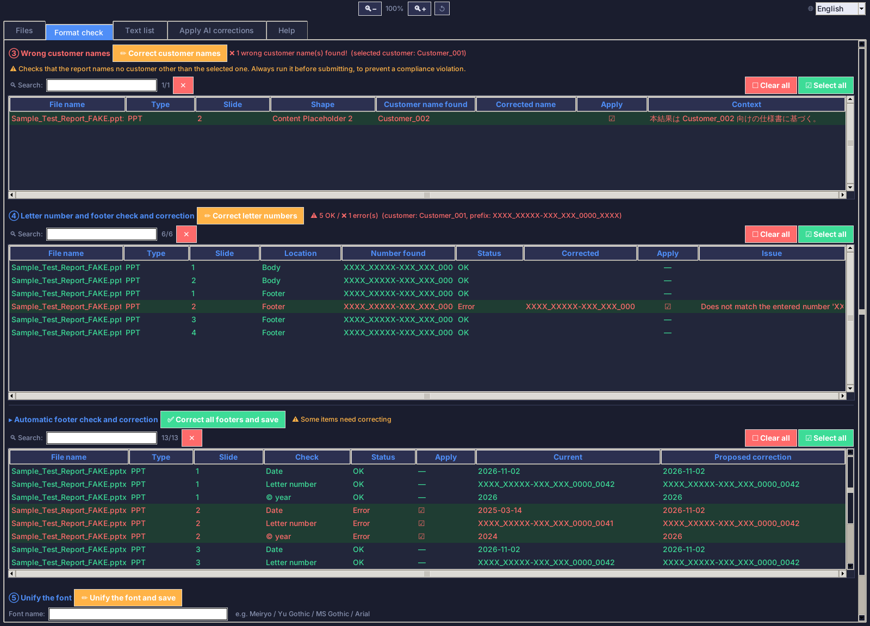
TOOL 3 OF 9 · PURPOSE
Document AI Editor
Checks customer deliverables (PPTX, DOCX, XLSX, PDF) before they go out and writes the corrections into a new file.
BEFORE
Footers, letter numbers and customer names checked by eye; hand edits could lose bold, color or font size.
WITH THE TOOL
Finds wrong customer names, letter numbers, dates, copyright years and missing page numbers
Copilot proposes spelling, wording and logic fixes (EN and JA); you review a preview first
Saves a new file with a change log; the original is never overwritten
Real app, demo data: a fake deck with deliberate defects
5
0.6
4
issue types reviewed
match floor, no guessing
document formats
Võ Hoài Linh · Achievement report 2023–2026 · 16 / 29

Slide 17
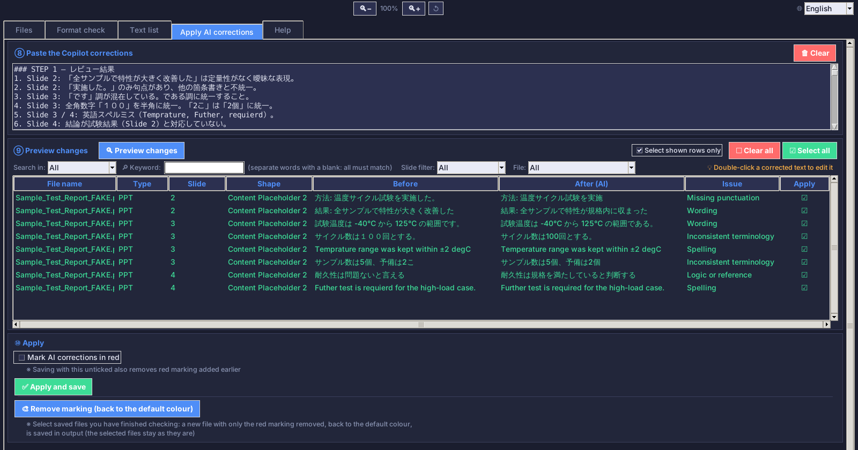
TOOL 3 OF 9 · HIGHLIGHTS
Document AI Editor: what stands out
1
Never overwrites the original: every save goes to output/ with a timestamp and a change log
2
Changes only the characters that differ, so bold, color and size of the rest are kept
3
Letter numbers follow each customer’s own format; other customers’ names are caught, aliases included
4
Refuses to edit when a paragraph cannot be matched with confidence, instead of guessing
Real app, demo data: previewed corrections from a mock AI answer
STATUS
5
11 automated check suites, including a round-trip test of run-level formatting
1,691
Run on Windows by the owner. The v1.1 EXE is not built yet. Excel files are read-only.
automated test functions in the check suites
Võ Hoài Linh · Achievement report 2023–2026 · 17 / 29

Slide 18
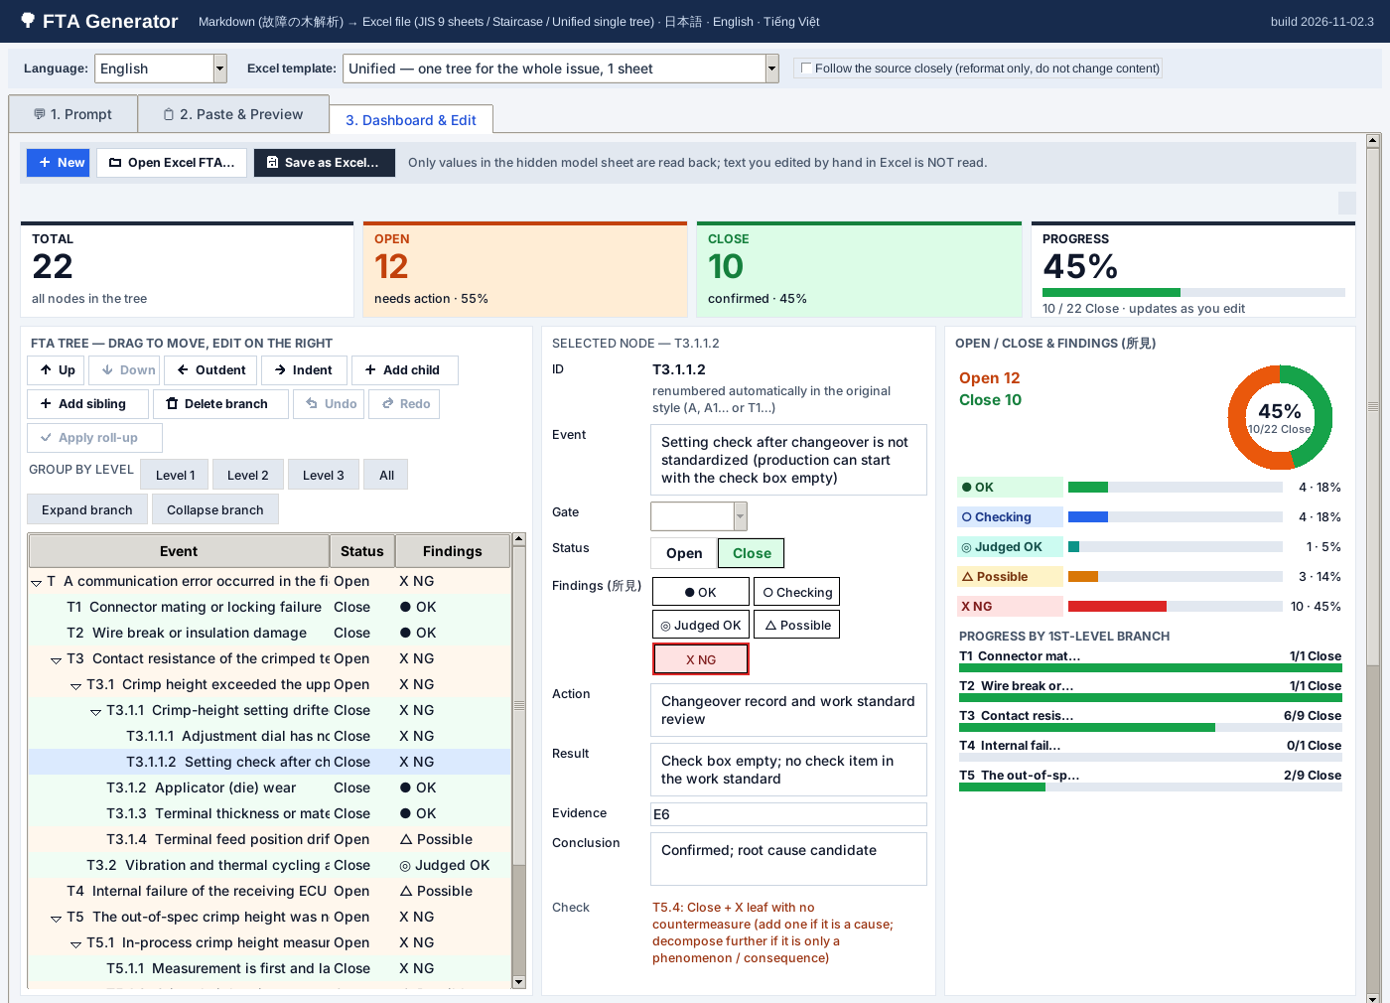
TOOL 4 OF 9 · PURPOSE
FTA generator
Turns Copilot’s fault tree analysis (FTA) text into a ready-to-use Excel file, built for a customer quality claim.
BEFORE
Copilot returns only text, so the fault tree, evidence and countermeasures had to be rebuilt by hand in Excel.
WITH THE TOOL
Paste Copilot’s output, preview the tree with self-check warnings, then generate
Four Excel templates, including a JIS 9-sheet workbook with the tree drawn as shapes
A visual editor: drag and drop, undo and redo, reopen an exported file
Real app, invented example case: dashboard and tree editor
924
3
9
FTA tests passing
languages: JA, EN, VI
sheets in the JIS workbook
Võ Hoài Linh · Achievement report 2023–2026 · 18 / 29

Slide 19
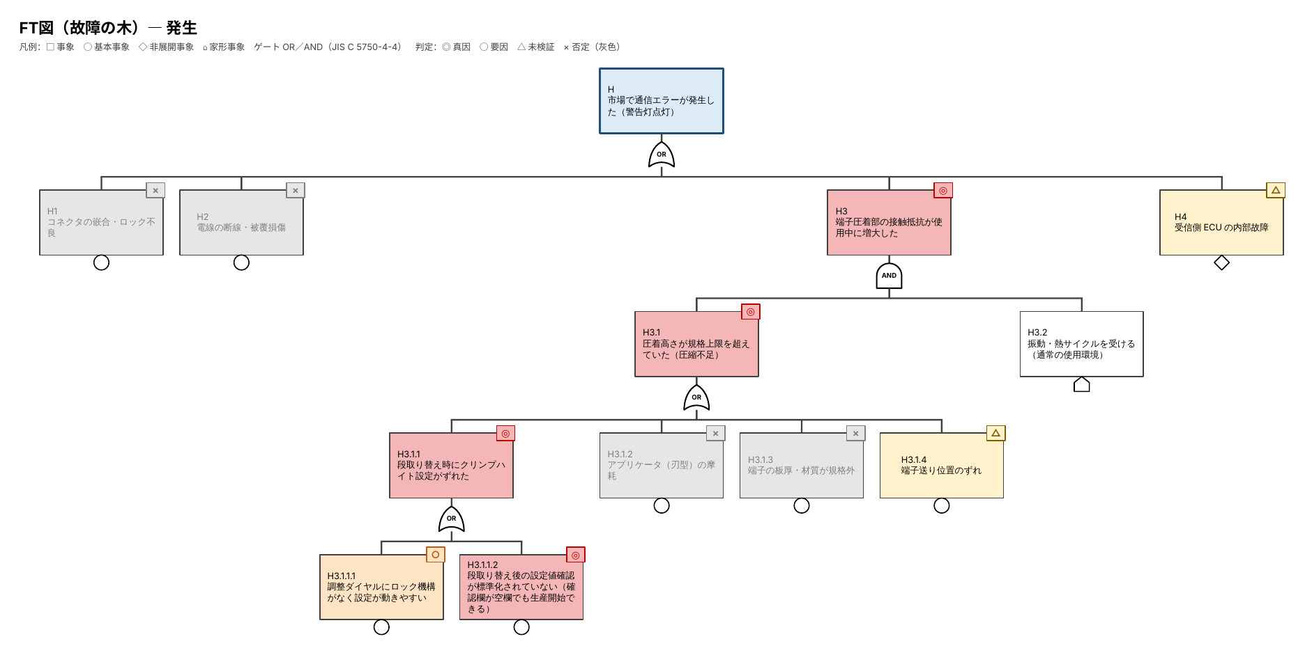
TOOL 4 OF 9 · HIGHLIGHTS
FTA generator: what stands out
1
The fault tree is drawn with JIS C 5750-4-4 symbols (events, AND and OR gates) as Excel shapes
2
A live dashboard: change a node’s status in Excel and the counts and charts update
3
Tolerates Copilot’s mistakes: odd IDs, broken tables and truncated output can be pasted in parts
4
Never overwrites a file; the older templates stay byte-for-byte identical, locked by tests
Output of the tool: fault tree sheet (JIS template), invented example, rendered with LibreOffice
STATUS
5
Hands the 5 Why section over to the PowerPoint generator in one click
924
Tried on Windows by the owner. Real Excel and live Copilot checks are still open.
test functions pass without a GUI
Võ Hoài Linh · Achievement report 2023–2026 · 19 / 29

Slide 20
TOOL 5 OF 9 · PURPOSE
Temperature assessment
RESULT STATES, HIGHLIGHTED AUTOMATICALLY
OK
NG
An Excel/VBA tool that evaluates worst-case temperatures and colors every result automatically.
Not enough
Driven criteria
BEFORE
Reading each temperature result against its limit and marking OK or NG by hand, with no history to learn from.
WITH THE TOOL
Highlights every result against its criteria automatically
A temperature database gathers past test data to reveal trends by type
Built in the Leader-CIP activity with three EET1 teammates
4
1
2 → 0
EET1 members in the Leader-CIP team
commendation received
data errors, original vs fixed workbook
Author’s own account, not provable from files: CIP team, commendation, temperature database
Võ Hoài Linh · Achievement report 2023–2026 · 20 / 29

Slide 21
TOOL 5 OF 9 · HIGHLIGHTS
Temperature assessment: my contribution
1
Traced a wrongly colored sub-table to three root causes: one in the data, two in the logic
AUDIT RESULT
2 → 0
2
Built an audit script that checks every limit cell, so a script and not a person finds the errors
data errors, original vs fixed
3
Patched the workbook at file level, so every other part stays byte-identical
7
4
A Python twin of the VBA logic acts as an executable specification, backed by 75 tests
limit cells the old macro linked wrongly
5
Macros were never executed during the analysis; seven manual Excel cases confirm the fix
Pending
confirmation of the VBA fix in Excel
Võ Hoài Linh · Achievement report 2023–2026 · 21 / 29

Slide 22
TOOL 6 OF 9 · PURPOSE
Shipping inspection
Photos
1
Renamed by capture time; originals are copied, never touched
Checks laser marking before shipment: photos in, marking read by AI, a checklist in photo order, a person confirms.
2
AI reads the marking
Copilot prompts in batches; numbered stamps keep the photo order
3
Checklist in photo order
BEFORE
Excel list filled in a copy; the DMC code is read from the image
Comparing the marking with the drawing by eye and typing the checklist by hand: slow and easy to get wrong.
4
Flags what cannot be trusted
Unreadable, missing or misordered records are errors, never guesses
WITH THE TOOL
5
A person confirms
Renames photos by capture time, with preview and undo
Parses AI answers strictly: a missing or misordered record is a hard error
Fills the Excel checklist and reads the DMC code automatically
Final OK or NG stays human; automatic drawing comparison is planned
950
0
3
automated test functions
product photos in the repository
UI languages: EN, VI, JA
Võ Hoài Linh · Achievement report 2023–2026 · 22 / 29

Slide 23
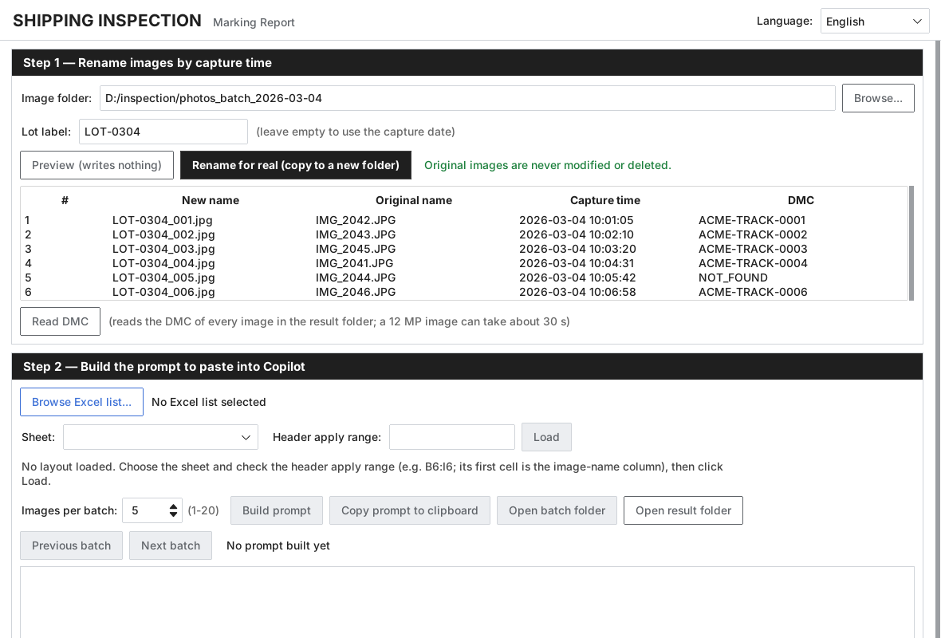
TOOL 6 OF 9 · HIGHLIGHTS
Shipping inspection: what stands out
1
Original photos are never deleted or overwritten: preview first, copies, a manifest and undo
2
Photo order is never guessed: a record count mismatch or a reordered stamp is a hard error
3
Never a false OK: every row stays “needs human check” until a person confirms it
4
The strict parser refuses to “fix” part numbers, dates or codes; unreadable fields are flagged
Real app, generated sample photos: 6 renamed by capture time, 5 DMC codes read, 1 flagged NOT_FOUND
5
Tests use generated images; no real product photo is stored, and writes and deletes are audited
STATUS
In use for marking checks, per the project docs. Next: automatic comparison with the drawing.
Võ Hoài Linh · Achievement report 2023–2026 · 23 / 29

Slide 24
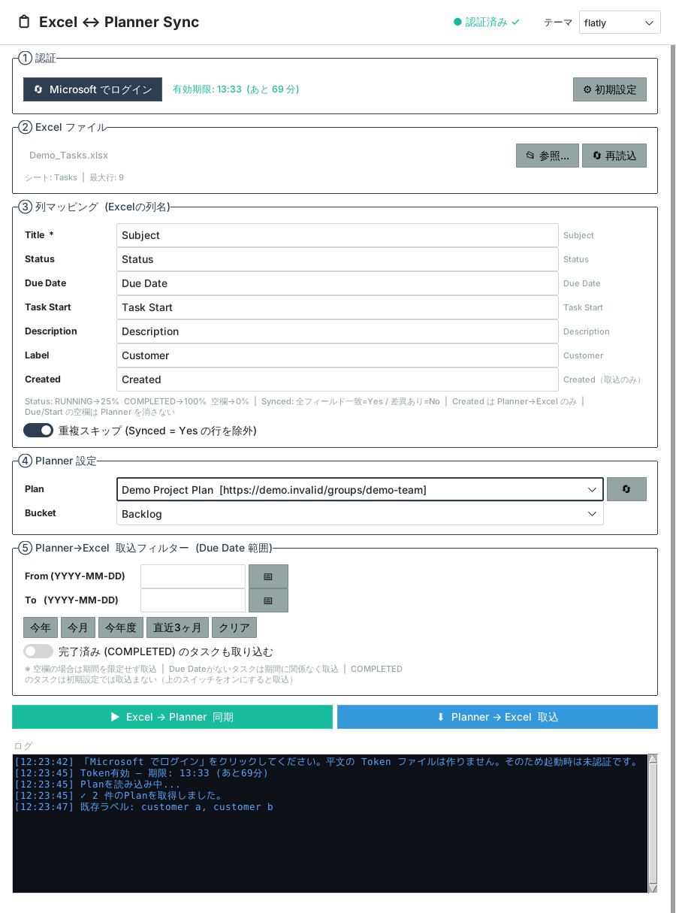
TOOL 7 OF 9 · PURPOSE
Excel ↔ Planner sync
1
A Windows app that keeps tasks in an Excel file and in a Microsoft Planner plan in sync, in both directions.
Graph permission requested, the minimum possible
601
BEFORE
Plans lived in Excel while work was assigned and reported in Planner: every task typed twice, and the two copies drifted apart.
automated test functions, no GUI or Graph needed
WITH THE TOOL
7
Excel → Planner creates or updates tasks with one button and marks each row Synced yes or no
Planner → Excel pulls tasks for a due-date range
Signs in with your own Microsoft account and asks for a single permission
fields synced: title, status, dates, text, label
Real app, demo data and a mocked Microsoft sign-in (Japanese UI)
Võ Hoài Linh · Achievement report 2023–2026 · 24 / 29

Slide 25
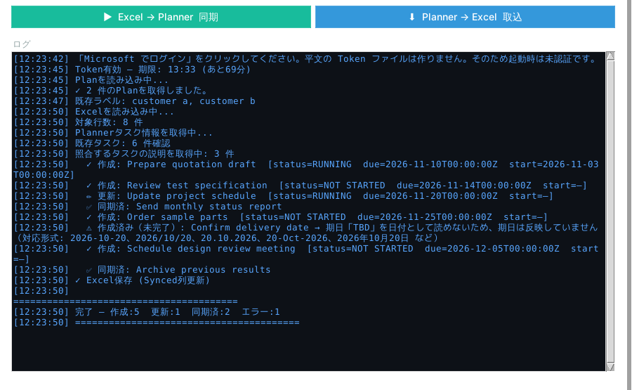
TOOL 7 OF 9 · HIGHLIGHTS
Excel ↔ Planner sync: what stands out
1
Matches tasks by title, so running it again never creates duplicates
2
Excel stays safe: rolling backup, formulas never overwritten, macros kept
3
Bad dates or statuses are never dropped silently: each row is flagged in the log
4
Built for the corporate network: Windows proxy and TLS inspection are handled
Real app, demo data: log of a sync run (5 created, 1 updated, 2 synced, 1 flagged)
5
Least privilege: one Graph permission, locked by an automated test
STATUS
Working Windows app. Wider rollout needs IT approval of the single Graph permission, still to be confirmed.
Võ Hoài Linh · Achievement report 2023–2026 · 25 / 29

Slide 26
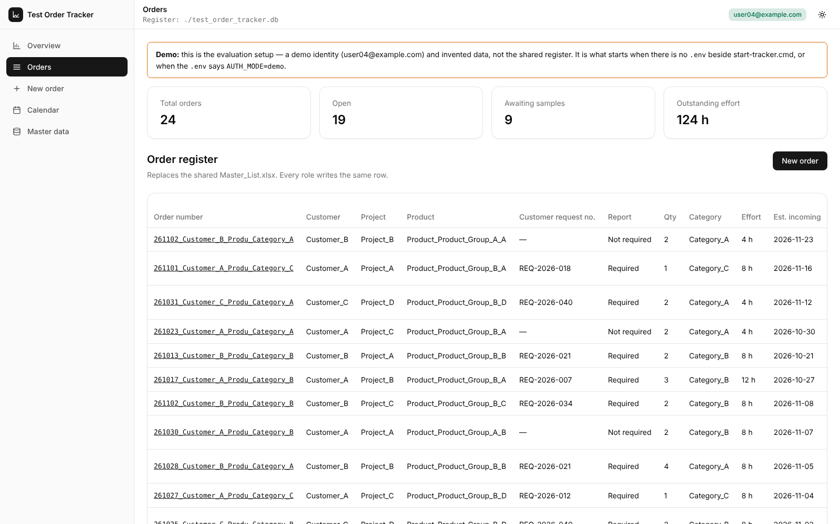
TOOL 8 OF 9 · PURPOSE
Test Order Tracker
A web app that replaces a shared Excel master list for tracking sample test orders, from request to delivery of samples.
BEFORE
Several people wrote to one Excel row. The second person to open it got a stale copy, and late orders showed only when someone looked.
WITH THE TOOL
Real app, invented demo data: the order register
One register for every order; status comes from the dates, never typed
A progress card shows who each order is waiting on
Total effort and estimated delivery are calculated automatically
3
1,551
7
measuring processes, defined as data
automated test functions
design rules kept, e.g. append-only history
Võ Hoài Linh · Achievement report 2023–2026 · 26 / 29

Slide 27
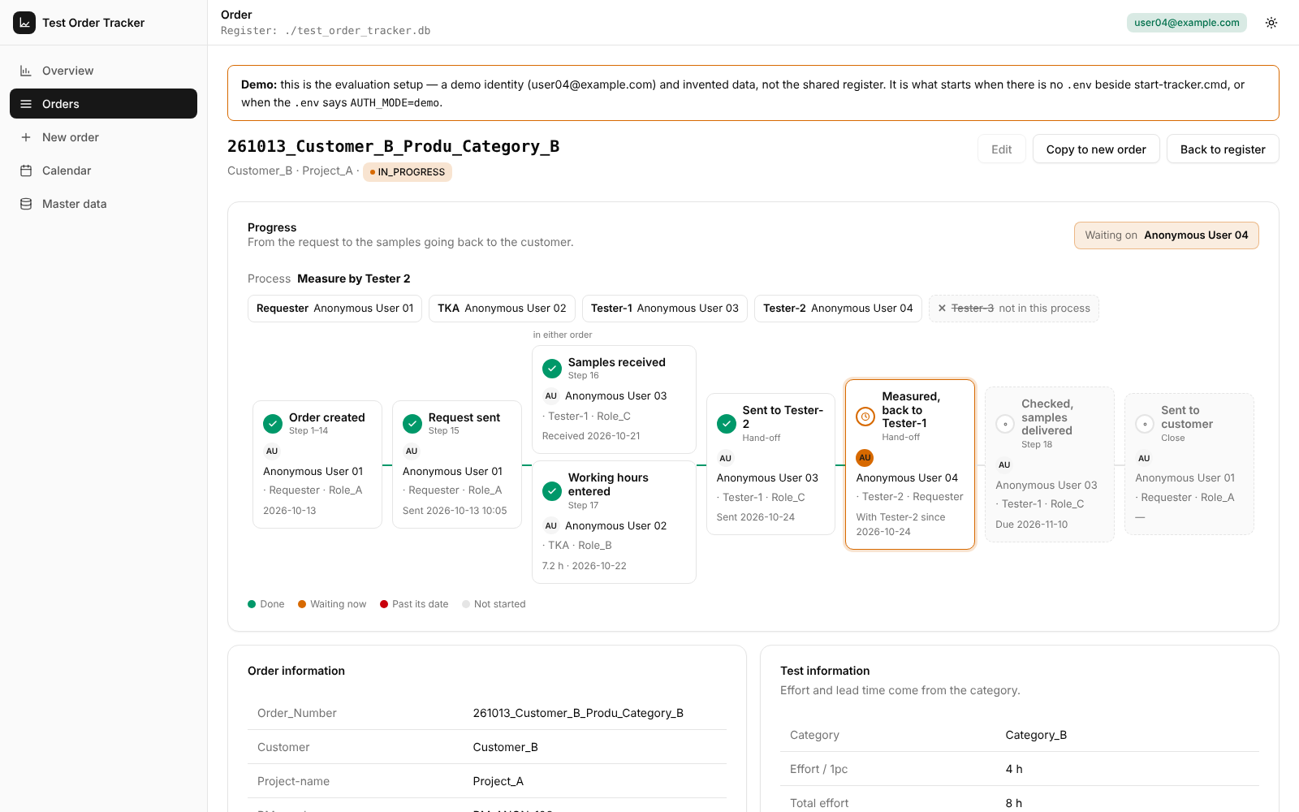
TOOL 8 OF 9 · HIGHLIGHTS
Test Order Tracker: what stands out
1
Three measuring processes are defined as data, each with its own hand-offs and tests
2
Rules come straight from the spreadsheet: effort = per piece × quantity, delivery = incoming + lead time
3
History is append-only and status is always computed from dates, so nothing can drift
4
Overview and calendar show late orders, orders due soon and the on-time rate over 12 weeks
Real app, invented demo data: progress card, “waiting on”
5
Mail sits behind a gateway: SMTP by default, an Outlook helper for Approve and Reject buttons
STATUS
Working prototype. Windows and Outlook steps still need manual verification; daily use with real data is not yet shown.
Võ Hoài Linh · Achievement report 2023–2026 · 27 / 29

Slide 28
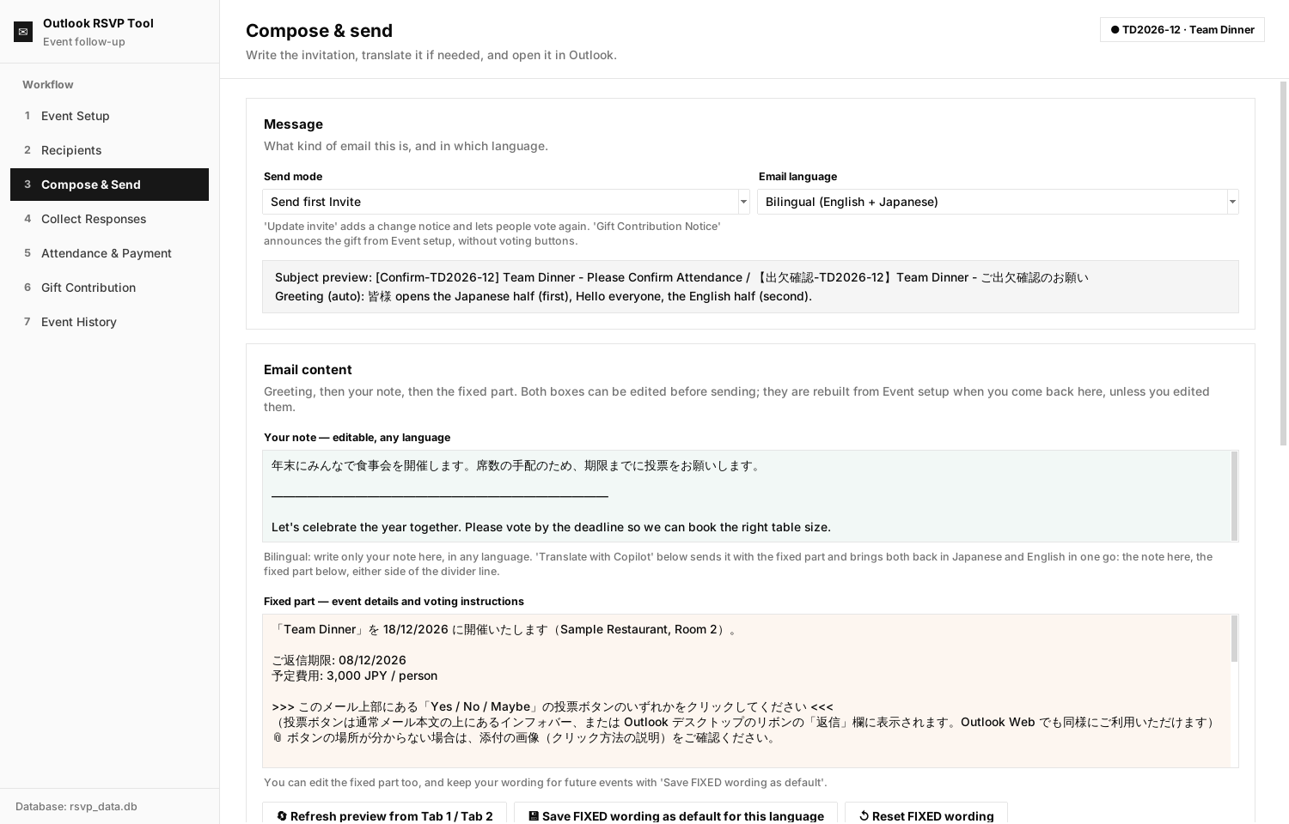
TOOL 9 OF 9 · PURPOSE
Outlook RSVP tool
Runs a department event from the invitation to the final accounting: RSVP mail, attendance, money, gifts and history.
BEFORE
One event meant many manual steps: invite, collect answers, chase payments, buy a gift, report what was left.
WITH THE TOOL
Builds the invitation from the event details, in English, Japanese or both
Sends calendar invites only to people who said Yes or Maybe
Tracks contributions, gifts and the department fund left
Real app, invented demo data: a bilingual English and Japanese invitation
7
EN·JA·VI
329
steps, from event setup to history
email languages, plus bilingual JA + EN
automated test functions
Võ Hoài Linh · Achievement report 2023–2026 · 28 / 29

Slide 29
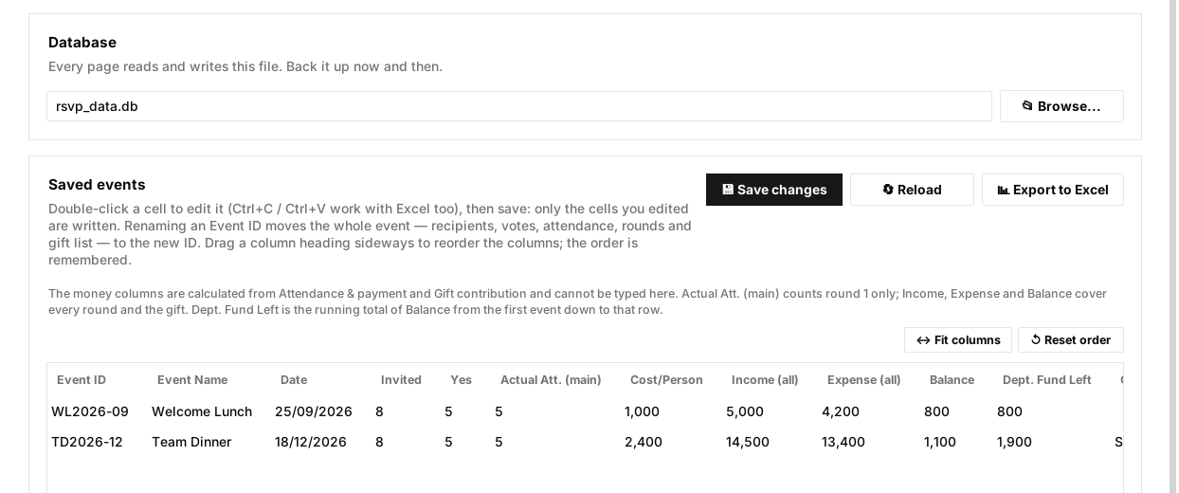
TOOL 9 OF 9 · HIGHLIGHTS
Outlook RSVP tool: what stands out
1
Safe by default: mail opens as a draft in Outlook and auto-send is switched off
2
Reminders go only to people who have not answered; calendar invites only to Yes and Maybe
3
Money per round and gifts roll up into a balance and a running department fund left
Real app, invented demo data: event history with the fund left
4
Copilot translations are checked: missing or invented numbers, dates, currencies and vote buttons are flagged
STATUS
Used for small real events by the owner. Outlook COM code is verified by reading only, with no end-to-end run recorded. Scheduled reminders are not built yet.
5
Automatic guards stop personal data from being committed and catch missing EN, JA or VI texts
Võ Hoài Linh · Achievement report 2023–2026 · 29 / 29

