Slide 1
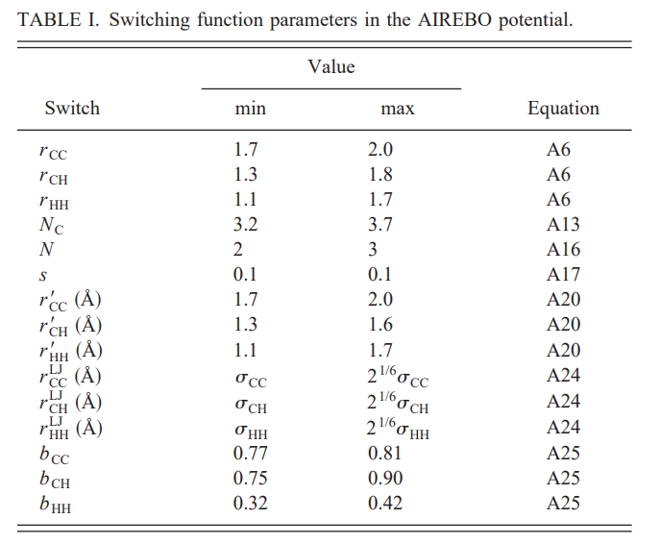
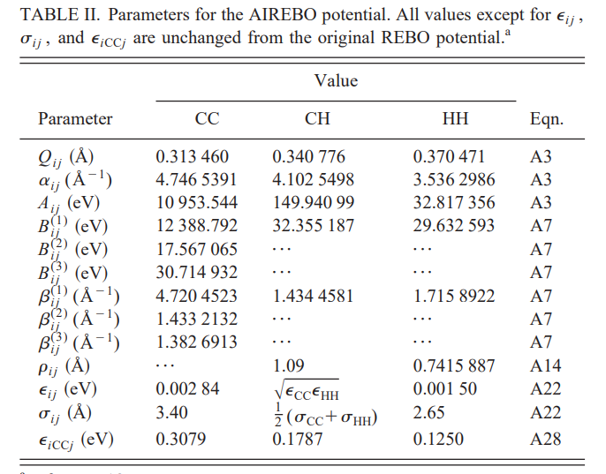
Interatomic potential summary – AIREBO potential
For details of all equations, please refer to the original paper:
S. J. Stuart, “A reactive potential for hydrocarbons with intermolecular interactions” J. Chem. Phys. 112, 6472 (2000).

Slide 2
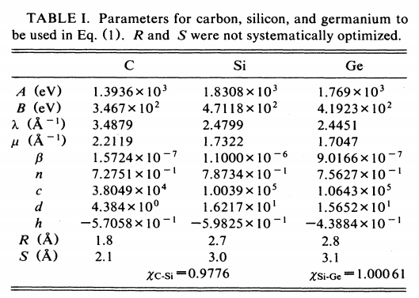
Interatomic potential summary – Tersoff potential
For details of all equations, please refer to the original paper:
J. Tersoff, “Modeling solid-state chemistry: Interatomic potentials for multicomponent systems” Phys. Rev. B 39, 5566(R)

Slide 3
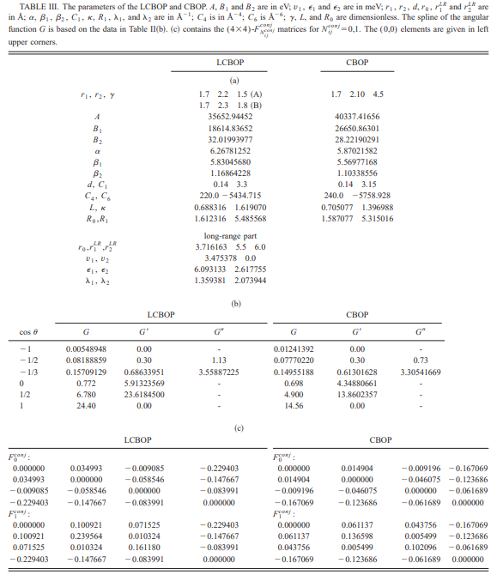
Interatomic potential summary – LCBOP potential
For details of all equations, please refer to the original paper:
J. H. Los and A. Fasolino, “Intrinsic long-range bond-order potential for carbon: Performance in Monte Carlo simulations of graphitization” Phys. Rev. B 68, 024107 (2003)
For each potential, there are about 20 or more equations.
It would be better to directly refer to the original paper for more details.

Slide 4
Test of MD-κ of graphene with different parameters,
using TERSOFF potential at 200 K, using 88000-atom system
I used this setting for all other calculations
 | TERSOFF κ (W/mK) | Boundary condition | Time step (fs) | Correlation Length | Sample Interval | Relaxation step | Relaxation Time (ps) | Data pro Step | Data pro Time (ps)
1 | 746.3010 | ppp | 0.5 | 5000 | 10 | 100000 | 50 | 1000000 | 500
2 | 746.3010 | ppf | 0.5 | 5000 | 10 | 100000 | 50 | 1000000 | 500
3 | 1080.1195 | ppp | 0.5 | 5000 | 10 | 100000 | 50 | 2000000 | 1000
4 | 1225.3011 | ppp | 0.5 | 5000 | 10 | 100000 | 50 | 5000000 | 2500
5 | 1360.7957 | ppp | 0.5 | 5000 | 10 | 100000 | 50 | 10000000 | 5000
6 | 801.1311 | ppp | 0.5 | 10000 | 10 | 100000 | 50 | 1000000 | 500
7 | 1367.5928 | ppp | 0.5 | 10000 | 10 | 100000 | 50 | 6000000 | 3000
8 | 1032.6821 | ppp | 0.5 | 20000 | 10 | 100000 | 50 | 6000000 | 3000
9 | 795.2540 | ppp | 0.5 | 30000 | 10 | 100000 | 50 | 6000000 | 3000
10 | 656.2827 | ppp | 0.5 | 10000 | 5 | 100000 | 50 | 1000000 | 500
11 | 799.4861 | ppp | 0.5 | 10000 | 20 | 100000 | 50 | 1000000 | 500
12 | 1684.8223 | ppp | 0.5 | 5000 | 10 | 500000 | 250 | 1000000 | 500
13 | 670.7653 | ppp | 0.5 | 5000 | 10 | 1000000 | 500 | 1000000 | 500

Slide 5
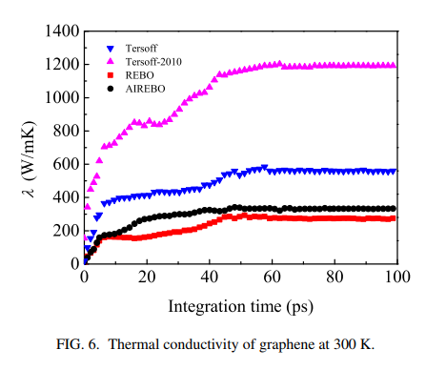
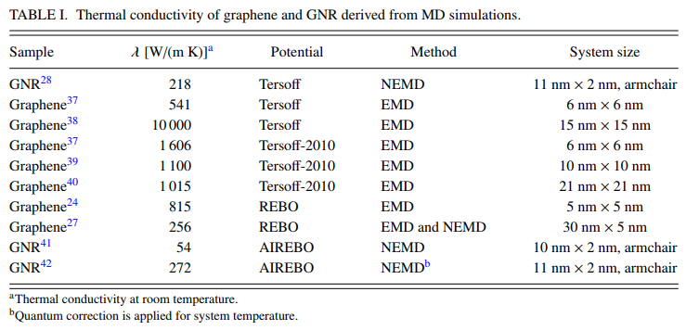
MD-κ of graphene with different potentials, from published results
I trust this result
Reference: J.-H. Zou, et al. “Phonon thermal properties of graphene from molecular dynamics using different potentials” J. Chem. Phys. 145, 134705 (2016).
Comment: The EMD-calculated thermal conductivity varies a lot, with different dimensions, parameters, and potentials. An important problem in the calculation is to determine the exact volume of the single-layer graphene. In all my calculations, I used the area of the graphene to replace the volume, since we regard the graphene as a 2D material, but under finite temperature, the 2D graphene bends and will have the 3rd dimension of thickness. How to determine the real volume is a big challenge in EMD using Green-Kubo method. I would not suggest using EMD for calculations, although it is convenient. The real results of κ of graphene at room temperature should approach 200~250 W/m-K, but the theoretical results may close to 1000 or more, regardless of the bending phenomenon. Quantifying the bending (related to thickness) and its impact on the thermal conductivity or other properties may be an interesting topic.

Slide 6
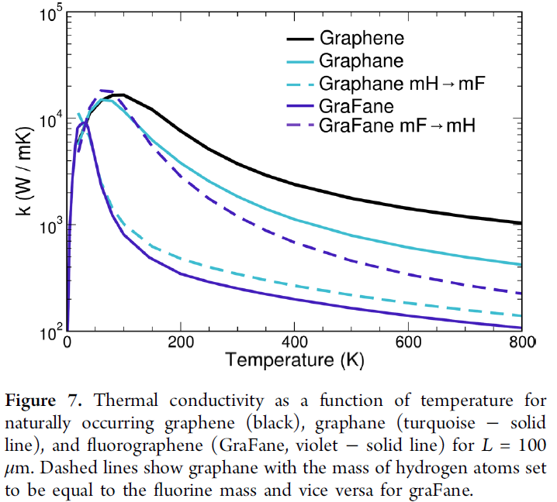
Experimental and MD-κ of graphene
Sta2040C: using stampede2 with 2040 cores
Com960C: using Comet with 960 cores.
The core numbers have been tested. # of atoms: 88,000
T (K) | EXP κ (W/m-K) | AIREBO κ (W/m-K) | A-resource and time |  | TERSOFF κ (W/mK) | T-resource and time |  | LCBOP κ (W/m-K) | L-resource and time
200 | 7500 | 612.0185 | Sta2040C | 3h49m | 746.3010 | Com960C | 12m | 588.2891 | Sta6400C | 43m
250 | 5200 | 1056.2257 | ditto | 3h47m | 847.7276 | ditto | 15m | 631.7429 | Stam2048C | 1h15m
300 | 3900 | 742.1970 | ditto | 3h48m | 923.4621 | Com1200C | 12m | 563.0737 | ditto | 1h15m
350 | 3000 | 804.0993 | ditto | 3h49m | 690.2895 | Com960C | 14m | 431.8681 | ditto | 1h15m
400 | 2500 | 759.1816 | ditto | 3h49m | 867.3660 | ditto | 13m | 495.7894 | ditto | 1h15m
450 | 2000 | 410.1717 | ditto | 3h48m | 350.9835 | ditto | 15m | 485.4828 | ditto | 1h15m
500 | 1850 | 166.8312 | ditto | 3h49m | 604.1600 | ditto | 14m | 297.7780 | ditto | 1h15m
550 | 1680 | 377.9355 | ditto | 3h51m | 518.9972 | ditto | 13m | 231.5714 | ditto | 1h15m
600 | 1400 | 437.2820 | ditto | 3h48m | 413.2289 | ditto | 15m | 382.5955 | ditto | 1h15m
650 | 1300 | 362.6768 | ditto | 3h50m | 329.5522 | ditto | 13m | 109.6000 | ditto | 1h15m
700 | 1230 | 245.7759 | ditto | 3h50m | 303.3588 | ditto | 13m | 299.6612 | ditto | 1h15m
750 | 1160 | 383.0134 | ditto | 3h49m | 277.8238 | ditto | 14m | 227.4127 | ditto | 1h15m
800 | 1100 | 325.7567 | ditto | 3h51m | 234.1002 | ditto | 13m | 178.4214 | ditto | 1h15m
Reference: G. Fugallo, et. al. “Thermal Conductivity of Graphene and Graphite: Collective Excitations and Mean Free Paths” Nano Lett., 2014, 14 (11), pp 6109–6114

Slide 7
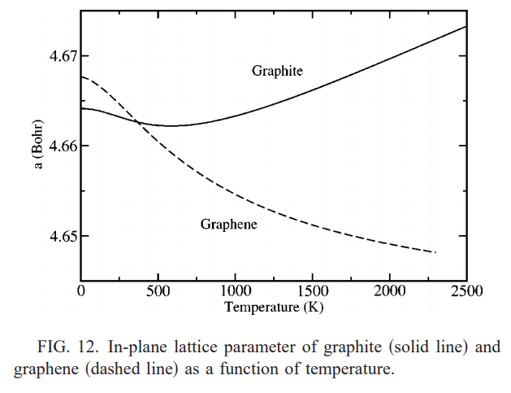
DFT and MD lattice constant of graphene, atom number is 220
T (K) | DFT a (Å) | AIREBO a (Å) | A-resource and time |  | TERSOFF a (Å) | T-resource and time |  | LCBOP a (Å) | L-resource and time
250 | 2.4684 | 2.4181 | Sta320C | 1h20m | 2.5287 | Com96C | 4m | 2.4572 | Sta320C | 47min
500 | 2.4662 | 2.4182 | ditto | ditto | 2.5277 | ditto | ditto | 2.4562 | ditto | ditto
750 | 2.4645 | 2.4176 | ditto | ditto | 2.5276 | ditto | ditto | 2.4540 | ditto | ditto
1000 | 2.4631 | 2.4193 | ditto | ditto | 2.5279 | ditto | ditto | 2.4549 | ditto | ditto
1250 | 2.4621 | 2.4189 | ditto | ditto | 2.5289 | ditto | ditto | 2.4538 | ditto | ditto
1500 | 2.4613 | 2.4210 | ditto | ditto | 2.5285 | ditto | ditto | 2.4548 | ditto | ditto
1750 | 2.4607 | 2.4228 | ditto | ditto | 2.5294 | ditto | ditto | 2.4547 | ditto | ditto
2000 | 2.4602 | 2.4236 | ditto | ditto | 2.5312 | ditto | ditto | 2.4577 | ditto | ditto
2250 | 2.4598 | 2.4249 | ditto | ditto | 2.5313 | ditto | ditto | 2.4583 | ditto | ditto
For lattice constant, I just used the 220-atom system. Larger the system is, more serious bending will occur (increasing the thickness of the single graphene layer, thus it will be much more inaccurate to determine the lattice constant).
Reference: N. Mounet and N. Marzari, “First-principles determination of the structural, vibrational and thermodynamic properties of diamond, graphite, and derivatives” Phys. Rev. B 71, 205214 (2005)

Slide 8
Table of summary
Thermal conductivity, 88000-atom system
T (K) | EXP κ (W/mK) | AIREBO κ (W/mK) | TERSOFF κ (W/mK) | LCBOP κ (W/mK)
200 | 7500 | 612.0185 | 746.3010 | 588.2891
250 | 5200 | 1056.2257 | 847.7276 | 631.7429
300 | 3900 | 742.1970 | 923.4621 | 563.0737
350 | 3000 | 804.0993 | 690.2895 | 431.8681
400 | 2500 | 759.1816 | 867.3660 | 495.7894
450 | 2000 | 410.1717 | 350.9835 | 485.4828
500 | 1850 | 166.8312 | 604.1600 | 297.7780
550 | 1680 | 377.9355 | 518.9972 | 231.5714
600 | 1400 | 437.2820 | 413.2289 | 382.5955
650 | 1300 | 362.6768 | 329.5522 | 109.6000
700 | 1230 | 245.7759 | 303.3588 | 299.6612
750 | 1160 | 383.0134 | 277.8238 | 227.4127
800 | 1100 | 325.7567 | 234.1002 | 178.4214
Lattice constant, 220-atom system
T (K) | DFT a (Å) | AIREBO a (Å) | TERSOFF a (Å) | LCBOP a (Å)
250 | 2.4684 | 2.4181 | 2.5287 | 2.4572
500 | 2.4662 | 2.4182 | 2.5277 | 2.4562
750 | 2.4645 | 2.4176 | 2.5276 | 2.4540
1000 | 2.4631 | 2.4193 | 2.5279 | 2.4549
1250 | 2.4621 | 2.4189 | 2.5289 | 2.4538
1500 | 2.4613 | 2.4210 | 2.5285 | 2.4548
1750 | 2.4607 | 2.4228 | 2.5294 | 2.4547
2000 | 2.4602 | 2.4236 | 2.5312 | 2.4577
2250 | 2.4598 | 2.4249 | 2.5313 | 2.4583

