Slide 1
Groovy Collections
Shubham Sharma

Slide 2
Agenda
Collections
Lists
Sets
Ranges
Maps

Slide 3
Prerequisites
Knowledge of Java collections.
Basic working of groovy.
Working knowledge of Closure.

Slide 4
Groovy Collections
Data structure that helps in dealing with a number of objects.
A wide variety of methods available for easy manipulation.

Slide 5
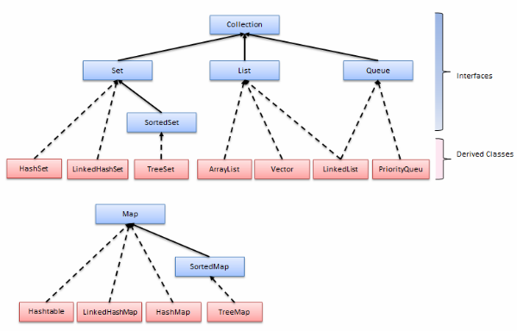

Slide 6
Lists
A list cares about the index
Elements are assigned indices on the basis of how they are added
Has methods related to the index
Index starts from 0
Creating list
//create empty list with ech element of type 'def'
List list = [ ]
//create empty list with elements of type 'type'
List<type> list = [ ]
List<type> list = new ArrayList()

Slide 7
Lists
Adding an element
list.add(“element1”)
list << “element1”
list += “element1”
list.push(element)
List firstList = [1,2,3,4,5]
List secondList = [“element2”]
List thirdList = firstList + secondList
println thirdList // [1,2,3,4,5,”element2”]
fourthlist = thirdlist - firstlist
println fourthlist // [“element2”]

Slide 8
Lists
Fetching elements:
list[i] – Get ith element in list starting from 0
list.get(0) – Get first element in list
list.getAt(0) – Get first element in list
list.first() - Get first element of list
list.head() - Get the head of list
list.last() - Get last element of list
list.tail() - Get all elements except first
list.getAt(1..10) – Get elements from index 1 to 10 (includes index 10)
list.subList(1, 10) - Get elements at index 1 to 10 (index 10 excluded)

Slide 9
Lists
Removing duplicates from a List :
list.unique() // Alters original list
list as Set
Deleting an element from a List :
(All of them alter original list)
list.remove(idx)
list.pop()
list.removeAll(collection)

Slide 10
Lists
Convert String into List:
“Hi” as List / “Hi”.toList()
string.tokenize('_') : Splits the string into a list with argument used as delimiter.
string.split('_') : Same as tokenize but can also accept regular expressions as delimiters
Convert List into String:
list.join(',')

Slide 11
Lists
Operations on each element of list:
println list*.name // Use of spread operator
list.collect { it.multiply(2) } // what if 'it' refers to string?
list.find { it.name==”abc” } // returns one object
list.findAll { it.name==”abc” } // returns list
list.each { println it.name }
list.eachWithIndex{p, index ->
println index +”. “ + p.name
}
list.reverseEach { println it.name }

Slide 12
List Methods
size() - Get size of list
reverse() - reverses the order of list elements
contains(value) – Find if list contains specified value
sum(closure) - Sum all the elements of the list
min(closure) – Get min value of list
max(closure) – Get max value of list
flatten() - Make nested lists into a simple list
sort(closure) - Sort the list in ascending order

Slide 13
List Methods (Continued..)
.list1.intersect(list2) : returns a list that contains elements that exist in both the lists.
.list1.disjoint(list2) : Returns true/false indicating whether lists are disjoint or not.
.every{condition} : checks whether every element of the list satisfy the condition.
.any{condition} : checks whether any of the element of the satisfy the condition.

Slide 14
Sets
A Set cares about uniqueness - it doesn't allow duplicates
It can be considered as a list with restrictions, and is often constructed from a list.
Set set = [1,3,3,4] as Set
([1,3,4])
No Ordering; element positions do not matter

Slide 15
Sets
Most methods available to lists, besides those that don't make sense for unordered items, are available to sets.
Like - getAt, putAt, reverse

Slide 16
Ranges
Ranges allow you to create a list of sequential values.
These can be used as Lists since Range extends java.util.List.
Generally used for looping, switch, lists etc
Ranges defined with the “..” notation are inclusive (that is the list contains the from and to value).
Ranges defined with the “..<” notation are exclusive, they include the first value but not the last value.

Slide 17
Ranges
Range range = 1..10
range = -10..<10
range = '#'..'~'
Methods
range.from – Get the lower limit of range
range.to – Get upper limit of range
range.contains(value) – Does range contain value?

Slide 18
Maps
A Map cares about unique identifiers.
Each key can map to at most one value. Keys and values can be of any type, and mixed together.
Initializing a Map :
def map = [:] ,
Map map = new HashMap()
Map<keyType, ValueType> map = [:]
Map<keyType, ValueType> map = new HashMap()
e.g. Map m = [1:'a', 2:'b', (true):'p', (false):'q', null:'z' ]

Slide 19
Maps
Adding an element:
map.put(key, value)
map.putAll(Map)
map.key = value
map[key] = value
Fetching elements:
map[key] / map.get(key) / map.key

Slide 20
Maps
Removing elements:
map.remove(key) : Remove key value pair associated with a particular key
Adding Two Maps:
Map map3 = map1 + map2
Map.getClass()

Slide 21
Maps
Operations on keys:
map.containsKey(key)
map.keySet()
Operations on values:
map.containsValue(value)
map.values()

Slide 22
Maps
map.find { } - Find first occurence of element being searched
map.findAll { } - Return map of all occurences of element being searched
map.each { } - Perform action with all elements
map.eachWithIndex {key,value->
println key + “. “ + value
}

Slide 23
More Map Methods...
isEmpty() - Is map empty?
toMapString() - Return map as a string

Slide 24
Some more List methods
groupBy{condition} - We can group a list into a map using some criteria.

Slide 25
References
http://groovy.codehaus.org/Collections
http://groovy.codehaus.org/groovy-jdk/java/util/List.html
http://groovy.codehaus.org/api/groovy/lang/Range.html
http://groovy.codehaus.org/JN1035-Maps
http://groovy.codehaus.org/JN1015-Collections (sets)

Slide 26
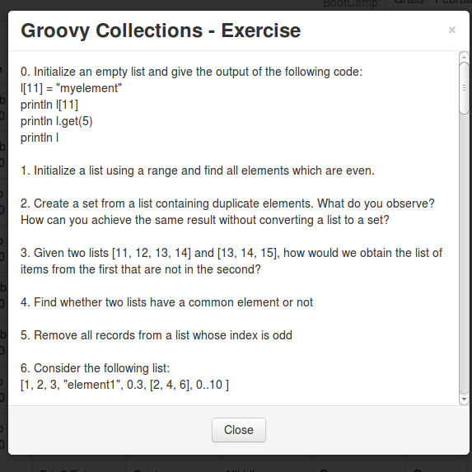
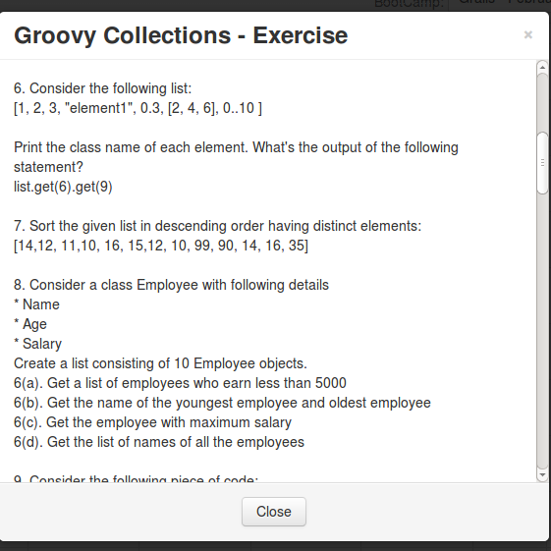
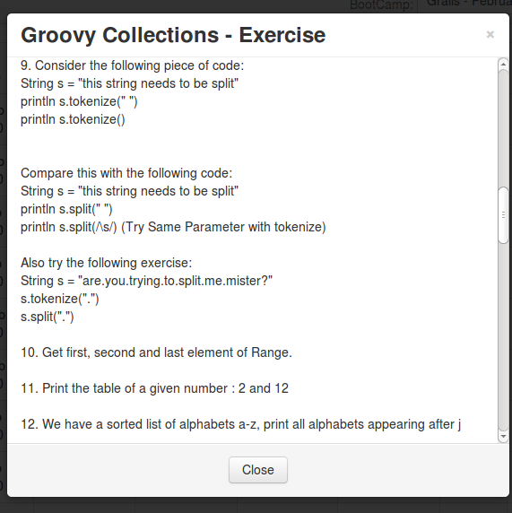
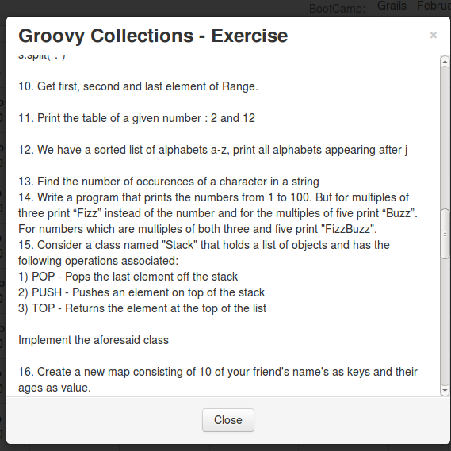
Exercise

Slide 27
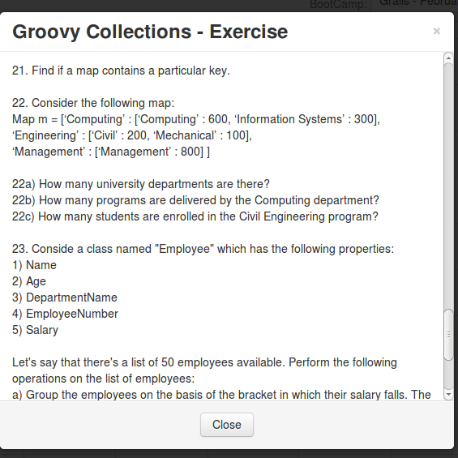
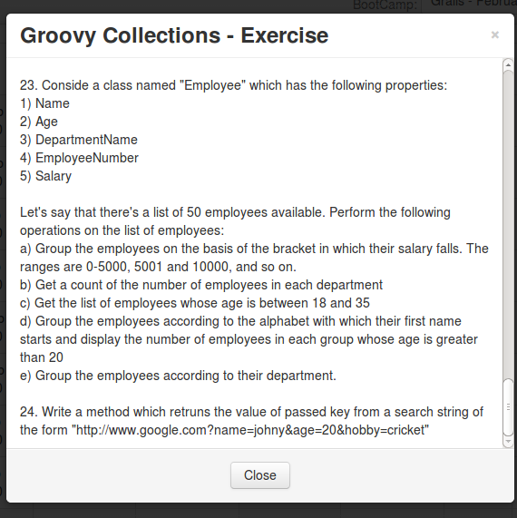
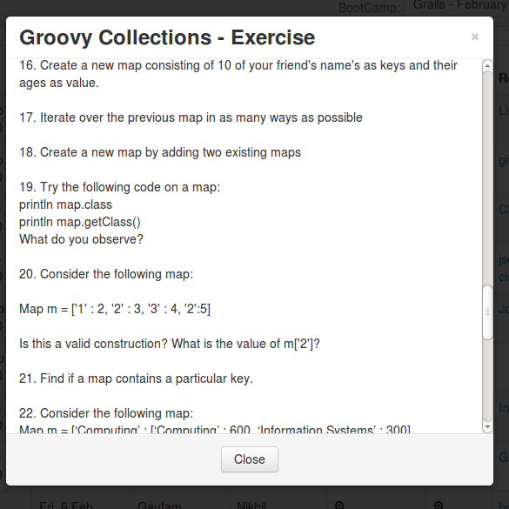
Exercise

