Slide 1
Web Basics

Slide 2
Agenda
Client Server Architecture
Communication Modal
HTTP
HTML
Servers
Web Frameworks

Slide 3
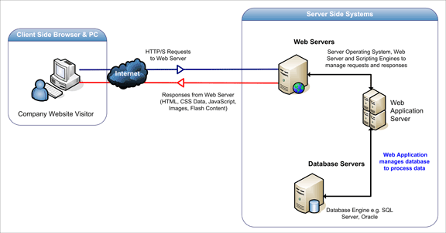
Client Server Architecture

Slide 4
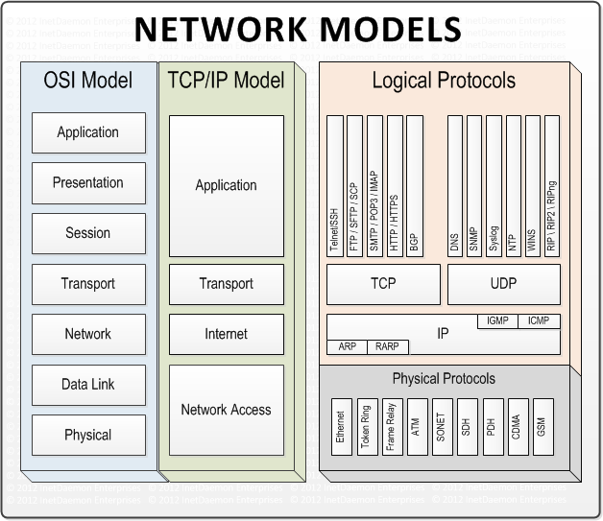
Communication Modal

Slide 5
HTTP
The Hypertext Transfer Protocol (HTTP) is an application protocol for distributed, collaborative, hypermedia information systems.
Basic Feature:-
Foundation of data communication over world wide web.
Its a hyper text based protocol.
Its connection less.
Its stateless.

Slide 6
HTTP Contd..
GET
PUT
POST
DELETE
Less commonly used.
OPTIONS
TRACE
CONNECT
PATCH
Http also comes with the status codes like 200, 403, 404.

Slide 7
HTML
Hyper Text Markup language
Needs markup parser to understand the tags.
Common Response for the server requests.
Specs governed by the W3C
￼

Slide 8
Servers
A server is a program that awaits and fulfills requests from client programs in the same or other computers. A given application in a computer may function as a client with requests for services from other programs and also as a server of requests from other programs.
Specific to the Web, a Web server is the computer program (housed in a computer) that serves requested HTML pages or files. A Web client is the requesting program associated with the user. The Web browser in your computer is a client that requests HTML files from Web servers.

Slide 9
Web Frameworks
A web framework (WF) or web application framework (WAF) is a software framework that is designed to support the development of web applications including web services, web resources and web APIs. Web frameworks aim to alleviate the overhead associated with common activities performed in web development. For example, many web frameworks provide libraries for database access and session management, and they often promote code reuse.

Slide 10
Questions??

Slide 11

• • • • • • • • • • • • • • • • • • • • • • • • • • • • • • • • • • • • • • • • • • • • • • • • • • • • • • • • • • • • • • • • • • • • • • • • • • • • • • • • • • • • • • • • • • • • • • • •
Thank you!!
• • • • • • • • • • • • • • • • • • • • • • • • • • • • • • • • • • • • • • • • • • • • • • • • • • • • • • • • • • • • • • • • • • • • • • • • • • • • • • • • • • • • • • • • • • • • • • • •

