Slide 1
INTRODUCTION TO
JAVA - 1
Nikhil Khari
Notes:
33

Slide 2
Agenda
Installation and Setup
What is Java
Compilation and Execution Process.
Understanding JDK, JVM & JRE.
Compiled vs Interpreted Languages.
Keywords
Identifiers
Data Types
Operators
Class
Object
Access Modifiers
Conditional Statements
Loops
<number>

Slide 3
Installation and Setup
Install sdkman
curl -s "https://get.sdkman.io" | bash
source "$HOME/.sdkman/bin/sdkman-init.sh"
sdk version
Install Java 8
sdk install java 8.0.292.hs-adpt
Java -version

Slide 4
What is Java?
Object Oriented Programming Language
Created by James Gosling in 1995
3 Billion devices run java programs
Similar to C++ but easier
Very Popular
Build Mobile apps for android, Desktop Apps using Java Swing, JavaFX, Enterprise and Web applications, Games and much more.

Slide 5
Compilation and Execution Process
Source Code: Any program( or code) that is written using any programming language.
The Compiler (JAVAC): Java uses javac as compiler to compile source code to byte code.
Byte Code: Suppose that the java source code is saved in the file called Hello.java. The source file is compiled using the javac compiler and a class file called Hello.class is generated. This file is called Byte code.
Bytecode is a standardized, machine independent language code. The bytecode files are loaded and interpreted at the client machine by a special program call the Java Virtual Machine (JVM). The bytecode is converted to the machine code(native code) by the JVM only. The Bytecode generated by the Java compiler is platform independent. This means that we can run the java bytecode on any machine provided it has JVM installed on the machine, That's why java is called platform independent.

Slide 6
Understanding JDK, JRE & JVM
JDK(Java Development Kit)- Provides all the tools, executables and binaries required to compile, debug and execute a Java Program. JDK = JRE + (Java compiler, debugger, and core classes).
JRE(Java Runtime Environment)- JRE consists of JVM and java binaries and other classes to execute any program successfully. (rt.jar, java)
JVM(Java Virtual Machine)- JVM is responsible for converting Byte code to the machine specific code. It provides core java functions like memory management, garbage collection, security etc. JVM contains JIT

Slide 7
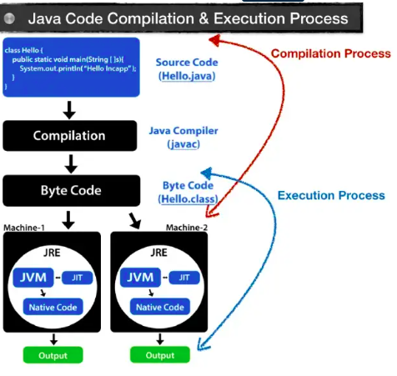

Slide 8
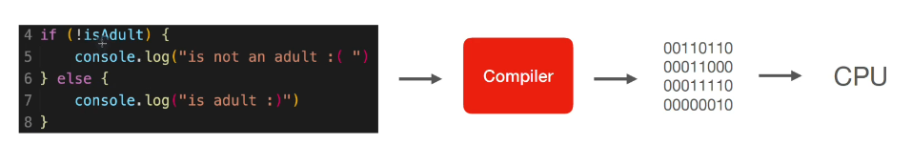
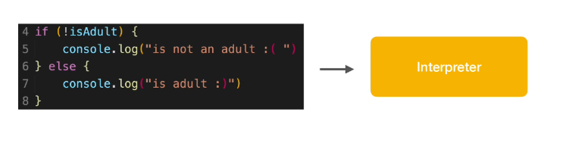
Compiled vs Interpreted Languages
Compiled | Interpreted
Code can be executed directly by computer's CPU | Another program executes code
Code must be transformed into machine readable instructions | No transformation required
Runs faster | Slower
Better Performance | Faster for development

Slide 9
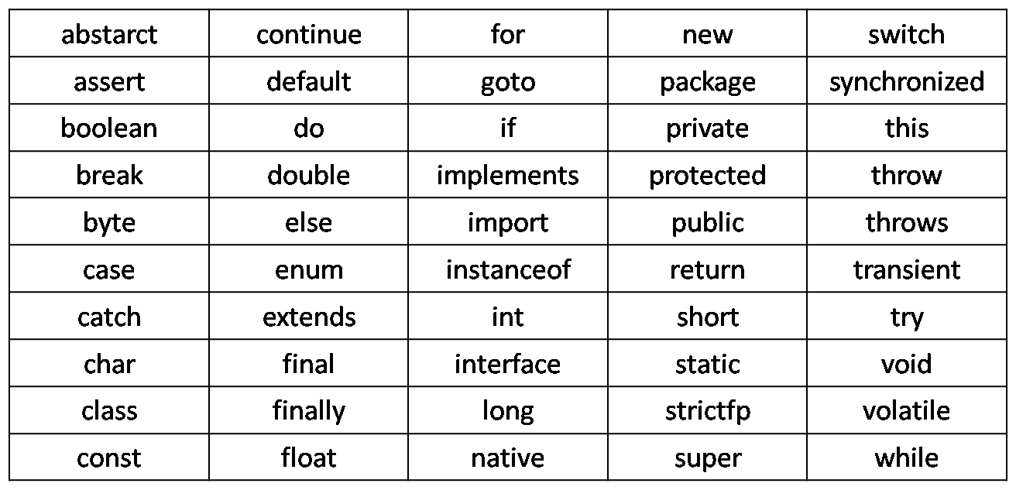
Keywords
Keywords are reserved words that are predefined by the language. Here is a list of keywords in the Java which cannot be used as identifiers in our java program. The keywords const and goto are reserved, even though they are not currently used. true, false, and null might seem like keywords, but they are actually literals; we cannot use them as identifiers in our programs.

Slide 10
Identifiers
Identifiers are the names given to variables, methods, classes and interfaces. Rules for identifier :
Identifiers must be composed of letters, numbers, the underscore_ and the dollar-sign $.
Identifier cannot begin with a number.
There is no limit to the length of a java variable name.
Identifier cannot be a Keyword.
All variable names are case-sensitive, for example: MyVariable is not the same as myVariable.
Examples:
Valid identifiers: MyVariable, x, i, _myvariable, $myvariable, _9pins.
Invalid identifiers: My Variable, 9pins, a+c, testing-1-2-3.

Slide 11
Data Types
Data types specify the different sizes and values that can be stored in the variable. Data Types in Java can be categorized into two parts:
Primitive Data Types: are used to store simple values. For example, Whole numbers, Decimal values, and characters. Available primitive data types are byte, short, int, long, char, float, double , and boolean.
Non-Primitive (Reference) Data Types: these are the types, which belong to a class, an interface, or an array. All these concepts will be covered later.
Unicode Character Set: Unicode is a two-byte character code set that has characters representing almost all characters in almost all human alphabets that allows writing systems around the world including English, Arabic, Chinese and more.
// char c1= '\u00AE';
// char c2= '\u00BD';

Slide 12
Operators in Java
The Operators can be characterized as unary and binary operators. The unary operators are used with only one operand, whereas the binary operand has two operands. For example,
The minus sign in –2 ( a negative number is a unary operator.
The minus sign in the expression 3-2 is a binary operator.
The operators can further be broadly categorized as:
Assignment Operator (=)
Arithmetic Operators( +, -, /, *, %)
Short-hand Assignment Operators(+=, -=, *= ,/=, %=)
Increment and decrement Operators( ++, --)
Relational Operators (<, >, <=, >=, ==, !=)
Logical Operators( &&, ||, !)
Conditional Operatos ( ? :)
Bitwise Operators ( &, |, <<, >>)
Special Operator( . , instanceof etc)

Slide 13
What is Class in Java?
Class: Class is a blueprint of an object. Class is a concept that came from world classification which means objects that have similar types of state and behaviour are represented via class. Programmatically, Using Class we can implement all the features of OOP
Declaring a class
Here class keyword tells the compiler that DemoClass is a class. Pair of curly braces defines the body of class. A class is a collection of fields and methods. Data and methods are collectively called members of a class.
Class DemoClass{
…...Data Members........
…....Methods.............
}
Let us now see how the methods and fields are created inside a class and how they are used in upcoming slides....

Slide 14
Class contd..
Method
A method is a collection of statements that performs some operation on the data defined inside a class. For example, the println() method that we have used in our programs is an inbuilt method that displays the string enclosed within brackets. There are number of other inbuild(predefined) methods in Java. Similiarly we can also create our own methods as per our need.
public int demoMethod(int number1, int number2){
Int sum = number1+ number2;
System.out.println(result);
}
Field
A Java field is declared using the following syntax:
[access_modifier] [static] [final] type name [= initial value] ;
The square brackets [ ] around some of the keywords mean that this option is optional. Only type and name are required.
private static final companyName = "RXLOGIX CORPORATION PVT LTD"

Slide 15
Static and Non-static Fields
A Java field can be static or non-static.
A static field belongs to the class. Thus, no matter how many objects you create of that class, there will only exist one field located in the class, and the value of that field is the same, no matter from which object it is accessed. Here is a diagram illustrating static fields
public class Customer {
static String staticField;
String nonStaticField;
}
Static fields are located in the class, so you don't need an instance of the class to access static fields. You just write the class name in front, like this:
Customer.staticField = "XYZ";
To access a non-static field you need an instance of the class (an object) on which you can access it. Here is an example:
Customer customer = new Customer();
customer.nonStaticField = "value";
System.out.println(customer.nonStaticField);

Slide 16
Access Modifiers in Java
A modifier assigns certain characteristics to the methods, data and variables. It specifies the availability of the class and its data members to the other classes in Project. Variables and methods can be at any of the following access level default, public, protected or private.
default: If we don't give any explicit modifier to a variable, class or method they will be automatically treated as default. It means that access is permitted from any method only in classes that are members of the same package as the target.
public: public variable, class or methods can be accessed by all classes in our application
protected: The protected access modifier is like the package modifier, except subclasses of the class can also access the variable or methods, even if the subclass is not located in the same package.
private: private variables or methods can be accessed only from the methods of the class to which it belongs, A subclass also does not have access to the private variables.

Slide 17
Object
Object is an instance of a class and required to access members of a class.In java new keyword is used to create new objects. Here is an example of creating an object of type Employee.
Employee e; //declare the variable of type Employee class
E = new Employee(); //instantiate the object
The first statement declares a variable to hold the object reference and the second one actually assigns the object reference to the variable.
We can create any number of objects of Employee class.
Employee e1= new Employee()
Employee e2 = new Employee()
It is important to understand that each object has its own copy of the instance varibales of its class. This means that any changes to the variable of one object have no effect on the variable of another.

Slide 18
Accessing Class Members
Now that we have created objects, each containing its own set of variables, we should assign values to these variables in order to use them in our program.
object_name.variable_name = value; // to access class fields
object_name.method_name(arguments); // to access class methods
class DemoClass {
public static void maine(String s[]) {
Employee e1 = new Employee();
e1.name = "Ram";
e1.age = 24;
System.out.println("Employee name "+e1.name);
System.out.println("Employee age "+ e1.age);
}
}

Slide 19
Naming Conventions in Java
For class:
First Letter of each word of a class name is capitalized
Example: MyFirstClass, String, StringBuffer, etc..
For method:
In case of methods first letter of each word except the first word is capitalized.
Example: setName, showData, getText
For static variable:
In case of static variable all letters of each word are capitalized. In case of more than one word, words are seprated by underscore ( _ )
Example: CITY, SCHOOL_NAME, COMPANY_ADDRESS

Slide 20
Conditional Statements
1. if
if(condition)
{
// Statements to execute if
// condition is true
}
2. if-else
if (condition)
{
// Executes this block if
// condition is true
}
else
{
// Executes this block if
// condition is false
}
Notes:
33

Slide 21
Conditional Statements
3. nested-if
if (condition1)
{
// Executes when condition1 is true
if (condition2)
{
// Executes when condition2 is true
}
}
Notes:
33

Slide 22
Conditional Statements
4. if-else-if
if (condition)
statement;
else if (condition)
statement;
.
.
else
statement;
Notes:
33

Slide 23
Conditional Statements
5. switch-case
switch (expression)
{
case value1:
statement1;
break;
case value2:
statement2;
break;
.
.
case valueN:
statementN;
break;
default:
statementDefault;
}
Notes:
33

Slide 24
Conditional Statements
6. break - break is majorly used for:
Terminate a sequence in a switch statement, to exit a loop.
7. continue - continue running the loop but stop processing the remainder of the code in its body for this particular iteration.
8. return - return statement is used to explicitly return from a method, it causes a program control to transfer back to the caller of the method.
Notes:
33

Slide 25
Loops
1. while - while loop is a control flow statement that allows code to be executed repeatedly based on a given Boolean condition.
while (boolean condition)
{
loop statements...
}
2. do while - do while loop is similar to while loop with only difference that it checks for condition after executing the statements.
Notes:
<number>

Slide 26
Loops
do
{
statements..
}
while (condition);
3. for - for statement consumes the initialization, condition and increment/decrement in one line.
for (initialization condition; testing condition;
increment/decrement)
{
statement(s)
}
Notes:
<number>

Slide 27
Loops
String names[] = {"AK", "PK", "DK"};
//enhanced for loop
for (String x:names)
{
System.out.println(x);
}
Notes:
<number>

Slide 28
Exercise
How java follows "Write Once And Run Anywhere" concept?
Do java support pass by value and pass by reference?
Write a program to add 3 to the ASCII value of the character 'd' and print the equivalent character.
What is the size in bits for a 'byte' data type.
5) Which of the following lines will compile without warning or error?
char d="d";
float f=3.1415;
int i=34;
byte b=257;
boolean isPresent=true;

Slide 29
Exercise
6)Which of the following expressions will evaluate to 7?
2 + 4 * 3- 7
(2 + 4) * (3 - 7)
2 + (4 * 3) - 7
((2 + 4) * 3) - 7)
7) Which of the following statement will compile?
int i = 5; int j = 10;
while(i < j) {}
while(i) {}
while(i = 5) {}
while((i = 12)!=5) {}
8) What is the result of the following operation?
System.out.println(4 % 3);

Slide 30
Exercise
9)Which of the following if statements will compile without errors?
int i = 3; int j = 3; int k = 3;
if(i > j) {}
if(i > j > k) {}
if(i > j && i > k) {}
if(i > j && > k) {}

Slide 31
Exercise
10) What will be printed out when the following code is executed?
switch (5) {
case 0:
System.out.println("zero");
break;
case 1:
System.out.println("one");
default:
System.out.println("default");
case 2:
System.out.println("two");
}

Slide 32
Exercise
11) What's the output of the following code?
public class Main { public static void main(String args[]) { boolean myVal = false; if (myVal = true) for (int i = 0; i < 2; i++) System.out.println(i); else System.out.println("else"); } }

Slide 33
Exercise
12) What's the output of the following code?
public class Main {
public static void main(String[] args) {
int i = 10;
do
while (i < 15)
i = i + 20;
while (i < 2);
System.out.println(i);
}
}

Slide 34
Thank You
33

