Slide 1

Memristors
Gradient Descent – Convolutional Neural Networks

Slide 2

Gradient Descent

Slide 3

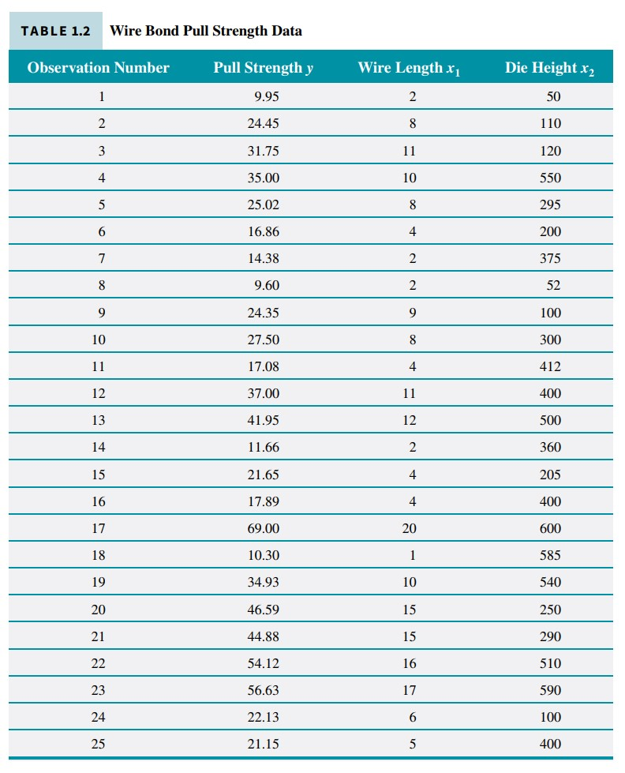
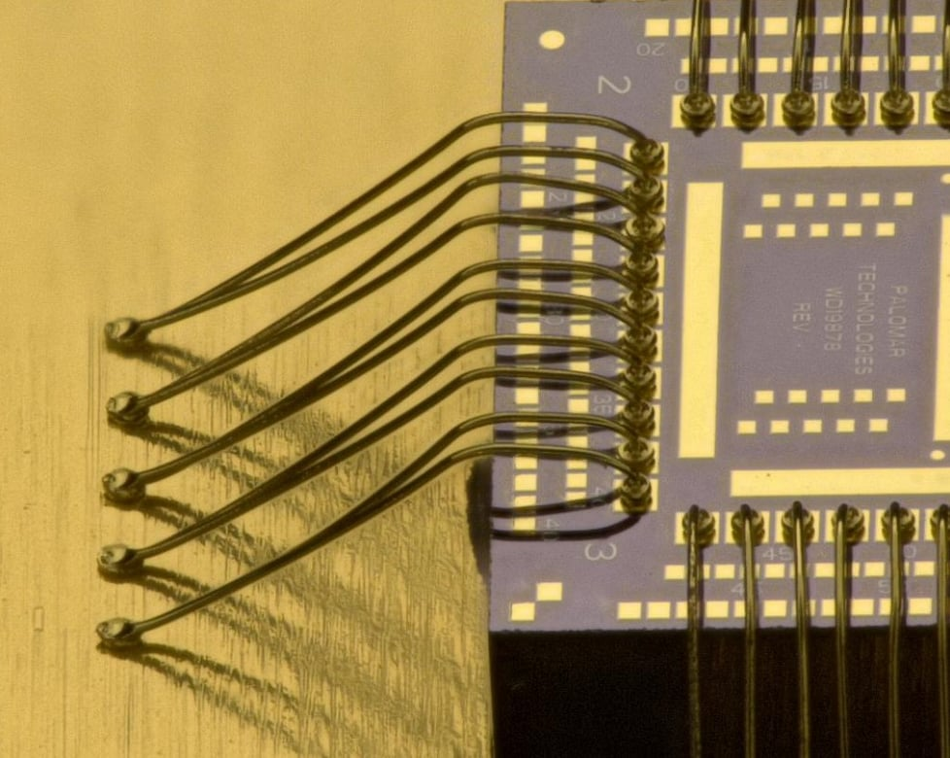
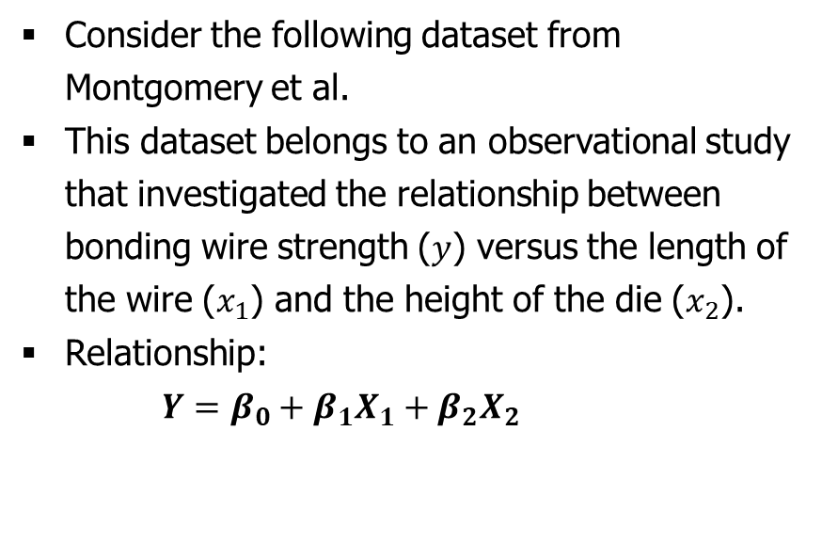
Gradient Descent
Example
Consider the following dataset from Montgomery et al.
This dataset belongs to an observational study that investigated the relationship between bonding wire strength ($y$) versus the length of the wire ($x_{1}$) and the height of the die ($x_{2}$).
Relationship:
$Y=β_{0}+β_{1}X_{1}+β_{2}X_{2}$

Slide 4
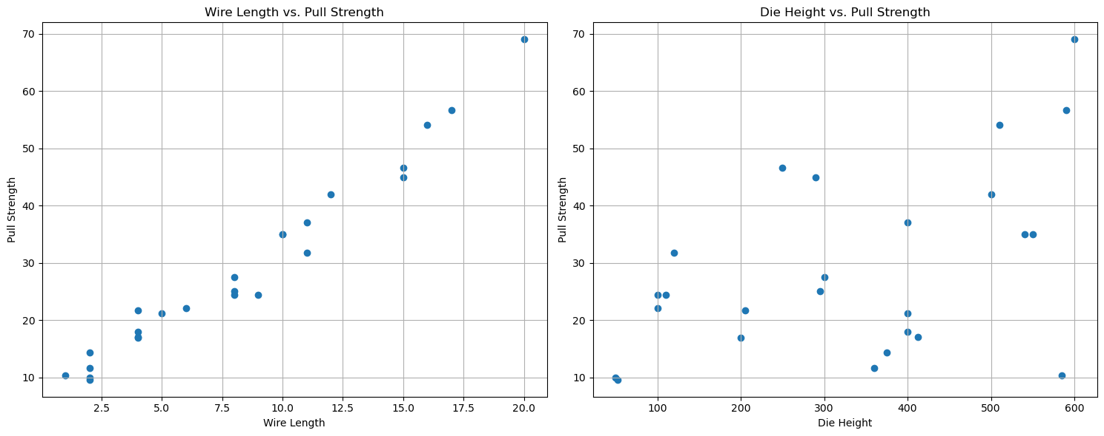
Example (cont.)
Consider the relationship separately.

Slide 5
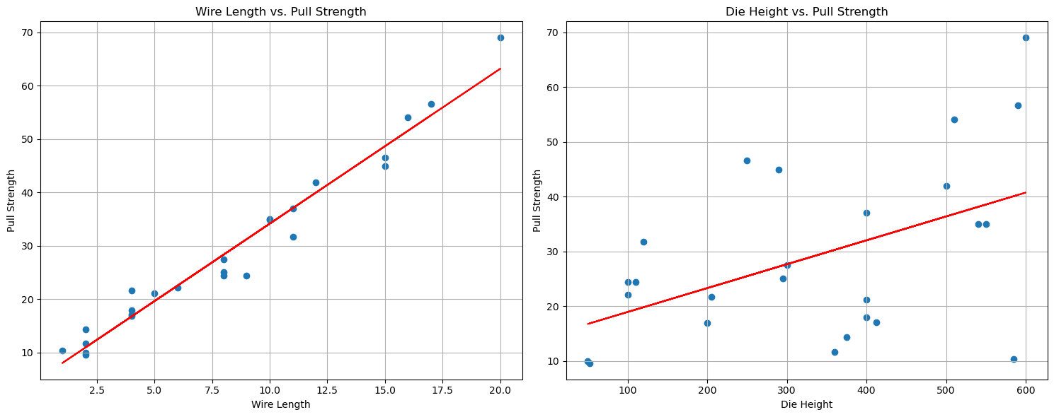
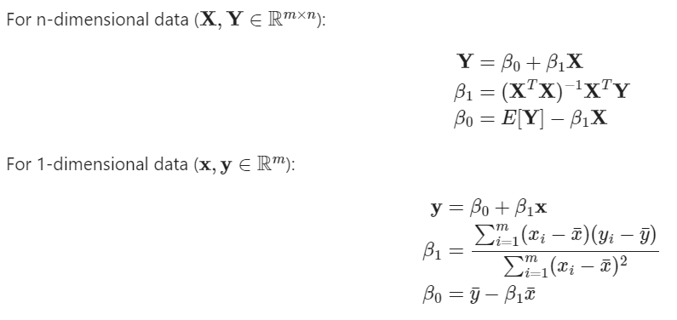

Example (cont.)
Consider the relationship separately.
$$pull strength=β_{0}+β_{1}\left(wire length\right)$$
$$pull strength=β_{0}+β_{1}\left(die heigth\right)$$
The parameters $β_{0}$ and $β_{1}$ can be found using the least square method:

Slide 6
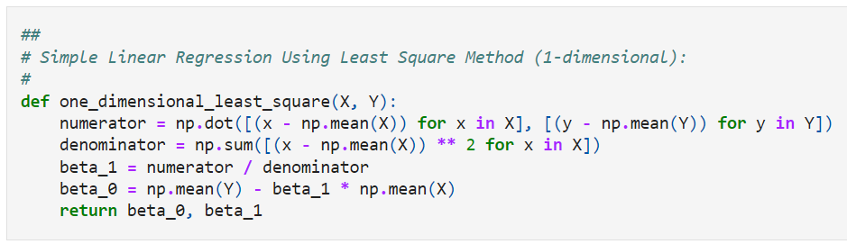
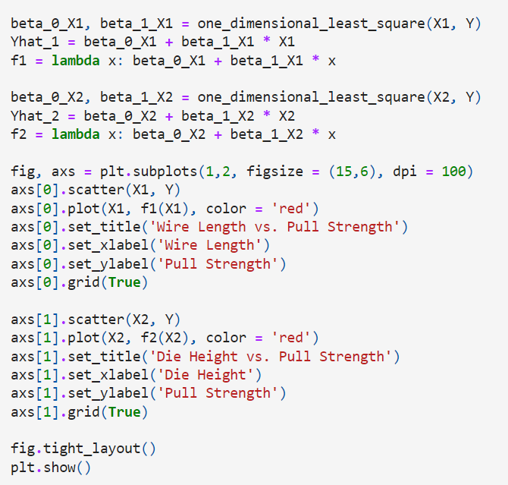
Example (cont.)
Code snippet:

Slide 7
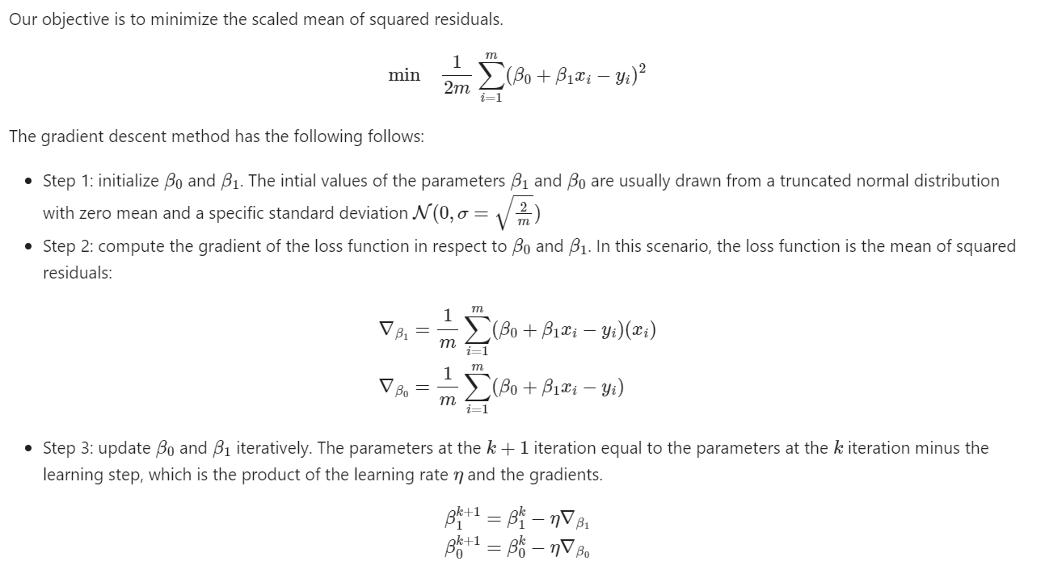
Example
With gradient descent, we can achieve the same result.

Slide 8
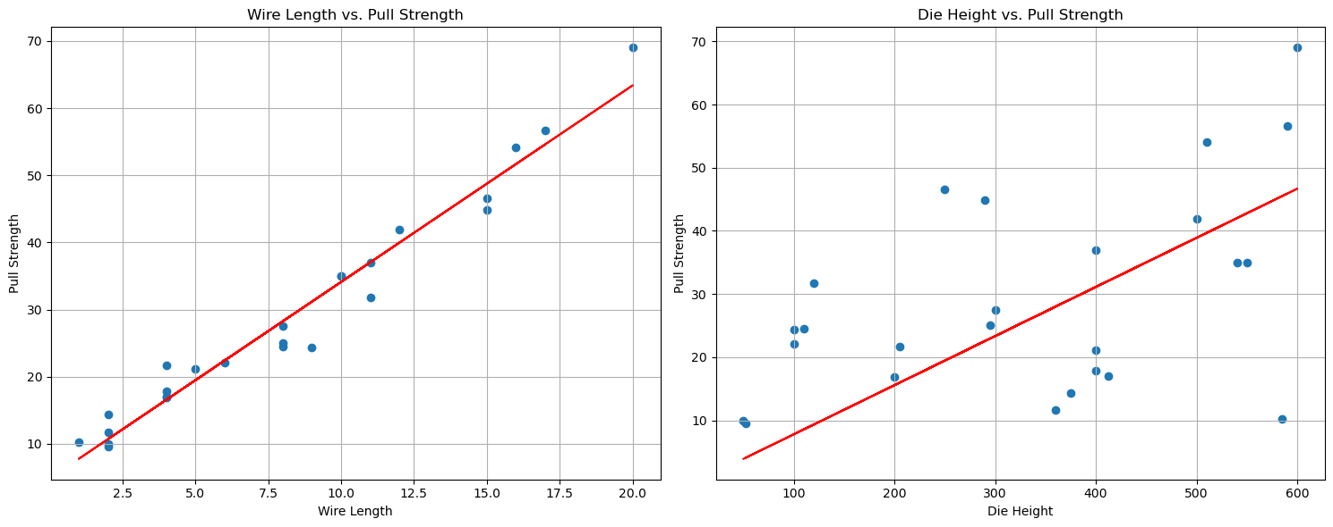
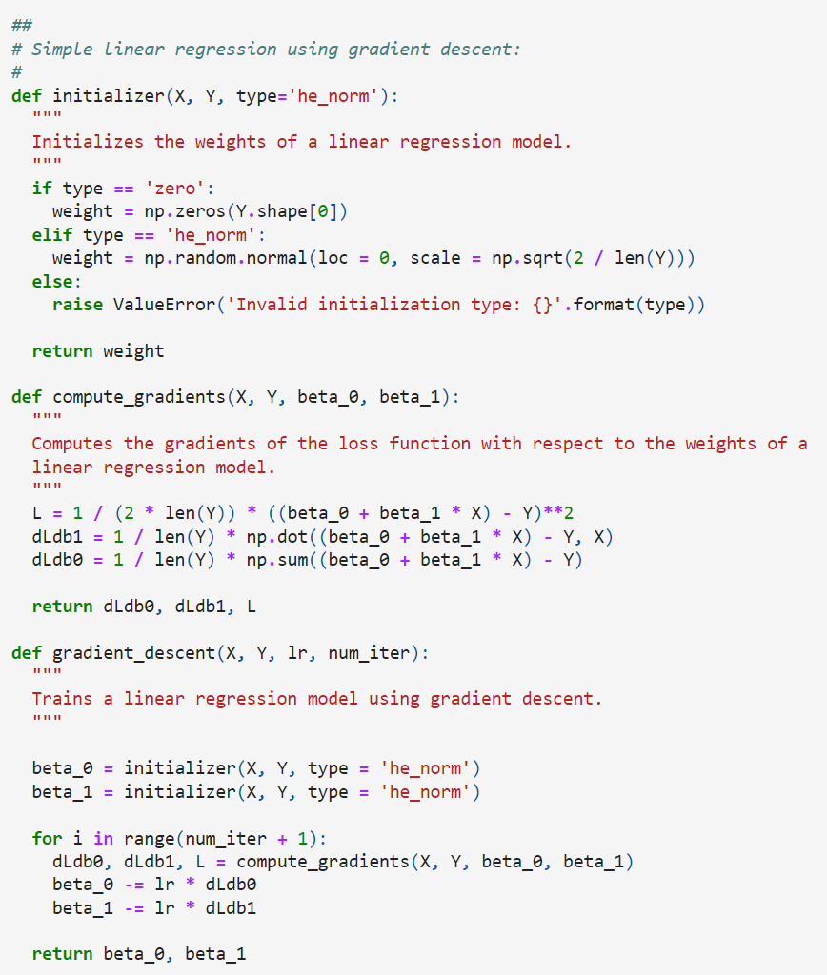
Example
Code snippet and results:

Slide 9
Example
Code snippet and results:

Slide 10
Discussion
Despite the promising performance of gradient descent for optimization, it is unlikely that it can be used for constrained optimization due to:
The initial weights that we initialized may be out of the feasible region.
Step-size selection.
Going back to the wire bonding example, the step size for the first factor (wire length) is different than that of die height.
When we selected these step sizes to be the same, our results were not optimal.
The objective function may not be differentiable.

Slide 11
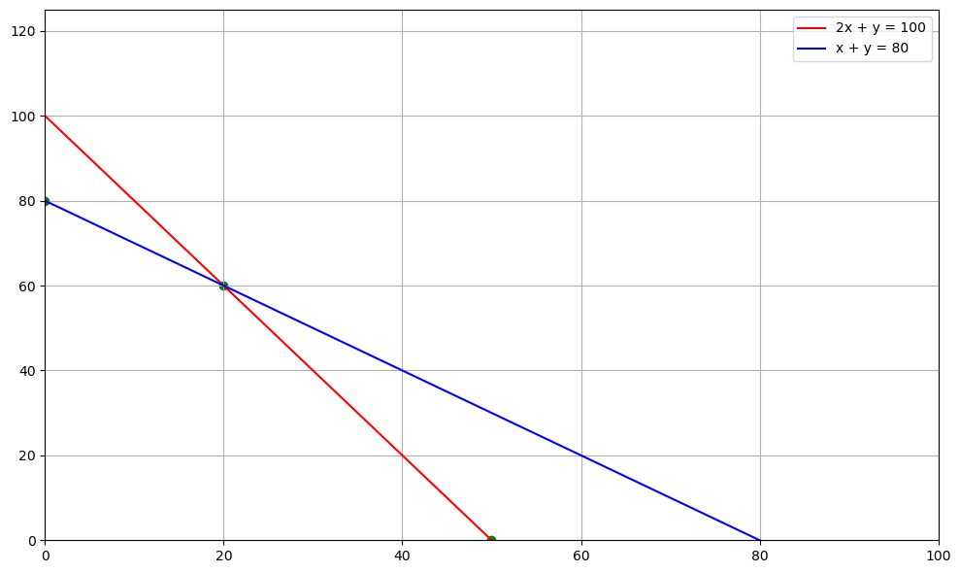

Discussion (cont.)
Consider the following linear programming problem:
$$\max{z=50x+18y}$$
s.t.
$$\left\{\begin{aligned}2x+y≤100 \\ x+y≤80 \\ x≥0 \\ y≥0\end{aligned}\right.$$
unfeasible region
feasible region

Slide 12
Convolution Neural Network

Slide 13
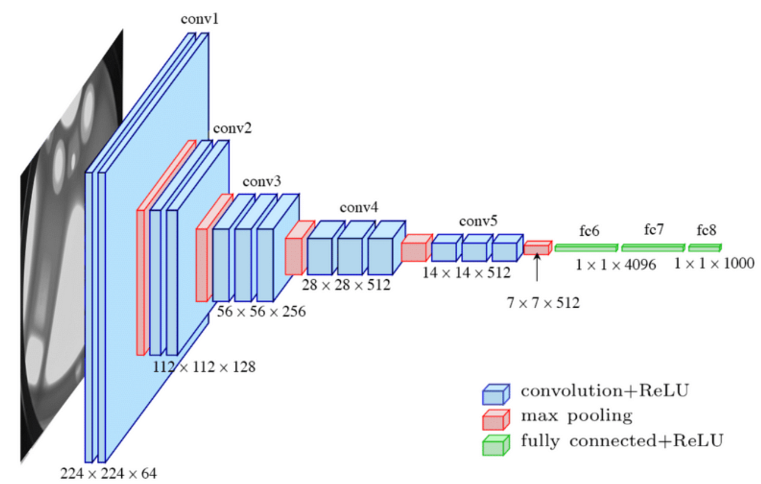
Architecture
Consider the architecture of VGG16, one of the basic CNN architectures, it has the following fundamental layers.
Convolution layer.
Pooling layer.
Fully connected layer.

Slide 14
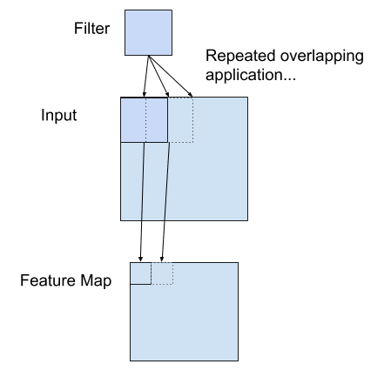
Convolution Layer
Operating principles of the convolution layer (assuming that there is padding):
First, the convolution operation between the input and the filter is executed. The result is a feature map.
Next, each element of the feature map is subjected to the activation function. The result is an activation map.

Slide 15
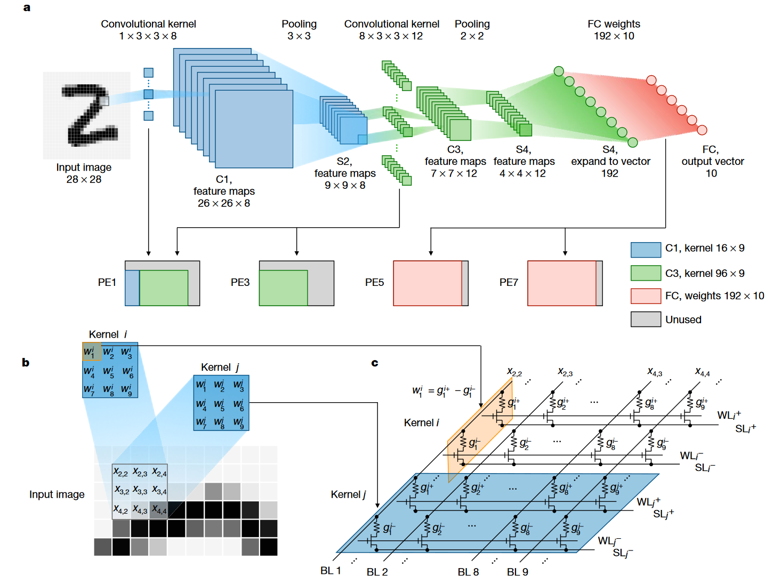
Convolution Layer (cont.)
How the convolutional layer is realized using memristor crossbar array:
A compact memristor crossbar as a set of sliding windows that slide over input feature maps in turn to obtain the output feature map.

Slide 16
Pooling Layer
Operating principles of the pooling layer (assuming that the pooling operation is averaging):
The convolution operation between the input and the filter is executed. The result is a feature map.
The main difference between the convolution layer and the pooling layer lies on their weights.

Slide 17
Pooling Layer (cont.)
How the pooling layer is realized using memristor crossbar array:

