Slide 1

Memristors
Convolutional Neural Networks

Slide 2

Convolution Neural Network

Slide 3
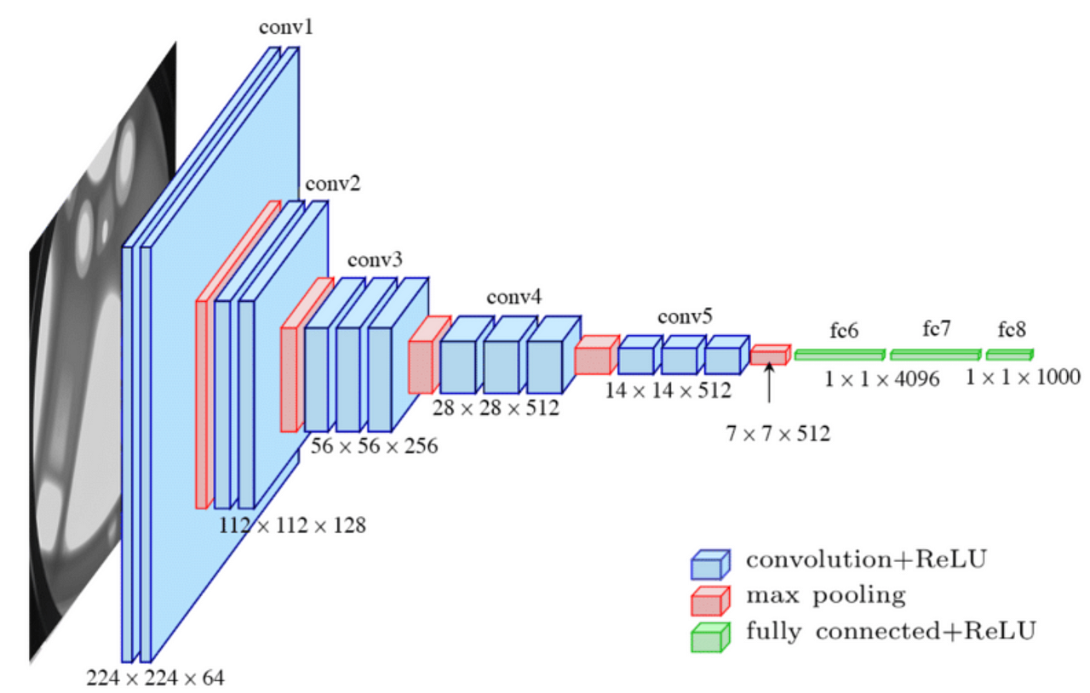
Architecture
Consider the architecture of VGG16, one of the basic CNN architectures, it has the following fundamental layers.
Convolution layer.
Pooling layer.
Fully connected layer.
Architecture of the VGG16

Slide 4
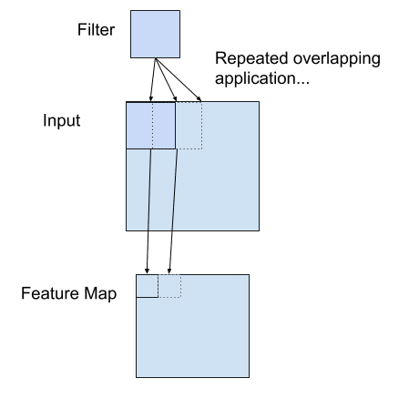
Convolution Layer
Operating principles of the convolution layer (assuming that there is padding):
First, the convolution operation between the input and the filter is executed. The result is a feature map.
Next, each element of the feature map is subjected to the activation function. The result is an activation map.
We apply padding so that the input dimension and the output are the same
How the output feature map is created from the input

Slide 5
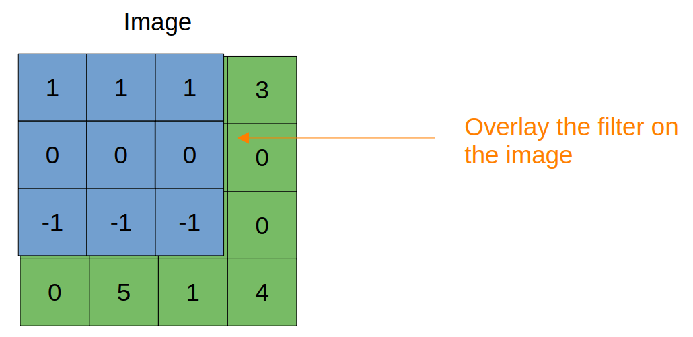
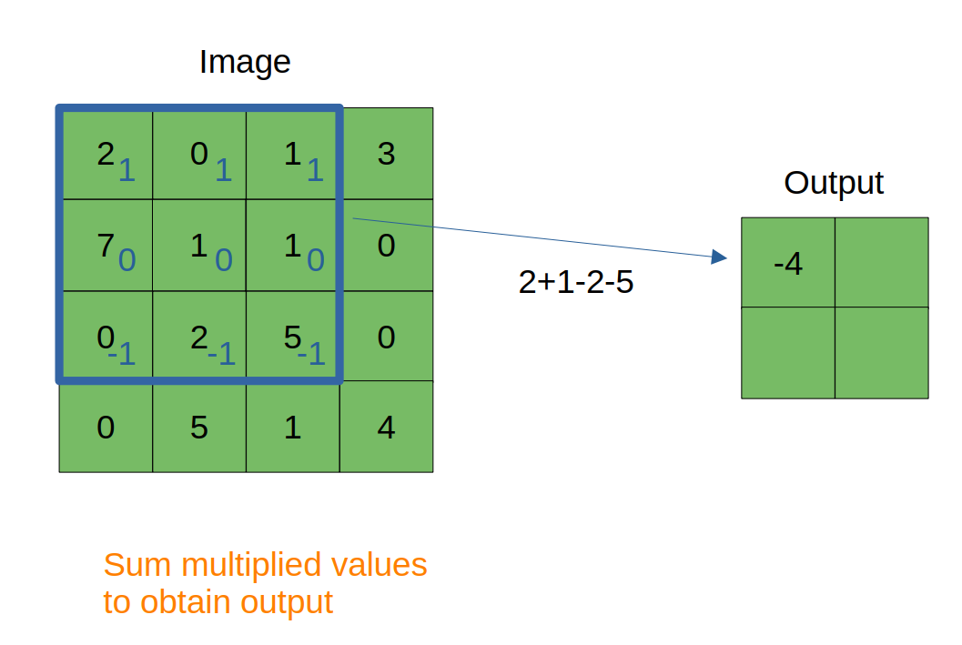
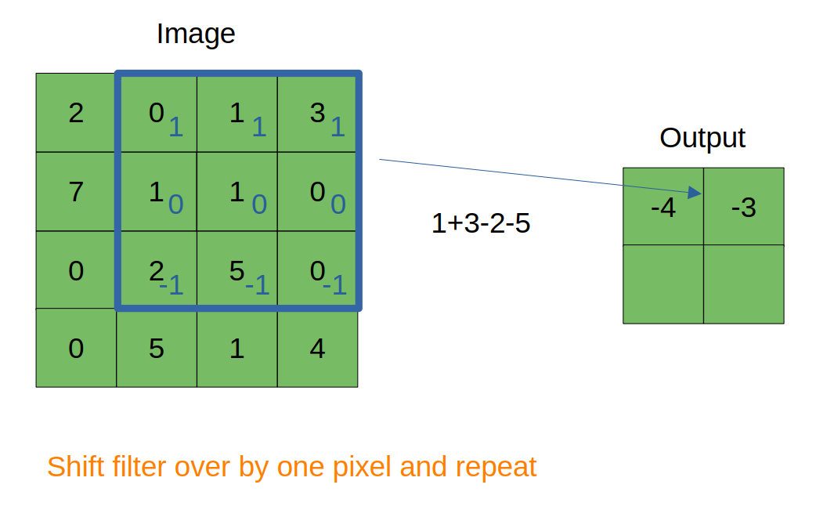
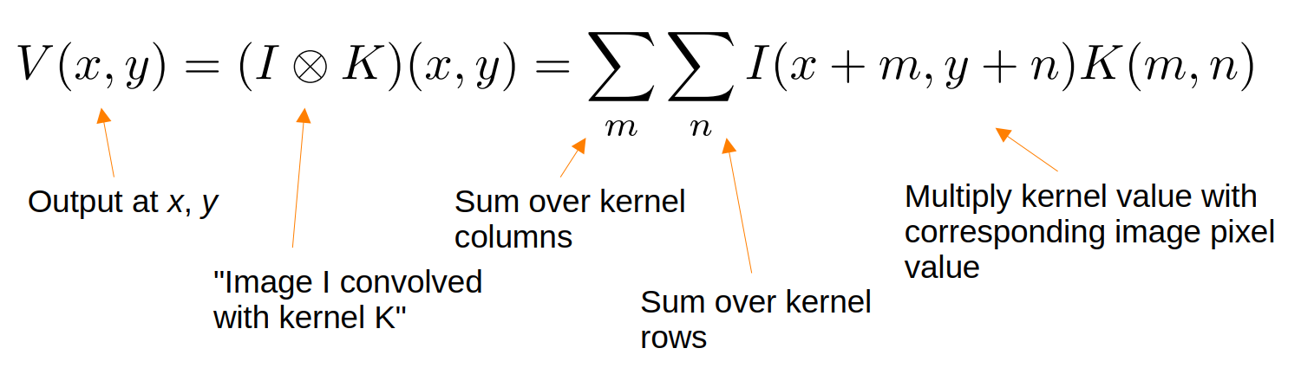
Convolution Layer (cont.)
(a)
(b)
(c)

Slide 6
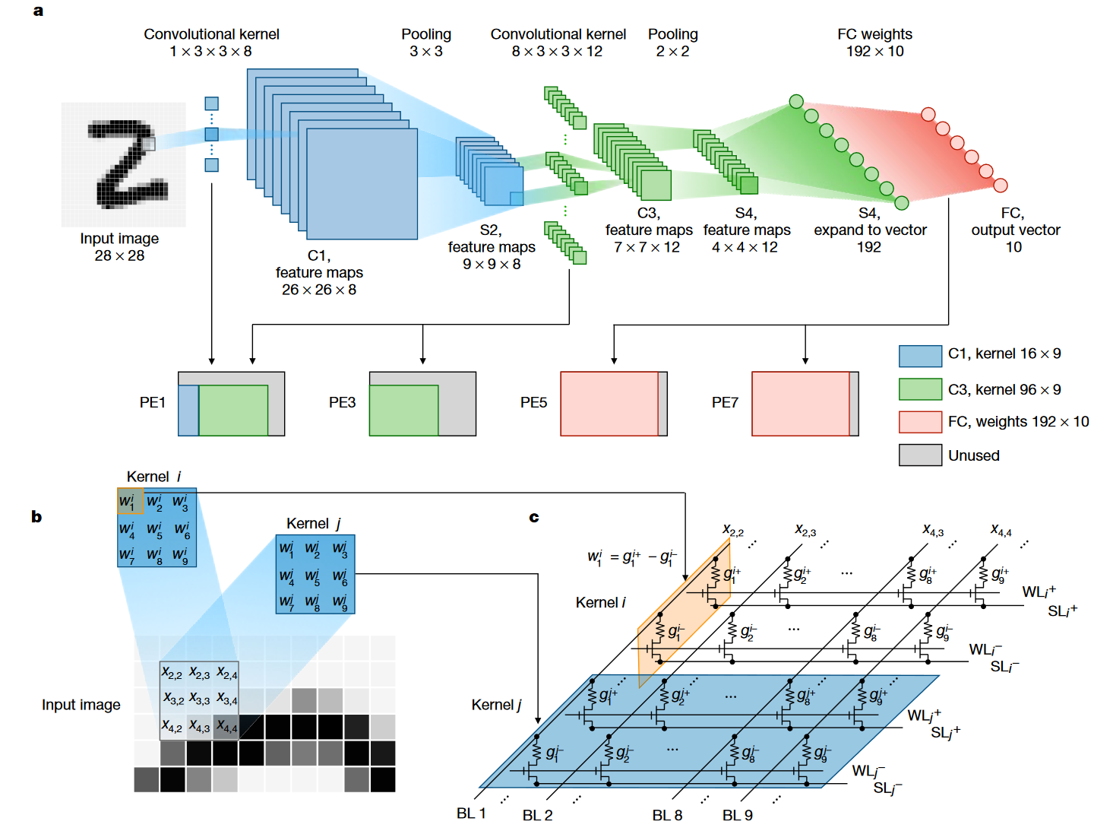
Convolution Layer (cont.)
How the convolutional layer is realized using memristor crossbar array:
A compact memristor crossbar as a set of sliding windows that slide over input feature maps in turn to obtain the output feature map.
Source: Yao et al. (Nature 2020)

Slide 7
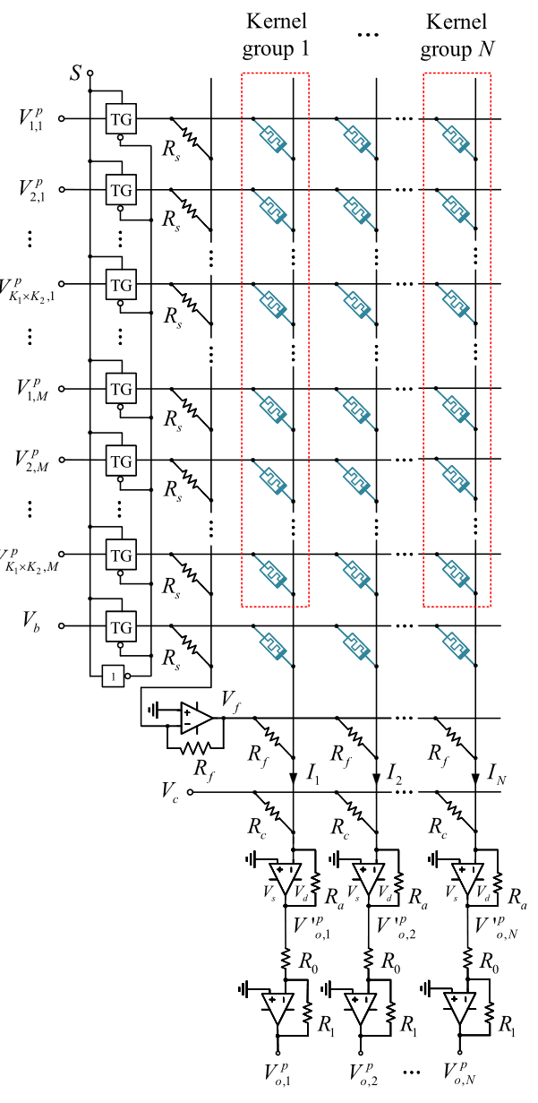

Convolution Layer (cont.)
How the convolutional layer is realized using memristor crossbar array:
Each column contains $M$ convolution kernels, and the number of columns $N$ is the same as the number of output channels.
Source: Liu & Zeng (Springer 2021)

Slide 8
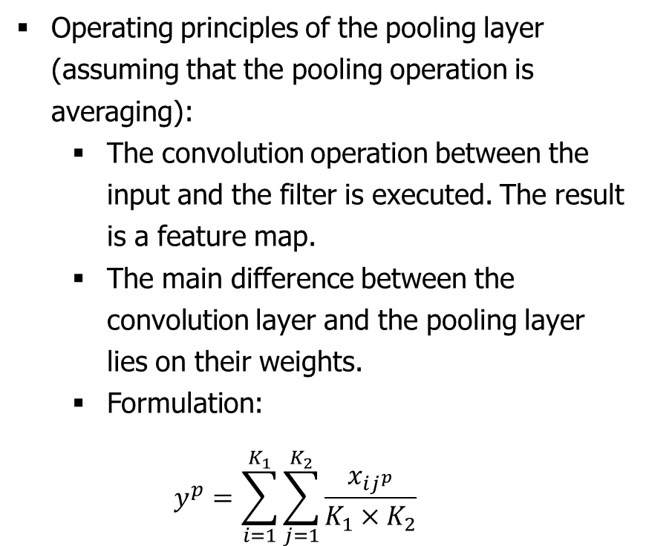
Pooling Layer
Operating principles of the pooling layer (assuming that the pooling operation is averaging):
The convolution operation between the input and the filter is executed. The result is a feature map.
The main difference between the convolution layer and the pooling layer lies on their weights.
Formulation:
$$y^{p}=\sum_{i=1}^{K_{1}}{\sum_{j=1}^{K_{2}}{\frac{x_{ij^{p}}}{K_{1}×K_{2}}}}$$

Slide 9
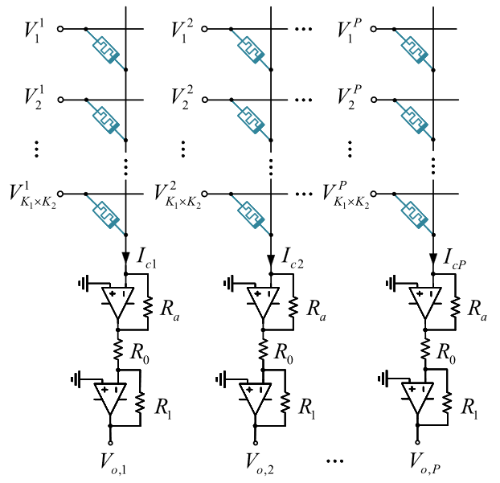
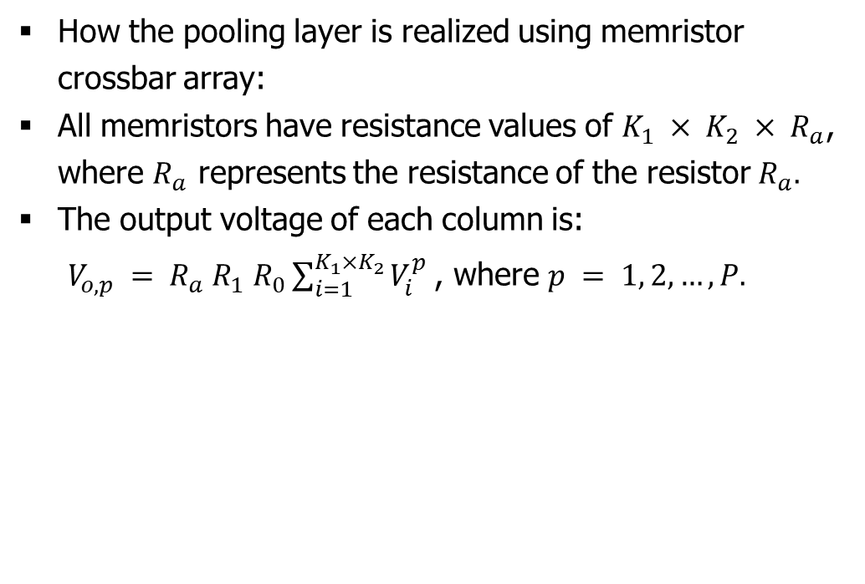
Pooling Layer (cont.)
How the pooling layer is realized using memristor crossbar array:
All memristors have resistance values of $K_{1} × K_{2} × R_{a}$, where $R_{a}$ represents the resistance of the resistor $R_{a}.$
The output voltage of each column is: $V_{o, p} = R_{a} R_{1} R_{0}\sum_{i=1}^{K_{1}×K_{2}}{V_{i}^{p}}$, where $p = 1, 2,…,P.$
Source: Liu & Zeng (Springer 2021)

Slide 10
Backpropagation Training

Slide 11
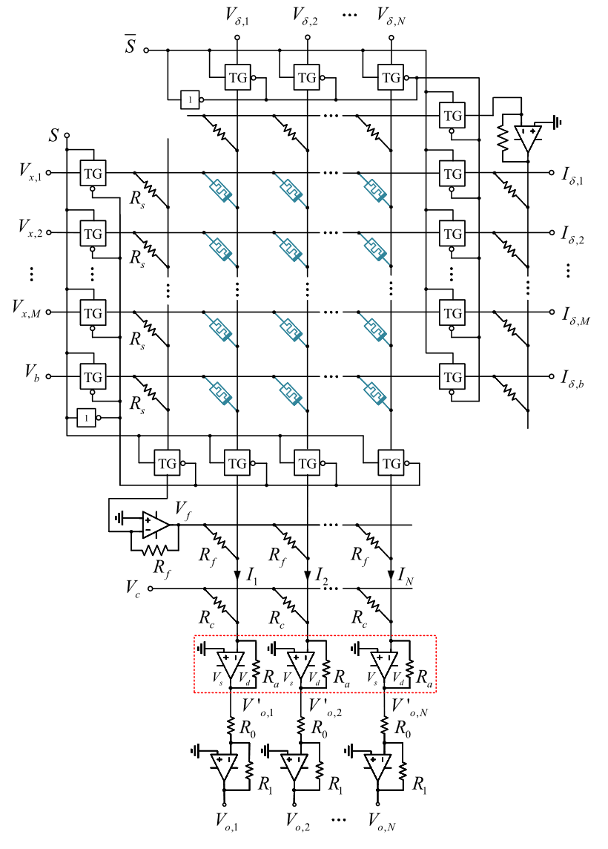
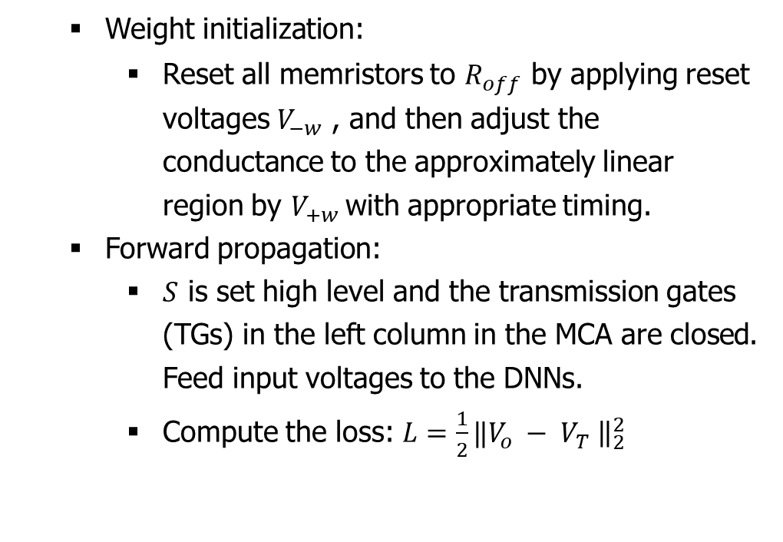
Backpropagation in MCA
Weight initialization:
Reset all memristors to $R_{off}$ by applying reset voltages $V_{−w}$ , and then adjust the conductance to the approximately linear region by $V_{+w}$with appropriate timing.
Forward propagation:
$S$ is set high level and the transmission gates (TGs) in the left column in the MCA are closed. Feed input voltages to the DNNs.
Compute the loss: $L=\frac{1}{2}‖V_{o} − V_{T} {\left.​\right\|}_{2}^{2}$
Source: Liu & Zeng (Springer 2021)

Slide 12
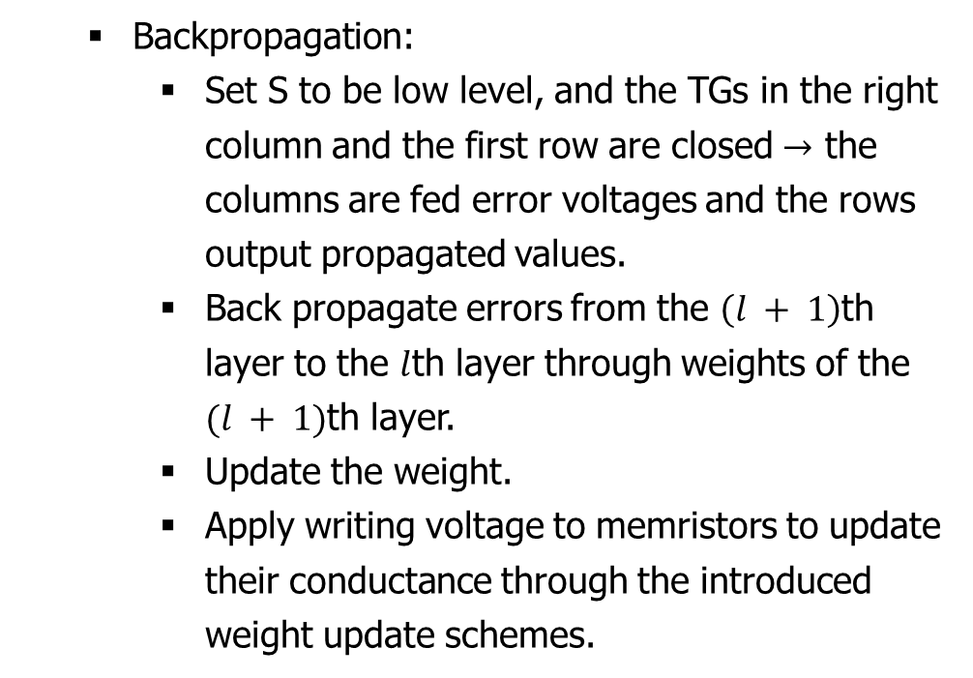
Backpropagation in MCA (cont.)
Backpropagation:
Set S to be low level, and the TGs in the right column and the first row are closed $→$ the columns are fed error voltages and the rows output propagated values.
Back propagate errors from the $\left(l + 1\right)$th layer to the $l$th layer through weights of the $(l + 1)$th layer.
Update the weight.
Apply writing voltage to memristors to update their conductance through the introduced weight update schemes.
Source: Liu & Zeng (Springer 2021)

Slide 13
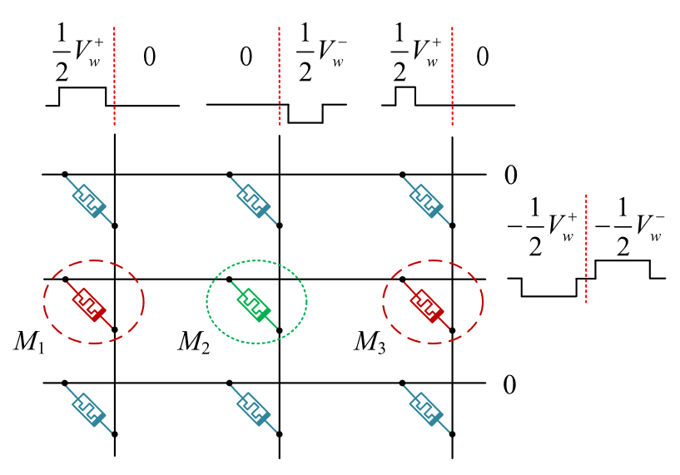
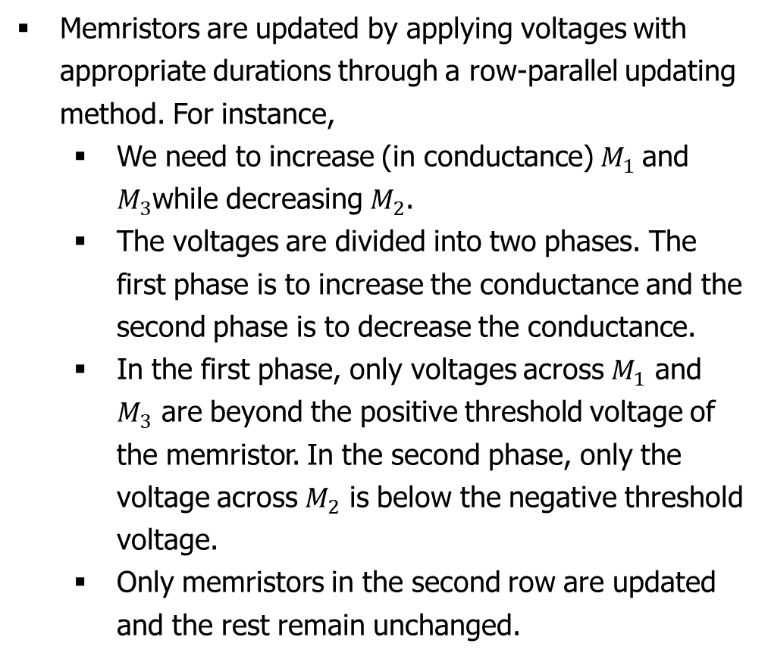
Weight update in MCA
Memristors are updated by applying voltages with appropriate durations through a row-parallel updating method. For instance,
We need to increase (in conductance)$M_{1}$ and $M_{3}$while decreasing $M_{2}$.
The voltages are divided into two phases. The first phase is to increase the conductance and the second phase is to decrease the conductance.
In the first phase, only voltages across $M_{1}$ and $M_{3}$ are beyond the positive threshold voltage of the memristor. In the second phase, only the voltage across $M_{2}$ is below the negative threshold voltage.
Only memristors in the second row are updated and the rest remain unchanged.
Source: Liu & Zeng (Springer 2021)

Slide 14
Appendix

Slide 15
Gradient Descent

Slide 16
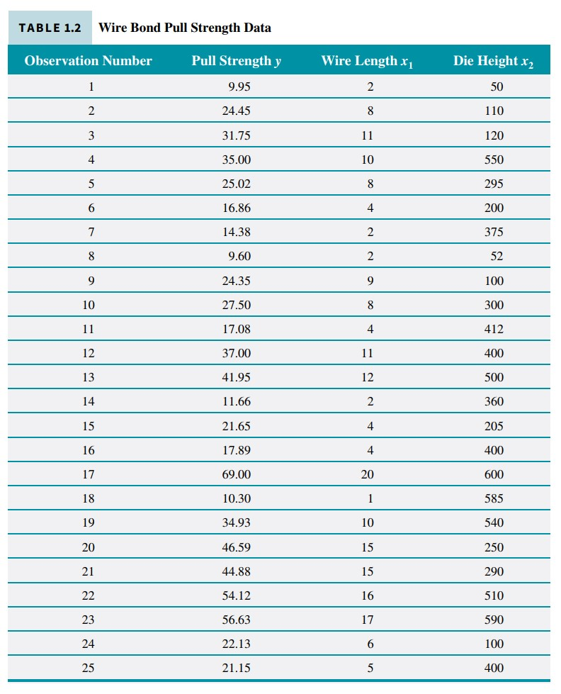
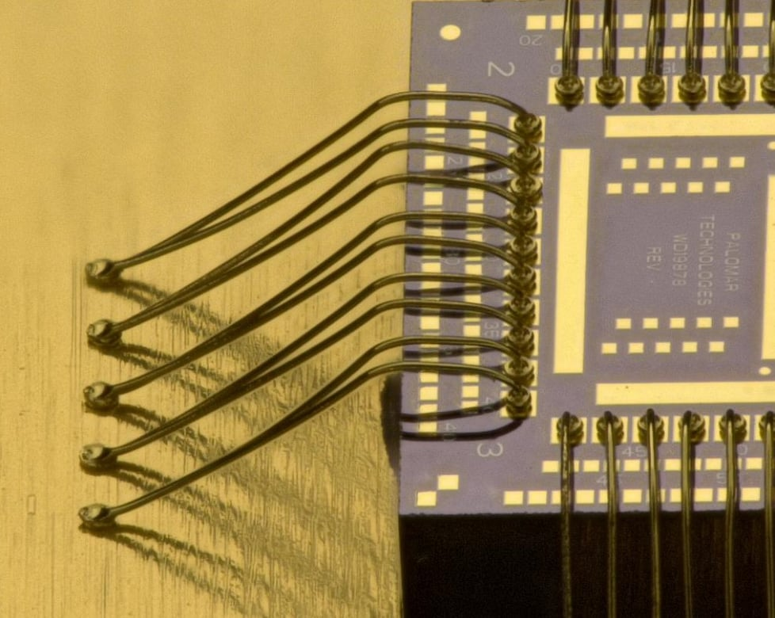
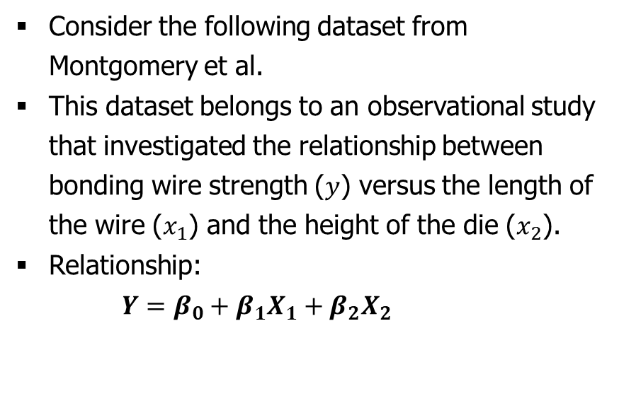
Gradient Descent
Example
Consider the following dataset from Montgomery et al.
This dataset belongs to an observational study that investigated the relationship between bonding wire strength ($y$) versus the length of the wire ($x_{1}$) and the height of the die ($x_{2}$).
Relationship:
$Y=β_{0}+β_{1}X_{1}+β_{2}X_{2}$
Source: Montgomery (Wiley 2019)

Slide 17
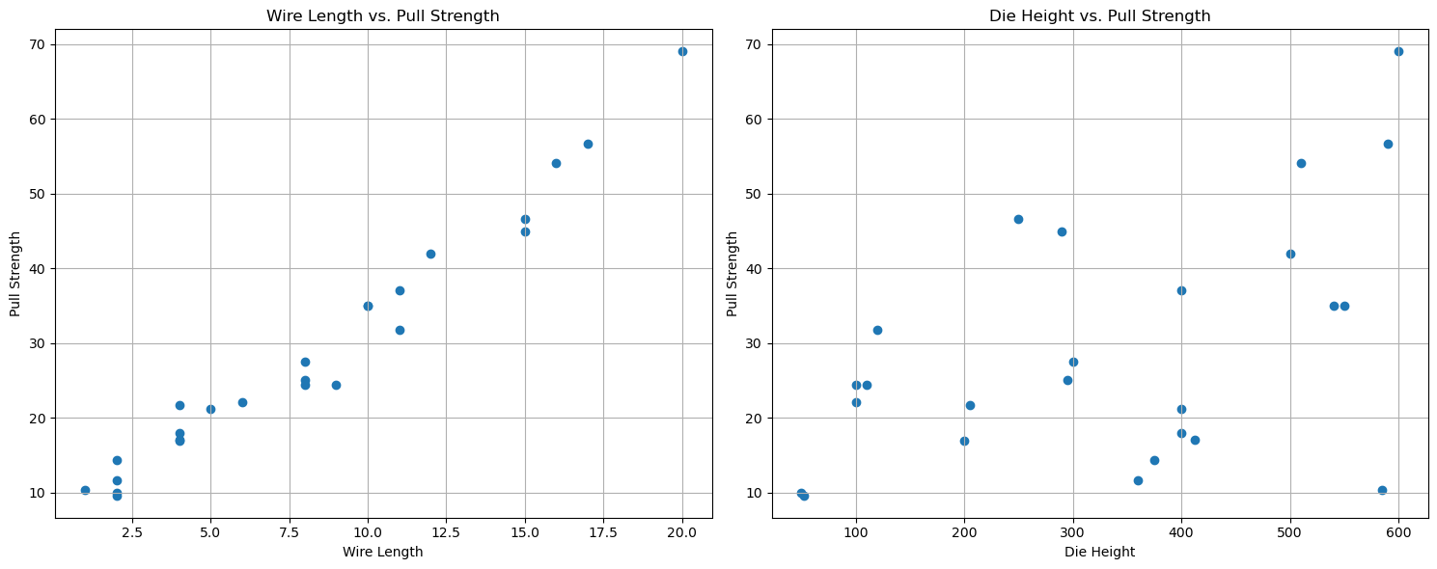
Example (cont.)
Consider the relationship separately.

Slide 18
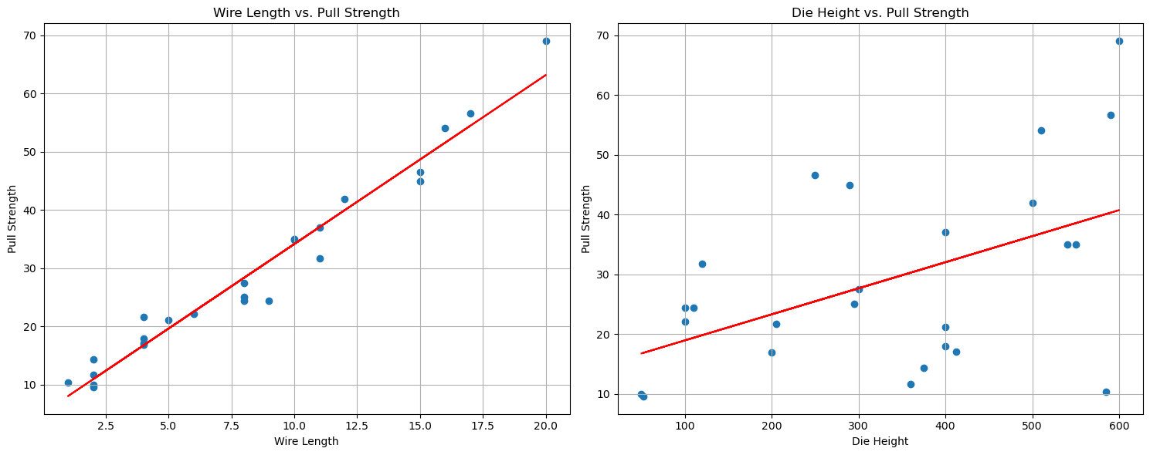
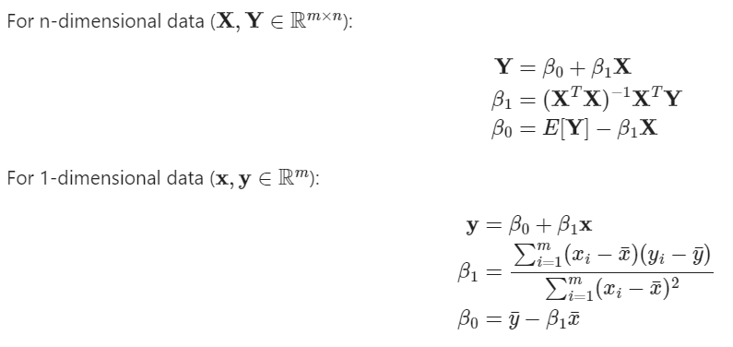

Example (cont.)
Consider the relationship separately.
$$pull strength=β_{0}+β_{1}\left(wire length\right)$$
$$pull strength=β_{0}+β_{1}\left(die heigth\right)$$
The parameters $β_{0}$ and $β_{1}$ can be found using the least square method:

Slide 19
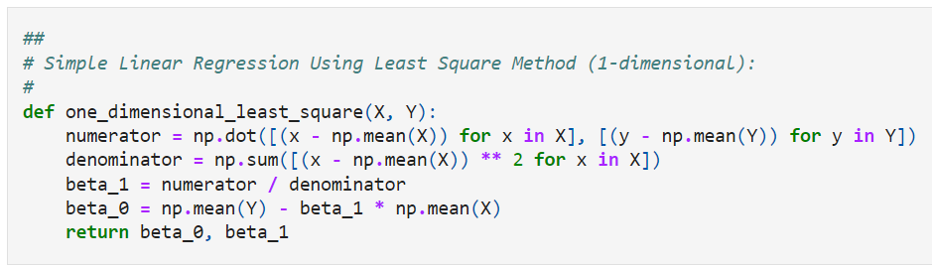
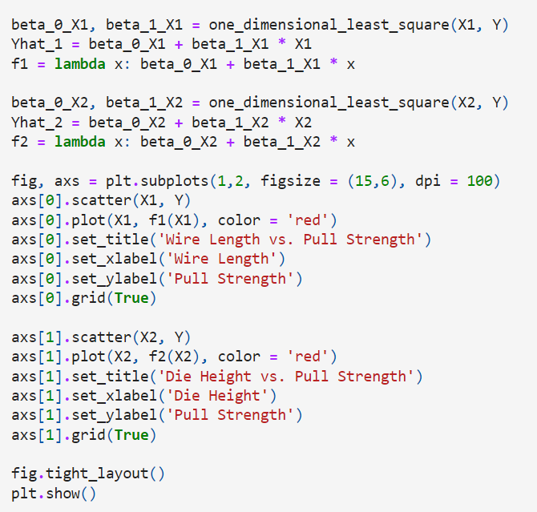
Example (cont.)
Code snippet:

Slide 20
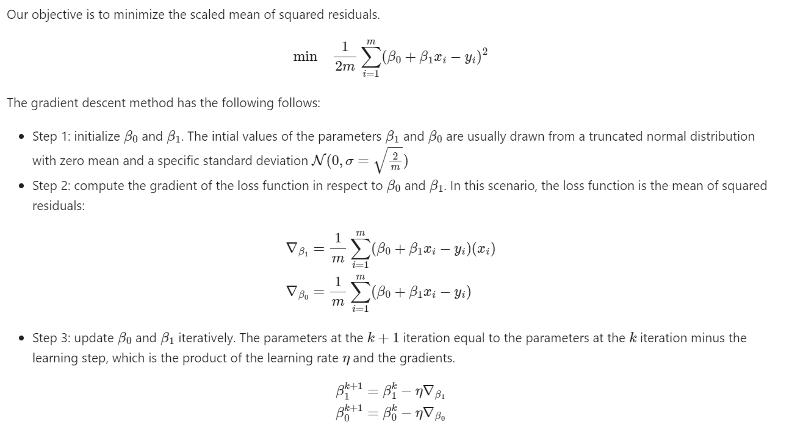
Example
With gradient descent, we can achieve the same result.

Slide 21
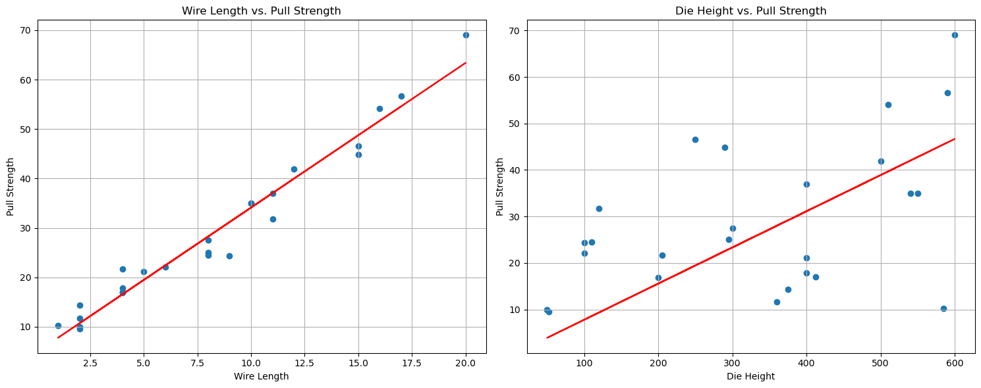
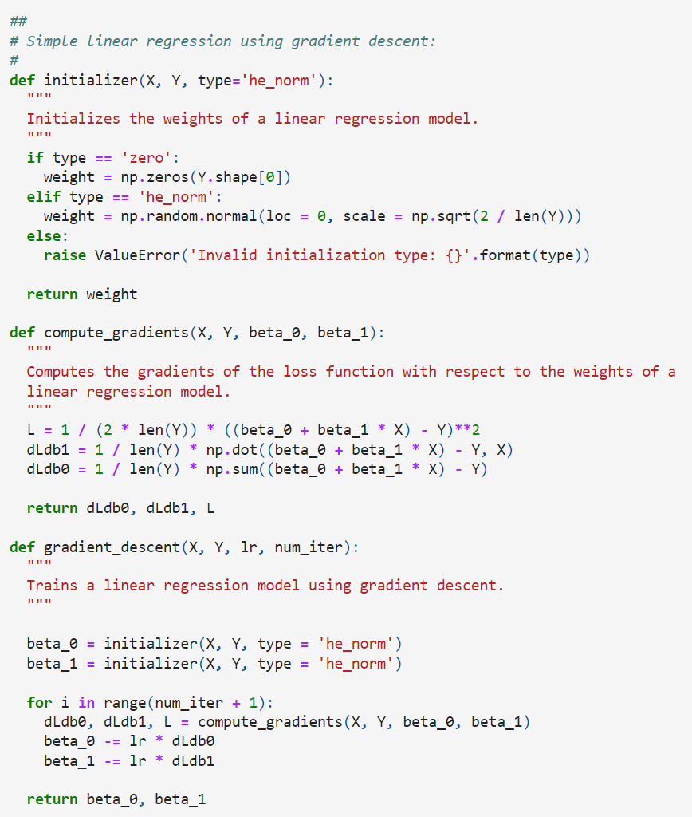
Example
Code snippet and results:

Slide 22
Example
Code snippet and results:

Slide 23
Discussion
Despite the promising performance of gradient descent for optimization, it is unlikely that it can be used for constrained optimization due to:
The initial weights that we initialized may be out of the feasible region.
Step-size selection.
Going back to the wire bonding example, the step size for the first factor (wire length) is different than that of die height.
When we selected these step sizes to be the same, our results were not optimal.
The objective function may not be differentiable.

Slide 24
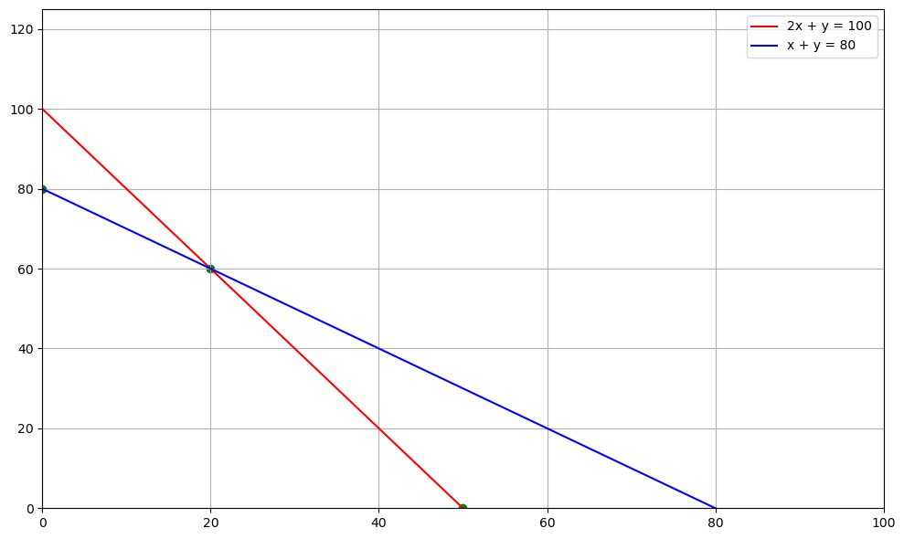

Discussion (cont.)
The line $y=−\frac{50}{18}x$ is translating across the feasible region
Consider the following linear programming problem:
$$\max{z=50x+18y}$$
s.t.
$$\left\{\begin{aligned}2x+y≤100 \\ x+y≤80 \\ x≥0 \\ y≥0\end{aligned}\right.$$
unfeasible region
feasible region

