Slide 1






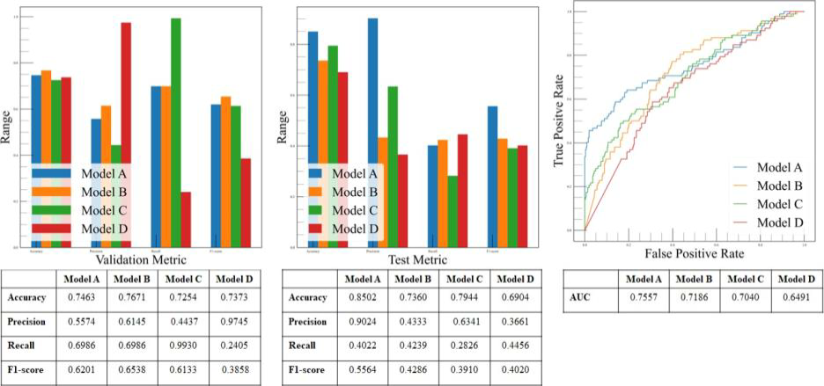
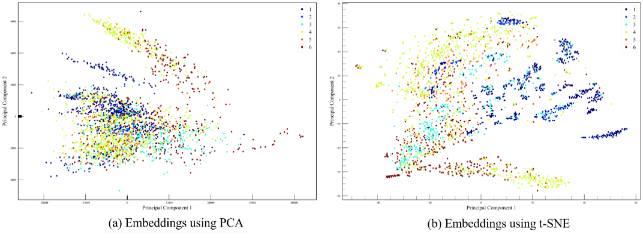
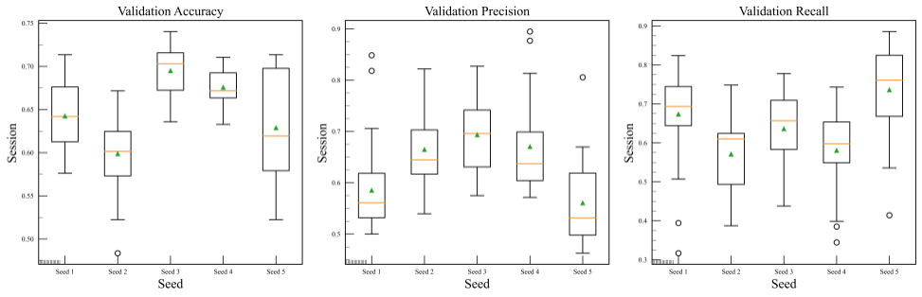
Deep Learning Models for Fault Detection and Diagnosis in Photovoltaic Modules Manufacture Khuong Nguyen-Vinh^{1,2}, Quang-Nguyen Vo-Huynh³, Khoa Nguyen-Minh⁴, Minh Hoang⁵
¹School of Science, Engineering and Technology, RMIT Vietnam, Ho Chi Minh City, Vietnam ⁴Department of Computer Science, Aalto University, Espoo, Finland ²Faculty of Electrical Engineering and Computer Science VSB - Technical University of Ostrava ⁵Paul G. Allen School of Computer Science and Engineering, University of Washington, Seattle, WA, USA ³School of Industrial Engineering and Management, Oklahoma State University, Stillwater, OK, USA
Introduction
Methods
The operation and maintenance (O&M) of solar farms is an essential duty that cannot be overlooked to maintain asset functionality and ensure that solar energy is produced.
The current method for assessing the quality of PV modules mostly includes of failure detection and diagnosis (FDD) during the production phase, which is a part of O&M services. This method, however, is difficult due to a variety of issues.
This study aims to propose a strategy to apply recent breakthrough in the applications of deep learning in object detection and recognition for the FDD of visual flaws on silicon PV modules intending to simplify and automate current reliability testing methods.
(A) Dataset
The public ELPV dataset is used in this study. It contains 2,624 samples of 300×300 pixels 8-bit grayscale images of functional (good) and defective (bad) solar cells with variable degrees of degradation.
The samples annotated with the defect probability of 33.33% and 66.67% are denoted as marginally defective (m.d.). Those annotated with 100% and 0% are denoted as defective (d.) and functional (f.), respectively. Thus, the dataset consists of six categories: mono-m.d., mono-d., mono-f., poly-m.d., poly-d., and poly-f.
When training deep learning models, the 33.33%, 66.67%, and 100% samples are grouped together to form one class (defective), while the other class (functional) is defined as 0% samples.
(B) Exploratory Data Analysis
Principal component analysis (PCA) and t-distributed stochastic neighbor embedding (t-SNE) are employed to visualize the distribution of the entire dataset.
(D) Model Training
The training scheme models consists of two phases. First, the proposed models are loaded with the pre-trained ImageNet weights and trained in a transfer-learning manner (only training the top layers). In the second phase, the weights of all layers are refined.
(C) Model Selection
To achieve the best possible results on the given dataset, multiple models are selected and trained to determined which has the best learning curve. A total of four supervised learning models are proposed: (1) VGG19, denoted as Model A, (2) ResNet152v2, denoted as Model B , (3) Inception-ResNetv2, denoted as Model C; (4) Nas- NetLarge, denoted as Model D.
Each model has the same number of fully connected (FC) layers, and the number of units for the first two FC layers is the same (4,096 units). The number of units for the third FC layer is selected to be equal to the number of kernels employed in the last convolutional layer in each respective model. Two dropout layers are included, and the dropout rate is 20% for these layers.
(E) Evaluation Metrics
Besides accuracy, other metrics are used to measure the performance of the models. These metrics are precision, recall, F1-score, underkill, overkill, AUC, and Matthew’s correlation coefficient (MCC, commonly known as ϕ coefficient).
(F) Random Trial Experiment
A random trial experiment is designed to evaluate the potential influence of random splitting on the dataset: firstly, the original dataset is shuffled, sampled, and partitioned into five seeds of 85:15 train and test subsets; a model selected from the four proposed models is then trained (the first phase only) with different random seeds; for each seed, the model is trained 30 consecutive times; using the recorded observations, a hypothesis test is conducted to quantify the impact of randomness on model training.
References
Buerhop-Lutz, C., Deitsch, S., Maier, A., Gallwitz, F., Berger, S., Doll, B., Hauch, J., Camus, C., Brabec, C.J.: A benchmark for visual identification of defective solar cells in electroluminescence imagery. In: European PV Solar Energy Conference and Exhibition (EU PVSEC) (2018).
Thomas G. Dietterich; Approximate Statistical Tests for Comparing Supervised Classification Learning Algorithms. Neural Comput 1998; 10 (7): 1895–1923.
Results and Discussion
Distribution of recorded validation metrics (accuracy, precision, and recall) in the random trial experiment.
(A) Exploratory Data Analysis
The PCA results show that it fails to assemble the combined features, or principal components, from the dataset into sensible clusters. Thus, these features are not linear combinations.
t-SNE manages to cluster the features into distinct groups: features associated with the mono-f. and mono-m.d. groups are usually clustered together; features associated with the poly-f. and poly-m.-d. groups also come together. Additionally, the t-SNE result draws better discrimination between most samples from the functional and defective groups. However, there is no clear distinction between a significant quantity of features originating from the mono-d. and poly-f. groups.
(B) Model Performance
Clearly Model A by far has the best performance since it has the highest test accuracy (85.02%), an outstanding test precision (90.24%), and the highest test F1-score (55.64%) among the proposed classification models. The AUC of Model A (75.57%) on Model A by far is the most capable model since it procures the highest MCC score (56.48%), the lowest underkill rate (1.52%), and the second lowest overkill rate (12.69%). Concerning the MCC score, the second-best model is Model B (26.39%) followed by Model D (23.07%) and Model C (22.38%). Despite having the best overkill rate (5.84%), Model C has the worst underkill rate (37.31%).
(C) Random Trial Experiment
Model A is selected to be the target of this experiment.
There are disparities in model performance when it is trained with different seeds of training data. The results of the Brown-Forsythe test demonstrate that except for validation accuracy, other recorded metrics are likely to have the same variance since the null hypothesis fails to be rejected. Hence, random splits of training data into train and validation subsets have a significant impact on the model’s performance.
Results of the ANOVA tests clearly show that the null hypothesis, i.e., there is no difference between five seeds, is rejected. Therefore, disparities in model performance due to different seeds splits are statistically significant.
(D) Further Research
Model A has the best performance among the proposed classification models given the above-defined hyperparameters (learning rates, optimizers, number of epochs, etc.) and training scheme. This raises a question on how optimal hyperparameters can be searched for to yield the best model out of the proposed Model A.
Assuming that different versions of Model A with different sets of hyperparameters are initialized, there is also a consideration of how these models can be gauged and compared to select the best one. In further research, hyperparameter optimization based on random search as well as the hypothesis test will be investigated to see how they are applicable to this study.
Distribution of dataset embeddings: (a) Embedding using PCA; (b) Embedding using t-SNE. The sample classes are designated as follows: 1 stand for mono-f.; 2 mono-m.d.; 3 mono-d.; 4 poly-f.; 5 poly- m.d.; 6 poly-d.
Performance assessment of proposed classification models on the validation subset and the test set.
Distribution of recorded validation metrics (accuracy, precision, and recall) in the random trial experiment.

