Slide 1
Wise Shopping
CSCI 5308: Adv. Topics in Software Development
Group 8
Nilesh Gupta (B00876771)
Adarsh Kannan Iyengar (B00900913)
Harsh Hariramani (B00899363)
Pavithra Gunasekaran (B00905274)
Elizabeth James (B00867159)
Professor: Dr. Tushar Sharma
TA: Harit Patwa
Client Team: Group 9

Slide 2
Table of Contents
Overview
Task Distribution
Tech stack
Project Timeline
Challenges
Goals
Second chance
Learnings

Slide 3
Overview
Wise Shopping Application will allow user to search the best products at affordable prices from multiple stores.
Insights on the best purchase time for the range of products.
Demand trend of a product.
Sharing the shopping carts with other users.
Subscriptions for price drop
Price comparison
Buy in-cart products from the cheapest selling store

Slide 4
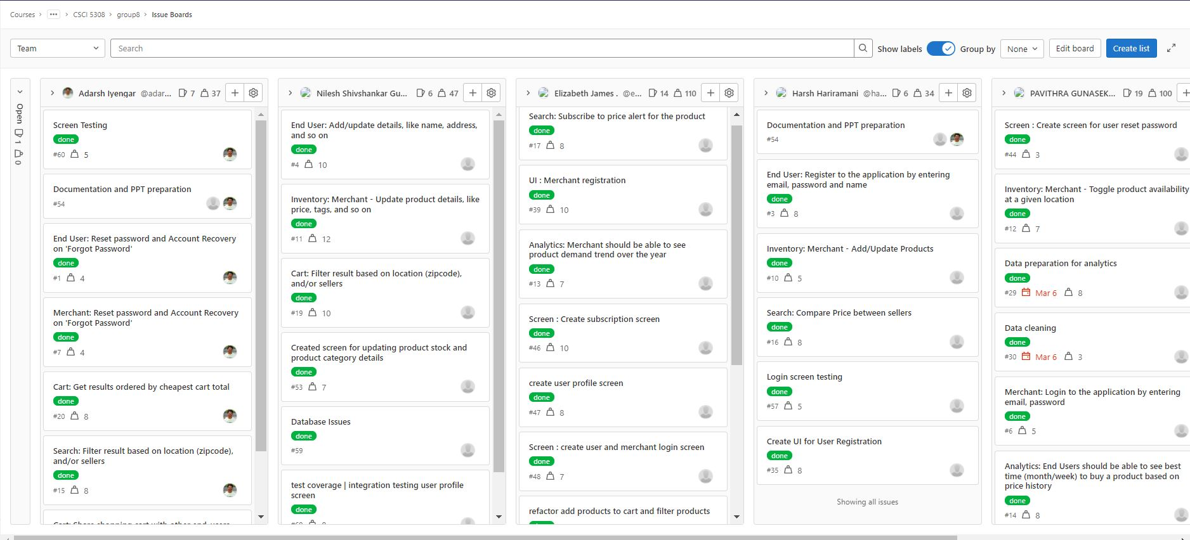
Task Distribution

Slide 5
Tech Stack
Technologies used
Java
MySQL
SpringBoot Framework

Slide 6
Project Timeline

Slide 7
Project proposal
Mid-term: Completed the essential features
End-term: Testing and deployment
01 February
16 Feb
02 March
16 March
04 April
Task distribution among team members
Started refactoring simultaneously

Slide 8
Challenges Faced
Challenge 1
Challenge 2
Challenge 3
Need for a UI
Solution
- POC
- not feasible
How can we enhance UX in console application
Solution
- Additional navigation
- Improved freedom of control
Data for analytics
Solution
- Search for data
- Clean and pre-process data

Slide 9
User Goals (All client requirements were met)
S.No | Goals | Status
1 | Authentication & Password Recovery | Done
2 | View products | Done
3 | Add products to cart | Done
4 | Filter products by criteria | Done
5 | Search products by tags | Done
7 | Get the cheapest cart | Done
8 | Share cart with other users | Done
9 | Subscription alerts | Done
10 | Price comparison of the products between sellers | Done
11 | Best time to buy a product (Price trend analytics) | Done

Slide 10
Merchant Goals (All client requirements were met)
S.No | Goals | Status
1 | Authentication and Password Recovery | Done
2 | Maintain Product Inventory list | Done
3 | Maintain stores | Done
4 | Product trend (demand trend analytics) | Done

Slide 11
UX Goals
S.No | Goals | Status
1 | Ease of navigation between menus | Done
2 | Map of menu | Done
3 | Accepts case insensitive inputs | Done
4 | Product demand trend | Done

Slide 12
If given a second chance...
Currently, console based – move to UI
Further increase efficiency of analytical algorithms
Scope for more analytics
Scope for recommendation system

Slide 13
Learnings and Experiences
Learnt SpringBoot and JPA
Tried UI – Had to give up
Looked up ways to enhance UX in console application
Implemented factory design pattern for implementing the different screens shown to the user

Slide 14
Thank You.

Slide 15
Any Questions?

