Slide 1
Predicting the Founding of Social Organizations
Among Tecnológico de Monterrey Alumni: A Machine Learning Approach
Gerardo Leiva Díaz · Isaac Sánchez Veloquio David Lozano Arreola · Jorge Betanzo Carriles
Tecnológico de Monterrey · June 2026

Slide 2
Introduction to the Problem
Mexico has over 40,000 registered non-profit organizations.
Yet we don't know who founds them — or whether a university education in social responsibility actually produces social entrepreneurs.
The question
Can we identify, from the characteristics of a Tec alumnus, whether they are likely to have founded a social organization?
QS 80th-anniversary survey · 25,356 alumni · Graduating classes 1952–2022

Slide 3
Our Hypothesis
H1
H2
H3
Civic behavior — volunteering and donations — is the strongest predictor of founding a social organization.
Accumulated experience — age, leadership, prior entrepreneurship — positively predicts founding.
Tec competency scores assessed at graduation leave a measurable imprint years later.
Three independent hypotheses — all testable with the available data.

Slide 4
What We Set Out to Do
Predict
Explain
Profile
Recommend
Train AI models to identify which alumni are most likely to have founded a social organization.
Understand which alumni characteristics drive that likelihood — and in which direction.
Describe what the high- probability founder looks like, so Tec can identify them early on.
Translate findings into concrete actions for institutional social impact programs.

Slide 5
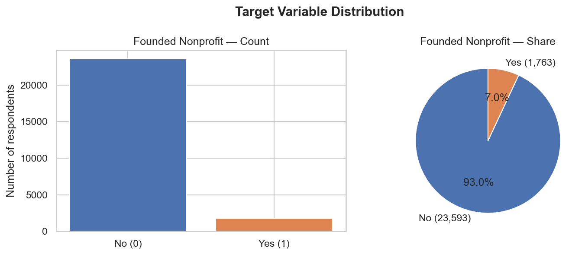
Method: Prediction with Artificial Intelligence
How does it work?
The data
The model learns patterns
from 25,356 alumni for whom we already know who founded and who didn't.
It analyzes 64 characteristics
per alumnus: age, career, leadership, volunteering, wellbeing…
It produces a score
indicating how likely it is that a given alumnus founded a social organization.
Only 7 in every 100 alumni founded a social organization.
It is validated on new data
to confirm the learned pattern is not just memorization.
The model is designed to surface that minority without overlooking them.

Slide 6
Models: Six Approaches, One Winner
Logistic Regression
Linear baseline — the simplest approach
Decision Tree
Interpretable non-linear baseline
Random Forest
Ensemble of trees — robust to noise
Gradient Boosting
Sequential learning — best for tabular data
WINNER
Naïve Bayes
Density-estimation baseline
QDA
Class-specific covariance baseline
All models were compared on the same data. Gradient Boosting best separated founders from non-founders — and held up equally well on data it had never seen.

Slide 7
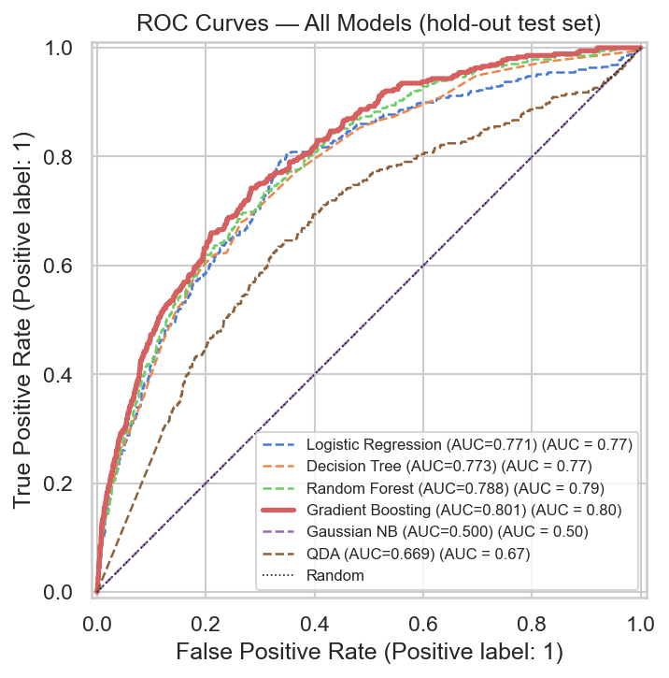
Results: How Well Does It Work?
Gradient Boosting is clearly ahead.
Each curve is a model. Higher and further left = better.
By adjusting the model's sensitivity, we go from identifying 54 → 550 founders per 1,000 alumni screened.
10× more impact · same model · same data

Slide 8
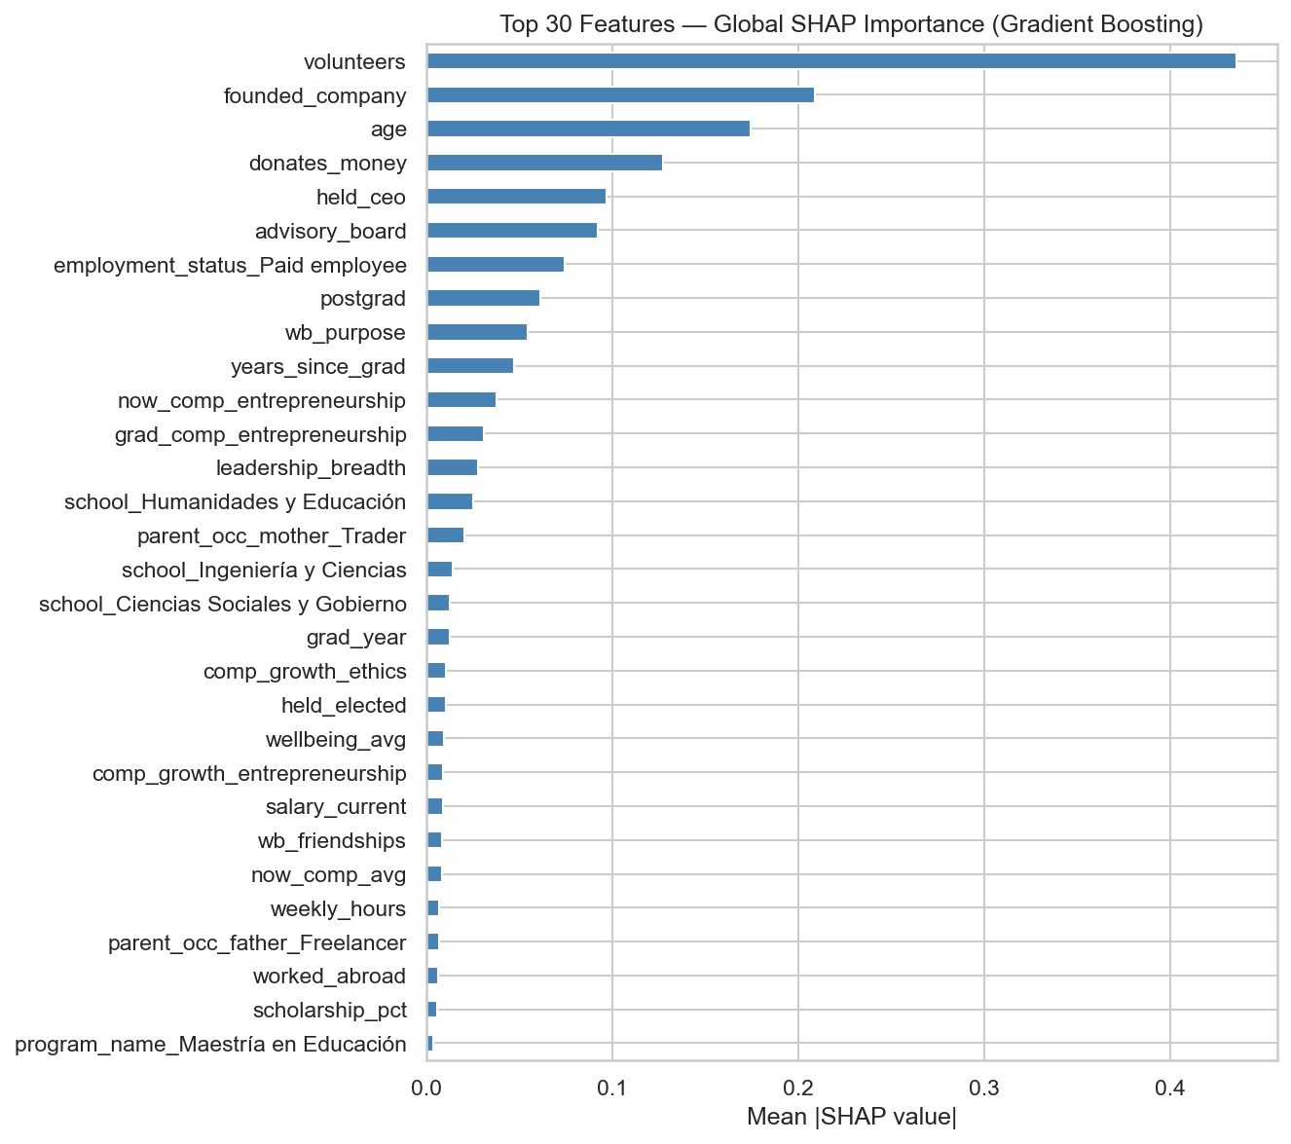
Results: Who Is the Founder?
The founder's profile
Active volunteer
The strongest signal — by far
Has founded another company
Prior entrepreneurship as a foundation
Older and more experienced
Maturity matters more than field
Donates to social causes
Civic intent expressed through action
Has held CEO or board roles
Formal leadership as a precursor
High entrepreneurship score since university
Tec leaves a measurable imprint
Civic behavior dominates. Demographics alone don't predict — what someone does matters more than who they are.

Slide 9
Conclusions & Implications
What we found
What Tec can do
▸ Volunteering is the most powerful predictor
Identify early
Volunteering · Entrepreneurship competency · Sense of purpose Already measured. No new data needed.
▸ Experience and leadership matter — not just age
▸ Tec shapes measurable social entrepreneurs decades later
Prioritize resources
Direct fellowship and incubation programs toward profiles with the highest social impact potential.
▸ Adjusted sensitivity: 10× more founders identified
▸ The founder profile is clear and actionable
Iterate with data
Re-train the model with new graduating cohorts. Pilot on one campus before scaling.
Audit for fairness
The model shows a mild socioeconomic skew — review before any institutional deployment.
Three signals already available: ① Volunteering · ② Entrepreneurship competency · ③ Sense of purpose

Slide 10
Thank you.
Questions & Discussion
Gerardo Leiva Díaz · Isaac Sánchez Veloquio David Lozano Arreola · Jorge Betanzo Carriles
Tecnológico de Monterrey · June 2026

