Slide 1
Group Purpose Workshop Aligning Our Aspirations with the Group Purpose
New - Roy Vincent M. Paring

Slide 2
A Journey of Reflection and Growth
Discovering Aspirations that Resonate with Fujifilm Group’s Purpose
Welcome to your personal reflection journey!
This workbook is designed to help you explore, reflect, and visualize your life story as a foundation for discovering your aspirations which resonate with Fujifilm Group’s Purpose. By engaging in this process, you’ll gain a deeper understanding of your personal impact, values, and the future you want to create.
This workbook includes:
Optional readings are provided to support your understanding and assist with completing your prework
Please complete the prework before the workshop. As it involves self-reflection and thoughtful consideration, we encourage you to start early and avoid leaving it until the last minute
Activities that will be done during the workshop
Reference
Prework
Workshop

Slide 3
Understanding the Layers of Identity
Reference
Identity is a multi-dimensional concept shaped by various interconnected layers. These layers interact and evolve over time, influenced by internal factors and external experiences:
Core Identity: The fundamental layer that encompasses an individual's core values, beliefs, and traits. It represents our true self and is stable over time.
Physical Identity: Represents our body, appearance, and physical attributes such as age, gender, and race. It also includes health and fitness levels.
Cultural Identity: Shaped by cultural background, including traditions, language, and community practices. This layer influences how we view the world and interact with others.
Professional Identity: Defined by our career, job roles, skills, and professional achievements. It influences how we perceive our purpose in the workplace.
Social Identity: The roles we hold in society, shaped by relationships with family, friends, colleagues, and communities. It includes gender, age, social class, and professional roles.
Digital Identity: Shaped by our presence and interactions online, such as social media profiles and digital behavior, influencing how we are seen in virtual spaces.
Experiential Identity: Focuses on individual experiences, interests, and preferences. It reflects our personal history, passions, and how we view ourselves.
These layers are interconnected and together shape our overall sense of self, constantly evolving as we navigate different stages and environments in life.

Slide 4
Reference
Understanding Motivation
Motivation is the driving force that fuels our actions, decisions, and behaviors. It can be influenced by both internal desires and external factors. Broadly, motivation can be categorized into two types: intrinsic motivation, which comes from within, and extrinsic motivation, which is driven by external rewards or pressures. Both types play a role in shaping who we are.
Intrinsic Motivation:
Personal Fulfillment: Driven by enjoyment or meaning in the activity itself.
Sense of Purpose: Motivation from aligning actions with core values.
Autonomy: Desire to act freely and independently.
Mastery: Motivation to improve and learn new skills.
Enjoyment: Driven by the pleasure of the activity.
Extrinsic Motivation:
Rewards & Recognition: External incentives like money, praise, or promotions.
External Pressure: Motivation from deadlines, expectations, or avoiding punishment.
Social Comparison: Desire to outperform others or gain status.
Obligations: Driven by societal or familial expectations.
Tangible Outcomes: Motivated by tangible rewards, such as financial gain.

Slide 5
Understanding Passion vs. Motivation
Reference
Passion and motivation are closely related but distinct concepts. Passion is the intense, emotional drive that fuels our enthusiasm and commitment to a particular activity or cause, often arising from deep personal values, emotional connections, and a sense of purpose. Motivation, on the other hand, is the broader psychological force that initiates and sustains goal-oriented behavior, which can be driven by both intrinsic factors (personal fulfillment, desire for mastery) and extrinsic factors (rewards, social pressure). While passion is often the spark that ignites motivation, motivation is the ongoing force that keeps us working towards our goals, whether fueled by passion or external rewards.
Internal Drives and Self-Connection:
Personal Values and Beliefs: Passion arises when actions align with core values or a sense of purpose
Identity and Self-Expression: Engaging in activities that reflect our authentic self
Purpose and Meaning: Pursuits that give life meaning, such as career goals or family contributions
Ambition and Desire for Achievement: The drive to reach specific goals or succeed
Emotional and Social Influences:
Emotional Connections: Deep emotional bonds with people, places, or memories
Social Influence and Support: Passion growing stronger through encouragement from others or shared goals
Inspiration: Exposure to inspiring individuals, stories, or works that spark emotional responses
Novelty and Growth:
Novelty and Exploration: New experiences and challenges that evoke excitement and passion.
Past Experiences: Positive memories of past successes or milestones that reignite passion.

Slide 6
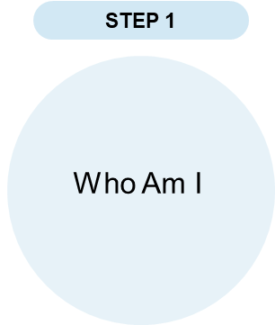
Prework
Creation of My +STORY – Present
PRESENT: WHO I AM TODAY
Think about your current self. Use the space below to describe the key aspects of who you are today.
PERSONALLY, and PROFESSIONALLY:
What are the key elements of my identity at home & at work?
What motivates me?
Personally, I am curious, disciplined, and eager to learn from my experiences. At home, I value patience, responsibility, and maintaining strong relationships with my family and friends.
Professionally, I am a motivated and hardworking software developer who enjoys learning new technologies and solving problems. I value teamwork, continuous improvement, and producing quality work even under pressure.
What motivates me is my desire to grow in the tech industry, support my family, and build systems that can help people and organizations.

Slide 7
Prework
Creation of My +STORY – Past
PAST: LIFE EXPERIENCES THAT MADE ME WHO I AM (PERSONAL)
Reflect on significant events and experiences from your life. Use the space below to write about moments that shaped your character and values. What were some of the highs (times of confidence and growth) and lows (times of self-doubt and/or transition) you experienced during childhood, young adulthood and in your recent past?
Age Range | HIGHS | LOWS
0 to10 | I grew up learning the importance of family, respect, and discipline. I enjoyed exploring new things, building friendships, and creating happy memories that shaped my values and personality. | As a child, I experienced shyness and fear of failure. There were times when I lacked confidence and felt afraid of making mistakes or trying new things.
10 to 19 | During my teenage years, I developed an interest in technology, computers, and problem-solving. School experiences helped me improve my communication skills, become more independent, and build meaningful friendships. | I faced pressure from academics, future goals, and self-doubt. There were times when I questioned my abilities and felt uncertain about my direction in life.
20 to 29 | In my 20s, I focused on personal growth and career development. Passing my projects, graduating college, and becoming part of Fujifilm helped me gain confidence, improve my technical skills, and become more responsible and goal-oriented. | I experienced stress, pressure, and uncertainty while balancing responsibilities, career goals, and client expectations. Challenges such as finding a job and handling failures tested my confidence, but they also taught me resilience and determination.
30 to 39
40 to 49
50 onward

Slide 8
Prework
Creation of My +STORY – Past
PAST: LIFE EXPERIENCES THAT MADE ME WHO I AM (PROFESSIONAL)
Reflect on significant events and experiences from your professional life. Use the space below to write about highs and lows that shaped you into the professional you are today.
Age Range | HIGHS | LOWS
20s | In my 20s, I started building my career and improving my skills in technology and web development. Passing my major projects, graduating college, and becoming part of Fujifilm gave me confidence and motivation to continue growing professionally. These experiences helped me become more responsible, independent, and determined to create a better future for myself and my family. | My journey also came with pressure, self-doubt, and challenges such as school responsibilities, financial struggles, difficulty finding a job, and project stress. There were times when I questioned my abilities, but these experiences taught me resilience, patience, and the importance of continuous learning. For me, every challenge became a lesson that helped me grow stronger and more confident as a software developer.
30s
40s
50s onward

Slide 9
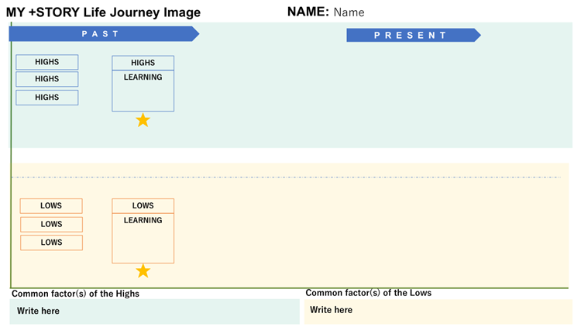
Prework
Creation of My +STORY – Life Journey Image
Now that you have reflected on your PRESENT and PAST, create an image of your +STORY Life Journey highlighting key moments (both high points and low/challenges) that have shaped who you are today.
PRESENT refers to your journey when you start your tenure with Fujifilm.
2
Adjust the lengths of indicators where necessary
1
3
List your High and Low events from past and present
Describe your insights / learnings from at least one High and Low event
4
Describe the common factors you have identified from your High and Low events

Slide 10
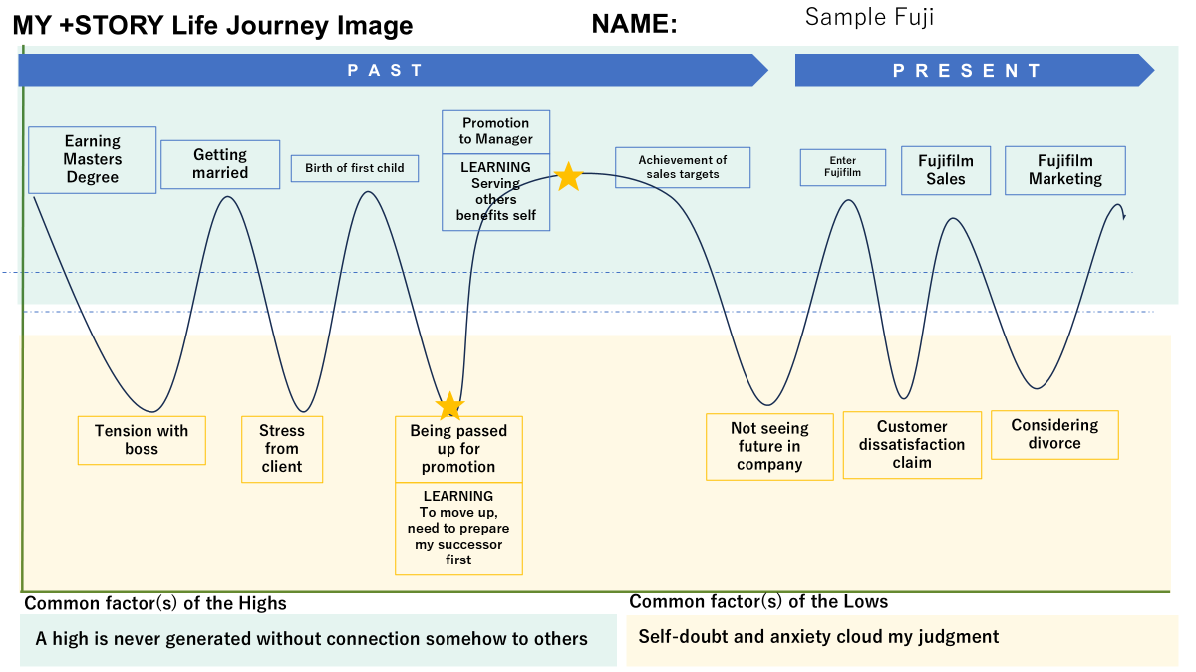
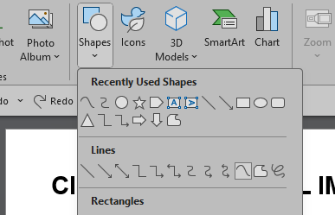
Prework
Creation of My +STORY – Life Journey Image
5
Draw a journey curve connecting the Highs and Lows
Go to "Insert" Tab: Click on "Shapes" in the toolbar.
Select "Curve" Shape: In the dropdown menu, find the "Curve" tool (usually under "Lines").
Draw Your Life Journey Image Line: (1) Click once on the timeline to start your line. (2) Click again at each point where your experience shifts (up for positive experiences, down for challenging ones). (3) To complete the line, double-click or connect back to the end point.
Print a copy of your MY +STORY Life Journey Image for your discussion group during the workshop.

Slide 11
Reference

Slide 12
Prework
MY +STORY Life Journey
Name:
PAST
PRESENT
Learning:
Hard work and dedication lead to achievement.
Passed college entrance exam
Passed Major Project and OJT
Graduated college
Enter Fujifilm
Learning new things
Met new friends
⭐
⭐
School activity pressure and family financial problem
Difficulty of finding a job
Project pressure
Stress from client
Learning:
Challenges built my confidence and determination
Common factor(s) of the Highs
Common factor(s) of the Lows
Achievements come from hard work, patience, and determination.
Difficult situations make me doubt myself but also help me mature.

Slide 13
Reference
Examples of Impact
Having a positive impact on others means influencing or contributing to their well-being, growth, happiness, or success in a meaningful way. It involves actions, attitudes, or words that uplift, support, or inspire others. Here are examples of what this could look like in different contexts:
In the Workplace
1. Mentorship: Guiding a junior colleague by sharing knowledge and providing feedback that helps them develop skills and confidence.
2. Creating an Inclusive Environment: Encouraging diverse perspectives and ensuring everyone feels valued.
In the Community
1. Volunteerism: Contributing time or resources to help those in need.
2. Environmental Stewardship: Encouraging sustainable practices that benefit others in the long term.
In Personal Relationships
1. Emotional Support: Being there for someone during difficult times and offering encouragement or a listening ear.
2. Celebrating Achievements: Recognizing and cheering on others' successes, big or small.
In Everyday Life
1. Acts of Kindness: Performing small gestures that brighten someone’s day.
2. Inspiring Change: Motivating others to improve their lives or pursue their dreams.
Having a positive impact is not about grand gestures but about being mindful of how your actions and words influence others. It’s about creating ripples of good that contribute to a better environment for those around you AND also provide you with the satisfaction that comes from interacting with others.

Slide 14
Prework
The IMPACT I Want To Create - Future
FUTURE: THE IMPACT I WANT TO CREATE
What impact do you want to have on others ?
What do you want to do more to make a difference?
In the future, I want to create a positive impact by using my skills and experiences to help people and improve organizations through technology. I want to inspire others to continue learning, work hard despite challenges, and believe in their abilities.
Beyond career success, I want to become a responsible and trustworthy person who can support my family, help others, and bring positive influence to the people around me. I believe every challenge and experience is an opportunity to grow and create meaningful change.

Slide 15

Reference
Understand Fujifilm Group’s History
https://holdings.fujifilm.com/special/90th/en/history/

Slide 16
Your Prework ends here
Please print and bring a copy of your workbook for the workshop
We look forward to seeing you at the workshop

Slide 17
Workshop
Understanding Who am I?
Reflect on your identity and your experiences to clarify your impact.
Present
Who am I today and what I want in my life?
Past
What are my learnings and abilities that I want to maximize?
Future
What is the impact I want to have on others?
Today, I see myself as someone who is continuously learning and improving both personally and professionally. I aim to become a responsible, skilled, and hardworking person who can create a positive impact through my work and actions.
My past experiences taught me the importance of perseverance, patience, and self-improvement. Challenges, failures, and pressure helped me become more resilient, while my passion for technology and problem-solving motivated me to continue learning and growing.
In the future, I want to use my skills and experiences to create meaningful solutions and inspire others to keep learning despite difficulties. I hope to contribute positively to my workplace, support the people around me, and become someone who makes a difference through hard work, and dedication.

Slide 18
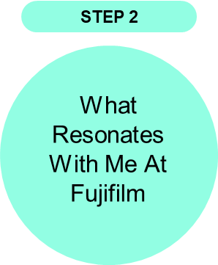
Workshop
Identifying My RESONANCE with Fujifilm
Having reviewed Fujifilm Group’s commitment
What is the overlap between the impact you want to make (step 1) and the commitments of Fujifilm?
What I relate to most about Fujifilm is the mindset of continuous learning and improving. As someone working in technology, I also believe that challenges help people grow and become better in what they do.
I like how Fujifilm values innovation, teamwork, and creating meaningful contributions. It matches my goal of improving my skills, learning from experiences, and using my knowledge to help the company and the people around me.
I want to continue growing as a software developer while contributing through hard work, responsibility, and willingness to learn new things.
Notes:
5mins – self

Slide 19

Workshop
Determining My ASPIRATION With Fujifilm
Determine my aspiration based on the overlap between the impact I want to make (step 1) and the commitments of Fujifilm (step 2)
My aspiration with Fujifilm is to continue growing as a software developer while learning new technologies and improving my skills. I want to contribute meaningful work, help improve processes, and become a better person while helping my team and learning from them.
I also aspire to become a professional who faces challenges with patience, responsibility, and determination. Through continuous learning and experience, I hope to build a stable and successful career while creating positive contributions to the people around me.
In the future, I want my work to reflect growth, dedication, teamwork, and the willingness to continuously improve, which are values I also see in Fujifilm.
Notes:
Personal action statement

