Slide 1
Group Purpose Workshop Aligning Our Aspirations with the Group Purpose
Enter your full name here

Slide 2
A Journey of Reflection and Growth
Discovering Aspirations that Resonate with Fujifilm Group’s Purpose
Welcome to your personal reflection journey!
This workbook is designed to help you explore, reflect, and visualize your life story as a foundation for discovering your aspirations which resonate with Fujifilm Group’s Purpose. By engaging in this process, you’ll gain a deeper understanding of your personal impact, values, and the future you want to create.
This workbook includes:
Optional readings are provided to support your understanding and assist with completing your prework
Please complete the prework before the workshop. As it involves self-reflection and thoughtful consideration, we encourage you to start early and avoid leaving it until the last minute
Activities that will be done during the workshop
Reference
Prework
Workshop

Slide 3
Understanding the Layers of Identity
Reference
Identity is a multi-dimensional concept shaped by various interconnected layers. These layers interact and evolve over time, influenced by internal factors and external experiences:
Core Identity: The fundamental layer that encompasses an individual's core values, beliefs, and traits. It represents our true self and is stable over time.
Physical Identity: Represents our body, appearance, and physical attributes such as age, gender, and race. It also includes health and fitness levels.
Cultural Identity: Shaped by cultural background, including traditions, language, and community practices. This layer influences how we view the world and interact with others.
Professional Identity: Defined by our career, job roles, skills, and professional achievements. It influences how we perceive our purpose in the workplace.
Social Identity: The roles we hold in society, shaped by relationships with family, friends, colleagues, and communities. It includes gender, age, social class, and professional roles.
Digital Identity: Shaped by our presence and interactions online, such as social media profiles and digital behavior, influencing how we are seen in virtual spaces.
Experiential Identity: Focuses on individual experiences, interests, and preferences. It reflects our personal history, passions, and how we view ourselves.
These layers are interconnected and together shape our overall sense of self, constantly evolving as we navigate different stages and environments in life.

Slide 4
Reference
Understanding Motivation
Motivation is the driving force that fuels our actions, decisions, and behaviors. It can be influenced by both internal desires and external factors. Broadly, motivation can be categorized into two types: intrinsic motivation, which comes from within, and extrinsic motivation, which is driven by external rewards or pressures. Both types play a role in shaping who we are.
Intrinsic Motivation:
Personal Fulfillment: Driven by enjoyment or meaning in the activity itself.
Sense of Purpose: Motivation from aligning actions with core values.
Autonomy: Desire to act freely and independently.
Mastery: Motivation to improve and learn new skills.
Enjoyment: Driven by the pleasure of the activity.
Extrinsic Motivation:
Rewards & Recognition: External incentives like money, praise, or promotions.
External Pressure: Motivation from deadlines, expectations, or avoiding punishment.
Social Comparison: Desire to outperform others or gain status.
Obligations: Driven by societal or familial expectations.
Tangible Outcomes: Motivated by tangible rewards, such as financial gain.

Slide 5
Understanding Passion vs. Motivation
Reference
Passion and motivation are closely related but distinct concepts. Passion is the intense, emotional drive that fuels our enthusiasm and commitment to a particular activity or cause, often arising from deep personal values, emotional connections, and a sense of purpose. Motivation, on the other hand, is the broader psychological force that initiates and sustains goal-oriented behavior, which can be driven by both intrinsic factors (personal fulfillment, desire for mastery) and extrinsic factors (rewards, social pressure). While passion is often the spark that ignites motivation, motivation is the ongoing force that keeps us working towards our goals, whether fueled by passion or external rewards.
Internal Drives and Self-Connection:
Personal Values and Beliefs: Passion arises when actions align with core values or a sense of purpose
Identity and Self-Expression: Engaging in activities that reflect our authentic self
Purpose and Meaning: Pursuits that give life meaning, such as career goals or family contributions
Ambition and Desire for Achievement: The drive to reach specific goals or succeed
Emotional and Social Influences:
Emotional Connections: Deep emotional bonds with people, places, or memories
Social Influence and Support: Passion growing stronger through encouragement from others or shared goals
Inspiration: Exposure to inspiring individuals, stories, or works that spark emotional responses
Novelty and Growth:
Novelty and Exploration: New experiences and challenges that evoke excitement and passion.
Past Experiences: Positive memories of past successes or milestones that reignite passion.

Slide 6
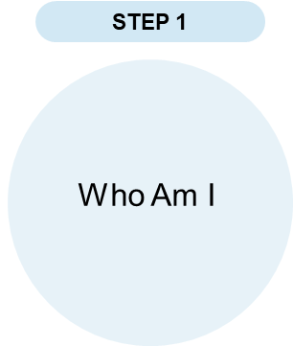
Prework
Creation of My +STORY – Present
PRESENT: WHO I AM TODAY
Think about your current self. Use the space below to describe the key aspects of who you are today.
PERSONALLY, and PROFESSIONALLY:
What are the key elements of my identity at home & at work?
What motivates me?

Slide 7
Prework
Creation of My +STORY – Past
PAST: LIFE EXPERIENCES THAT MADE ME WHO I AM (PERSONAL)
Reflect on significant events and experiences from your life. Use the space below to write about moments that shaped your character and values. What were some of the highs (times of confidence and growth) and lows (times of self-doubt and/or transition) you experienced during childhood, young adulthood and in your recent past?
Age Range | HIGHS | LOWS
0 to10
10 to 19
20 to 29
30 to 39
40 to 49
50 onward

Slide 8
Prework
Creation of My +STORY – Past
PAST: LIFE EXPERIENCES THAT MADE ME WHO I AM (PROFESSIONAL)
Reflect on significant events and experiences from your professional life. Use the space below to write about highs and lows that shaped you into the professional you are today.
Age Range | HIGHS | LOWS
20s
30s
40s
50s onward

Slide 9
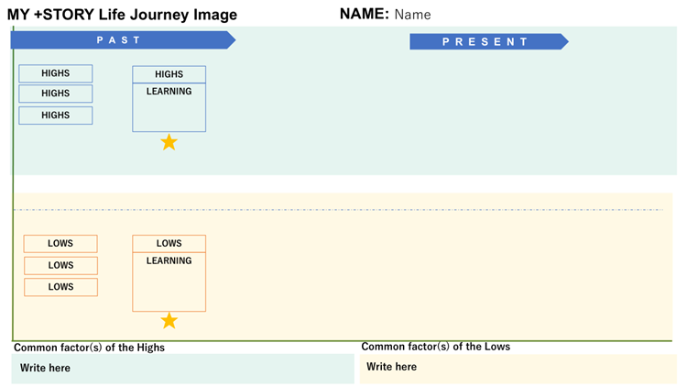
Prework
Creation of My +STORY – Life Journey Image
Now that you have reflected on your PRESENT and PAST, create an image of your +STORY Life Journey highlighting key moments (both high points and low/challenges) that have shaped who you are today.
PRESENT refers to your journey when you start your tenure with Fujifilm.
2
Adjust the lengths of indicators where necessary
1
3
List your High and Low events from past and present
Describe your insights / learnings from at least one High and Low event
4
Describe the common factors you have identified from your High and Low events

Slide 10
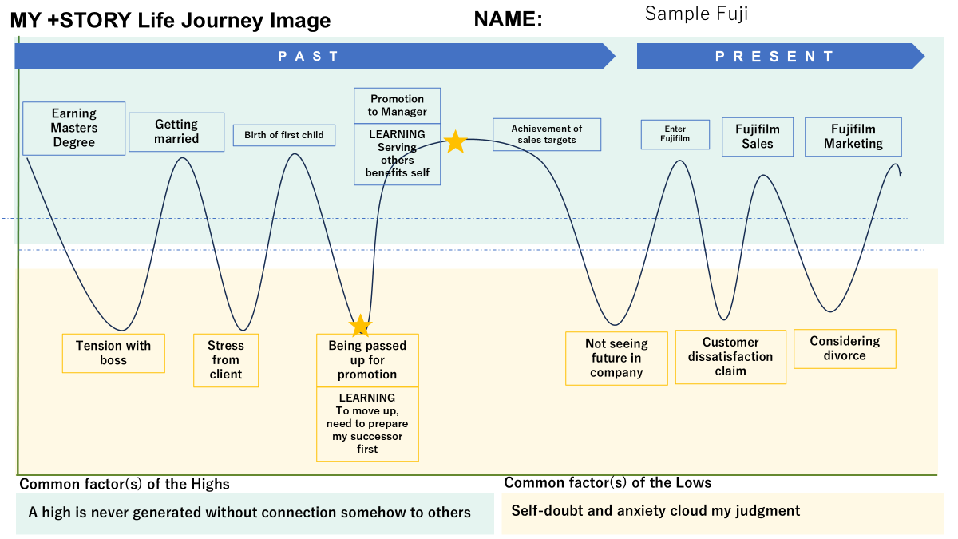
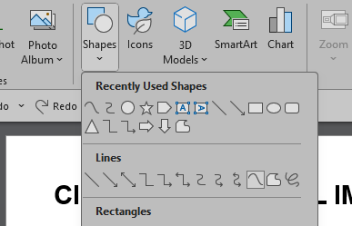
Prework
Creation of My +STORY – Life Journey Image
5
Draw a journey curve connecting the Highs and Lows
Go to "Insert" Tab: Click on "Shapes" in the toolbar.
Select "Curve" Shape: In the dropdown menu, find the "Curve" tool (usually under "Lines").
Draw Your Life Journey Image Line: (1) Click once on the timeline to start your line. (2) Click again at each point where your experience shifts (up for positive experiences, down for challenging ones). (3) To complete the line, double-click or connect back to the end point.
Print a copy of your MY +STORY Life Journey Image for your discussion group during the workshop.

Slide 11
Reference

Slide 12
Prework
MY +STORY Life Journey
Name:
PAST
PRESENT
Common factor(s) of the Highs
Common factor(s) of the Lows

Slide 13
Reference
Examples of Impact
Having a positive impact on others means influencing or contributing to their well-being, growth, happiness, or success in a meaningful way. It involves actions, attitudes, or words that uplift, support, or inspire others. Here are examples of what this could look like in different contexts:
In the Workplace
1. Mentorship: Guiding a junior colleague by sharing knowledge and providing feedback that helps them develop skills and confidence.
2. Creating an Inclusive Environment: Encouraging diverse perspectives and ensuring everyone feels valued.
In the Community
1. Volunteerism: Contributing time or resources to help those in need.
2. Environmental Stewardship: Encouraging sustainable practices that benefit others in the long term.
In Personal Relationships
1. Emotional Support: Being there for someone during difficult times and offering encouragement or a listening ear.
2. Celebrating Achievements: Recognizing and cheering on others' successes, big or small.
In Everyday Life
1. Acts of Kindness: Performing small gestures that brighten someone’s day.
2. Inspiring Change: Motivating others to improve their lives or pursue their dreams.
Having a positive impact is not about grand gestures but about being mindful of how your actions and words influence others. It’s about creating ripples of good that contribute to a better environment for those around you AND also provide you with the satisfaction that comes from interacting with others.

Slide 14
Prework
The IMPACT I Want To Create - Future
FUTURE: THE IMPACT I WANT TO CREATE
What impact do you want to have on others ?
What do you want to do more to make a difference?

Slide 15

Reference
Understand Fujifilm Group’s History
https://holdings.fujifilm.com/special/90th/en/history/

Slide 16
Your Prework ends here
Please print and bring a copy of your workbook for the workshop
We look forward to seeing you at the workshop

Slide 17
Workshop
Understanding Who am I?
Reflect on your identity and your experiences to clarify your impact.
Present
Who am I today and what I want in my life?
Past
What are my learnings and abilities that I want to maximize?
Future
What is the impact I want to have on others?

Slide 18
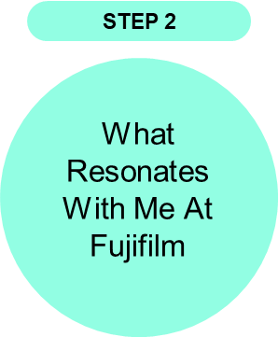
Workshop
Identifying My RESONANCE with Fujifilm
Having reviewed Fujifilm Group’s commitment
What is the overlap between the impact you want to make (step 1) and the commitments of Fujifilm?
Notes:
5mins – self

Slide 19

Workshop
Determining My ASPIRATION With Fujifilm
Determine my aspiration based on the overlap between the impact I want to make (step 1) and the commitments of Fujifilm (step 2)
Notes:
Personal action statement

