Slide 1



Build production-ready
agentic systems
[Speaker]

Slide 2
Topics
What are AI agents?
The path to autonomous agents
Dapr
Dapr Agents
Dapr Agent Types
Multi-Agent Systems
Agentic Patterns
Quickstarts

Slide 3
What are AI agents?

Slide 4
What are AI agents?
“AI agents are systems where large language models (LLMs) dynamically direct their own processes and tool usage, maintaining control over how they accomplish tasks”
Anthropic - Building Effective Agents - https://www.anthropic.com/engineering/building-effective-agents

Slide 5
Why are AI agents useful?
“Instead of simply asking questions and expecting answers, agentic AI can be given projects and
produce its own solutions”
Stefan Leichenauer, VP engineering SandboxAQ

Slide 6
Must have capabilities of an agentic framework
Instructions
User prompt
Role
Goals
System prompt
Temperature
Tools
Function calls
MCP
A2A
Code execution
Models
SaaS/Self-hosted
Open/Closed
Text/Multimodal
Single-pass/Thinking
Memory Types
Short term
Long term
Contextual
User preferences
Human-in-the-loop
Approval/Rejection
Feedback/Correction
Escalation handling
Edge case/Error handling

Slide 7

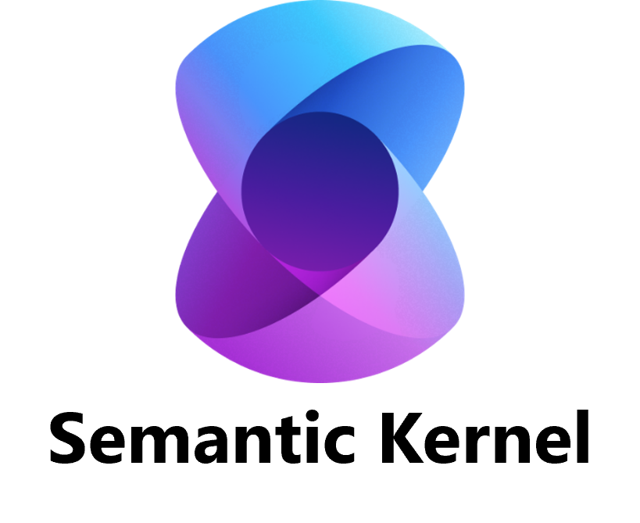






Many emerging agentic frameworks…
Operator

Slide 8
The path to autonomous agents

Slide 9


The path to autonomous agents
Single LLM
User
(input)
LLM
Final answer
(output)

Slide 10


The path to autonomous agents
Augmented LLM Agent
User
(input)
Tools
Memory
Final answer
(output)

Slide 11

The path to autonomous agents
Durable Workflow Agent
User (input)
Start
Durable workflow agents are systems where LLMs and tools are orchestrated via predefined code paths.
This allows for high control and well-defined deterministic tasks.
LLM A
External Event
Wait for event
LLM A
LLM A
End
Final answer
(output)

Slide 12
The path to autonomous agents
Reasoning Agent
Final answer
{
Reasoning
Input
AI agents are systems where LLMs dynamically direct their own processes and tool usage, maintaining control over how they accomplish tasks.
Action
User
LLM
Planning
Observation
Tools

Slide 13








The path to autonomous agents
Agent Mesh
Input
Final answer
agent
agent
User
An agent mesh has high agency. It is used for complex task automation and can handle unpredictable (non-deterministic) environments.
agent
agent

Slide 14
Dapr

Slide 15
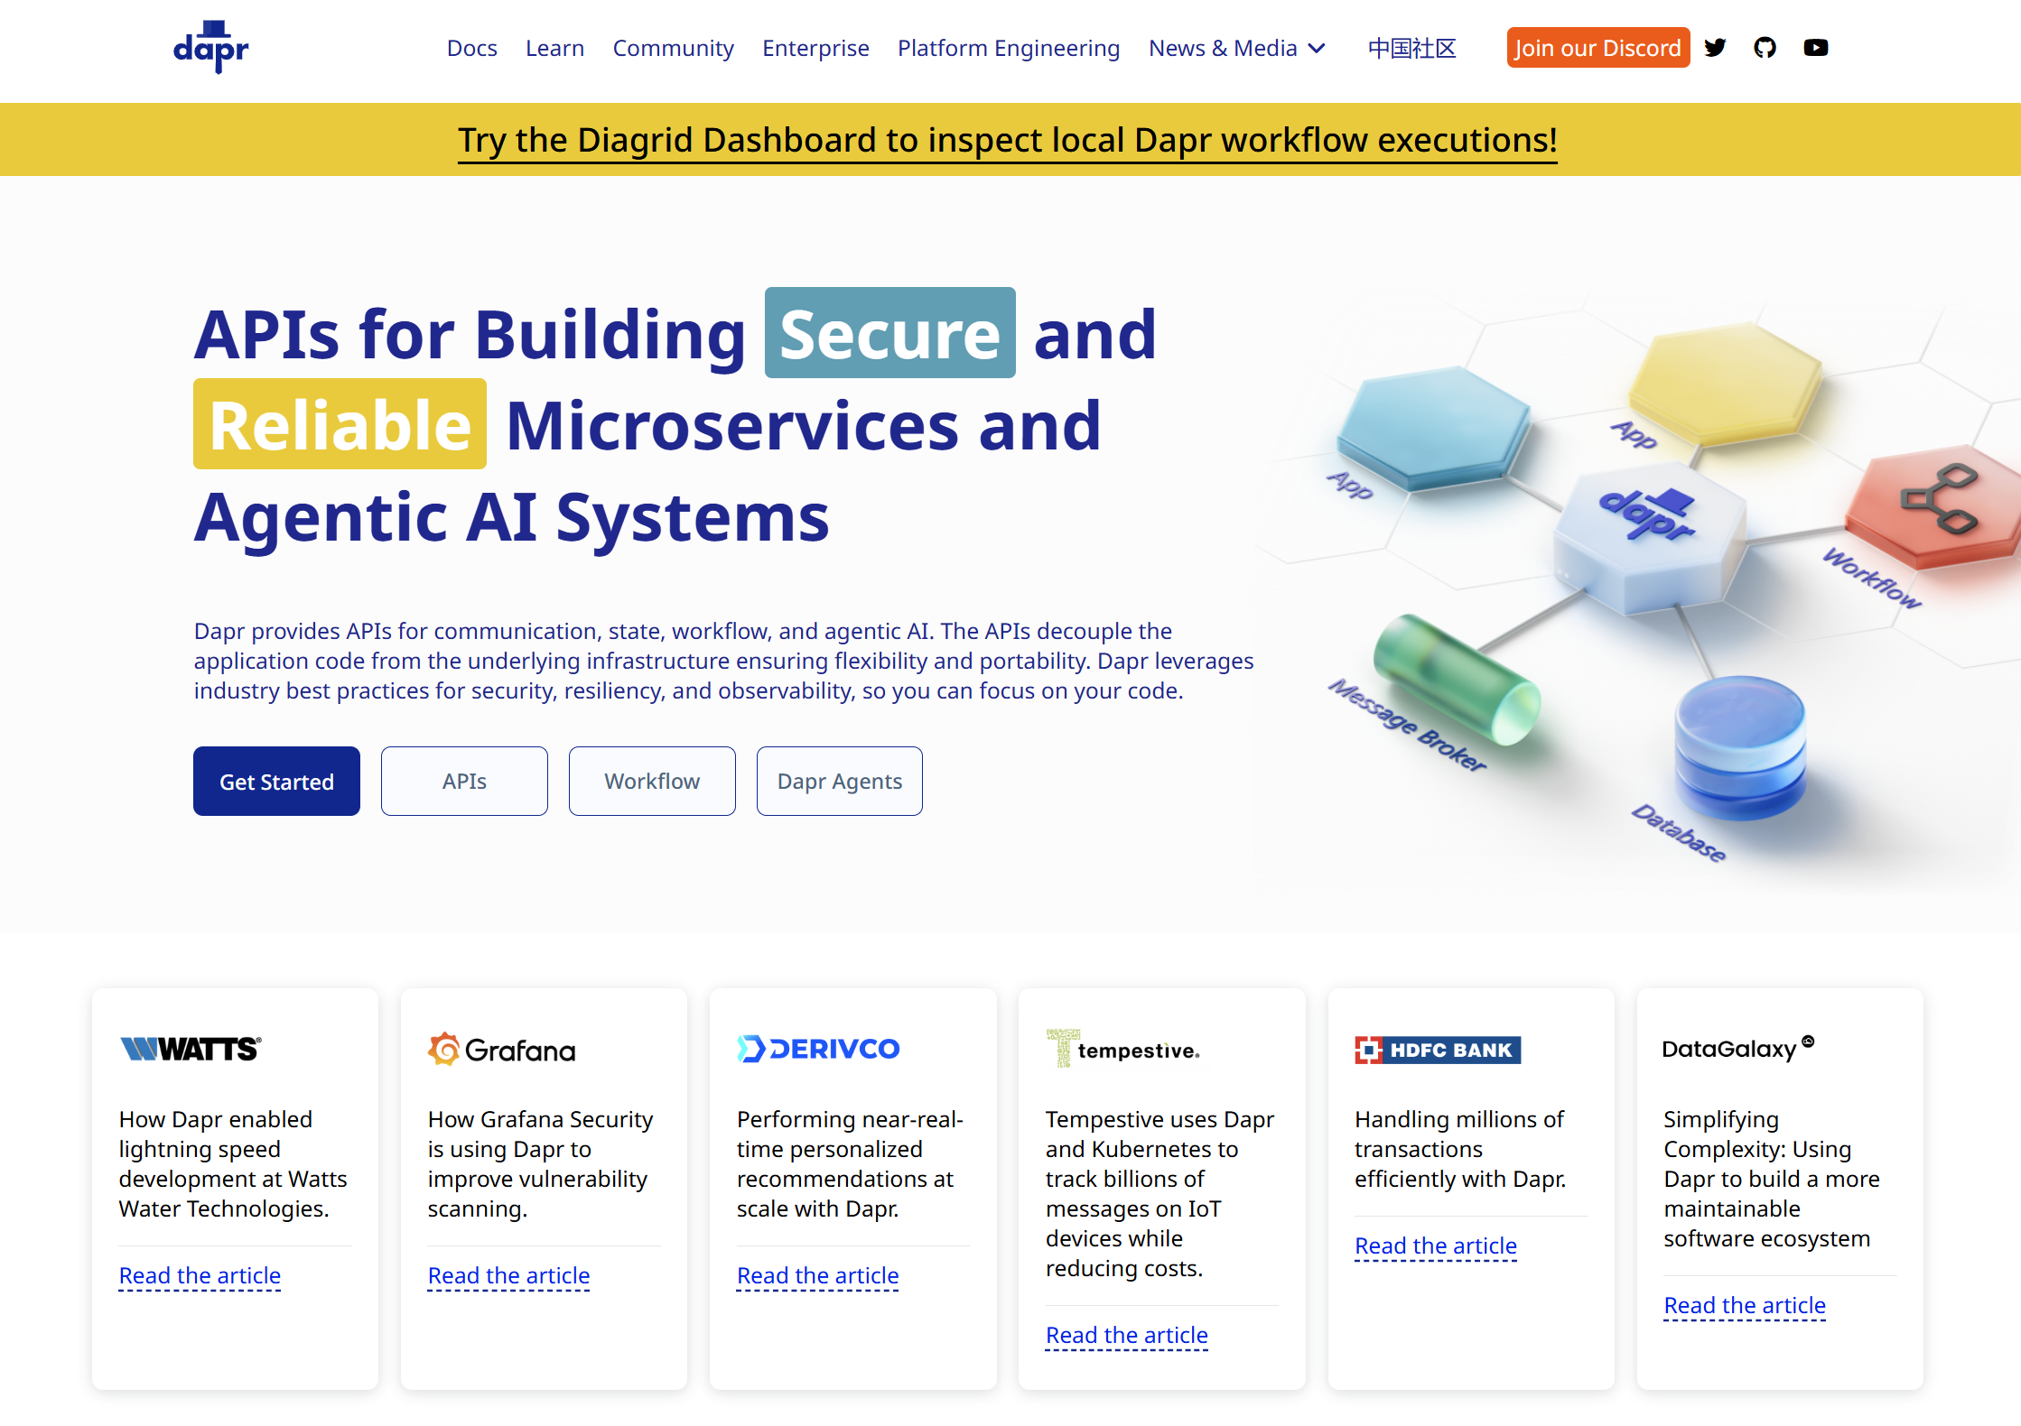


Distributed Application Runtime
dapr.io
Graduated project

Slide 16

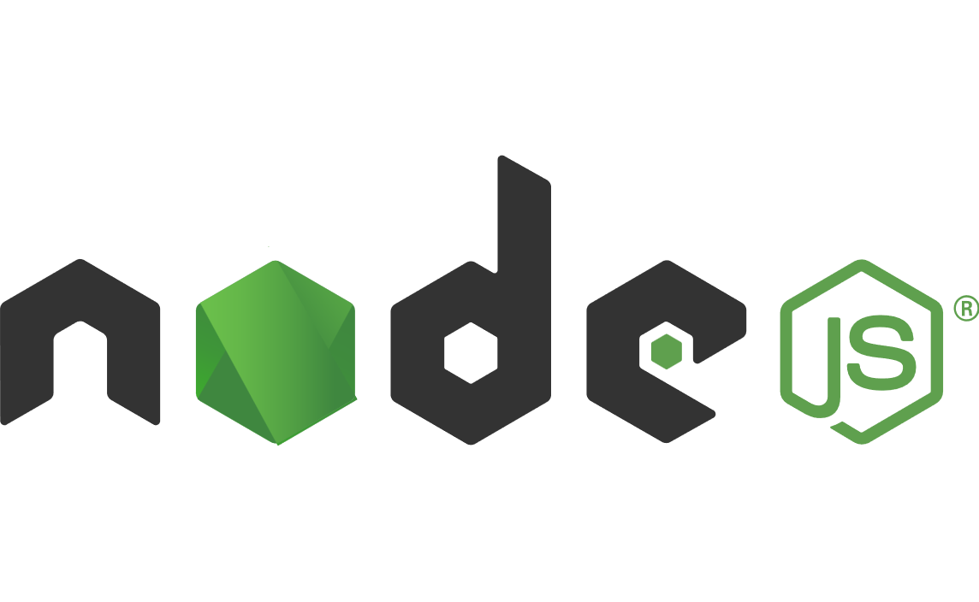







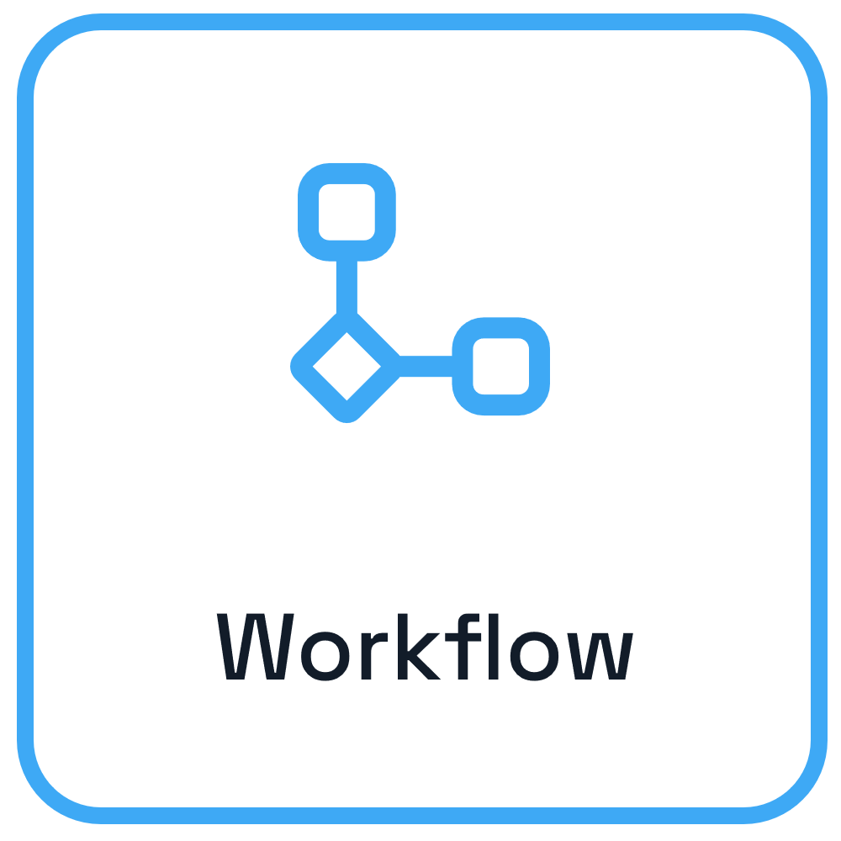

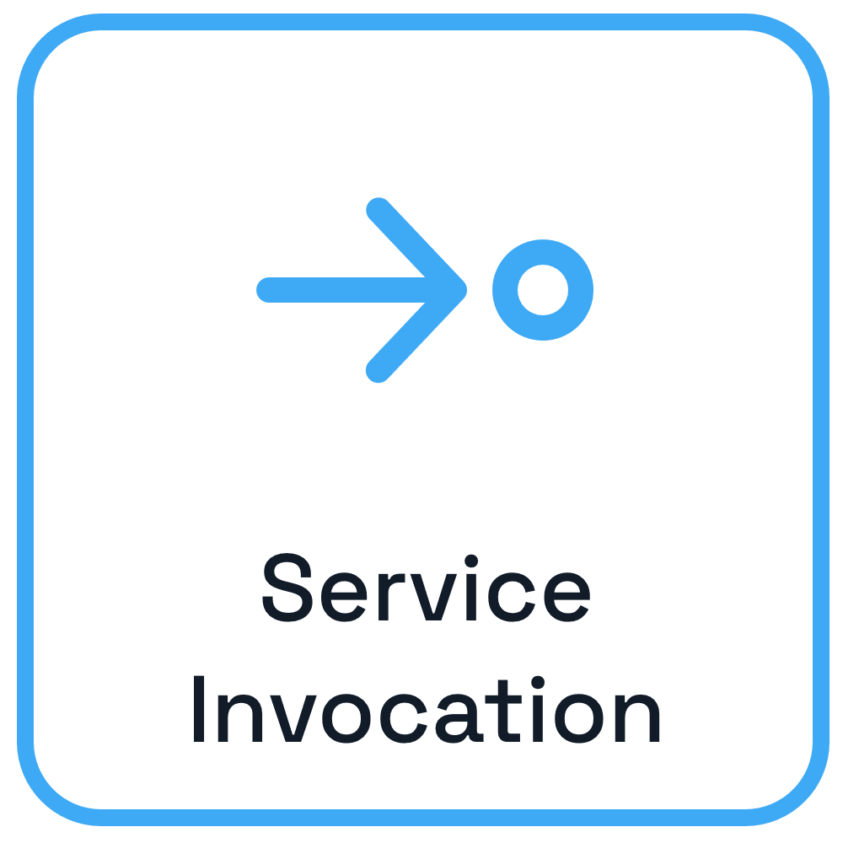
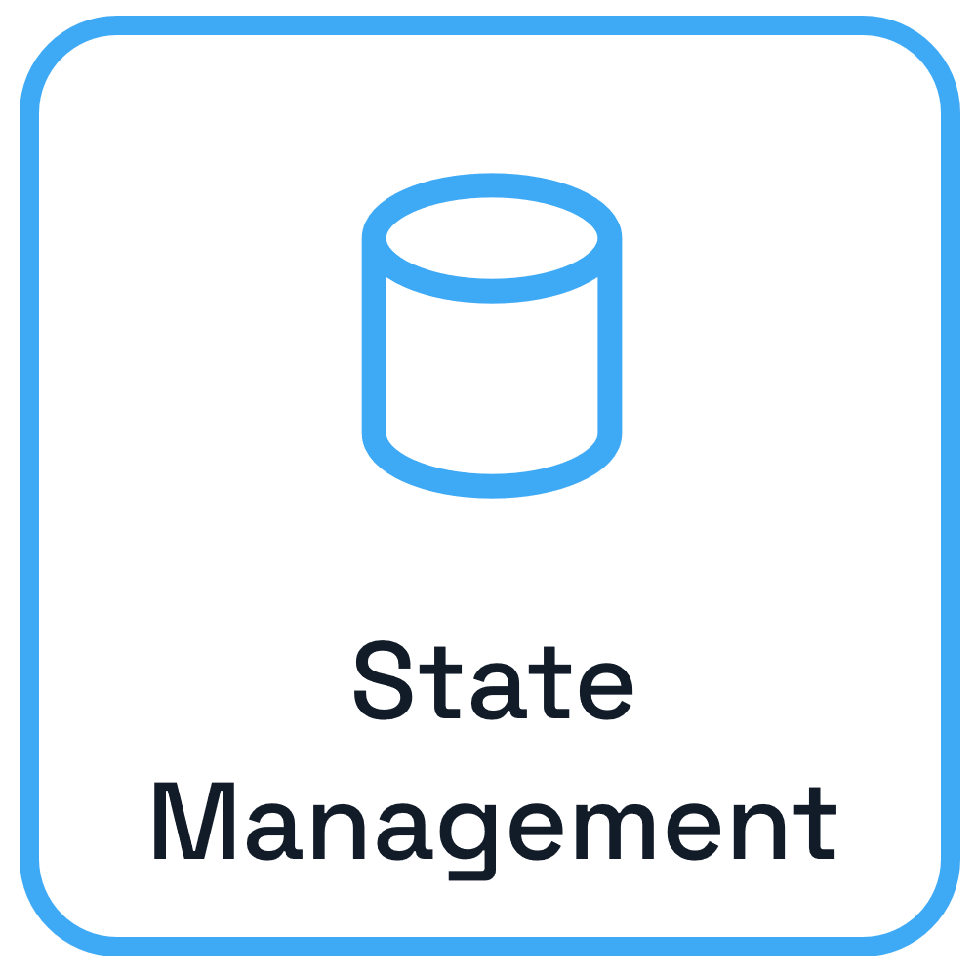
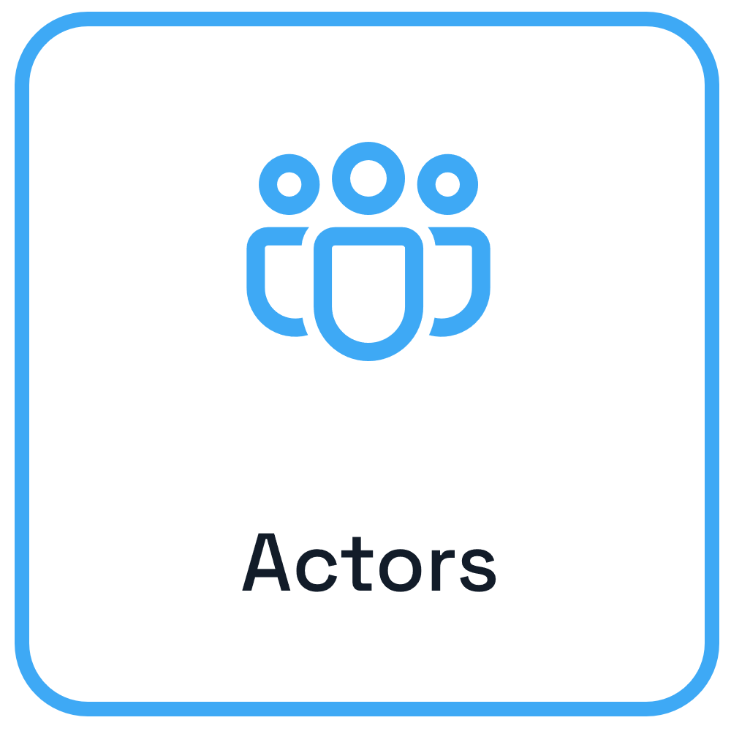

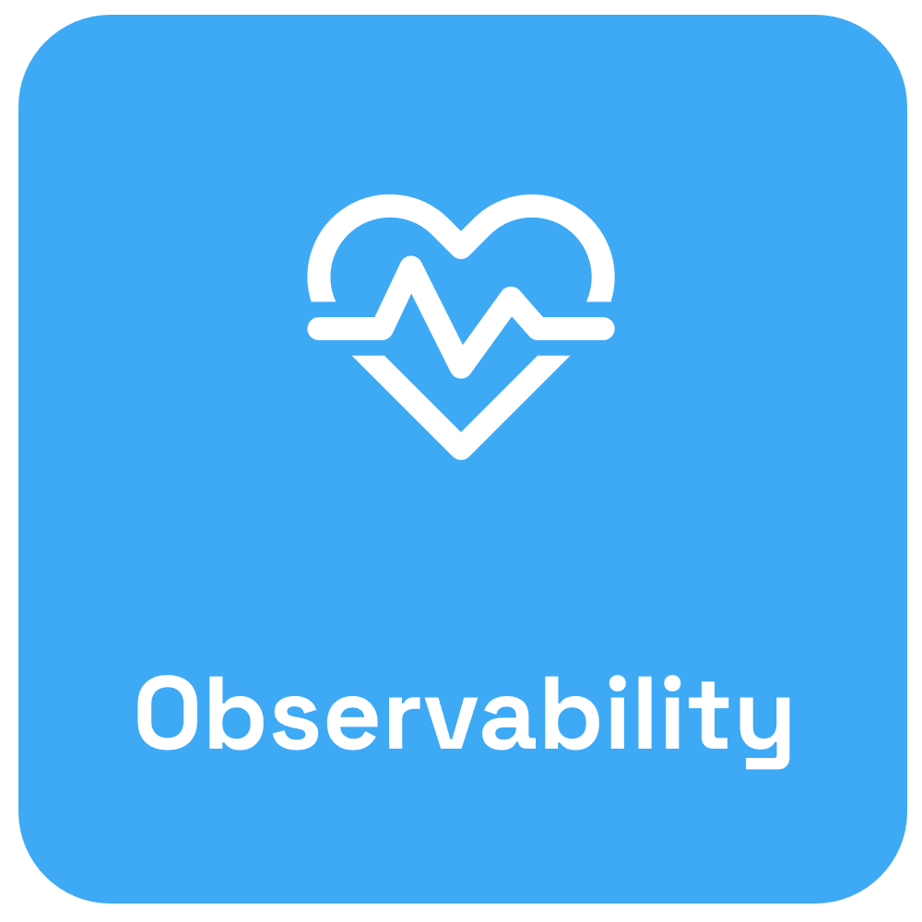

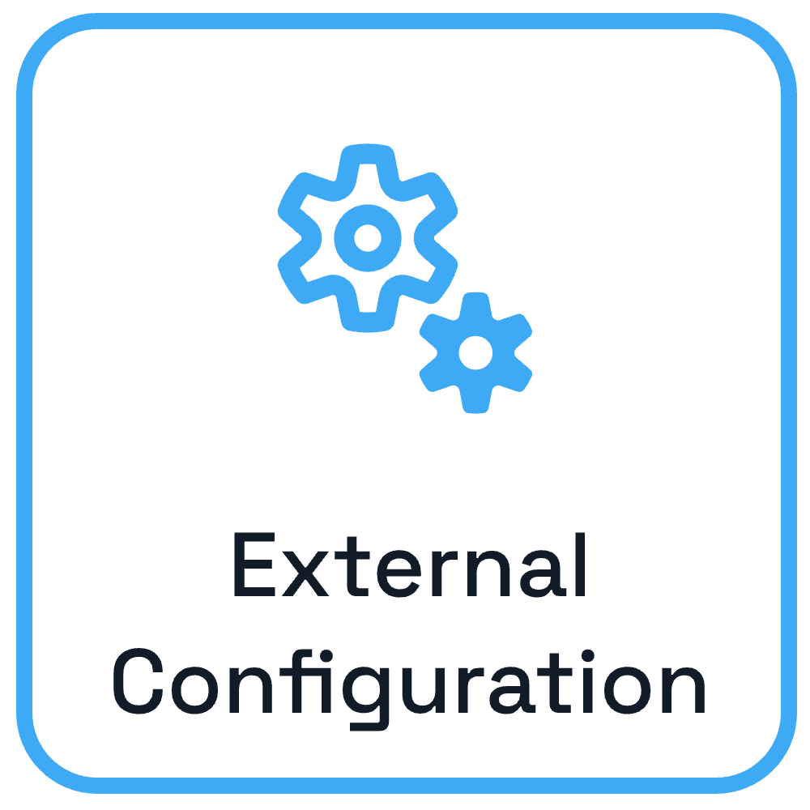

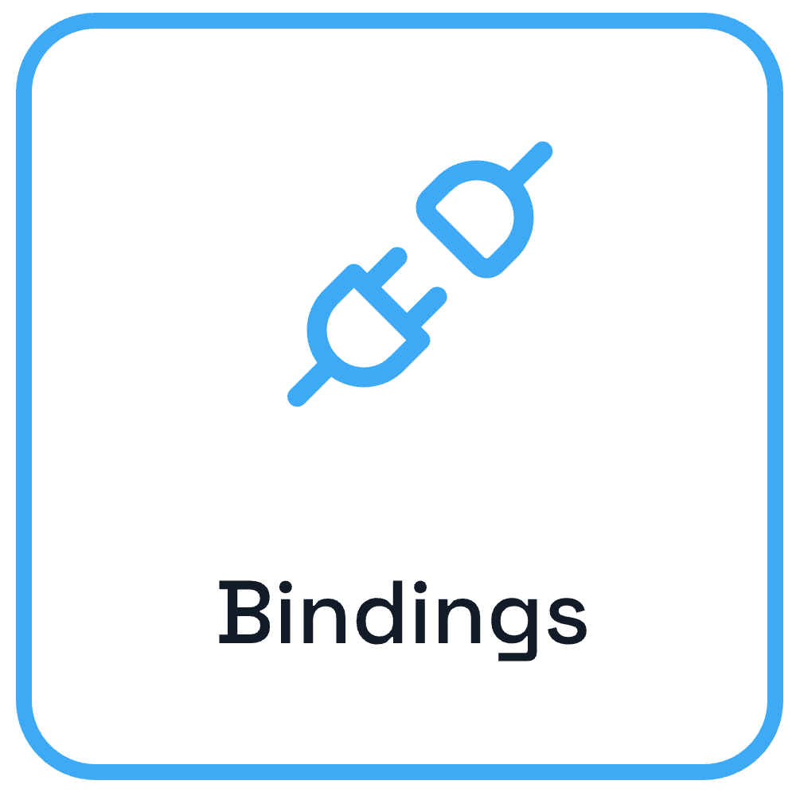

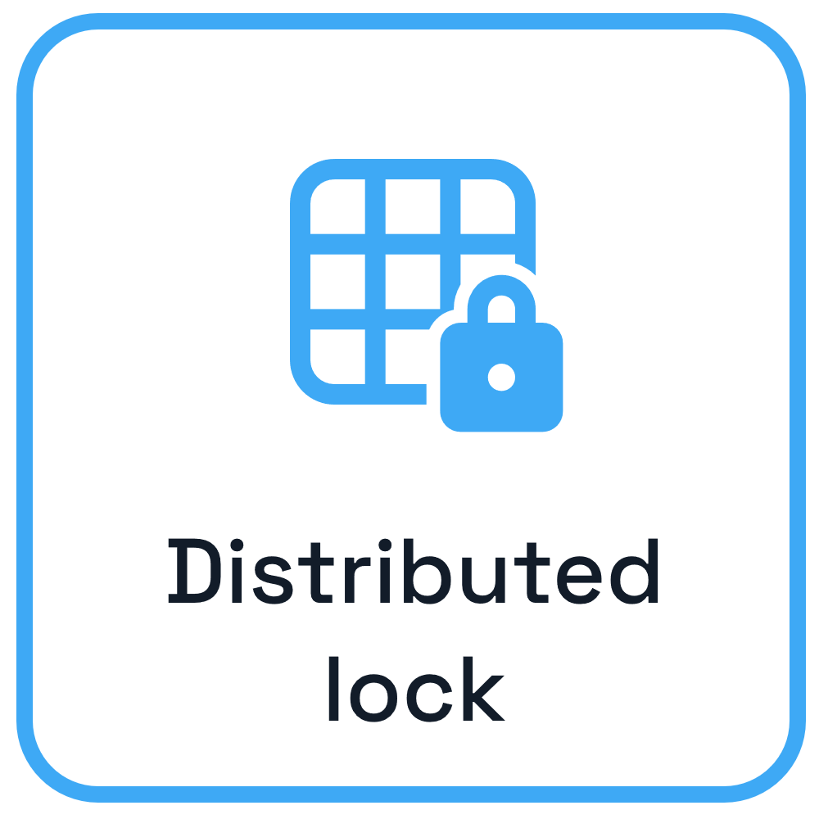

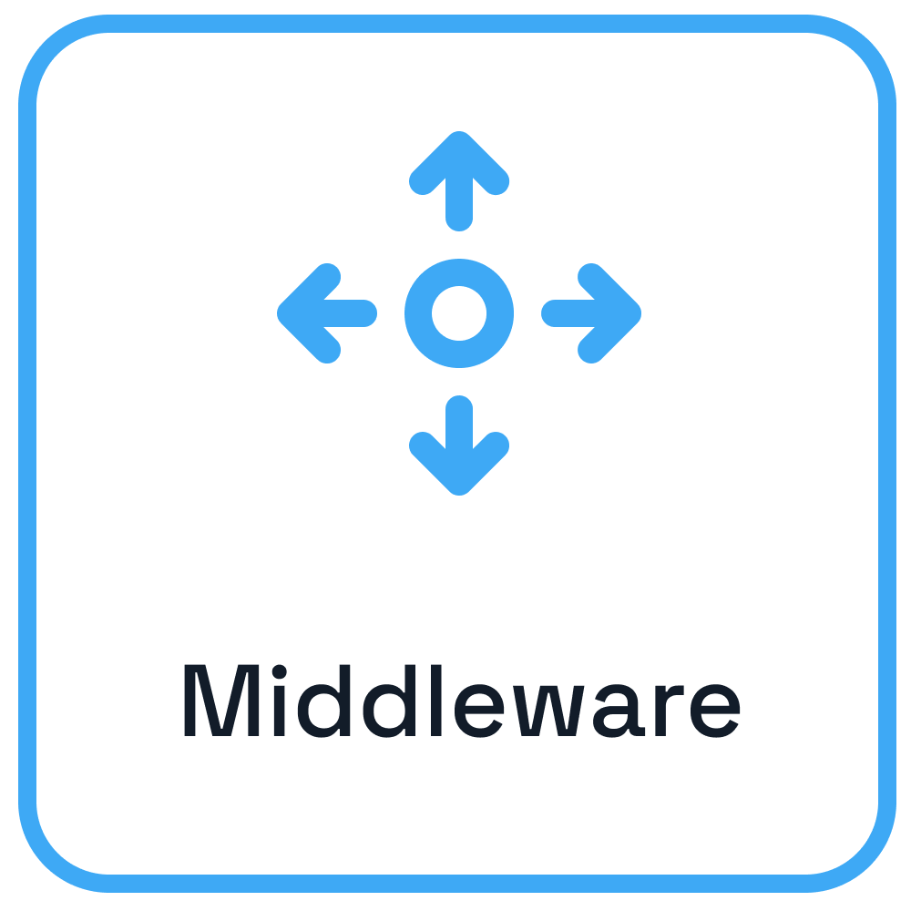









Dapr – Application developer platform
Use any language or runtime
App
HTTP/gRPC
Host on & integrate with any cloud or edge infrastructure
Databases
Message Brokers
Services

Slide 17

https://github.com/dapr/dapr-agents

Slide 18
Dapr Agents
A framework for developers to simplify the creation of AI agents that reason, act and collaborate using LLMs.

Slide 19
Dapr Agents Benefits
Durable agents using Dapr Workflow
Cloud native and decoupled infrastructure
Choice of multiple LLMs and state stores
Vendor neutral, open source
Production-ready reliability, security & observability

Slide 20


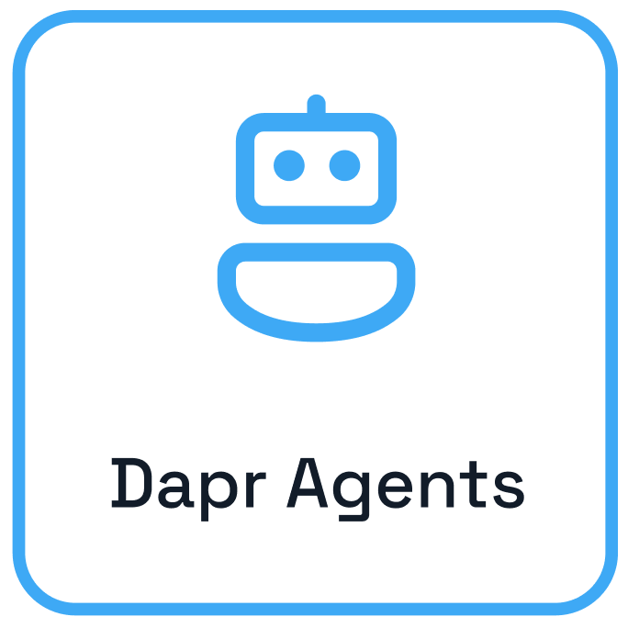




Dapr Agent Interactions
Planning
Memory
Interaction
Environment
User
Observation
Delegate tasks
Tools
Outside world
Notes:
Dapr Agents is designed to place agents, powered by LLMs, at the core of task execution and workflow orchestration. This principle emphasizes:
LLM-Powered Agents: Dapr Agents enables the creation of agents that leverage LLMs for reasoning, dynamic decision-making, and natural language interactions.
Adaptive Task Handling: Agents in Dapr Agents are equipped with flexible patterns like tool calling and reasoning loops (e.g., ReAct), allowing them to autonomously tackle complex and evolving tasks.
Seamless Integration: Dapr Agents’ framework allows agents to act as modular, reusable building blocks that integrate seamlessly into workflows, whether they operate independently or collaboratively.

Slide 21
Dapr – Application developer platform
Use any language or runtime
App
HTTP/gRPC
Host on & integrate with any cloud or edge infrastructure
Databases
Message Brokers
Services

Slide 22

Durable Agents
Workflow A
Input
Output
End
LLM A
User

Slide 23
Durable Agents
User
Input
LLM-based orchestrator
Workflow starts
Select agent and task
Trigger agent
Check
progress
Workflow ends
Not Completed
Completed
Continue as new

Slide 24
Dapr Agent Types

Slide 25
Dapr Agents Types
Agent (augmented LLM)
Stateless agent that manages conversation and executes tools based on LLM-generated tool calls.
Best for lightweight, reactive tasks requiring direct tool invocation.

Slide 26
Dapr Agents Types
Durable Agent (Workflow)
Durable Workflow agent for headless agent mode using REST or Pub/Sub messaging.
Designed for stateful, resilient, and routable agent workflows.

Slide 27
Multi-Agent Systems

Slide 28
Multi-Agent Systems
When solving complex tasks, multiple agents can collaborate using different coordination strategies. Each pattern trades off simplicity, flexibility, and control.

Slide 29
Multi-Agent Systems
Workflow-based Agent Orchestration
A multi-agent workflow where each agent performs a focused reasoning step, passing its output to the next.
When to use:
- A task can be decomposed into modular, sequential steps (e.g., extract → plan → expand)
- You want reproducible, deterministic orchestration of agents
- Each agent has a narrow, well-defined role
- You need durability and state across the multi-step process

Slide 30
Multi-Agent Systems
Asynchronous Agent Orchestration
A centralized, adaptive orchestration pattern where an LLM-based controller coordinates execution across multiple autonomous agents.
When to use:
- Tasks are complex or long-running with unknown execution paths
- Agent selection and ordering should be adaptive and data-driven
- You want persistent, recoverable orchestration using pub/sub and state
- You need agents to operate autonomously while still coordinating through a central orchestrator

Slide 31
Agentic Patterns

Slide 32
Agent Patterns
Augmented LLM Pattern
In
Out
LLM A
Query/Results
Read/Write
Call/Response
Retrieval
Memory
Tools

Slide 33
Agent Patterns
Durable Agent Pattern
Workflow A
In
Out
LLM A
Query/Results
Read/Write
Call/Response
Retrieval
Memory
Tools

Slide 34
Agent Patterns
Prompt Chaining Pattern
Output 2
Output 3
Pass
Out
LLM 2 A
LLM 3 A
Output 1
Gate
In
LLM 1 A
Exit
Fail

Slide 35
Agent Patterns
Parallelization Pattern
(Fan-out/fan-in)
LLM 1 A
In
Out
LLM 2 A
Aggregator
LLM 3 A

Slide 36
Agent Patterns
Routing Pattern
LLM 1 A
In
Out
Router
LLM 2 A
LLM 3 A

Slide 37
Agent Patterns
Evaluator Optimizer Pattern
Solution
In
LLM Call Generator
LLM Call Evaluator
Out
Rejected +
Feedback

Slide 38
Agent Patterns
Autonomous Agent Pattern
Action
In
LLM A
Environment
Feedback
Out

Slide 39
Agent Patterns
Orchestrator Workers Pattern
(Agent Mesh)
LLM 1 A
In
Out
Orchestrator
LLM 2 A
Synthesizer
LLM 3 A

Slide 40
Quickstarts
https://github.com/dapr/dapr-agents/tree/main/quickstarts

Slide 41







Dapr Resources
dapr.io
bit.ly/dapr-youtube
bit.ly/dapr-quickstarts
bit.ly/dapr-discord
@daprdev
dapr.io
@daprdev.bsky.social

Slide 42


Claim the Dapr Community Supporter badge!
bit.ly/dapr-supporter

Slide 43
Dapr Agents presentation assets
Source

Slide 44
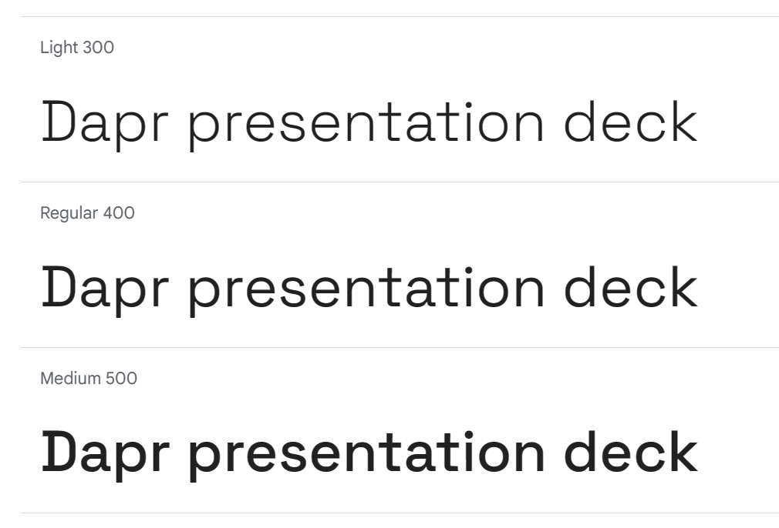
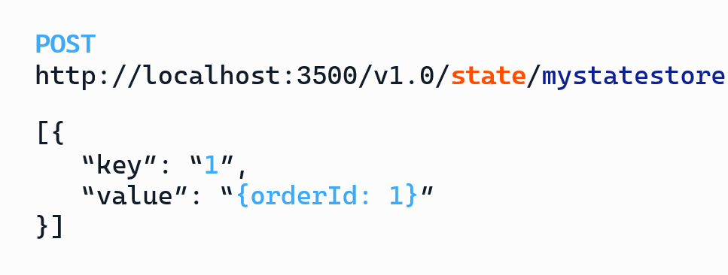
Fonts
Space Grotesk
for all regular texts
and labels
https://fonts.google.com/specimen/Space+Grotesk
CaskadiaCove Nerd Font for code / HTTP endpoints
https://github.com/ryanoasis/nerd-fonts/releases/download/v3.0.2/CascadiaCode.zip
https://www.nerdfonts.com/font-downloads

Slide 45
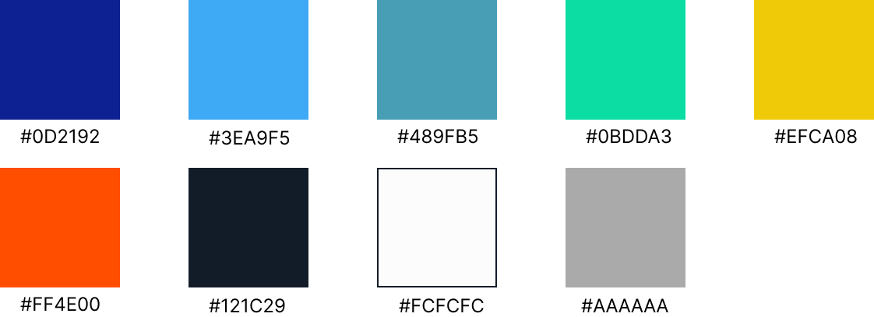
Colors

Slide 46


agent
agent
agent
agent
agent

