Slide 1
How to use this file
This file serves three purposes:
  Act as a branding guideline and resource for Dapr
  Provide a core set of slides to use when presenting Dapr
  Provide additional slides for deep-dive presentations.
  NOTE: You should customize this deck to your needs depending on the audience. The Slide Assets section at the end of this deck contains many assets that you can use to create more diagrams.
How to request updates this file:
Create an issue in https://github.com/dapr/community with details on what you’d like to add/update

Slide 2




Guidelines for building diagrams
App label
Apps are represented by a hexagon.
  App labels use the Space Grotesk font.
  When using only one App, use the green hexagon.
  When more than one application is present in a diagram, use alternate hexagon colors, with light blue, yellow and teal.
  The Dapr sidecar is represented by a white hexagon with a light blue border containing the Dapr logo.
  The sidecar icon can be in any corner if needed, although the bottom right is preferred.
App label
App label
App label

Slide 3


Guidelines for building diagrams
A key/value store is represented by a yellow vertical wide pipe.
  A message broker is represented by a green horizontal narrow pipe.
  Labels are in Space Grotesk font.
  Use 2pt size black arrows for connecting elements.
Database
Message broker

Slide 4


Dapr
APIs for building secure and reliable microservices
[Speaker]

Slide 5




Distributed applications
Front-end
Gateway
Shopping cart
Inventory
Storage
Notifications
Checkout
Message broker
Shipping
Shipping
Payment
Storage
Storage

Slide 6
Developer challenges – Service orchestration
Front-end
Gateway
Shopping cart
Inventory
Storage
Notifications
Checkout
Message broker
Shipping
Shipping
How do I orchestrate business logic across services?
Payment
Storage
Storage

Slide 7
Developer challenges – Distributed tracing
Front-end
Gateway
Shopping cart
Inventory
Storage
Notifications
Checkout
Message broker
Shipping
Shipping
How can I trace requests across services and message brokers?
Payment
Storage
Storage

Slide 8
Developer challenges – Access control
Front-end
Gateway
Shopping cart
Inventory
Storage
Notifications
Checkout
Message broker
Shipping
Shipping
How can I configure access to services and other resources?
Payment
Storage
Storage

Slide 9
Developer challenges – Resiliency
Front-end
Gateway
Shopping cart
Inventory
Storage
Notifications
Checkout
Message broker
Shipping
Shipping
How do I handle failed calls and perform retries?
Payment
Storage
Storage

Slide 10
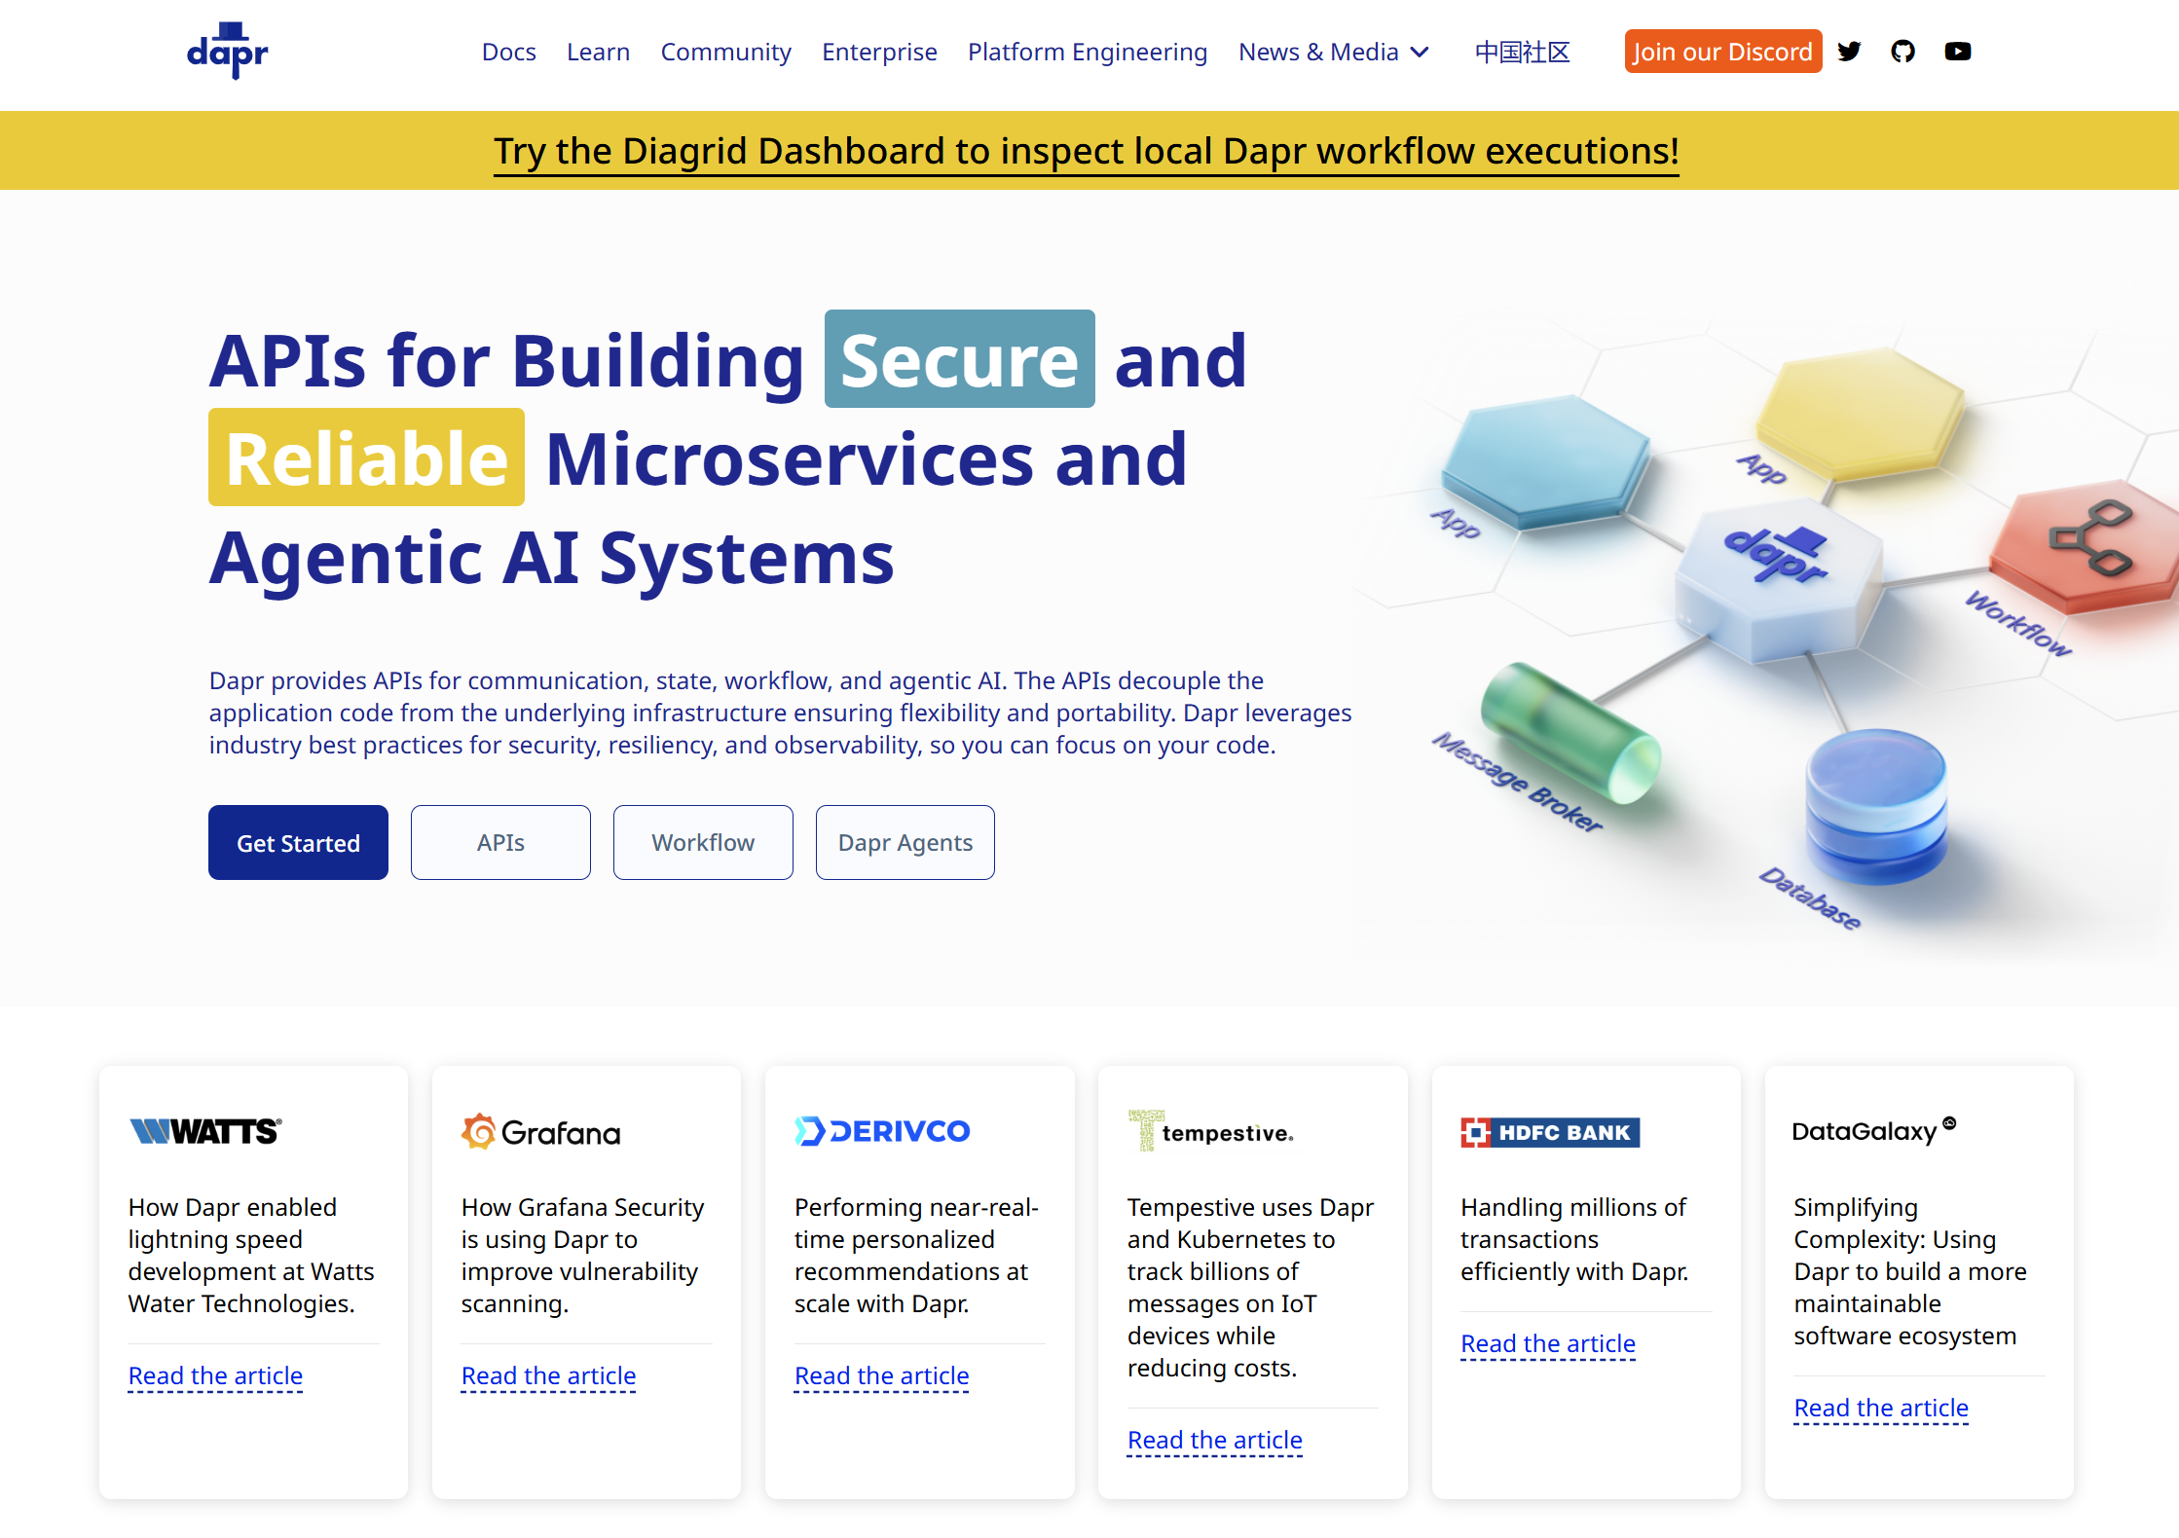


Distributed Application Runtime
dapr.io
Graduated project

Slide 11
Dapr uses a sidecar pattern
Front-end
Gateway
Shopping cart
Inventory
Storage
Notifications
Checkout
Message broker
Shipping
Shipping
Payment
Storage
Storage

Slide 12
The Dapr sidecar provides built-in security, resiliency and observability capabilities.

Slide 13
Speeds up application development by providing an integrated set of APIs for communication, state, and workflow.

Slide 14



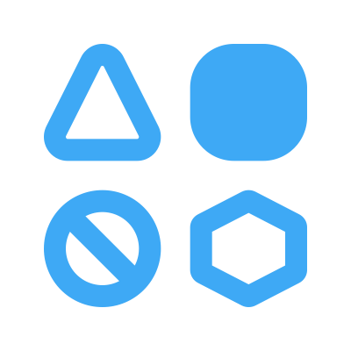
State of enterprise developers
Must develop resilient, scalable, distributed apps that interact with services.
Want to focus on writing code, not learning infrastructure.
Trending toward serverless platforms with simple code to cloud pipelines.
Use multiple languages and frameworks during development.

Slide 15



What is holding back distributed app development?
Limited tools and runtimes to build distributed applications.
Runtimes have limited language support and tightly controlled feature sets.
Runtimes only target specific infrastructure platforms with limited portability.

Slide 16






Dapr Goals
Provide an integrated set of APIs
Any language or framework
Includes best practices & standards
Platform agnostic
Extensible and pluggable
Community driven, vendor neutral

Slide 17

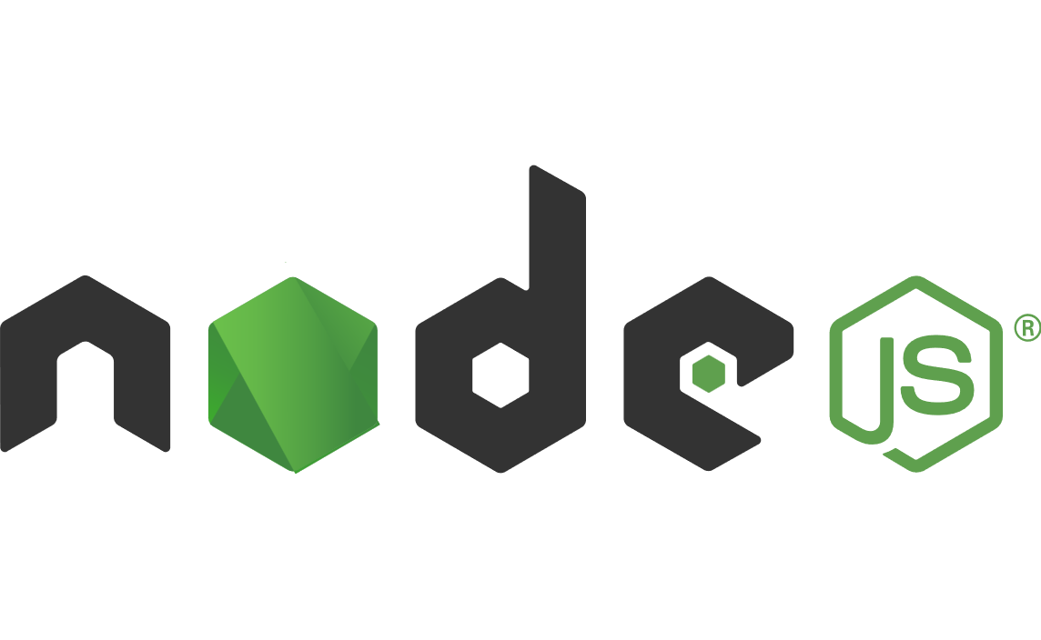


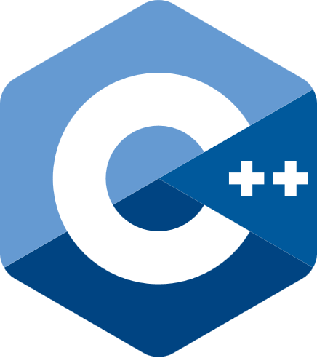




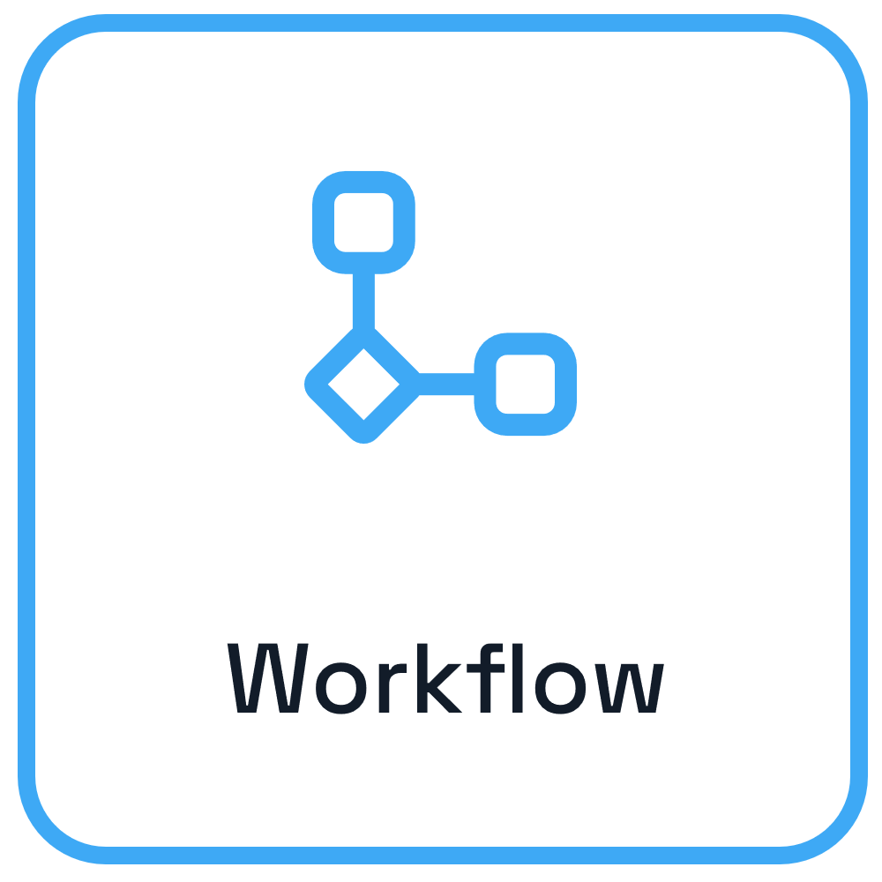

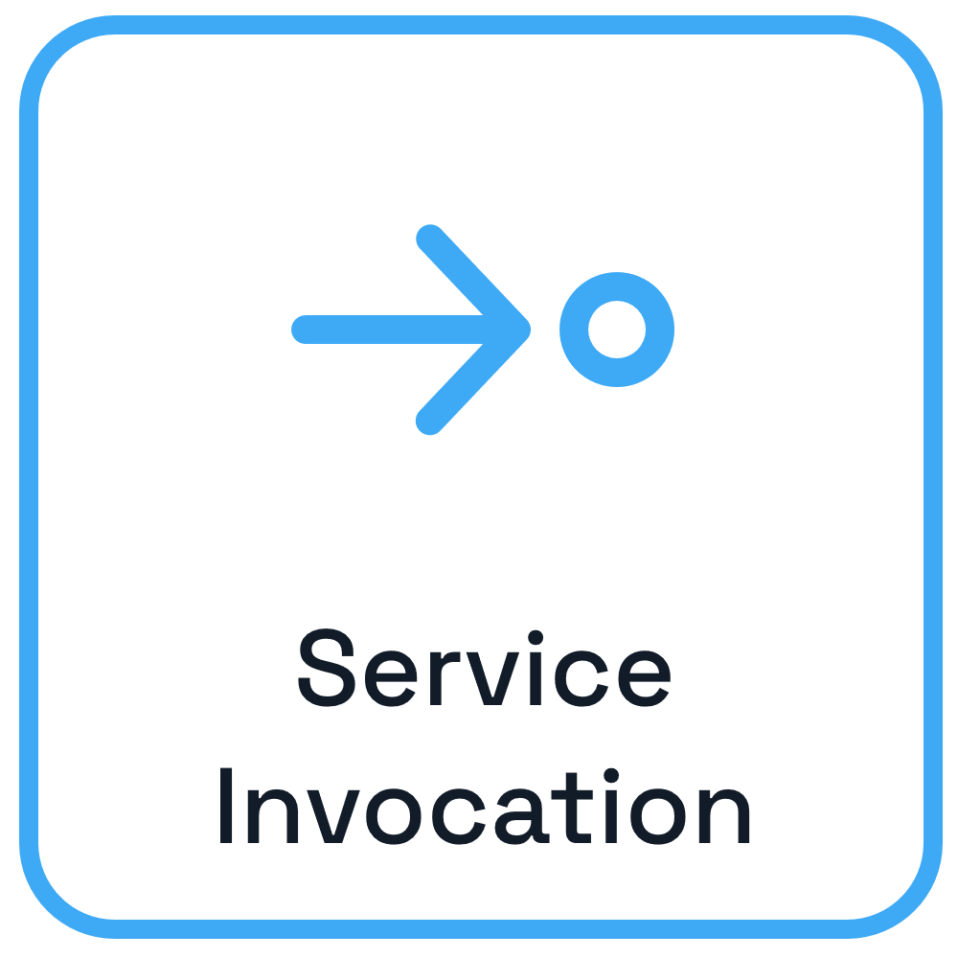
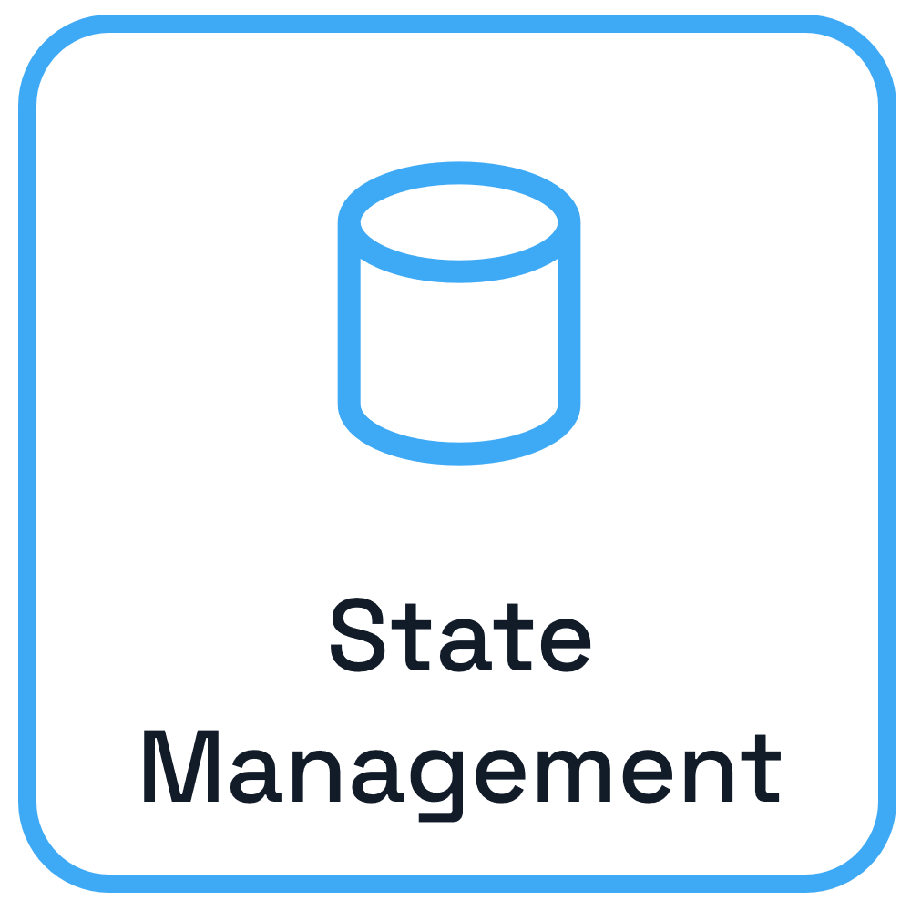
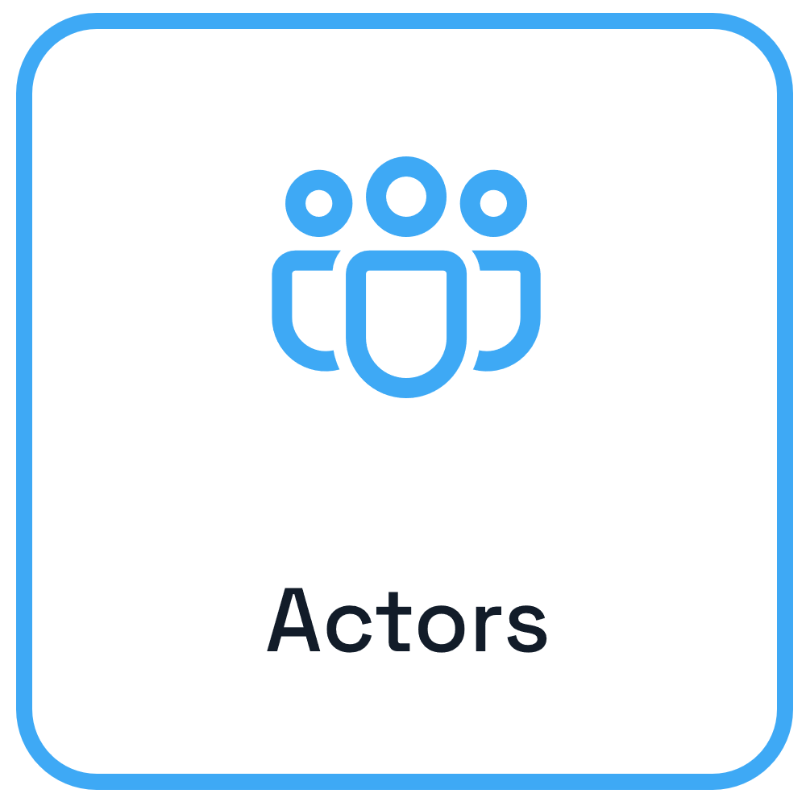
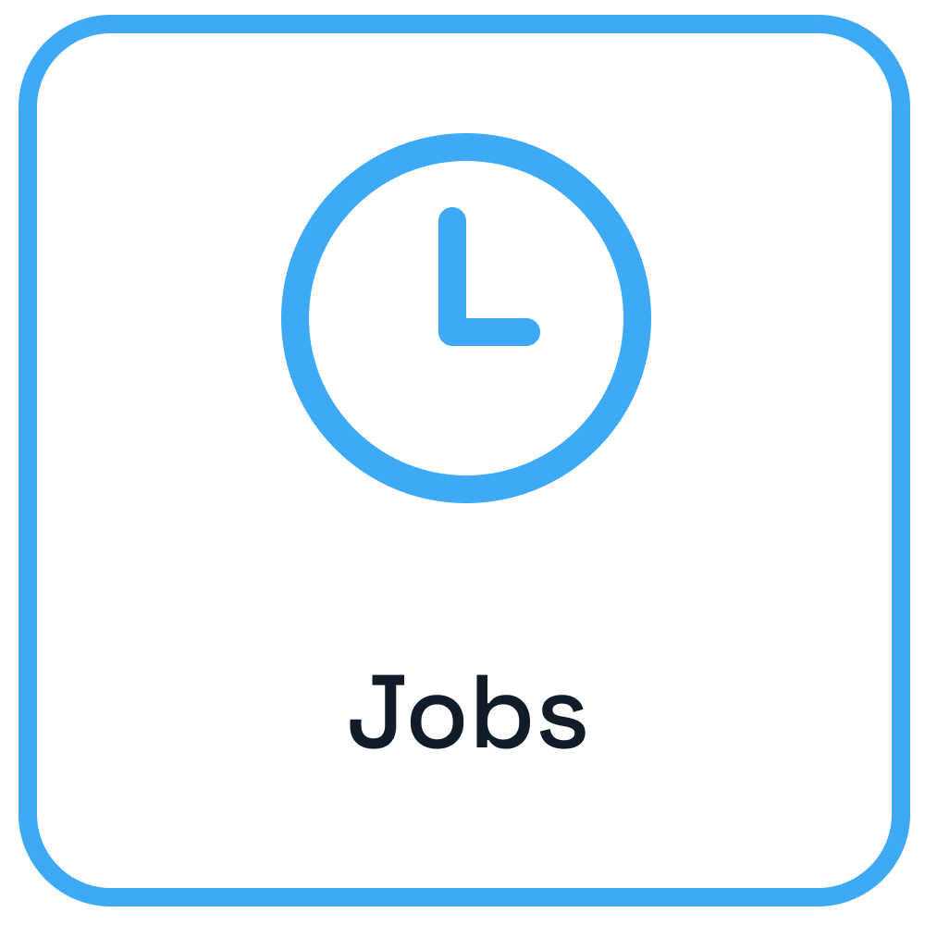
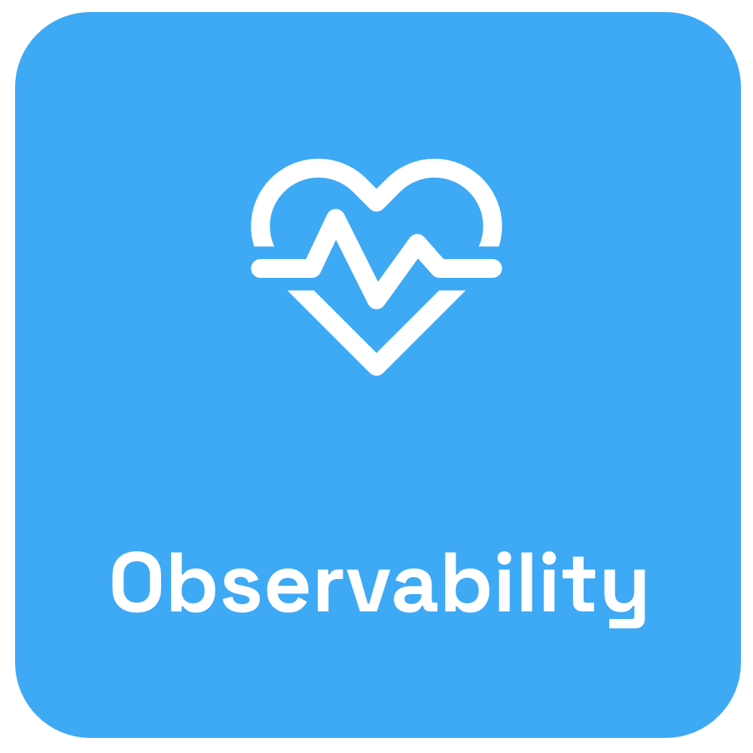

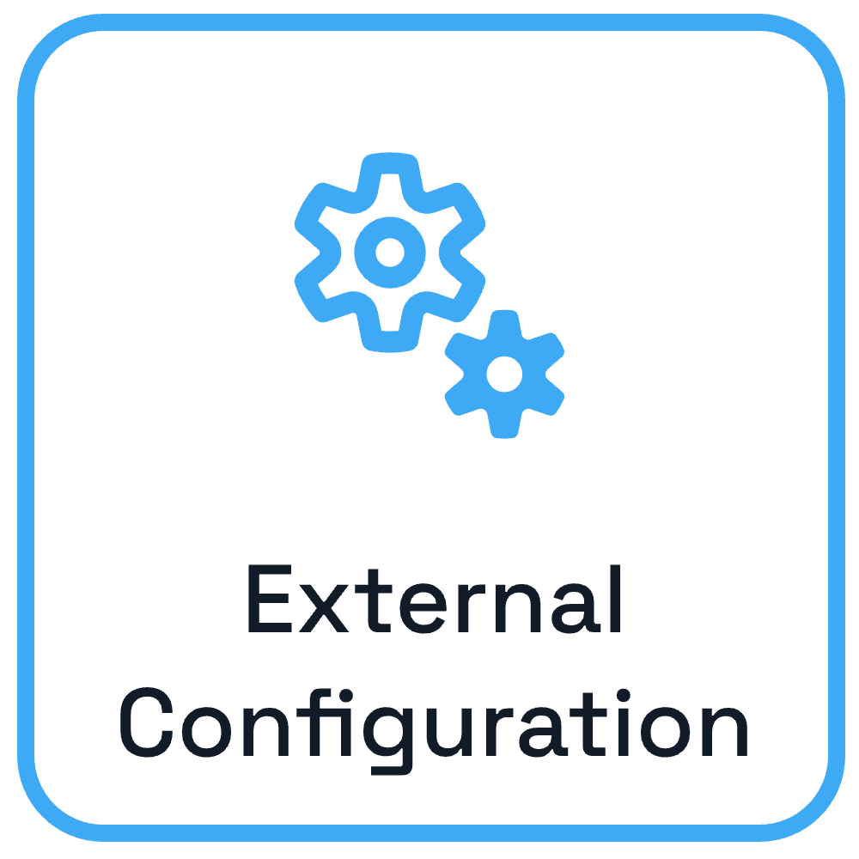

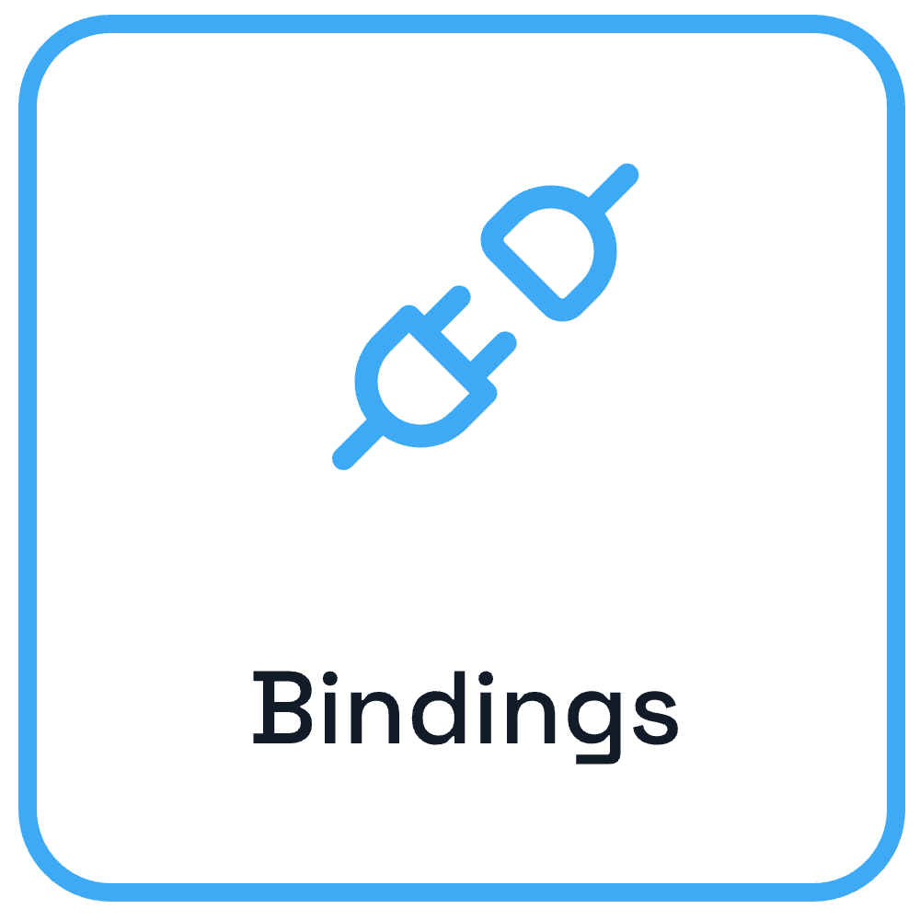

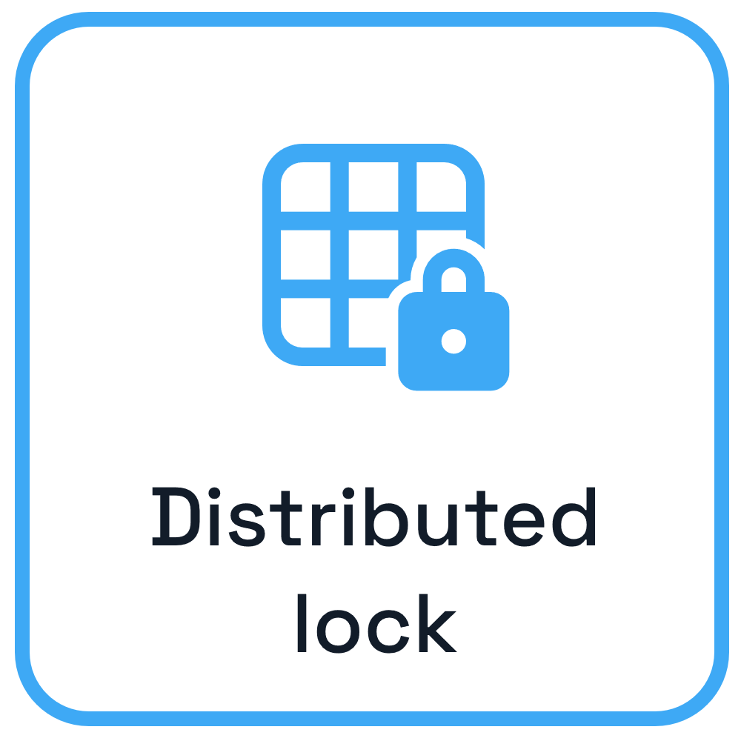

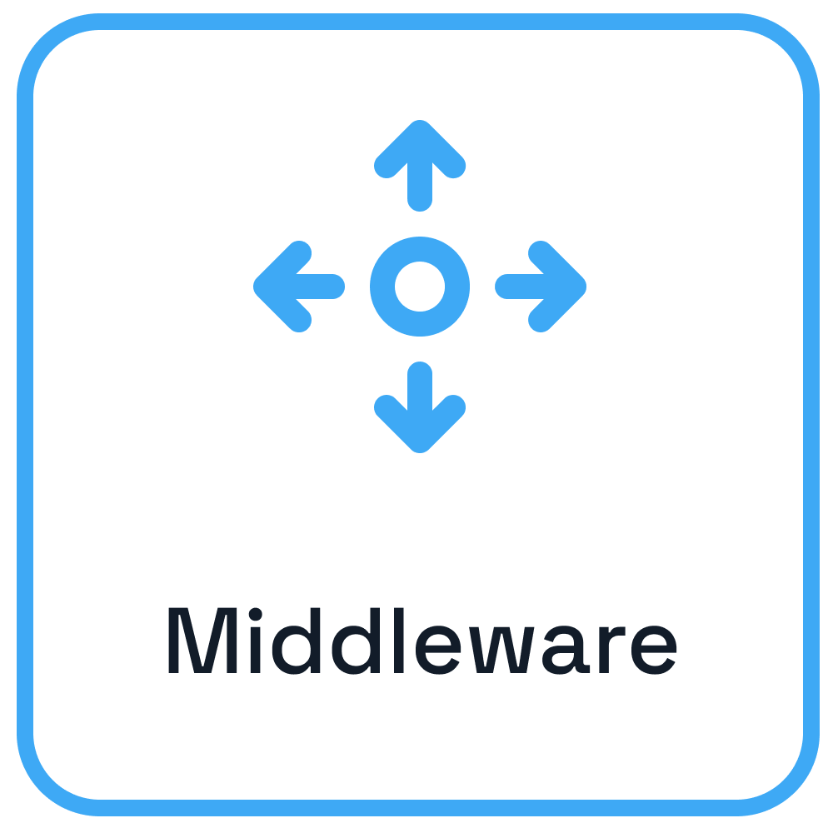
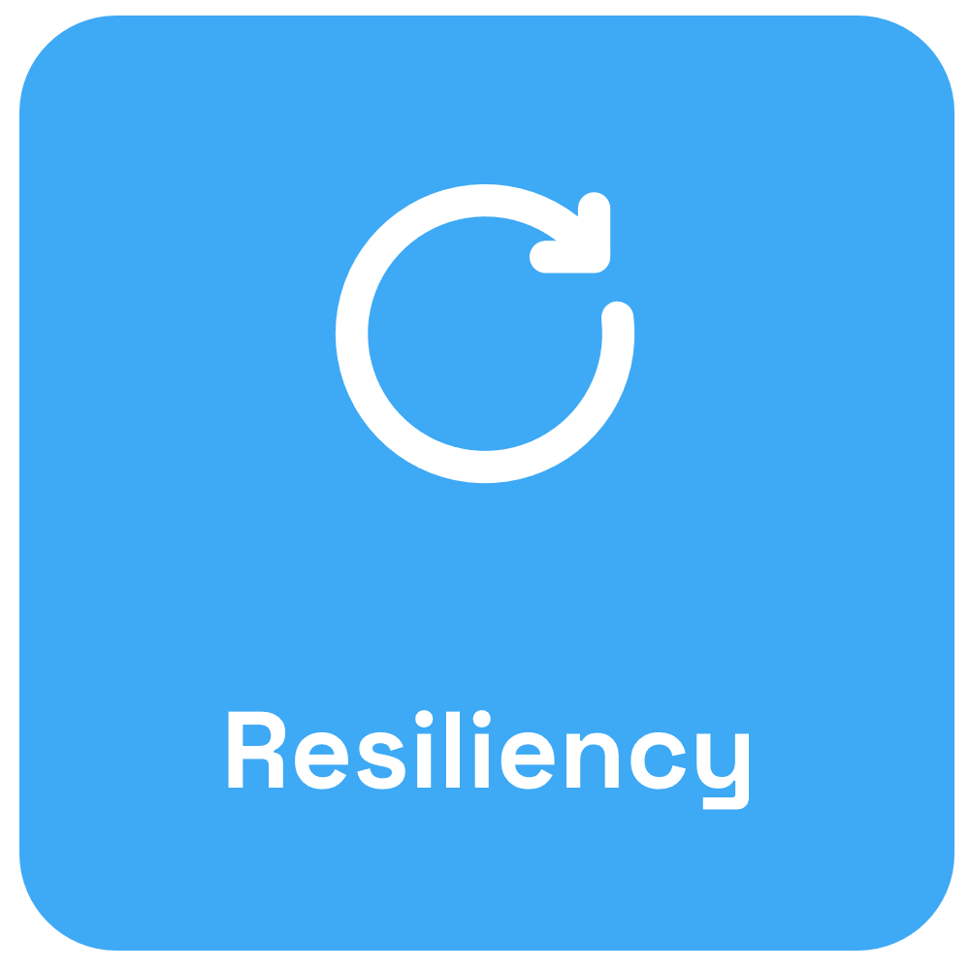








Dapr – Application developer platform
Use any language or runtime
App
HTTP/gRPC
Host on & integrate with any cloud or edge infrastructure
Databases
Message Brokers
Services

Slide 18





















































Apps using any language / runtime
Product teams
Dapr APIs decouple infrastructure services from application code
Other APIs & tools
Platform interfaces
Observability
Security
Resiliency
Payment
providers
CRM
Portals & dashboards
Graduated project
Connect with over 120 infrastructure resources & capabilities
Platform capabilities
Cloud native integrations include
Run on cloud or edge infrastructure
Infrastructure resources and service providers

Slide 19
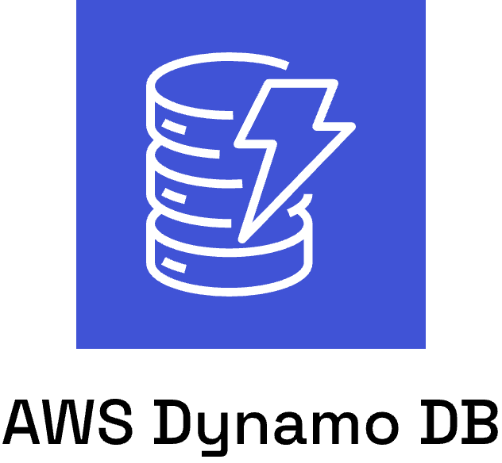
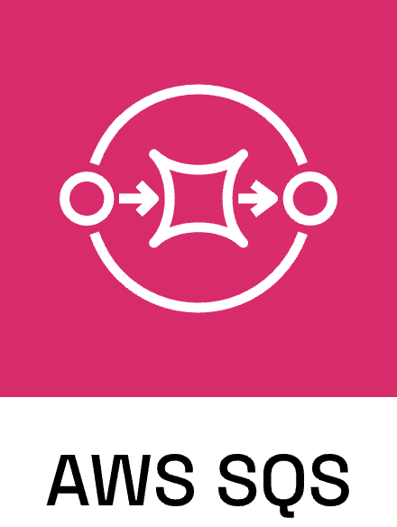


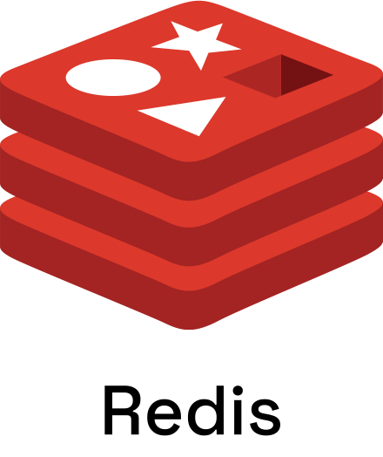

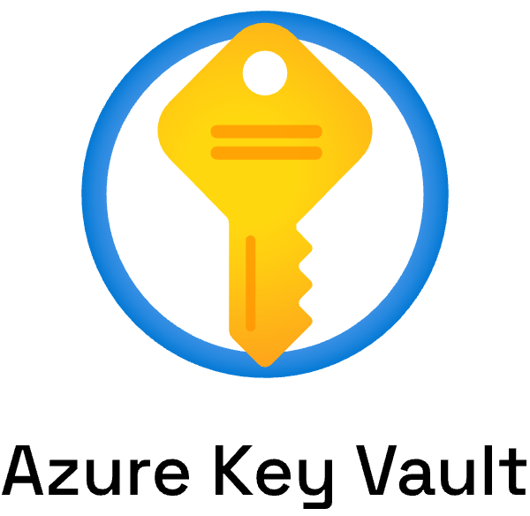
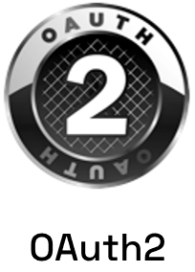

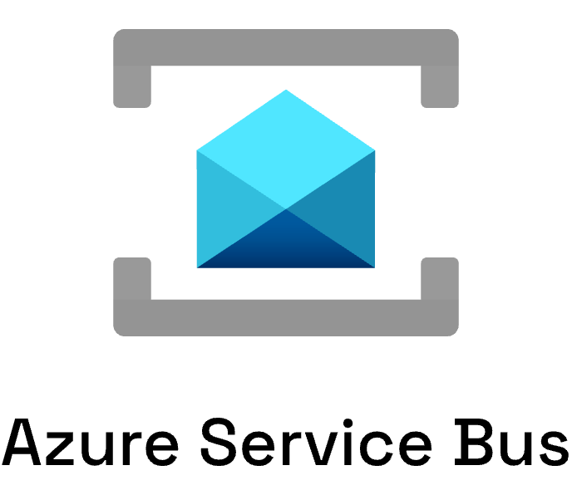
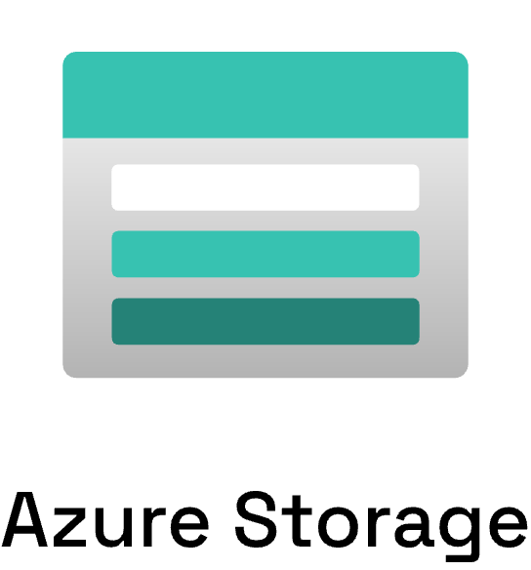
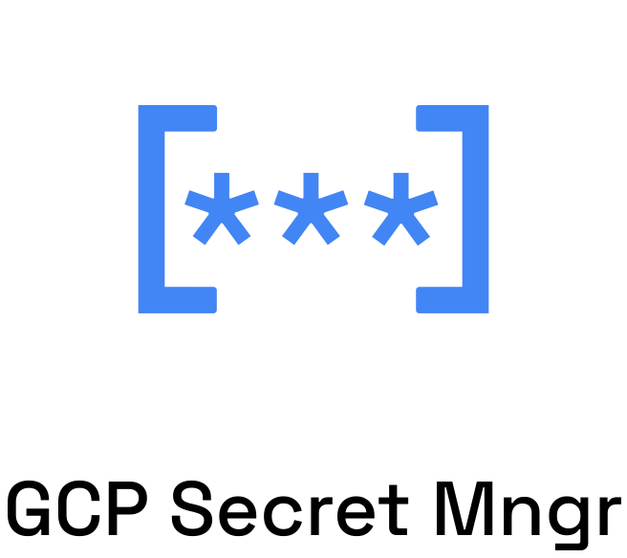
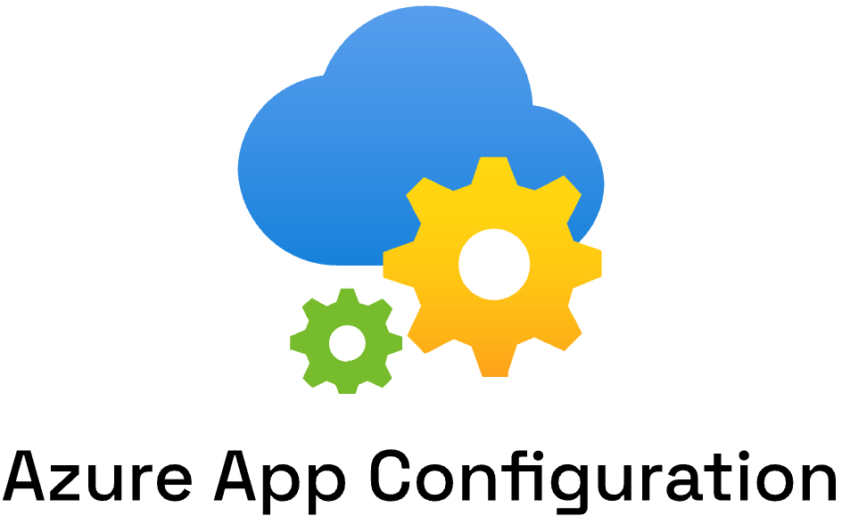


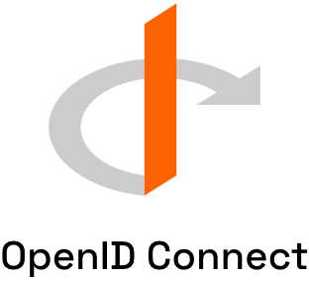

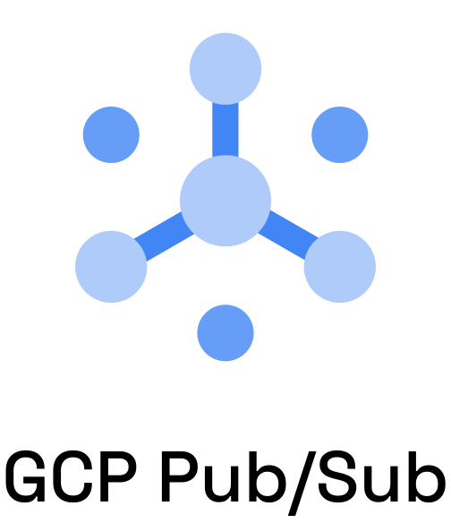
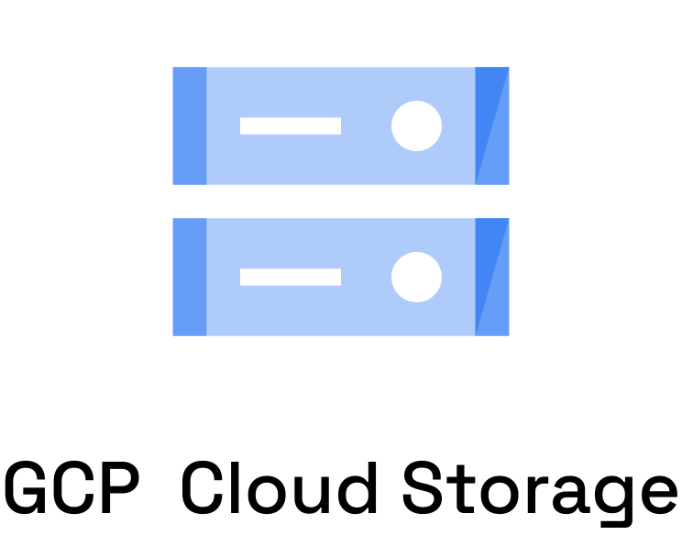


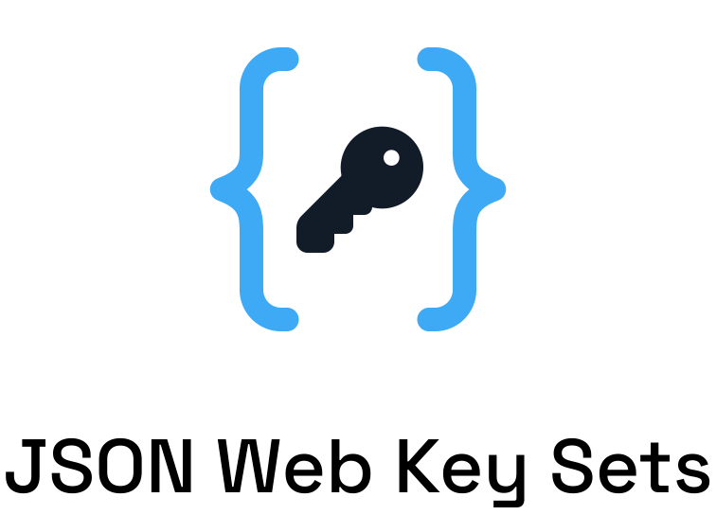






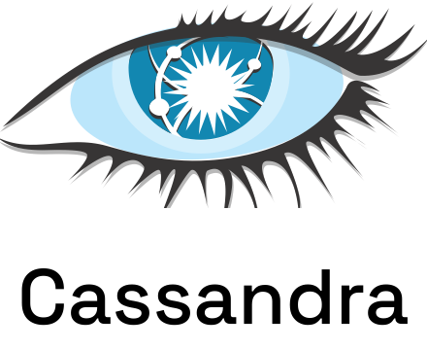





Dapr components
App

Slide 20
Sidecar pattern and the Dapr API
Dapr API
My App
App
HTTP/gRPC
Application code
Dapr sidecar
POST http://localhost:3500/v1.0/invoke/cart/method/order
GET http://localhost:3500/v1.0/state/inventory/item50
POST http://localhost:3500/v1.0/publish/mybroker/order-messages
GET http://localhost:3500/v1.0/secrets/vault/dbaccess
POST http://localhost:3500/v1.0/workflows/dapr/businessprocess/start

Slide 21





Using the Dapr APIs
Input Binding Trigger
GET /v1.0/secrets/
POST /v1.0/publish/
Subscription
POST /v1.0/binding/
App A
Message broker
App C
GET /dapr/subscribe/
POST /v1.0/invoke/
POST /v1.0/state/
App B
Storage
GET /v1.0/configuration/

Slide 22
Swappable component model
Local dev
Local file
In memory

Slide 23
Swappable component model

Slide 24
Swappable component model

Slide 25
Swappable component model

Slide 26
Swappable component model

Slide 27
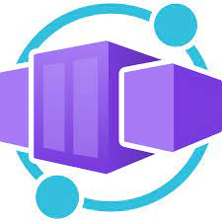






Use Dapr anywhere
Azure Container Apps

Slide 28









Dapr community
14/157
120
700k+
300k
Largest CNCF project
Community components
Docker Hub pulls/month
Unique doc views/month
📖
31k
3.9k
8k
GitHub stars
Discord members
Contributors
⭐

Slide 29
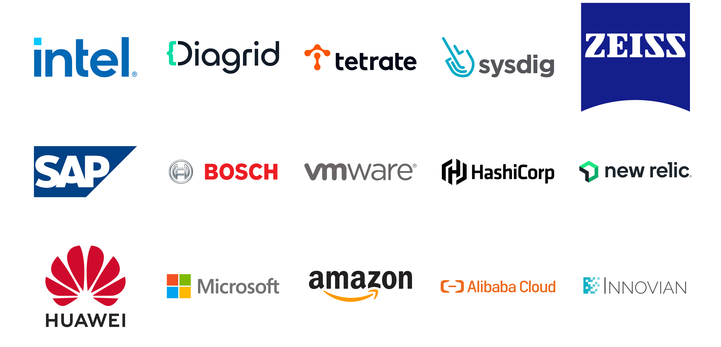
Dapr contributors

Slide 30
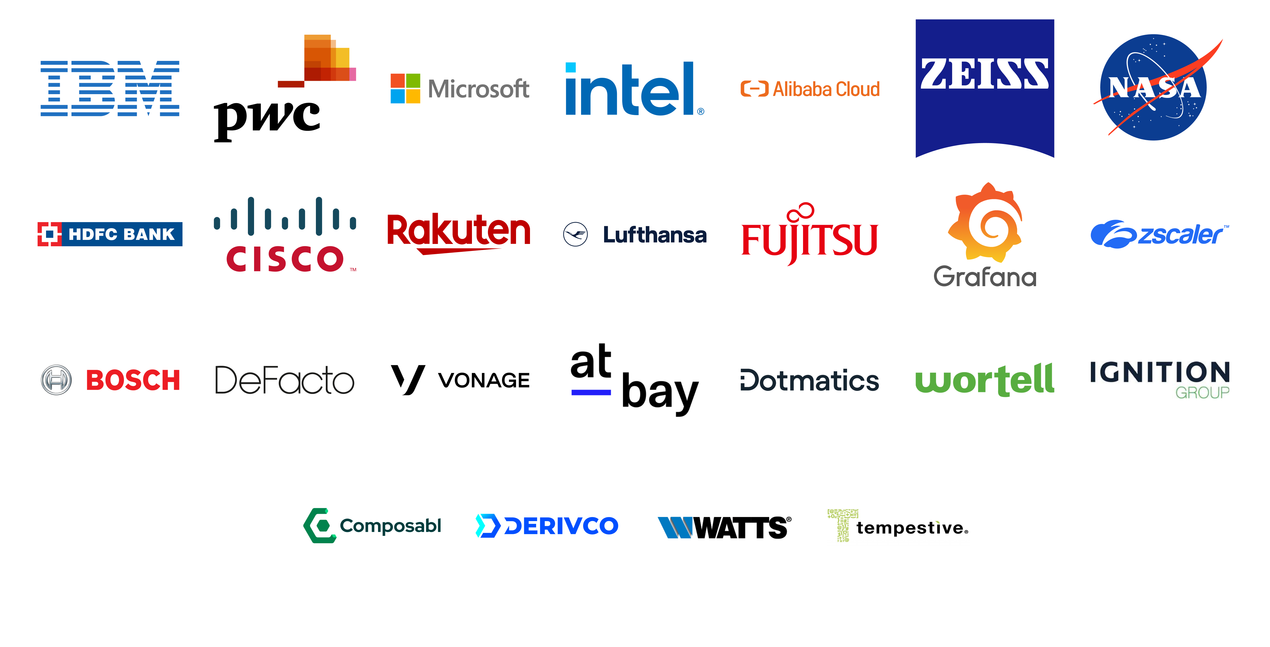
Dapr users

Slide 31
Dapr APIs & Cross cutting concerns
App B
App A
App C

Slide 32
Service Invocation API
https://docs.dapr.io/developing-applications/building-blocks/service-invocation/

Slide 33
Service Invocation
- Service discovery via name resolution components
- Invoke HTTP and gRPC services consistently
- Configurable resiliency policies
- Built-in distributed tracing & metrics
- Access control policies & mTLS
- Chain pluggable middleware components
The service invocation API allows synchronous communication between services.

Slide 34
Service Invocation
Customer
Checkout
POST
http://localhost:3500/v1.0/invoke/checkout/method/order
POST
http://localhost:5100/order

Slide 35


Service Invocation
Name resolution component for service discovery
Observability backend
DNS
Invoke method
Customer
Checkout
mTLS encryption
POST
http://localhost:3500/v1.0/invoke/checkout/method/order
POST
http://localhost:5100/order
Notes:
Name Resolution component for service discovery: mDNS, Kubernetes DNS, Hashicorp Consul

Slide 36
Service Invocation in .NET
var order = new Order(orderId);
var client = DaprClient.CreateInvokeHttpClient(appId: "order-processor");
var response = await client.PostAsJsonAsync("/orders", order);

Slide 37
Service Invocation in Python
base_url = os.getenv('BASE_URL', 'http://localhost') + ':’ +
os.getenv('DAPR_HTTP_PORT', '3500’)
headers = {'dapr-app-id': 'order-processor’, 'content-type’: 'application/json’}
order = {'orderId’: orderId}
result = requests.post(
url='%s/orders' % (base_url),
data=json.dumps(order),
headers=headers

Slide 38
Service Invocation Demo
https://docs.dapr.io/getting-started/quickstarts/serviceinvocation-quickstart/

Slide 39
Publish / Subscribe API
https://docs.dapr.io/developing-applications/building-blocks/pubsub/

Slide 40
Publish / Subscribe
- Integrates with many message brokers and queues
- Guaranteed at least one delivery
- Use declarative or programmatic subscriptions
- Use content-based message routing
- Set dead-letter topics and resiliency policies
- Limit publish and subscribe access by using scopes
The publish subscribe API allows asynchronous communication between services.

Slide 41
Publish / Subscribe
Publisher
Message
broker
Subscriber
POST
http://localhost:3500/v1.0/publish/mybroker/order-messages
POST
http://localhost:5100/orders

Slide 42

Publish / Subscribe
Observability backend
Cloudevents
Publisher
Message
broker
Subscriber
POST
http://localhost:3500/v1.0/publish/mybroker/order-messages
POST
http://localhost:5100/orders

Slide 43
Publish / Subscribe Component
apiVersion: dapr.io/v1alpha1
kind: Component
metadata:
name: mybroker
spec:
type: pubsub.redis
version: v1
metadata:
- name: redisHost
value: localhost:6379
- name: redisPassword
value: ""
Observability backend
Cloudevents
Publisher
Message
broker
Subscriber
POST
http://localhost:3500/v1.0/publish/mybroker/order-messages
POST
http://localhost:5100/orders

Slide 44
Publish / Subscribe with .NET SDK
Publish
var order = new Order(orderId);
using var client = new DaprClientBuilder().Build();
await client.PublishEventAsync("orderpubsub", "orders", order);
Subscribe
app.UseCloudEvents();
app.MapSubscribeHandler();
app.MapPost("/orders", [Topic("orderpubsub", "orders")] (Order order) =>
{
return Results.Ok(order);
});

Slide 45
Publish / Subscribe with Python SDK
Publish
with DaprClient() as client:
order = {'orderId’: orderId}
result = client.publish_event(
pubsub_name='orderpubsub',
topic_name='orders',
data=json.dumps(order),
data_content_type='application/json',
)

Slide 46
Publish / Subscribe with Python SDK
Subscribe
@app.route('/dapr/subscribe', methods=['GET'])
def subscribe():
subscriptions = [{
'pubsubname': 'orderpubsub',
'topic': 'orders',
'route': 'orders'
}]
return jsonify(subscriptions)
@app.route('/orders', methods=['POST'])
def orders_subscriber():
event = from_http(request.headers, request.get_data())
return json.dumps({'success': True}), 200, {
'ContentType': 'application/json'}

Slide 47
Publish / Subscribe Demo
https://docs.dapr.io/getting-started/quickstarts/pubsub-quickstart/

Slide 48
State Management API (Key/Value)
https://docs.dapr.io/developing-applications/building-blocks/state-management/

Slide 49
State Management
- Integrates with many state stores
- Configurable concurrency and consistency behaviors
- Use bulk operations
- Use resiliency policies
- Limit access by using scopes
The state management API allows key/value pair storage across many supported state stores.

Slide 50
State Management (Key/Value)
key | field | value
orders||order1 | data | "{orderId:1}"
orders||order1 | version | 1
Orders
State store
POST
http://localhost:3500/v1.0/state/mystatestore
[{
“key”: “order1”,
“value”: “{orderId: 1}”
}]

Slide 51
State Management (Key/Value)
key | field | value
orders||order1 | data | "{orderId:1}"
orders||order1 | version | 1
Orders
State store
GET
http://localhost:3500/v1.0/state/mystatestore/order1

Slide 52
State Management with .NET SDK
var order = new Order(orderId);
await client.SaveStateAsync(
DAPR_STORE_NAME,
orderId.ToString(),
order.ToString());
var result = await client.GetStateAsync<string>(
DAPR_STORE_NAME,
orderId.ToString());
await client.DeleteStateAsync(
DAPR_STORE_NAME,
orderId.ToString());

Slide 53
State Management with Python SDK
with DaprClient() as client:
order = {'orderId': orderId}
client.save_state(DAPR_STORE_NAME, orderId, str(order))
result = client.get_state(DAPR_STORE_NAME, orderId)
client.delete_state(store_name=DAPR_STORE_NAME, key=orderId)

Slide 54
State Management (Key/Value) Demo
https://docs.dapr.io/getting-started/quickstarts/statemanagement-quickstart/

Slide 55
Dapr Workflow
https://docs.dapr.io/developing-applications/building-blocks/workflow/

Slide 56
Dapr Workflow
- Durable execution due to persisting workflow state
- Works seamlessly with other Dapr APIs
- Author workflows in C#, Java, Python, JavaScript or Go
- Apply patterns such as: chaining, fan-out/fan-in, wait for external events, durable timers, child workflows.
The workflow API enables the durable execution of potentially long running business processes.

Slide 57


Workflow example
Receive message
Start
Get secret
Activity A
External Event
Wait for event
Invoke an API
Activity B
Activity C
Store event result
Activity D
Publish message
End

Slide 58
Task Chaining
Start
With task changing, multiple activities are executed in succession. Use this pattern when the order of execution is important. The output from one activity can be used as the input for the next activity.
Activity A
Activity B
Activity C
End

Slide 59
Task Chaining with with .NET SDK
var result1 = await context.CallActivityAsync<string[]>(“Activity1", workflowInput);
var result2 = await context.CallActivityAsync<int[]>(“Activity2", result1);
var result3 = await context.CallActivityAsync<string>(“Activity3", result2);
return result3;

Slide 60
Task Chaining with with Python SDK
result1 = yield ctx.call_activity(activity1, input=workflow_input);
result2 = yield ctx.call_activity(activity2, input=result1);
result3 = yield ctx.call_activity(activity3, input=result2);
return result3;

Slide 61
Fan-out/Fan-in
Start
With fan-out/fan-in, multiple activities can be executed simultaneously. Use this pattern when the activities are independent of each other. The result of the activities can be aggregated in the workflow.
Activity A
Activity B
Activity C
End

Slide 62
Fan-out/Fan-in with .NET SDK
// Get a list of N work items to process in parallel.
object[] workBatch = await context.CallActivityAsync<object[]>("GetWorkBatch", null);
// Prepare the parallel tasks, but don't wait for them to complete yet.
var parallelTasks = new List<Task<int>>(workBatch.Length);
for (int i = 0; i < workBatch.Length; i++)
{
Task<int> task = context.CallActivityAsync<int>("ProcessWorkItem", workBatch[i]);
parallelTasks.Add(task);
}
// Scheduled all tasks and wait here until all have completed.
await Task.WhenAll(parallelTasks);
// Aggregate all N outputs and publish the result.
int sum = parallelTasks.Sum(t => t.Result);
await context.CallActivityAsync("PostResults", sum);

Slide 63
Fan-out/Fan-in with Python SDK
// Get a list of N work items to process in parallel.
work_batch = yield ctx.call_activity(get_work_batch, input=workflow_input);
// Schedule the parallel tasks, but don't wait for them to complete yet.
parallel_tasks = [
ctx.call_activity(process_work_item, input=work_item) for work_item in work_batch
]
// Scheduled all tasks and wait here until all have completed.
outputs = yield wf.when_all(parallel_tasks);
// Aggregate all N outputs and process the result.
total = sum(outputs);
yield ctx.call_activity(process_results, input=total);

Slide 64
Monitor
Start
With the monitor pattern, a recurring activity is executed. This is usually combined with a timer to introduce a delay. Use this pattern to periodically check a status of a system and perform an action based on that status.
Activity
CreateTimer
Wait with further execution of the workflow
ContinueAsNew
Restart the workflow without the history

Slide 65
Monitor with .NET SDK
var status = await context.CallActivityAsync<string>("GetStatus");
if (status == "healthy")
{
myEntityState.IsHealthy = true;
myEntityState.UnHealthyCount = 0;
}
else
{
myEntityState.IsHealthy = false;
myEntityState.UnHealthyCount += 1;
if (myEntityState.UnHealthyCount > 3)
{
await context.CallActivityAsync("SendAlert", myEntityState);
}
}
// Put the workflow to sleep until the determined time
await context.CreateTimer(TimeSpan.FromMinutes(30));
// Restart from the beginning with the updated state
context.ContinueAsNew(myEntityState);

Slide 66
Monitor with Python SDK
status = yield ctx.call_activity(get_status, input=job)
if not ctx.is_replaying:
print(f"Job '{job.job_id}' is {status}.")
if status == 'healthy':
job.is_healthy = True
next_sleep_interval = 60 # check less frequently when healthy
else:
if job.is_healthy:
job.is_healthy = False
yield ctx.call_activity(send_alert, input=f"Job '{job.job_id}' is unhealthy!")
next_sleep_interval = 5 # check more frequently when unhealthy
yield ctx.create_timer(fire_at=timedelta(seconds=next_sleep_interval))
# restart from the beginning with a new JobStatus input
ctx.continue_as_new(job)

Slide 67
External System Interaction
Start
The external system interaction pattern allows the workflow to pause until an event is received that originates from an external source. The event could be triggered by a person who needs to approve a step in a business process.
GetApproval
Approval Event
Wait for event
Approved
Not Approved
End

Slide 68
External System Interaction with .NET SDK
await context.CallActivityAsync("RequestApproval", order);
// Pause and wait for a human to approve the order
var approvalResult = await context.WaitForExternalEventAsync<ApprovalResult>(
eventName: "ManagerApproval",
timeout: TimeSpan.FromDays(3));
if (approvalResult == ApprovalResult.Rejected)
{
// The order was rejected, end the workflow here
return new OrderResult(Processed: false);
}
else
{
await context.CallActivityAsync("OrderExpensiveItem", order);
}

Slide 69
External System Interaction with Python SDK
yield ctx.call_activity(request_approval, input=order);
// Pause and wait for a human to approve the order
approval_event = ctx.wait_for_external_event(‘manager_approval’)
timeout_event = ctx.create_timer(timedelta(days=3))
winner = yield wf.when_any([approval_event, timeout_event])
if winner == timeout_event:
return ‘Cancelled’;
approval_details = Approval.from_dict(approval_event.get_result())
if approval_details.isApproved :
yield ctx.call_activity(order_expensive_item, input=order)
else:
return ‘Rejected’

Slide 70
Workflow Engine
Schedule workflow / activity
Workflow App
gRPC stream
Return results
Workflow and Activity definitions
Dapr Workflow engine
Append only state store
POST http://localhost:3500/v1.0/workflows/dapr/businessprocess/start

Slide 71
Workflow Engine built on Dapr Actors
Orchestrator Actor
Workflow App
Customer
Workflow engine
Append only state store
Workflow and Activity definitions
Activity
Actor

Slide 72
Workflow management with HTTP API
POST http://localhost:<daprPort>/v1.0/workflows/dapr/<workflowName>/start
[?instanceID=<instanceID>]
GET http://localhost:<daprPort>/v1.0/workflows/dapr/<instanceId>
POST http://localhost:<daprPort>/v1.0/workflows/dapr/suspend/<instanceId>
POST http://localhost:<daprPort>/v1.0/workflows/dapr/resume/<instanceId>
POST http://localhost:<daprPort>/v1.0/workflows/dapr/terminate/<instanceId>
POST http://localhost:<daprPort>/v1.0/workflows/dapr/purge/<instanceId>

Slide 73
Workflow Demo
https://docs.dapr.io/getting-started/quickstarts/workflow-quickstart/

Slide 74
Bindings API
https://docs.dapr.io/developing-applications/building-blocks/configuration/

Slide 75
Bindings
- Trigger applications via external messaging systems
- Keep application code free from external
SDKs / libraries
- Switch bindings at runtime
- Use resiliency policies
- Build portable apps with environment specific bindings
The bindings API allows apps to be triggered by incoming events and interface with external systems.

Slide 76

Output Bindings
My App
Twilio
POST http://localhost:3500/v1.0/bindings/twilio
{
“data”: “Hello World!”
}
Notes:
Name Resolution component for service discovery: mDNS, Kubernetes DNS, Hashicorp Consul

Slide 77
Output Bindings with .NET SDK
var sqlText = $"insert into orders (orderid, customer, price) values ({order.OrderId}, '{order.Customer}', {order.Price});";
var command = new Dictionary<string, string>(){
{
"sql",
sqlText}
};
// Insert order using Dapr output binding via Dapr Client SDK
await client.InvokeBindingAsync(
bindingName: sqlBindingName,
operation: "exec",
data: "", metadata: command);
Notes:
Name Resolution component for service discovery: mDNS, Kubernetes DNS, Hashicorp Consul

Slide 78
Output Bindings with Python SDK
with DaprClient() as d:
sqlCmd = ('insert into orders (orderid, customer, price) values ' +
'(%s, \'%s\', %s)' % (order_line['orderid'],
order_line['customer'],
order_line['price’]))
payload = {'sql': sqlCmd}
# Insert order using Dapr output binding via Dapr Client SDK
resp = d.invoke_binding(binding_name=sql_binding, operation='exec',
binding_metadata=payload, data='')
Notes:
Name Resolution component for service discovery: mDNS, Kubernetes DNS, Hashicorp Consul

Slide 79
Input Bindings
My App
Kafka
Notes:
Name Resolution component for service discovery: mDNS, Kubernetes DNS, Hashicorp Consul

Slide 80
Input Bindings
My App
Kafka
[ApiController]
public class CheckoutServiceController : Controller
{
[HttpPost("/checkout")]
public ActionResult<string> getCheckout([FromBody] int orderId)
{
Console.WriteLine("Received Message: " + orderId);
return "CID" + orderId;
}
}
Notes:
Name Resolution component for service discovery: mDNS, Kubernetes DNS, Hashicorp Consul

Slide 81
Input Bindings
apiVersion: dapr.io/v1alpha1
kind: Component
metadata:
name: checkout
spec:
type: bindings.kafka
version: v1
metadata:
# Kafka broker connection setting
- name: brokers
value: localhost:9092
# consumer configuration: topic and consumer group
- name: topics
value: sample
- name: consumerGroup
value: group1
# publisher configuration: topic
- name: publishTopic
value: sample
- name: authRequired
value: false
- name: direction
value: input
My App
Kafka
[ApiController]
public class CheckoutServiceController : Controller
{
[HttpPost("/checkout")]
public ActionResult<string> getCheckout([FromBody] int orderId)
{
Console.WriteLine("Received Message: " + orderId);
return "CID" + orderId;
}
}
Notes:
Name Resolution component for service discovery: mDNS, Kubernetes DNS, Hashicorp Consul

Slide 82
Bindings Demo
https://docs.dapr.io/getting-started/quickstarts/bindings-quickstart/

Slide 83
Secrets Management API
https://docs.dapr.io/developing-applications/building-blocks/secrets/secrets-overview/

Slide 84
Secrets Management
- Integrates with public cloud and cloud-native
secret stores
- Safely access secrets in your applications
- Reference secrets in Dapr components
- Use scopes to limit access
The secrets management API enables access to sensitive information in secret stores.

Slide 85

Secrets Management
My App
Secret store
RESPONSE
{
“mysecret”: “secretvalue”
}
GET http://localhost:3500/v1.0/secrets/myvault/mysecret
Notes:
Name Resolution component for service discovery: mDNS, Kubernetes DNS, Hashicorp Consul

Slide 86
Secrets Management with .NET SDK
const string DAPR_SECRET_STORE = "localsecretstore";
const string SECRET_NAME = "secret";
var client = new DaprClientBuilder().Build();
var secret = await client.GetSecretAsync(DAPR_SECRET_STORE, SECRET_NAME);
Notes:
Name Resolution component for service discovery: mDNS, Kubernetes DNS, Hashicorp Consul

Slide 87
Secrets Management with Python SDK
DAPR_SECRET_STORE = 'localsecretstore'
SECRET_NAME = 'secret’
with DaprClient() as client:
secret = client.get_secret(store_name=DAPR_SECRET_STORE, key=SECRET_NAME)
Notes:
Name Resolution component for service discovery: mDNS, Kubernetes DNS, Hashicorp Consul

Slide 88
Secrets Management Demo
https://docs.dapr.io/getting-started/quickstarts/secrets-quickstart/

Slide 89
External Configuration API
https://docs.dapr.io/developing-applications/building-blocks/configuration/

Slide 90
External configuration
The external configuration API enables read access to configuration data.
- Integrates with many configuration stores
- Subscribe to configuration changes
- Use scopes to limit access

Slide 91

External Configuration
My App
External configurationstore
RESPONSE
{
“config1”: {
“value” : “configvalue”
}
}
GET http://localhost:3500/v1.0/configuration/myconfig?key=config1
Notes:
Name Resolution component for service discovery: mDNS, Kubernetes DNS, Hashicorp Consul

Slide 92
External Configuration with .NET SDK
const string DAPR_CONFIGURATION_STORE = "configstore";
var CONFIGURATION_ITEMS = new List<string> { "orderId1", "orderId2" };
var client = new DaprClientBuilder().Build();
var config = await client.GetConfiguration(
DAPR_CONFIGURATION_STORE,
CONFIGURATION_ITEMS);
foreach (var item in config.Items)
{
var configItem = System.Text.Json.JsonSerializer.Serialize(item.Value);
}
Notes:
Name Resolution component for service discovery: mDNS, Kubernetes DNS, Hashicorp Consul

Slide 93
External Configuration with Python SDK
DAPR_CONFIGURATION_STORE = 'configstore'
CONFIGURATION_KEYS = ['orderId1', 'orderId2']
with DaprClient() as client:
for key in CONFIGURATION_KEYS:
resp = client.get_configuration(store_name=DAPR_CONFIGURATION_STORE, keys=[key], config_metadata={})
print(f"Configuration for {key} : {resp.items[key].value}", flush=True)
Notes:
Name Resolution component for service discovery: mDNS, Kubernetes DNS, Hashicorp Consul

Slide 94
External Configuration Demo
https://docs.dapr.io/getting-started/quickstarts/configuration-quickstart/

Slide 95
Actors API
https://docs.dapr.io/developing-applications/building-blocks/actors/

Slide 96
Actors
- Uses the Virtual Actor pattern
- State is persisted in a configurable state store
- Uses turn-based access in concurrent systems
- Built-in actor distribution and fail-over
- Schedule period work using timers & reminders
- Author actors in C#, Java, JavaScript, Python and Go
- Use the Actors API with any language
The Actors API allows to write concurrent applications using the actor model.

Slide 97
Virtual Actor Model
Actor lifetime is not tied to their in-memory representation.
No need to explicitly create or destroy an actor.
Notes:
Name Resolution component for service discovery: mDNS, Kubernetes DNS, Hashicorp Consul

Slide 98
Actor placement
Pod 1
My App
POST /v1.0/actors/MyActor/A/method/update
App
Instance 1
MyActor A
3
2
1
MyActor B
Pod 2
Actor Type | Dapr Instances
MyActor | Partition1 Partition2
OtherActor | Partition 2
1
Placement Service
App
Instance 2
MyActor C
OtherActor A
Notes:
Name Resolution component for service discovery: mDNS, Kubernetes DNS, Hashicorp Consul

Slide 99
Actors API
Invoke the update method on MyActor “A”
Create actor reminder
POST /v1.0/actors/MyActor/A/method/update
POST /v1.0/actors/MyActor/A/reminders/process
Save MyActor “A” state
Create actor timer
POST /v1.0/actors/MyActor/A/state
POST /v1.0/actors/MyActor/A/timer/process
Get MyActor “A” state
GET /v1.0/actors/MyActor/A/state/key
Notes:
Name Resolution component for service discovery: mDNS, Kubernetes DNS, Hashicorp Consul

Slide 100
Authoring Actors with .NET SDK
public interface ISmartDevice : IActor
{
Task<string> SetDataAsync(SmartDeviceData device);
Task<SmartDeviceData> GetDataAsync();
Task DetectSmokeAsync();
Task SoundAlarm();
Task ClearAlarm();
}
public class SmartDeviceData
{
public string Status { get; set; } = default!;
public string Location { get; set; } = default!;
}
Notes:
Name Resolution component for service discovery: mDNS, Kubernetes DNS, Hashicorp Consul

Slide 101
Authoring Actors with .NET SDK
var deviceActorId1 = new ActorId("device1");
// Create a new instance of the data class that will be stored in the actor
var deviceData1 = new SmartDeviceData(){
Location = "First Floor",
Status = "Ready",
};
// Create the local proxy by using the same interface that the service implements.
// You need to provide the type and id so the actor can be located.
// If the actor matching this id does not exist, it will be created
var proxySmartDevice1 = ActorProxy.Create<ISmartDevice>(
deviceActorId1,
"SmokeDetectorActor");
// Now you can use the actor interface to call the actor's methods.
var setDataResponse1 = await proxySmartDevice1.SetDataAsync(deviceData1);
Notes:
Name Resolution component for service discovery: mDNS, Kubernetes DNS, Hashicorp Consul

Slide 102
Actors Demo
https://docs.dapr.io/getting-started/quickstarts/actors-quickstart/

Slide 103
Jobs API
https://docs.dapr.io/developing-applications/building-blocks/jobs/jobs-overview/

Slide 104
Jobs
ALPHA
The Jobs API is an orchestrator that schedules tasks to be executed at a specific time or on a specific interval.
- Uses the Scheduler Service to schedule tasks
- Guarantees at least once delivery
- Combine it with other Dapr APIs such as delaying pub/sub messages or schedule service invocation calls

Slide 105

Jobs
Scheduler
gRPC / HTTP calls
schedule/get/delete
My App
OnJobEvent
WatchJobs
Sidecar
Notes:
Name Resolution component for service discovery: mDNS, Kubernetes DNS, Hashicorp Consul

Slide 106
Jobs with .NET SDK
var jobData = new JobData
{
Droid = droidJob.Name,
Task = droidJob.Job
};
await jobsClient.ScheduleJobWithPayloadAsync(droidJob.Name, DaprJobSchedule.FromDuration(TimeSpan.FromSeconds(droidJob.DueTime)), payload: jobData, repeats: 1); //Schedule cron job that repeats once
Notes:
Name Resolution component for service discovery: mDNS, Kubernetes DNS, Hashicorp Consul

Slide 107
Jobs with .NET SDK
app.MapDaprScheduledJobHandler((string jobName, ReadOnlyMemory<byte> jobPayload) =>
{
var deserializedPayload = Encoding.UTF8.GetString(jobPayload.Span);
if (deserializedPayload is null)
{
throw new Exception("Payload is null");
}
var jobData = JsonSerializer.Deserialize<JobData>(deserializedPayload);
if (jobData?.Droid is null || jobData?.Task is null)
{
throw new Exception("Invalid format of job data.");
}
Console.WriteLine($"Starting droid: {jobData.Droid}");
Console.WriteLine($"Executing maintenance job: {jobData.Task}");
return Task.CompletedTask;
});
Notes:
Name Resolution component for service discovery: mDNS, Kubernetes DNS, Hashicorp Consul

Slide 108
Jobs Demo
https://docs.dapr.io/getting-started/quickstarts/jobs-quickstart/

Slide 109
Conversation API
https://docs.dapr.io/developing-applications/building-blocks/conversation/

Slide 110
LLM Conversation
ALPHA
The Conversation API reduces the complexity of securely and reliably interacting with Large Language Models (LLM) at scale.
- One consistent API to talk to underlying LLM providers
- Use prompt caching to reduce latency and cost
- Use PII obfuscation to remove sensitive user input

Slide 111
LLM Conversation
LLMs
Converse
My App
Sidecar
POST http://localhost:3500/v1.0-alpha1/conversation/<llm-name>/converse
Where <llm-name> contains the name of the LLM component

Slide 112
LLM Conversation with .NET SDK
const string prompt = "What is dapr?";
var conversationClient = app.Services.GetRequiredService<DaprConversationClient>();
var response = await conversationClient.ConverseAsync(ConversationComponentName, [new(prompt, DaprConversationRole.Generic)]);
if (response != null)
{
  Console.Write("Output response:");
foreach (var resp in response.Outputs)
{
Console.WriteLine($" {resp.Result}");
}
}

Slide 113
LLM Conversation with Python SDK
PROMPT = 'What is dapr?'
with DaprClient() as d:
inputs = [
ConversationInput(content=PROMPT, role='user', scrub_pii=True),
]
metadata = {
'model': 'modelname',
'key': 'authKey',
'cacheTTL': '10m',
}
response = d.converse_alpha1(
name=CONVERSATION_COMPONENT, inputs=inputs, temperature=0.7, context_id='chat-123’, metadata=metadata
)
for output in response.outputs:
print(f'Output response: {output.result}')

Slide 114
Conversation Demo
https://docs.dapr.io/getting-started/quickstarts/conversation-quickstart/

Slide 115
Distributed Lock API
https://docs.dapr.io/developing-applications/building-blocks/distributed-lock/

Slide 116
Distributed lock
ALPHA
- Only a single instance of an application can hold a lock
- Locks are scoped to a Dapr app-id
- Uses a lease-based locking mechanism to prevent deadlocks
The distributed lock API provides mutually exclusive access to resources.

Slide 117


Distributed lock
POST
http://localhost:3500/v1.0-alpha1/lock/statestore
My App
{
"resourceId" : “lock1",
"lockOwner" : “app1",
"expiryInSeconds": 60
}
Lock component
State store

Slide 118

Distributed lock
POST
http://localhost:3500/v1.0-alpha1/lock/statestore
App instance 1
{
"resourceId" : “lock1",
"lockOwner" : “app1",
"expiryInSeconds": 60
}
Lock component
State store
App instance 1

Slide 119

Distributed lock
POST
http://localhost:3500/v1.0-alpha1/unlock/statestore
App instance 1
{
"resourceId" : “lock1",
"lockOwner" : “app1“
}
Lock component
State store
App instance 1

Slide 120
Cryptography API
https://docs.dapr.io/developing-applications/building-blocks/cryptography/

Slide 121
Cryptography
- Perform cryptographic operations securely
- Use external vaults or cryptographic components
- Enables better separation of concerns and least privilege practices
ALPHA
The cryptography API enables safe encryption and decryption in your applications.

Slide 122
Cryptography
Cloud
Encrypt & Decrypt API
My App
Generic
Built-in
cryptographic engine
(for generic components)
Notes:
Name Resolution component for service discovery: mDNS, Kubernetes DNS, Hashicorp Consul

Slide 123
Cryptography Demo
https://docs.dapr.io/getting-started/quickstarts/cryptography-quickstart/

Slide 124

https://docs.dapr.io/developing-ai/dapr-agents/

Slide 125

Dapr Agents
Dapr Agents is a developer framework designed to build production-grade resilient AI agent systems that operate at scale.
- Built on top of Dapr Workflow
- Kubernetes-Native
- Data-Driven Agents
- Multi-Agent Systems

Slide 126



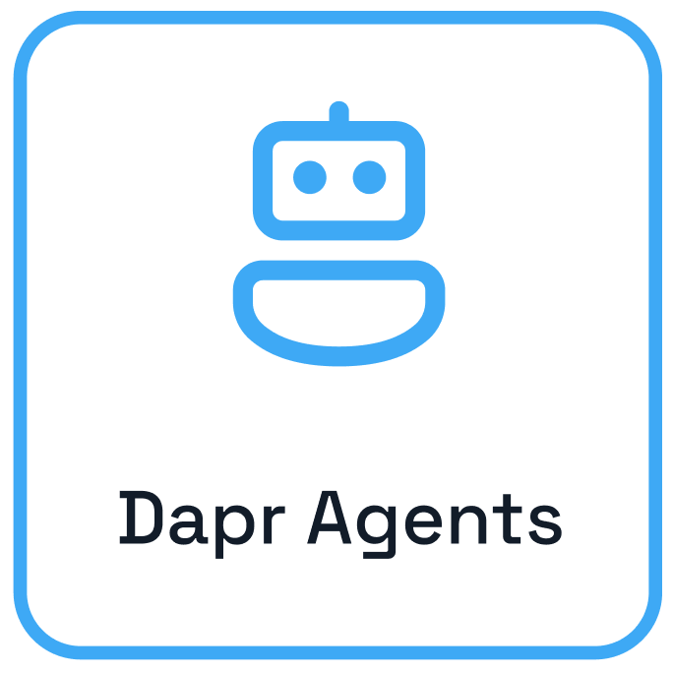




Agent Interactions
Planning
Memory
Interaction
Environment
User
Observation
Delegate tasks
Tools
Outside world
Notes:
Dapr Agents is designed to place agents, powered by LLMs, at the core of task execution and workflow orchestration. This principle emphasizes:
LLM-Powered Agents: Dapr Agents enables the creation of agents that leverage LLMs for reasoning, dynamic decision-making, and natural language interactions.
Adaptive Task Handling: Agents in Dapr Agents are equipped with flexible patterns like tool calling and reasoning loops (e.g., ReAct), allowing them to autonomously tackle complex and evolving tasks.
Seamless Integration: Dapr Agents’ framework allows agents to act as modular, reusable building blocks that integrate seamlessly into workflows, whether they operate independently or collaboratively.

Slide 127


Dapr Agents
AI Agent
Response
{
Reasoning
Prompt
Action
User
LLM
Planning
Observation
Tools
Outside world
Notes:
Agents in Dapr Agents are autonomous systems powered by Large Language Models (LLMs), designed to execute tasks, reason through problems, and collaborate within workflows. Acting as intelligent building blocks, agents seamlessly combine LLM-driven reasoning with tool integration, memory, and collaboration features to enable scalable, agentic systems.

Slide 128
ReAct flow
User
LLM
Thought
Act
Act
Obs
Obs
Tool A
Tool B
Final answer
Notes:
The ReAct (Reason + Act) pattern was introduced in 2022 to enhance the capabilities of LLM-based AI agents by combining reasoning with action. This approach allows agents not only to reason through complex tasks but also to interact with the environment, taking actions based on their reasoning and observing the outcomes. ReAct enables AI agents to dynamically adapt to tasks by reasoning about the next steps and executing actions in real time.

Slide 129

Toolcall flow
Chat completion payload
1
User message
Tools
What is the weather in Virginia?
Jump
User
get_weather
Assistant message
Tools calls
LLM
id: call_12345
name: get_weather
args: {“location”:”virginia”}
2
Tool message
AI Agent
tool_call_id: call_12345
name: get_weather
content: {”virginia”:”80F”}
3
Assistant message
The weather in virginia is 80 F.
4
LLM
User
Notes:
Tool Calling is an essential pattern in autonomous agent design, allowing AI agents to interact dynamically with external tools based on user input. One reliable method for enabling this is through OpenAI's Function Calling capabilities, introduced on June 13, 2023. This feature allows developers to describe functions to models trained to generate structured JSON objects containing the necessary arguments for tool execution, based on user queries.

Slide 130
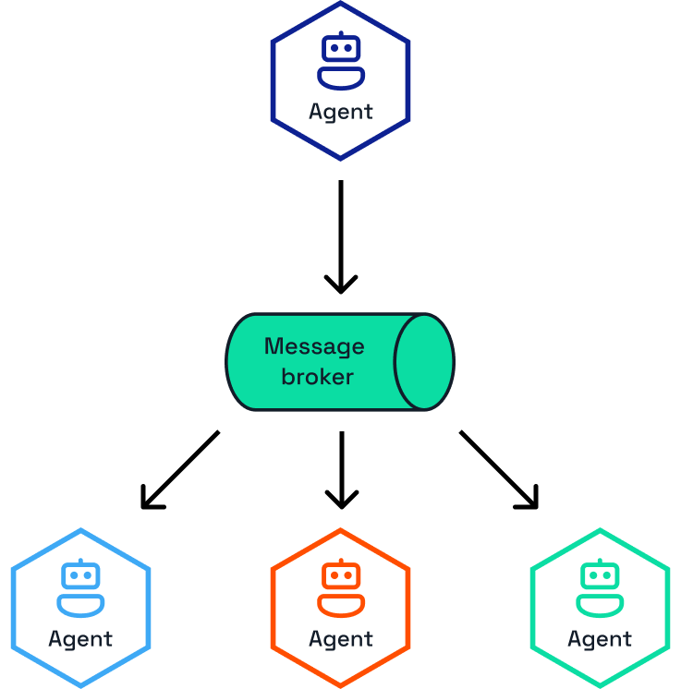
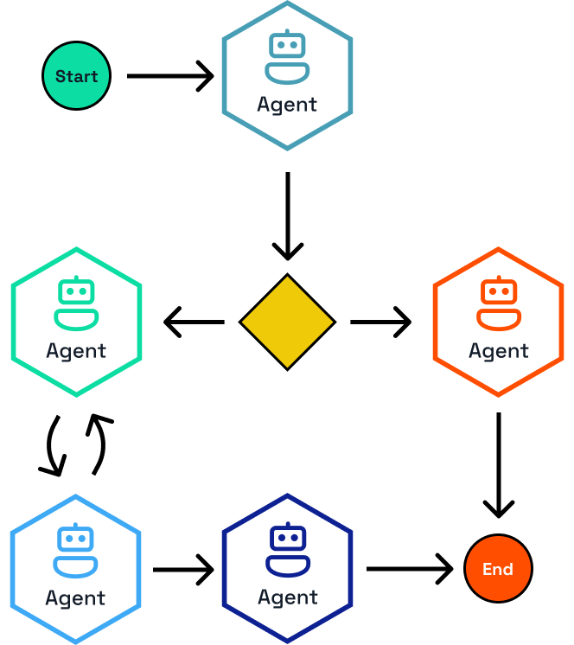
Leverage Dapr pub/sub & workflow APIs

Slide 131
Security
https://docs.dapr.io/concepts/security-concept/

Slide 132
Secure Dapr to Dapr communication
Service A
Service B
mTLS

Slide 133
mTLS in K8s mode
Sentry Pod
Read existing root/issuer cert
OR
Create self-signed cert
Pod A
Pod B
(optional)
Operator brings existing root and issues certs
Service A
Request workload certificate
Service B
mTLS
Inject trust anchors (root cert)
Operator
Injector Pod
Read root cert

Slide 134

Access policies
apiVersion: dapr.io/v1alpha1
kind: Configuration
metadata:
name: appconfig
namespace: default
spec:
api:
allowed:
- name: invoke
version: v1
protocol: grpc
- name: pubsub
version: v1
protocol: grpc
MyApp

Slide 135

Access policies
apiVersion: dapr.io/v1alpha1
kind: Configuration
metadata:
name: appconfig
spec:
accessControl:
defaultAction: deny
trustDomain: "public"
policies:
- appId: app1
defaultAction: allow
trustDomain: 'public'
namespace: "default"
App1
MyApp
App2

Slide 136
Observability
https://docs.dapr.io/concepts/observability-concept/

Slide 137



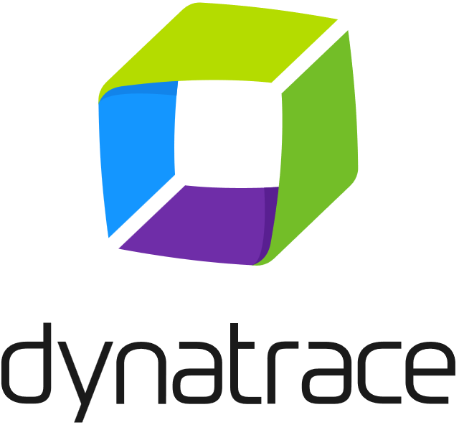


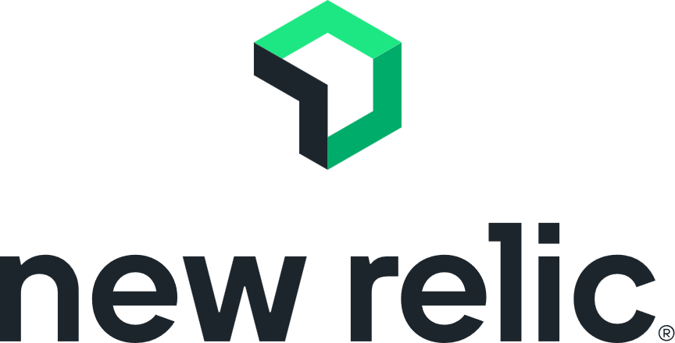
Distributed tracing
Monitoring tools
App label
Tracing
Service invocation
Tracing
Tracing
App label
App label
Publish
Message
broker
Subscribe

Slide 138
Resiliency
https://docs.dapr.io/concepts/resiliency-concept/

Slide 139

Service invocation resiliency
The built-in service invocation retries are always performed with a backoff interval of 1 second up to a threshold of 3 times.
App A
App B
Additionally, service invocation resiliency polices for retries, timeouts and circuit breakers can be applied.

Slide 140
Outbound component resiliency
Component resiliency polices can be applied to outbound component calls. For example, calls to a state store.
App
Outbound
State Store
Additionally, some components have retry capabilities built-in. The policies are configured on a per component basis.

Slide 141

Inbound component resiliency
Resiliency polices can be applied to inbound component calls. For example, pub/sub subscriptions and input bindings.
App label
Inbound
App
Cron input binding

Slide 142
Pub/Sub resiliency
Outbound component resiliency policies for can be applied to message publishing.
Inbound component resiliency polices can be applied to subscriptions when delivering messages.
Outbound
Inbound
App A
Message
broker
App B
Additionally, many pub/sub components have retry capabilities built-in. The policies are configured on a per component basis.

Slide 143
Resiliency
apiVersion: dapr.io/v1alpha1
kind: Resiliency
metadata:
name: myresiliency
scopes:
- order-processor
spec:
policies:
retries:
retryForever:
policy: constant
duration: 5s
maxRetries: -1
circuitBreakers:
simpleCB:
maxRequests: 1
timeout: 5s
trip: consecutiveFailures >= 5
targets:
components:
statestore:
outbound:
retry: retryForever
circuitBreaker: simpleCB
Resiliency patterns can be applied across Dapr APIs:
          Retries
Timeouts
Circuit breakers
Declarative and decoupled from application code.
Available across all component types, service invocation, and actors.

Slide 144
Hosting modes

Slide 145



Hosting modes
Self-hosted
Run dapr init to install Docker images.
Run any app with a Dapr side car using dapr run.
Virtual/Physical machines
Self-deploy Dapr control plane and Hashicorp Consul per machine.
Use the Dapr Installer Bundle for airgapped environments.
Run any app with a Dapr side car using dapr run.
Kubernetes
Run dapr init -k to install Dapr (or use Helm). Integrated Dapr control plane. Deploys placement, operator, sentry and injector pods.
Automatically injects a Dapr sidecar into all annotated pods.

Slide 146

Hosting modes
Serverless
The Dapr side car is hosted by a provider.
You only manage your applications.

Slide 147


Local development with the Dapr CLI
Docker Desktop
dapr init
placement
Create mapping table of actor instances and pods
App
scheduler
Schedule jobs for Jobs API and Actor reminders
Use components
redis
State management & pub/sub messaging
dapr run [flags]
zipkin
Send distributed tracing
https://docs.dapr.io/getting-started/install-dapr-cli/

Slide 148


Dapr in self-hosted mode on VMs
VM1
VM2
VM3
App A
App B
Consul for DNS name resolution
Consul
Leader
Consul
Follower
Consul
Follower
Schedule jobs for Jobs API and Actor reminders
Job scheduler
scheduler
Job scheduler
scheduler
Job scheduler
scheduler
Actor placement
Create mapping
table of
actor instances
Actor placement
Actor placement
placement
placement
placement
Cert authority & identity
Assign Spiffe identity
Manage mTLS
Cert authority & identity
Cert authority & identity
sentry
sentry
sentry
Cert store

Slide 149
Dapr on Kubernetes
Pod
Pod
Pod
Pod
Actor partition placement
Dapr runtime injector
Cert authority and identity
Manage component changes
placement
injector
sentry
operator
Create mapping table of actor instance to pods
Inject Dapr sidecar into annotated pods
Inject env variables
Manage mTLS between services
Assign spiffe identity
Manage component updates
Manage Kubernetes service endpoints
Pod
Pod
Jobs Scheduler
scheduler
App
Schedule jobs for Jobs API and Actor reminders
Kubelet
Readiness and liveness probe on healthz API to determine Dapr health state
Use components
Host on any cloud or edge infrastructure

Slide 150
Serverless
Azure Container Apps
Dapr API*
Use components
App
Managed
* The number of Dapr APIs offered by serverless platforms can deviate from the APIs in Dapr OSS.
https://docs.dapr.io/operations/hosting/serverless/

Slide 151
Serverless
App Host
Dapr API*
Use components
App
Managed
* The number of Dapr APIs offered by serverless platforms can deviate from the APIs in Dapr OSS.
https://docs.dapr.io/operations/hosting/serverless/

Slide 152






Dapr Resources
dapr.io
bit.ly/dapr-youtube
bit.ly/dapr-quickstarts
bit.ly/dapr-discord
@daprdev
dapr.io
@daprdev.bsky.social

Slide 153


Claim the Dapr Community Supporter badge!
bit.ly/dapr-supporter

Slide 154
Dapr presentation assets
Source

Slide 155
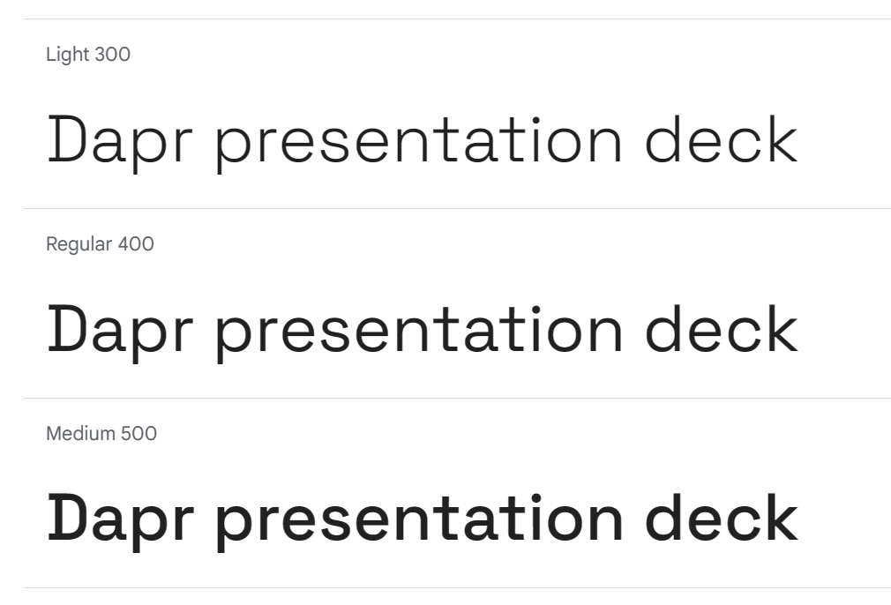
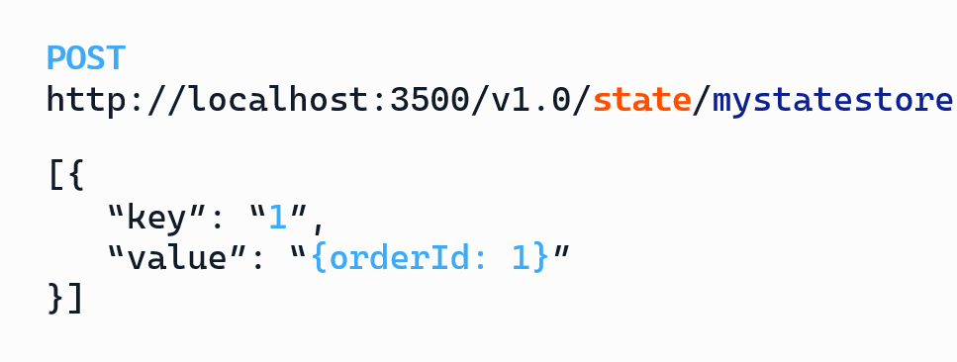
Fonts
Space Grotesk
for all regular texts
and labels
https://fonts.google.com/specimen/Space+Grotesk
CaskadiaCove Nerd Font for code / HTTP endpoints
https://github.com/ryanoasis/nerd-fonts/releases/download/v3.0.2/CascadiaCode.zip
https://www.nerdfonts.com/font-downloads

Slide 156
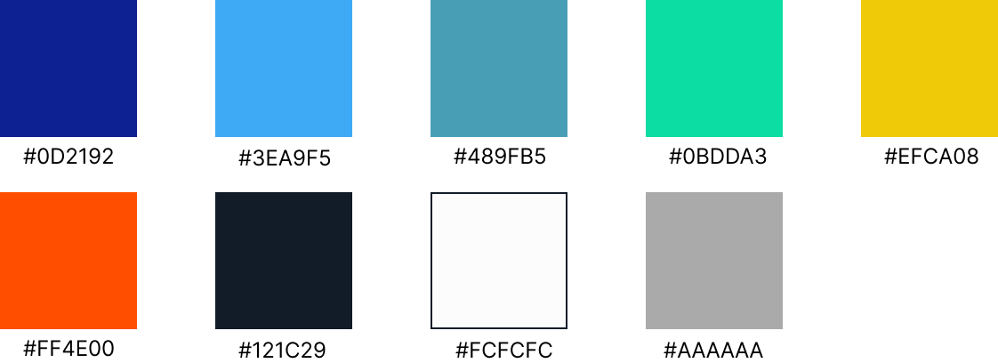
Colors

Slide 157
APIs / Components

Slide 158






API icons and labels
Workflow
Publish / Subscribe
Service invocation
Key/Value
Actors
Conversation
Middleware
External Configuration
Secrets
Bindings
Cryptography
Distributed lock
Jobs

Slide 159

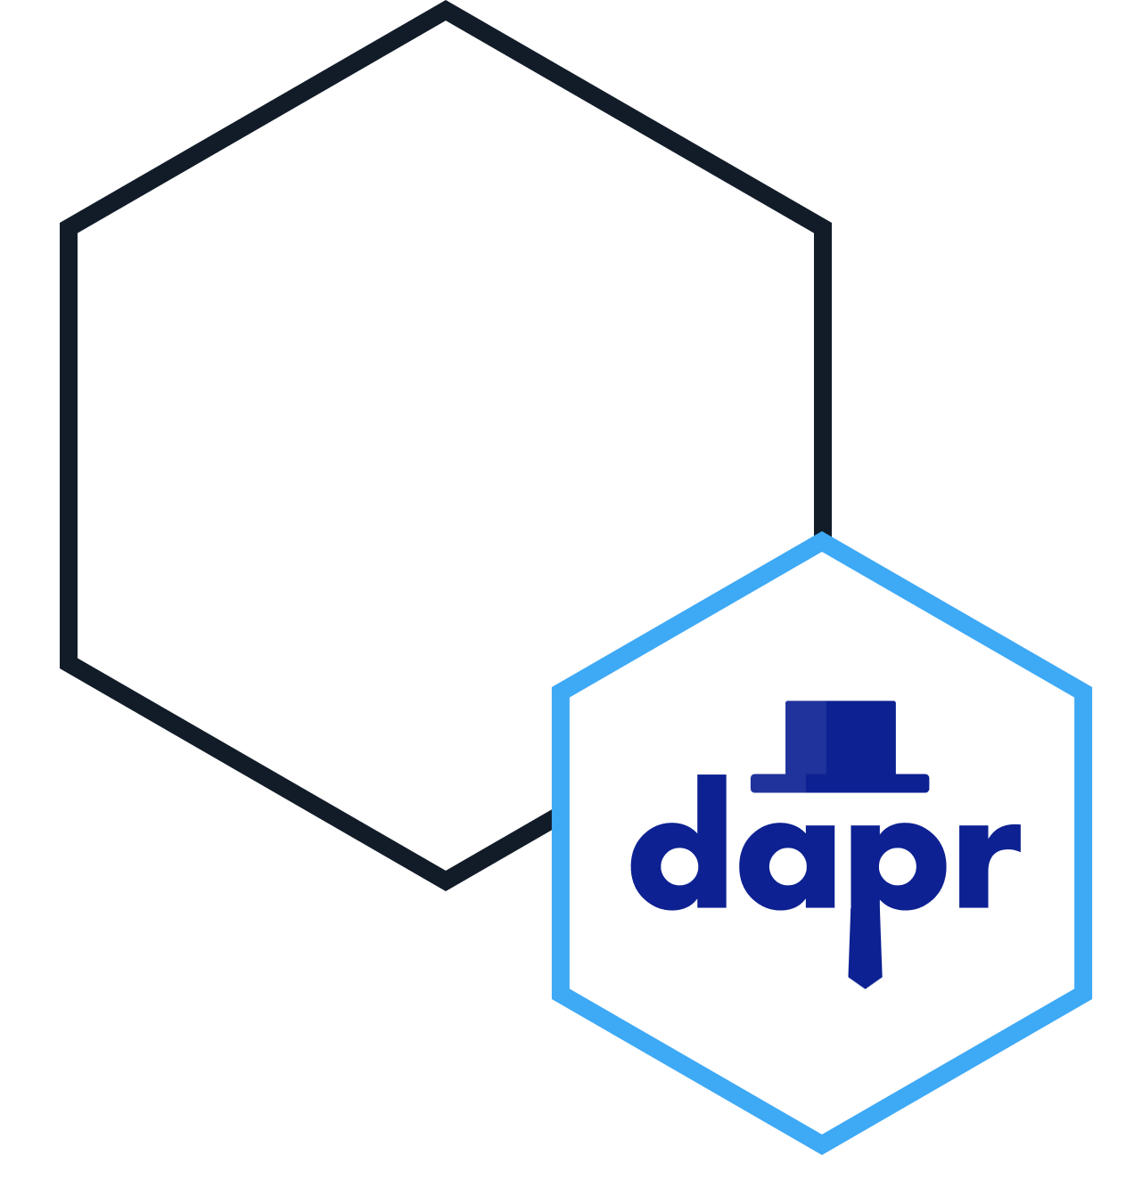


App with Dapr sidecar on the right
App label
App label
App label
App label
App label
App label
App label
App label
App label

Slide 160



App with Dapr sidecar on the left
App label
App label
App label
App label
App label
App label
App label
App label
App label

Slide 161




App hexagons
App label
App label
App label
App label
App label
App label
App label
App label
App label
App label
App label
App label
App label
App label

Slide 162


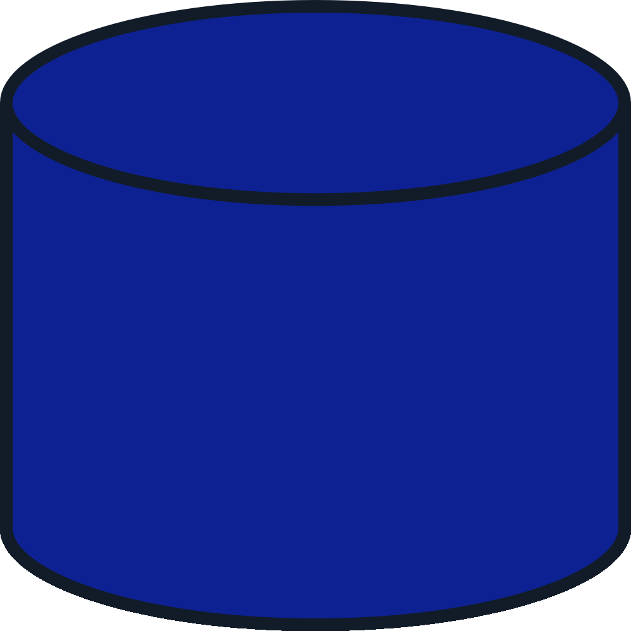

Database label
Database label
Database label
Database label
Database label
Database label
Database label
Database label
Database label

Slide 163






Message broker label
Message broker label
Message broker label
Message broker label
Message broker label
Message broker label
Message broker label
Message broker label
Message broker label

Slide 164






Label
Label
Label
Label
Label
Label
Label
Label
Label

Slide 165
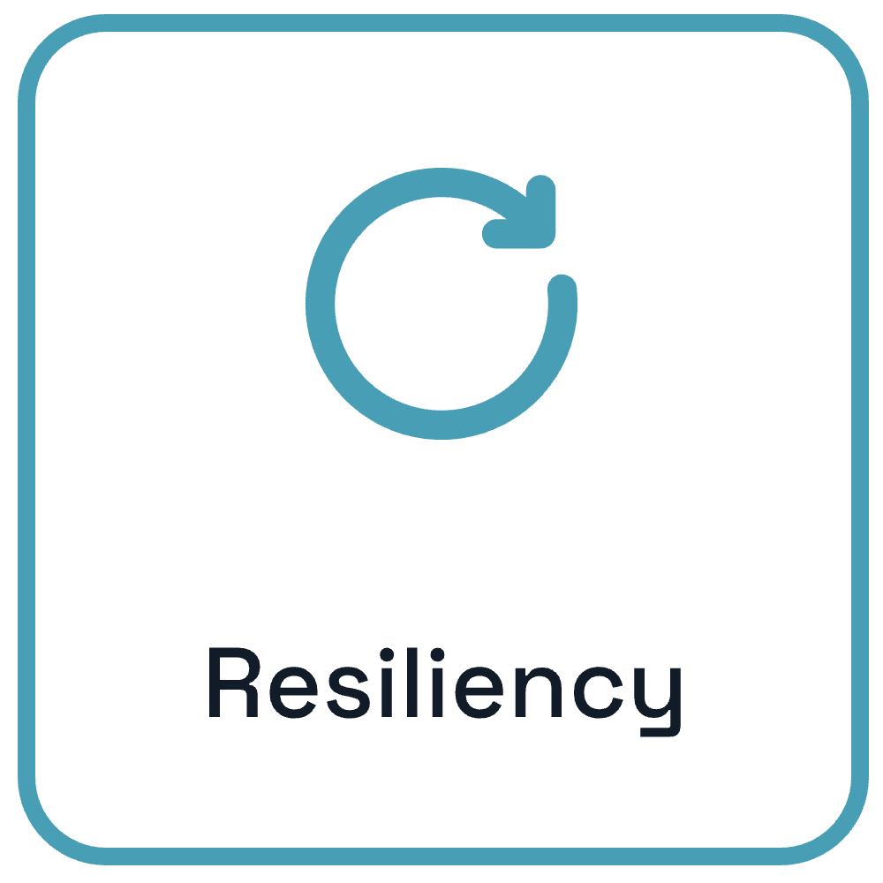

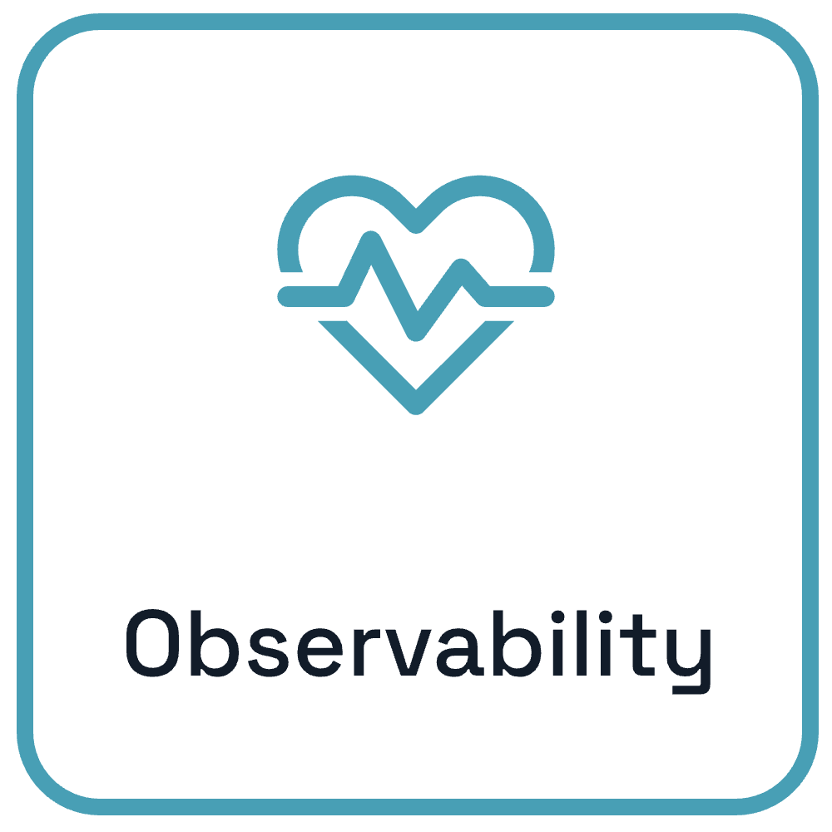
Cross Cutting Concerns

Slide 166
Cross cutting concern icons
Resiliency
Security
Observability
Resiliency
Security
Observability

Slide 167
arrow label
arrow label

Slide 168









Slide 169

Sidecars

Slide 170
Dapr services
placement
sentry
injector
operator
scheduler

Slide 171

Logo

Slide 172
Languages and runtimes

Slide 173


























Misc Icons
Source: https://icon-sets.iconify.design/fluent/

Slide 174
Hosting
Azure Container Apps

Slide 175





