Slide 1
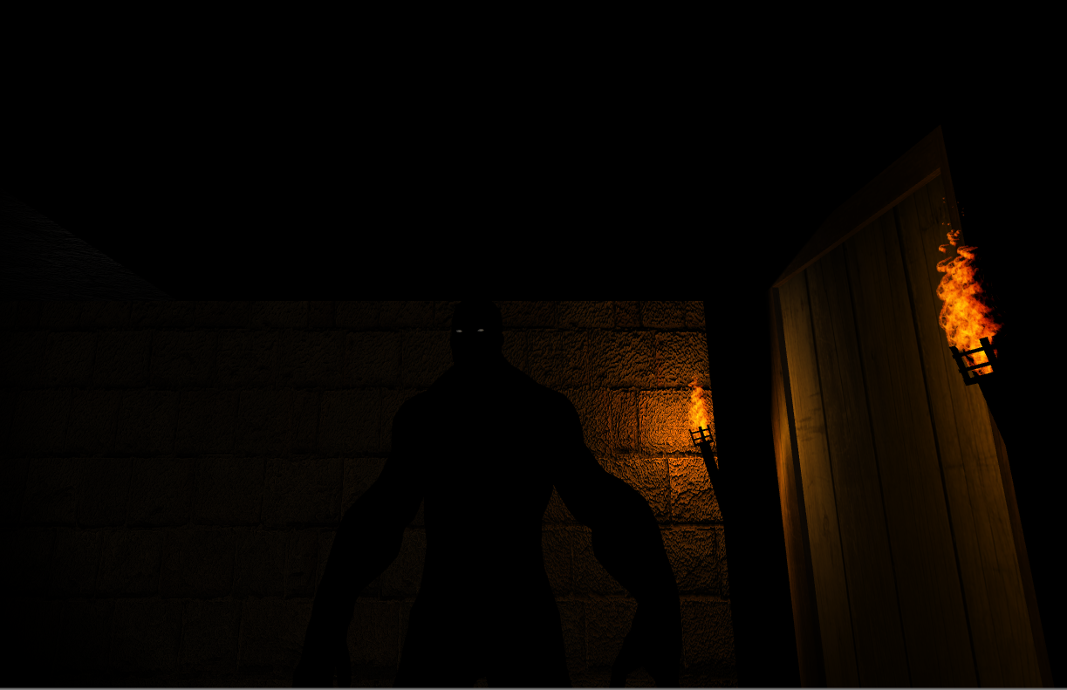



Wheel-U-Survive
Wheel U Survive
Game Start
Option
Exit
Team 4
Alex 0760831
Michel 0516110
Jerry 0856646

Slide 2
01
02
03
04
What is Wheel-U-Survive?
Ideas, Story, Gameplay
Technical Stuff
Haptic, Locomotion
Status Report
Current progress
To-Do-List
Our agenda to complete the project

Slide 3
Wheel-U-Survive
Ideas
Story
Gameplay

Slide 4
Wheel-U-Survive
Wheel-U-Survive is a single player horror game which let the user dives in a horrible zombie world where everything is darkness; All along the game, the user will have to use a flashlight in order to see the objects on his/her path. The game consists of 2 puzzles, in the first puzzle, the goal will be to find a key but in 3 steps

Slide 5


First
Puzzle
Step 1 Go to a room to get a diamond but a battery and a flashlight will be needed to see the path clearly
Step 2 Walk to a garden to insert the diamond into a statue
Step 3 The statue will give you a key to another room
Puzzle solved
As soon as the player opens the room in step 1, the zombies will start chasing him/her.

Slide 6
Wheel-U-Survive
In the second puzzle, the goal will be to finally escape from zombies in 3 steps:
The key from the first puzzle will be used to open a second room
Find another key from the second room to open a gate
This gate needs to collect a card to finally escape
The number of zombies will increment along the path (there will be 2 crawling zombies, one walking zombie and one running zombie).
There will be a timer that will be set to 10~15 minutes. If the timer ends before the 2 puzzles are solved then the player loses the game otherwise he/she wins.
During the entire horror game, the player won’t have any weapons, the only thing the user can do is to run or hide from zombies. The haptic (fan) will guide player to choose the correct puzzle and help player escape from the dungeon

Slide 7
Second
Puzzle
Step 1 The key from the first puzzle will be used to open a second room
Step 2 Find another key from the second room to open a gate
Step 3 This gate needs to collect a card to finally escape
Puzzle solved

Slide 8
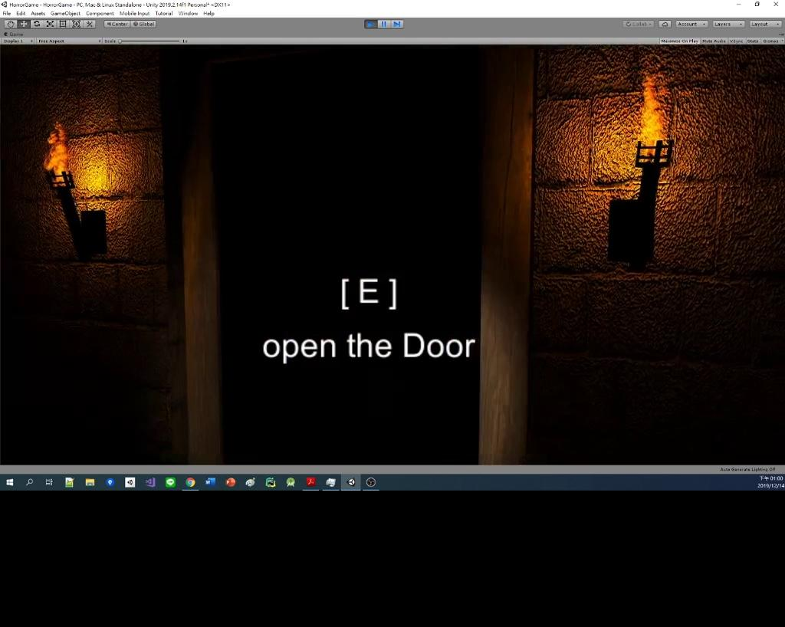

Slide 9
Technical Stuff
HAPTIC
LOCOMOTION

Slide 10
Locomotion
2x Wheel for the left and right side of the player
Just roll the wheel to move.

Slide 11


Slide 12
Locomotion Details
Straight
Roll both of the wheel forward to move forward
Turn Left
Rotate the right wheel forward, keep the left wheel steady
Rotate the right wheel forward, rotate the left wheel backward
Turn Right
Rotate the left wheel forward, keep the right wheel steady
Rotate the left wheel forward, rotate the right wheel backward
Backward
Roll both of the wheel backward to move backward

Slide 13
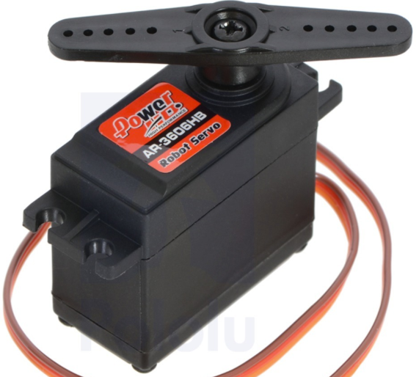
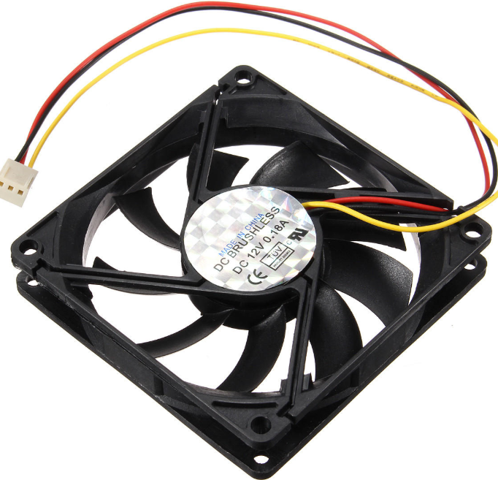

Haptic
1x Servo
Fan
2x bamboo chopstick

Slide 14
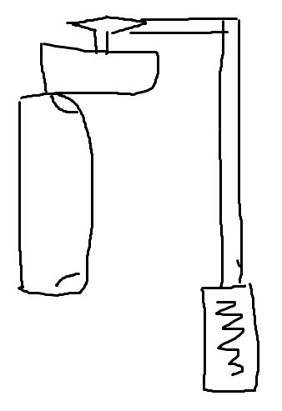
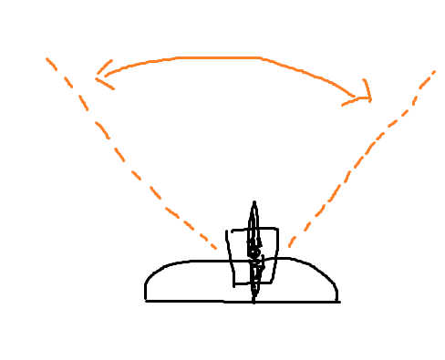
TOP-DOWN VIEW
SERVO
90 degree rotation
SIDE VIEW
CHOPSTICK
HMD
FAN

Slide 15
Status Report
Locomotion
The locomotion already tested, but not yet applied to the project.
Haptic - Servo & Fan
In progress
Game UI
In progress

Slide 16
To-Do-List
Combine with SteamVR
Only build half of the scene right now
Wheelchair Locomotion
Haptic experience
Cinemachine

Slide 17
Thanks
Does anyone have any questions?

