Slide 1
CPU Scheduling
FCFS, SJF, SRTF, and Round Robin
Nathan Posniak

Slide 2
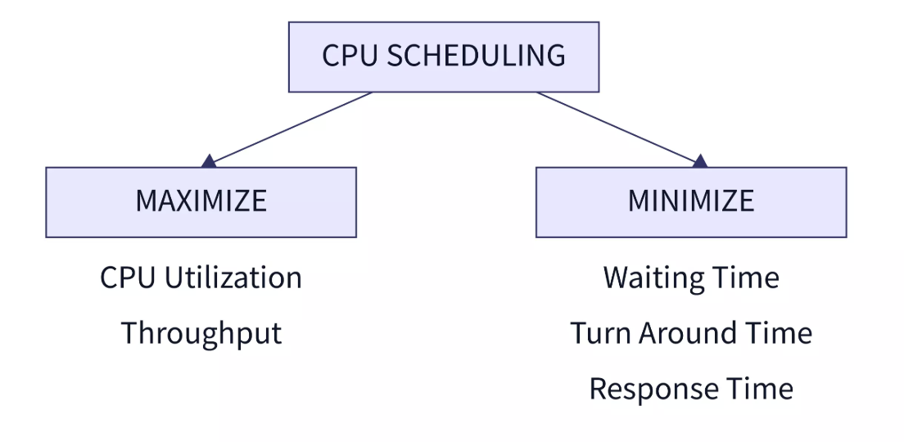
CPU Scheduling Overview And Important Concepts
A CPU scheduler’s job is to manage processes by allocating CPU time efficiently. We can measure CPU efficiency by measuring;
  Turnaround Time
    Total time from process arrival to its completion
  Waiting Time
    Total time the process spends ready while not executing
  Response Time
    Time from process arrival until the first time it starts executing.

Slide 3
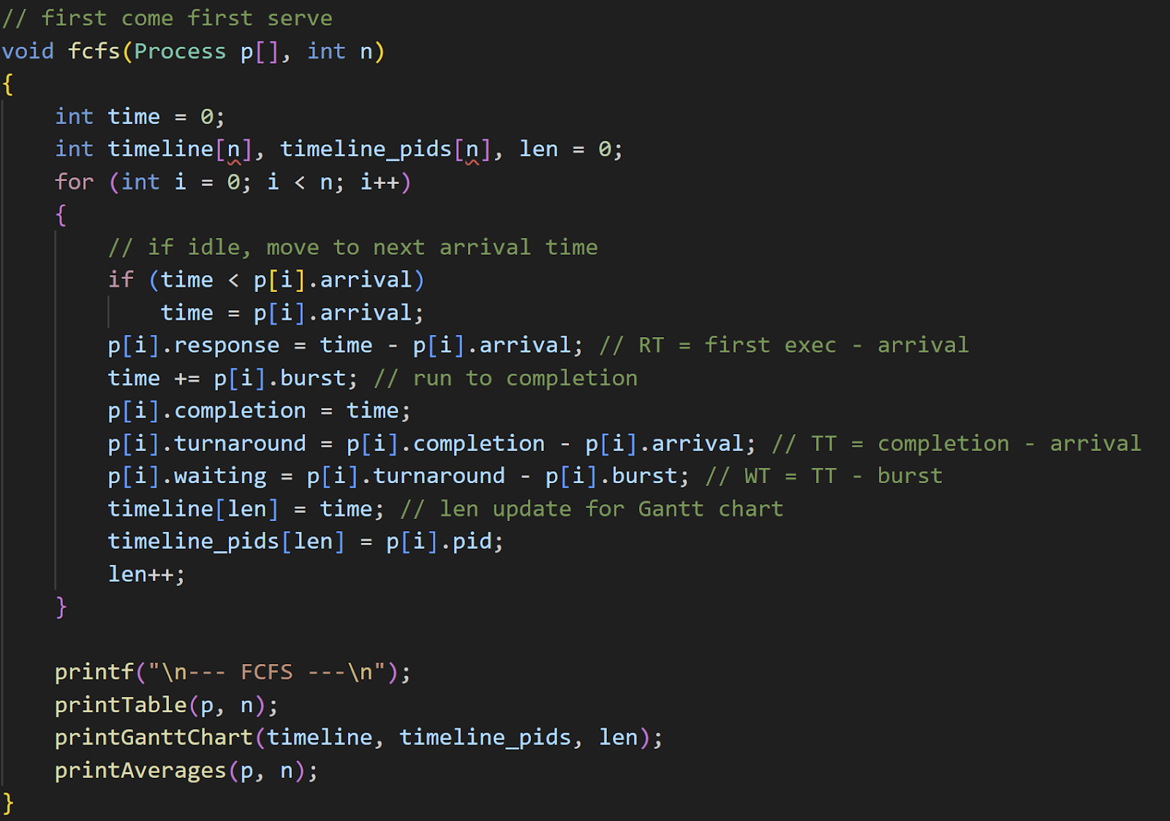
First-Come First-Served
Simplest scheduling algorithm; works by executing jobs in the order in which they arrived
Advantages
  Simple implementation and overhead
  ‘Fair’ in terms of arrival order
Disadvantages
  Early long processes can hold up later arriving short ones, leading to poor average wait times, response times and turnaround

Slide 4
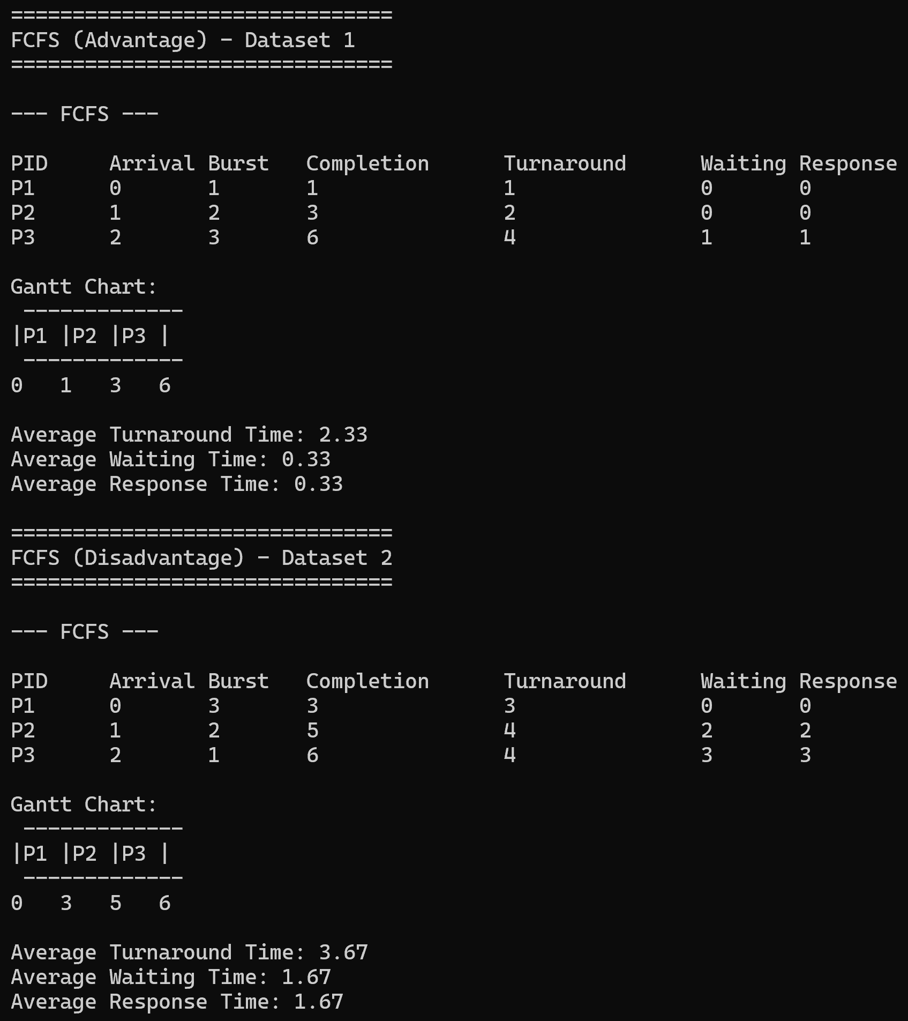
First-Come First-Served Testing
Between the advantaged and disadvantaged data set the same three jobs arrived but in a different order
  When the jobs arrived in order of ascending burst time, turnaround, waiting, and response times were quite low
  When the jobs arrived in order of descending burst time, these values all ballooned, as the early larger process led to the later processes waiting for longer

Slide 5
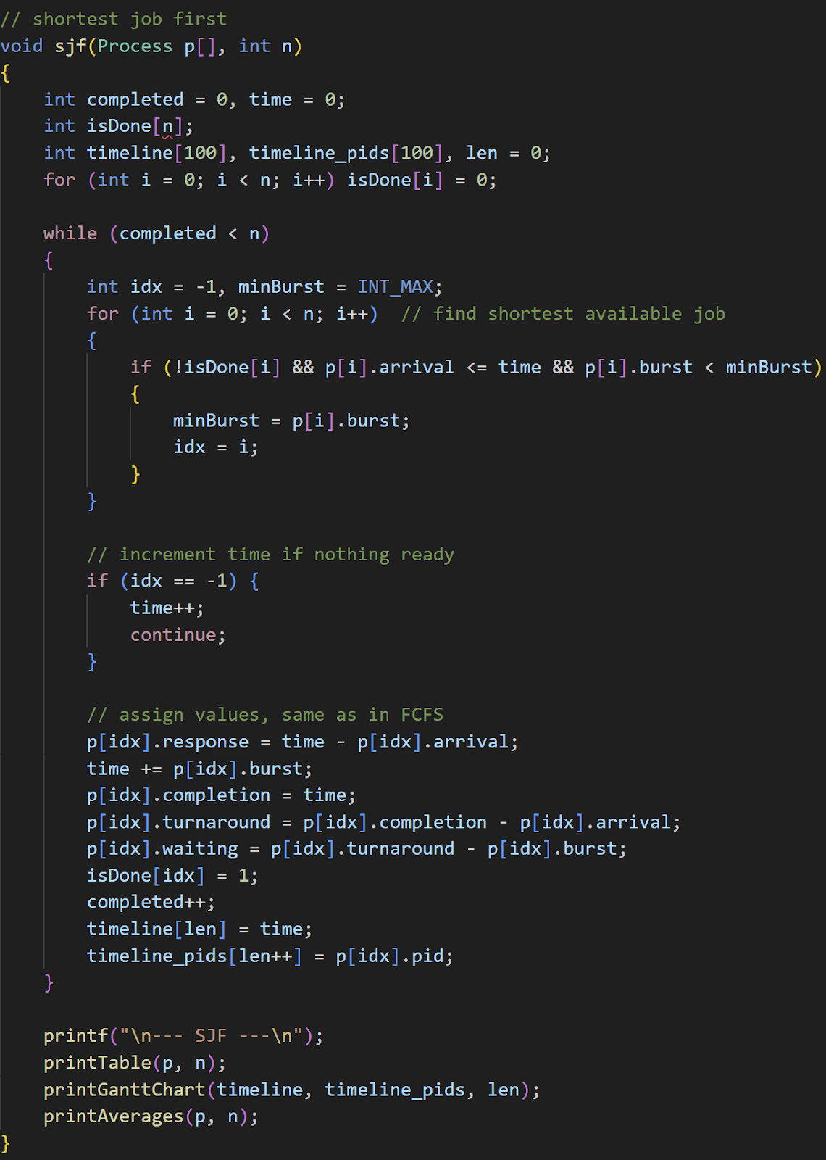
Shortest Job First
A slightly more complex scheduling algorithm, it queues arriving processes in order of shortest burst time, then executes the front of the queue until completion
Advantages
  Can minimize waiting time when given predictable job lengths
  Has a high throughput in the short term
Disadvantages
  Shorter jobs arriving regularly can starve longer jobs and balloon their wait times
  Very dependent on receiving certain workload types
  Can be unfair to larger jobs which arrive early but still have long waiting times

Slide 6
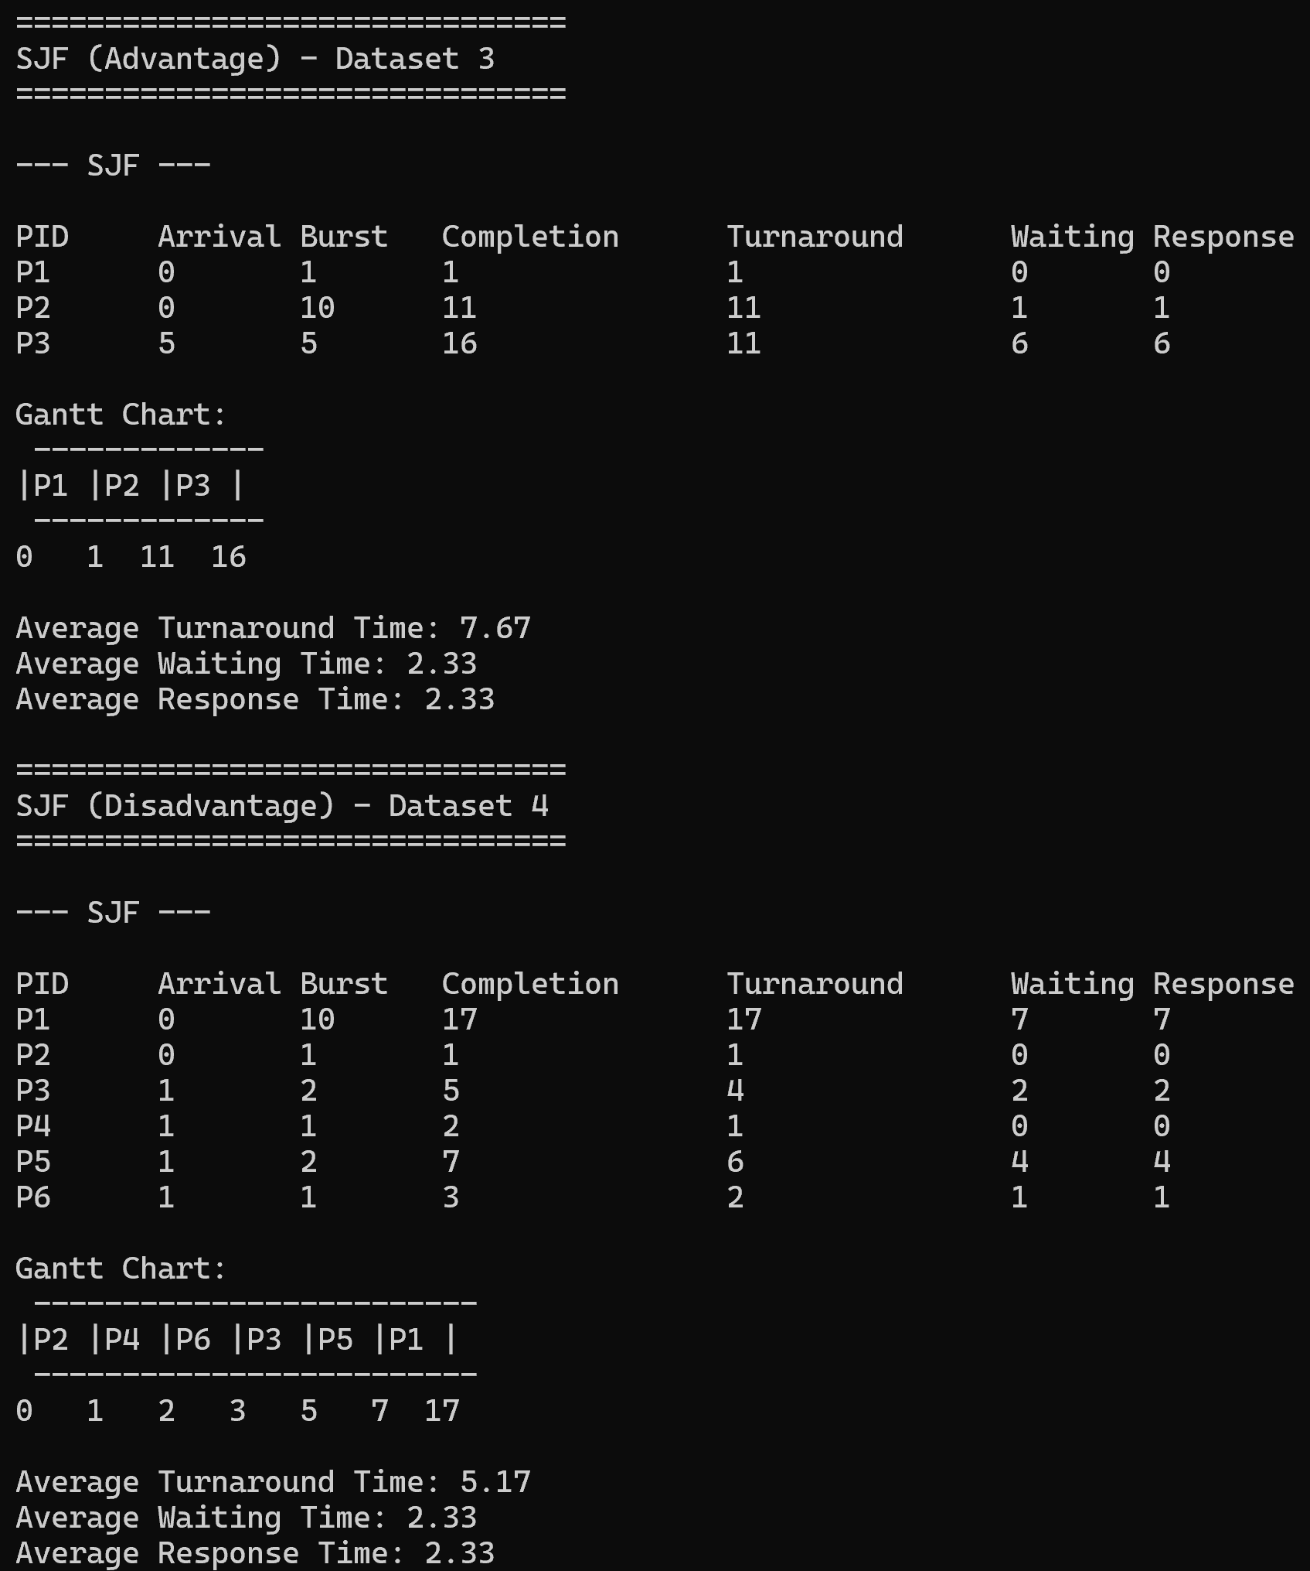
Shortest Job First testing
Both data sets contain mostly small jobs, along with a larger one, this algorithm is manageable when there are nearly all small jobs, and if there are larger jobs, the scheduler is less busy
In the advantaged dataset, there are a few smaller jobs and one larger job, allowing relative efficiency
In the disadvantaged dataset, there are many smaller jobs alongside the longer job, starving it from the CPU

Slide 7
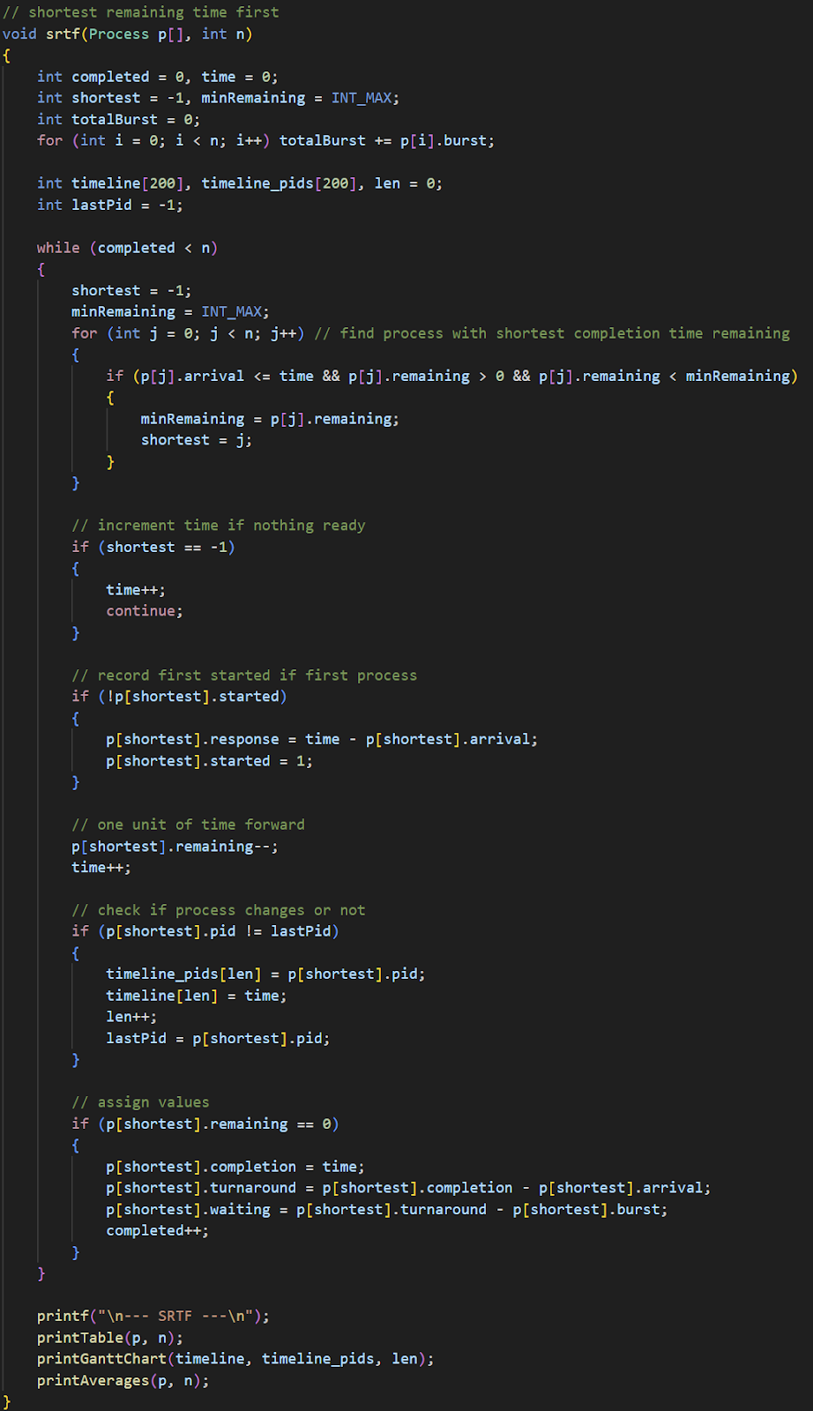
Shortest Remaining
Time First
An evolved version of SJF, it queues arriving processes in order of shortest burst time, with the queue updating every unit of time. Rather than executing every job until completion, the scheduler will switch if a new job comes along with a shorter remaining burst time
Advantages
  Best average turnaround time
  More efficient on some mixed workloads where SJF and FCFS fall short
Disadvantages
  Highly complex, and can starve outlier longer processes like SJF

Slide 8
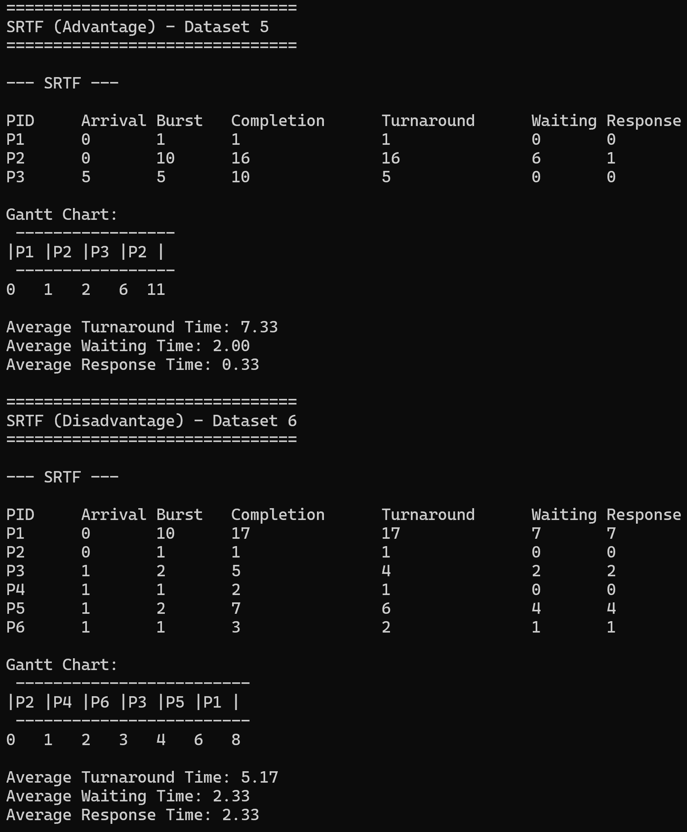
Shortest Remaining Time First Testing
The same data set used for SJF, both sets contain mostly small jobs, along with a larger one
In the advantaged dataset, there are a few smaller jobs and one larger job, allowing relative efficiency, notice the switch in the Gantt chart
In the disadvantaged dataset, there are many smaller jobs alongside the longer job, starving it from the CPU, no different from SJF

Slide 9
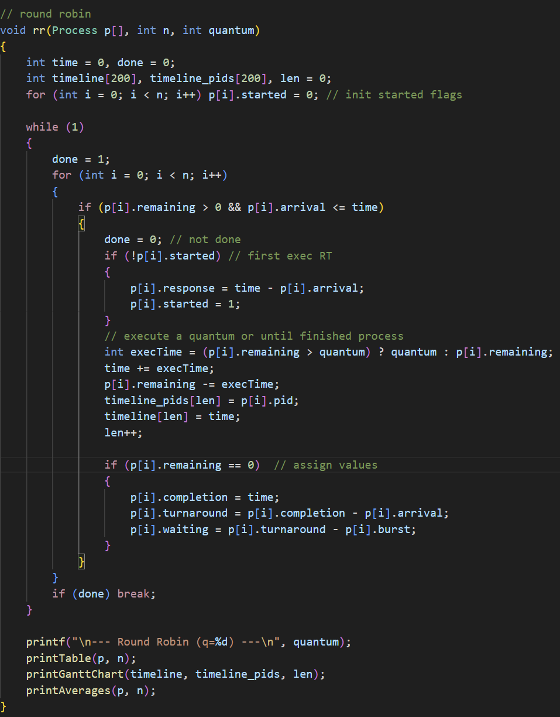
Round Robin
This algorithm returns to sorting the queue in order of arrival time, however rather than executing the whole job it executes each job in the queue for a set time, the quantum, then places that job back at the end of the queue if it does not finish
Advantages
  The fairest system, every process gets equal time on the CPU
  Great for lots of processes of similar lengths
Disadvantages
  The quantum must be the right size, too small the constant switching creates a large overhead, too large it behaves like the inefficient FCFS

Slide 10
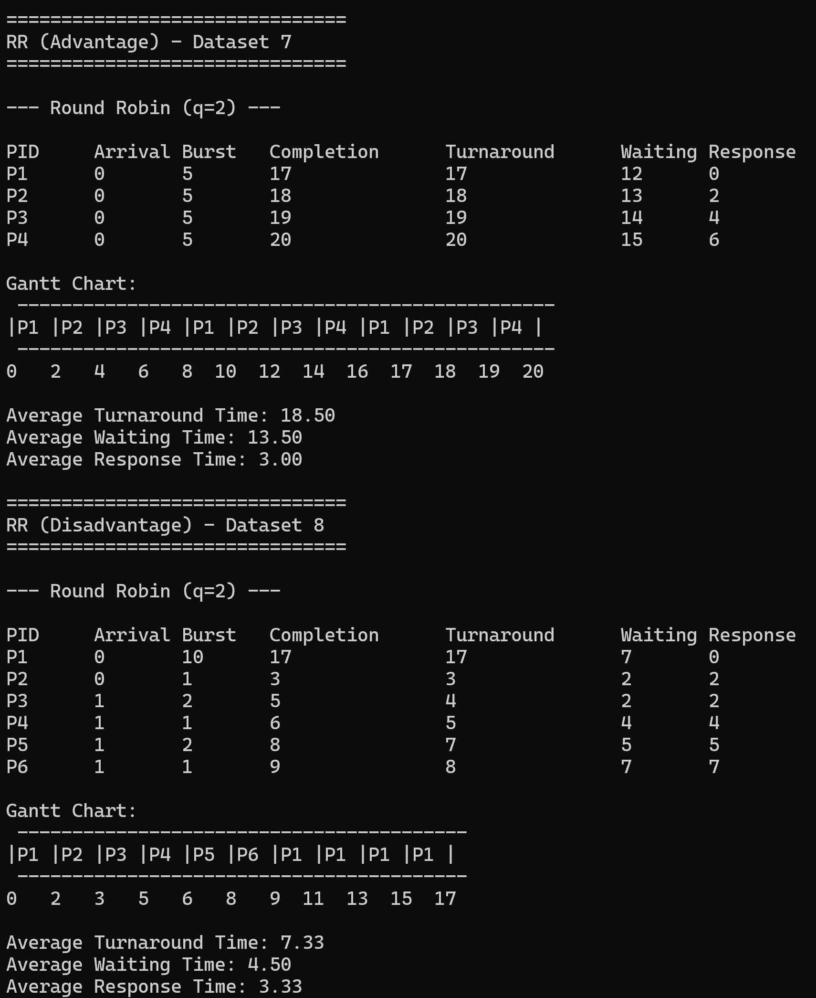
Round Robin Testing
In the advantaged data set, there are four jobs of equal length, notice the low response time, and decent waiting and turnaround times relative to the job’s burst times.
This is the same disadvantaged dataset as in SJF and SRTF, notice how it also struggles with the bigger task being starved by shorter ones.

Slide 11
Conclusion
There is no ‘best’ algorithm for all uses, if there was, every application would just use that one every time all the time
Instead, there are times in which different approaches are optimal depending on the context of the data, and the wants and needs of the scheduler
Understanding these algorithms helps system designers balance fairness, efficiency, and responsiveness within modern operating systems

