Slide 1



Virus game
Play
Quit

Slide 2
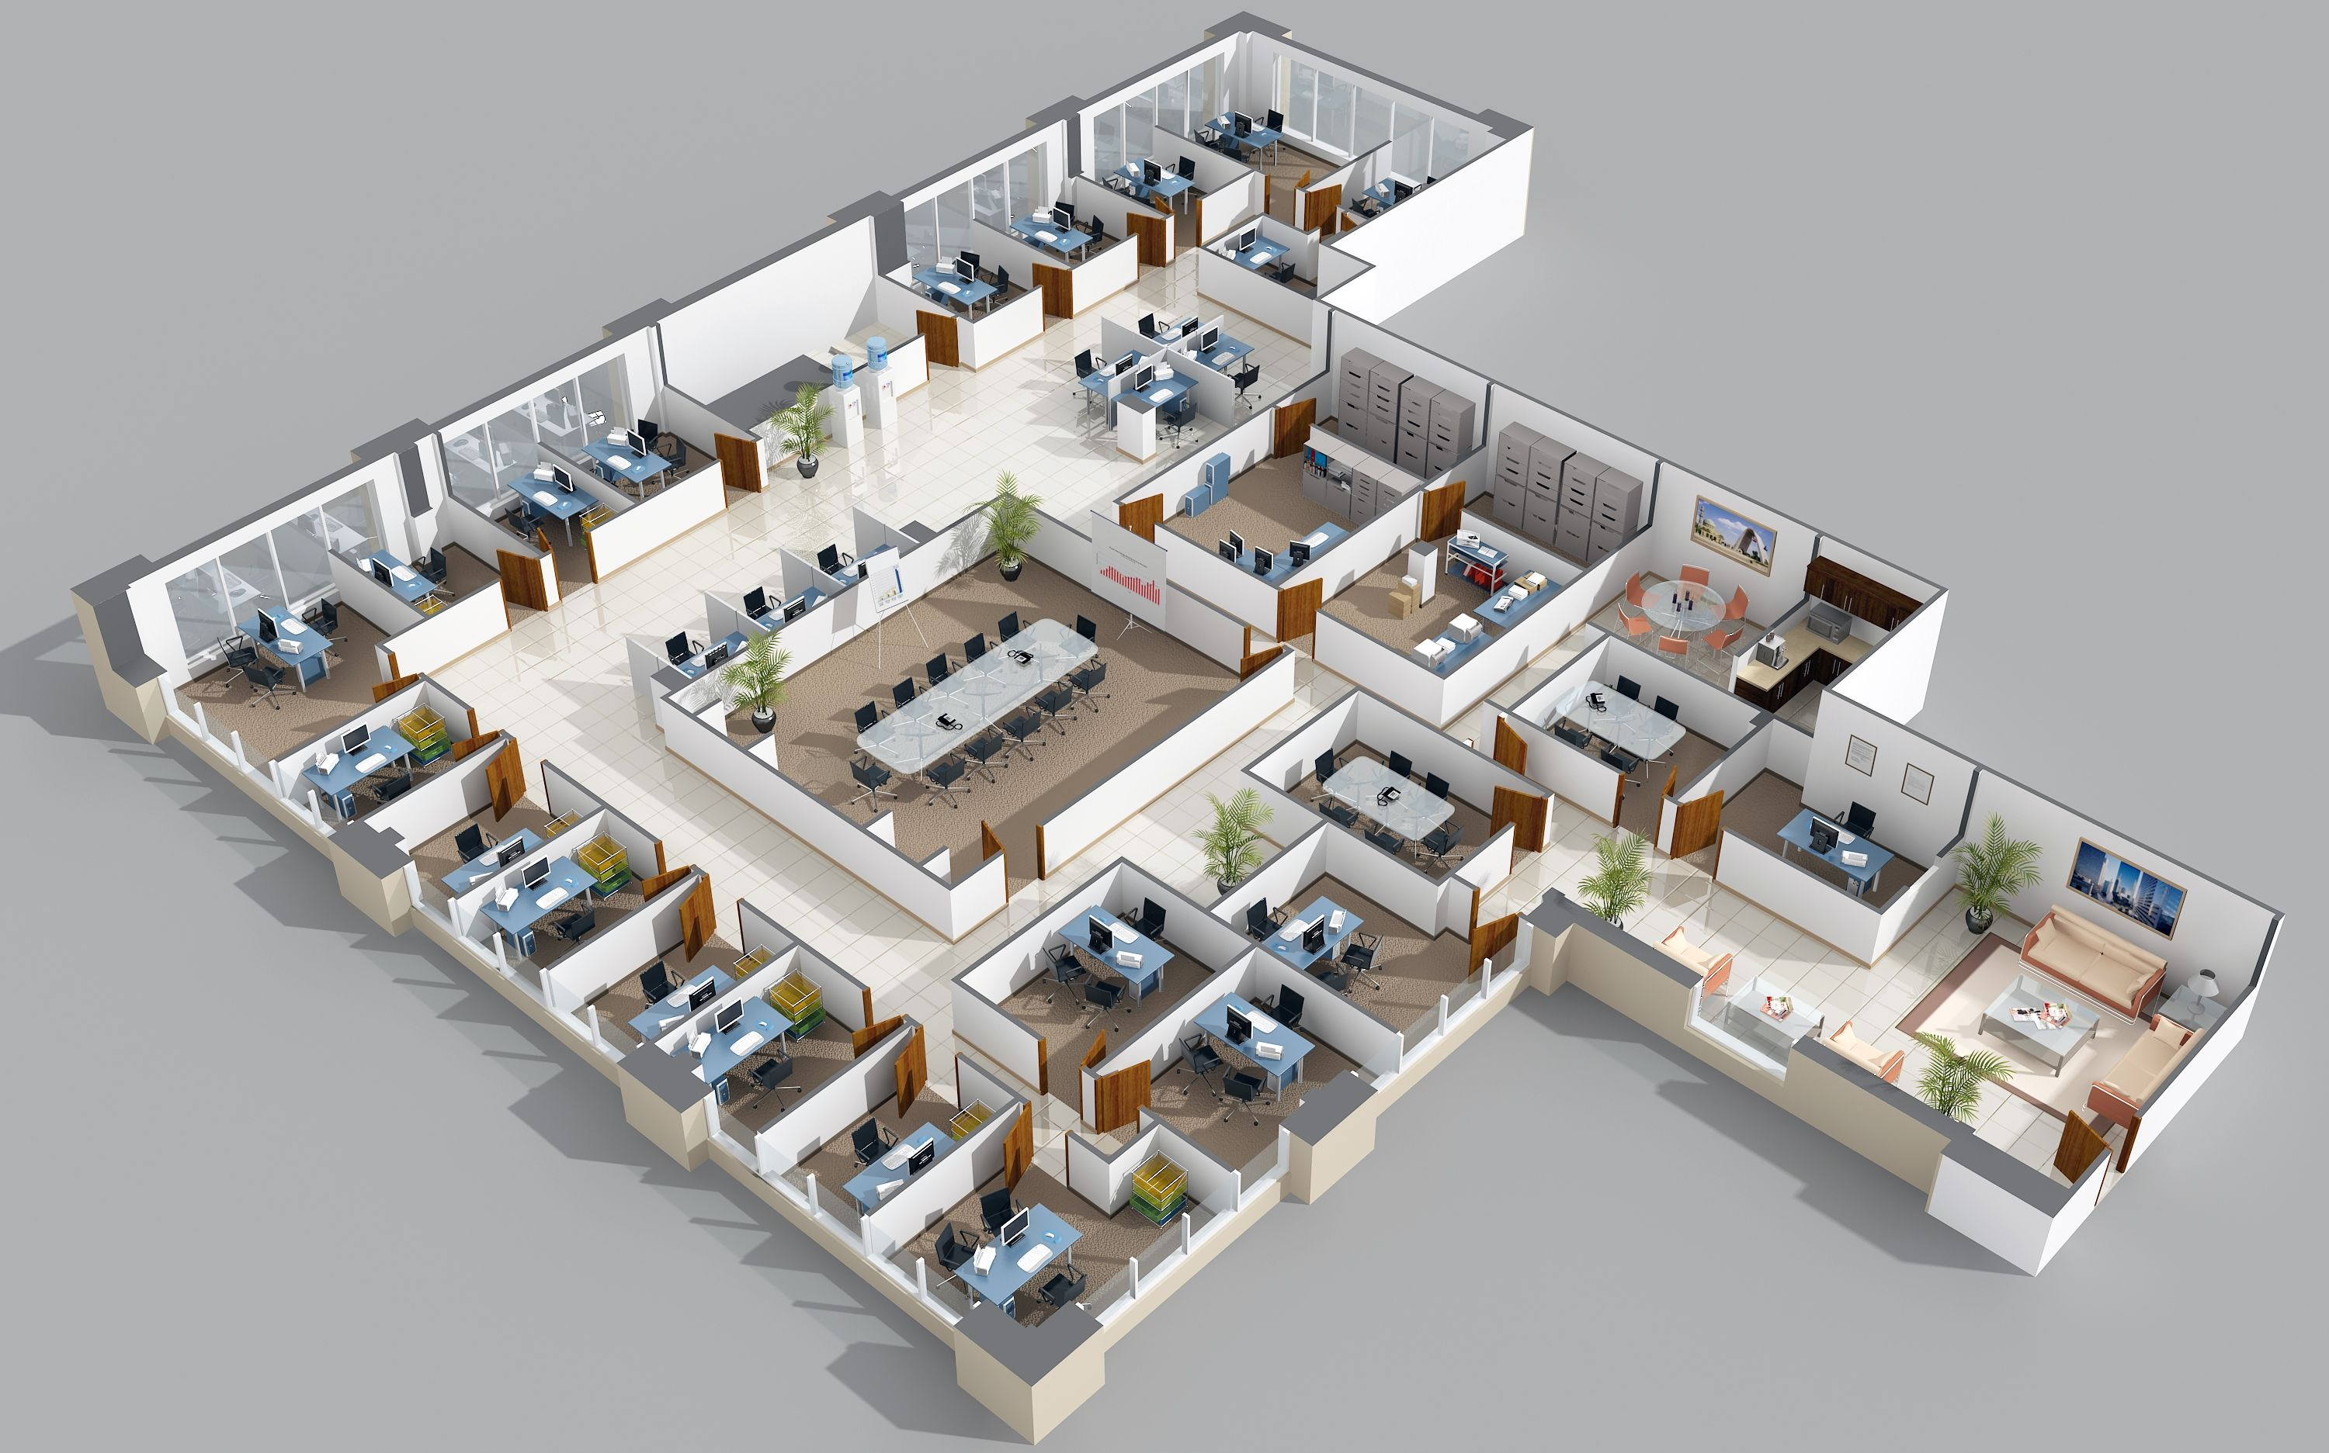
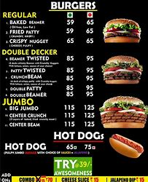
Progress: 1% infected
Time until antivirus upgrade: 6 days
Access
DDOS – $5
Access
Upgrades
Hire Goons
$700
Date: 25/2/2007

Slide 3
Access
Resume
Settings
DDOS
Save & Quit
Access
Upgrades
Hire Goons

Slide 4
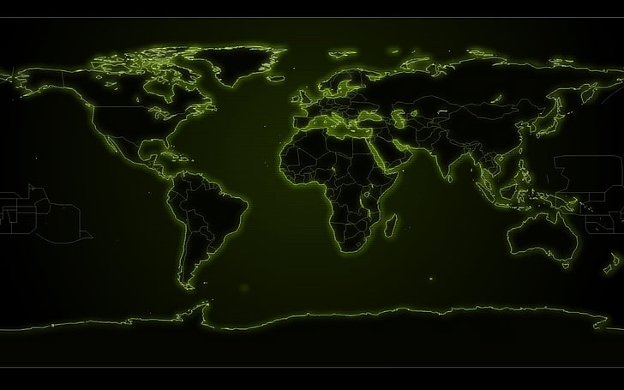
Upgrades
Transmission
Abilities

