Slide 1
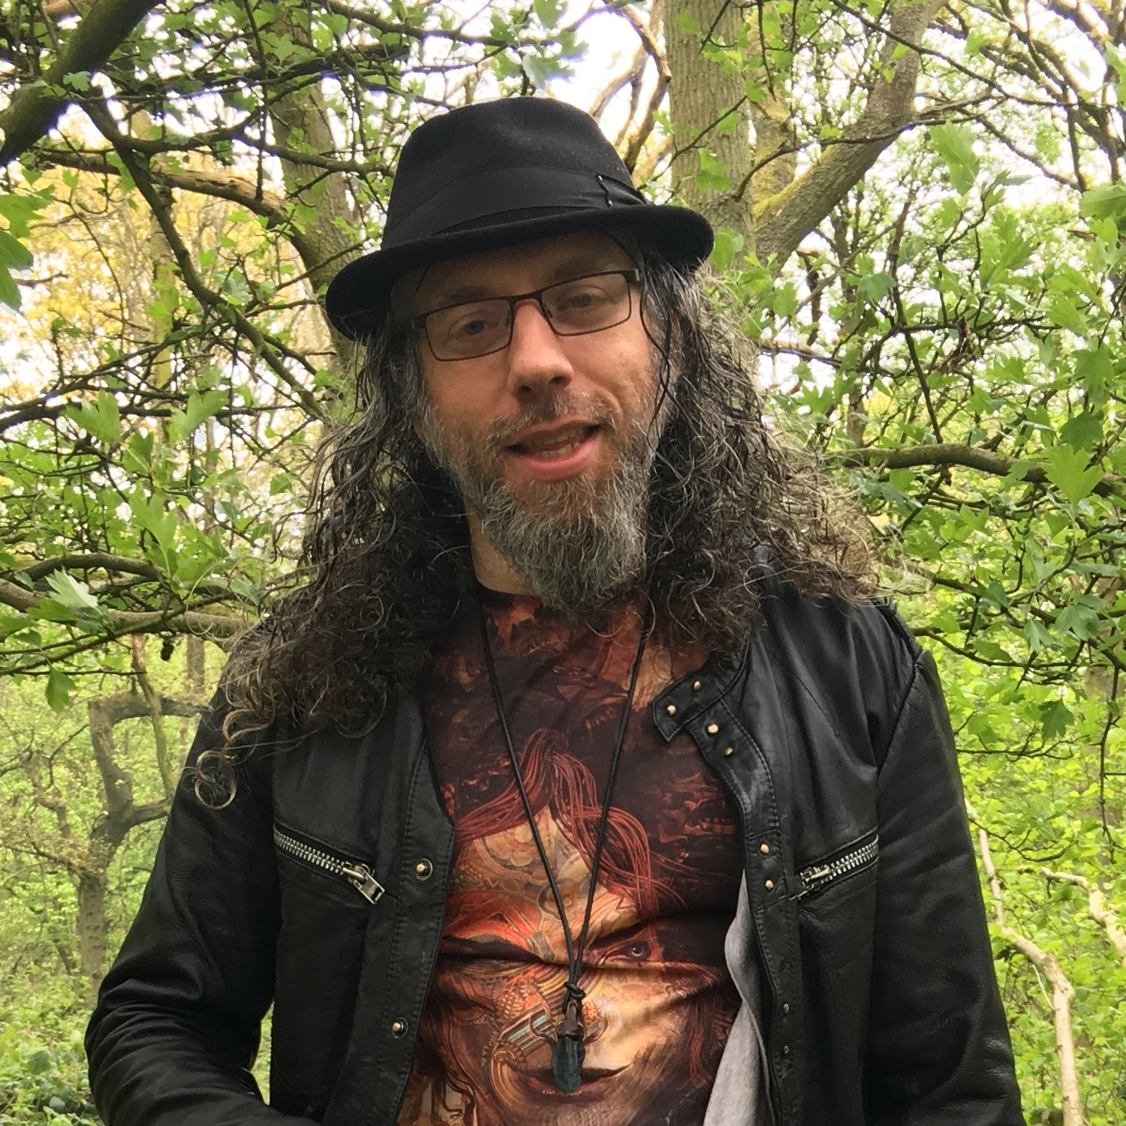
Michael Foord
https://agileabstractions.com/
Python trainer & contractor
Python developer since 2002
Core Python Developer
Author of IronPython in Action
Creator of “unittest.mock”
Twitter: @voidspace

Slide 2
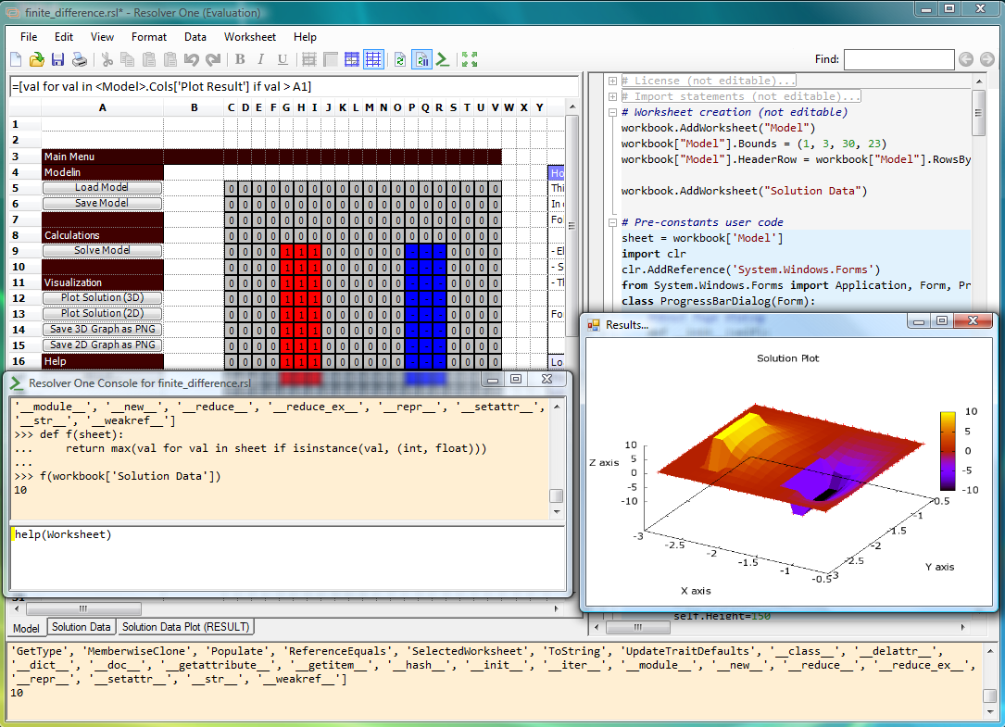

Slide 3
Agile, DevOps and Scrum, along with the tooling and technologies of modern engineering enable us to tackle the difficult problems of building and running robust systems with confidence. – Michael Foord

Slide 4
Some Core Values from Agile
Testing: quality and confidence
MVP, do the simplest thing, grow organically and refactor
Tooling: version control, Kanban, issue tracking
Iterations: able to change direction (agile)
Estimation and prioritisation

Slide 5
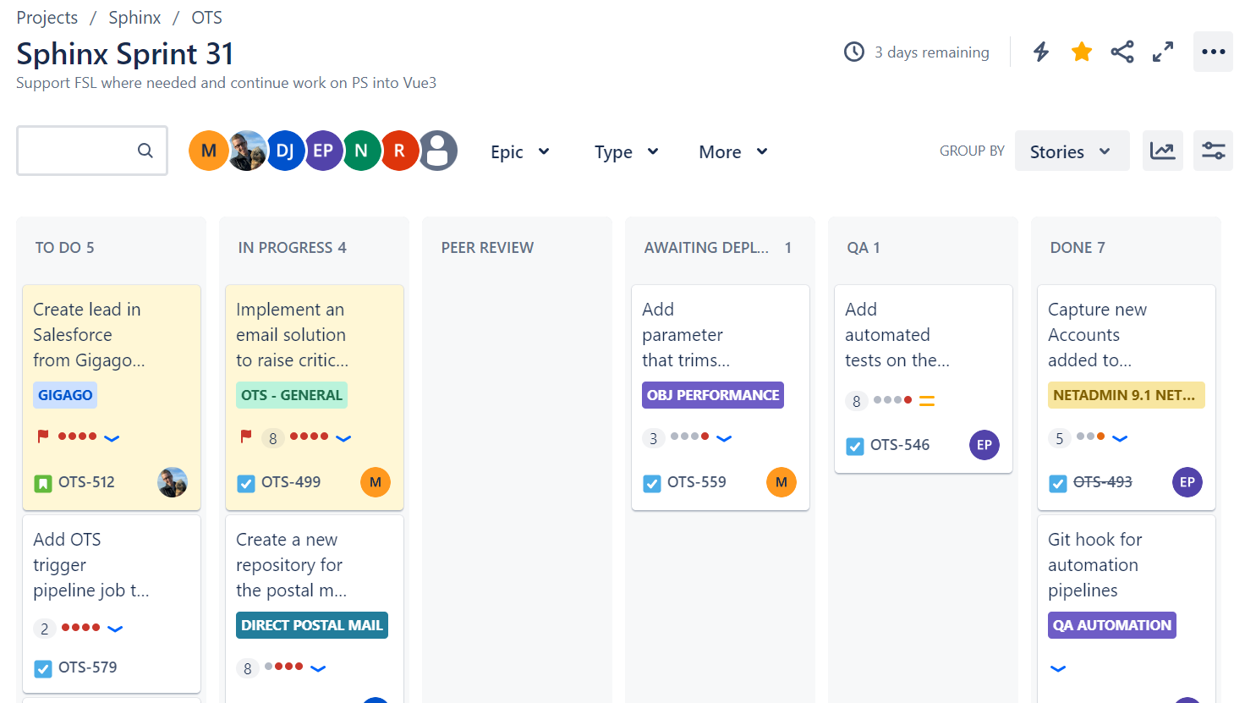
Kanban with Jira

Slide 6
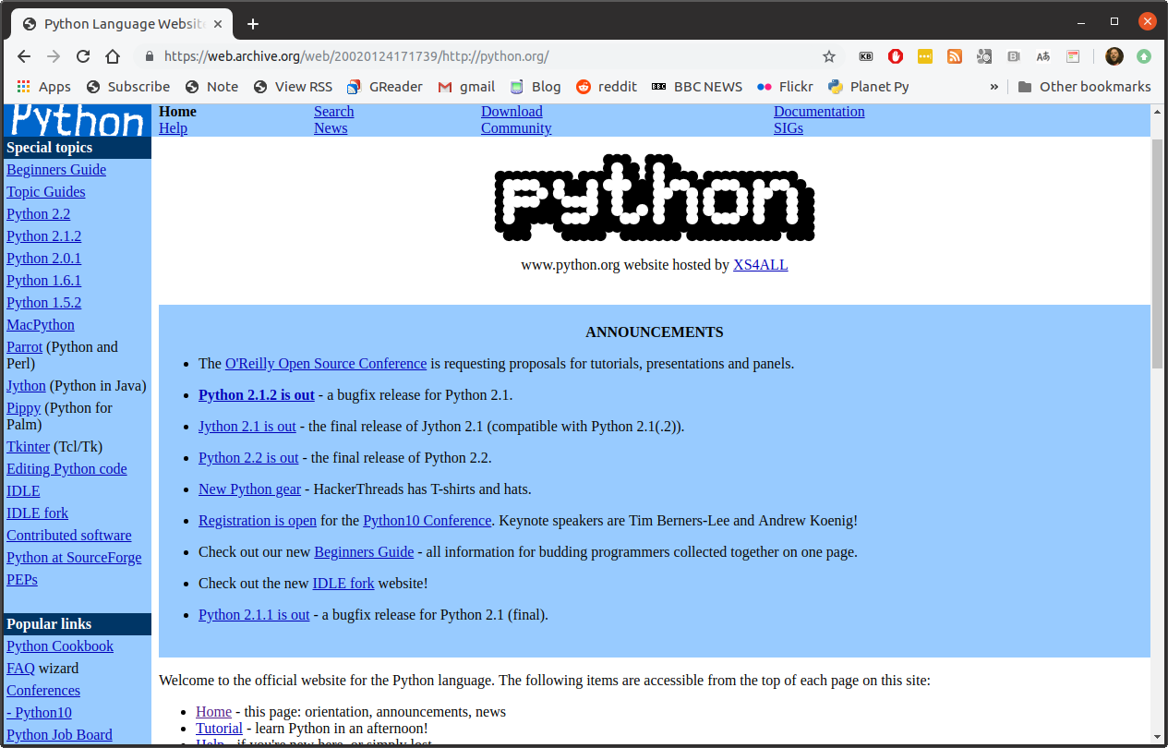

Slide 7
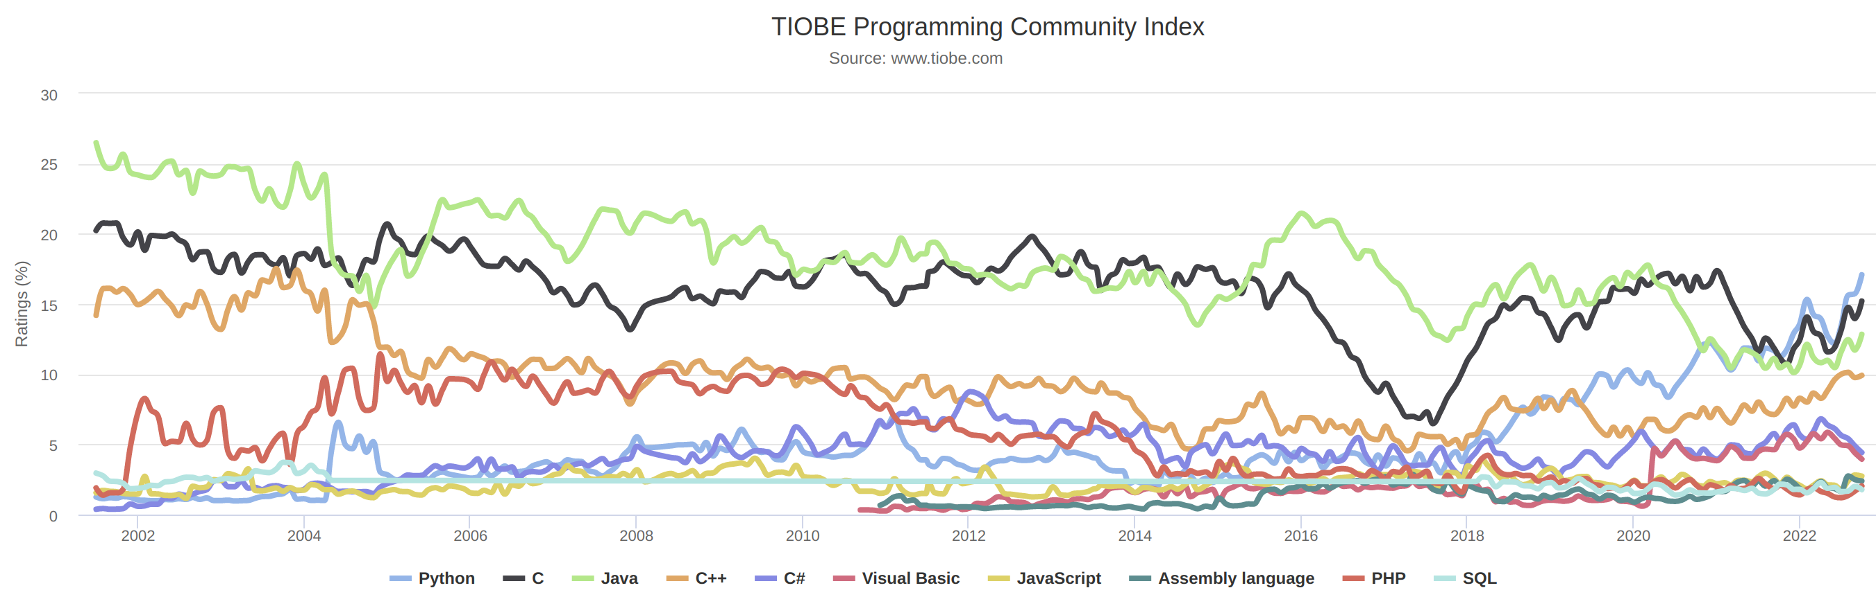

Slide 8
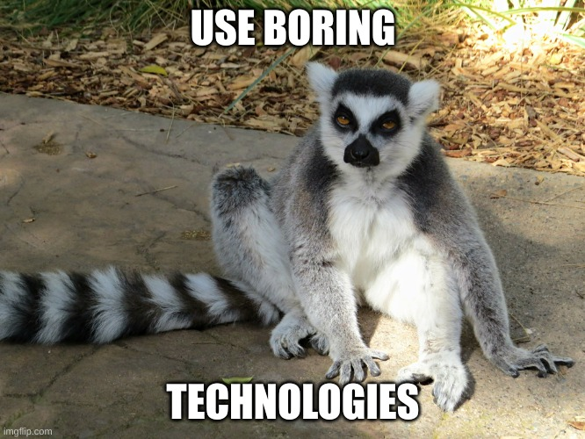

Slide 9
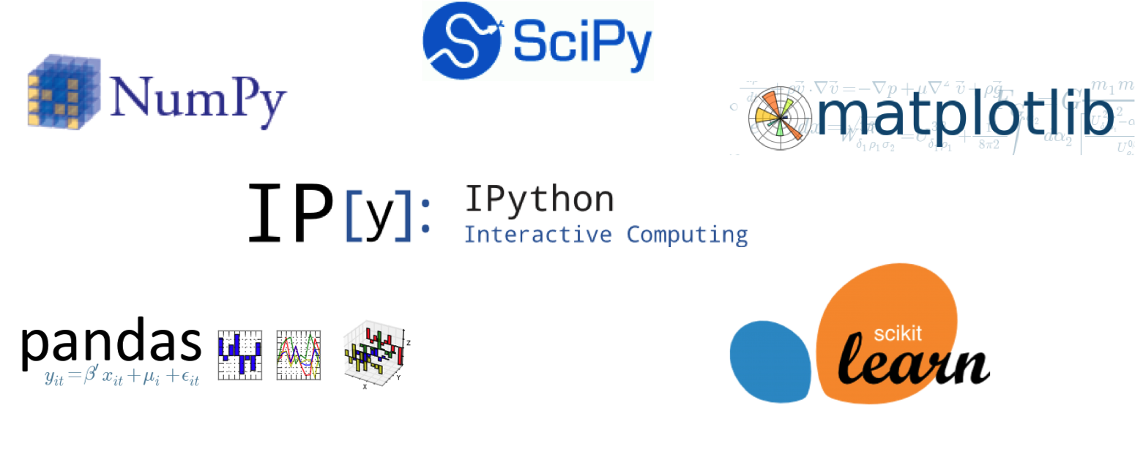
Python is Boring Technology

Slide 10
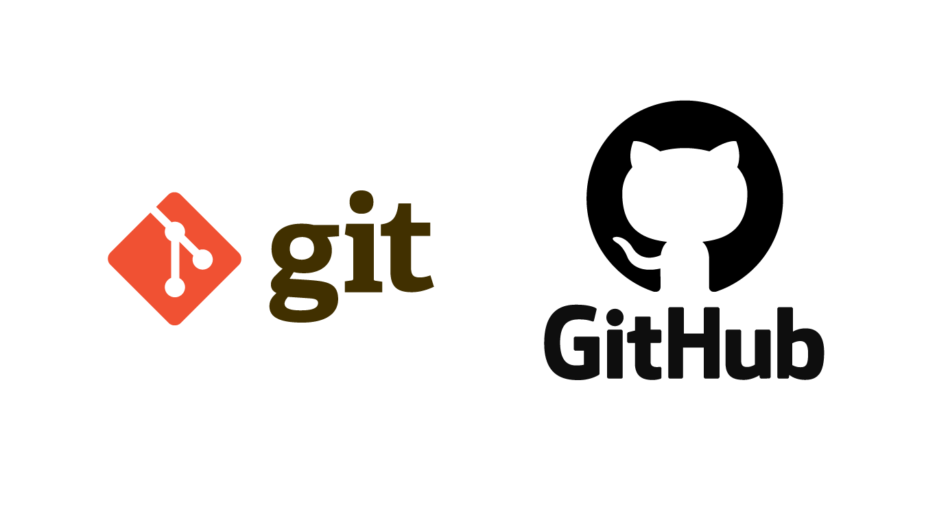

Slide 11
Version Control
A backup
Always know which is the latest version
Be able to go back to earlier versions
Merge changes from several sources

Slide 12
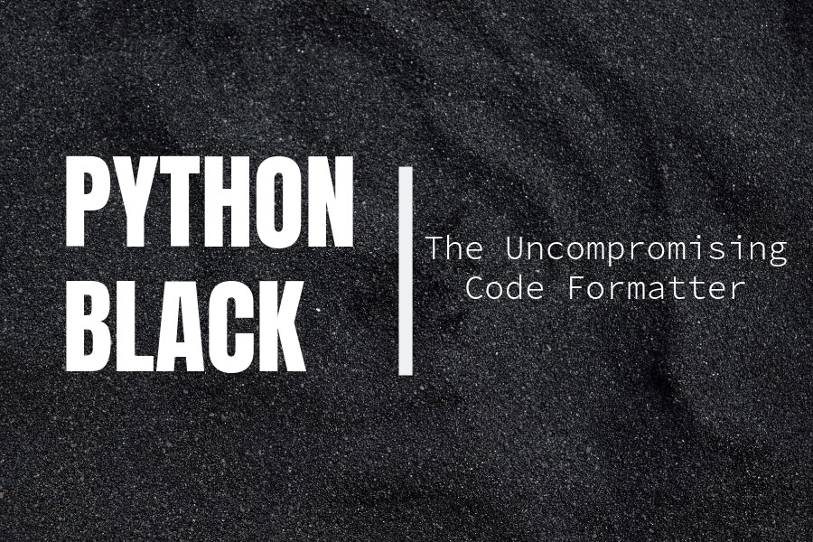

Slide 13
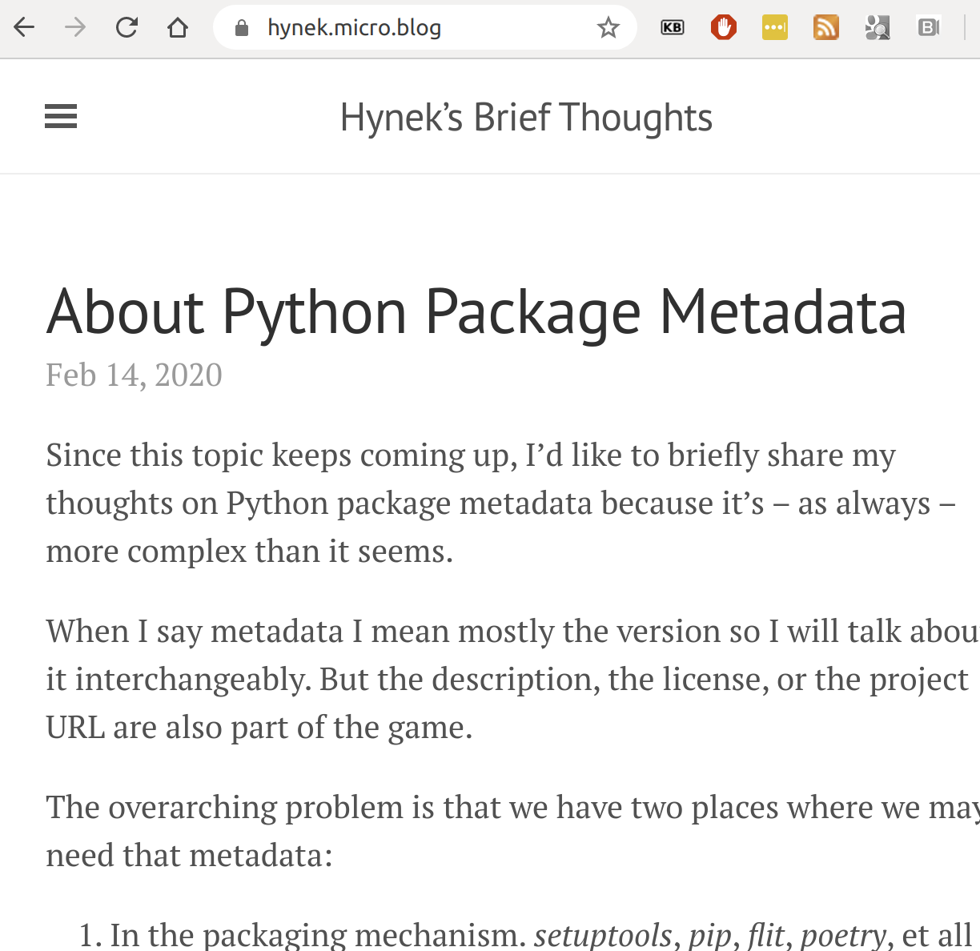
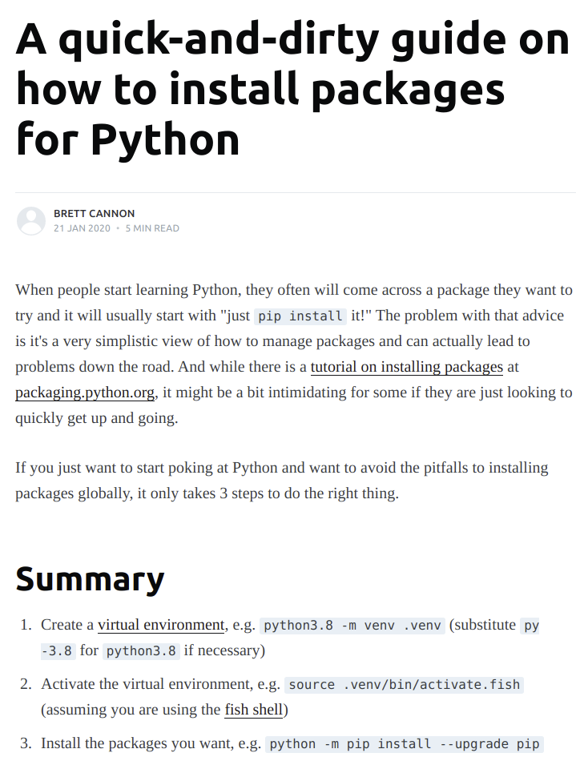

Slide 14
Dependency Management
git clone https://github.com/voidspace/…
cd repository
python -m venv .env
.env\Scripts\activate
pip install -r requirements.txt

Slide 15
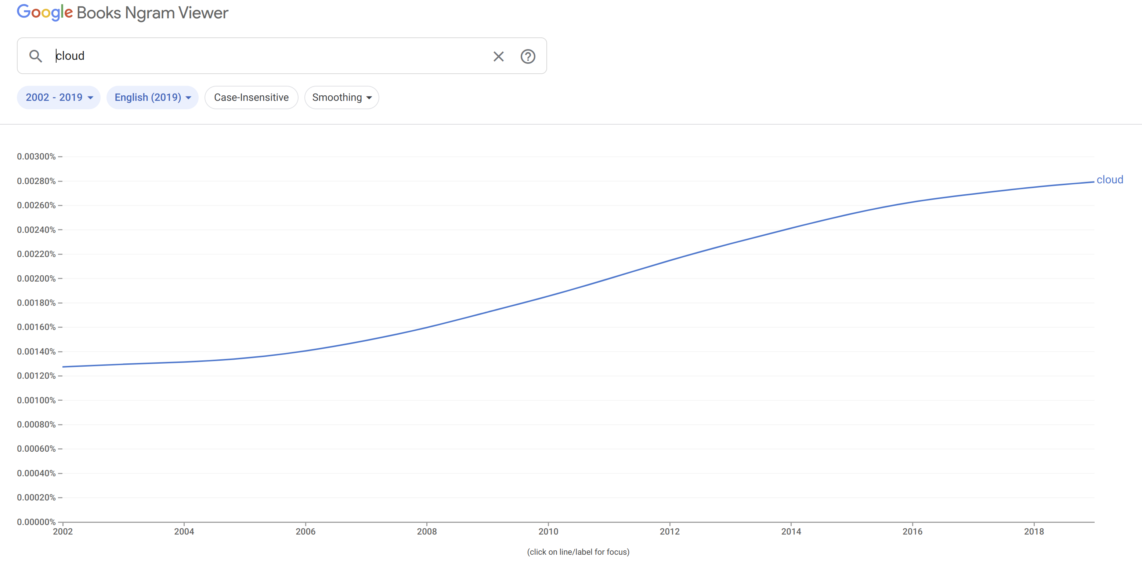

Slide 16
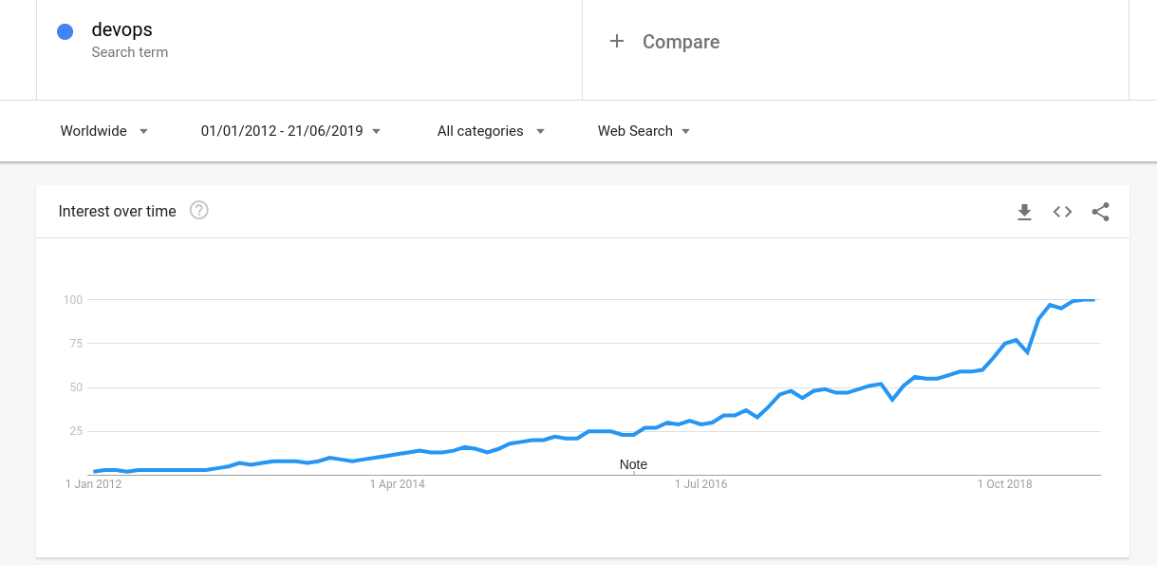

Slide 17
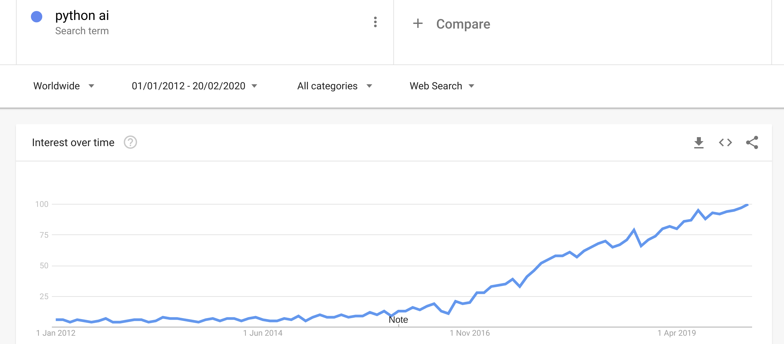

Slide 18
The Cloud and DevOps
The cloud enabled devops
Containers as the unit of deployment
Repeatable automated builds and deployment
Dev build artefact similar to prod environment
Docker and Docker images! (and then kubernetes)

Slide 19
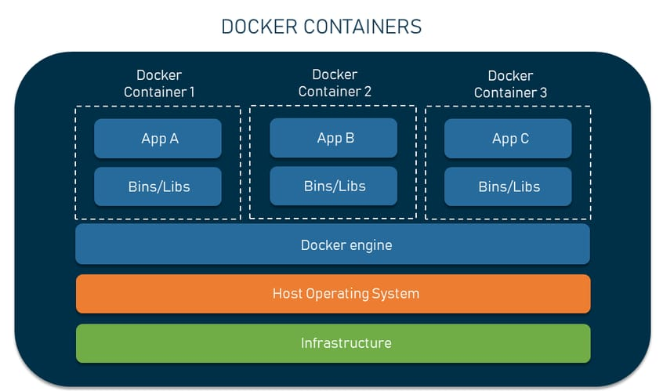

Slide 20
DevOps
Running services as well as building them
Automated workflows
  Automated testing: deploy with confidence
  Push button deploy and rollback
  Continuous Integration/Continuous Deployment
Caring for the system for the whole lifecycle
Tooling like docker, kubernetes, ansible, infrastructure as code

Slide 21
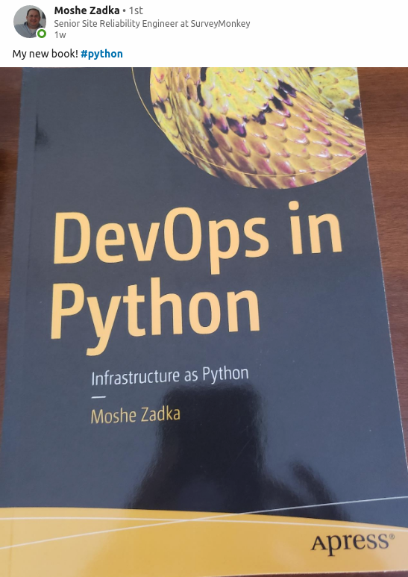
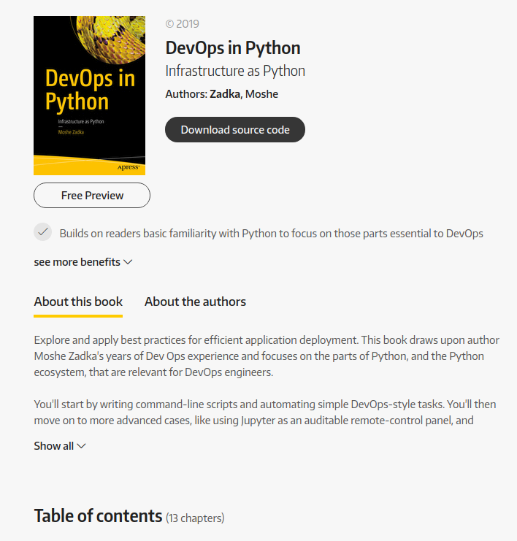
Disposable virtual environments

Slide 22
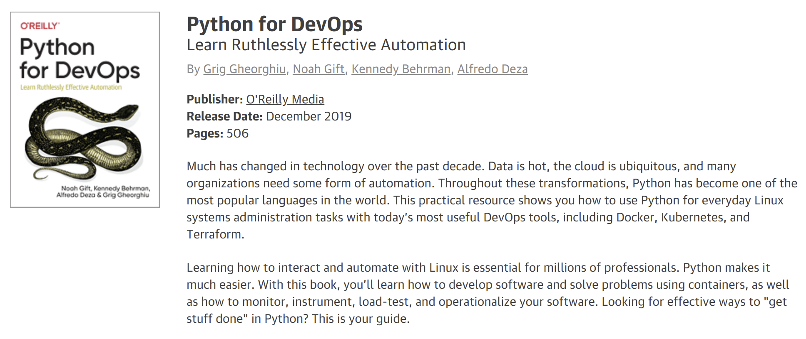
Great interviews with prominent Python developers

Slide 23
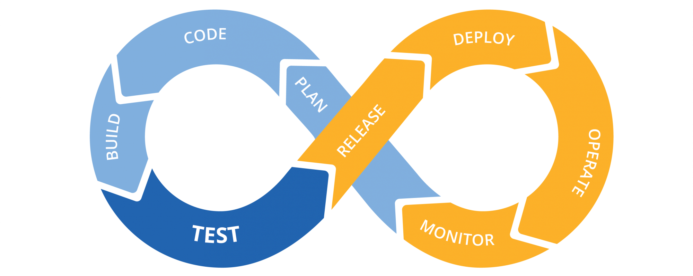
CI/CD
Government Digital Services, Singapore

Slide 24
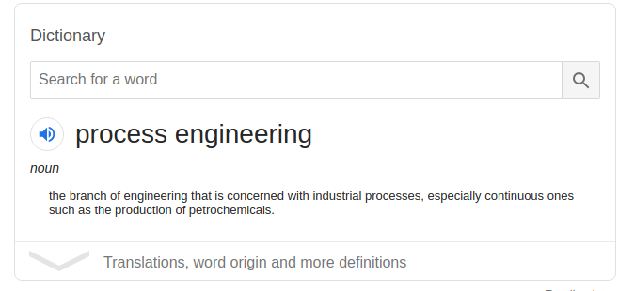

Slide 25
The deliberate design of processes and workflows, supported by tooling, to enable the continuous and sustained delivery and maintenance of a quality system.

Slide 26
The modern Python ecosystem and infrastructure, along with conventions and understanding from the wider programming community, means that the “how” of software engineering is often a solved problem. What and why still remain to be solved...

Slide 27
Agile, DevOps and Scrum, along with the tooling and technologies of modern engineering enable us to tackle the difficult problems of building and running robust systems with confidence – Michael Foord

Slide 28
sys.exit(0)

