Slide 1
Xiphod’s Notes on IBM5100 Scroller PALM Code
June 2025

Slide 2
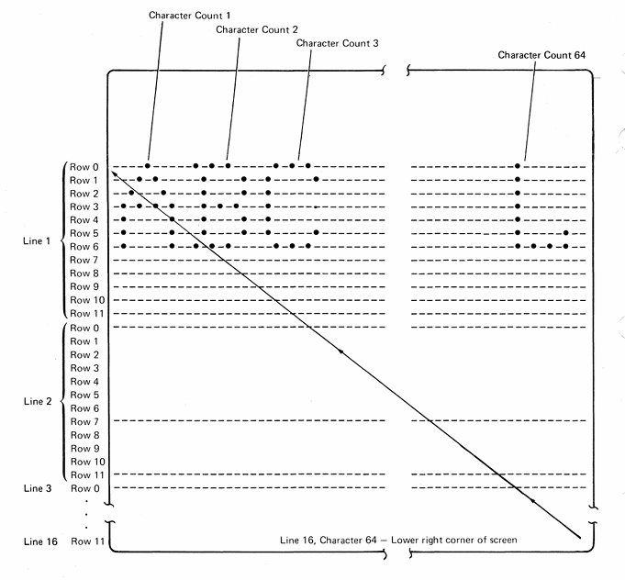
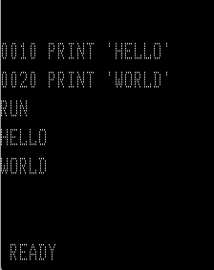
6x7 pixel characters. Columns 2 pixel padded, rows 5 pixel padded.
Notes:
IBM 5100 MIM 4-46 pg244

Slide 3
1 2 3 4 5 6 1234567890123456789012345678901234567890123456789012345678901234
LINE 1 0x0200
LINE 2 0x0240
LINE 3 0x0280
LINE 4 0x02C0
LINE 5 0x0300
LINE 6 0x0340
LINE 7 0x0380
LINE 8 0x03C0
LINE 9 0x0400
LINE 10 0x0440
LINE 11 0x0480
LINE 12 0x04C0
LINE 13 0x0500
LINE 14 0x0540
LINE 15 0x0580
LINE 16 0x05C0
0x0600

Slide 4
1 2 3 4 5 6 1234567890123456789012345678901234567890123456789012345678901234
LINE 1 0x0200
LINE 2 0x0240
LINE 3 0x0280
LINE 4 0x02C0
LINE 5 0x0300
LINE 6 0x0340
LINE 7 0x0380
LINE 8 0x03C0
LINE 9 0x0400
LINE 10 0x0440
LINE 11 0x0480
LINE 12 0x04C0
LINE 13 0x0500
LINE 14 0x0540
LINE 15 0x0580
LINE 16 0x05C0
0x0600
ROW 1 0x1000
ROW 2 ???
ROW 3 ???
ROW 4 ???
ROW 5 ???
ROW 6 ???
ROW 7 ???
ROW 8 ???
ROW 9 ???
ROW 10 ???
___AAAA___BBBBB____CCCC___DDDDD___EEEEEE__FFFFFF___GGGG___HH HH__IIIIII______JJ__KK KK__LL
__AAAAAA__BBBBBB__CCCCCC__DDDDDD__EEEEEE__FFFFFF__GGGGGG__HH HH__IIIIII______JJ__KK_ KK__LL
__AA AA__BB BB__CC CC__DD DD__EE __FF __GG GG__HH HH____II ______JJ__KK KK __LL
__AA AA__BB BB__CC __DD DD__EE __FF __GG __HH HH____II ______JJ__KK KK __LL
__AAAAAA__BBBBB___CC __DD DD__EEEE __FFFF __GG __HHHHHH____II ______JJ__KKKK __LL
__AAAAAA__BB BB__CC __DD DD__EEEE __FFFF __GG GGG__HHHHHH____II ______JJ__KKKK __LL
__AA AA__BB BB__CC __DD DD__EE __FF __GG GGG__HH HH____II __JJ__JJ__KK KK __LL
__AA AA__BB BB__CC CC__DD DD__EE __FF __GG GG__HH HH____II __JJ__JJ__KK KK __LL
__AA AA__BBBBBB__CCCCCC__DDDDDD__EEEEEE__FF __GGGGGG__HH HH__IIIIII__JJJJJ___KK KK__LLLLLL
__AA AA__BBBBB____CCCC___DDDDD___EEEEEE__FF ___GGGG___HH HH__IIIIII___JJJ____KK KK__LLLLLL
Define “big letters” using 8x10 bytes.
Means 8 characters fills the width of the 64-column screen.

Slide 5
1 2 3 4 5 6 1234567890123456789012345678901234567890123456789012345678901234
LINE 1 0x0200
LINE 2 0x0240
LINE 3 0x0280
LINE 4 0x02C0
LINE 5 0x0300
LINE 6 0x0340
LINE 7 0x0380
LINE 8 0x03C0
LINE 9 0x0400
LINE 10 0x0440
LINE 11 0x0480
LINE 12 0x04C0
LINE 13 0x0500
LINE 14 0x0540
LINE 15 0x0580
LINE 16 0x05C0
0x0600
ROW 1 0x1000
ROW 2 ???
ROW 3 ???
ROW 4 ???
ROW 5 ???
ROW 6 ???
ROW 7 ???
ROW 8 ???
ROW 9 ???
ROW 10 ???
___AAAA___BBBBB____CCCC___DDDDD___EEEEEE__FFFFFF___GGGG___HH HH__IIIIII______JJ__KK KK__LL____
__AAAAAA__BBBBBB__CCCCCC__DDDDDD__EEEEEE__FFFFFF__GGGGGG__HH HH__IIIIII______JJ__KK_ KK__LL
__AA AA__BB BB__CC CC__DD DD__EE __FF __GG GG__HH HH____II ______JJ__KK KK __LL
__AA AA__BB BB__CC __DD DD__EE __FF __GG __HH HH____II ______JJ__KK KK __LL
__AAAAAA__BBBBB___CC __DD DD__EEEE __FFFF __GG __HHHHHH____II ______JJ__KKKK __LL
__AAAAAA__BB BB__CC __DD DD__EEEE __FFFF __GG GGG__HHHHHH____II ______JJ__KKKK __LL
__AA AA__BB BB__CC __DD DD__EE __FF __GG GGG__HH HH____II __JJ__JJ__KK KK __LL
__AA AA__BB BB__CC CC__DD DD__EE __FF __GG GG__HH HH____II __JJ__JJ__KK KK __LL
__AA AA__BBBBBB__CCCCCC__DDDDDD__EEEEEE__FF __GGGGGG__HH HH__IIIIII__JJJJJ___KK KK__LLLLLL
__AA AA__BBBBB____CCCC___DDDDD___EEEEEE__FF ___GGGG___HH HH__IIIIII___JJJ____KK KK__LLLLLL
Define “big letters” using 8x10 bytes.
Means 8 characters fills the width of the 64-column screen.
EXAMPLE: 8 bytes per character x 12 characters = 96 characters (bytes) per row

Slide 6
1 2 3 4 5 6 1234567890123456789012345678901234567890123456789012345678901234
LINE 1 0x0200
LINE 2 0x0240
LINE 3 0x0280
LINE 4 0x02C0
LINE 5 0x0300
LINE 6 0x0340
LINE 7 0x0380
LINE 8 0x03C0
LINE 9 0x0400
LINE 10 0x0440
LINE 11 0x0480
LINE 12 0x04C0
LINE 13 0x0500
LINE 14 0x0540
LINE 15 0x0580
LINE 16 0x05C0
0x0600
ROW 1 0x1000
ROW 2 0x1060
ROW 3 0x10C0
ROW 4 0x1120
ROW 5 0x1180
ROW 6 0x11E0
ROW 7 0x1240
ROW 8 0x12A0
ROW 9 0x1300
ROW 10 0x1360
___AAAA___BBBBB____CCCC___DDDDD___EEEEEE__FFFFFF___GGGG___HH HH__IIIIII______JJ__KK KK__LL
__AAAAAA__BBBBBB__CCCCCC__DDDDDD__EEEEEE__FFFFFF__GGGGGG__HH HH__IIIIII______JJ__KK_ KK__LL
__AA AA__BB BB__CC CC__DD DD__EE __FF __GG GG__HH HH____II ______JJ__KK KK __LL
__AA AA__BB BB__CC __DD DD__EE __FF __GG __HH HH____II ______JJ__KK KK __LL
__AAAAAA__BBBBB___CC __DD DD__EEEE __FFFF __GG __HHHHHH____II ______JJ__KKKK __LL
__AAAAAA__BB BB__CC __DD DD__EEEE __FFFF __GG GGG__HHHHHH____II ______JJ__KKKK __LL
__AA AA__BB BB__CC __DD DD__EE __FF __GG GGG__HH HH____II __JJ__JJ__KK KK __LL
__AA AA__BB BB__CC CC__DD DD__EE __FF __GG GG__HH HH____II __JJ__JJ__KK KK __LL
__AA AA__BBBBBB__CCCCCC__DDDDDD__EEEEEE__FF __GGGGGG__HH HH__IIIIII__JJJJJ___KK KK__LLLLLL
__AA AA__BBBBB____CCCC___DDDDD___EEEEEE__FF ___GGGG___HH HH__IIIIII___JJJ____KK KK__LLLLLL
8 bytes per character x 12 characters = 96 characters per row
For each row, increment address by 96.
96 decimal == 0x60 (6*16¹ + 0*16⁰ = 96)

Slide 7
1 2 3 4 5 6 1234567890123456789012345678901234567890123456789012345678901234
WORKING_ADDRESS
LINE 1 0x0200
LINE 2 0x0240
LINE 3 0x0280
LINE 4 0x02C0
LINE 5 0x0300
LINE 6 0x0340
LINE 7 0x0380
LINE 8 0x03C0
LINE 9 0x0400
LINE 10 0x0440
LINE 11 0x0480
LINE 12 0x04C0
LINE 13 0x0500
LINE 14 0x0540
LINE 15 0x0580
LINE 16 0x05C0
0x0600
ROW 1 0x1008
ROW 2 0x1068
ROW 3 0x10C8
ROW 4 0x1128
ROW 5 0x1188
ROW 6 0x11E8
ROW 7 0x1248
ROW 8 0x12A8
ROW 9 0x1308
ROW 10 0x1368
___AAAA___BBBBB____CCCC___DDDDD___EEEEEE__FFFFFF___GGGG___HH HH__IIIIII______JJ__KK KK__LL
__AAAAAA__BBBBBB__CCCCCC__DDDDDD__EEEEEE__FFFFFF__GGGGGG__HH HH__IIIIII______JJ__KK_ KK__LL
__AA AA__BB BB__CC CC__DD DD__EE __FF __GG GG__HH HH____II ______JJ__KK KK __LL
__AA AA__BB BB__CC __DD DD__EE __FF __GG __HH HH____II ______JJ__KK KK __LL
__AAAAAA__BBBBB___CC __DD DD__EEEE __FFFF __GG __HHHHHH____II ______JJ__KKKK __LL
__AAAAAA__BB BB__CC __DD DD__EEEE __FFFF __GG GGG__HHHHHH____II ______JJ__KKKK __LL
__AA AA__BB BB__CC __DD DD__EE __FF __GG GGG__HH HH____II __JJ__JJ__KK KK __LL
__AA AA__BB BB__CC CC__DD DD__EE __FF __GG GG__HH HH____II __JJ__JJ__KK KK __LL
__AA AA__BBBBBB__CCCCCC__DDDDDD__EEEEEE__FF __GGGGGG__HH HH__IIIIII__JJJJJ___KK KK__LLLLLL
__AA AA__BBBBB____CCCC___DDDDD___EEEEEE__FF ___GGGG___HH HH__IIIIII___JJJ____KK KK__LLLLLL

Slide 8
1 2 3 4 5 6 1234567890123456789012345678901234567890123456789012345678901234
WORKING_ADDRESS
LINE 1 0x0200
LINE 2 0x0240
LINE 3 0x0280
LINE 4 0x02C0
LINE 5 0x0300
LINE 6 0x0340
LINE 7 0x0380
LINE 8 0x03C0
LINE 9 0x0400
LINE 10 0x0440
LINE 11 0x0480
LINE 12 0x04C0
LINE 13 0x0500
LINE 14 0x0540
LINE 15 0x0580
LINE 16 0x05C0
0x0600
ROW 1 0x1008
ROW 2 0x1068
ROW 3 0x10C8
ROW 4 0x1128
ROW 5 0x1188
ROW 6 0x11E8
ROW 7 0x1248
ROW 8 0x12A8
ROW 9 0x1308
ROW 10 0x1368
___AAAA___BBBBB____CCCC___DDDDD___EEEEEE__FFFFFF___GGGG___HH HH__IIIIII______JJ__KK KK__LL
__AAAAAA__BBBBBB__CCCCCC__DDDDDD__EEEEEE__FFFFFF__GGGGGG__HH HH__IIIIII______JJ__KK_ KK__LL
__AA AA__BB BB__CC CC__DD DD__EE __FF __GG GG__HH HH____II ______JJ__KK KK __LL
__AA AA__BB BB__CC __DD DD__EE __FF __GG __HH HH____II ______JJ__KK KK __LL
__AAAAAA__BBBBB___CC __DD DD__EEEE __FFFF __GG __HHHHHH____II ______JJ__KKKK __LL
__AAAAAA__BB BB__CC __DD DD__EEEE __FFFF __GG GGG__HHHHHH____II ______JJ__KKKK __LL
__AA AA__BB BB__CC __DD DD__EE __FF __GG GGG__HH HH____II __JJ__JJ__KK KK __LL
__AA AA__BB BB__CC CC__DD DD__EE __FF __GG GG__HH HH____II __JJ__JJ__KK KK __LL
__AA AA__BBBBBB__CCCCCC__DDDDDD__EEEEEE__FF __GGGGGG__HH HH__IIIIII__JJJJJ___KK KK__LLLLLL
__AA AA__BBBBB____CCCC___DDDDD___EEEEEE__FF ___GGGG___HH HH__IIIIII___JJJ____KK KK__LLLLLL
8 bytes per character x 12 characters = 96 characters per row
96 characters per row x 10 rows = 960 characters (bytes)

Slide 9
8 bytes per character x 120 characters = 960 characters per row
960 characters per row x 10 rows = 9600 characters (bytes) (yikes!)
Instead, we can represent each row of a “big letter” as a hex sequence.
___AAAA_ == 0001 1110 == 1E 80 bytes (8x10) now expressed __AAAAAA == 0011 1111 == 3F in only 10 bytes. __AA AA == 0011 0011 == 33
__AA AA == 0011 0011 == 33 Add a symbol header, becomes
__AAAAAA == 0011 1111 == 3F now 12 bytes.
__AAAAAA == 0011 1111 == 3F
__AA AA == 0011 0011 == 33
__AA AA == 0011 0011 == 33
__AA AA == 0011 0011 == 33
__AA AA == 0011 0011 == 33
Then we can programmatically compute a big-letter sequence from a
given “normal string” sequence.

Slide 10
8 bytes per character x 120 characters = 960 characters per row
960 characters per row x 10 rows = 9600 characters (bytes) (yikes!)
Instead, we can represent each row of a “big letter” as a hex sequence.
___AAAA_ == 0001 1110 == 1E → _ _ _ X X X X _ __AAAAAA == 0011 1111 == 3F → _ _ X X X X X X __AA AA == 0011 0011 == 33 → _ _ X X _ _ X X
__AA AA == 0011 0011 == 33 → _ _ X X _ _ X X
__AAAAAA == 0011 1111 == 3F → _ _ X X X X X X
__AAAAAA == 0011 1111 == 3F → _ _ X X X X X X
__AA AA == 0011 0011 == 33 → _ _ X X _ _ X X
__AA AA == 0011 0011 == 33 → _ _ X X _ _ X X
__AA AA == 0011 0011 == 33 → _ _ X X _ _ X X
__AA AA == 0011 0011 == 33 → _ _ X X _ _ X X
NOTE: Would like to control what on-system display-symbol is used for any expanded “big letter.”

Slide 11
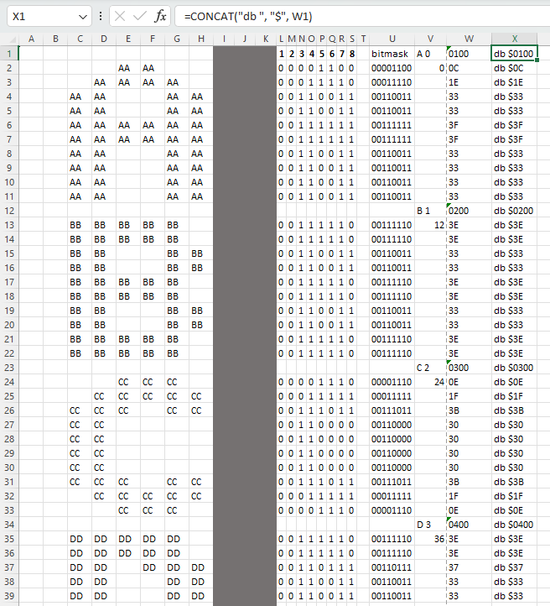
01
00
“big letter” #1
IBM symbol index
Pad/future settings
“big letter” #2
“big letter” #3
“big letter” #4

Slide 12
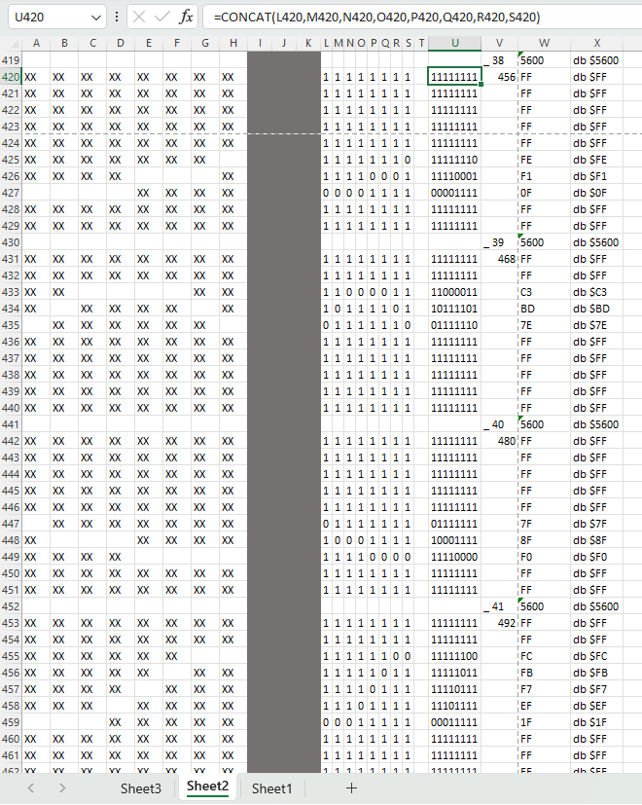
56
00
“big letter” #38
IBM symbol index
Pad/future settings
“big letter” #39
Symbol index offset can be
greater than 255 (0xFF)
“big letter” #40
“big letter” #41

Slide 13
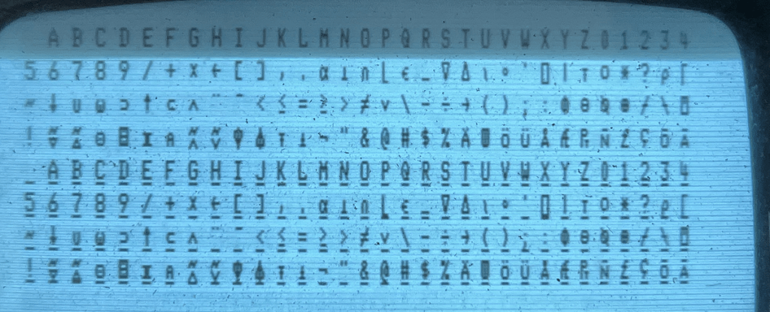
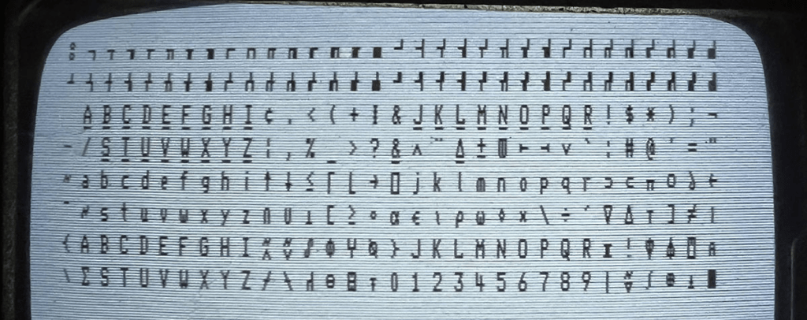
IBM 5100
0 (00)
32 (20)
64 (40)
96 (60)
128 (80)
160 (A0)
192 (C0)
224 (E0)
IBM 5110
0 (00)
32 (20)
64 (40)
96 (60)
128 (80)
160 (A0)
192 (C0)
224 (E0)

Slide 14
00020406 080A0C0E 10121416 181A1C
1E…
1 2 3 4 5 6 1234567890123456789012345678901234567890123456789012345678901234
WORKING_ADDRESS
LINE 1 0x0200
LINE 2 0x0240
LINE 3 0x0280
LINE 4 0x02C0
LINE 5 0x0300
LINE 6 0x0340
LINE 7 0x0380
LINE 8 0x03C0
LINE 9 0x0400
LINE 10 0x0440
LINE 11 0x0480
LINE 12 0x04C0
LINE 13 0x0500
LINE 14 0x0540
LINE 15 0x0580
LINE 16 0x05C0
0x0600
ROW 1 0x101E
ROW 2 0x107E
ROW 3 0x10DE
ROW 4 0x113E
ROW 5 0x119E
ROW 6 0x11FE
ROW 7 0x125E
ROW 8 0x12BE
ROW 9 0x131E
ROW 10 0x137E
___AAAA___BBBBB____CCCC___DDDDD___EEEEEE__FFFFFF___GGGG___HH HH__IIIIII______JJ__KK KK__LL
__AAAAAA__BBBBBB__CCCCCC__DDDDDD__EEEEEE__FFFFFF__GGGGGG__HH HH__IIIIII______JJ__KK_ KK__LL
__AA AA__BB BB__CC CC__DD DD__EE __FF __GG GG__HH HH____II ______JJ__KK KK __LL
__AA AA__BB BB__CC __DD DD__EE __FF __GG __HH HH____II ______JJ__KK KK __LL
__AAAAAA__BBBBB___CC __DD DD__EEEE __FFFF __GG __HHHHHH____II ______JJ__KKKK __LL
__AAAAAA__BB BB__CC __DD DD__EEEE __FFFF __GG GGG__HHHHHH____II ______JJ__KKKK __LL
__AA AA__BB BB__CC __DD DD__EE __FF __GG GGG__HH HH____II __JJ__JJ__KK KK __LL
__AA AA__BB BB__CC CC__DD DD__EE __FF __GG GG__HH HH____II __JJ__JJ__KK KK __LL
__AA AA__BBBBBB__CCCCCC__DDDDDD__EEEEEE__FF __GGGGGG__HH HH__IIIIII__JJJJJ___KK KK__LLLLLL
__AA AA__BBBBB____CCCC___DDDDD___EEEEEE__FF ___GGGG___HH HH__IIIIII___JJJ____KK KK__LLLLLL
ROW 1 0x1000
ROW 2 0x1060
ROW 3 0x10C0
ROW 4 0x1120
ROW 5 0x1180
ROW 6 0x11E0
ROW 7 0x1240
ROW 8 0x12A0
ROW 9 0x1300
ROW 10 0x1360
WORKING_ADDRESS_INITIAL

Slide 15
ASCII to “big letters” Translation
…
include "cp5100.inc“ (cp == codepage) codepage cp5100 (activate the designated codepage)
… db “ VCF DALLAS 2025 – IBM 5100 SCROLLER “ ← ASCII “data byte” (db) becomes encoded as a byte-sequence… $00, $00, $00, $00, $00, $00, $00, $00, $14, $03, $06, $00, $04, $01, …
But we will need 16-bit offsets… use “data words” (dw)
dw $01BC,$01BC,$01BC,$01BC,$01BC,$01BC,$01BC,$01BC ; 8
dw $00FC,$0018,$003C,$01BC ; "VCF " ; 4
dw $0024,$0000,$0084,$0084,$0000,$00D8,$01BC ; "DALLAS " ; 7
dw $0150,$01B0,$0150,$0174,$01BC,$0138,$01BC ; "2025 - " ; 7
dw $0060,$000C,$0090,$01BC,$0174,$0144,$01B0,$01B0,$01BC ; "IBM 5100 " ; 9
dw $00D8,$0018,$00CC,$00A8,$0084,$0084,$0030,$00CC,$01BC ; "SCROLLER " ; 9
dw $01BC,$01BC,$01BC,$01BC,$01BC,$01BC,$01BC,$01BC ; 8 +
dw $FFFF ; --
; 52 len.

Slide 16
Initial Look at PALM Assembly Code
ADDR_SCREEN equ $0200 ; Start address of CRT display (top left)
BG_SYMBOL_W equ $0000 ; used in Clear Screen function (_W for “word”)
; BG for “background” (00 = space/blank on 5100)
…
ClrScr:
LWI R14, ADDR_SCREEN ; R14 used as the screen offset [ LWI = Load Word Immediate ]
LWI R9, BG_SYMBOL_W ; R9 full word is used as screen code that is
; to be written (e.g. “ “)
LBI R3, $06 ; Lo R3 = $06 (will be used to check to see if our address
; pointer has reached $06xx yet) [ LBI = Load Byte Immediate ]
cs_1:
MOVE (R14)+, R9 ; RWS[R14] = R9, then R14 = R14 + 2 (next address)
; (this does the actual character display update)
SBSH R14, R3 ; Have we reached $0600 yet? (one past end of screen)
; [ Skip if All Set Bits of R3 are Also Set in Hi R14 ]
; NOTE: The above SBSH will set R1 = R0+4 -- this
; is in case the code after the jump goes to a
; subroutine -- as documented in IBM 5100
; MIM Appendix C-16)
BRA cs_1 ; Did not match yet, repeat again for next address
RET R2 ; We “skip” (jump) to here if all the R3 bits match (return to caller)
…

Slide 17
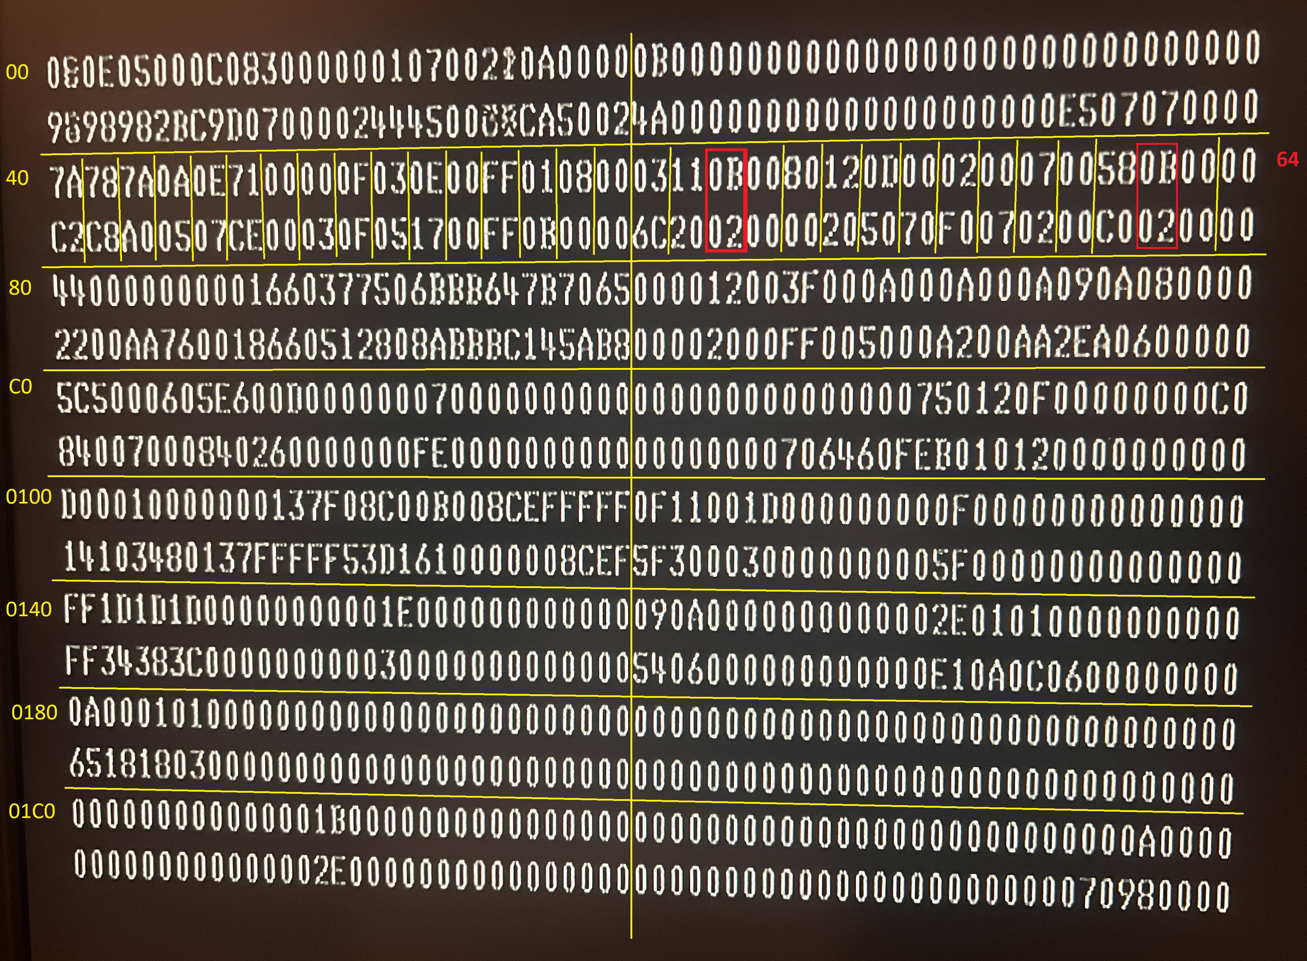
Memory Map
IBM 5100 “registers” Display Mode [ e.g. 0040 == 7CA2 ]
HEX. ADDRESS DESCRIPTION 0000 – 001F LEVEL 0 REGISTERS
(R0) (R15) (NORMAL OPERATION)
0020 – 003F LEVEL 1 REGISTERS
(COMM. / SERIAL IO)
0040 – 005F LEVEL 2 REGISTERS
(PRINTER / TAPE)
0060 – 007F LEVEL 3 REGISTERS
(KEYBOARD)
0080 – 01FF RWS / RAM (SYSTEM)
0200 – 05FF DISPLAY MEMORY MAP
(64x16 = 1024)
0600 – 3FFF RWS / RAM (16KB) 4000 – 7FFF RWS / RAM (32KB)
8000 – FFFF RWS / RAM (64KB)

Slide 18
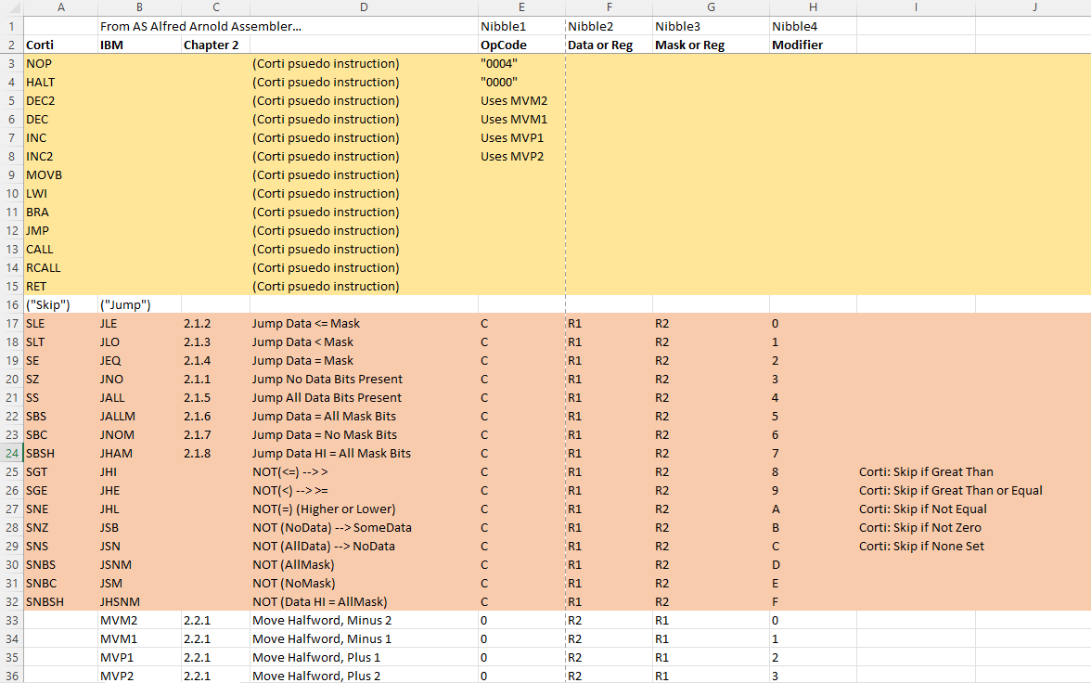
P.A.L.M. INSTRUCTION SET

Slide 19
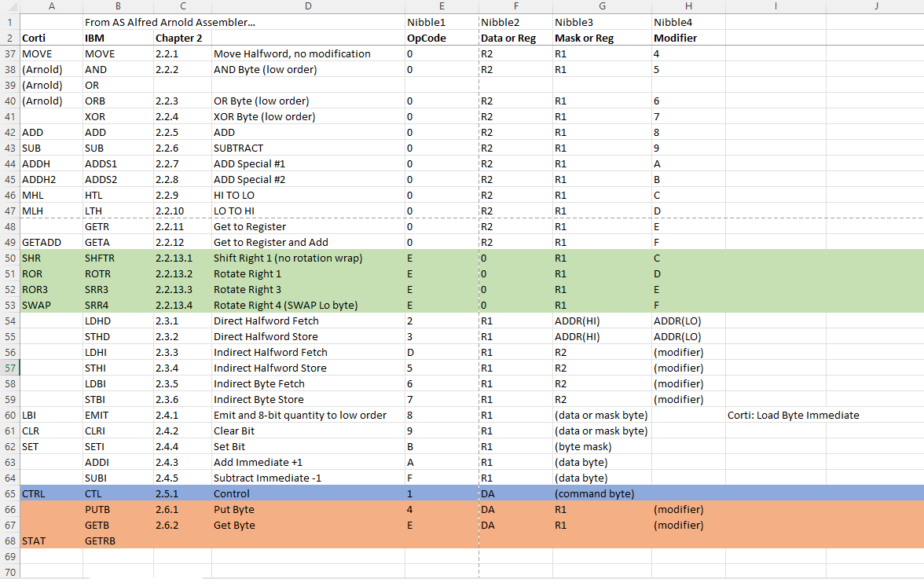
P.A.L.M. INSTRUCTION SET

Slide 20
HI LO
1 2 3 4 5 6 1234567890123456789012345678901234567890123456789012345678901234
R0
0700
LINE 1 0x0200
LINE 2 0x0240
LINE 3 0x0280
LINE 4 0x02C0
LINE 5 0x0300
LINE 6 0x0340
LINE 7 0x0380
LINE 8 0x03C0
LINE 9 0x0400
LINE 10 0x0440
LINE 11 0x0480
LINE 12 0x04C0
LINE 13 0x0500
LINE 14 0x0540
LINE 15 0x0580
LINE 16 0x05C0
0x0600
R1
----
R2
----
R3
----
R4
----
R5
----
R6
----
R7
----
R8
----
R9
----
R10
----
R11
----
R12
----
R13
----
R14
----
R15
----

Slide 21
HI LO
1 2 3 4 5 6 1234567890123456789012345678901234567890123456789012345678901234
R0
PC
LINE 1 0x0200
LINE 2 0x0240
LINE 3 0x0280
LINE 4 0x02C0
LINE 5 0x0300
LINE 6 0x0340
LINE 7 0x0380
LINE 8 0x03C0
LINE 9 0x0400
LINE 10 0x0440
LINE 11 0x0480
LINE 12 0x04C0
LINE 13 0x0500
LINE 14 0x0540
LINE 15 0x0580
LINE 16 0x05C0
0x0600
R1
----
R2
----
R3
----
R4
----
R5
----
R6
----
R7
----
R8
----
R9
008D
R10
0000
R11
0700 0203 D021 09F4 CALL ClrScr, R2
0706 D901 0E00 LWI R9, BANNER_LEN → R9 = 0x0E00
070A 6998 LDBI R9, R9 → R9 = 141
070C 8A00 LBI R10, 0 → Lo R10 = 0
070E 0AAD LTH R10, R10 → Hi R10 = 0
----
R12
----
R13
----
R14
----
R15
----

Slide 22
HI LO
1 2 3 4 5 6 1234567890123456789012345678901234567890123456789012345678901234
R0
PC
LINE 1 0x0200
LINE 2 0x0240
LINE 3 0x0280
LINE 4 0x02C0
LINE 5 0x0300
LINE 6 0x0340
LINE 7 0x0380
LINE 8 0x03C0
LINE 9 0x0400
LINE 10 0x0440
LINE 11 0x0480
LINE 12 0x04C0
LINE 13 0x0500
LINE 14 0x0540
LINE 15 0x0580
LINE 16 0x05C0
0x0600
R1
----
R2
----
R3
----
R4
----
R5
----
R6
----
R7
----
R8
----
R9
0000
R10
0468
FIND_LEN_NEXT: 0710 C903 SZ R9
0712 A001 BRA FIND_LEN_BYTES
0714 A005 BRA CALCULATE_NEXT_SETUP
FIND_LEN_BYTES: 0716 AA07 ADDI R10, #8 → R10 = R10+8
0718 0991 DEC R9 → R9 = R9-1
071A F00B BRA FIND_LEN_NEXT CALCULATE_NEXT_SETUP:
071C
R11
----
R12
----
R13
----
R14
----
R15
----
R10 = R9 * 8 → 141 * 8 = 1,128 (0x0468)

Slide 23
HI LO
CALCULATE_NEXT_SETUP:
071C 09AC HTL R9, R10 → Lo R9 = Hi R10
071E DB01 1000 LWI R11, BANNER_TARGET
0722 DC01 0C96 LWI R12, WORKING_ADDRESS
0726 DD01 0CAA LWI R13, WORKING_ADDRESSI
072A 5BC1 MOVE (R12)+, R11 ; ROW 1
072C 5BD1 MOVE (R13)+, R11
072E 0203 D021 0A06 CALL IncreaseR11_by_Len, R2
0734 5BC1 MOVE (R12)+, R11 ; ROW 2
0736 5BD1 MOVE (R13)+, R11
0738 0203 D021 0A06 CALL IncreaseR11_by_Len, R2
073E 5BC1 MOVE (R12)+, R11 ; ROW 3
0740 5BD1 MOVE (R13)+, R11
0742 0203 D021 0A06 CALL IncreaseR11_by_Len, R2 0748 5BC1 MOVE (R12)+, R11 ; ROW 4
074A 5BD1 MOVE (R13)+, R11
074C 0203 D021 0A06 CALL IncreaseR11_by_Len, R2
...
R0
PC
R1
----
R2
----
R3
----
R4
----
R5
----
R6
----
R7
----
R8
----
R9
0004
R10
0468
R11
1000
R12
0C96
R13
0CAA
R14
----
R15
----

Slide 24
HI LO
CALCULATE_NEXT_SETUP:
071C 09AC HTL R9, R10
071E DB01 1000 LWI R11, BANNER_TARGET
0722 DC01 0C96 LWI R12, WORKING_ADDRESS
0726 DD01 0CAA LWI R13, WORKING_ADDRESSI
072A 5BC1 MOVE (R12)+, R11 ; ROW 1
072C 5BD1 MOVE (R13)+, R11
072E 0203 D021 0A06 CALL IncreaseR11_by_Len, R2
0734 5BC1 MOVE (R12)+, R11 ; ROW 2
0736 5BD1 MOVE (R13)+, R11
0738 0203 D021 0A06 CALL IncreaseR11_by_Len, R2
073E 5BC1 MOVE (R12)+, R11 ; ROW 3
0740 5BD1 MOVE (R13)+, R11
0742 0203 D021 0A06 CALL IncreaseR11_by_Len, R2 0748 5BC1 MOVE (R12)+, R11 ; ROW 4
074A 5BD1 MOVE (R13)+, R11
074C 0203 D021 0A06 CALL IncreaseR11_by_Len, R2
...
R0
PC
R1
----
R2
----
R3
----
R4
----
R5
----
R6
----
0C96
0C98
0C9A
0C9C
0C9E
0CA0
0CA2
0CA4
0CA6
0CA8
1000
1468
18D0
1D38
----
---- ---- ---- ---- ----
R7
----
R8
----
R9
0004
R10
0468
R11
21A0
R12
0C9E
0CAA
0CAC
0CAE
0CB0
0CB2
0CB4
0CB6
0CB8
0CBA
0CBC
1000
1468
18D0
1D38
----
---- ---- ---- ---- ----
R13
0CB2
R14
----
R15
----

Slide 25
HI LO
074C 0203 D021 0A06 CALL IncreaseR11_by_Len, R2
... IncreaseR11_by_Len:
0A06 0494 MOVE R4, R9 → R4 = R9
0A08 05A4 MOVE R5, R10 → R5 = R10
RepeatR11IncHi:
0A0A C403 SZ R4
0A0C A001 BRA ContinueR11IncHi
0A0E A007 BRA IncreaseR11ChkLo
ContinueR11IncHi:
0A10 ABFE ADDI R11,#$FF
0A12 AB00 ADDI R11,#1
0A14 0441 DEC R4
0A16 F00D BRA RepeatR11IncHi
IncreaseR11ChkLo:
0A18 C503 SZ R5
0A1A A001 BRA ContinueR11IncLo
0A1C 0024 RET R2
ContinueR11IncLo:
0A1E AB00 ADDI R11,#1
0A20 0551 DEC R5
0A22 F00B BRA IncreaseR11ChkLo
R0
074C
R1
----
R2
----
R3
----
R4
0004
R5
0468
R6
----
R7
----
256
R8
----
R9
0004
R10
0468
R11
1D38
R12
0C9E
R13
0CB2
R14
----
R15
----
R11=(LoR4*256)+LoR5 (full word addition)

Slide 26
HI LO
... 0752 5BC1 MOVE (R12)+, R11 ROW 5
0754 5BD1 MOVE (R13)+, R11
0756 0203 D021 0A06 CALL IncreaseR11_by_Len, R2
075C 5BC1 MOVE (R12)+, R11 ROW 6
075E 5BD1 MOVE (R13)+, R11
0760 0203 D021 0A06 CALL IncreaseR11_by_Len, R2
0766 5BC1 MOVE (R12)+, R11 ROW 7
0768 5BD1 MOVE (R13)+, R11
076A 0203 D021 0A06 CALL IncreaseR11_by_Len, R2
0770 5BC1 MOVE (R12)+, R11 ROW 8
0772 5BD1 MOVE (R13)+, R11
0774 0203 D021 0A06 CALL IncreaseR11_by_Len, R2
077A 5BC1 MOVE (R12)+, R11 ROW 9
077C 5BD1 MOVE (R13)+, R11
077E 0203 D021 0A06 CALL IncreaseR11_by_Len, R2
0784 5BC1 MOVE (R12)+, R11 ROW 10
0786 5BD1 MOVE (R13)+, R11
0788 D301 0E02 LWI R3, BANNER_STRING
CALCULATE_NEXT: 078C ...
R0
078C
R1
0A1C
R2
0784
R3
0E02
R4
0000
R5
0400
R6
----
0C96
0C98
0C9A
0C9C
0C9E
0CA0
0CA2
0CA4
0CA6
0CA8
1000
1468
18D0
1D38
21A0
2608
2A70
2ED8
3340
37A8
R7
----
R8
----
R9
0004
R10
0468
R11
37A8
R12
0CAA
0CAA
0CAC
0CAE
0CB0
0CB2
0CB4
0CB6
0CB8
0CBA
0CBC
1000
1468
18D0
1D38
21A0
2608
2A70
2ED8
3340
37A8
R13
0CBE
R14
----
R15
----

Slide 27
HI LO
... CALCULATE_NEXT:
078C D531 MOVE R5, (R3)+ → R5 = MEM[R3], R3=R3+2
078E 045C HTL R4, R5
0790 86FF LBI R6, NULL_TERM_HI
0792 C642 SE R6, R4
0794 A00B BRA CALCULATE_LARGE
0796 86FF LBI R6, NULL_TERM_LO
0798 C652 SE R6, R5
079A A005 BRA CALCULATE_LARGE
079C 0203 CALL MAINLOOP_INIT, R2
079E D021
07A0 08F6
CALCULATE_LARGE:
07A2 D601 LWI R6, BIG_LETTERS
...
R0
0792
R1
0A1C
R2
0784
R3
0E04
R4
0001
R5
01BC
R6
--FF
0E02
0E04
0E06
0E08
0E0A
0E0C
0E0E
0E10
0E12
0E14
0E16
0E18
0E1A
0E1C
0E1E
0E20
0E22
0E24
0E26
0E28
01BC (header blank 1)
01BC (header blank 2)
01BC (header blank 3)
01BC (header blank 4)
01BC (header blank 5)
01BC (header blank 6)
01BC (header blank 7)
01BC (header blank 8)
00FC 252 V
0018 24 C
003C 60 F
01BC 444 " " (blank)
0024 36 D
0000 0 A
0084 132 L
0084 132 L
0000 0 A
00D8 216 S
01BC 444 " " (blank)
0150 336 2
…
R7
----
R8
----
R9
0004
R10
0468
R11
37A8
R12
0CAA
R13
0CBE
R14
----
R15
----

Slide 28
HI LO
... CALCULATE_NEXT:
078C D531 MOVE R5, (R3)+ → R5 = MEM[R3], R3=R3+2
078E 045C HTL R4, R5
0790 86FF LBI R6, NULL_TERM_HI
0792 C642 SE R6, R4 → Skip If Lo R6 = Lo R4 (Equal)
0794 A00B BRA CALCULATE_LARGE
0796 86FF LBI R6, NULL_TERM_LO
0798 C652 SE R6, R5
079A A005 BRA CALCULATE_LARGE
079C 0203 CALL MAINLOOP_INIT, R2
079E D021
07A0 08F6
CALCULATE_LARGE:
07A2 D601 LWI R6, BIG_LETTERS
...
R0
0792
R1
0A1C
R2
0784
R3
0E04
R4
0001
Else: since the LO is equal,
then check the HI portion
also. If both match, then
we are done calculating
and so, proceed to the
main-loop portion.
R5
01BC
R6
--FF
R7
----
R8
----
R9
0004
R10
0468
R11
37A8
R12
0CAA
R13
0CBE
R14
----
R15
----

Slide 29
HI LO
BIG_LETTERS:
0A24 01 A 0
0A25 00 (reserved)
0A26 0C 00001100 0A27 1E 00011110
0A28 33 00110011
0A29 33 00110011
0A2A 3F 00111111
0A2B 3F 00111111
0A2C 33 00110011
0A2D 33 00110011
0A2E 33 00110011
0A2F 33 00110011
0A30 02 B 12
0A31 00 (reserved)
0A32 3E 00111110
0A33 3E 00111110
0A34 33 00110011
0A35 33 00110011
0A36 3E 00111110
0A37 3E 00111110
0A38 33 00110011
0A39 33 00110011
0A3A 3E 00111110
0A3B 3E 00111110
...
0BE0 00 " "(blank) 444
0BE1 00 (reserved)
0BE2 00 00000000
0BE3 00 00000000
0BE4 00 00000000
0BE5 00 00000000
0BE6 00 00000000
0BE7 00 00000000
0BE8 00 00000000
0BE9 00 00000000
0BEA 00 00000000
0BEB 00 00000000
CALCULATE_LARGE:
07A2 D601 0A24 LWI R6, BIG_LETTERS
AGAIN_HI:
07A6 C403 SZ R4
07A8 A001 BRA EXHAUST_HI
07AA A007 BRA AGAIN_LO
EXHAUST_HI:
07AC A6FE ADDI R6, #$FF
07AE A600 ADDI R6, #1
07B0 0441 DEC R4
07B2 F00D BRA AGAIN_HI
AGAIN_LO:
07B4 C503 SZ R5
07B6 A001 BRA EXHAUST_LO
07B8 A005 BRA PROCESS_ROWS
EXHAUST_LO:
07BA A600 ADDI R6, 1
07BC 0551 DEC R5
07BE F00B BRA AGAIN_LO
PROCESS_ROWS:
07C0 ...
R0
PC
R1
0A1C
R2
0784
R3
0E04
R4
0001
R5
01BC
R6
0A24
R7
----
R8
----
R9
0004
R10
0468
R11
37A8
R12
0CAA
R13
0CBE
R14
----
R15
----
R6 = @BIG_LETTERS + (Lo R4 * 256) + Lo R5
0x01BC (hex) == 444 decimal (same 16-bit ADD as done in IncreaseR11_by_Len)

Slide 30
HI LO
PROCESS_ROWS:
07C0 D761 MOVE R7, (R6)+ → R7 = MEM[R6], R6=R6+2
07C2 077C HTL R7, R7 → Lo R7 = Hi R7
07C4 DC01 0C96 LWI R12, WORKING_ADDRESS
07C8 8905 LBI R9, #$05 → Lo R9 = 05
PROCESS_ROWS_NEXT:
07CA DBC8 MOVE R11, (R12)
07CC D861 MOVE R8, (R6)+
07CE 048C HTL R4, R8
07D0 8E80 LBI R14, #128
07D2 C4ED SNBS R4, R14
07D4 A005 BRA SET_COL1
07D6 8500 LBI R5, BG_SYMBOL
07D8 055D LTH R5, R5
07DA A001 BRA DO_COL2
SET_COL1:
07DC 057D LTH R5, R7
DO_COL2:
07DE 048C HTL R4, R8
R0
07C0
R1
07B8
R2
0784
R3
0E04
R4
0000
5x counter of “double rows” will mean that 10 total rows get processed.
BIG_LETTERS:
0A24 01 A 0
0A25 00 (reserved)
0A26 0C 00001100 0A27 1E 00011110
0A28 33 00110011
0A29 33 00110011
0A2A 3F 00111111
0A2B 3F 00111111
0A2C 33 00110011
0A2D 33 00110011
0A2E 33 00110011
0A2F 33 00110011
...
0BE0 00 " "(blank) 444
0BE1 00 (reserved)
0BE2 00 00000000
0BE3 00 00000000
0BE4 00 00000000
0BE5 00 00000000
0BE6 00 00000000
0BE7 00 00000000
0BE8 00 00000000
0BE9 00 00000000
0BEA 00 00000000
0BEB 00 00000000
R5
0100
R6
0BE2
R7
0000
0xBE0 – 0xA24 = 0x1BC
R8
----
R9
0005
R10
0468
R11
37A8
WORKING_ADDRESS:
#1
R12
0C96
0C96
0C98
0C9A
0C9C
0C9E
0CA0
0CA2
0CA4
0CA6
0CA8
1000
1468
18D0
1D38
21A0
2608
2A70
2ED8
3340
37A8
#2
R13
0CBE
#3
R14
----
#4
R15
----
#5

Slide 31
HI LO
PROCESS_ROWS:
07C0 D761 MOVE R7, (R6)+ → R7 = MEM[R6], R6=R6+2
07C2 077C HTL R7, R7 → Lo R7 = Hi R7
07C4 DC01 0C96 LWI R12, WORKING_ADDRESS
07C8 8905 LBI R9, #$05 → Lo R9 = 05
PROCESS_ROWS_NEXT:
07CA DBC8 MOVE R11, (R12) → R11 = MEM[R12]
07CC D861 MOVE R8, (R6)+ → R8=R6, R6=R6+2
07CE 048C HTL R4, R8 → Lo R4 = Hi R8
07D0 8E80 LBI R14, #128 → Lo R14 = 1000 0000
07D2 C4ED SNBS R4, R14 → Skip If Not Bit Set
07D4 A005 BRA SET_COL1
07D6 8500 LBI R5, BG_SYMBOL → Lo R5 = 00
07D8 055D LTH R5, R5 → Lo R5 = Hi R5
07DA A001 BRA DO_COL2
SET_COL1:
07DC 057D LTH R5, R7
DO_COL2:
07DE ...
R0
PC
R1
07B8
R2
0784
R3
0E04
R4
0000
BIG_LETTERS:
0A24 01 A 0
0A25 00 (reserved)
0A26 0C 00001100 0A27 1E 00011110
0A28 33 00110011
0A29 33 00110011
0A2A 3F 00111111
0A2B 3F 00111111
0A2C 33 00110011
0A2D 33 00110011
0A2E 33 00110011
0A2F 33 00110011
...
0BE0 00 " "(blank) 444
0BE1 00 (reserved)
0BE2 00 00000000
0BE3 00 00000000
0BE4 00 00000000
0BE5 00 00000000
0BE6 00 00000000
0BE7 00 00000000
0BE8 00 00000000
0BE9 00 00000000
0BEA 00 00000000
0BEB 00 00000000
R5
0000
R6
0BE4
R7
0000
R8
0000
R9
0005
R10
0468
R11
1000
WORKING_ADDRESS:
#1
R12
0C96
0C96
0C98
0C9A
0C9C
0C9E
0CA0
0CA2
0CA4
0CA6
0CA8
1000
1468
18D0
1D38
21A0
2608
2A70
2ED8
3340
37A8
#2
R13
0CBE
Processed Column 1, now process Column 2.
#3
R14
xx80
#4
R15
----
#5

Slide 32

HI LO
PROCESS_ROWS:
07C0 D761 MOVE R7, (R6)+ → R7 = MEM[R6], R6=R6+2
07C2 077C HTL R7, R7 → Lo R7 = Hi R7
07C4 DC01 0C96 LWI R12, WORKING_ADDRESS
07C8 8905 LBI R9, #$05 → Lo R9 = 05
PROCESS_ROWS_NEXT:
07CA DBC8 MOVE R11, (R12) → R11 = MEM[R12]
07CC D861 MOVE R8, (R6)+ → R8=R6, R6=R6+2
07CE 048C HTL R4, R8 → Lo R4 = Hi R8
07D0 8E80 LBI R14, #128 → Lo R14 = 1000 0000
07D2 C4ED SNBS R4, R14 → Skip If Not Bit Set
07D4 A005 BRA SET_COL1
07D6 8500 LBI R5, BG_SYMBOL → Lo R5 = 00
07D8 055D LTH R5, R5 → Lo R5 = Hi R5
07DA A001 BRA DO_COL2
SET_COL1:
07DC 057D LTH R5, R7
DO_COL2:
07DE ...
EXAMPLE
R0
PC
R1
07B8
R2
0784
R3
0E04
R4
00C3
BIG_LETTERS:
0A24 01 A 0
0A25 00 (reserved)
0A26 0C 00001100 0A27 1E 00011110
0A28 33 00110011
0A29 33 00110011
0A2A 3F 00111111
0A2B 3F 00111111
0A2C 33 00110011
0A2D 33 00110011
0A2E 33 00110011
0A2F 33 00110011
...
0BE0 26 " "(blank) 444
0BE1 00 (reserved)
0BE2 C3 11000011
0BE3 E1 11100001
0BE4 00 00000000
0BE5 00 00000000
0BE6 00 00000000
0BE7 00 00000000
0BE8 00 00000000
0BE9 00 00000000
0BEA 00 00000000
0BEB 00 00000000
R5
26xx
R6
0BE4
R7
2626
R8
C3E1
R4: 1100 0011 (C3)
R14: 1000 0000 (80)
R9
0005
R10
0468
R11
1000
WORKING_ADDRESS:
#1
R12
0C96
0C96
0C98
0C9A
0C9C
0C9E
0CA0
0CA2
0CA4
0CA6
0CA8
1000
1468
18D0
1D38
21A0
2608
2A70
2ED8
3340
37A8
#2
R13
0CBE
Processed Column 1, now process Column 2.
#3
R14
xx80
#4
R15
----
COLUMN 12345678 (0x1000) ROW 1: ++____++
(0x1468) ROW 2: +++____+
#5

Slide 33
HI LO
DO_COL2:
07DE 048C HTL R4, R8 → Lo R4 = Hi R8
07E0 8E40 LBI R14, #64 → R14 = 0100 0000
07E2 C4ED SNBS R4, R14 → Skip If Not Bit Set
07E4 A005 BRA SET_COL2
07E6 8500 LBI R5, BG_SYMBOL
07E8 55B1 MOVE (R11)+, R5
07EA A003 BRA DO_COL3
SET_COL2:
07EC 057C HTL R5, R7 → Lo R5 = Hi R7
07EE 55B1 MOVE (R11)+, R5 → MEM[R11] = R5,
DO_COL3: R11 = R11+2
07F0 ...
EXAMPLE
R0
PC
R1
07B8
R2
0784
R3
R4: 1100 0011 (C3)
R14: 0100 0000 (40)
0E04
R4
00C3
BIG_LETTERS:
0A24 01 A 0
0A25 00 (reserved)
0A26 0C 00001100 0A27 1E 00011110
0A28 33 00110011
0A29 33 00110011
0A2A 3F 00111111
0A2B 3F 00111111
0A2C 33 00110011
0A2D 33 00110011
0A2E 33 00110011
0A2F 33 00110011
...
0BE0 26 " "(blank) 444
0BE1 00 (reserved)
0BE2 C3 11000011
0BE3 E1 11100001
0BE4 00 00000000
0BE5 00 00000000
0BE6 00 00000000
0BE7 00 00000000
0BE8 00 00000000
0BE9 00 00000000
0BEA 00 00000000
0BEB 00 00000000
R5
2626
R6
0BE4
R7
2626
R8
C3E1
R9
0005
R10
0468
R11
1000
Processed Column 2, commit column 1 and 2 to memory.
Then process Column 3 and 4.
WORKING_ADDRESS:
#1
R12
0C96
0C96
0C98
0C9A
0C9C
0C9E
0CA0
0CA2
0CA4
0CA6
0CA8
1000
1468
18D0
1D38
21A0
2608
2A70
2ED8
3340
37A8
#2
R13
0CBE
#3
R14
xx40
#4
R15
----
COLUMN 12345678 (0x1000) ROW 1: ++____++
(0x1468) ROW 2: +++____+
#5

Slide 34
HI LO
SET_COL8:
0852 057C HTL R5, R7 → Lo R5 = Hi R7
0854 55B1 MOVE (R11)+, R5 → MEM[R11]=R5, R11=R11+2
DONE_COLUMNS_FIRST_ROW:
0856 5BC1 MOVE (R12)+, R11→ MEM[R12]=R11, R12=R12+2
0858 DBC8 MOVE R11, (R12) → R11 = MEM[R12]
DO_COL1_R2: ; R2 == ROW2 (Lo PORTION OF R8)
085A 0484 MOVE R4, R8 → R4 = R8
085C 8F80 LBI R15, #128 → Lo R15 = 0x80
085E C4FD SNBS R4, R15
0860 A005 BRA SET_COL1_R2
0862 8500 LBI R5, BG_SYMBOL
0864 055D LTH R5, R5
0866 A001 BRA DO_COL2_R2
SET_COL1_R2:
0868 057D LTH R5, R7
DO_COL2_R2:
086A 0484 MOVE R4, R8
086C 8F40 LBI R15, #64
EXAMPLE
R0
085E
R1
07B8
R2
0784
R3
0E04
R4
C3E1
BIG_LETTERS:
0A24 01 A 0
0A25 00 (reserved)
0A26 0C 00001100 0A27 1E 00011110
0A28 33 00110011
0A29 33 00110011
0A2A 3F 00111111
0A2B 3F 00111111
0A2C 33 00110011
0A2D 33 00110011
0A2E 33 00110011
0A2F 33 00110011
...
0BE0 26 " "(blank) 444
0BE1 00 (reserved)
0BE2 C3 11000011
0BE3 E1 11100001
0BE4 00 00000000
0BE5 00 00000000
0BE6 00 00000000
0BE7 00 00000000
0BE8 00 00000000
0BE9 00 00000000
0BEA 00 00000000
0BEB 00 00000000
R5
2626
R6
0BE4
R4: 1110 0001 (E1)
R15: 1000 0000 (80)
R7
2626
R8
C3E1
R9
0005
R10
0468
R11
1468
WORKING_ADDRESS:
#1
R12
0C98
0C96
0C98
0C9A
0C9C
0C9E
0CA0
0CA2
0CA4
0CA6
0CA8
1008
1468
18D0
1D38
21A0
2608
2A70
2ED8
3340
37A8
#2
R13
0CBE
#3
R14
xx01
#4
R15
xx80
COLUMN 12345678 (0x1000) ROW 1: ++____++
(0x1468) ROW 2: +++____+
#5

Slide 35
HI LO
SET_COL8_R2:
08DE 057C HTL R5, R7
08E0 55B1 MOVE (R11)+, R5
DONE_COLUMNS_NEXT_ROW:
08E2 5BC1 MOVE (R12)+, R11 → MEM[R12]=R11,R12=R12+2
08E4 0991 DEC R9 → D9=D9-1
08E6 C903 SZ R9 → Skip if R9 is Zero
08E8 A005 BRA PROCESS_ROWS_BIGJUMP
08EA 0203 CALL CALCULATE_NEXT, R2 → (JMP BROKE)
08EC D021
08EE 078C
PROCESS_ROWS_BIGJUMP:
08F0 0203 CALL PROCESS_ROWS_NEXT, R2 → (JMP BROKE)
08F2 D021
08F4 07CA
MAINLOOP_INIT:
08F6 09A4 MOVE R9, R10
R0
08EA
R1
08B6
R2
08F6
R3
0E14
R4
0C0C
BIG_LETTERS:
0A24 01 A 0
0A25 00 (reserved)
0A26 0C 00001100 0A27 1E 00011110
0A28 33 00110011
0A29 33 00110011
0A2A 3F 00111111
0A2B 3F 00111111
0A2C 33 00110011
0A2D 33 00110011
0A2E 33 00110011
0A2F 33 00110011
...
0B20 16 V 252
0B21 00 (reserved)
0B22 33 00110011
0B23 33 00110011
0B24 33 00110011
0B25 33 00110011
0B26 33 00110011
0B27 1F 00011111
0B28 1E 00011110
0B29 1E 00011110
0B2A 0C 00001100
0B2B 0C 00001100
R5
0000
R6
0B2C
Calculate next letter in the banner string.
R7
1616
R8
0C0C
R9
0000
If R9 was not yet 0, then process next pair of rows in the current big-letter.
R10
0468
R11
37F0
WORKING_ADDRESS:
#1
R12
0CAA
0C96
0C98
0C9A
0C9C
0C9E
0CA0
0CA2
0CA4
0CA6
0CA8
1048
14B0
1918
1D80
21E8
2650
2AB8
2F20
3388
37F0
#2
R13
0CBE
#3
R14
xx01
#4
R15
xx01
COLUMN 12345678 (0x3380) ROW 9: ____VV__
(0x37E8) ROW10: ____VV__
#5

Slide 36
“High RAM” general storage copied over to the 0x0200 addresses that are memory-mapped to the CRT display.
Copy 32x “words” (2 bytes each) from RWS-to-RWS
1 2 3 4 5 6 1234567890123456789012345678901234567890123456789012345678901234
LINE 1 0x0200
LINE 2 0x0240
LINE 3 0x0280
LINE 4 0x02C0
LINE 5 0x0300
LINE 6 0x0340
LINE 7 0x0380
LINE 8 0x03C0
LINE 9 0x0400
LINE 10 0x0440
LINE 11 0x0480
LINE 12 0x04C0
LINE 13 0x0500
LINE 14 0x0540
LINE 15 0x0580
LINE 16 0x05C0
0x0600
ROW 1 0x1000
ROW 2 0x1468
ROW 3 0x18D0
ROW 4 0x1D38
ROW 5 0x21A0
ROW 6 0x2608
ROW 7 0x2A70
ROW 8 0x2ED8
ROW 9 0x3340
ROW 10 0x37A8
__________________________________________________________________VV__VV____CCC___FFFFFF
__________________________________________________________________VV__VV___CCCCC__FFFFFF
__________________________________________________________________VV__VV__CCC_CC__FF____
__________________________________________________________________VV__VV__CC______FF____
__________________________________________________________________VV__VV__CC______FFFF__
___________________________________________________________________VVVV___CC______FFFF__
___________________________________________________________________VVVV___CC______FF____
___________________________________________________________________VVVV___CCC_CC__FF____
____________________________________________________________________VV_____CCCCC__FF____
____________________________________________________________________VV______CCC___FF____
0x1058
0x14C0
0x1928
0x1D90
0x21F8
0x2660
0x2AC8
0x2F30
0x3398
0x3800

Slide 37
1 2 3 4 5 6 1234567890123456789012345678901234567890123456789012345678901234
LINE 1 0x0200
LINE 2 0x0240
LINE 3 0x0280
LINE 4 0x02C0
LINE 5 0x0300
LINE 6 0x0340
LINE 7 0x0380
LINE 8 0x03C0
LINE 9 0x0400
LINE 10 0x0440
LINE 11 0x0480
LINE 12 0x04C0
LINE 13 0x0500
LINE 14 0x0540
LINE 15 0x0580
LINE 16 0x05C0
0x0600
(initial)
ROW 1 0x1000
ROW 2 0x1468
ROW 3 0x18D0
ROW 4 0x1D38
ROW 5 0x21A0
ROW 6 0x2608
ROW 7 0x2A70
ROW 8 0x2ED8
ROW 9 0x3340
ROW 10 0x37A8
__________________________________________________________________VV__VV____CCC___FFFFFF
__________________________________________________________________VV__VV___CCCCC__FFFFFF
__________________________________________________________________VV__VV__CCC_CC__FF____
__________________________________________________________________VV__VV__CC______FF____
__________________________________________________________________VV__VV__CC______FFFF__
___________________________________________________________________VVVV___CC______FFFF__
___________________________________________________________________VVVV___CC______FF____
___________________________________________________________________VVVV___CCC_CC__FF____
____________________________________________________________________VV_____CCCCC__FF____
____________________________________________________________________VV______CCC___FF____
0x1000
0x1468
0x18D0
0x1D38
0x21A0
0x2608
0x2A70
0x2ED8
0x3340
0x37A8
(working)

Slide 38
1 2 3 4 5 6 1234567890123456789012345678901234567890123456789012345678901234
LINE 1 0x0200
LINE 2 0x0240
LINE 3 0x0280
LINE 4 0x02C0
LINE 5 0x0300
LINE 6 0x0340
LINE 7 0x0380
LINE 8 0x03C0
LINE 9 0x0400
LINE 10 0x0440
LINE 11 0x0480
LINE 12 0x04C0
LINE 13 0x0500
LINE 14 0x0540
LINE 15 0x0580
LINE 16 0x05C0
0x0600
(initial)
ROW 1 0x1000
ROW 2 0x1468
ROW 3 0x18D0
ROW 4 0x1D38
ROW 5 0x21A0
ROW 6 0x2608
ROW 7 0x2A70
ROW 8 0x2ED8
ROW 9 0x3340
ROW 10 0x37A8
__________________________________________________________________VV__VV____CCC___FFFFFF
__________________________________________________________________VV__VV___CCCCC__FFFFFF
__________________________________________________________________VV__VV__CCC_CC__FF____
__________________________________________________________________VV__VV__CC______FF____
__________________________________________________________________VV__VV__CC______FFFF__
___________________________________________________________________VVVV___CC______FFFF__
___________________________________________________________________VVVV___CC______FF____
___________________________________________________________________VVVV___CCC_CC__FF____
____________________________________________________________________VV_____CCCCC__FF____
____________________________________________________________________VV______CCC___FF____
0x1006
0x146E
0x18D6
0x1D3E
0x21A6
0x260E
0x2A76
0x2EDE
0x3346
0x37AE
(working)

Slide 39
1 2 3 4 5 6 1234567890123456789012345678901234567890123456789012345678901234
LINE 1 0x0200
LINE 2 0x0240
LINE 3 0x0280
LINE 4 0x02C0
LINE 5 0x0300
LINE 6 0x0340
LINE 7 0x0380
LINE 8 0x03C0
LINE 9 0x0400
LINE 10 0x0440
LINE 11 0x0480
LINE 12 0x04C0
LINE 13 0x0500
LINE 14 0x0540
LINE 15 0x0580
LINE 16 0x05C0
0x0600
(initial)
ROW 1 0x1000
ROW 2 0x1468
ROW 3 0x18D0
ROW 4 0x1D38
ROW 5 0x21A0
ROW 6 0x2608
ROW 7 0x2A70
ROW 8 0x2ED8
ROW 9 0x3340
ROW 10 0x37A8
__________________________________________________________________VV__VV____CCC___FFFFFF
__________________________________________________________________VV__VV___CCCCC__FFFFFF
__________________________________________________________________VV__VV__CCC_CC__FF____
__________________________________________________________________VV__VV__CC______FF____
__________________________________________________________________VV__VV__CC______FFFF__
___________________________________________________________________VVVV___CC______FFFF__
___________________________________________________________________VVVV___CC______FF____
___________________________________________________________________VVVV___CCC_CC__FF____
____________________________________________________________________VV_____CCCCC__FF____
____________________________________________________________________VV______CCC___FF____
0x100E
0x1476
0x18DE
0x1D46
0x21A6
0x21AE
0x2A7E
0x2EE6
0x334E
0x37B6
(working)

Slide 40
1 2 3 4 5 6 1234567890123456789012345678901234567890123456789012345678901234
LINE 1 0x0200
LINE 2 0x0240
LINE 3 0x0280
LINE 4 0x02C0
LINE 5 0x0300
LINE 6 0x0340
LINE 7 0x0380
LINE 8 0x03C0
LINE 9 0x0400
LINE 10 0x0440
LINE 11 0x0480
LINE 12 0x04C0
LINE 13 0x0500
LINE 14 0x0540
LINE 15 0x0580
LINE 16 0x05C0
0x0600
(initial)
ROW 1 0x1000
ROW 2 0x1468
ROW 3 0x18D0
ROW 4 0x1D38
ROW 5 0x21A0
ROW 6 0x2608
ROW 7 0x2A70
ROW 8 0x2ED8
ROW 9 0x3340
ROW 10 0x37A8
__________________________________________________________________VV__VV____CCC___FFFFFF
__________________________________________________________________VV__VV___CCCCC__FFFFFF
__________________________________________________________________VV__VV__CCC_CC__FF____
__________________________________________________________________VV__VV__CC______FF____
__________________________________________________________________VV__VV__CC______FFFF__
___________________________________________________________________VVVV___CC______FFFF__
___________________________________________________________________VVVV___CC______FF____
___________________________________________________________________VVVV___CCC_CC__FF____
____________________________________________________________________VV_____CCCCC__FF____
____________________________________________________________________VV______CCC___FF____
0x1018
0x1480
0x18E8
0x1D50
0x21B0
0x21B8
0x2A88
0x2EF0
0x3358
0x37C0
(working)

Slide 41
1 2 3 4 5 6 1234567890123456789012345678901234567890123456789012345678901234
LINE 1 0x0200
LINE 2 0x0240
LINE 3 0x0280
LINE 4 0x02C0
LINE 5 0x0300
LINE 6 0x0340
LINE 7 0x0380
LINE 8 0x03C0
LINE 9 0x0400
LINE 10 0x0440
LINE 11 0x0480
LINE 12 0x04C0
LINE 13 0x0500
LINE 14 0x0540
LINE 15 0x0580
LINE 16 0x05C0
0x0600
(initial)
ROW 1 0x1000
ROW 2 0x1468
ROW 3 0x18D0
ROW 4 0x1D38
ROW 5 0x21A0
ROW 6 0x2608
ROW 7 0x2A70
ROW 8 0x2ED8
ROW 9 0x3340
ROW 10 0x37A8
__________________________________________________________________VV__VV____CCC___FFFFFF
__________________________________________________________________VV__VV___CCCCC__FFFFFF
__________________________________________________________________VV__VV__CCC_CC__FF____
__________________________________________________________________VV__VV__CC______FF____
__________________________________________________________________VV__VV__CC______FFFF__
___________________________________________________________________VVVV___CC______FFFF__
___________________________________________________________________VVVV___CC______FF____
___________________________________________________________________VVVV___CCC_CC__FF____
____________________________________________________________________VV_____CCCCC__FF____
____________________________________________________________________VV______CCC___FF____
0x1058
0x14C0
0x1928
0x1D90
0x21F8
0x2660
0x2AC8
0x2F30
0x3398
0x3800
Should scroll increment by 1 byte or 2 byte?
Decided to go with 2 byte – easier and less code.
But will it look “jittery” ?

Slide 42
HI LO
CALCULATE_NEXT:
078C D531 MOVE R5, (R3)+
078E 045C HTL R4, R5
0790 86FF LBI R6, NULL_TERM_HI
0792 C642 SE R6, R4
0794 A00B BRA CALCULATE_LARGE
0796 86FF LBI R6, NULL_TERM_LO
0798 C652 SE R6, R5
079A A005 BRA CALCULATE_LARGE
079C 0203 CALL MAINLOOP_INIT, R2 ; (JMP BROKE)
079E D021
07A0 08F6
CALCULATE_LARGE:
07A2 ...
R0
079C
R1
08EA
R2
08F0
R3
0F1E
R4
00FF
R5
FFFF
R6
0BFF
R7
0000
R8
0000
R9
0000
R10
0468
… 0F08 00A8 168 O
0F0A 00A8 168 O
0F0C 01BC (footer blank 1)
0F0E 01BC (footer blank 2)
0F10 01BC (footer blank 3)
0F12 01BC (footer blank 4)
0F14 01BC (footer blank 5)
0F16 01BC (footer blank 6)
0F18 01BC (footer blank 7)
0F1A 01BC (footer blank 8)
0F1C FFFF END OF STRING marker
0F1E FFFF
R11
3C10
R12
0CAA
R13
0CBE
R14
xx01
R15
xx01

Slide 43
HI LO
MAINLOOP_INIT:
08F6 09A4 MOVE R9, R10 → R9 = R10 (copy length)
08F8 F93F SUBI R9, #64 → R9 = R9 – 64 (sub. 64)
08FA 8800 LBI R8, 0 → Lo R8 = 0 (split to R8/R9)
08FC 088D LTH R8, R8 → Hi R8 = Lo R8
08FE 089C HTL R8, R9 → Lo R8 = Hi R9
0900 E08C SHR R8 → Lo R8 = (Lo R8 >> 1)
0902 E09C SHR R9 → Lo R9 = (Lo R9 >> 1)
0904 D401 LWI R4, TITLE_STRING (shift Hi & Lo)
0906 0CBE
0908 D501 LWI R5, TITLE_STRING_TEMP
090A 0D80
090C 5458 MOVE (R5), R4 → MEM[R5] = R4
MAINLOOP_INIT2:
090E ...
To avoid scrolling past the last edge of the big letters, we need to decide how many “scroll steps” is appropriate for this banner.
We take the total number of expanded per-row length, subtract one screen width of columns (64 for this system), then divide by two since we are stepping 2-bytes per scroll.
STEPS = (LEN – 64) / 2
R0
090E
R1
08EA
R2
07A2
R3
0F1E
R4
0CBE
R5
0D80
R6
0BFF
R7
0000
R8
0002
R9
0414
R10
0468
R11
3C10
0x0468 = 0000 0100 0110 1000 ( R9)
0000 0100 0010 1000 = 0x042B (- 64)
0000 0010 0001 0100 = 0x0214
(R8 >> 1) (R9 >> 1)
R12
0CAA
R13
0CBE
R14
0601
R15
1201
SHIFT-RIGHT operation used to divide by 2.

Slide 44
HI LO
MAINLOOP_INIT:
08F6 09A4 MOVE R9, R10 → R9 = R10 (copy length)
08F8 F93F SUBI R9, #64 → R9 = R9 – 64 (sub. 64)
08FA 8800 LBI R8, 0 → Lo R8 = 0 (split to R8/R9)
08FC 088D LTH R8, R8 → Hi R8 = Lo R8
08FE 089C HTL R8, R9 → Lo R8 = Hi R9
0900 E08C SHR R8 → Lo R8 = (Lo R8 >> 1)
0902 E09C SHR R9 → Lo R9 = (Lo R9 >> 1)
0904 D401 LWI R4, TITLE_STRING (shift Hi & Lo)
0906 0CBE
0908 D501 LWI R5, TITLE_STRING_TEMP
090A 0D80
090C 5458 MOVE (R5), R4 → MEM[R5] = R4
MAINLOOP_INIT2:
090E ...
R0
090E
R1
08EA
R2
07A2
R3
0F1E
R4
0CBE
R5
0D80
R6
0BFF
R7
0000
R8
0002
R9
0414
We initialize TITLE_STRING_TEMP to the initial value of the @TITLE_STRING (address). At the end of its scrolling, TITLE_STRING_TEMP will get reset back to @TITLE_STRING.
R10
0468
R11
3C10
R12
0CAA
R13
0CBE
R14
0601
R15
1201

Slide 45
HI LO
MAINLOOP_INIT2:
090E 8300 LBI R3, #0 → Lo R3 = 0
0910 033D LTH R3, R3 → Hi R3 = Lo R3
0912 D401 LWI R4, WORKING_ADDRESS → R4 = @WORK_ADDR
0914 0C96
0916 D501 LWI R5, WORKING_ADDRESSI → R5 = @WORK_ADDRI
0918 0CAA
091A 870A LBI R7, #10 → Lo R7 = 10 (decimal)
REPEAT_RESET:
091C ...
R0
091C
R1
08EA
R2
07A2
R3
0000
R4
0C96
R5
0CAA
R6
0BFF
R7
000A
R8
0002
R3 will be used as our scene “step counter” to monitor for when we’ve reached near the edge.
R4 points to the array of addresses for each of the big_letter rows (used for the copy made on next page).
R7 is a loop counter to keep count of how many rows we have copied so far (counting down from 10).
R9
0414
R10
0468
R11
3C10
R12
0CAA
R13
0CBE
R14
0601
R15
1201

Slide 46
HI LO
REPEAT_RESET:
091C D651 MOVE R6, (R5)+ → R6 = MEM[R5], R5=R5+2
091E 5641 MOVE (R4)+, R6 → MEM[R4] = R6, R4=R4+2
0920 0771 DEC R7 → R7 = R7-1
0922 C703 SZ R7 → Skip if (R7 == 0)
0924 F009 BRA REPEAT_RESET
0926 D401 LWI R4, TITLE_STRING_TEMP
0928 0D80
092A D448 MOVE R4, (R4) → R4 = MEM[R4]
092C 8A80 LBI R10, #128 → Lo R10 = 0x80
MAINLOOP:
092E 860A LBI R6, #10
0930 DE01 LWI R14, FIRST_BANNER_ROW
0932 0280
0934 DD01 LWI R13, WORKING_ADDRESS
0936 0C96
MAINLOOP_A:
0938 ...
Reset all 10 entries of WORKING_ADDRESS back to the starting values stored in the WORKING_ADDRESS_I array.
R0
092E
R1
0926
R2
07A2
R3
0000
R4
0CBE
R5
0CBE
R6
37A8
0C96
0C98
0C9A
0C9C
0C9E
0CA0
0CA2
0CA4
0CA6
0CA8
1000
1468
18D0
1D38
21A0
2608
2A70
2ED8
3340
37A8
R7
0000
R8
0002
R9
0414
R10
0480
R11
3C10
R12
0CAA
0CAA
0CAC
0CAE
0CB0
0CB2
0CB4
0CB6
0CB8
0CBA
0CBC
1000
1468
18D0
1D38
21A0
2608
2A70
2ED8
3340
37A8
R13
0CBE
R4 now restored to where we were in the single row “title string” being scrolled.
R10 is used to determine when to “reset” the single row “title string” scroll. We scroll the main string (64 chars) and then 64-blanks (so 128 steps).
R14
0601
R15
1201

Slide 47
HI LO
REPEAT_RESET:
091C D651 MOVE R6, (R5)+ → R6 = MEM[R5], R5=R5+2
091E 5641 MOVE (R4)+, R6 → MEM[R4] = R6, R4=R4+2
0920 0771 DEC R7 → R7 = R7-1
0922 C703 SZ R7 → Skip if (R7 == 0)
0924 F009 BRA REPEAT_RESET
0926 D401 LWI R4, TITLE_STRING_TEMP
0928 0D80
092A D448 MOVE R4, (R4) → R4 = MEM[R4]
092C 8A80 LBI R10, #128 → Lo R10 = 0x80
MAINLOOP:
092E 860A LBI R6, #10
0930 DE01 LWI R14, FIRST_BANNER_ROW
0932 0280
0934 DD01 LWI R13, WORKING_ADDRESS
0936 0C96
MAINLOOP_A:
0938 ...
Reset all 10 entries of WORKING_ADDRESS back to the starting values stored in the WORKING_ADDRESS_I array.
R0
0938
R1
0926
R2
07A2
R3
0000
R4
0CBE
R5
0CBE
R6
370A
0C96
0C98
0C9A
0C9C
0C9E
0CA0
0CA2
0CA4
0CA6
0CA8
1000
1468
18D0
1D38
21A0
2608
2A70
2ED8
3340
37A8
R7
0000
R8
0002
R9
0414
R10
0480
R11
3C10
R12
0CAA
R13
0C96
R6 now used as 10-iteration loop counter (number of rows).
R13 is first entry of the addresses used for each row.
R14 is starting row on the CRT screen of where to output.
R14
0280
R15
1201

Slide 48
HI LO
MAINLOOP_A:
0938 8720 LBI R7, #32 → R7 = 32
093A DCD8 MOVE R12, (R13) → R12 = MEM[R13]
MAINLOOP_B:
093C DBC1 MOVE R11, (R12)+
093E 5BE1 MOVE (R14)+, R11
0940 0771 DEC R7
0942 C703 SZ R7
0944 F009 BRA MAINLOOP_B
0946 DCD8 MOVE R12, (R13)
0948 0CC3 INC2 R12
094A 5CD1 MOVE (R13)+, R12
094C 0661 DEC R6
094E C603 SZ R6
0950 F019 BRA MAINLOOP_A
0952 0203 CALL SmallDelay, R2
0954 D021
0956 09AC
0958 ...
R0
093C
R1
0926
R2
07A2
R3
0000
R4
0CBE
R5
0CBE
R6
370A
0C96
0C98
0C9A
0C9C
0C9E
0CA0
0CA2
0CA4
0CA6
0CA8
1000
1468
18D0
1D38
21A0
2608
2A70
2ED8
3340
37A8
R7
0020
R8
0002
R9
0414
R10
0480
R11
3C10
R12
1000
R13
0C96
R6 for number of rows, R7 for number of 2-byte groups to copy.
R12 is the address of the starting row of the banner portion to be copied onto the screen.
R14
0280
R15
1201

Slide 49
HI LO
MAINLOOP_A:
0938 8720 LBI R7, #32 → R7 = 32
093A DCD8 MOVE R12, (R13) → R12 = MEM[R13]
MAINLOOP_B:
093C DBC1 MOVE R11, (R12)+ → R11=MEM[R12], R12=R12+2
093E 5BE1 MOVE (R14)+, R11 → MEM[R14]=R11, R14=R14+2
0940 0771 DEC R7 → R7 = R7-1
0942 C703 SZ R7 → Skip If (R7 == 0)
0944 F009 BRA MAINLOOP_B ; (next column this row)
0946 DCD8 MOVE R12, (R13) → R12 = MEM[R13]
0948 0CC3 INC2 R12 → R12 = R12+2 (shift row)
094A 5CD1 MOVE (R13)+, R12 → MEM[R13]=R12, R13=R13+2
094C 0661 DEC R6 → R6 = R6-1
094E C603 SZ R6 → Skip If (R6 == 0)
0950 F019 BRA MAINLOOP_A ; (next row)
0952 0203 CALL SmallDelay, R2 ; (uses R12)
0954 D021
0956 09AC
0958 ...
R0
0958
R1
09F0
R2
09F8
R3
0000
R4
0CBE
R5
0CBE
R6
3700
0C96
0C98
0C9A
0C9C
0C9E
0CA0
0CA2
0CA4
0CA6
0CA8
1002
146A
18D2
1D3A
21A2
260A
2A72
2EDA
3342
37AA
R7
0000
R8
0002
R9
0414
R10
0480
R11
0000
R12
0100
R13
0CAA
R14
Do a MEMCPY for each 64 bytes (32x2) of the pre-computed big_letter content over to what fits on the screen. After each row, update the pointer so that the next time through, the row will be shifted over by two characters. When all the rows are done, perform a brief delay.
0500
R15
1201

Slide 50
HI LO
MAINLOOP_A:
0938 8720 LBI R7, #32 → R7 = 32
093A DCD8 MOVE R12, (R13) → R12 = MEM[R13]
MAINLOOP_B:
093C DBC1 MOVE R11, (R12)+ → R11=MEM[R12], R12=R12+2
093E 5BE1 MOVE (R14)+, R11 → MEM[R14]=R11, R14=R14+2
0940 0771 DEC R7 → R7 = R7-1
0942 C703 SZ R7 → Skip If (R7 == 0)
0944 F009 BRA MAINLOOP_B ; (next column this row)
0946 DCD8 MOVE R12, (R13) → R12 = MEM[R13]
0948 0CC3 INC2 R12 → R12 = R12+2 (shift row)
094A 5CD1 MOVE (R13)+, R12 → MEM[R13]=R12, R13=R13+2
094C 0661 DEC R6 → R6 = R6-1
094E C603 SZ R6 → Skip If (R6 == 0)
0950 F019 BRA MAINLOOP_A ; (next row)
0952 0203 CALL SmallDelay, R2 ; (uses R12)
0954 D021
0956 09AC
0958 ...
Several shifts later…
R0
0958
R1
09F0
R2
09F8
R3
0000
R4
0CC0
R5
0D80
R6
3700
0C96
0C98
0C9A
0C9C
0C9E
0CA0
0CA2
0CA4
0CA6
0CA8
1006
146E
18D6
1D3E
21A6
260E
2A76
2EDE
3346
37AE
R7
0000
R8
0002
R9
0414
R10
047E
R11
0000
R12
0100
R13
0CAA
R14
Do a MEMCPY for each 64 bytes (32x2) of the pre-computed big_letter content over to what fits on the screen. After each row, update the pointer so that the next time through, the row will be shifted over by two characters. When all the rows are done, perform a brief delay.
0500
R15
0000

Slide 51
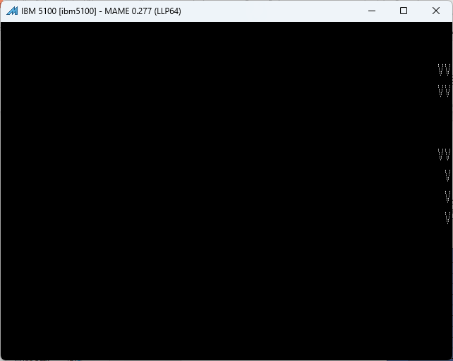
1 2 3 4 5 6 1234567890123456789012345678901234567890123456789012345678901234
LINE 1 0x0200
LINE 2 0x0240
LINE 3 0x0280
LINE 4 0x02C0
LINE 5 0x0300
LINE 6 0x0340
LINE 7 0x0380
LINE 8 0x03C0
LINE 9 0x0400
LINE 10 0x0440
LINE 11 0x0480
LINE 12 0x04C0
LINE 13 0x0500
LINE 14 0x0540
LINE 15 0x0580
LINE 16 0x05C0
0x0600
(initial)
ROW 1 0x1000
ROW 2 0x1468
ROW 3 0x18D0
ROW 4 0x1D38
ROW 5 0x21A0
ROW 6 0x2608
ROW 7 0x2A70
ROW 8 0x2ED8
ROW 9 0x3340
ROW 10 0x37A8
__________________________________________________________________VV__VV____CCC___FFFFFF
__________________________________________________________________VV__VV___CCCCC__FFFFFF
__________________________________________________________________VV__VV__CCC_CC__FF____
__________________________________________________________________VV__VV__CC______FF____
__________________________________________________________________VV__VV__CC______FFFF__
___________________________________________________________________VVVV___CC______FFFF__
___________________________________________________________________VVVV___CC______FF____
___________________________________________________________________VVVV___CCC_CC__FF____
____________________________________________________________________VV_____CCCCC__FF____
____________________________________________________________________VV______CCC___FF____
0x1006
0x146E
0x18D6
0x1D3E
0x21A6
0x260E
0x2A76
0x2EDE
0x3346
0x37AE
(working)

Slide 52
HI LO
0958 DC01 LWI R12, ADDR_SCREEN+(14*64)
095A 0580
095C 8B40 LBI R11, #64 → Lo R11 = 64
095E 0544 MOVE R5, R4 → R5 = R4
PrintStringNextChar:
0960 6F40 MOVB R15, (R4)+ → Lo R15 = MEM[R4], R4=R4+1
0962 CF0C SNS R15 → Skip Not All Set, R15
0964 A007 BRA RESET_STRING
0966 7FC0 MOVB (R12)+, R15 → MEM[R12]=R15, R12=R12+2
0968 0BB1 DEC R11 → R11 = R11-1
096A CB03 SZ R11 → Skip if (R11 = 0)
096C F00D BRA PrintStringNextChar
RESET_STRING:
096E ...
R0
096E
R1
096E
R2
0958
R3
0002
R4
0000
R5
0CC0
R6
3700
R7
0000
R8
0002
R9
0414
R10
047E
R11
0000
R12
05CD
R13
0CAA
R14
R12 set to the address of the row on the CRT to render the single-row string. This involves copying 64 characters across the entire CRT (R11). R4 is the address into the single row string to copy (incremented during the loop.
0500
R15
0000

Slide 53
HI LO
RESET_STRING:
096E 0454 MOVE R4, R5
0970 A400 ADDI R4, #1
0972 D501 0D80 LWI R5, TITLE_STRING_TEMP
0976 5458 MOVE (R5), R4
0978 0AA1 DEC R10
097A CA03 SZ R10
097C A011 BRA NextDelay
097E D401 0CBE LWI R4, TITLE_STRING
0982 D501 0D80 LWI R5, TITLE_STRING_TEMP
0986 5458 MOVE (R5), R4
0988 D401 0D80 LWI R4, TITLE_STRING_TEMP
098C D448 MOVE R4, (R4)
098E 8A80 LBI R10, #128
NextDelay:
0990 ...
R0
0990
R1
097E
R2
0958
R3
0002
R4
0CC1
R5
0D80
R6
3700
R7
0000
R8
0002
R9
0414
R10
047D
R11
0000
R12
05C0
R13
0CAA
R14
0500
R15
0000

Slide 54
HI LO
NextDelay:
0990 0203 CALL SmallDelay, R2
0992 D021
0994 09AC
0996 A300 ADDI R3, #1
0998 0F3C HTL R15, R3 → Lo R15 = Hi R3
099A CF82 SE R15, R8 → Skip if Lo R15 == Lo R8
099C F06F BRA MAINLOOP ; not yet reached number of steps to shift
099E C392 SE R3, R9 → Skip if Lo R3 == Lo R9
09A0 F073 BRA MAINLOOP ; perform one scroll cycle
09A2 F095 BRA MAINLOOP_INIT2 ; Restart big banner from left
09A4 F077 BRA MAINLOOP ; not required
09A6 0000 HALT ; extra precaution
09A8 0004 NOP
09AA 0004 NOP
R0
099A
R1
09F0
R2
0996
R3
0003
R4
0CC1
R5
0D80
R6
3700
R7
0000
R8
0002
R9
0414
R10
047D
R11
0000
R12
0100
R13
0CAA
R14
0500
R15
0000

Slide 55
HI LO
SmallDelay:
09AC DC01 01C0 LWI R12, DELAY_COUNT
09B0 DCC8 MOVE R12,(R12)
delay_1:
09B2 DB01 NOP ; 1
09B4 01C0 NOP ; 2
09B6 DF01 NOP ; 3
...
09DE 55F8 NOP ; 23
09E0 0004 NOP ; 24
09E2 0CC1 DEC R12
09E4 CC03 SZ R12
09E6 F031 BRA delay_1
09E8 0CCC HTL R12, R12
09EA 0CC1 DEC R12
09EC CC0B SNZ R12
09EE 0024 RET R2
09F0 0CCD LTH R12, R12
09F2 F03D BRA delay_1
R0
PC
DELAY_COUNT = 0x2CFF
R1
----
R2
----
R3
----
R4
----
R5
----
R6
----
R7
----
R8
----
R9
----
R10
----
R11
----
R12
----
R13
----
R14
----
R15
----

Slide 57
Modifications…
Adding the Up/Down Key polling to adjust scroll speed

Slide 58
Ideas for the reserved “Per Character Settings”
Bits used for “special effects”
Alternate “symbol 1” vs “symbol 2” across each banner cycle
Counter to store number of full banner cycles (0-255)
“Invert” bit (reverse when to draw symbol vs background)
Trigger varying speed (to speed up/down delay)

