Slide 1
Build Your Own Internet from the Ground Up
Part 1: How Computers Talk
James Arcus

Slide 2
Introduction
Today’s workshop:
  Basic Linux setup
  Origins of computer communication
  Demo: Serial connection between two computers
  Overview of Ethernet
  Demo: Inspecting Ethernet frames
Helpful knowledge: Basic Linux command line usage
Many tutorials: https://ubuntu.com/tutorials/command-line-for-beginners is but one
Don’t worry too much

Slide 3
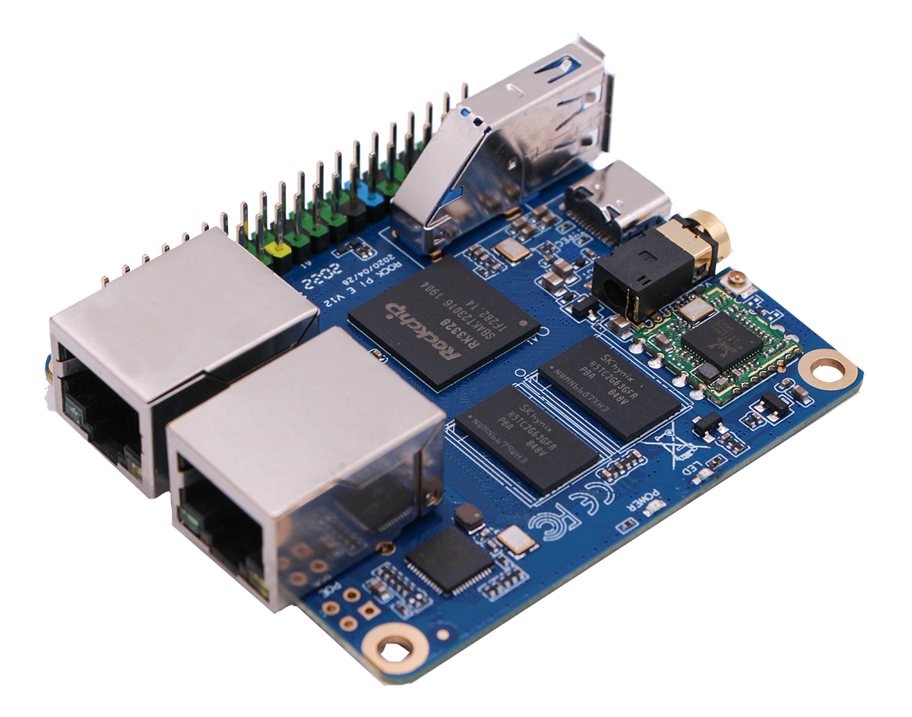
(This is Where I Wanted You to)
Meet the Boards
Model: Rock Pi E
Think Raspberry Pi, but less powerful
But has 2x Ethernet ports
No HDMI/video though, so command line only

Slide 4


Slide 5
Never Mind, They Showed Up
This afternoon!
No chance to actually set them up, though...

Slide 6
Initial Setup
Basic system image has been created for you
  Debian Linux, VM running in the UCC VM cluster
For now, we’ll start with a single machine
  We are imagining we’re “pre-internet” after all
  I’ll demonstrate some initial setup
  Then, you can SSH to demo@130.95.13.172
    from the UCC network
  You can each set up an account, and then use that

Slide 7
Demo: E-mail
Let’s send each other some email, the old fashioned way

Slide 8
Computer Communication
Before computers, were the TeleTYpewriters (in the 1800’s!)
Needed a way to encode characters as an electrical signal, and not get mangled
Settled on asynchronous communication due to hardware limitations
RS-232 standard codified in 1960
Pretty soon, was co-opted by computer manufacturers
  First for communication to TTYs and modems, but soon used for computer-to-computer connections as well

Slide 9
Serial Communication
TL;DR: Each character is sent with a start bit (0), the 8 bits that make it up, and then an end bit (1)
  Sending can happen at any time
Ben Eater’s video on RS-232 is great if you want to know more:https://www.youtube.com/watch?v=AHYNxpqKqwo
The Arduinos use +5 and 0 volts instead of +12 and -12 volts, pretty much the same otherwise
Let’s see it in action!

Slide 10
Demo: Things Over Serial
Sending text backwards and forwards
Logging in to one system from a serial terminal
Next time (with the Rock Pis) if people are interested: network over serial using PPP

Slide 11
Serial is slow and only really good for point-to-point links
  What comes next?
  De-confliction, and addressing
Several technologies come and go for both WAN and LAN networks
  Ethernet wins on the LAN
  More and more, Ethernet wins on the WAN as well
What does Ethernet do?

Slide 12
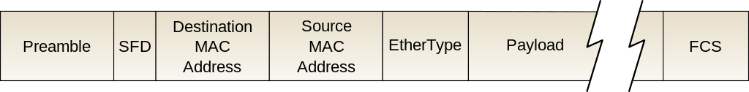
Demo: Capturing Ethernet Frames
I could tell you about what Ethernet carries, but why not show you?
Let’s go over to Wireshark...

Slide 13
Wrap Up & Questions
Hopefully not too much of an info dump
Next time, we’ll play with the actual hardware
Hands on with the IP protocol, addressing and routing
Will be more practical
Questions?

Slide 14
This work is licensed under a Creative Commons Attribution-ShareAlike 3.0 Unported License.
It makes use of the works of Mateus Machado Luna.

