Slide 1
What’s in a (c)name?
Setting up a DNS from scratch
James Arcus

Slide 2
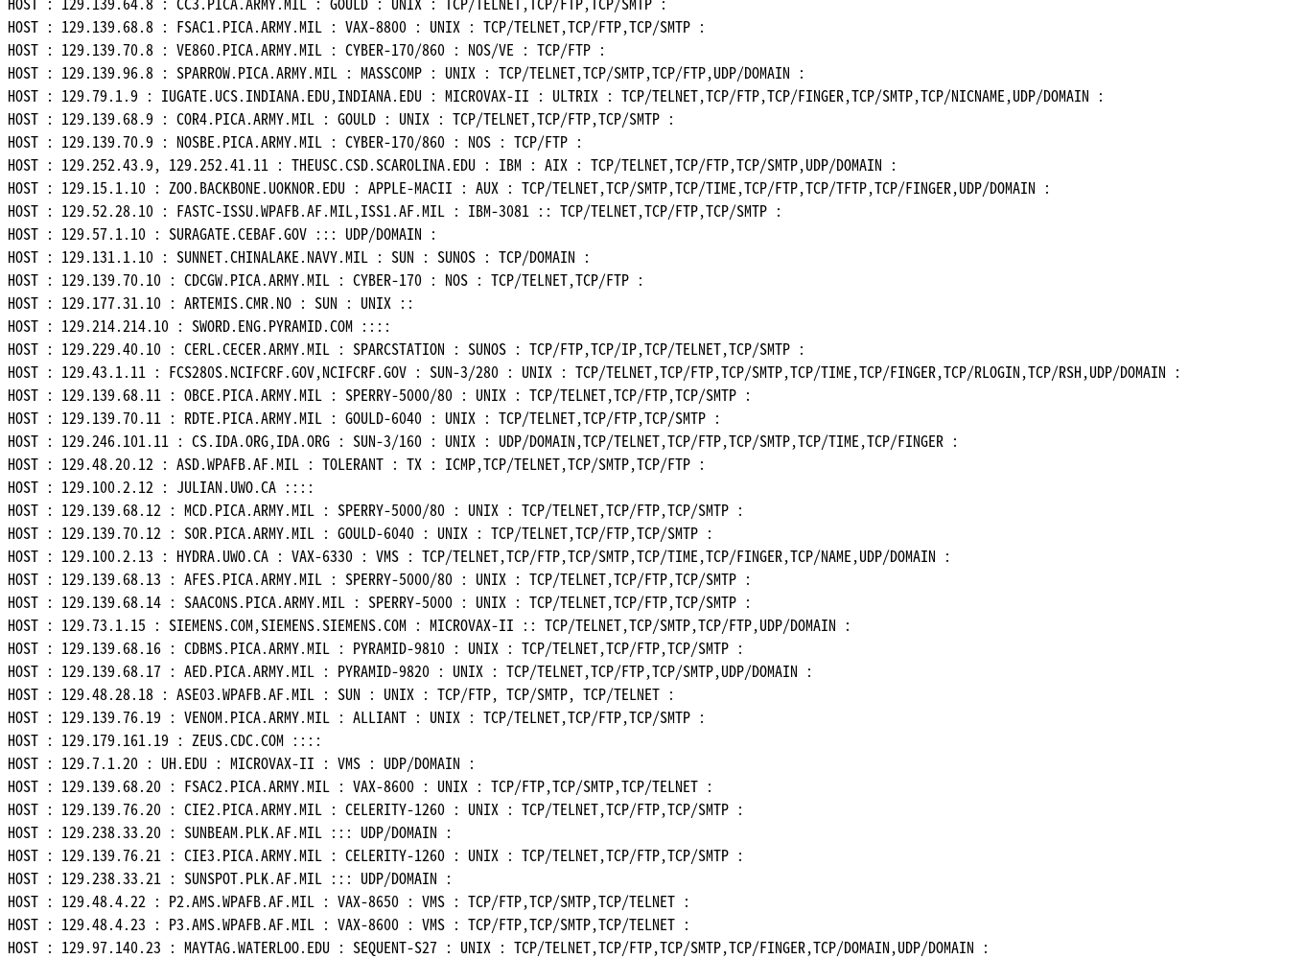
So what is DNS, actually?
We know hosts (can) have names
  Better than remembering IP addresses
  “Decoupled” from current network position
Names aren’t useful if people don’t know them
  /etc/hosts used to be it

Slide 3
So what is DNS, actually?
Names are more useful in hierarchies
  How many “mailserver1”s are there in the world?
  Administrative vs. physical
Names are more useful if people can add them and learn them
  Need an automated system

Slide 4
So what is DNS, actually?
Wikipedia: “The Domain Name System (DNS) is a hierarchical and distributed naming system for computers, services, and other resources in the Internet”
Written as a dot-separated sequence of parts, from right-to-left (for some reason!): motsugo.ucc.gu.uwa.edu.au. (note the trailing dot, which is usually omitted)
Components are separated into “zones” that can be “delegated”
  Top of the hierarchy is the root zone, “.”
Two main roles for a server:
  Authoritative: Hosts the data for some part of the DNS
  Recursive: Gathers and caches data from authoritative servers
Common server software includes: BIND (both), Unbound (recursive), KnotDNS (authoritative), inter alia

Slide 5
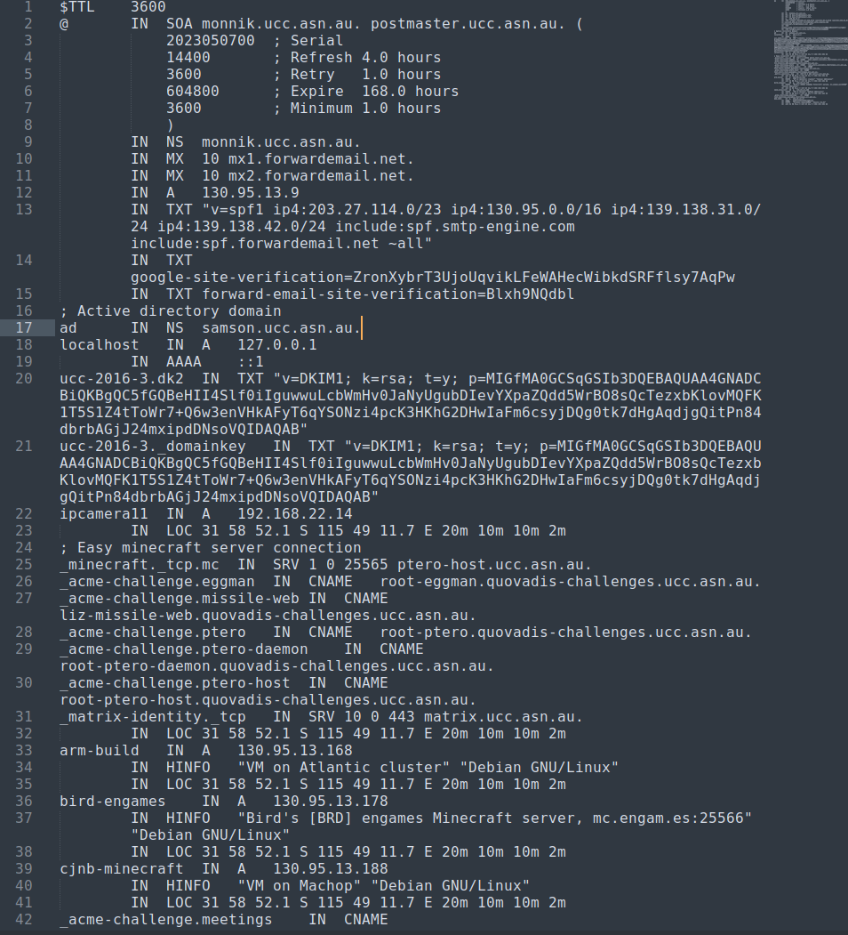
Configuring BIND
Configured in /etc/named.conf or /etc/bind/named.conf
Configuration is split into a series of “zones” which define administrative boundaries
Zone data then stored in “zonefiles” either under /etc/bind/domains/ or /var/named

Slide 6
Demo: The UCC Zones
Common record types:
  A (IPv4 address)
  AAAA (IPv6 address)
  MX (mail server)
  NS (DNS name server)
  TXT (generic text)

Slide 7
Activity: A simple, replacement root
Every record starts with basic info in SOA
Each line is a record (or part of one, with the bracket syntax)
Fields: name, TTL, class, type, value
;; begins a comment
Note the “glue record” that solves the bootstrapping problem
  How do I find the name server for something if I don’t have the name server for it?
Needs a server config as well

Slide 8
This work is licensed under a Creative Commons Attribution-ShareAlike 3.0 Unported License.
It makes use of the works of Mateus Machado Luna.

