Slide 1
ENGI 301 Instrument Glove PCB (Project 02) Proposal
11/26/2019
Eric Voigt

Slide 2
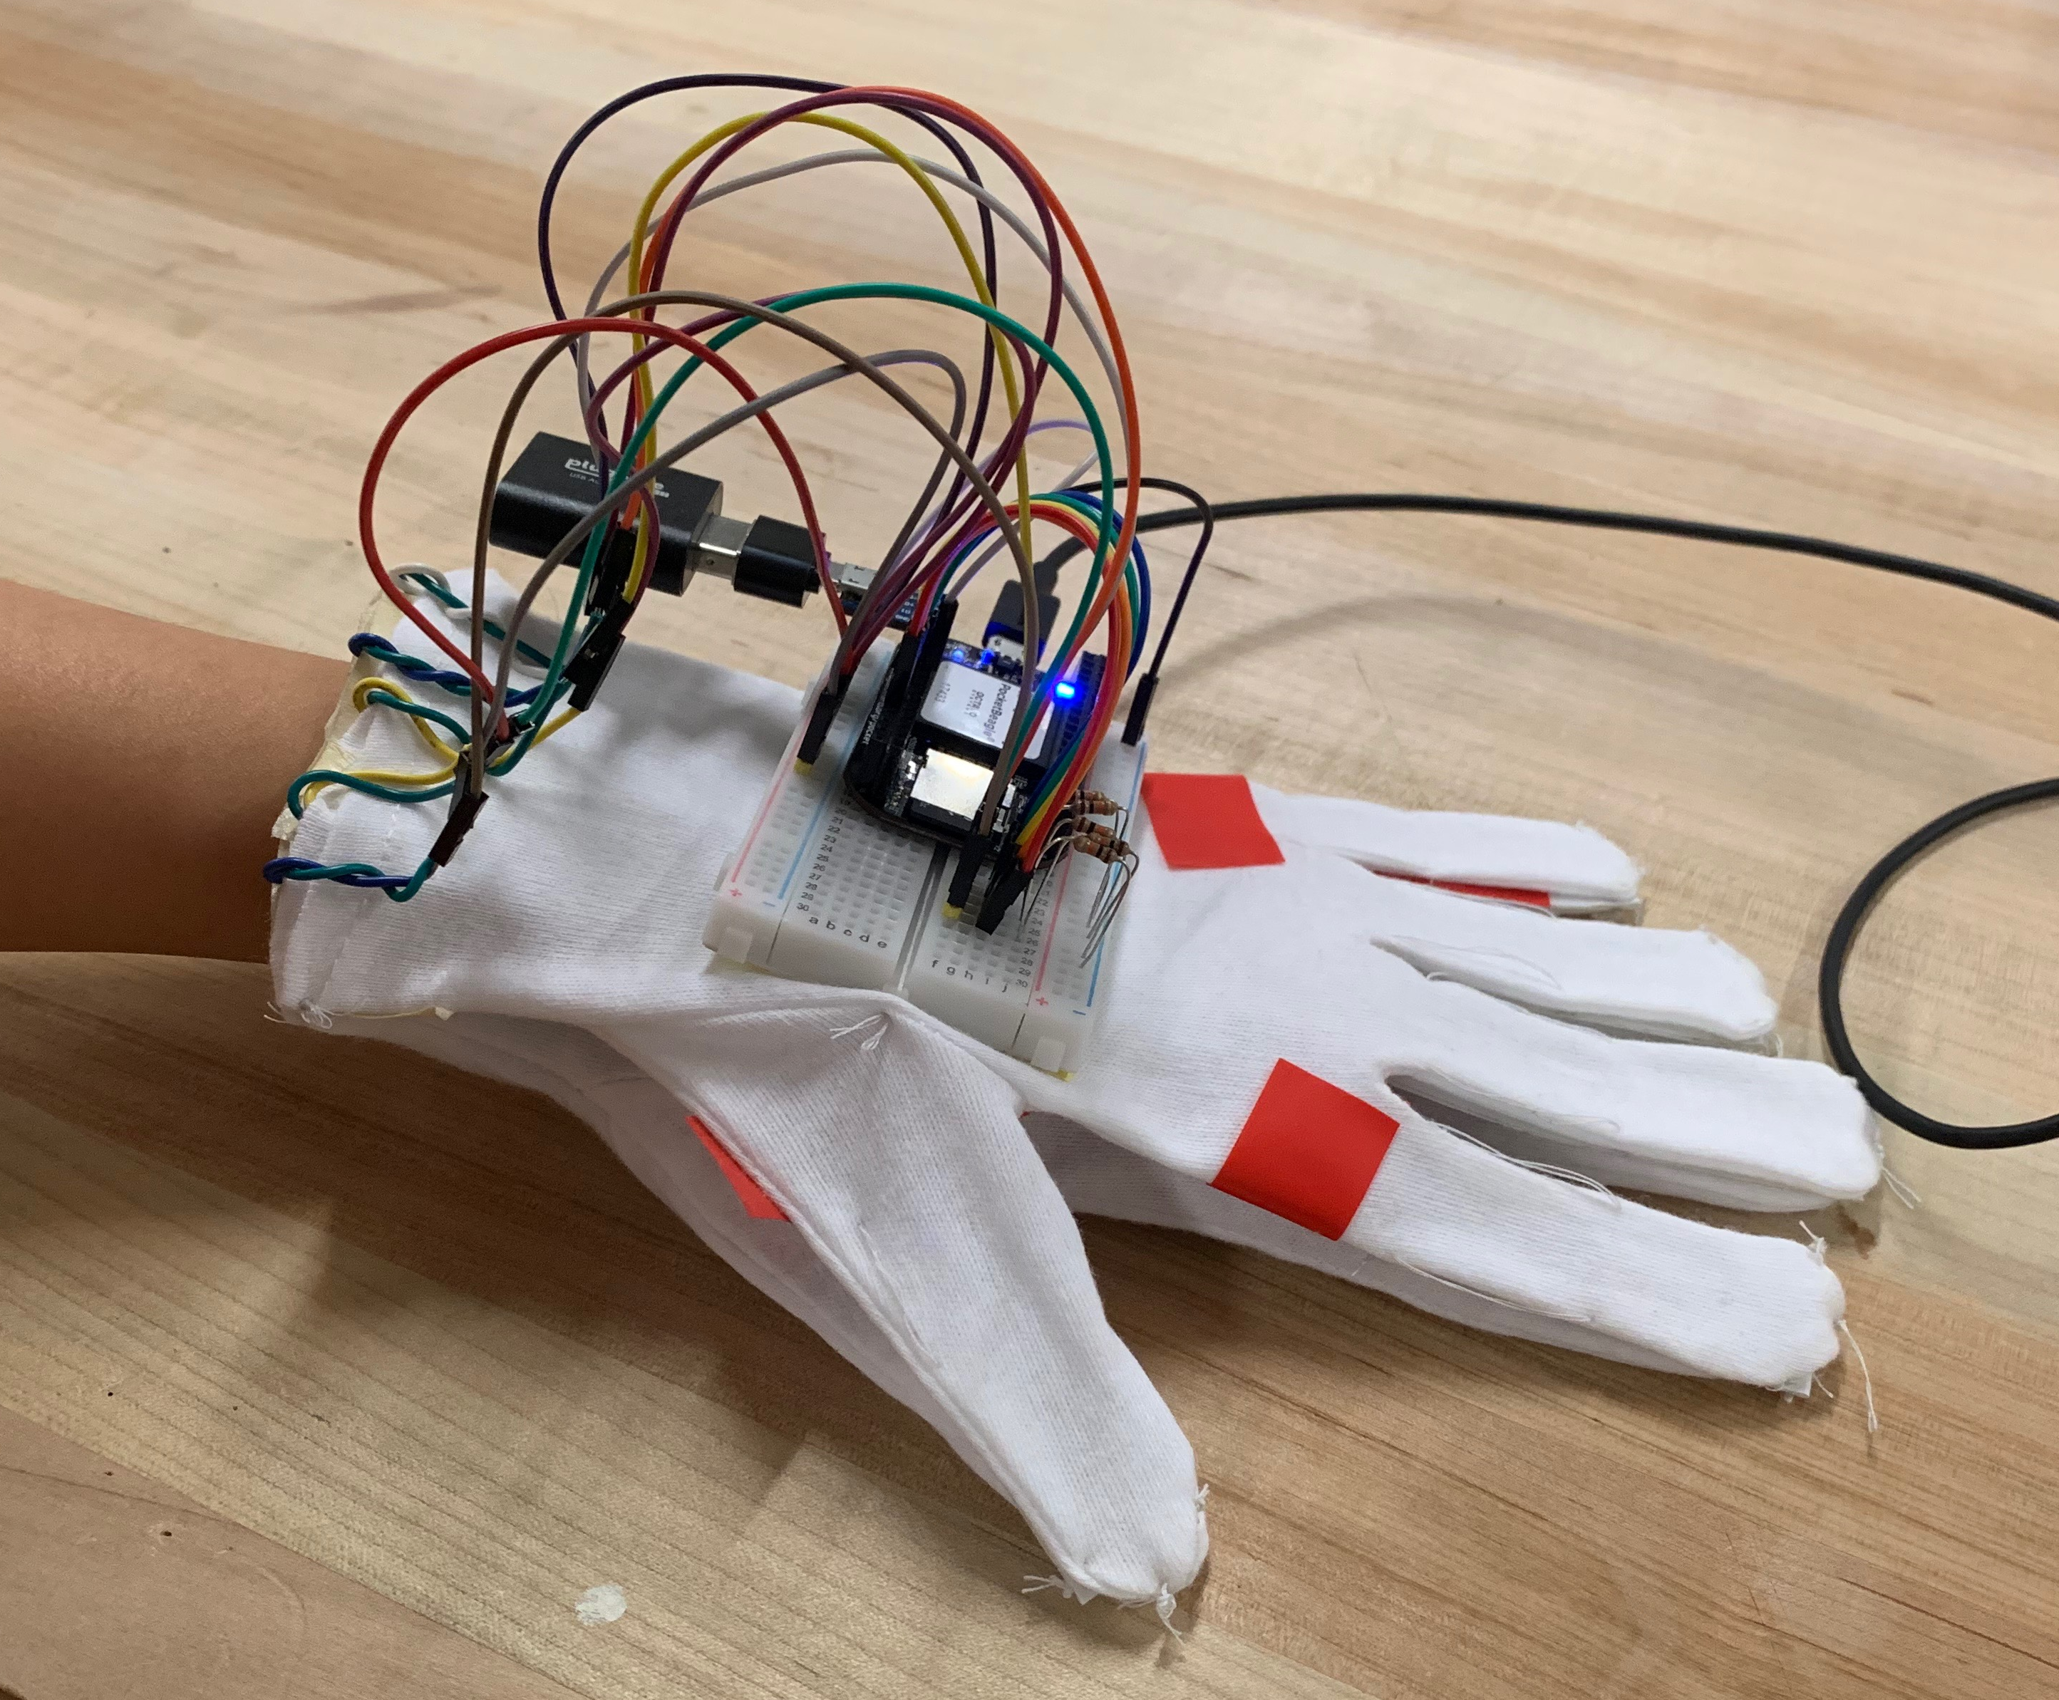
Background Information
PCB for electrical components on instrument glove project
GitHub https://github.com/voigteric/ENGI301/tree/master/project_01
Hackster https://www.hackster.io/eric-voigt/instrument-glove-4537b7
PCB takes care of messy wiring and breadboard
More mechanically robust
Slimmer profile
Easy attachment

Slide 3
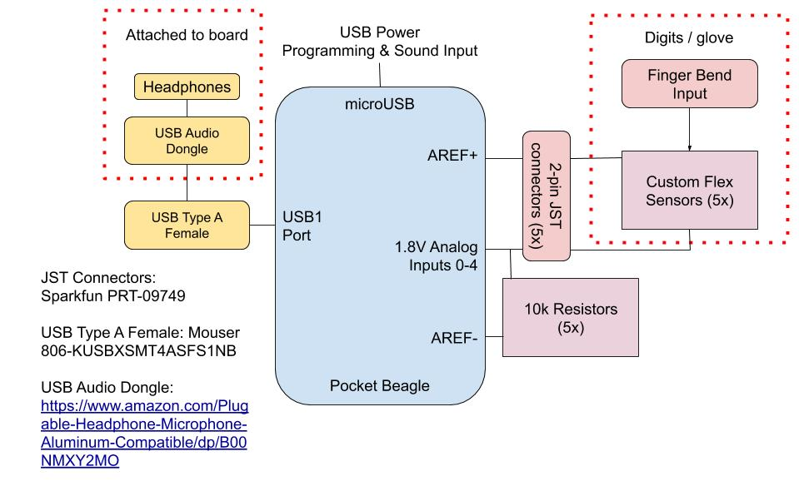
System Block Diagram

Slide 4
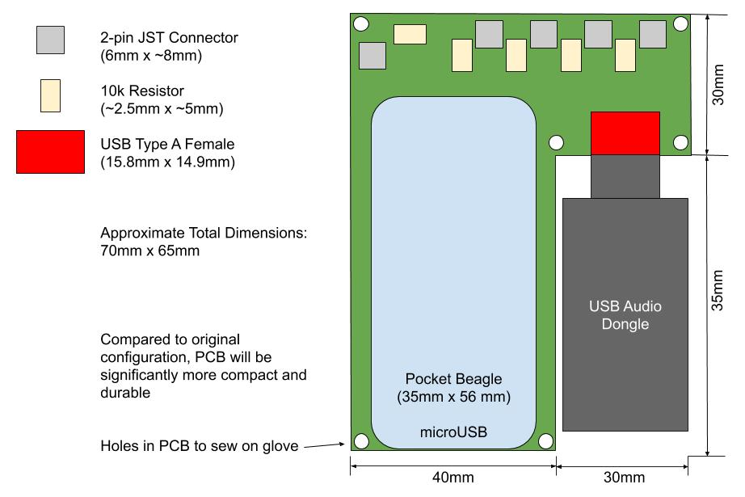
Mechanical Block Diagram

