Slide 1
ENGI 301 Keyboard Glove Proposal
10/18/2019
Eric Voigt

Slide 2
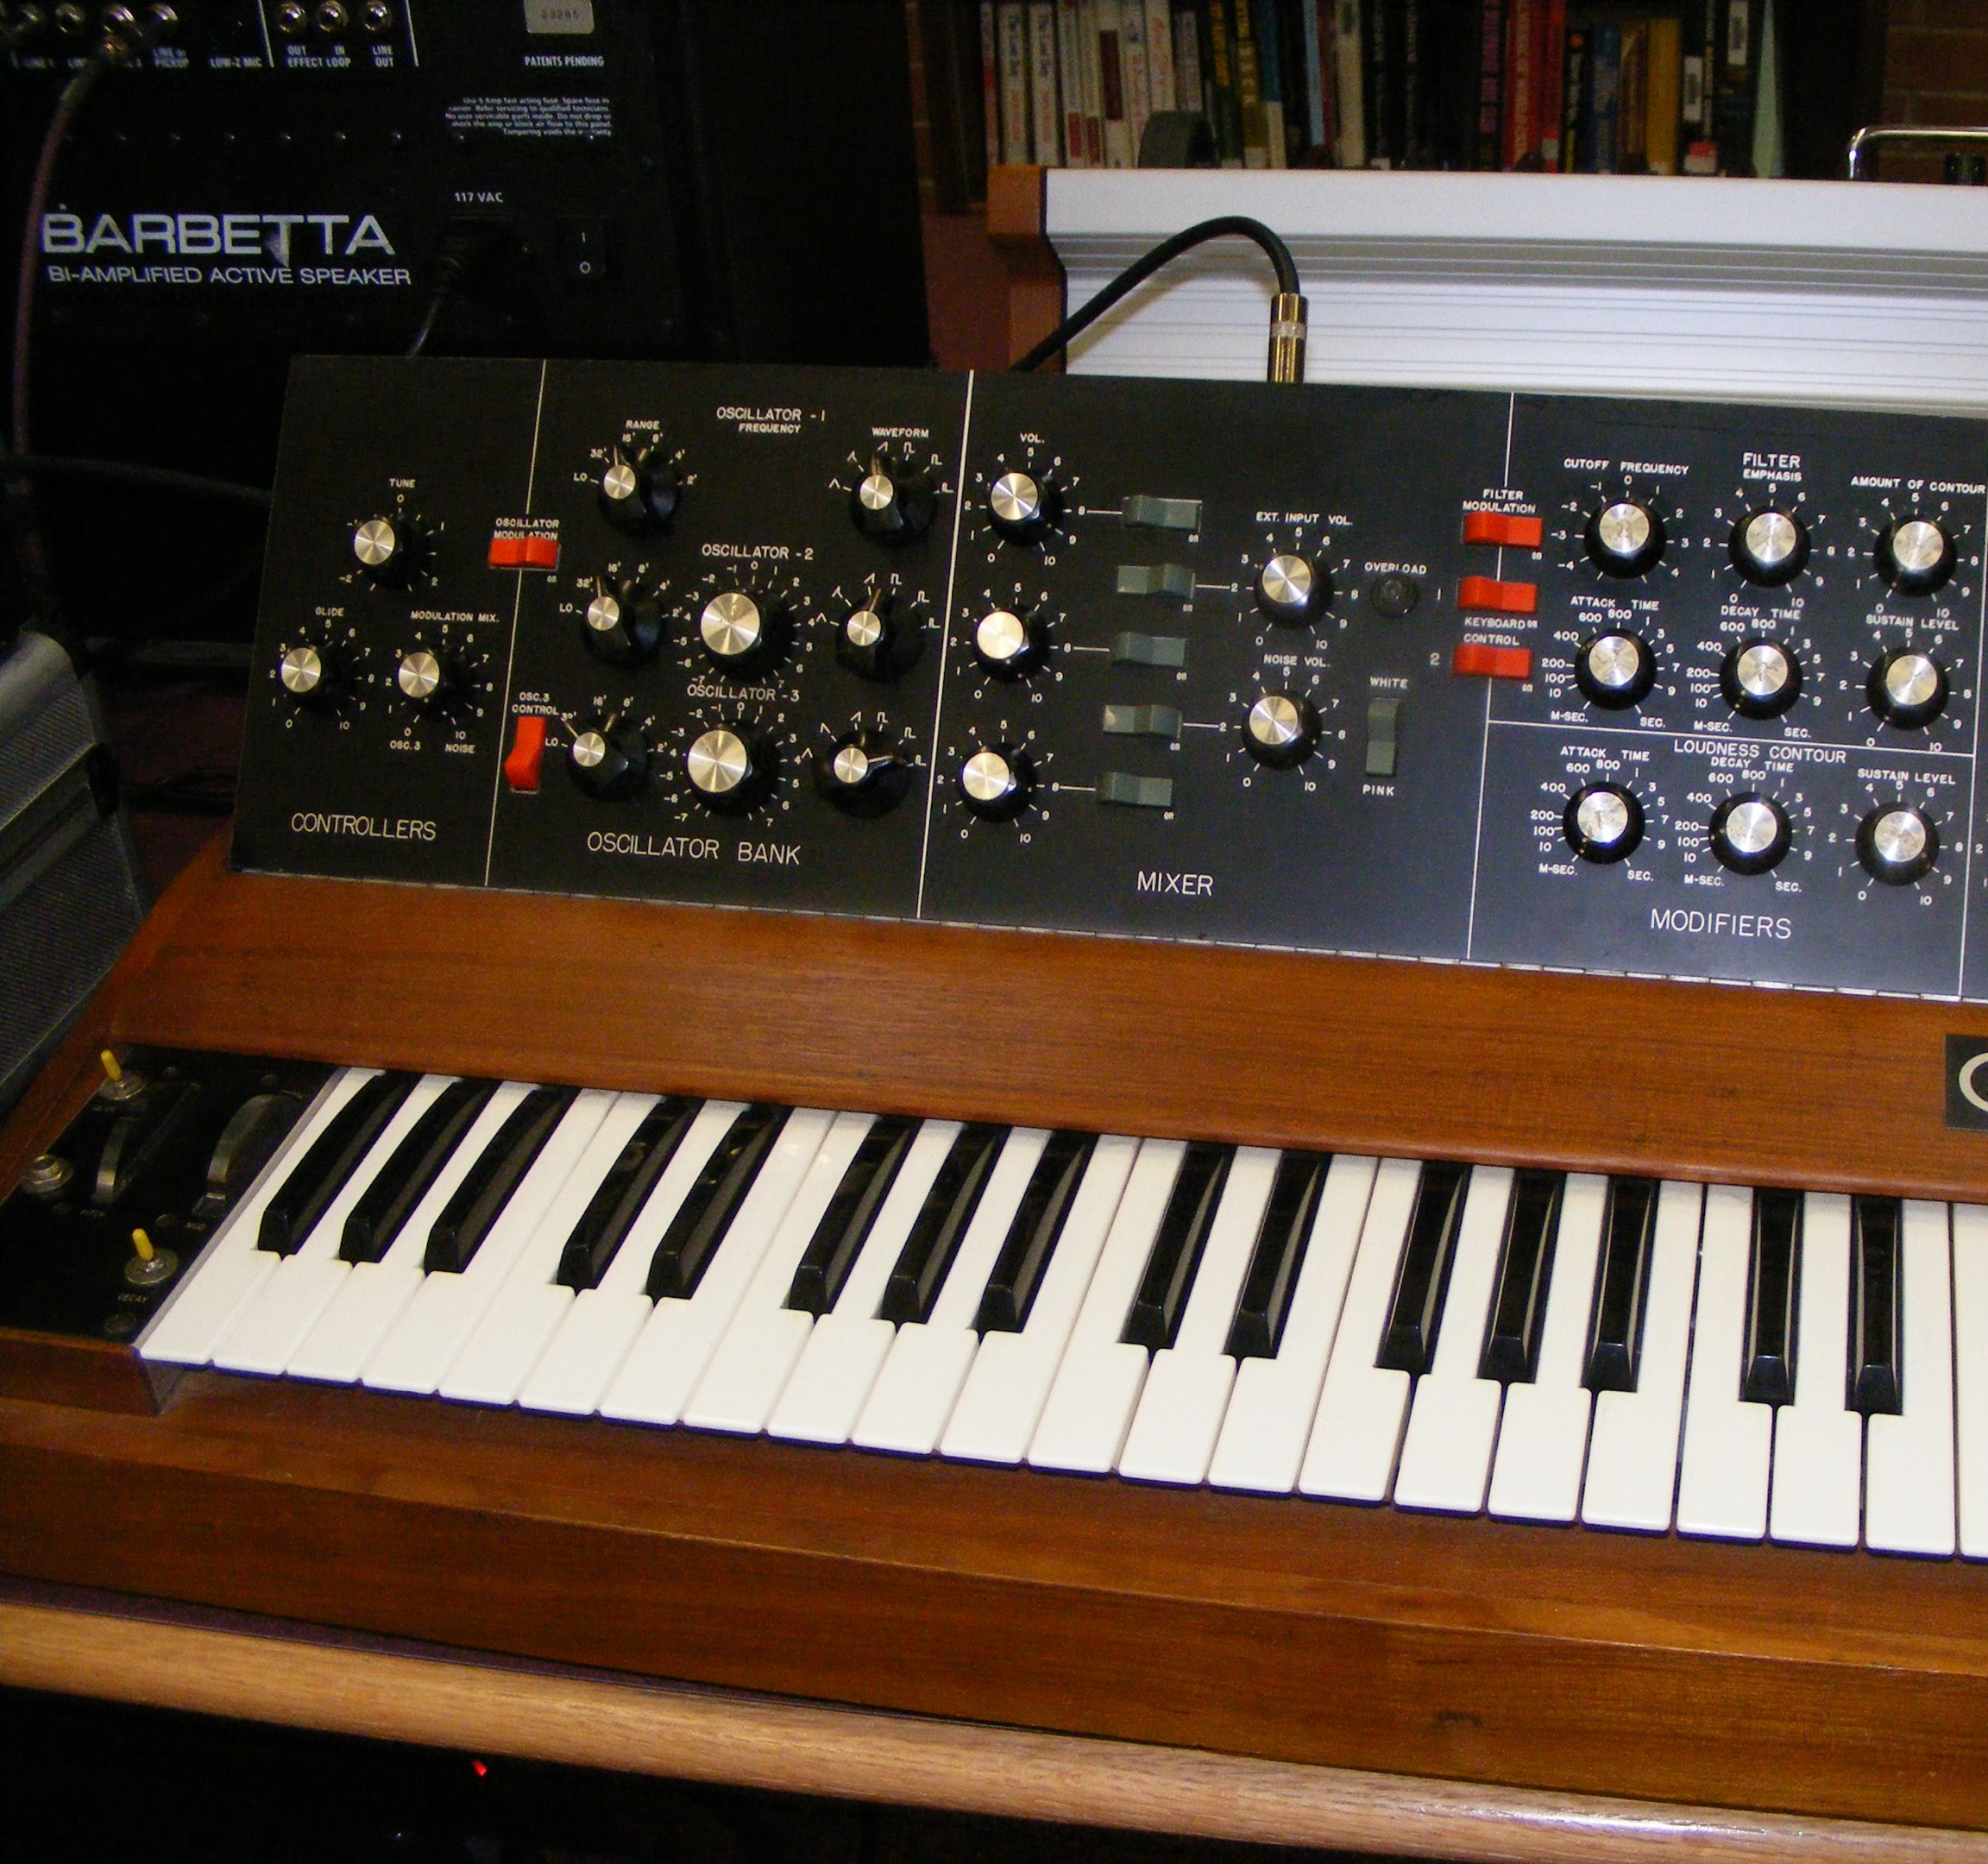
Background Information
Wearable synth glove
1st-5th note scale
Note triggered by bend in finger
Headphone connection
USB power
Attachment to glove
Sewn sensors
Wrist mount for board

Slide 3
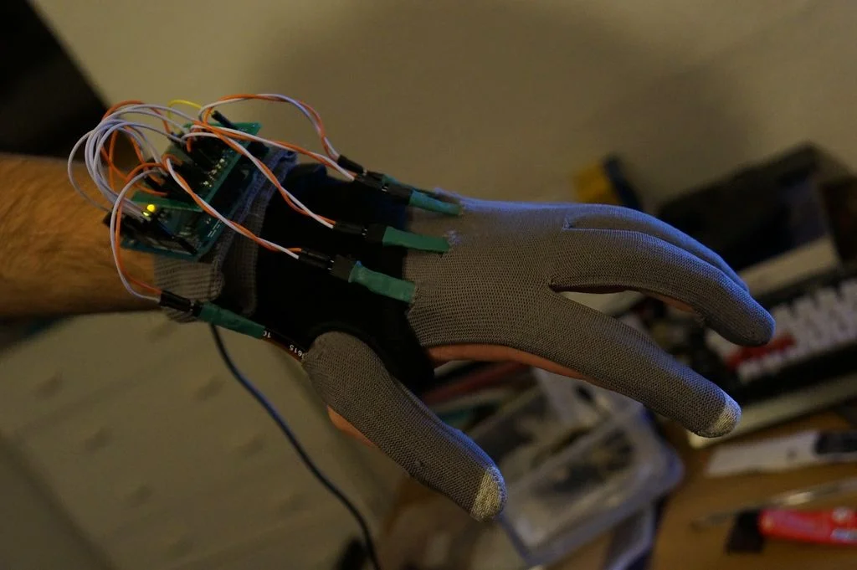
Changes and Improvements
Based on Existing Arduino project
Arduino → Pocket Beagle
Python environment
Smaller board
Flex Sensors → Velostat
Stretch material
More reliable hardware & connection
Far less expensive
3.5mm audio output
https://www.instructables.com/id/Gesture-Input-Typing-Glove/

Slide 4
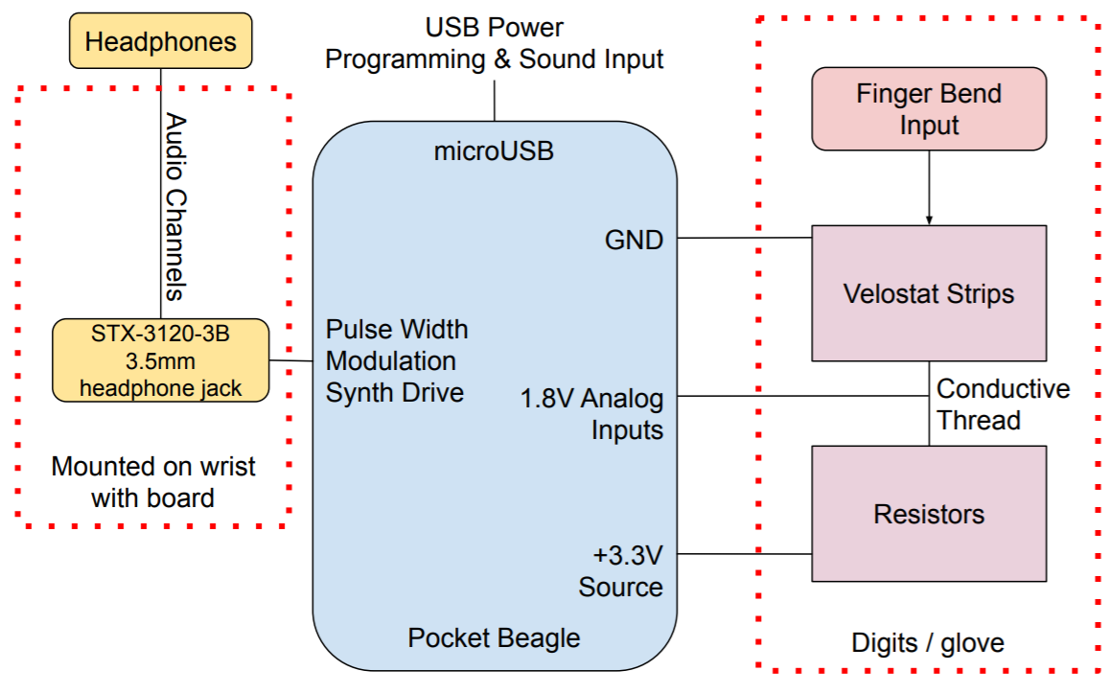
System Block Diagram

Slide 5
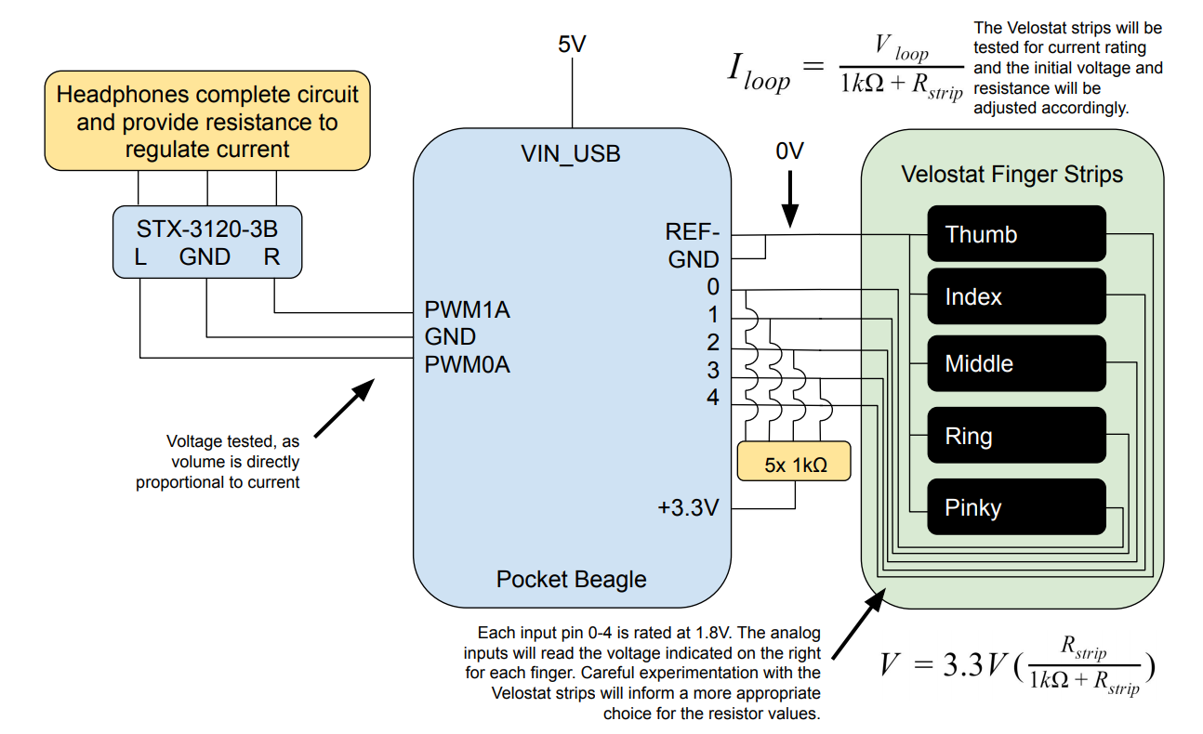
Power Block Diagram

Slide 6
Components / Budget
Component | Need to Buy | Cost
Gloves (https://tinyurl.com/y2j92c5k) | 1 pair | $4.48
Velostat (https://tinyurl.com/y3tynyvd) | 1 sheet | $4.95
3.5mm Headphone Jack (https://www.adafruit.com/product/1699) | 1 ct | $0.95
Conductive Sewing Thread (https://tinyurl.com/y5r9hoyz) | 1 spool | $6.87
Breadboard | OEDK | $0
Jumper Wires | OEDK | $0
Total | (- tax & ship) | $17.25
Resources
http://www.eng.auburn.edu/~nelson/courses/elec3040_3050/LabWriteups/ELEC30x0_Lab7_alt.pdf
https://www.instructables.com/id/Flex-Sensor-Glove/

