Slide 1
Soar Data Collection

Slide 2
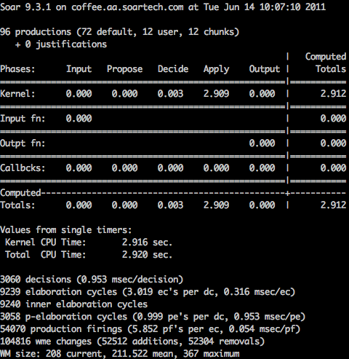
Motivation
Stats accumulates values but not history
Stats history useful for agent evaluation
What is the worst-case reactivity?
Optimizing agents for long-running robot experiments

Slide 3
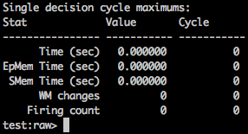
Approach
Kernel changes to stats command: “max-cycle” stats collection
Time, production firings, working memory size
EpMem/SMem time each cycle
Efficient history storage
External tool: Implemented in Java in SML
Idea: Flexible for easy integration with existing environments
Focus on performance
Minimize expensive API calls, “uncertainty principle”
Collect data rows in periods of decision cycles or elapsed time
Output to spreadsheet-compatible format for easy inspection
CSV (comma separated values)
Notes:
A lot of work has been done to prevent callbacks to increase performance
Rarely flush

Slide 4
Data
Agent name and settings (e.g. what learning systems are on)
Wall clock, Kernel times, CPU times
Production firing counts and firing time
Working memory element counts: max, mean, min, additions, removals
Episodic and semantic memory: time, retrievals, queries, stores etc.
Many statistics record maximums and means that reset on each call to collect
“How long did the slowest decision cycle take since I last checked?”

Slide 5
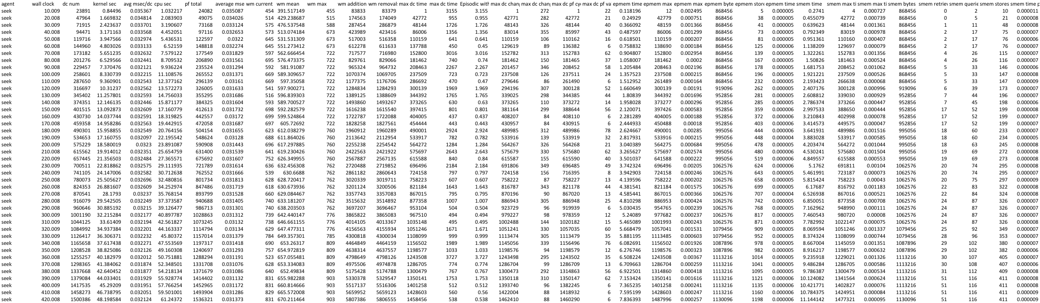
Example Data

Slide 6
Usage Details
Single class Java library
Instantiate once for all agents
Call methods during three events:
Soar system start: onStart
Update (after all agents pass output): onUpdateEvent, collect
Soar system stop: onStop, collect
Utility methods to help timing collection
Every n decision cycles: setPeriodCycles
Every n milliseconds: setPeriodMillis
Flushing to file is expensive, doesn’t happen while agents are running
Should explicitly call every so often in case of catastrophic failures

Slide 7
Nuggets/Coal
Lots of work to
Support different output formats: sqlite, speedy
Tricky to use because of the performance goal
Successfully used to collect data during long runs
Useful to optimize agents

Slide 8
Download
Currently on github
https://github.com/voigtjr/soar-datacollector
Will be moved in to SoarSuite

