Slide 1
Market Response to a Fear Impulse
Nikolaus Hautsch Albert J. Menkveld Stefan Voigt
Discussion by
Marios Panayides
University of Cyprus
Future of Financial Information Conference
Stockholm, 2022

Slide 2
The paper is interesting and well-motivated.
  Using primarily a rich dataset (thirty billion Nasdaq order book messages) of four exchange traded funds (asset classes: SPY, HYG, LQD, TLT) for the period July 2007-April 2021, the authors study:
    “if and how flight-to-safety and market fragility are related”
    (Pedersen, 2009, Brunnermeier, 2009)

Slide 3
Methodology:
  Empirical Methodology: Generalized Impulse Response Functions.
    Using surprise shocks to implied volatility (VIX) changes the authors investigate six response variables: order flow (initiator signed volume), midquote returns, volume, bid-ask spread, order depth, and the Amihud illiquidity ratio.
    Decomposing the VIX changes into changes in risk aversion and changes in cash-flow risk, the authors investigate response dynamics for each measure of risk.
  A three-period model with endowment shocks (Vayanos and Wang, 2012):
    Adding risk aversion shock and cash flow risk, the authors are able to provide predictions that are consistent with empirical findings.

Slide 4
Empirical Findings:
  VIX increases lead to:
    Active selling of equities and active buying of government bonds (Flight-to-safety)
    Prices drop for equities and increase for government bonds
    No effect on Liquidity
With VIX decomposition
  Risk-aversion increases lead to:
    Active selling of equities and active buying of government bonds (Flight-to-safety)
    Prices drop for equities and increase for government bonds
    No effect on Liquidity
  Cash-flow risk increases lead to:
    Active buying of equities (and active buying of government bonds)
    No effect on Prices
    Market Liquidity deteriorates (Market fragility)
Notes:
The authors provide evidence that flight-to-safety and market fragility are affected by VIX changes through different channels. (Also verified through a model).

Slide 5
Comments and Suggestions: Summary
  Three main comments/suggestions
    Market Fragility and Cash Flow Risk
    Market Fragility and Risk Aversion
    Implications of the main results.
    Other comments and suggestions

Slide 6
Comments and Suggestions: Market Fragility and Cash Flow Risk
The authors explanation for why positive shocks to cash flow risk lead to an increase in market fragility (Amihud illiquidity measure) needs to be elaborated further.
  The authors provide alternative explanations. In the introduction they argue, following Hendershott and Menkveld (2014), in footnote 3, that their illiquidity result is consistent with inventory management. And yet, further in the introduction (and in their theoretical model) the argument is based on information asymmetry.
    The authors should be consistent across the paper.
    The theory builds up arguments that would suggest that quoted spreads should be affected (due to increases in adverse selection costs). We do not see that in the data.

Slide 7
Comments and Suggestions: Market Fragility and Risk Aversion
The authors do not find evidence that changes in risk aversion affect market fragility. More explanation as to why this is the case could be beneficial.
  Changes in risk aversion produce predictable order flow (migration away from equities into less risky assets such as government bonds). Liquidity providers could take advantage of such predictability.
    Brogaard, Sokolov, and Zhang (2021) show that large uninformative order flow provides contrarian profits to liquidity providers. This is consistent with contemporaneous increases in depth shown in Figure 4.
    How about the following hour responses? Figure 4 shows decreases in depth. This could be consistent with inventory constraints (Brogaard et al., 2021).
    The paper can benefit from similar analysis on liquidity supply dynamics.

Slide 8
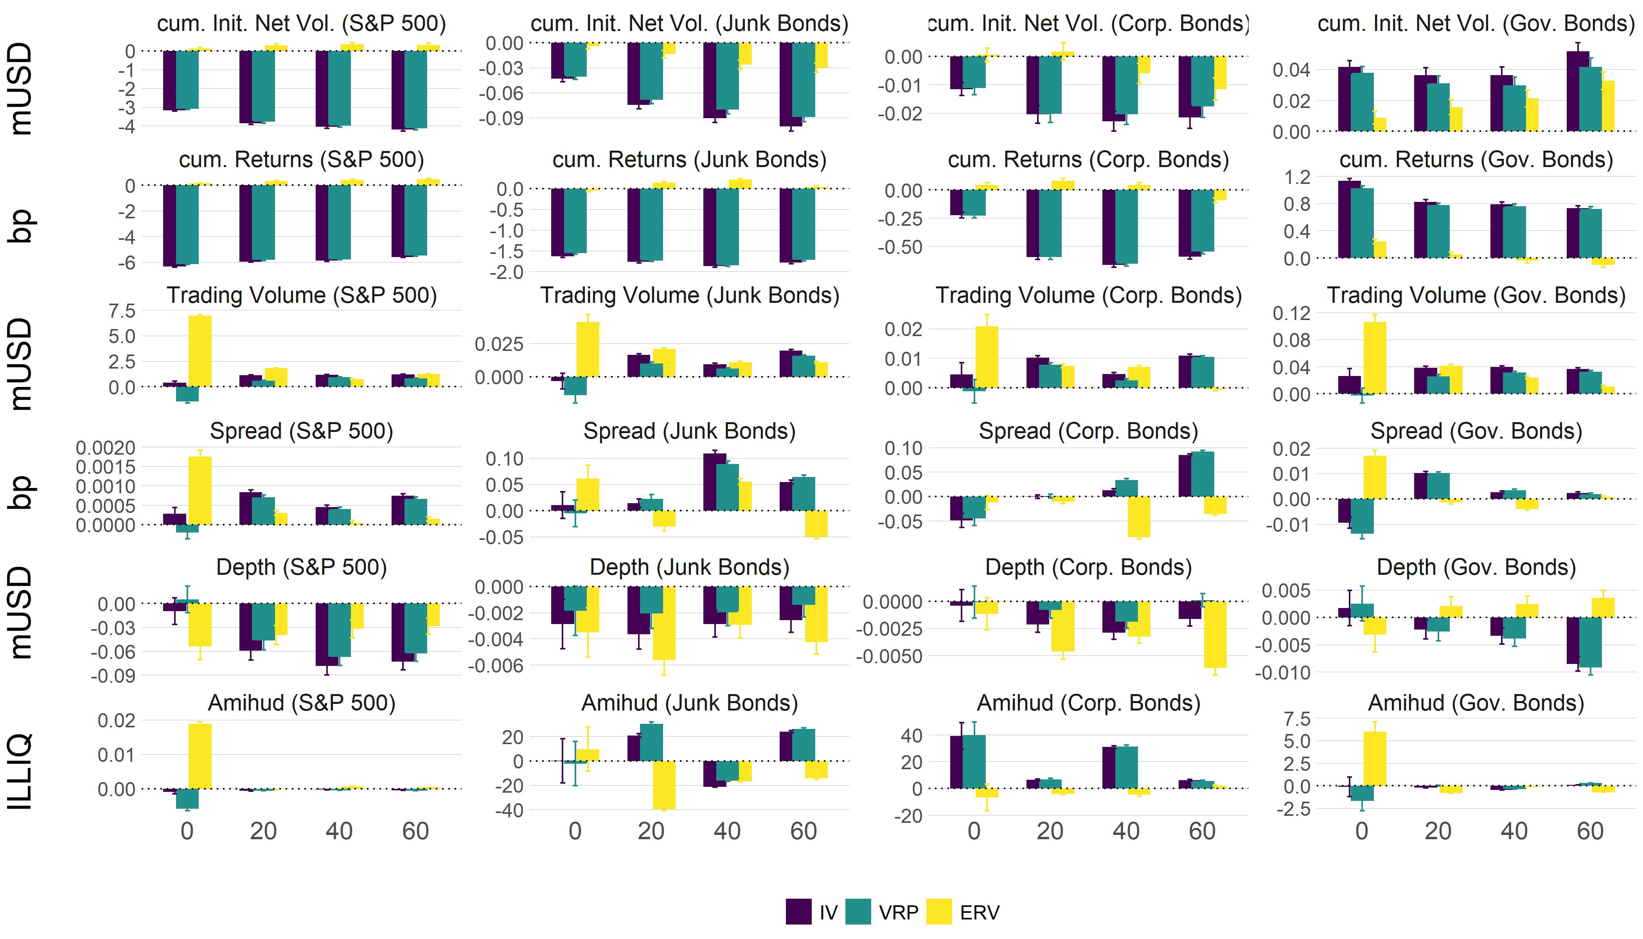

Slide 9
Comments and Suggestions: Implications
The authors should elaborate further on the implications of their main findings:
  Knowing that the mechanisms behind flight-to-safety and market fragility are different, how can we make markets more resilient? (Especially during downturn markets.)
  Possible investigation that could help:
    The authors could focus on the two important events (global financial crisis and the Covid-19 outbreak) and show how strong their findings are during crisis periods? In would be very interesting to see which of the two risk mechanisms is stronger (dominates) and why (e.g., the authors in the paper mention that during non-crisis periods investors are risk-neutral).
    Why was the flash crash removed from the analysis? The authors could identify interesting patterns during this high uncertainty event since they have high frequency data.

Slide 10
Other Comments and Suggestions
The authors do not take “complete advantage of” the richness of their data.
  They could also investigate the rate of cancellations during risk-aversion or cash-flow risks. Which risk is driving cancellations?
  I expect for some liquidity providers such as high frequency market makers, the rate of cancellations to be affected by cash-flow risk (due to adverse selection or inventory management).
For completeness, the authors may investigate shocks to other variables (e.g., equities returns, or order imbalance) and the responses of VIX changes.

Slide 11
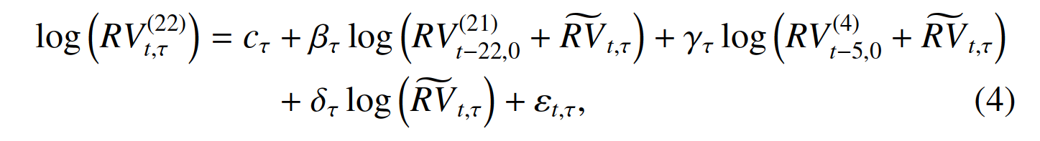
Minor Correction:
The authors could change the notation of some variables when predicting monthly realized volatility (Equation 4). (It can be confusing).

Slide 12
Thank You

