Slide 1
Issued Permits by City of Redmond by Aleksey Kramer
The dashboard is designed to show the following:
Number of issued permits in Redmond, WA, USA
Revenue (fees) by type of project
Revenue (fees) by project valuation
Valuation of individual projects
Revenue (fees) of individual projects
Number of permits issued by permit category
Tooltips provide additional information
The main driver for the dashboard are the filters located in the upper right corner of the vis (Permit Type, and date slider).
Each chart can be used as a filter (but the vis works better with filters)

Slide 2
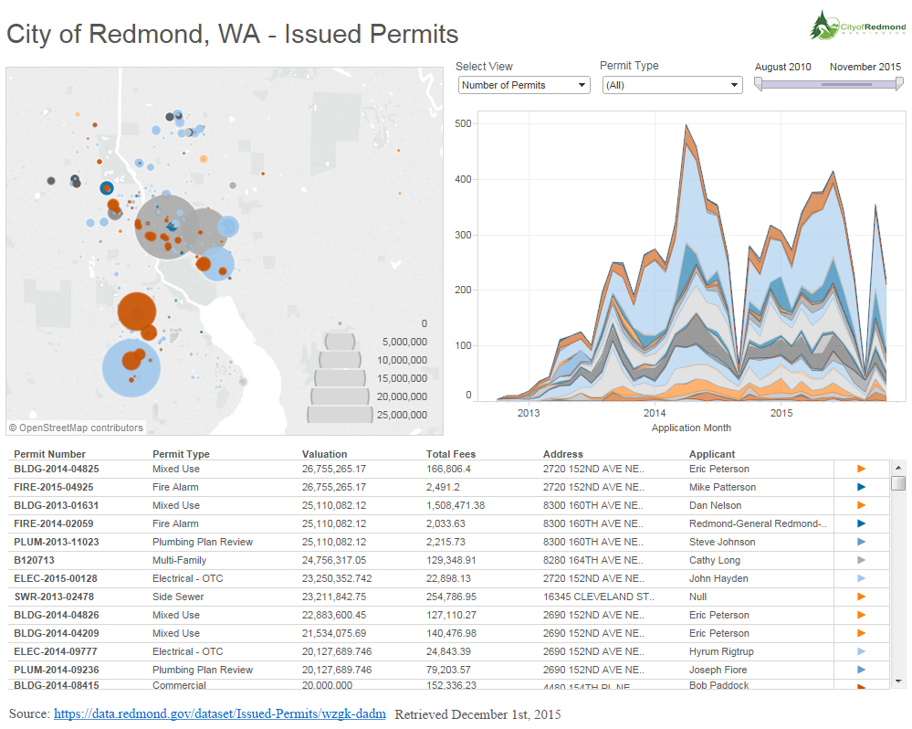
Viz. Screenshot and URL by Aleksey Kramer
Final Project URL: https://public.tableau.com/profile/publish/DATAVIZ100-FINALPROJECT/DATAVIZ100-FinalProject#!/publish-confirm

Slide 3
City of Redmond - Issued Permits Database by Aleksey Kramer
URL of the data: https://data.redmond.gov/dataset/Issued-Permits/wzgk-dadm
Method: Exploratory
Data Retrieved 12/01/2015
Data is modified to separate Latitude and Longitude from the Address field in the dataset
Incomplete records (null values for longitude and latitude) are removed
Valuation and Total Fees fields changed to be type of Currency

