Slide 1
This was interesting
http://www.ft.com/intl/cms/s/0/3f195d40-b851-11e5-b151-8e15c9a029fb.html#axzz3yHOL7uFB
http://cliffmass.blogspot.com/2016/01/major-atmospheric-river-period-for-west.html

Slide 2

Quality of data
&
Data preparation fundamentals
Week 3
Jan 24, 2016

Slide 3
Week 2 topics
Clean up and visualize home sales data
Strategies and techniques for data cleanup
Exercise: Cleaning up and visualizing “Washington”

Slide 4
Quality of data
Quality of data = quality of visualization
Garbage in -> garbage out
Data preparation will be:
Tedious
Time-consuming
Rewarding

Slide 5
Residential home sales
Problems include: Strange Y-axis & X-axis, super-spike of “Average Sale Price”, unreadable “Sales Count”. All because of the data quality.

Slide 6
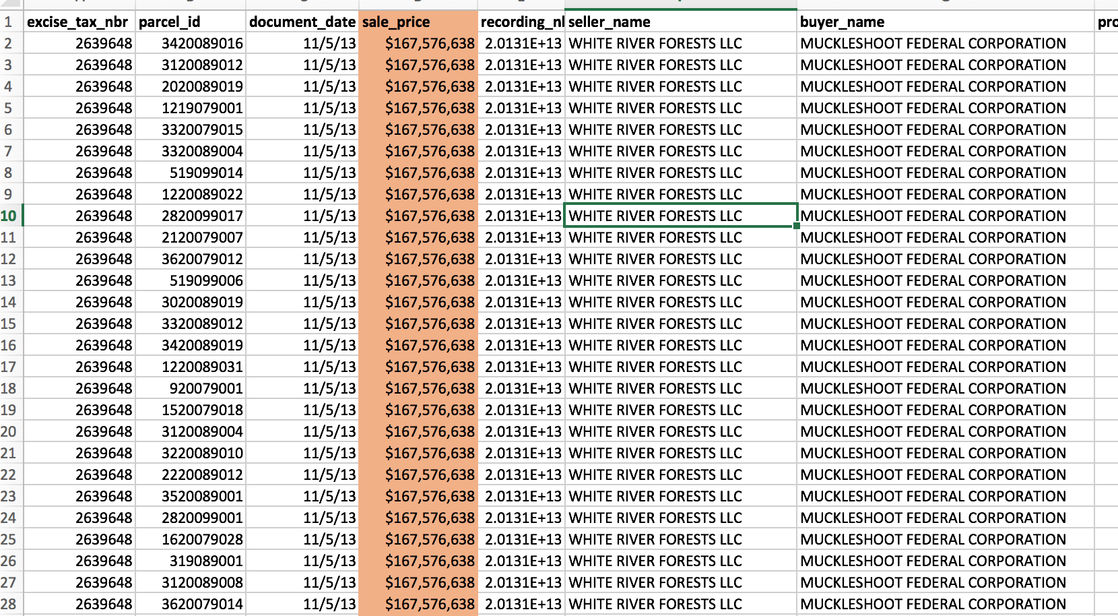
Residential home sales
The spike bothered me the most. So, I took a look at highest prices sales in Q4, 2013. Pretty apparent we’ve got some anomalous data here.

Slide 7
Residential home sales

Slide 8
Residential home sales
Blue gridlines to tie all of the price data together. Might make things a bit busy.
Call out critical numbers
Highlight the central Sale Price data with same color
Years weren’t default axis labels, but make sense for 25 year range
Sales count (volume) adds context. Use grey to bring it to background. Should be on left, not right.

Slide 9
Average vs Median

Slide 10
Cleaning data
Data preparation, aka data cleaning
From easy to very hard problems
As you’ve probably realized, many times the visualization is the easy part
A lot can be accomplished in Excel. Let’s work on that first.

Slide 11
Cleaning data with Excel
Column headers
All columns must have a header. One row preferred.
Informative and concise headers. Go longer, if necessary, but think about other places data will be used.
Remove empty columns
Verify that filter and sort work well.

Slide 12
Cleaning data with Excel
Column headers, formatting
Wrap text on long names
Make the header readable, with a different style
Freeze the top row, and possibly a column or two

Slide 13
Cleaning data with Excel
The data
Keep the columns narrow enough to see all data, if possible
Each row should have same number of columns
Remove empty rows
Remove duplicate rows
Understand the data type

Slide 14
Cleaning data with Excel
The data
Fill in empty values, if possible
Watch out for dangling data, offset columns, etc
Use the same format for every cell in a column
Understand the data type

Slide 15
Data Types
Discrete vs continuous
Eye color: brown, green, blue – discrete
Height: continuous
Dimensions vs measures
A bit more fluid. But rule of thumb is dimensions are things you’d “group by”
An example measure would be a home list prices
All of the above will also have an underlying data type

Slide 16
Data Types
Integer
Represented by only numeric digits and a +/- sign.
Also known as int, or long.
Careful about its size > 2,147,483,647
Although Excel easily adds commas, dollars signs, be careful of commas or any other characters

Slide 17
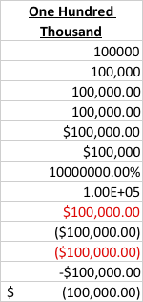
Data Types
A picture is worth 1,000.00 words
These are all examples of numbers in Excel:
Pick a format and stick to it
The less decorative, the better
Know the meanings of each format

Slide 18
Data Types
Decimal numbers
Use decimals when dealing with small numbers
Don’t overdue significant digits
Numbers like latitude and longitude require decimals for precision

Slide 19
Data Types
Date and Time
Dates can be especially difficult. formats vary widely
Pay special attention to international dates
Like everything else, keep dates simple
I like the international standard:
YYYY-MM-DD and time hh:mm:ss
Did you know dates in Excel are numbers? [Dates in Excel]

Slide 20
Data Types
Other special cases
Phone numbers, emails, URLs, addresses, images. Each have their own unique challenges
Any open text fields on a form. If possible, use dropdowns or checkboxes

Slide 21
Data validation
A few cleaning techniques
Range checks for numbers
Spell check
Pattern matching and filtering
Compare other data to cross-check
VLOOKUP to cross-check

Slide 22
Exercise: Cleanup this mess of data
Goal: Report on “Washington” and the corresponding donations counts and amounts over time.
The data is a real mess, so watch out.

Slide 23
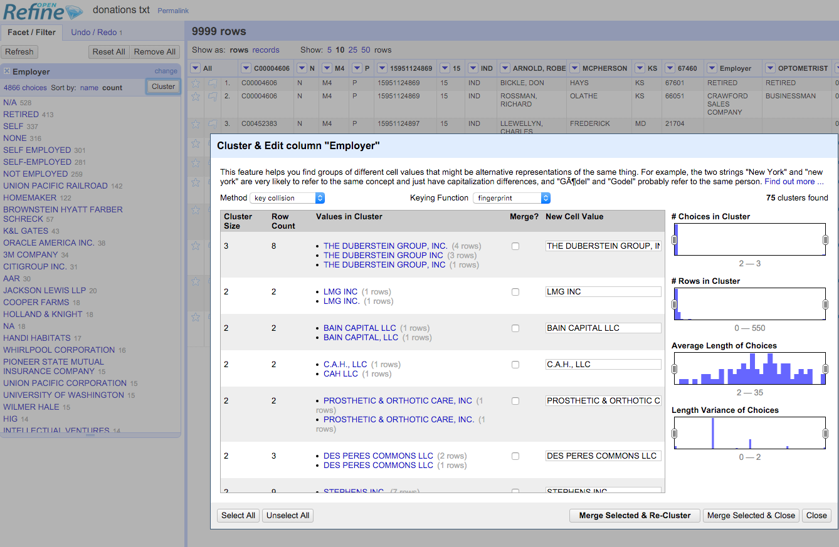
Open Refine
Cleaning your data with a powerful tool http://openrefine.org/

Slide 24
Other Tools for Data Prep/Cleaning ($)
http://www.alteryx.com/
http://www.datawatch.com/
http://dataladder.com/
http://datacleaner.org/

Slide 25
References
https://support.office.com/en-us/article/Top-ten-ways-to-clean-your-data-2844b620-677c-47a7-ac3e-c2e157d1db19
http://kb.tableau.com/articles/knowledgebase/preparing-excel-files-analysis
http://kb.tableau.com/articles/knowledgebase/addin-reshaping-data-excel
https://support.office.com/en-us/article/Filter-for-unique-values-or-remove-duplicate-values-ccf664b0-81d6-449b-bbe1-8daaec1e83c2
https://infoactive.co/data-design/ch07.html

Slide 26
Exercise/Homework: Visualize Redmond Home Sales
Visualize home prices for a small city(?), large town(?) in suburban Seattle, WA. Because I’ve spent a long time working with & visualizing real estate data, this is an opportunity to be as advanced as you wish.
Create one or more visualizations of Redmond residential home sales that would be appropriate for a local Redmond news story. It could be as simple as “Home prices rose from $300k to $400k last year”. There is one other required task: get rid of data that doesn’t belong.

