Slide 1
Links this week
Worst visualization(s) I’ve seen this week:
http://www.vice.com/en_uk/read/foi-uk-drug-conviction-ethnicity-282/page/1
Not a great visualization, but good data and analysis:
https://www.washingtonpost.com/news/wonk/wp/2015/09/25/what-it-looks-like-when-a-bank-structures-its-business-to-avoid-minorities/
A very good data visualization. Takes a minute to figure out
http://bgrsquared.com/places/

Slide 2

Mashups:
Finding, Combining
& Visualizing Data
Week 5
Feb 9, 2016

Slide 3
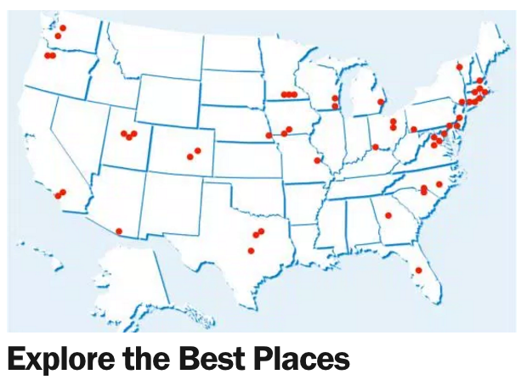
What is a mashup?
Mashup – a buzzword that simply means combining two or more data sets or sources.
Alternate definition: data on a map
Why mashups?
Change over time – Census 2014 vs 2005
Maps – A list becomes a map
Explain why – Income and politics
Build an index – CNN Best Places

Slide 4
Change over time: Median Income
From US Census: median income
Timeframe: 2014 and 2005
Larger time range nice, but harder to get
More granular years doesn’t add a a lot of value, initially
Geography: US, State, County, Metro, Zip
Metro is local, familiar, large

Slide 5
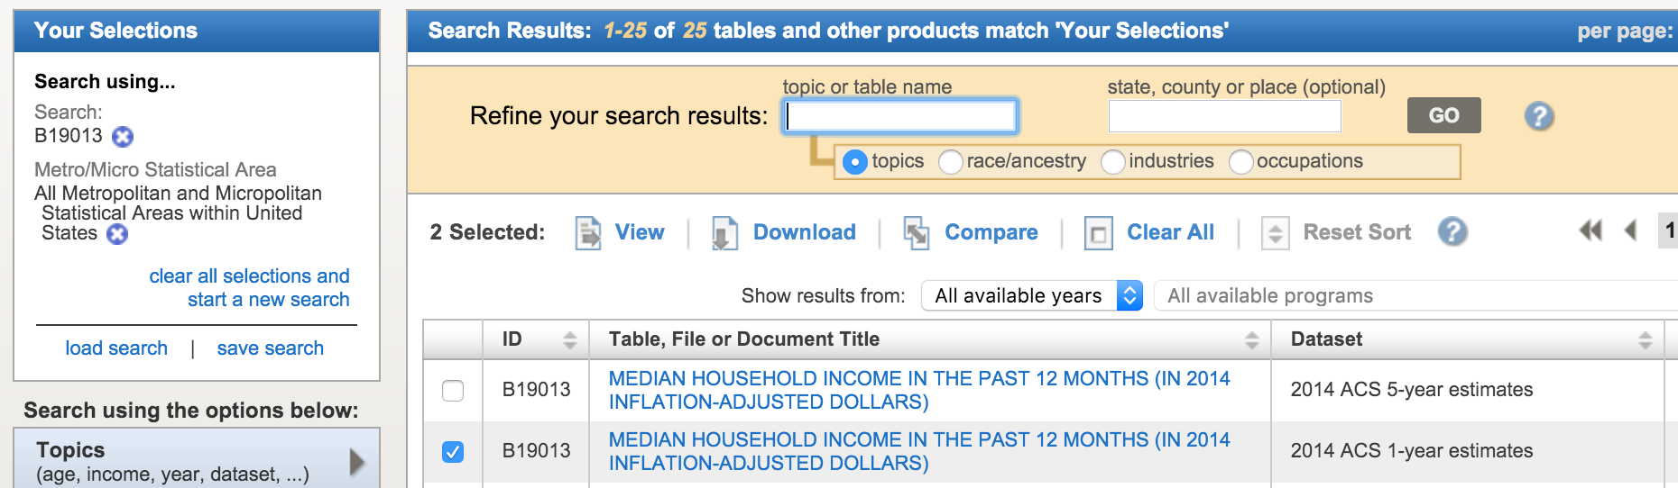
Change over time: Median Income
Downloading the data
Select geography, “All Metropolitan and Micropolitan Statistical Areas within United States” (310)
Search “Median Household Income”, table id is “B19013”
Choose 2014 (1-year estimate) and 2005
Add “B01003” for Total Population count (context)

Slide 6
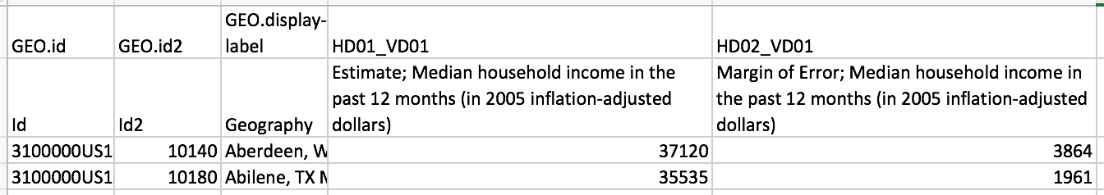
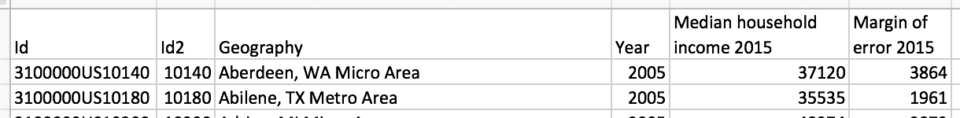
Change over time: Median Income
Preparing and cleaning the data (using Excel)
Make header just one row
Clean up header names
Make sure header names can be distinguished
Confirm there are only numbers in numeric fields
Rename the three data files to better names median-income-[year].csv and total-population-2014.csv
Remove extraneous files, keep txt files for reference
Before
After

Slide 7
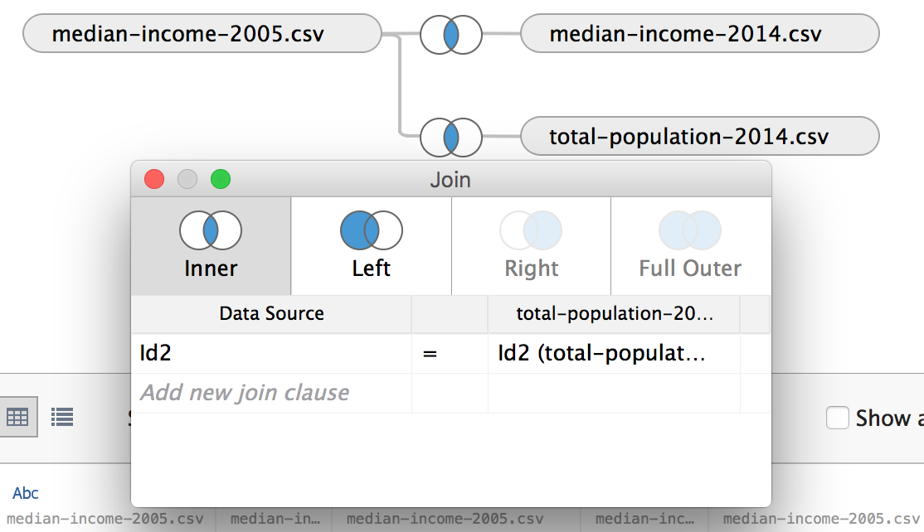
Change over time: Median Income
Loading the data
Drag and drop in Tableau. It automatically, knows how to join this data. Using the “Id2” field was the right choice.
We now have two incomes to compare and a total population to filter and sort with.

Slide 8
Regular Expressions Aside
Also known as “Regex”.
They are way of “programming” using (sometimes) just a few characters.
Usually used for finding, replacing, or extracting text.
Great for cleanup of data and repetitive tasks.
Can be hard to read.
Usually include “regex” somewhere in the function name.
Similar syntax across technologies, but are some differences.
Available in:
Tableau
Google Sheets
Text editors (Sublime, Vi, etc)
Most databases
All programming languages
Not Excel
A Quickstart to Regular Expressions
Tableau Regular Expression Resource

Slide 9
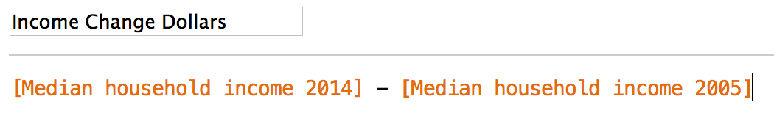
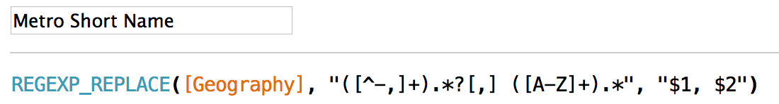
Median Income: customization
A few calculated fields
Income Change, between 2014 and 2005
Simple formula
Let’s us show change “on top” of 2005
Short Metro Name
Regular expressions. Can be powerful, can be complicated. Great for modifying text
Since Metro is generally defined by the prominent city and state. Details:
Get first letters that are not ‘-’ or ‘,’. This is $1, the city.
Keep going until we see a comma and a space.
Take the next characters. This is $2, the state.
Ignore everything after that.

Slide 10
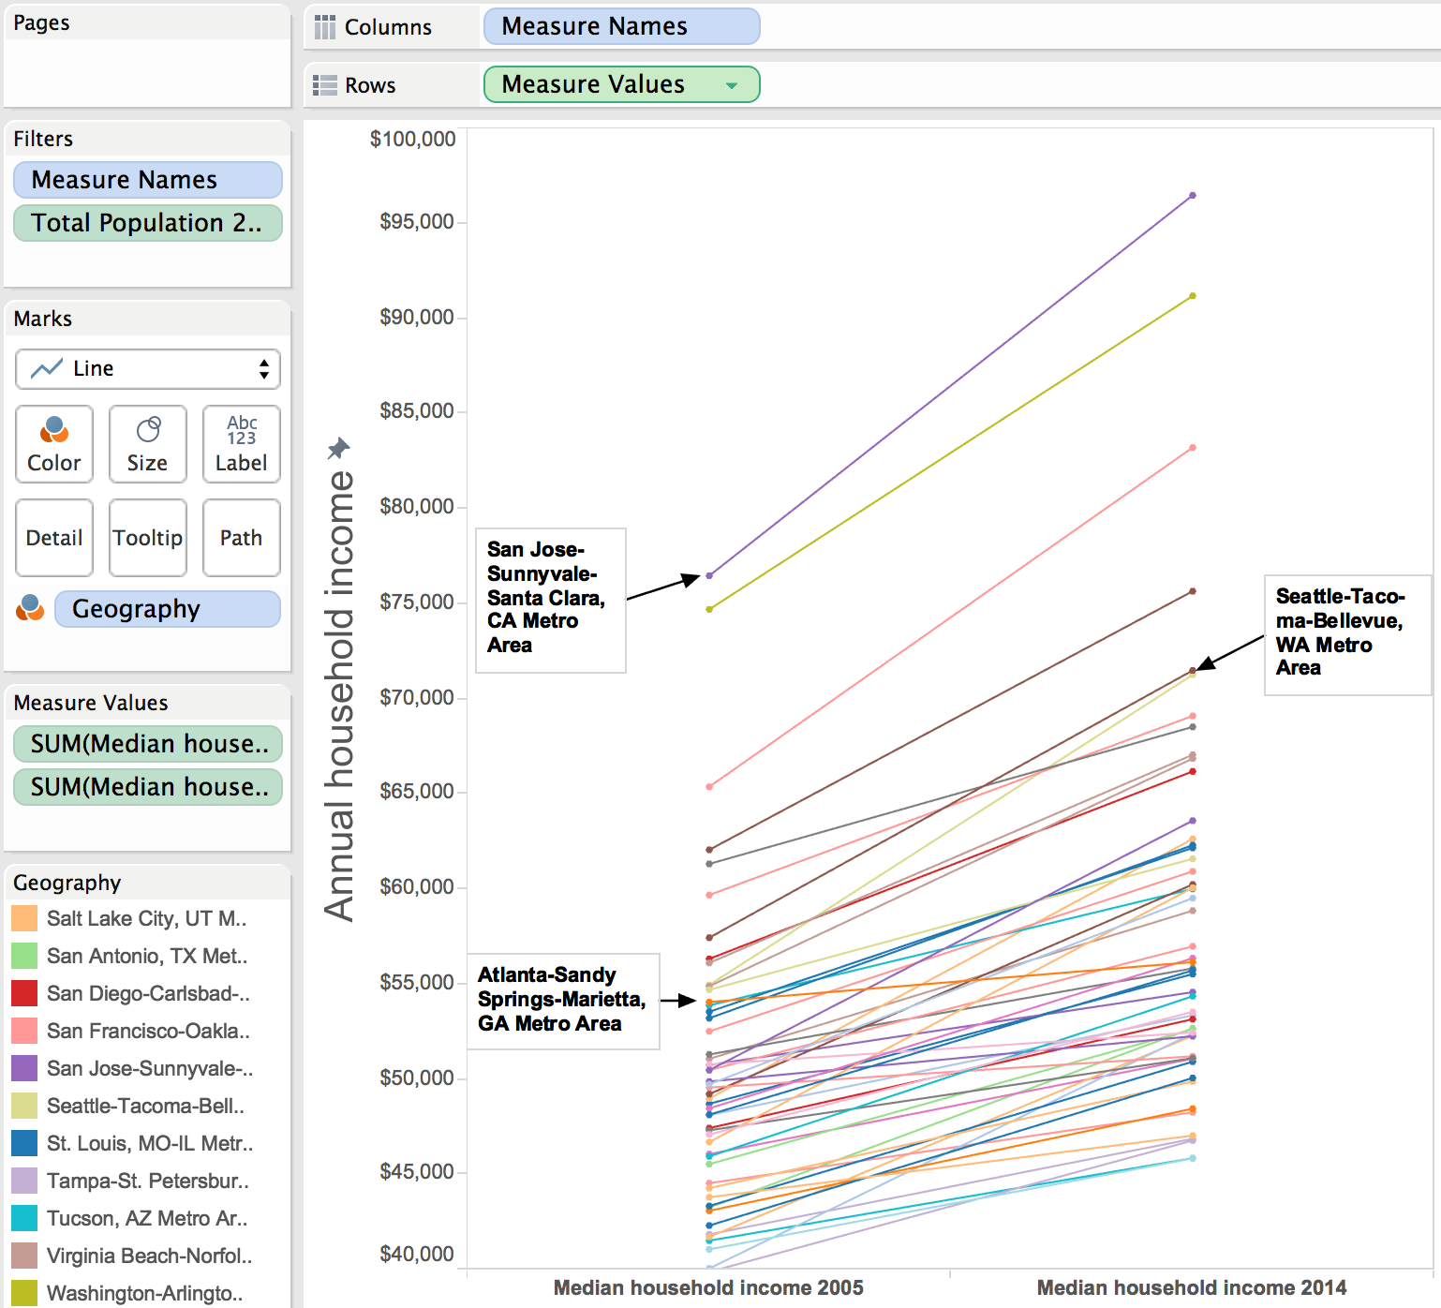
Median Income: customization
We have two “Measures”. A subtle trick…
Drag Measure Values to Rows
Select the median income fields
Drag Measure Names to the Columns
Finishing up
Color by Geography
Add dots via Color button
Filter Total Population > 1mm
Highlight “points of interest”
What could be improved?

Slide 11
Median Income: Needs Improvement
Colors are extensive & require interaction.
Labels aren’t great.
Some of the stories are probably buried in the spaghetti.
Styling called-out lines would be great, but because we’ve “joined” the data, it doesn’t work.

Slide 12
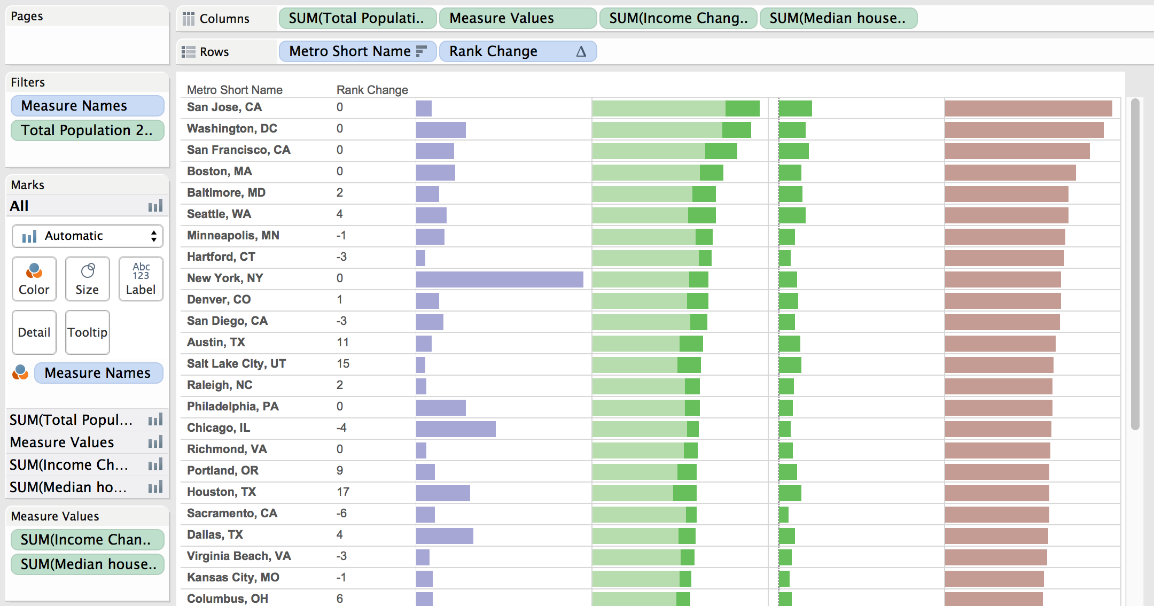
Median Income: Improved?

Slide 13
Another look at Income: Middle Class
Are there places that could be quantitatively described as more middle-class than others?
Are there places that don’t have a lot of middle class households?
Let’s use income bands from the US Census to take a look at Zip-Code level data. Why zips? Because they are relatively local, but also have a lot of related data (like election donations)

Slide 14
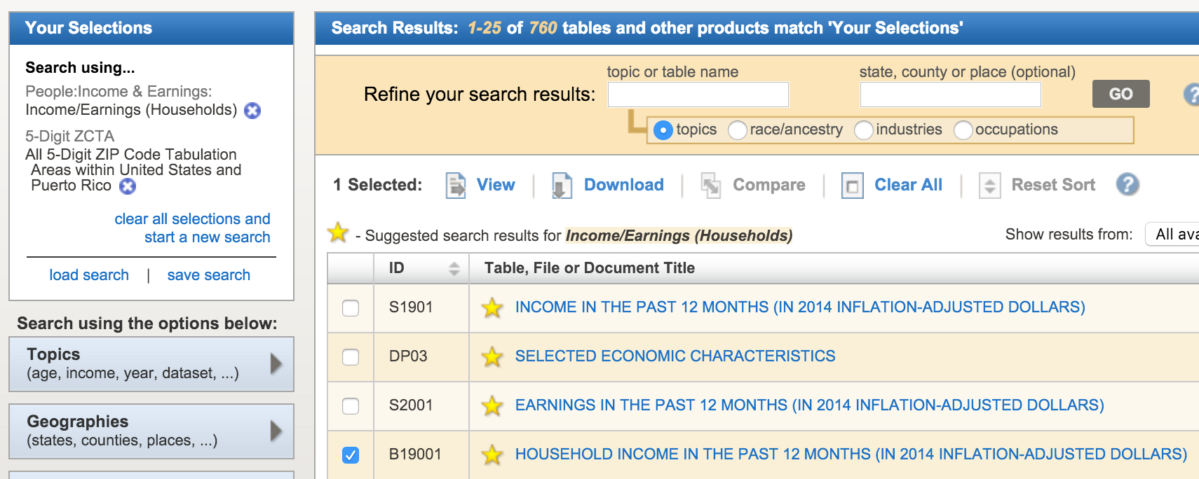
Middle Class Income Data
Get the data
Income Data: http://factfinder.census.gov/faces/nav/jsf/pages/index.xhtml
"HOUSEHOLD INCOME IN THE PAST 12 MONTHS (IN 2014 INFLATION-ADJUSTED DOLLARS)" B19001
2010-2014 American Community Survey 5-Year Estimates
Geography: ZCTA also known as zip code.

Slide 15
Middle Class Income Data
Clean and Prepare
Remove extra header row
Remove non-numeric characters in numeric fields
File still had "250,000+" and "2,500" that need to be fixed
Analyze the quantities in each income bracket to determine middle class
I went with $30,000 to $100,000 as the middle class
($30k is probably low, especially for a family, but an individual could do ok in some parts of the country with this salary)

Slide 16

So many ways to visualize just a few numbers
https://twitter.com/lenagroeger/status/697197701583237120

Slide 17
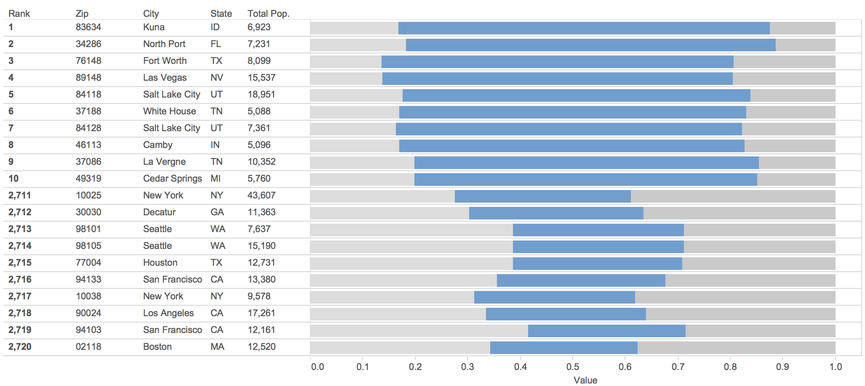
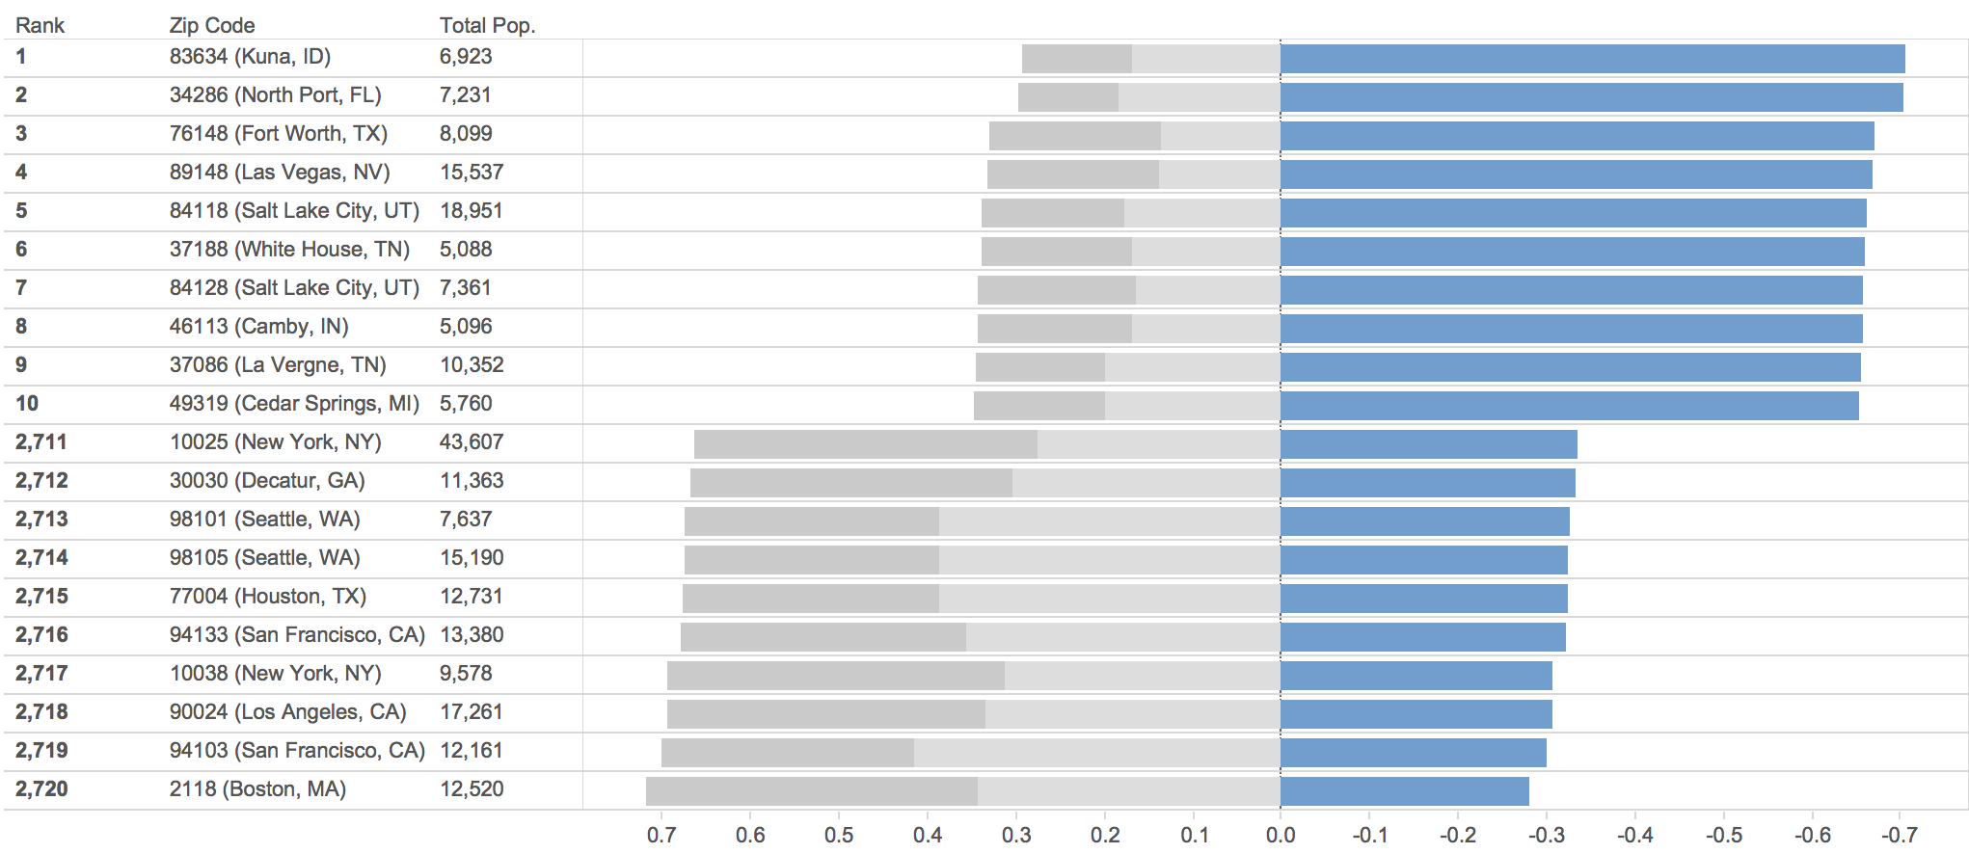
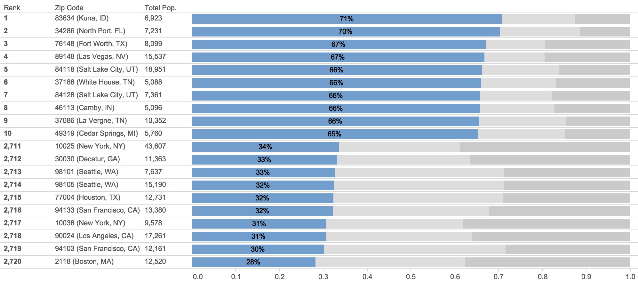
Middle Class Income: Iterating the Visualization
Middle as middle was the theme.
Tough to grasp size as lower and upper change.
Can I do better on the row labels?
Middle class bars start at zero.
The “negative” bars is probably not idea.
But, I have made a better Zip Code label, I think
Middle class bars start at zero.
Other bars finish off the 100%. ”Lower” in the middle position not ideal, but it’s a tradeoff for readability
Added labels to middle-class bars.

Slide 18
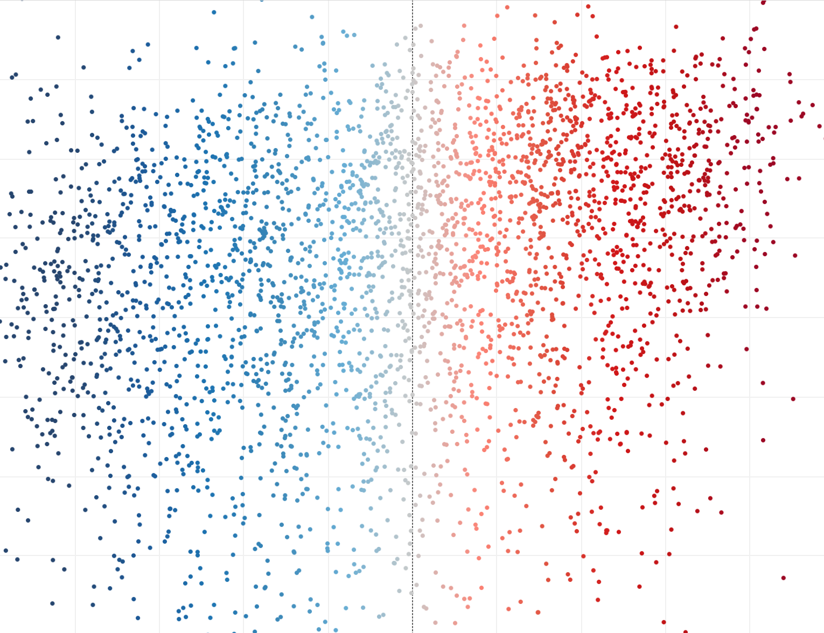
Is there a relationship between Middle Class and Political Party Donation preferences?

Slide 19
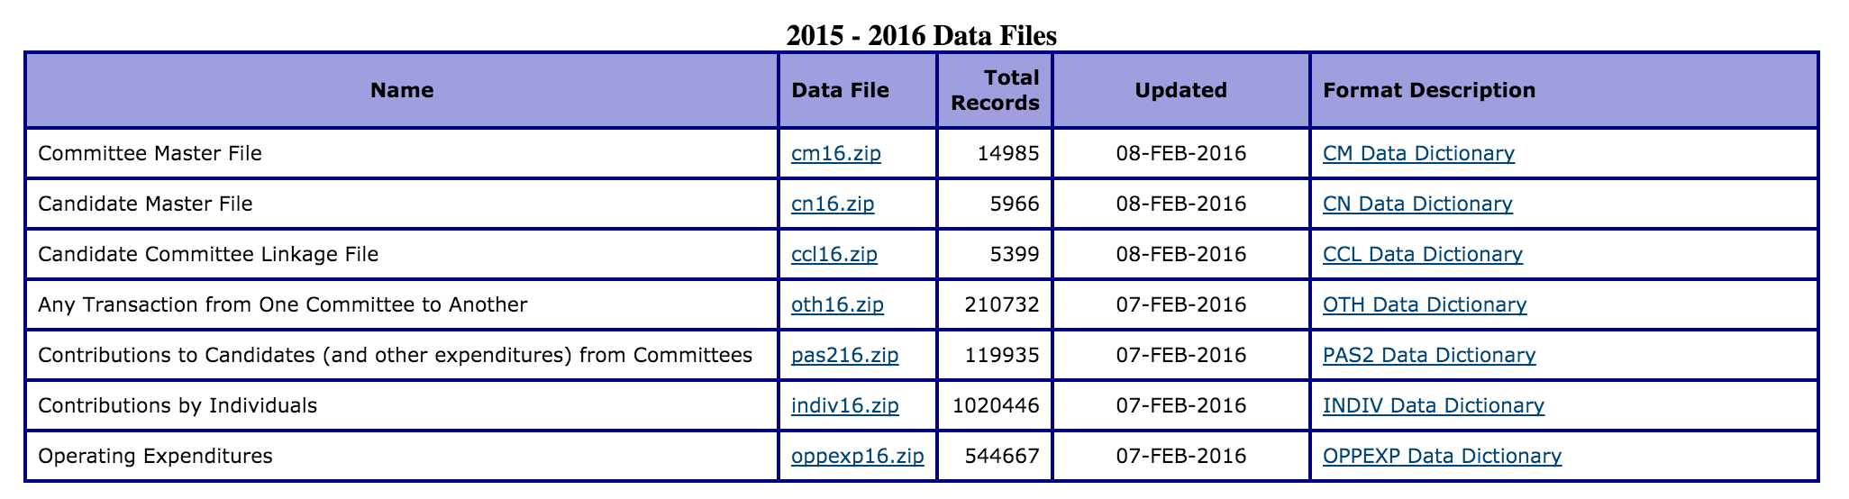
FEC Candidate Contribution by Individuals Data
Get the data
Get list of candidate, committee, and individual donation files
Download the contents of the web page that includes all links: http://www.fec.gov/finance/disclosure/ftpdet.shtml
There are already some surprises. This page requires JavaScript. Use inspect to download rendered HTML.
We have the list of files which all look like: indiv[year].zip, cn[year].zip, cm[year].zip
Downloading the Zip files would crash from time-to-time. Had to run the download step multiple times to get through everything.
Downloading a bunch of largish files, only download if you don't already have them

Slide 20
FEC Candidate Contribution by Individuals Data
Prepare data
Because we have ~25 million rows of data, must put into a database (or process it with some form of code)
For Postgresql, I had pay attention to:
header - CSV HEADER
delimiter is "|" - DELIMITER '|’
encoding - needed to be "windows-1251" because there were non-ascii characters - ENCODING 'windows-1251'
null is the empty string. NULL AS ''
ignore double quotes, which normally wrap strings, I had to hack it - QUOTE E'\b’

Slide 21
FEC Candidate Contribution by Individuals Data
After all that... Still hit a few more errors at import time.
Ended up manually editing two CSVs
I had to lengthen a few of the VARCHAR fields beyond the "data dictionary"
On the indiv file I had to convert three (out of 25 million rows!) to integers that including strings
One of the committee files included a single garbage character
One late learning: committee and candidate files had a lot of redundancy
The final command to import the data looked like this:
cat /tmp/indiv08.txt | psql -U postgres -d work -c "COPY fec_individual_donation_import FROM STDIN WITH CSV HEADER encoding 'windows-1251' DELIMITER '|' NULL AS ''”

Slide 22
Building a data-driven map: Challenges
Geocoding data – can be hard
Presenting multiple metrics – can be impossible
Data/geographic coverage – people aren’t good at dealing with spaces in geo data.
People’s knowledge and perceptions of geography – Depending on familiarity with various geographies, a person may or may not understand the map
Gracefully handling scale, sizes, density, details – Getting all these things right is difficult.
Projections can be difficult – Look at Alaska…
Have a plan. Find something that works

Slide 23
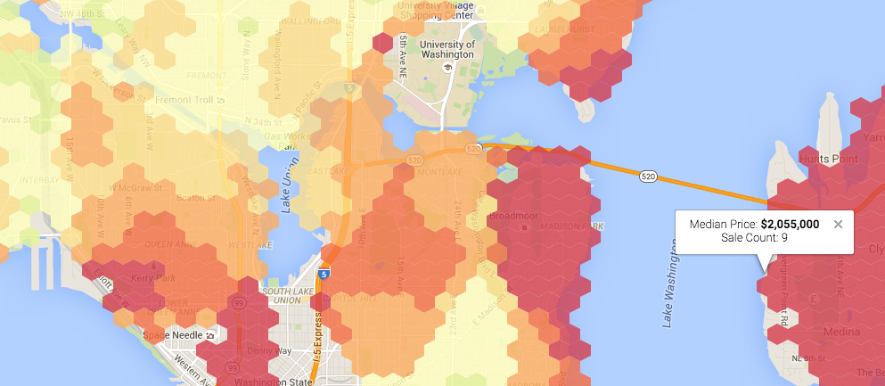
Data-driven map: Best Practices
Keep metrics and data simple.
If using filled shapes (choropleth), try to keep colors to a minimum unless there are large contiguous areas with the same values.
Make sure your audience will understand the underlying geography.
Use labels to help “ground” your audience.
Use color palettes from Cynthia Brewer’s http://colorbrewer2.org/
Be careful when using distortions of shapes.
http://vizz.site/king-county-prices-heatmap.html

Slide 24
Homework: Mashup two data sets.
Bring two data sets together and build two visualizations: one map and/or one chart.
The two data sets should be joined on geography and/or timeframe (or something else if you choose).
Examples:
Combine home prices and income to visualize affordability.
Combine stock prices with company earnings to visualize a good or bad stock.
Combine income by occupation data with rent prices to visualize what jobs pay enough for a good apartment in your area.
Suggested Reading: Nathan Yau – Visualize This – Chapter 8: Visualizing Spatial Relationships
For further technical tutorials, also recommend Nathan Yau’s: https://flowingdata.com/membership/ ($5/month or $54/year)

