Slide 1

Forecasting Canadian Election
Johnson Vo

Slide 2
Motivation
Data availability – polling data is difficult to gather
Simplicity – survey data is easily applicable on seat counts
Minimizes data sources and increases transparency
Easiest to interpret and understand

Slide 3
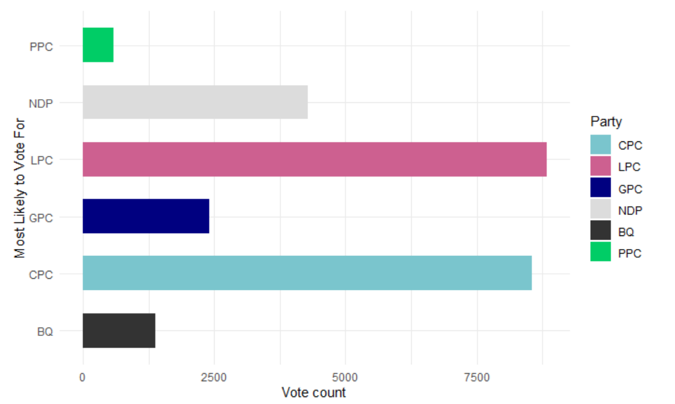
Data Used
2019 Canada Election Study
recurring election survey
sample size of 37822 responses

Slide 4
Data Used
2016 Canadian Census
370 656 observations
“divide” the census into cells for each “demographic” found in the model
results in 8112 total cells or 24 sub-groups per district

Slide 5
Model
Modal is very good for binomial data
Implemented 6 logistic models for each party of the form
r denotes riding, i for each individual and p for each party
Probability for an individual in a electoral riding based on their gender, age and education to vote for party p

Slide 6
Post-Stratify
Use the census to “re-weight” everything based on each cell’s proportions to reduce bias
Each cell is determined by gender {2 categories}, age {4 categories}, education {3 categories} and ridings {338 categories}
This allows us to reweight the proportion of the survey to the proportion of the population that each cell represents

Slide 7
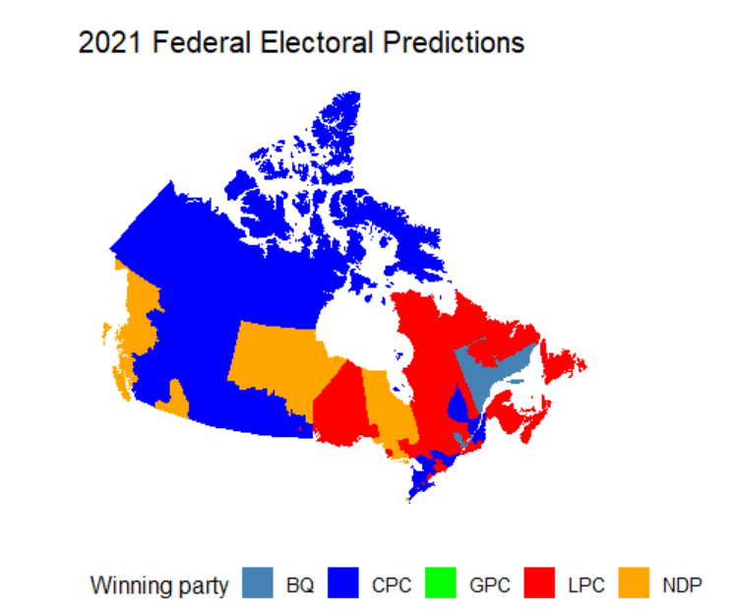
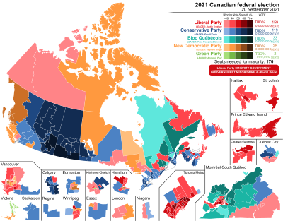
Results
Apply all 6 trained models on the post-stratified data and determine the riding vote based on the highest proportion among the 6

Slide 8
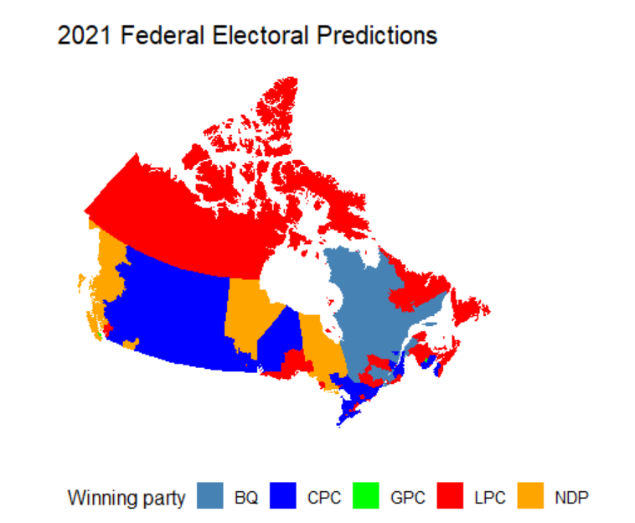
Results - 2019

Slide 9
Caveats
Use more recent data (survey or census)
Does not account for swing ridings nearly as much (could have estimated vote shares instead)
Census has gender only as a binary variable – does not account

