Slide 1
Kick-Off Meeting
SETT
8. 8. 2024

Slide 2
01
Introduction & Roles
02
Vision, Goals & Expectations
03
Foundation Phase Timeline & Deliverables
04
Tools & Ways of Working
05
Next Steps
06
QA

Slide 3
Introduction & Roles
01

Slide 4

Oscar French - Product Manager
Introduction and Roles
Experience
Responsibilities
6+ years building digital products
Overall accountability of the project
Product strategy & discovery
Project management
Background
Product Management, Data Warehouse Management.
Industries: Finance, Property, Legal, HR
Fun Fact
Typically English - I love tea with milk and everything to do with football.
I have a twin brother.
Previous Projects
Virtual Dining Concepts - FoodTech organization, managing ghost kitchens and tools for revenue optimization.
Simyra - LegalTech platform to parse complex financial agreements.

Slide 5
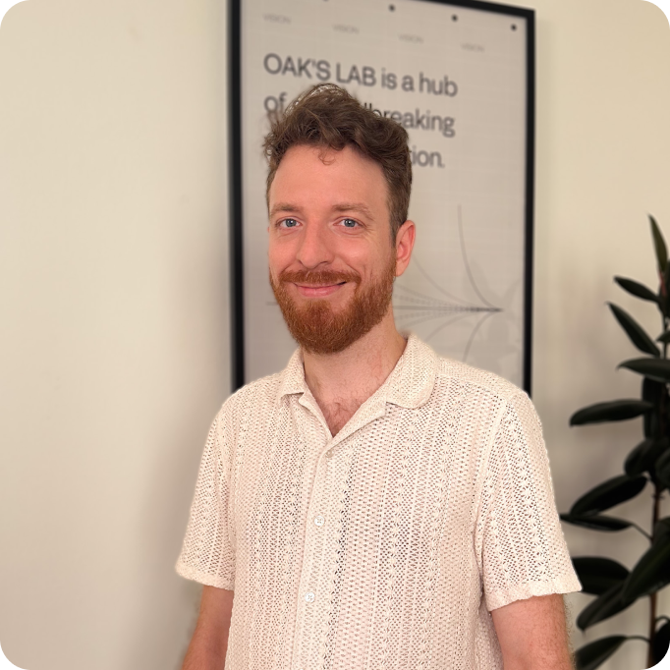
Jakub Kohout - Lead Designer
Introduction and Roles
Experience
Responsibilities
8 years in Design Industry
User Experience and User Interface design
Interactive prototypes
Web design
Wireframes
Background
Product Design, UX/UI Design, Front end development
Fun Fact
Previous Projects
I grew up in a village of 60 people, but later on moved to NYC where I found my love for basketball.
NPM - bringing private companies, banks and brokers, stakeholders, and investors together to transact in one marketplace.
Kimoby - Managing valet services for car dealerships
SmartGift - eCommerce SaaS gifting platform

Slide 6

Honza Malcak - Lead Engineer
Introduction and Roles
Experience
Responsibilities
7 years in the Industry
Technical Leadership
Architecture & Design
Development
Leading the engineering team
Background
Engineering & Software Architect with a focus on the business side of the project.
Fun Fact
Previous Projects
Amateur photographer, archer, dog owner, EV fan.
Reservoir - Credentialing platform for universities and students
Other Projects:
- IT Systems for virtual mobile operators.
- Electricity trading platform for EU producers.
- Marketplace for merchandising.
- Fundraising platform for US nonprofits.

Slide 7

Petr Máčal - Tech Consultant
Introduction and Roles
Experience
Responsibilities
13 years in the Industry
Solution Architecture consultation
AI PoC Exploration
Technical Consultation
Background
Full-Stack Senior Software Engineer & Solution Architect
Fun Fact
Previous Projects
Hockey cards collector
Avast - Cybersecurity
Crave - FoodTech
Storyvine - AI-Driven VidTech platform

Slide 8
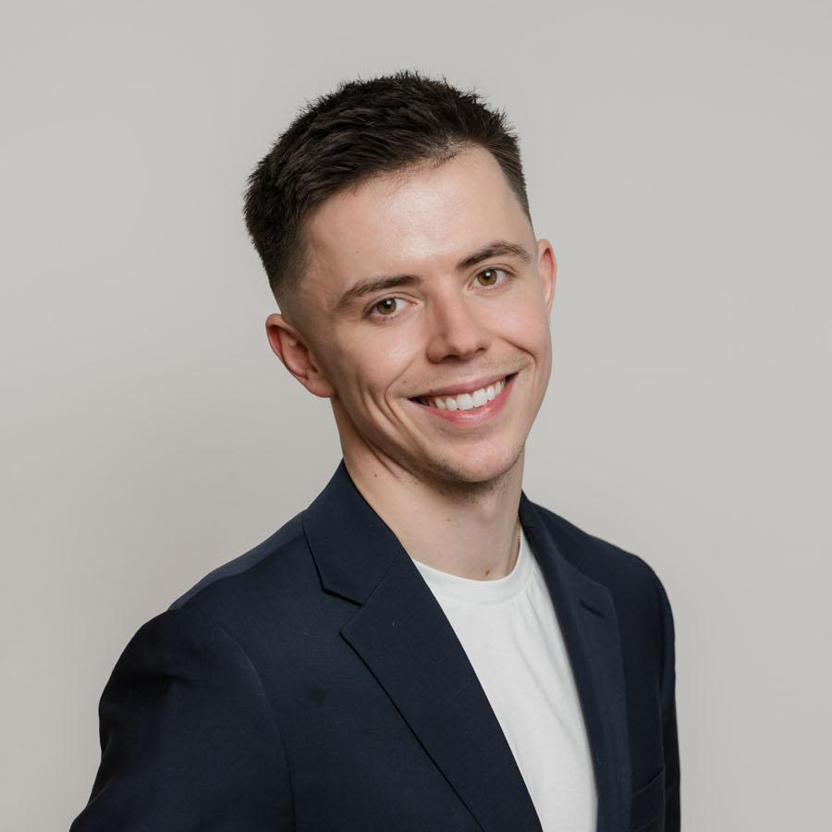
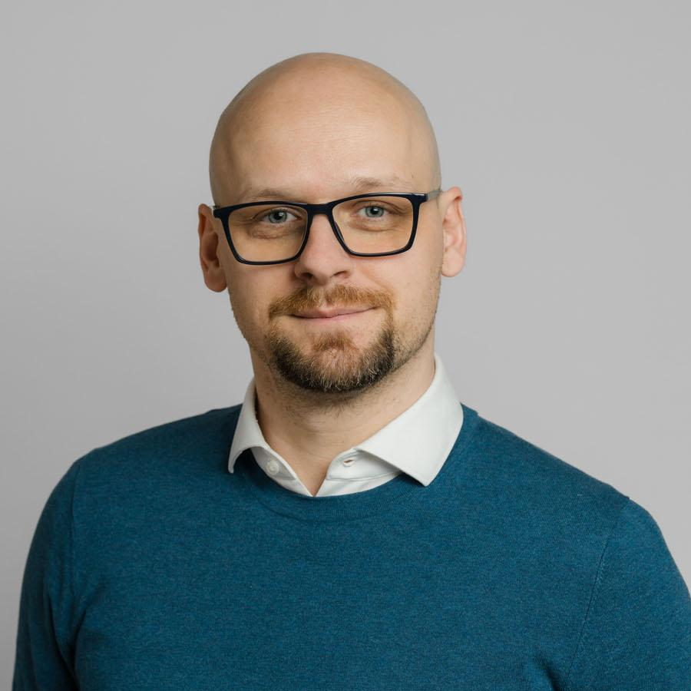
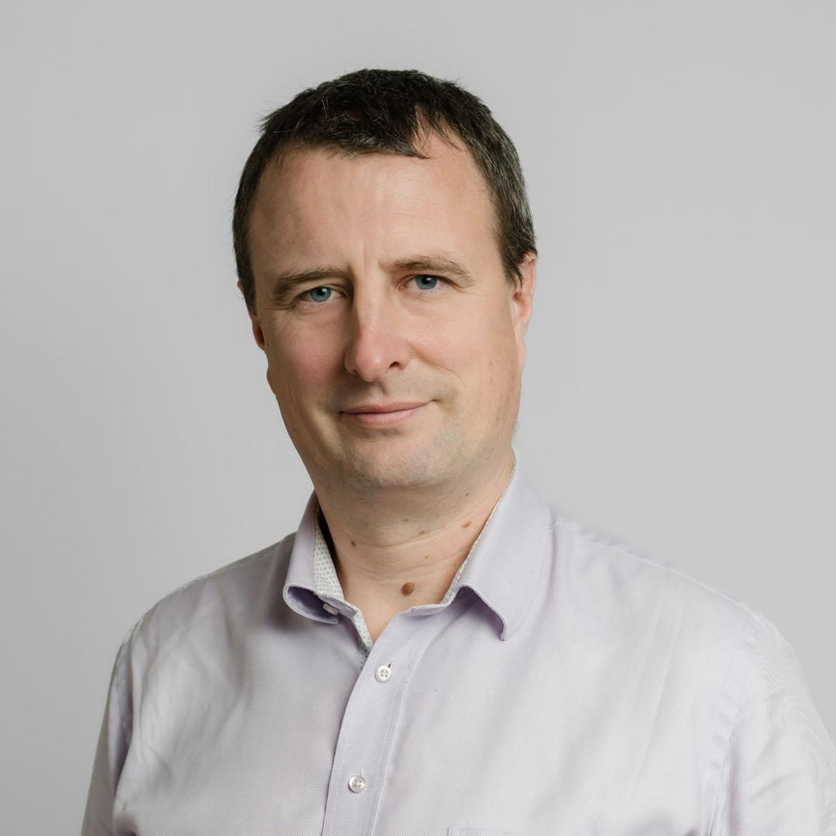

Management Team
Introduction and Roles
Andy Powell
Chief Business Officer
Igor Tadić
Head of Product Management
Tonda Kmoch
Head of Engineering & Delivery
Vladimir Rehor
Head of Technology
Andy oversees product development for all startups at OAK’S DIGITAL and has experience co-founding a startup and taking it from pre-seed to Series B. Andy will be your partner to ensure we deliver to your needs.
Igor, former Ernst & Young Innovation Director, led 200+ product designs, launched 20+ ventures, and advised 30+ enterprises. At OAK’S LAB, he empowers product teams to focus innovation driving business value.
Tonda, with 20+ years of diverse software experience, led 30+ projects, including the largest ever IT project for Raiffeisen Bank in the Czech Republic. At OAK’S LAB, he guides engineers and product teams to top-quality delivery.
Vladimir has over 15 years of experience building successful software applications in the startup and enterprise environment. At OAK’S LAB, he is accountable for the technology strategy on every project, overseeing DevOps, and security.

Slide 9
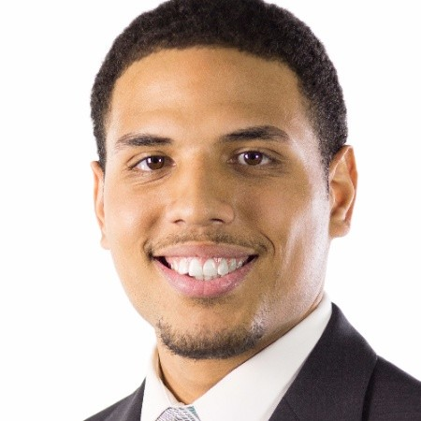
Team SETT
Introduction and Roles

Slide 10
Vision, Goals & Expectations
02

Slide 11
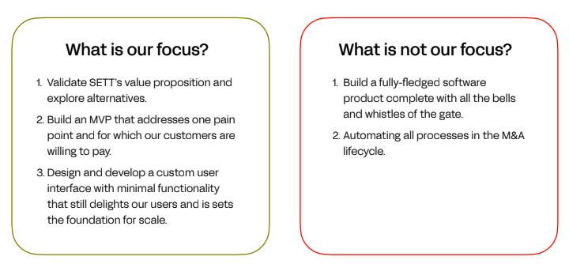
Business Vision
Vision
Project Goals
Vision, Goals & Expectations
SETT aims to be the leading platform for M&A process management. By creating a modern digital product that automates tedious workflows, SETT can provide immediate value to M&A businesses and operation teams.
Pain Point for MVP: Inefficiencies in converting hand-drawn visualizations into digital formats for PowerPoint presentations.

Slide 12
Project Deliverables
Vision, Goals & Expectations
User Web Interface
A user can upload all inputs sent by clients/management to format into individual components to form the presentation.
This is a secure platform for clients to set their brand, styles and leverage company content.
Admin Interface
Enables SETT to manage the clients, users and specific information to display in the User Web Interface.

Slide 13
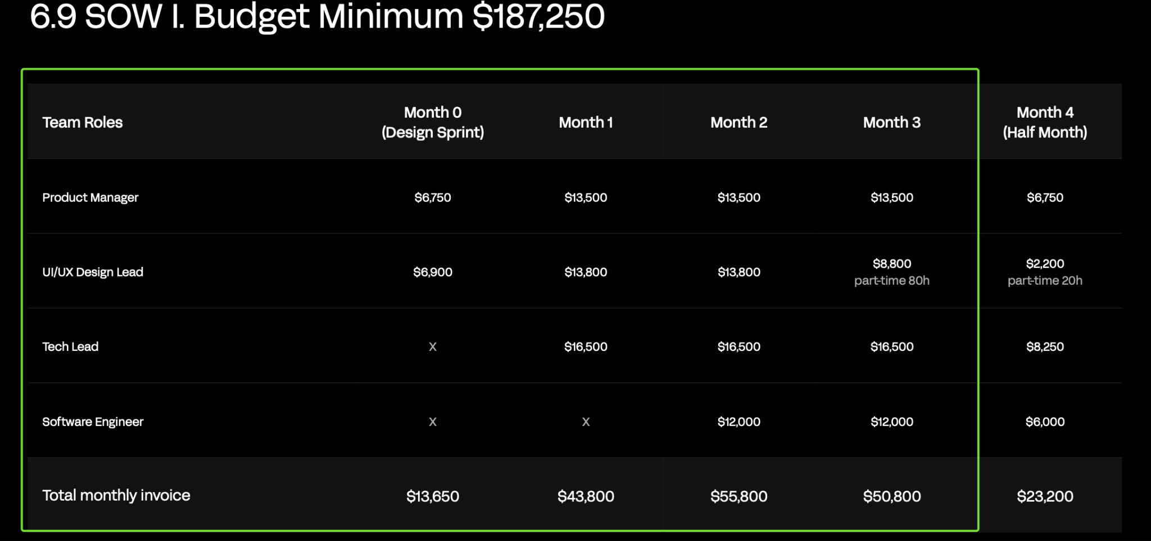
Team Composition
Vision, Goals & Expectations

Slide 14
Foundation Phase timeline & deliverables
03

Slide 15
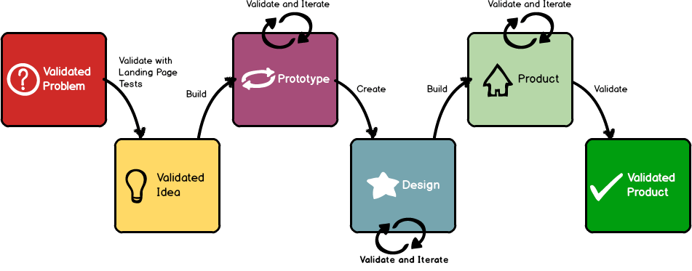

Our Approach to SETT
Foundation Phase timeline & deliverables
We are aiming to take the pain point and quickly validate the solution hypothesis. We have a strong understanding of the problem we’re aiming to solve, and we need to define how we solve it.
Our approach will cover the following
First 1-2 weeks
Align on high level vision
Explore some approaches for solving the pain point
Validate the approach with potential users
Week 2-6
Building PoCs to test and learn
Define, design and assess the scope
Define rollout and Go-To-Market
Week 6 onwards
Develop, Test and Launch the MVP
This approach will allow us to iterate quickly, fail quickly, and ultimately produce a product that meets the market's needs.
We are here

Slide 16

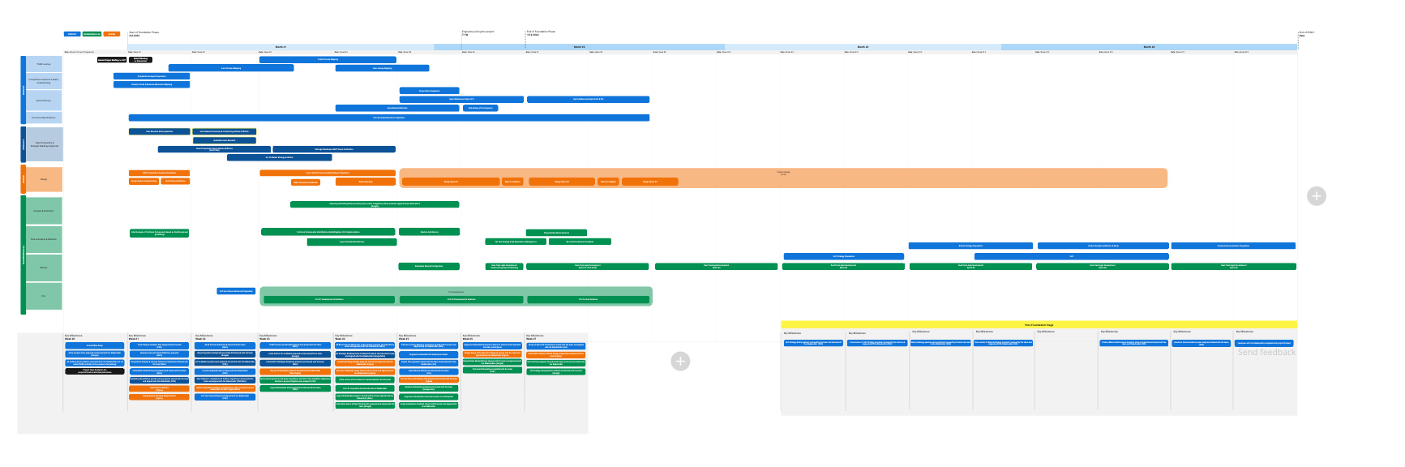
Foundation Timeline (Link)
Foundation Phase timeline & deliverables

Slide 17
Desired Output of the Foundation Phase
Foundation Phase timeline & deliverables
Vision Board and Goal Definition
Value Proposition & Key Features Definition
AS-IS and TO-BE User Flows
Product Roadmap including high-level Go-To-Market Plan
Clear Definition of the Scope of the MVP
Technical PoC/s already developed that allows us to test the solution

Slide 18
Tools & ways of working
05

Slide 19
Time
Challenges
Tools & ways of working
The more insights, access, and time you can give us, the better and faster the outcomes.
It would be great to get an understanding of:
Availability and schedule
When you’re in Prague, how often you’ll be able to come to the office?
We will face challenges and we might even disagree on some decisions. This is a normal part of the product development process. However, please share with us any feedback you have quickly and directly if you feel like we’re going in the wrong direction.

Slide 20
Potential risks
Tools & ways of working
Scope Definition
We know what we want to achieve. In this MVP we need to be laser-focused achieving our goal. The ideal outcome is that users adopt our platform as an irreplaceable tool when working on M&A projects.
User Inputs
An iterative feedback loop will allow us to learn fast and build a product that solves the problem. This means continuously engaging users and accessing as many real life examples as we can.
Business value of V1
The first MVP will likely handle the most common use cases but will not fully replace graphics departments or external firms. This is expected, and we will be used as a complementary product initially.
Scope Size
Over the course of the foundation phase, we will define the scope and estimate this with the engineering team. This scope is what we can commit in the timeline to achieve the goal. Any additional scope will need to be assessed and affect time, resources, or already agreed scope.

Slide 21







Virtual Office (Google Cal Link), (Slack Link), Drive (Link)
Tools & ways of working
Goal
Create feeling of being in the same room by choosing tools we will use to collabore. Meetings twice per week? + ad hoc meetings agreed/scheduled on Slack
Why
To collaborate effectively, One shared drive with all the key assets and info, including raw data from interviews
Gmail
Google Meet
Google Drive
Confluence
Figma
Miro
Slack

Slide 22
Next steps
06

Slide 23
Action Items For The Next 7 Days
Next steps
Schedule meetings for the first activities to starting with Vision board which we will begin after this presentation.
Initial draft of AS-IS Process defined
Talk to users/network to bring them into the process.
Competitor analysis from UI/UX perspective
Competitor analysis for business logic
Define our North Star and the different approaches to build SETT.
Let’s revolutionise the M&A process together 🚀

Slide 24
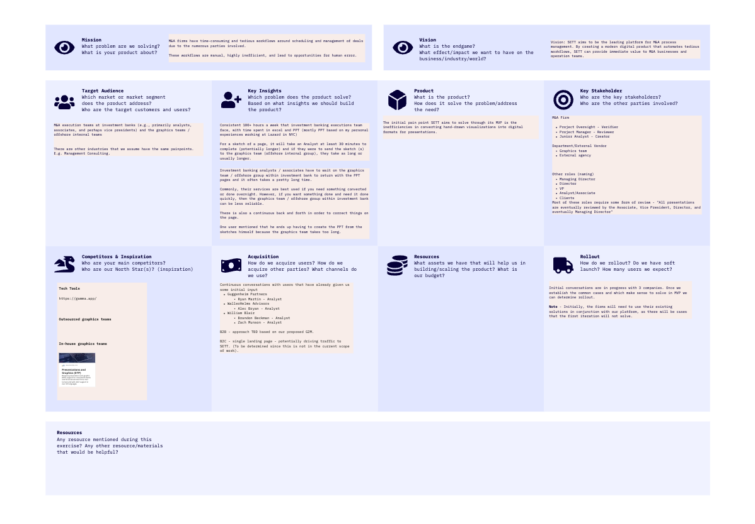
Waller Action Items
Next steps
Review questions previously shared here.
Discuss Vision Board and clarify points from Entry Analysis.
Reach out and se tup calls with contacts/user base.

Slide 25
Q&A
07
Notes:
Visual preferences, websites she likes and why Domain? If no answers - we have questions for you - Entry analysis, that would help us

