Slide 1
Sprint Review
S44
For: Nasdaq Private Market
2023-12-20

Slide 2
Agenda
Executive Summary
How We Performed
What We Delivered
Risks & Challenges
Q&A
Next Steps

Slide 3
Executive Summary
We delivered 62 tickets
Sprint S44 was about
Bugfixing
Small improvements
Continuing on Investor+
Specification check (if code and specification are aligned)
From Design perspective
From API perspective

Slide 4
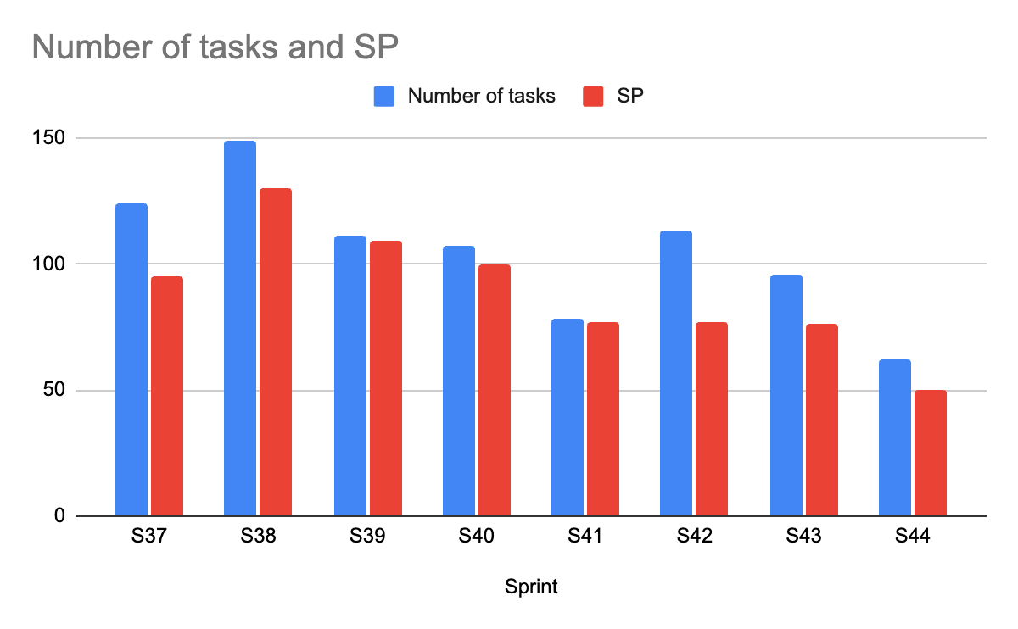
How We Performed
We delivered 62 tickets in worth of 50 SP in this sprint
QA has closed 80~ tickets
Including tickets from current and previous sprint
~10% re-open rate

Slide 5
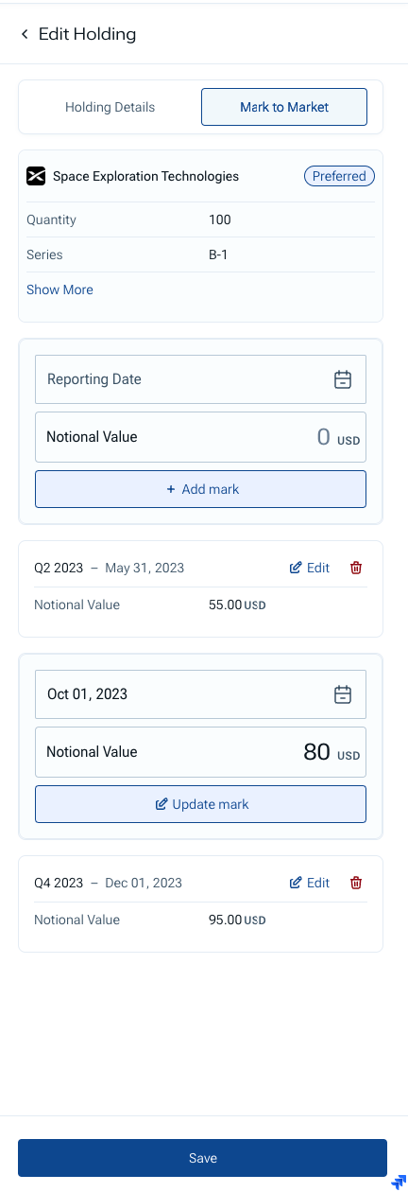
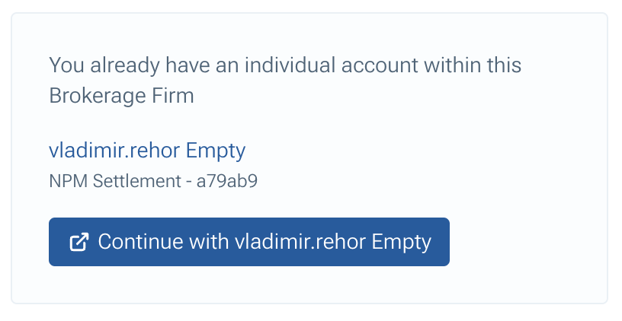
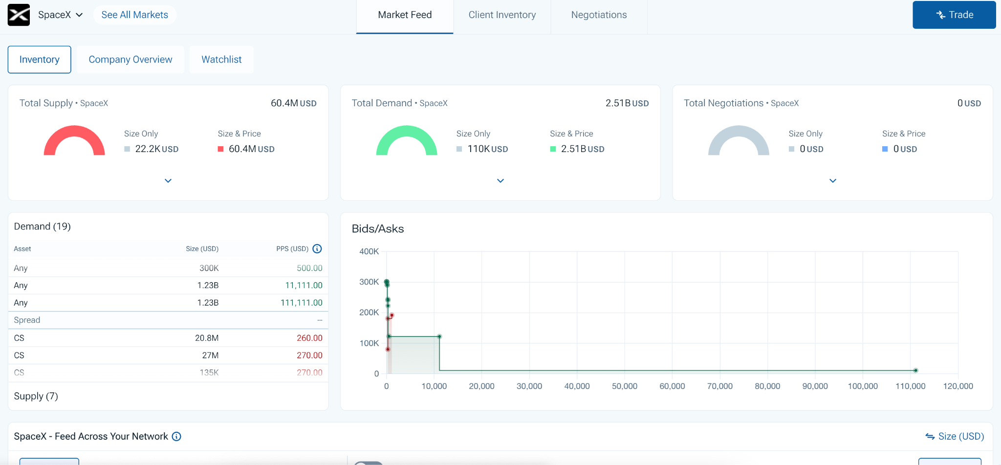
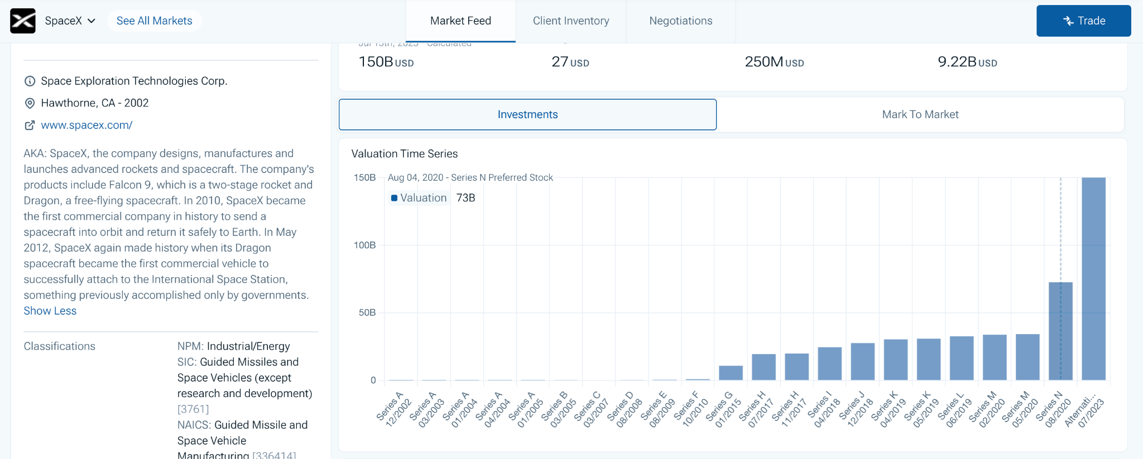
What We Delivered
Improvements & Investor+
Investor+
Portfolio import - changes
Finished edit holding drawer
Finished marks drawer
Added animation for finalise import job
Other improvements
SM
Inventory - layout optimisation
Support edit for IOI
Company Overview - New chart for Investment tab
INV WS
Onboarding / Account Setup - Show card if the individual account already exists for the selected brokerage firms

Slide 6
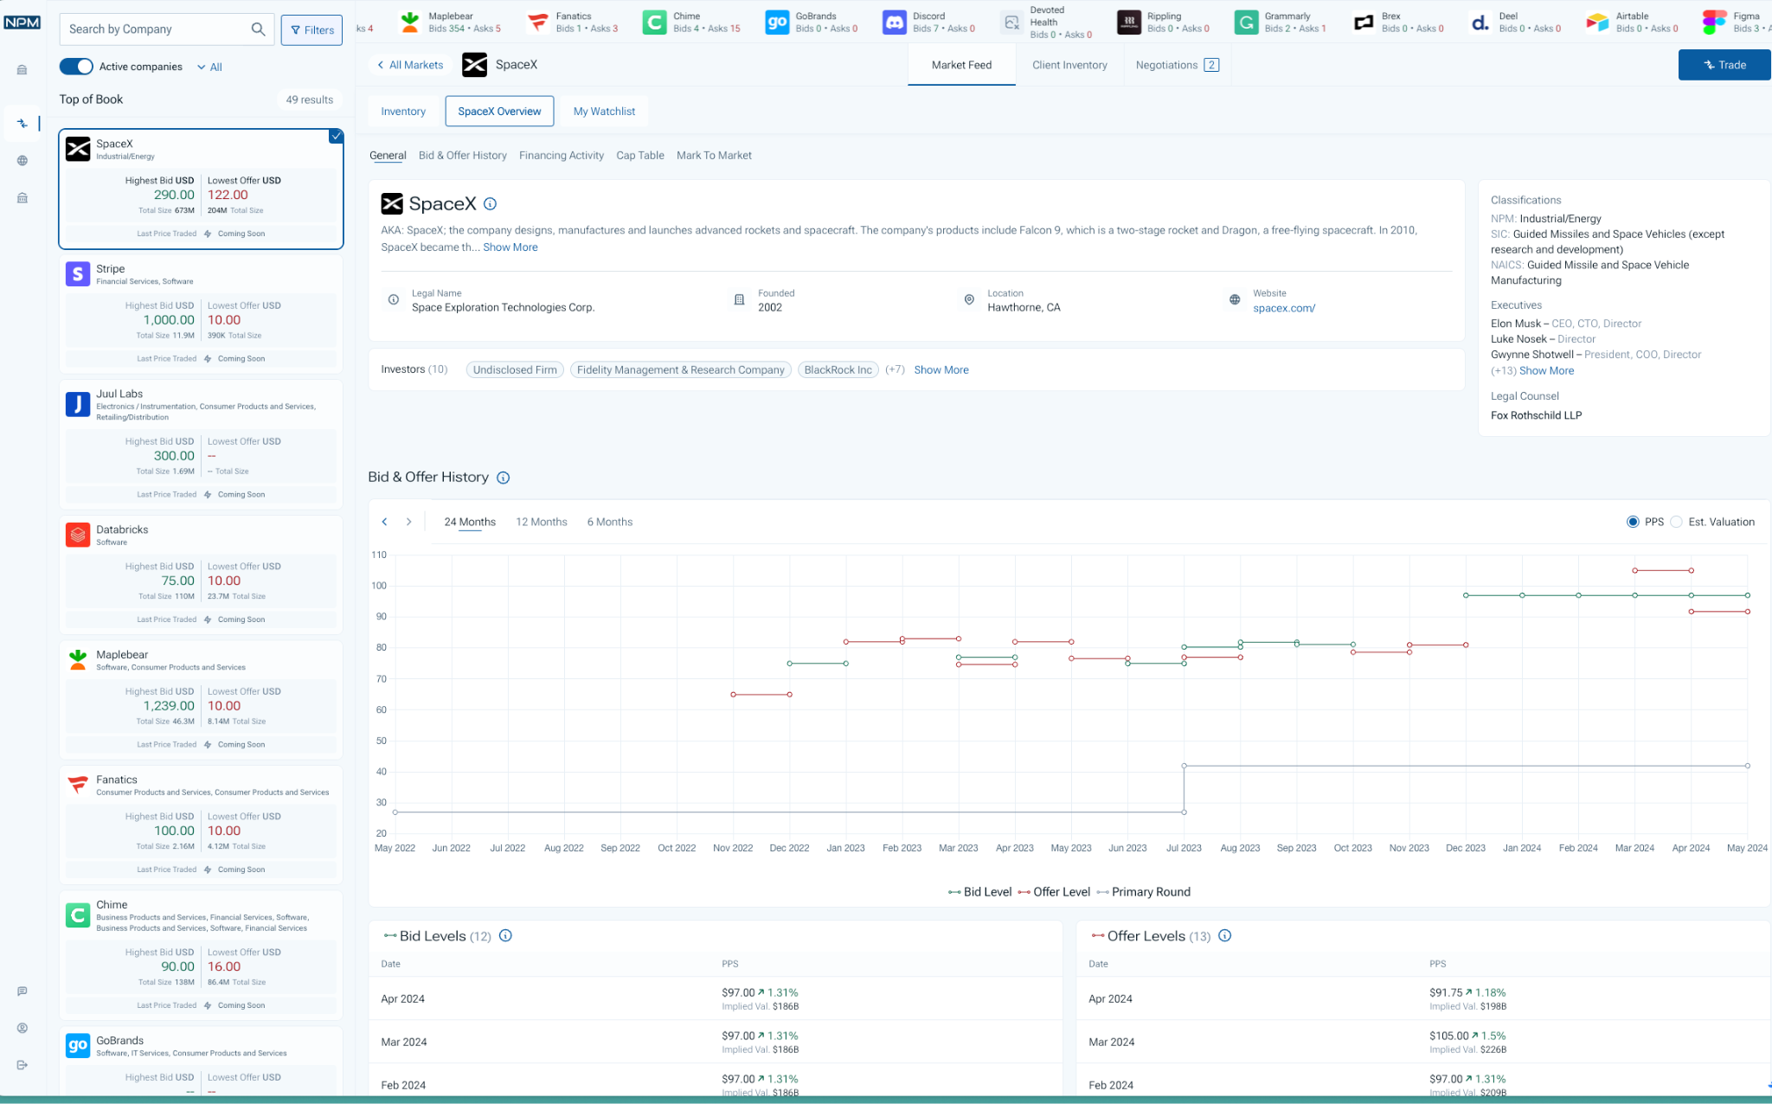
Risks & Challenges
Risk that affects production support
Not finalised and accepted FE rollout plan!
Not finalised and accepted level of support OAK’S should do
Missing release management
How often we are going to release
Code freeze (at least 3 days) + dedicated time for QA
How to be in sync with all the teams (NPM API, NPM FE, MTM, Venus, …)
FE handover is not completed (we need another 2-3 sessions)

Slide 7
Next Steps
Next steps to mitigate risks and challenges
Product is involved in planning and delivery
We are working together on realistic roadmap
Production support
We are going to restart knowledge sharing between OAK’S LAB and NPM FE engineers
We are going to assign tickets to NPM FE engineers from January

