Slide 1
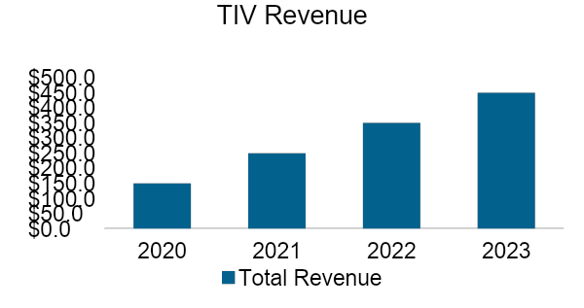



Bar Chart Sample
TIV
Premium
$ in millions
$ in millions
2020 – 2023: 15.5% CAGR
2020 – 2023: 15.5% CAGR
PF Gross Commission
PF EBITDA
$ in millions
$ in millions
2020 – 2023: 15.5% CAGR
2020 – 2023: 15.5% CAGR

Slide 2
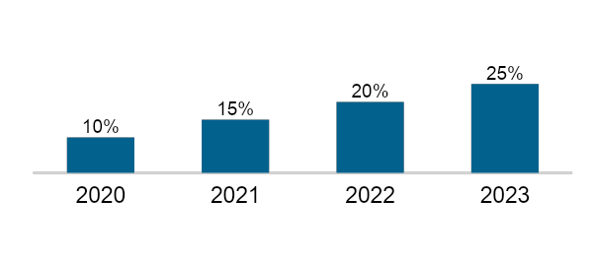
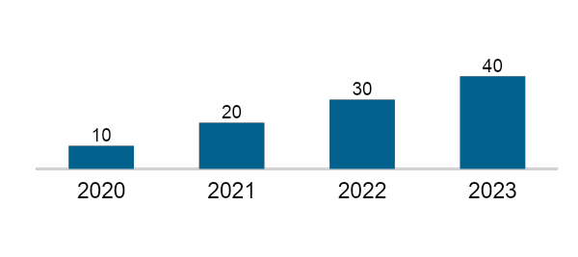
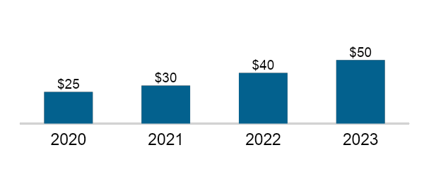
Projection Assumptions
Description
Property Rate
TBU
TBU
TBU
TBU
TBU
TBU
TBU
TBU
TBU
TBU
TBU
TBU
TBU
TBU
TBU
TBU
TBU
TBU
TBU
TBU
TBU
TBU
2020 – 2023: 15.5% CAGR
# of Quotes or Binds
2020 – 2023: 15.5% CAGR
New Product Premium (Total)
$ in millions
2020 – 2023: 15.5% CAGR

