Slide 1
Fedora Applications Recommender
Vojtěch Trefný
PV254 – Recommender systems

Slide 2
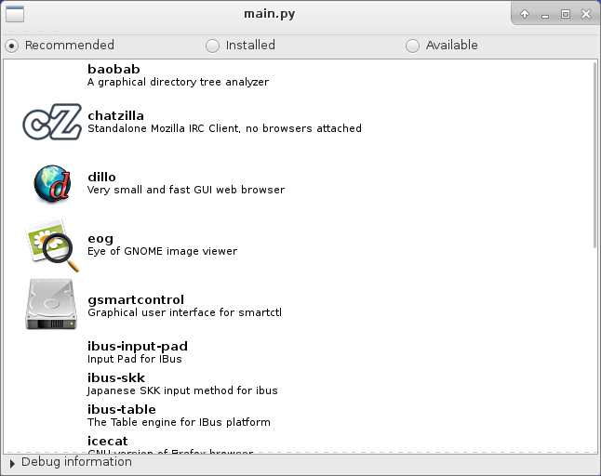
About
Desktop tool for application recommendations
Recommendations based on currently installed applications
Designed for Fedora Linux distribution

Slide 3
Data
List of available/installed packages
  Live from running system (using dnf)
  Includes package description
Package “tags”
  From Fedora Tagger online app
  https://apps.fedoraproject.org/tagger/
Categories
  From Fedora Project Packages GIT repositories
  http://pkgs.fedoraproject.org/cgit/

Slide 4
Recommendations
Content-based filtering
Recommendation
  Based on installed (“favourite”) applications
  Recommendations per package category
  Cosine similarity of “installed” tags and tags for available applications
  Term frequency using package description

Slide 5
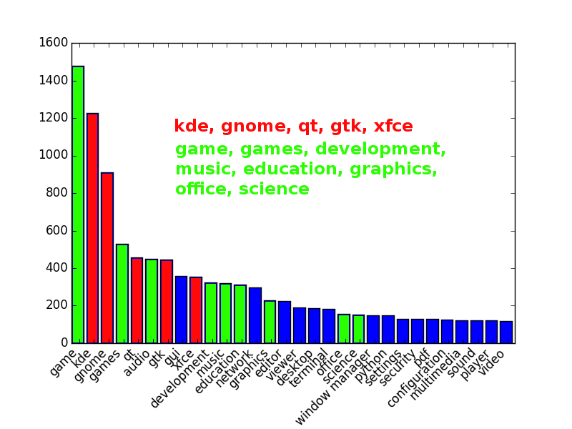
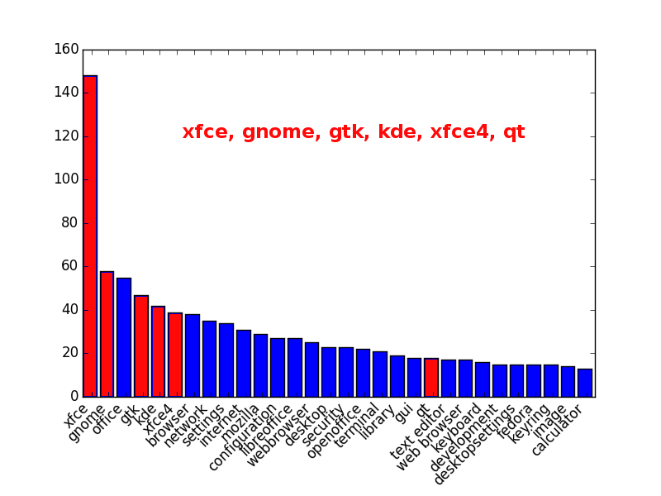
Problems
Too generic tags
  Packages mostly tagged based on it's framework or category

Slide 6
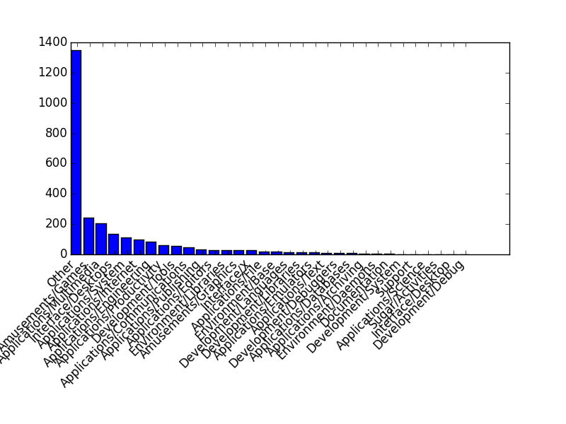
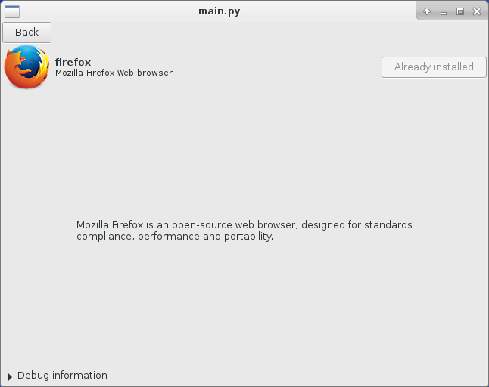
Problems 2
Insufficient data
  32 categories, but more than 50 % “Other”
  Sometimes very short descriptions

Slide 7
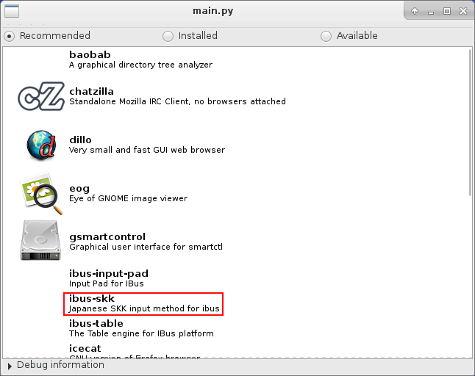
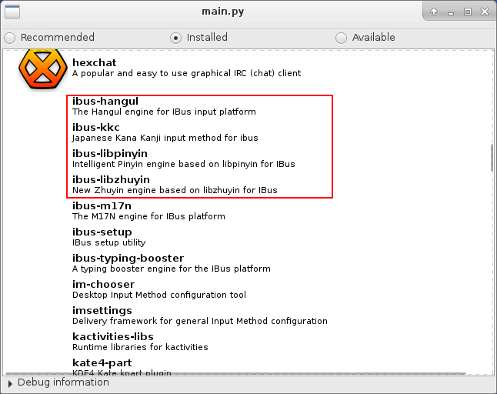
Problems 3
Installed vs. “Favourite” applications
  Automatically installed applications you never use
  Recommended: ibus-skk (“A Japanese Simple Kana Kanji Input Method Engine for ibus.”)
  Installed: ibus-hangul, ibus-kkc, ibus-libpinyin, ibus-libzhuyin

Slide 8
Testing
Complicated
  No online app – necessary to download and install/run a desktop application
  Available only for Fedora (DNF, package names)
Testing
  Using VMs with different installations
  Using colleagues at Red Hat

Slide 9
Questions
Thank you for your attention.
Source
  https://github.com/vojtechtrefny/recsys
  For testing use prepared tarball with code + pre-downloaded application data

