Slide 1
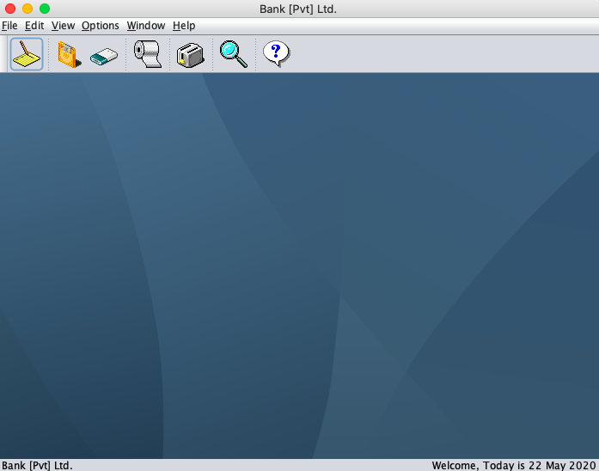
Banking System
JAVA (OOCP) Project Team Member - 1: Vinay Omkumar Khilwani - 18BCP126 (Leader) Team Member - 2: Vasu Gondaliya - 18BCP123
Team Member - 3: Umang Mehta - 18BCP120

Slide 2
Abstract
The broad increase in the advancement of technology has also led to technological advances in the Banking Sector as well. An efficient banking system will lead to more easiness in the Banking facilities such as Loan, Deposit, Withdrawal, Change of Address, etc. The Banking System, designed by us is an efficient, 'easy to work with' and user-friendly Banking System, which includes some of the Banking Facilities, such as "Account Creation", "Account Deletion", "Withdraw Money", "Deposit Money", "View All Accounts". The data, about all the customers is stored, moderated and retrieved from a particular separate file, using 'File Handling'.

Slide 3
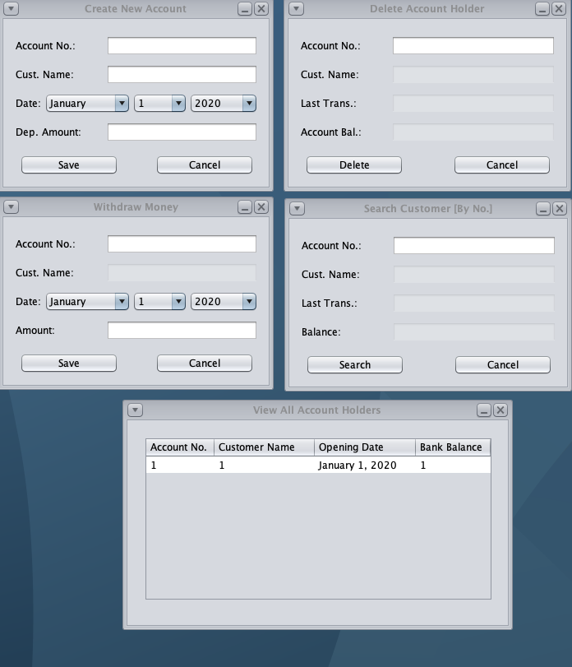
Stage-1
We thought of the functionalities, we want in our Banking System, which include "Deposit Money", "Withdraw Money", "New Account", "Delete Account", "View Account(s)", & "View All Accounts".
We made the class files of these functionalities, in the Stage-1 of our project.
When using these functionalities, the System basically interacts with the data stored in the database File, "Bank.dat".

Slide 4
Stage-2
We thought, to make the System more user-friendly, by adding the functionality to change "Theme", "Background", and/or "Layout Style" of the System.
This will encourage the user to work with more engaging feel, on the System.
Hence, we made class files of the "Themes", and "Layout Styles", which we thought to add, in this stage.

Slide 5

STAGE-3
We decided to make the Menus and Menu-Bar, more better visually, we decided to add images for some types of facilities.
We also made class, for "Help" and "About System" features of the overall System.
This was the last stage of the implementation, of our Project.

Slide 6
Functionalities of our project
Open New Account: Open New Bank Account.
Deposit Money: Deposit Money, into a particular account.
Withdraw Money: Withdraw Money, from a particular account.
Search by Account No.: Search Bank Account, by Account No.
Search by Name: Search Bank Account(s), by
View Accounts, one by one: View all the Bank Accounts, one by one.
View All Accounts: View all the current Bank Accounts, in a Tabular Format.
Change Background Colour: Change Background Colour of the System.
Change Layout Style: Change the Layout Style of the System.

Slide 7
Functionalities of our project
Delete Customer: Delete a Bank Account.
Apply Theme: Change the theme of the System.
Close All Windows: Close all the open Windows.
Close Active Window: Close the current open Window.
Help: Any Help, related to the System, which redirects to a Web Page/HTML File.
About the System: About the System (Creation and Name).
Print Customer Balance: Directly Print "Customer Balance".
Quit: Quit the System.

Slide 8
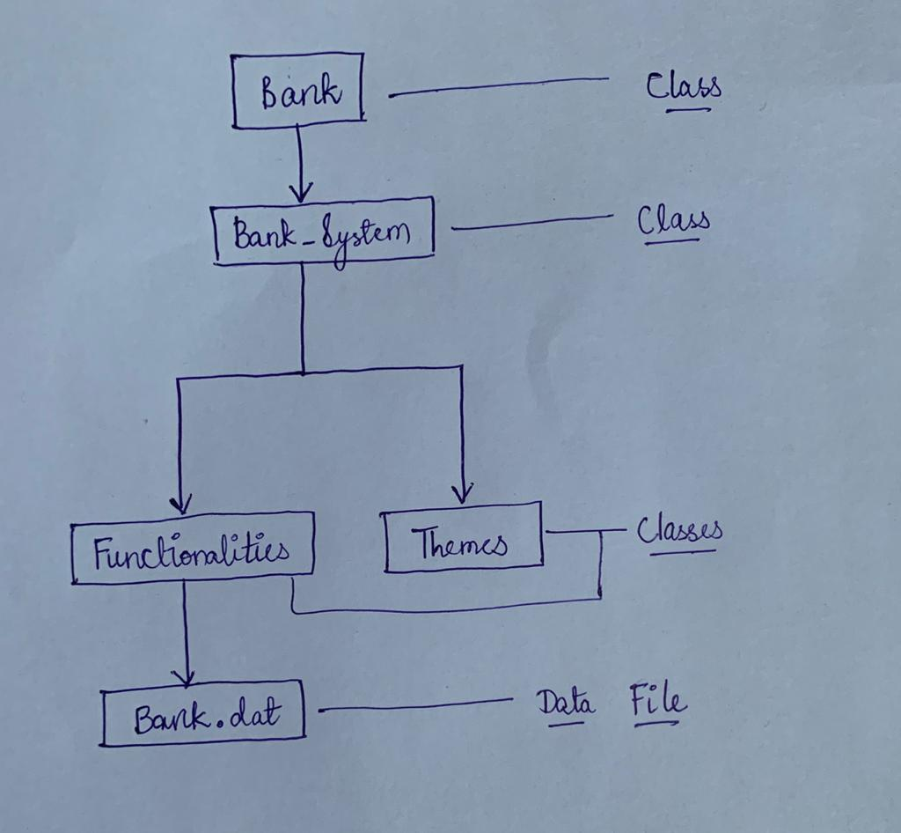
Flow-Chart of the "Project Implementation"

Slide 9
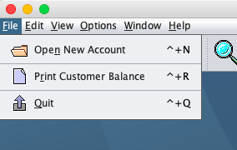
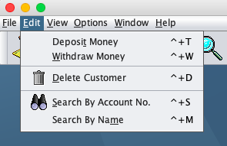
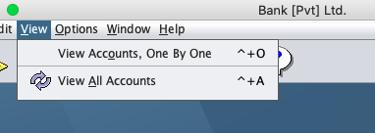
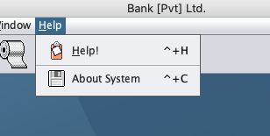
Screenshots of the working System

Slide 10
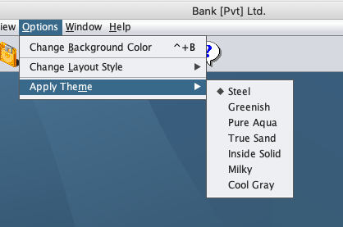
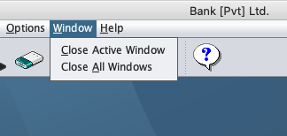
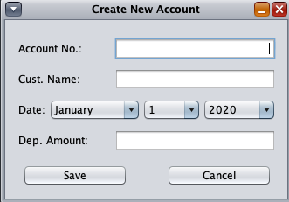
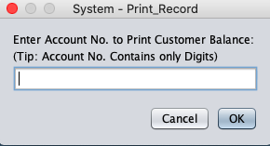
Screenshots of the working System

Slide 11
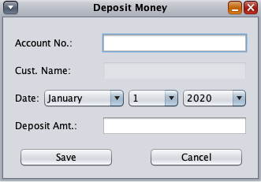
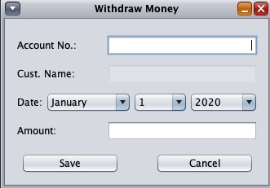
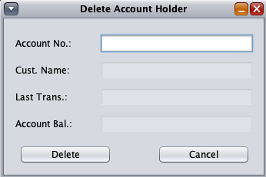
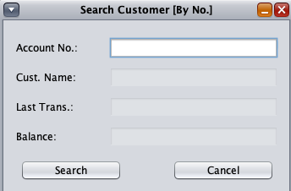
Screenshots of the working System

Slide 12
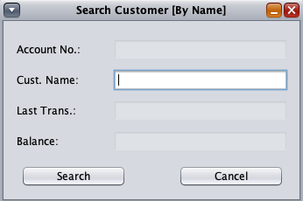
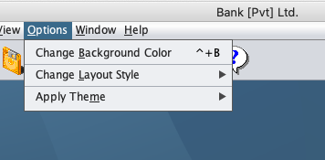
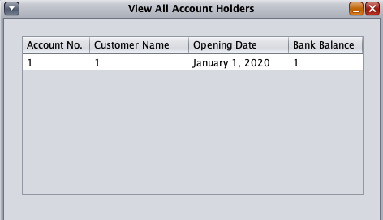
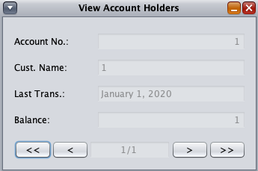
Screenshots of the working System

Slide 13
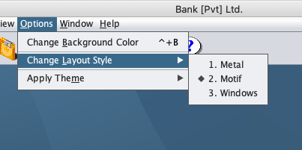
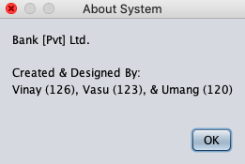
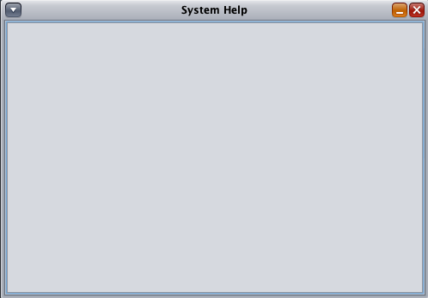
Screenshots of the working System

Slide 14
Exception-handling in the system
Type of Exception | Task, for which the Exception is Handled
IOException | Caught, while moderating and accessing the Data File, of the Bank Accounts, and also while some other actions.
MalformedURLException | It is caught, when the URL of the Web Page, linked to "Help" Section of the System, is Malformed or erroneous.
EOFException | Caught, when "Printing Customer Balance" Sheet, and also while some other actions.
Exception (Any Kind of Exception) | This exception is caught, for many actions, which includes "Closing a Window", "Quitting the System", "File Reading and Writing", etc.

Slide 15
Implementation details
GUI Used: Java Swing
Components of GUI, used:
JFrame
JDesktopPane
JMenuBar
JMenu
JMenuItem
JButton
JLabel
JToolBar
JPanel
JPopUpMenu
JScrollPane
JInternalFrame
JEditorPane
JWindow
JTextField
JComboBox
JTable
JComponent
JOptionPane

Slide 16
Implementation details
Other Component(s) Used (other than 'General Ones'):
ColorUIResource
SwingUtilities
Other Libraries Used (other than 'General Ones'):
swing.border.*
swing.plaf.*
swing.plaf.metal.*
beans.*
text.*
net.URL
net.MalformedURLException
awt.event.*
awt.PrintJob.*

Slide 17
'File Handling' Details
'FileInputStream' and 'DataInputStream': Used to retrieve the data from the file "Bank.dat", for functionalities like "View Accounts, One by One", "View all Accounts", etc.
'FileOutputStream' and 'DataOutputStream': Used to write the data into the file "Bank.dat", for functionalities like "New Account", "Delete Account (Customer)", etc.

Slide 18
Details about classes and interfaces
In-Built Interfaces Used:
ActionListener
PropertyChangeListener
HyperLinkListener
'Class' Flow of the System:
Bank (Class)
Bank_System (Class)
Classes of all the Facilities, of Banking
All Classes for Generating the Different Themes

Slide 19
Applications of our project
Can be used as an efficient System in real-world Banks and Companies.
Automating Customer Bank Accounts.
Maintaining human error-free records, of transactions and customers, in the Bank System.
Maintaining centralised data, about the customers and transactions of the Bank.

Slide 20
References
https://www.javatpoint.com/java-jcombobox
https://docs.oracle.com/javase/7/docs/api/javax/swing/plaf/ColorUIResource.html
https://www.programcreek.com/java-api-examples/index.php?api=javax.swing.plaf.ColorUIResource
https://www.javatpoint.com/java-jpopupmenu
https://docs.oracle.com/javase/7/docs/api/javax/swing/JOptionPane.html

