Slide 1
Further Evaluation of Automated Essay Score Validity
P. Adam Kelly
Houston VA Medical Center and
Baylor College of Medicine
http://people.bcm.tmc.edu/~pakelly
Paper Repository: www.ncme.org

Slide 2
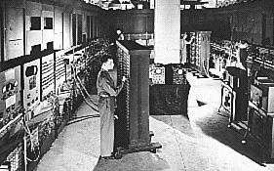
  It would appear that we have reached the limits of what is possible to achieve with computer technology.
  – John von Neumann, computer scientist, 1949

Slide 3
Research Questions
How do automated essay scoring models behave when:
    The level of specificity of models (“generic” vs. “prompt-specific”) is varied;
    The essay task type (“discuss an issue” vs. “make an argument”) and program type (grad school admissions vs. grade school achievement) is varied; and
    The distributional assumptions of the independent and dependent variables are varied?
What are the consequences of score interpretations/uses, as stated by end users

Slide 4
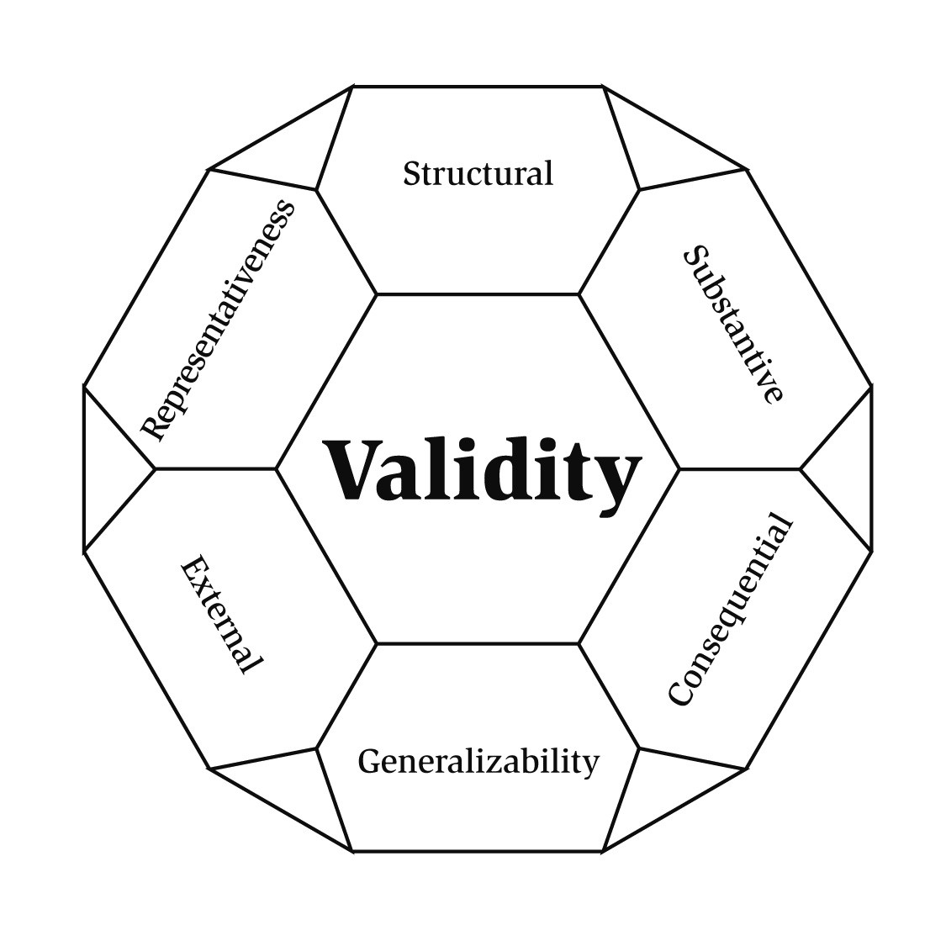
The six aspects of evidence in Messick’s (1995)
unitary validity framework
Notes:
Representativeness Evidence
Relevance of content the scoring model measures to the content domain for the trait “ graduate-level writing proficiency”
Structural Evidence
Comparability of the scoring model’s network of constructs to the network of constructs in writing proficiency, as judged by experts
Substantive Evidence
Consistency of rater tasks/behaviors while scoring an essay, indicating rater engagement in cognitive processes germane to writing proficiency (“think-alouds,” interviews)
External Evidence
Convergence of scores from presumed similar scoring models, and divergence of scores from presumed substantively different models
Generalizability Evidence
Consistency of scoring models across task and program types and through variations of model assumptions
Consequential Evidence
Documentation of effects on examinees, both perceived and real, of the interpretation and use of scores for
stated purpose(s)

Slide 5
Essay Samples and Scoring Program
~1,800 GRE® Writing Assessment essays:
  “Issue” task: ~600 essays on 3 prompts, scored by raters and by computer
  “Argument” task: ~1,200 essays, “ “ “ “ “ “ “ “
~ 900 National Assessment of Educational Progress (NAEP) writing assessment essays:
“Informative” task: ~450 essays, scored by raters and by computer
“Persuasive” task: ~450 essays, “ “ “ “ “ “
e-rater™ (ETS Technologies, Inc.):
Linear regression model: 59 variables, covering content, rhetorical structure, and syntactic structure “features” of essays:
“Generic” models calibrated for multiple prompts, and “prompt-specific” models

Slide 6
“In-Task” vs. “Out-of-Task” e-scores
Using the GRE W. A. “Issue” generic model, generated
“out-of-task” scores for ~900 “Argument” essays
Using the GRE W. A. “Argument” generic model, generated “out-of-task” scores for ~400 “Issue” essays
“Issue”: Proportions of agreement and correlations of “in-task” (correct) with “out-of-task” e-scores exceeded the statistics for “in-task” scores with rater scores (Kelly, 2001).
“Argument”: Ditto.
Meaning: Models may be somewhat invariant to task type

Slide 7
“In-Program” vs. “Out-of-Program” e-scores
Using the GRE W. A. “Issue” generic model, generated
“out-of-program” scores for ~450 NAEP “Informative” essays
Using the GRE W. A. “Argument” generic model, generated “out-of-program” scores for ~450 NAEP “Persuasive” essays
For both NAEP task types: Proportions of agreement and correlations of “in-program” (correct) with “out-of-program”
e-scores fell well below the statistics for “in-program”
e-scores with rater scores.
Meaning: Strong evidence of discrimination between programs

Slide 8
Generic vs. Prompt-Specific e-scores
Generic Scoring Model:
“Issue” “Argument”
Prompt-Specific Models:
Exact + adjacent agreement >.95 >.90
Correlation >.80 .72 - .77
These statistics are similar in magnitude to rater/e-rater agreement statistics presented in Kelly (2001).
Meaning: Evidence supporting generalizability of e-scores from prompt-specific to generic models

Slide 9
“Modified Model” e-scores
e-rater’s linear regression module replaced with ordinal regression
“Modified model” e-scores generated for GRE essays
Both task types: Proportions of agreement remained roughly constant, but correlations increased noticeably
Meaning: An ordinal regression model may improve the accuracy of e-scores, especially in the extremes of the score distribution (e.g., 5s and 6s)

Slide 10
Consequences of e-score interpretation/use
How are the scores interpreted? Used? By whom?
What are the implications of this?
Interviewed graduate program admissions decision-makers: open-ended questions, by phone, recorded on audio tape
The sample: 12 humanities, 18 social sciences,
28 business graduate faculty

Slide 11
Examples of Responses …
Humanities:
  Not familiar with GRE W. A. or e-rater
  Wouldn’t be inclined to use an essay test for admissions
  Concerned that computer scoring could undervalue creativity and ethnically diverse writing styles/formats
Social Sciences:
  Not familiar with GRE W. A. or e-rater
  Essay test likely only used to assess English language proficiency
  Less concerned about potential threat to creativity; some disciplines have rigid writing styles anyway

Slide 12
Examples of Responses …
Business:
  Didn’t realize that a computer currently helps score GMAT W. A., or knew it but wasn’t affected by it
  Rarely use GMAT W. A. scores, then only to assess English language proficiency
  Concerned that computer scoring could marginalize
  W. A., but (may) feel it is already useless
  Meaning: Since scores largely discounted by users, the consequences of interpretation/use are nonexistent
  (at present, at least).

Slide 13
Conclusions … (this year and last)
Content representativeness evidence: Variables that “drive”
e-rater are identifiable and constant, group into factors forming reasonably interpretable, parsimonious factor models
Structural evidence: (Most of) the factors resemble writing qualities listed in the GRE W. A. Scoring Guides – just as
ETS Technologies has claimed
Substantive evidence: Raters agreed that the “syntactic” and “content” factors are relevant, identifiable, and reflective of what a rater should look for, but were highly skeptical of others

Slide 14
Conclusions … (this year and last)
Correlational evidence: Apparent strong discrimination of “in-program” from “out-of-program” essays; important for commercial applications across academic/professional fields
Generalizability evidence: the use of less expensive “generic” models, trained only to the task type, not the prompt, appears to be supported
Consequential evidence: Many graduate program admissions decision-makers do not use the GRE W.A. or GMAT W. A.; those that do use it mostly for diagnostic/remedial purposes (so the scores matter, but not for the reasons thought …)

Slide 15
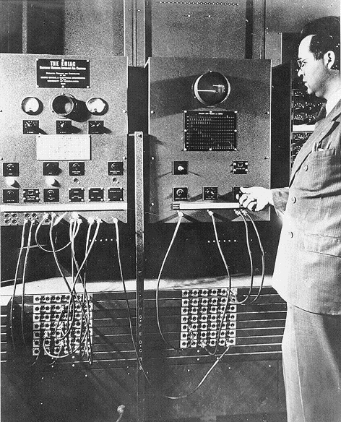
“D**n this computer,
I think that I
shall sell it.
It never does what I
want it to do,
only what I tell it!”

